Slide 1
THE CLINICAL SAFETY, PHARMACOKINETICS AND LDL-CHOLESTEROL LOWERING EFFICACY OF MK-0616, AN ORAL PCSK9 INHIBITOR
Douglas G Johns, PhD FAHA| Clinical Director, Translational Medicine, Merck & Co., Inc., Kenilworth, NJ, USA

Slide 2
DISCLOSURES
I have the following conflicts of interest that relate to this presentation:
Affiliation/Financial Interest | Nature of Conflict/Commercial Company Name
Pharmaceutical-industry related conflict of interest | Employee of Merck Sharp & Dohme Corp., a subsidiary of Merck & Co., Inc., Kenilworth, NJ USA; study sponsor
Stock shareholder | Stock shareholder Merck & Co., Inc., Kenilworth, NJ USA

Slide 3
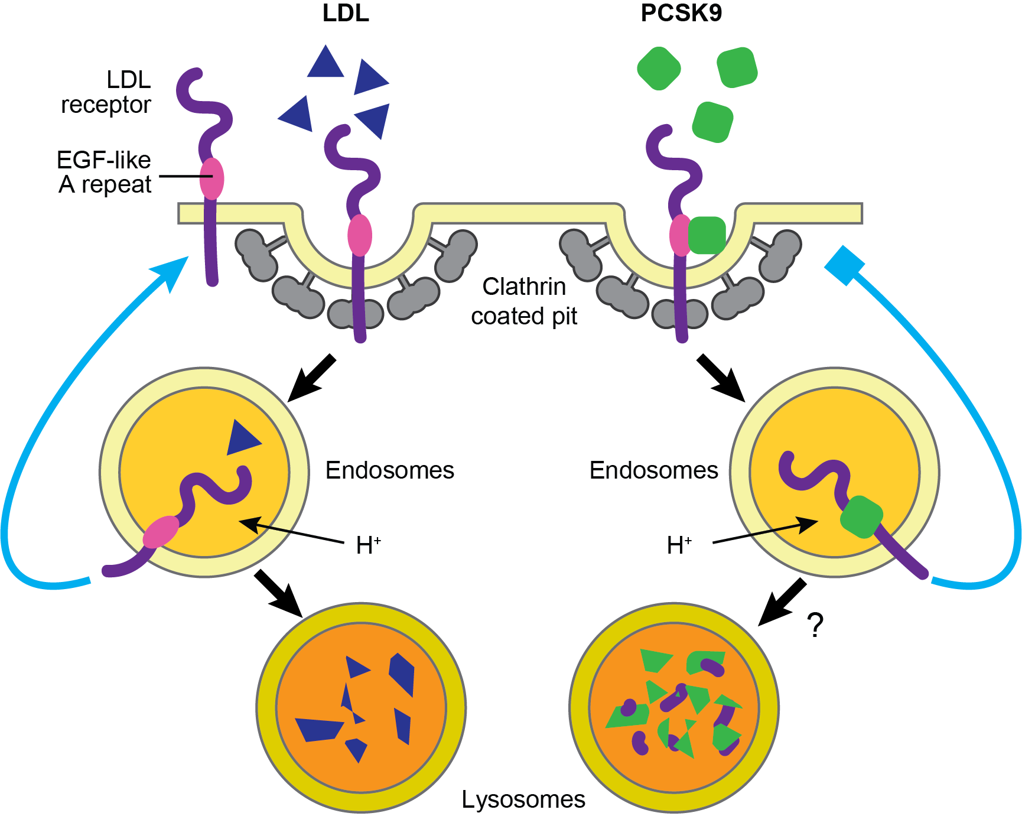
PCSK9 AS A THERAPEUTIC TARGET
Unmet need: millions of hypercholesterolemic patients treated but still not at LDL-C goal
Genetic evidence supports targeting PCSK9
  PCSK9 Loss-of-function mutants: ↓LDL-C, ↓CV risk
  PCSK9 Gain-of-function mutants: ↑LDL-C, ↑CV risk
Three injectable PCSK9 inhibitors showing ~50-60% LDL-C reduction
  REPATHA®, PRALUENT® – mAb, SC Q2W/Q4W; CVOTs with 15% relative risk reduction for cardiovascular events
  LEQVIO® – small interfering RNA, SC Q6M; CVOT ongoing
  Uptake of injectables has been limited, often late in the patient’s journey
Currently no marketed oral PCSK9 inhibitors
Based on Cohen JC, Hobbs HH. Science. 2013;340(6133):689-90.

Slide 4
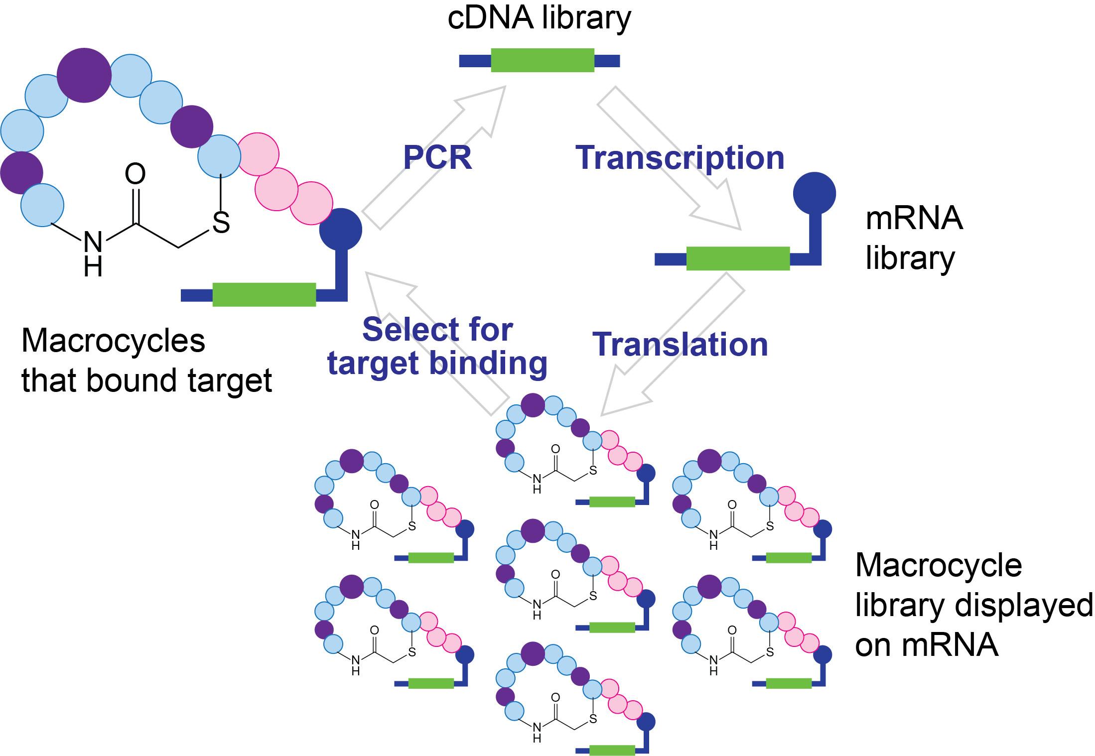
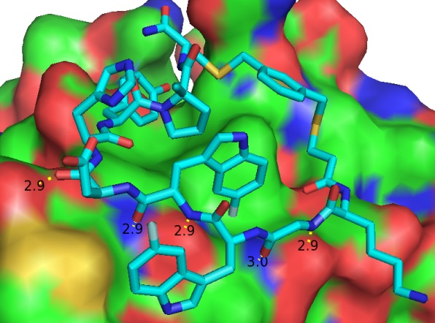
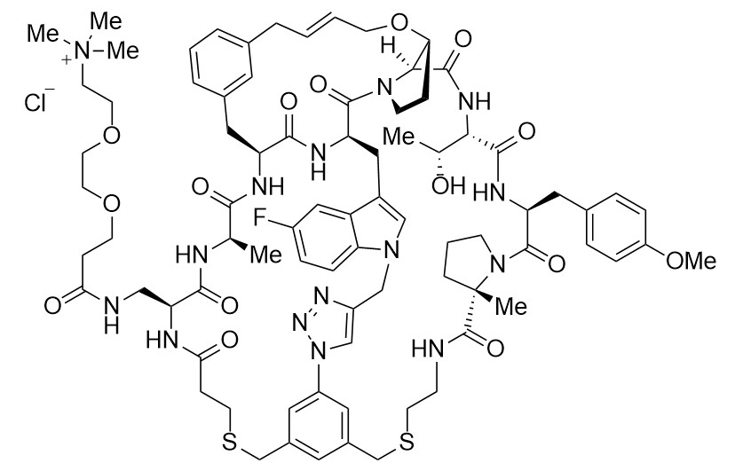
CYCLIC PEPTIDE PLATFORM ENABLES TARGETING “DIFFICULT-TO-DRUG” PROTEINS
PRO: “mAb-like” potency/selectivity at a lower molecular weight
CON: poor inherent oral absorption (%F: <0.1%), require permeation enhancers to achieve relevant exposure
Hit-finding platform
mRNA display
Merck Global Chemistry
Structure-Based Drug Discovery
Cyclic Peptide
Predecessor to MK-0616
Identifies macrocyclic peptides as inhibitors of protein-protein interactions (PPI)
Cyclic peptides bind to the flat PCSK9:LDL-R interface with mAb-like affinity
MW = ~1500 g/mol
Ki = 2-5 pM

Slide 5
MK-0616 PROPERTIES
Picomolar binding affinity against human PCSK9
Chemically stable and resistant to GI degradation
GI absorption improved with permeation enhancer (Labrasol, sodium caprate) in rats, non-human primates
Preclinical (GLP) toxicity studies support clinical development
  Subcutaneous dosing (systemic exposure) + oral arms (local tolerability)
  No observed adverse effects up to/including highest doses administered
  MK-0616-related findings limited to pharmacology (reductions in blood cholesterol)

Slide 6
MK-0616 PROTOCOL 001: FIH TRIAL
Randomized, double blind, placebo-controlled, single- ascending dose trial
Baseline Characteristics
Gender Male (n) | 60
Age (years) Adults (18-50 yr) (n) Mean SD Median Range | 60 38.1 9.2 40 19 to 50
Race (n) American Indian or Alaska Native Black or African American White | 1 1 58
Ethnicity (n) Hispanic or Latino Not Hispanic or Latino Unknown | 1 57 2
Key questions/design:
  Safety and tolerability of single doses of MK-0616 (10 mg -300 mg)
  Pharmacokinetics (PK) of MK-0616
    Effect of permeation enhancer dose on PK
    Effect of food on PK
    Effect of various capsule formulations on PK
  Target engagement (% change in free PCSK9)
  n=9 MK-0616, n=3 PBO per panel

Slide 7
MK-0616 PROTOCOL 001: GENERAL SAFETY/TOLERABILITY
No deaths, no SAEs
Discontinuations (6 out of 60)
  3 due to AE (maculopapular rash, wound associated with concussion/injury,
  lower back pain)
  2 due to protocol violations
  1 withdrawal due to work conflict
All treatment-related AEs were mild/moderate; exception – severe back pain (not drug-related)
AEs reported by Investigator as related to study drug:
  Abdominal discomfort, diarrhea, dyspepsia, headache, and maculopapular rash
No treatment-related trends in lab safety, vital signs, or ECG

Slide 8
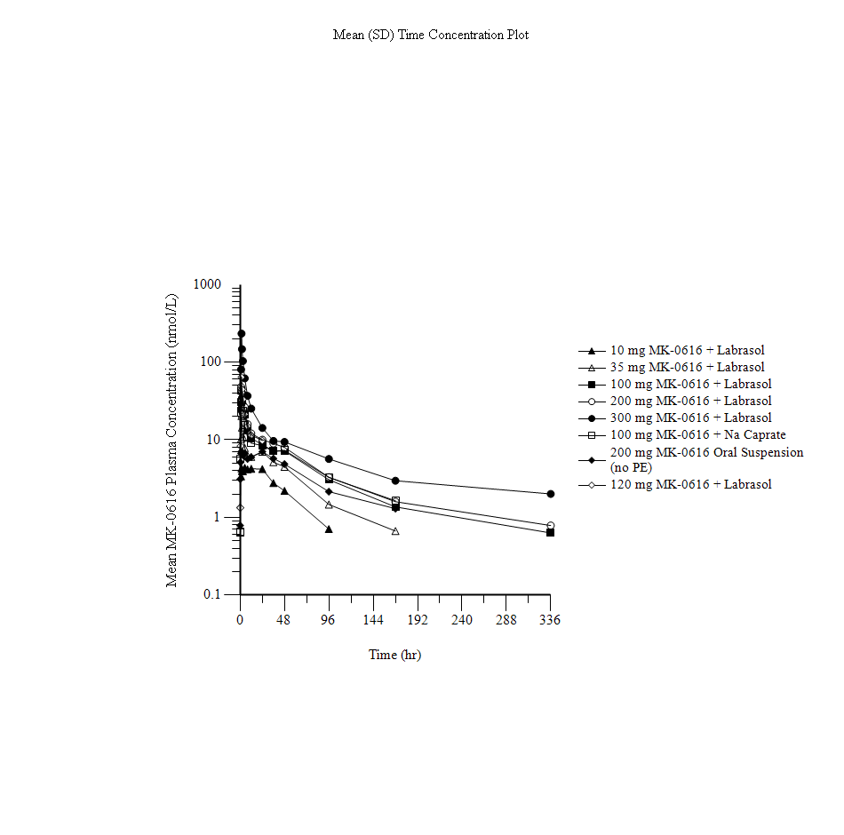
MK-0616 PROTOCOL 001: PHARMACOKINETICS
MK-0616 dose
Permeation enhancer improves absorption (Cmax 5-6X higher with Labrasol® vs no permeation enhancer)
Nearly identical PK between Labrasol® and sodium caprate
Negative food effect observed with a meal consumed 30 min pre-dose (exposure ↓50-60%)
Food effect less prominent with meal consumed 30 min post-dose
10 mg
35 mg
100 mg
Labrasol®
(1,800mg)
200 mg
300 mg
100 mg
Sodium Caprate
(1,800 mg)
Oral bioavailability estimated ~2%

Slide 9
MK-0616 PROTOCOL 001: REDUCTION OF FREE PCSK9 FOLLOWING SINGLE DOSE
-100
-90
10 mg
100 mg
Day 1
Days 2 - 7
-80
-70
35 mg
Placebo
-60
-50
-40
-30
-20
-10
0
% Reduction from Baseline of Free-PCSK9
10
20
30
40
50
60
80%
70
80
90
100
110
0
1
2
3
5
12
24
36
48
96
168
Time Post-Dose (hour)

Slide 10
MK-0616 PROTOCOL 003 MULTIPLE DOSE: DESIGN AND BASELINE CHARACTERISTICS
Randomized, placebo-controlled, double-blind multiple-dose study of MK-0616
Men and women of non-childbearing potential receiving statin therapy
Four panels (once-daily dosing for 14 days)
  10, 20 mg MK-0616 (360 mg sodium caprate)
  10 mg MK-0616 (180 mg sodium caprate)
  10 mg MK-0616 (+ food before dose)
Baseline Characteristics
Gender Male (n) Female (n) | 27 13
Age (years) Adults (18-65 yr) (n) Mean SD Median Range | 40 57.7 8.5 60 19-65
Race (n) White | 40
Ethnicity (n) Not Hispanic or Latino | 40
% taking moderate/high intensity statin | 85%

Slide 11
MK-0616 PROTOCOL 003 MULTIPLE DOSE: GENERAL SAFETY/TOLERABILITY
No deaths, no SAEs
No discontinuations
All treatment-related AEs were mild/moderate
AEs reported by Investigator as related to study drug :
  dizziness, dry mouth, dyspepsia, hunger, decreased appetite, flushing, insomnia, and gastroesophageal reflux
No treatment-related trends in lab safety, vital signs, or ECG

Slide 12
MK-0616 PROTOCOL 003 MULTIPLE DOSE:
LDL-C REDUCTION
QD dosing

Slide 13
SUMMARY
MK-0616 was generally well tolerated up to doses of 300 mg
  No deaths, SAEs, significant vital signs, ECG, or lab changes associated with MK-0616
MK-0616 single doses reduced free PCSK9 by >90%
MK-0616 multiple doses reduced LDL-C by ~65% after 14 days

Slide 14
CONCLUSIONS/PERSPECTIVES
These Phase 1 results are encouraging, showing robust LDL-C lowering on top of statins.
As an oral PCSK9 inhibitor, MK-0616 has the potential to be a highly effective, cholesterol-lowering medicine for patients with high cholesterol.
Such a medicine could overcome barriers to treatment, allowing more patients to achieve LDL-C goals reduce cardiovascular risk earlier in their therapeutic journey.
Additional, larger clinical trials evaluating the efficacy and safety of MK-0616 are required.

Slide 15
ACKNOWLEDGEMENTS: CO-AUTHORS
Yuddy Almonte
Puja Banka
An Bautmans
Louis-Charles Campeau
Mark Cancilla
Justin Chapman
Inne Crevecoeur
Erik Guetschow
Anya Kauh
Eseng Lai
Christine Lanning
Anita Lee
Li Li
Yale Mitchel
Aubrey Stoch
Kristien van Dyck
Frederic Vanhoutte
Bram Volckaert
Dennis Wolford
Blair Wood
Andy Xu
Tian Zhao
Susan Zhou

Slide 16
THANK YOU

