Slide 1
Atrioventricular Interval Modulation (AVIM) Therapy for Blood Pressure Control
Hans-Peter Stoll, MD, PhD
Chief Clinical Officer, Orchestra BioMed Yuval Mika, Ph.D.
15. May 2024

Slide 2
Potential conflicts of interest
Speaker's name : Hans Peter Stoll
☑ I have the following potential conflicts of interest to declare: Full time employee - Chief Clinical Officer: Orchestra BioMed

Slide 3
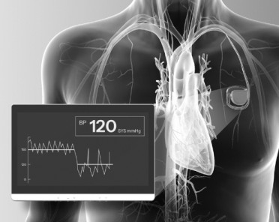
Atrioventricular Interval Modulation (AVIM) Therapy Overview
Designed to immediately, substantially, & persistently reduce blood pressure
Delivered via dual-chamber pacemaker
Does not require an additional procedure
Compatible with traditional right ventricle (RV) & conduction system pacing (CSP) lead placement
Intended to be applicable to a broad range of hypertensive patients
Programmable, adjustable, & can be activated and deactivated, as needed
AVIM therapy is also known as CNT (Cardiac Neuromodulation Therapy). AVIM therapy is investigational and not commercially approved. No claims can be made until regulatory approvals.

Slide 4
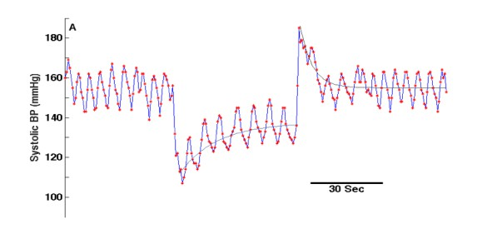
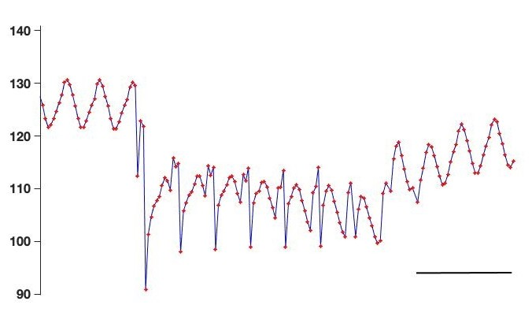
Novel Mechanism of Action Designed to Reduce Blood Pressure
Short AV-Delay Pacing
lowers preload & immediately reduces BP, but there is a rebound due to ANS activation
BackBeat AVIM Pacing
combines short AV intervals with longer AV intervals to avoid undesired ANS activation
Pressure overshoot indicating increased TPR
Slow increase in BP suggesting significant impact on ANS activity & TPR
BackBeat AVIM pacing
180
Short AV pacing
Baseline
Baseline
Systolic BP (mmHg)
Systolic BP (mmHg)
160
140
BackBeat AVIM Activation
120
100
30 Sec
BP reduction activates sympathetic
ANS response via baroreceptors
Immediate & sustained reduction in BP
BP: Blood Pressure, ANS: Autonomic Nervous System, TPR: Total peripheral resistance
Yang B, et al., Rationale and evidence for the development of a durable device-based cardiac neuromodulation therapy for hypertension, J Am Soc Hypertens 2018; 12(5): 381–391.

Slide 5
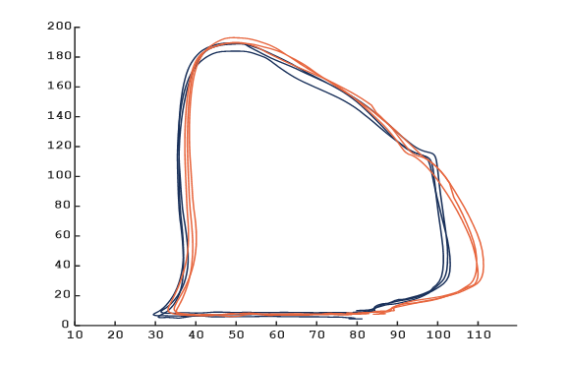
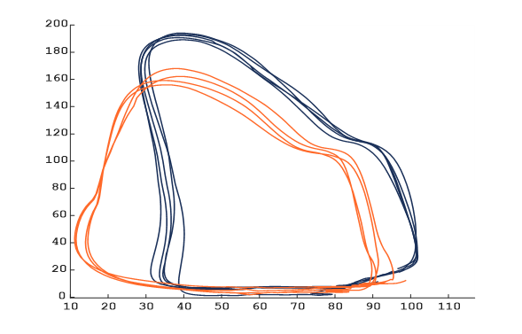
AVIM Therapy Achieves Favorable Hemodynamics with LV Relief
Decreases systolic
blood pressure (↓ SBP)
Decreases intra-cardiac volume & pressure
(↓ EDV, ↓ ESV, & ↓ P_{ES})
Decreases total peripheral
resistance (↓ TPR)
Improves efficiency of work
AV Sequential Pacing vs.
Intrinsic Conduction (Baseline)
AVIM vs. Intrinsic Conduction
TPR
↓
SBP↓
AVIM
Intrinsic Conduction
AV Sequential Pacing Intrinsic Conduction
LV Pressure (mmHg)
LV Pressure (mmHg)
P_{ES}↓
ESV↓
EDV↓
LV Volume (ml) LV Volume (ml)
EDV (End-Diastolic Volume), ESV (End-Systolic Volume), SBP (Systolic Blood Pressure), P_{ES} (End-Systolic Pressure), TPR (Total Peripheral Resistance)
Data on file with Orchestra BioMed. Burkhoff CRT 2024. Fischer ICI 2024.

Slide 6
MODERATO I Study Design & Results
Prospective, single-arm study of 27 patients with persistent hypertension (oSBP > 150mmHg) despite 2 or more anti-hypertensive medications & an indication for pacemaker
- 1-month run-in to account for Hawthorne effect, followed by 3 months activation
Primary safety & efficacy assessed at 3 months post AVIM therapy activation; follow-up through 2 years^{1,2}
Significant Reduction in 24-Hour aSBP
+1 Day +1 Month +3 Months
Significant Reduction in oSBP Through 24 Months
+1 Month +3 Months +6 Months +12 Months +18 Months
0
+24 Months
-11.6
P < 0.001
-8.3
P < 0.02
-10.1
P < 0.007
0
-16.8
P < 0.006
-16.1
P < 0.001
-11.1
P < 0.011
-15.6
P < 0.001
-14.4
P < 0.001
-13.1
P < 0.003
-5
-5
Δ aSBP (mmHg)³
Δ oSBP (mmHg)³
-10
-10
-15
-15
-20
AVIM (n=16)⁴
-20
AVIM (n=27)⁵
¹Neuzil et al. Journal of the Am Heart Assoc. 2017;6:e006974. https://doi.org/10.1161/JAHA.117.006974. ²Burkhoff MODERATO I Study 2-Year Results TCT 2018. ³Compared to pre-activation. ⁴aSBP (n=16) at pre-activation. ⁵AVIM (n=21) continued after completion of study at 3 months to be followed for 2 years. Definitions: oSBP (Office Systolic Blood Pressure), aSBP (Ambulatory Systolic Blood Pressure).

Slide 7
MODERATO II Randomized, Double-Blind Study Results
-11.1 mmHg in 24-Hour aSBP at 6 months
Significant Reduction in 24-Hr aSBP and oSBP^{1,2}
aSBP
AVIM therapy showed encouraging results in MODERATO II, a prospective, multi-center, randomized (AVIM therapy + medical therapy vs. continued medical therapy), controlled, double- blind, pilot study of pacemaker patients with persistent hypertension
oSB P
1 day
6 Months
-3.1
P =0.17
6 Months
24 Months
0
-15.6
P < 0.001
- 17.5
0%
MACE vs. 14.3% in control group at 6 months
-1.5
P = 0.5
-0.1
P = 0.94
-5
Δ in BP (mmHg)
-10
-15
-11.1
P < 0.001
-12.4
P < 0.001
-17.5 mmHg
in oSBP at 2 years
Δ -8.1
⁻²⁰ p = 0.01
Δ -12.3
p = 0.02
Mean of 3.3 meds used in both control & AVIM groups
88.5% of AVIM group had ISH (vs. 71.4% in control group)
Δ -14.1
p = 0.001
85%
of patients with reduction in aSBP
Control (n=20)³
AVIM Therapy (n=26)
¹Kalaras et al. Journal of the Am Heart Assoc. 2021;10:e020492 ahajournals.org/doi/10.1161/JAHA.120.020492; ²Burkhoff MODERATO II Study 2-Year Results TCT 2021; ³24-Hr aSBP Control (n=19),1 control patient could not be measured despite repeat measurement (patient had extremely high blood pressure); Definitions: Major Adverse Cardiac Events (MACE) included death, heart failure, clinically significant arrhythmias (i.e., persistent or
increased atrial fibrillation, serious ventricular arrhythmias), myocardial infarction, stroke and renal failure in treatment group calculated per patient; ISH (Isolated Systolic Hypertension).

Slide 8
New Randomized Global Pivotal BackBeat Study
Randomized, prospective, multi-center, double-blind, controlled trial investigating the efficacy & safety of AVIM therapy in patients indicated for a dual-chamber pacemaker who also have uncontrolled hypertension (HTN) despite the use of anti-HTN medications
N=500 patients across 80 sites globally Key screening criteria:
Inclusion: oSBP ≥ 140 mmHg & ≥ aSBP 130 mmHg with stable anti-HTN treatment regimen for 4 weeks
prior to consent
Exclusion: AF burden > 10%, LVEF < 50%, NYHA Class II+, no or > 3 classes of anti-HTN medications Study endpoints:
Primary Efficacy endpoint: Between group difference in the change in mean 24-hour aSBP at 3 months
post-randomization
Primary Safety endpoint: Freedom from unanticipated serious adverse device events at 3 months post- randomization
Secondary/additional endpoints: Double-blind follow-up will continue through 12 months to enable collection
of additional long-term safety and efficacy results and secondary endpoints

Slide 9
BACKBEAT Global Pivotal Study Flowchart
Pre-Screening
90 days
Run-in Phase
4-weeks
Enrollment / Randomization
Double-Blind Study Phase
12 months
Open-Label Crossover Follow-up Phase
Treatment Group: AVIM therapy + medical therapy
Primary**
@3M
Secondary**
@12M
Hypertensive patients with
a recent Medtronic pacemaker implant*
Informed Consent
AVIM
RAMware download & set up
+2 years from unblindin g
Run-In Phase
Standard Pacing only
R
Control Group:
Medical therapy
Test eligibility at the beginning & end of Run-in
Primary**
@3M
Secondary**
@12M
No
No
Withdraw
Withdraw
*Implant is decoupled from study outcomes & endpoints. **Evaluated post-randomization: +3 months for primary endpoints and +12 months for secondary/additional endpoints. Definitions: M (Months).

Slide 10
Summary
AVIM therapy is designed to immediately, substantially, & persistently reduce blood pressure
Delivered via dual-chamber pacemaker & applicable to a broad range of hypertensive patients
Mechanism of action includes pre-load reduction through short AV interval pacing and baroreceptor- mediated neuromodulation to avoid ANS activation
Pressure-volume loop studies of AVIM therapy demonstrated a reduction of peripheral arterial resistance leading to significant hemodynamic relief for the left ventricle
Clinical pilot studies have shown a durable blood pressure lowering effect in the absence of notable safety signals

Slide 11
PCRonline.com

Slide 12
AVIM Therapy Achieves Favorable Hemodynamics with LV Relief
Measure | Percent Change from Baseline (N = 14)
 | RV Pacing (DDD) RV lead | AVIM (DDD) RV lead
△ SBP | -1% 1.7±5.1 mmHg | -12%* -17.1 ± 10.1 mmHg
△ LV ESV | 4% 2.1 ± 12.0 ml | -22%* -11.0 ± 11.4 ml
△ LV EDV | -1% -1.6 ± 16.8 ml | -11%* -12.6 ± 14.0 ml
△ LV EDP | 3% 0.29 ± 2.4 mmHg | -16%* -2.3 ± 3.9 mmHg
△ Stroke Volume | -2% -1.7 ± 13.4 ml | -2% -1.6 ± 12.7 ml
△ Ea (TPR) | 2% 0.04 ± 0.45 ml/mmHg | -11%* -0.2 ± 0.4 ml/mmHg
△ Stroke Work | 0% -42.1 ± 1691 | -20%* -1596 ± 1934
↓ SBP
↓ ESV, ↓ EDV, & ↓ EDP
↓ TPR
Improves efficiency of work
No changes in
contractility (± 1%)
*P < 0.05
SBP (Systolic Blood Pressure), ESV (End-Systolic Volume), EDV (End-Diastolic Volume), EDP (End-Diastolic Pressure), Ea (Effective Arterial Elastance), TPR (Total Peripheral Resistance)
Data on file with Orchestra BioMed. Burkhoff CRT 2024. Fischer ICI 2024.

Slide 13
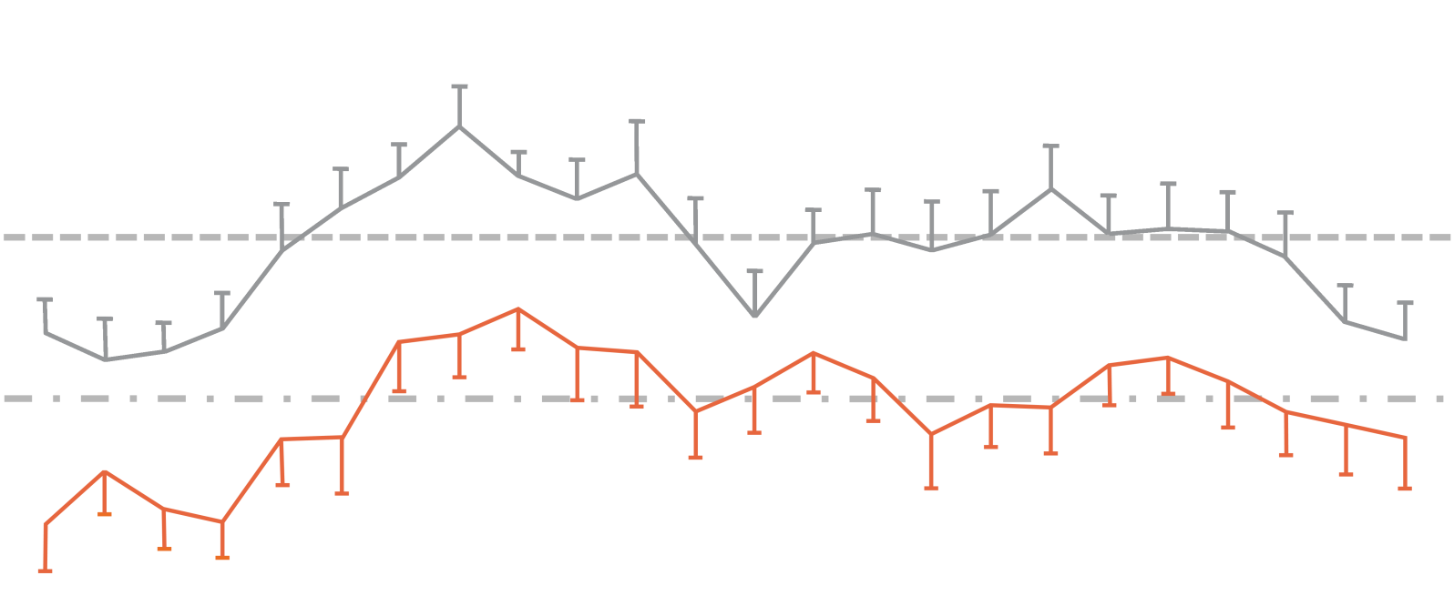
MODERATO II: Circadian 24-Hour aSBP Distribution Preserved
Paired average 24-hour aSBP profile after 6 months of AVIM therapy
150
145
140
135
130
125
120
aSBP (mmHg)
115
Pre-activation (n=26) 6 months (n=26)
110
00:00
01:00
02:00
03:00
04:00
05:00
06:00
07:00
08:00
09:00
10:00
11:00
12:00
13;00
14:00
15:00
16:00
17:00
18:00
19:00
20:00
21:00
22:00
23:00
P < 0.01 for all times of day
Burkhoff MODERATO II Study 2-Year Results TCT 2021.

Slide 14
MODERATO II: Long-Term SBP Reduction with AVIM Therapy
AVIM therapy demonstrated sustained, long-term blood pressure reduction
Significant Reduction in 24-Hr aSBP and oSBP^{1,2,3}
aSBP
-8.9 mmHg
in 24-Hour aSBP from baseline at 3.6 years (±0.6)
Long-term blood pressure from a follow-up study of 16 patients from MODERATO II*
8 AVIM & 8 control patients who crossed-over to AVIM therapy at the end of the 6- month double-blind phase of MODERATO II & agreed to be followed long-term
Each patient had aSBP and oSBP measured at an average of 3.6 years (±0.6) following initiation of AVIM therapy
*Patients were re-consented for long-term follow-up
oSBP
6 months 3.6 years (±0.6)
0
-5
-10
-15
-20
6 months 3.6 years (±0.6)
-8.9
P < 0.001
-8.9
P < 0.001
-14.2
P < 0.001
-12.5
P < 0.001
-12.5 mmHg in oSBP at 3.6 years (±0.6)
Δ in BP (mmHg)
100% of patients with reduction in aSBP at
3.6 years (±0.6)
P-value between 6 months & 3.6 years (±0.6) = ns
¹Kalaras et al. Journal of the American Heart Association. 2021;10:e020492 ahajournals.org/doi/10.1161/JAHA.120.020492; ²Burkhoff MODERATO II Study 2-Year Results TCT 2021;
³Fischer MODERATO Study Long-term Results ICI 2024; Definitions: SBP (Systolic Blood Pressure), aSBP (Ambulatory Systolic Blood Pressure), oSBP (Office Systolic Blood Pressure), ns (Non-significant).

