Slide 1
Highlights from CLOSE and REDUCE Trials: Which PFO Should We Close?
Ted Feldman, M.D., MSCAI FACC FESC
Evanston Hospital
CRT
Cardiovascular Research Technologies
Washington D.C.
March 4-6th, 2018
Notes:
Patent Foramen Ovale, Left Atrial Appendage Occluders11:42 AM - 1:00 PM11:42 AMSession ModeratorsModerator: Mark Carlson, MDModerator: Steven L. Goldberg, MD, FSCAI, FACC11:42 AMThe Occlutech Atrial Flow Regulator (AFR) for Pulmonary Hypertension and Heart FailureSpeaker: Hans R. Figulla, MD, PhD11:52 AMPatent Foramen Ovale Devices and Trials Update: Is the Current Data Sufficient for Approval?Speaker: Steven L. Goldberg, MD, FSCAI, FACC12:02 PMAnticoagulation Protocols Post Left Atrial Appendage ClosuresSpeaker: Michael J. Rinaldi, MD12:12 PMLAA Closure: Design Modifications, Patient Populations, and Reimbursement StatusSpeaker: Ian T. Meredith AM, MBBS, BsC, PhD, FSCAI12:22 PMLAA Closure with the Amulet DeviceSpeaker: Sameer A. Gafoor, MD12:32 PMHighlights from CLOSE and REDUCE Trials: Which PFO Should We Close?Speaker: Ted Feldman, MD, MSCAI12:42 PMPanel Discussion: What is the Unmet Need for Occluder Technology?Panel Moderator: Mark Carlson, MDPanel Moderator: Steven L. Goldberg, MD, FSCAI, FACCPanel: Hans R. Figulla, MD, PhDPanel: Sameer A. Gafoor, MDPanel: Dan Gutfinger, MDPanel: Brijeshwar S. Maini, MDPanel: Ian T. Meredith AM, MBBS, BsC, PhD, FSCAIPanel: Michael J. Rinaldi, MD1:00 PMAdjourn

Slide 2
Ted Feldman MD, MSCAI FACC FESC
Disclosure Information The following relationships exist: Grant support: Abbott, BSC, Cardiokinetics, Corvia, Edwards, WL Gore
Consultant: Abbott, BSC, Edwards, WL Gore
Stock Options: Mitralign
Off label use of products and investigational devices will be discussed in this presentation

Slide 4
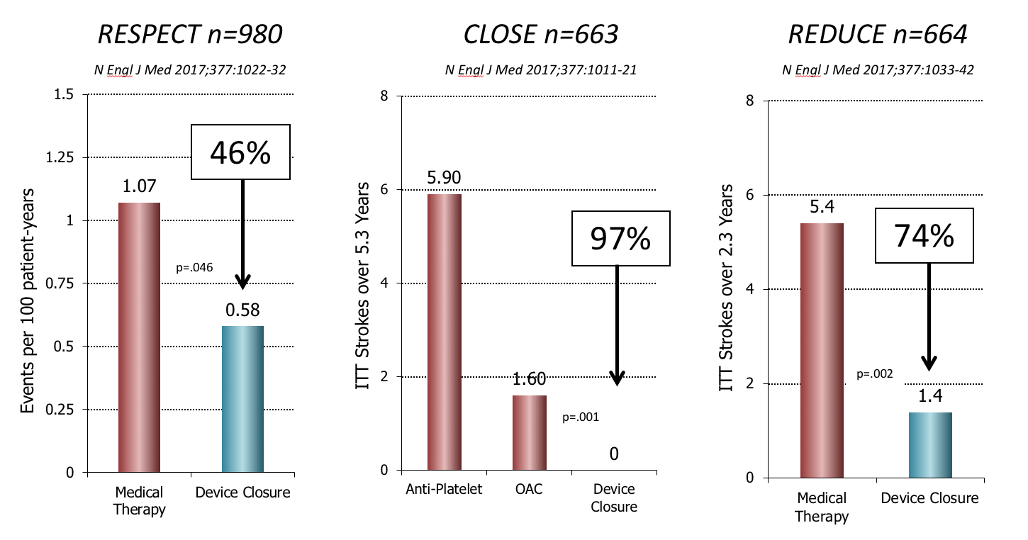
Randomized Trials
PFO Closure vs Medical Therapy
Notes:
CLOSE N Engl J Med 2017;377:1011-21 663 patients underwent randomization and were followed for a mean (±SD) of 5.3±2.0ITT Stroke Closure 0Antiplatelet 14/235=5.9%Anticoagulant 3/187=1.6%
REDUCE N Engl J Med 2017;377:1033-42.664 patients (mean age, 45.2 years), median follow-up of 3.2 yearslinical ischemic stroke occurred in 6 of 441 patients (1.4%) in the PFO closure group and in 12 of 223 patients (5.4%) in the antiplatelet-only group (hazard ratio, 0.23; 95% confidence interval [CI], 0.09 to 0.62; P=0.002).
RESPECT N Engl J Med 2017;377:1022-32.We enrolled 980 patients (mean age, 45.9 years) at 69 sites. Patients were followed for a median of 5.9 years. In the intention-to-treat population, recurrent ischemic stroke occurred in 18 patients in the PFO closure group and in 28 patients in the medical-therapy group, result- ing in rates of 0.58 events per 100 patient-years and 1.07 events per 100 patient- years, respectively (hazard ratio with PFO closure vs. medical therapy, 0.55; 95% confidence interval [CI], 0.31 to 0.999; P=0.046 by the log-rank test).

Slide 5
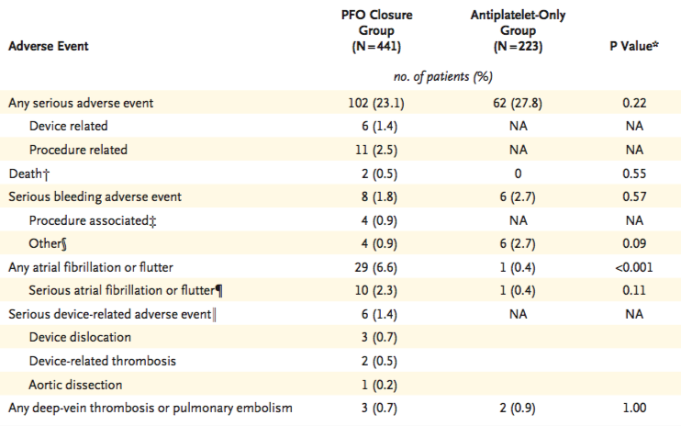
REDUCE Adverse Events
N Engl J Med 2017;377:1033-42

Slide 6
CLOSE Adverse Events
N Engl J Med 2017;377:1011-21

Slide 7
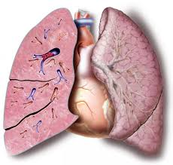
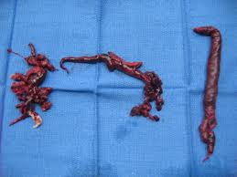
RESPECT DVT
the rate of pulmonary embolism was 0.41 per 100 patient-years in the PFO closure group and 0.11 per 100 patient-years in the medical-therapy group (hazard ratio, 3.48; 95% CI, 0.98 to 12.34; P = 0.04
RESPECT N Engl J Med 2017;377:1022-32
Notes:
the rate of pulmonary embolism was 0.41 per 100 patient-years in the PFO closure group and 0.11 per 100 patient-years in the medical-therapy group (hazard ratio, 3.48; 95% CI, 0.98 to 12.34; P = 0.04), and the rate of deep- vein thrombosis was 0.16 per 100 patient-years and 0.04 per 100 patient-years, respectively (haz- ard ratio, 4.44; 95% CI, 0.52 to 38.05; P=0.14).RESPECT N Engl J Med 2017;377:1022-32.

Slide 9
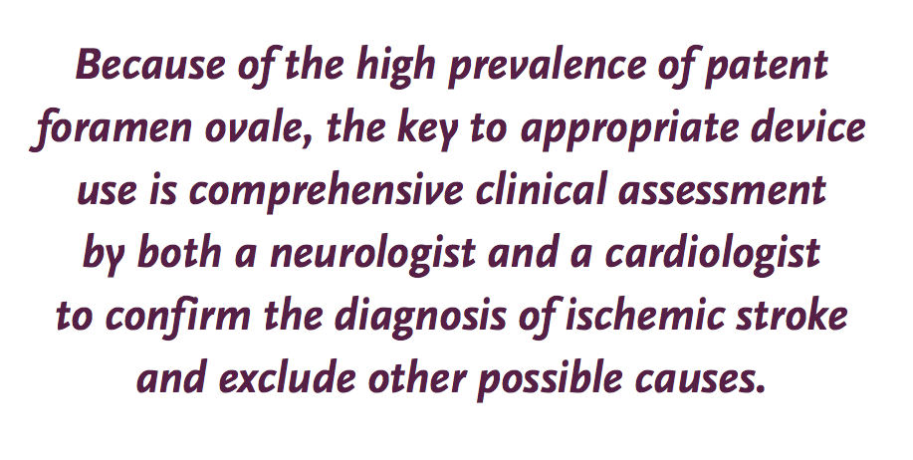
NEJM 377;11 September 14, 2017

Slide 10
Nearly 1/3 of Recurrent Strokes in Extended Follow-up Are of Known Mechanism
Atherosclerosis = 1
Small Vessel Disease = 6
Cardioembolic = 5 (AF = 4, endocarditis = 1)
Other = 1 (radiation arteriopathy)
Dissection = 0
Subjects with Recurrent Ischemic Stroke
Cryptogenic (Possibly Paradoxical Embolism)
Known Mechanisms
RESPECT Extended Follow-up Carroll JD TCT 2015

Slide 11
Incidence & size PFO during the first 10 decades of life an autopsy study of 965 normal hearts
Hagen PT, Scholz DG, Edwards WD. Mayo Clin Proc. 1984 Jan;59(1):17-20
Notes:
Hagen PT, Scholz DG, Edwards WD. Mayo Clin Proc. 1984 Jan;59(1):17-20
Incidence and size of patent foramen ovale during the first 10 decades of life: an autopsy study of 965 normal hearts.
The incidence and size of the patent foramen ovale were studied in 965 autopsy specimens of human hearts, which were from subjects who were evenly distributed by sex and age. Neither incidence nor size of the defect was significantly different between male and female subjects. The overall incidence was 27.3%, but it progressively declined with increasing age from 34.3% during the first three decades of life to 25.4% during the 4th through 8th decades and to 20.2% during the 9th and 10th decades. Among the 263 specimens that exhibited patency in our study, the foramen ovale ranged from 1 to 19 mm in maximal potential diameter (mean, 4.9 mm). In 98% of these cases, the foramen ovale was 1 to 10 mm in diameter. The size tended to increase with increasing age, from a mean of 3.4 mm in the first decade to 5.8 mm in the 10th decade of life.

Slide 12
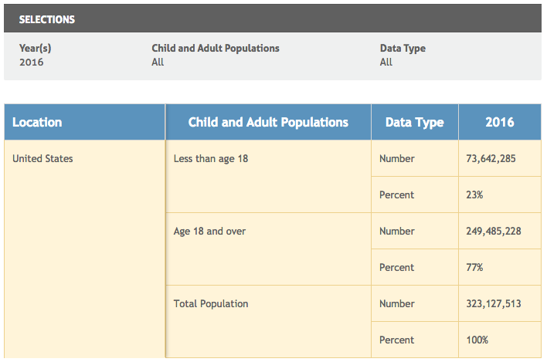
Child and adult populations
15% incidence PFO = 37,422,784
http://datacenter.kidscount.org/data/tables/99-total-population-by-child-and-adult#detailed/1/any/false/870/39,40,41/416,417

Slide 13
Transvenous Pacing Leads and Systemic Thromboemboli in Patients With Intracardiac Shunts
RR 2.6
p=.026
n=202 with intracardiac shunts
FU 7-17 years
RR 2.6 with transvenous lead (p=.026)
ASA/Warfarin not protective
PFO+RV lead=embolism
Circulation113: 2391 – 2397, 2006
Notes:
Paul Khairy, Michael J. Landzberg, Michael A. Gatzoulis, Lise-Andrée Mercier, Susan M. Fernandes, Jean-Marc Côté, Jean-Pierre Lavoie, Anne Fournier, Peter G. Guerra, Alexandra Frogoudaki, Edward P. Walsh, Annie Dore for the Epicardial Versus ENdocardial pacing and Thromboembolic events (EVENT) Investigators multicenter, retrospective cohort study of 202 patients with intracardiac shunts: Sixty-four had transvenous leads (group 1), 56 had epicardial leads (group 2), and 82 had right-to-left shunts but no pacemaker or implantable cardioverter defibrillator leads (group 3). Patient-years were accrued until the occurrence of systemic thromboemboli or study termination. Censoring occurred in the event of complete shunt closure, death, or loss to follow-up. Mean ages for groups 1, 2, and 3 were 33.9±18.0, 22.2±12.6, and 22.9±15.0 years, respectively. Respective oxygen saturations were 91.2±9.1%, 88.1±8.1%, and 79.7±6.7%. During respective median follow-ups of 7.3, 9.3, and 17.0 years, 24 patients had at least 1 systemic thromboembolus: 10 (15.6%), 5 (8.9%), and 9 (11.0%) in groups 1, 2, and 3, respectively. Univariate risk factors were older age (hazard ratio [HR], 1.05; P=0.0001), ongoing phlebotomy (HR, 3.1; P=0.0415), and an transvenous lead (HR, 2.4; P=0.0421). In multivariate, stepwise regression analyses, transvenous leads remained an independent predictor of systemic thromboemboli (HR, 2.6; P=0.0265). In patients with transvenous leads, independent risk factors were older age (HR, 1.05; P=0.0080), atrial fibrillation or flutter (HR, 6.7; P=0.0214), and ongoing phlebotomy (HR, 14.4; P=0.0349). Having had aspirin or warfarin prescribed was not protective. Epicardial leads were, however, associated with higher atrial (P=0.0407) and ventricular (P=0.0270) thresholds and shorter generator longevity (HR, 1.9; P=0.0176).
Conclusions— Transvenous leads incur a >2-fold increased risk of systemic thromboemboli in patients with intracardiac shunts.

Slide 14
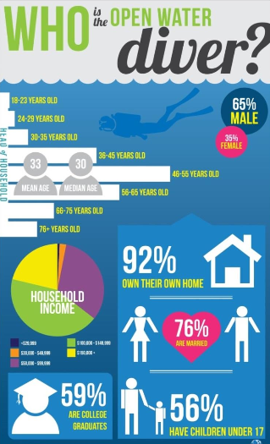
500,000 high risk PFO
Hip replacement
In 2010, 310,800 total hip replacements were performed among inpatients aged 45 and over. https://www.cdc.gov/nchs/products/databriefs/db186.htm
46,620 with PFO
Scuba divers
2.7 to 3.5 million active scuba divers in the US Sports and Fitness Industry Association
450,000 with PFO

Slide 15
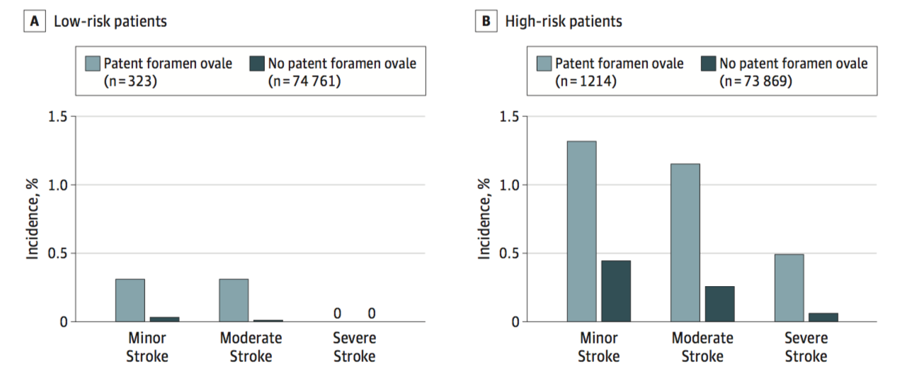
Association of PFO With Perioperative Ischemic Stroke
150198 cases analyzed(median age,55±16years)
1540(1.0%) had a diagnosis of PFO before surgery
ischemic strokes <30 days of surgery in 3.2% with PFO vs 0.5% without PFO
Patients with PFO had increased risk of ischemic stroke odds ratio 2.66 P<.001.
Risks of stroke were 5.9 for every 1000 patients with PFO vs 2.2 without PFO
PFO patients also had increased risk of large vessel territory stroke relative risk ratio 3.14 P<.001and more severe stroke-related neurologic NIHSS deficit P=.02
JAMA. 2018;319(5):452-462
JAMA. 2018;319(5):446-447
Notes:
IMPORTANCEPerioperative stroke is a major complication for patients undergoing surgery.Patent foramen ovale (PFO) represents a possible anatomical link between venousthrombosis and stroke.
OBJECTIVETodeterminewhetherapreoperativelydiagnosedPFOisassociatedwithincreased risk of perioperative ischemic stroke.
DESIGN,SETTING,ANDPARTICIPANTSRetrospectivecohortstudyfromMassachusettsGeneral Hospital and 2 affiliated community hospitals between January 1, 2007, andDecember 31, 2015. Participants were 182 393 consecutive adults undergoing noncardiacsurgery with general anesthesia.
EXPOSURESPreoperativelydiagnosedPFO.
MAINOUTCOMESANDMEASURESPerioperativeischemicstrokeoccurringwithin30daysofsurgery; stroke subtype by Oxfordshire Community Stroke Project classification and strokeseverity by National Institute of Health Stroke Scale (NIHSS).
RESULTSAmongthe150198patientcasesanalyzed(median[SD]age,55[16]years),1540(1.0%) had a diagnosis of PFO before surgery. A total of 850 (0.6%) ischemic strokesoccurred within 30 days of surgery (49 [3.2%] among patients with PFO and 801 [0.5%]among patients without PFO). In adjusted analyses, patients with PFO had an increased riskof ischemic stroke compared with patients without PFO (odds ratio, 2.66 [95% CI, 1.96-3.63];P<.001). The estimated risks of stroke were 5.9 for every 1000 patients with PFO and 2.2 forevery 1000 patients without PFO (adjusted absolute risk difference, 0.4% [95% CI,0.2%-0.6%). Patients with PFO also had an increased risk of large vessel territory stroke(relative risk ratio, 3.14 [95% CI, 2.21-4.48];P<.001) and a more severe stroke-relatedneurologic deficit measured by NIHSS (median, 4 [interquartile range {IQR}, 2-10] vs median,3 [IQR, 1-6] for those without PFO;P=.02).
CONCLUSIONSANDRELEVANCEAmongadultpatientsundergoingnoncardiacsurgeryat3hospitals, having a preoperatively diagnosed PFO was significantly associated with increasedrisk of perioperative ischemic stroke within 30 days after surgery. Further research is neededto confirm these findings and to determine whether interventions would decrease this risk.

Slide 16
Indications and Usage
The AMPLATZERTM PFO Occluder is indicated for percutaneous transcatheter closure of a patent foramen ovale (PFO) to reduce the risk of recurrent ischemic stroke in patients, predominantly between the ages of 18 and 60 years, who have had a cryptogenic stroke due to a presumed paradoxical embolism, as determined by a neurologist and cardiologist following an evaluation to exclude known causes of ischemic stroke.

Slide 17
Understanding Treatment Benefit of PFO Closure
The absolute yearly rate of ischemic strokes is low in both groups but lower with PFO closure
The treatment effect continues to accrue with time
Important if you are 40 years old
Patients with high-risk PFO characteristics of ASA or large shunt have a large relative risk reduction from PFO closure
At ten years the expected frequency of recurrent stroke in RESPECT would be reduced from12.90% to 2.94% from PFO closure with a calculated number needed to treat of only 10!

