Slide 1
Management of Procedural (Conscious) Sedation
Kenneth A. Gorski, BSN, RN, RCIS BE SMITH – AMN Healthcare Interim Manager: Mission Health Hospital Asheville, North Carolina

Slide 2
Kenneth A. Gorski, BSN, RN, RCIS
I have no relevant financial relationships

Slide 3
Our patients are underdoing a procedure on their HEART - They fear the unknown - They do not want additional pain Our Goals: - Reduce Anxiety - Minimize Discomfort - No Negative/ill Effects

Slide 4
Cath Lab Sedation

Slide 5
Pain Free Dentistry

Slide 6
Difference Between Conscious and Unconscious Sedation (Posted in Sedation Dentistry)
In conscious sedation, the patient is given a sedative either orally or intravenously the puts the patient in a very relaxed and drowsy state. In some cases the patient may doze off, but the patient is always conscious. Conscious sedatives partially block memory formation so even if the patient was not actually asleep, it may seem that way since they have little or no memory of the procedure.
In unconscious sedation, general anesthesia is used to fully sedate the patient. The patient is unconscious throughout the procedure and cannot respond to questions or directions.

Slide 7
Yes, a man named Snow was the first to “Snow a patient”
https://www.slideshare.net/anaesthesiology-mgmcri/anesthesia-history-63732808

Slide 8
Cath Lab Sedation circa mid 1980s
Pre Procedure:
+/- Benadryl 25-50mg PO
+/- Valium 2.5-5mg PO
Intra Procedure
Morphine 5mg IV
Valium 5mg IV
Patient monitored with NIBP and “Bouncing Ball” Monochrome Oscilloscope

Slide 9
Moderate Sedation
Moderate (formerly Conscious) Sedation: minimally depressed, patient maintains patent airway independently, responds appropriately to physical stimulation and verbal commands

Slide 10
Deep Sedation
Deep Sedation: controlled state which the patient is not easily aroused, responds purposely to repeated or painful stimuli, may require assistance to maintain a patent airway, spontaneous ventilation may be impaired.

Slide 11
General Anesthesia
General Anesthesia: loss of consciousness, unable to arouse even with painfull stimuli, inability to maintain independent ventilation, requires assistance to maintain patent airway, cardiovascular function may be impaired.

Slide 12
Monitored Anesthesia Care (MAC)
Monitored anesthesia care (MAC) has been described as a specific anesthesia service for diagnostic or therapeutic procedures performed under local anesthesia along with sedation and analgesia, titrated to a level that preserves spontaneous breathing and airway reflexes, according to the latest American Society of Anesthesiologists (ASA) update in 2008.[

Slide 13
In October 2014, the American Society of Anesthesiologists (ASA) Committee on Standards and Practice Parameters recommended new guidelines for moderate sedation to guide other medical practitioners and encourage education and training.

Slide 14
Monitor Requirements
The following monitors must be present, with appropriate alarm ranges turned on at all times:
Blood pressure
ECG
Pulse oximeter
End tidal CO2 monitoring is recommended by the ASA

Slide 15
Limitations of Pulse Oximetry
Pulse-oximetry assess oxygenation, the amount of oxygen inhaled by the lungs that reaches the bloodstream
Measures how much of each red blood cell is bound with oxygen.
A normal SPO2 is 92-96%.
It does not provide a full picture of how well a patient is ventilating
It does not provide information on the cellular environment that can impact the uptake of oxygen.

Slide 16
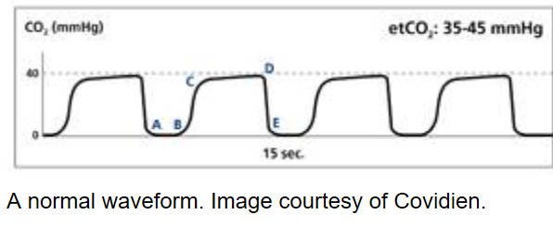
Why Capnography?
Capnography assesses ventilation, air movement in and out of the lungs
Represents the amount of carbon dioxide (CO2) in exhaled air
Assesses ventilation.
It consists of a number and a graph. The number is capnometry, which is the partial pressure of CO2 detected at the end of exhalation, or End-tidal CO2
A normal ETCO2) which is normally 35-45 mm Hg.

Slide 18
Airway Management
Supplemental O2 and accessories (nasal canula, simple mask, non-rebreather, etc.)
Ambu bag
Continuous suction system with catheters
Emergency Airway Management supplies / Intubation Tray
Crash Cart with Resuscitation Meds

Slide 19
Reversal Agents
Narcan
Flumazenil

Slide 20
Most Commonly Used (United States)
Midazolam
Benzodiazepine most commonly used
Fast onset of sedation
Amnesic effects
less pain on injection and improved awakening compared with Valium
Fentanyl
Provide analgesia and sedation
Has been favored because of its prompt onset and short duration of action
Fentanyl is a synthetic opioid pain reliever that, according to the CDC, is 50 to 100 times more potent than morphine.

Slide 21
Increasing public awareness/concern

Slide 22
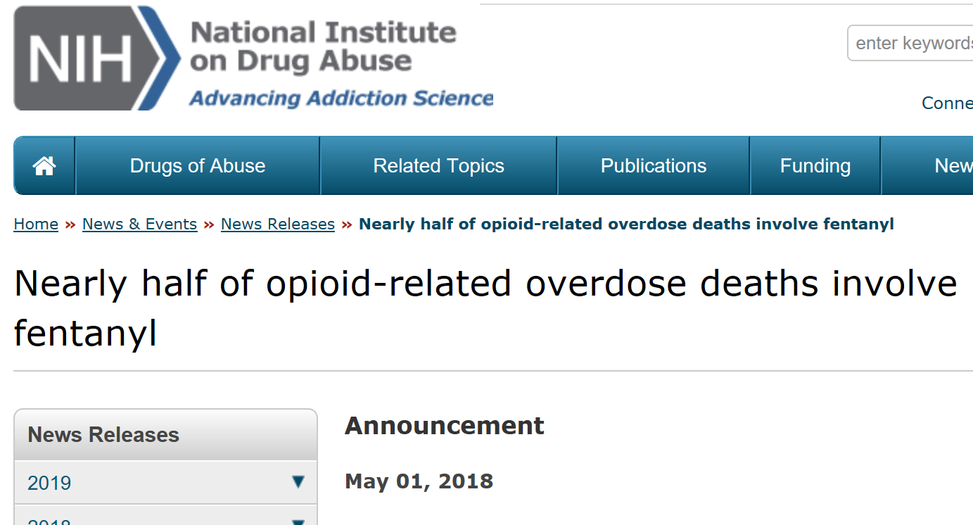
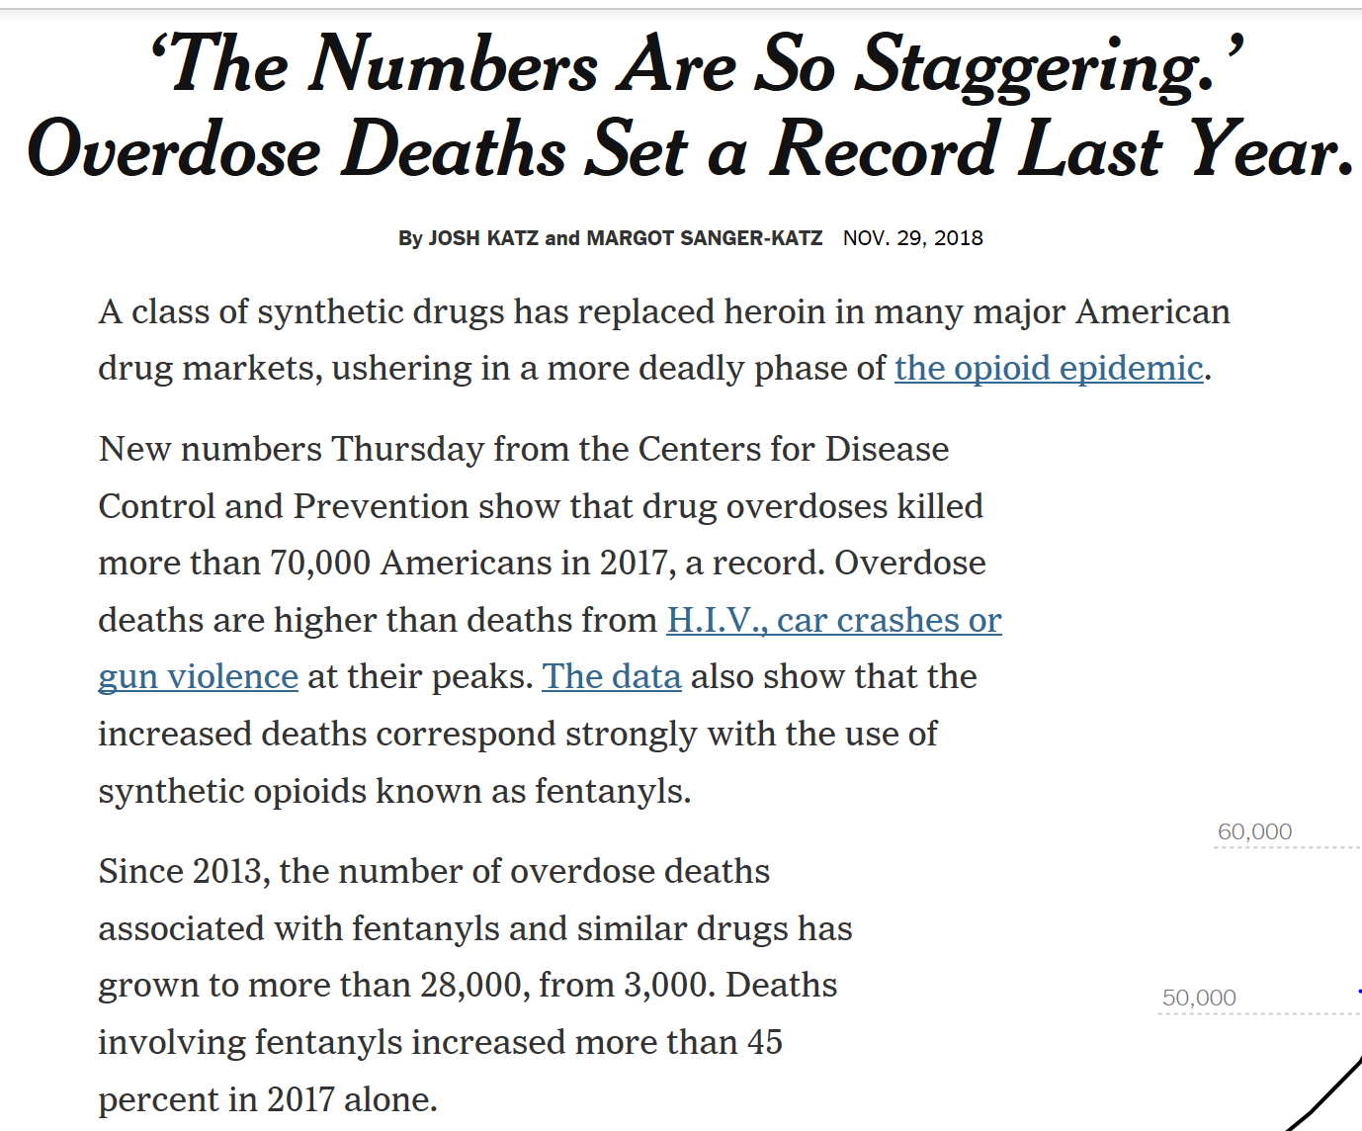

Slide 23
Alternatives to Fentanyl
Midazolam only
Propofol
Ketamine
Procedural Doses typically used does not affect pharyngeal-laryngeal reflexes Patent airway and spontaneous respiration maintained
Particularly useful for emergency procedures when fasting is not assured.
Hallucinogenic effects

Slide 24
