Slide 1

EuroPCR 2018; Hotline TAVI 1; Room Maillot, Level 2
Tuesday, 22nd May 2018, 13:45 – 13:53
30-Day Clinical and Echocardiographic Results of
Next Generation Balloon Expandable TAVR System (MyVal)
in Patients with Severe Stenosis of Native Aortic Valve
Dr. Ravinder Singh Rao, MD, DM, FACC
Eternal Heart Care Centre & Research Institute
Jaipur, India
For The MyVal-1 Investigators

Slide 2
Speaker’s Name: Dr. Ravinder Singh Rao
I do not have the any conflicts of interest to report.

Slide 3

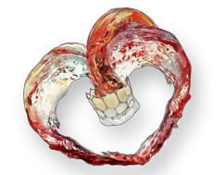

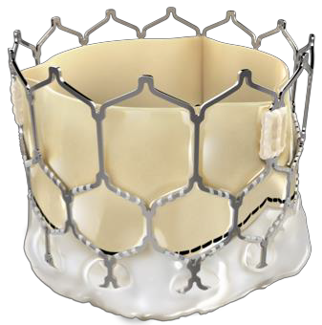








MyVal – Balloon Expandable THV Design Philosophy
Nickel Cobalt alloy frame for high radial strength & RO
Open cells on upper half to ensure access of coronary ostia
Hybrid Honeycomb Cell
Design Concept
≈ 53%
Frame height 17-20 mm
Bovine pericardium Tri-leaflet valve
Closed cells on lower half for high radial strength
≈ 47%
External PET buffing to minimize para-valvular leaks
Internal PET sealing cuff for lower profile & puncture resistance
Ø – 20 mm, 23 mm, 26 mm, 29 mm
21.5 mm, 24.5 mm, 27.5 mm, 32 mm new
MyVal THV has been indigenously developed by Meril Life Sciences, Vapi, India

Slide 4


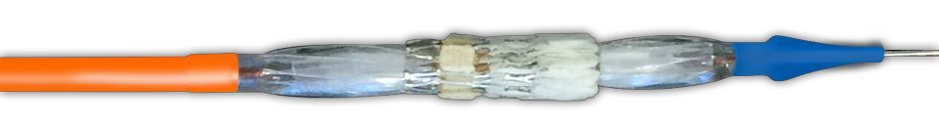


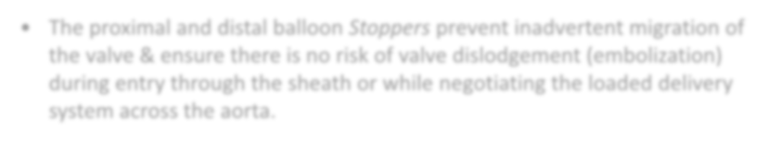


Delivering TAVI Made Easy
MyVal THV device is recommended to be crimped directly on the balloon
The crimped valve with delivery system is then loaded through 14/16Fr Python – Expandable Sheath
Navigator balloon delivery system has a set of proximal and distal Stoppers
which ensure that valve crimping is precise and snug.
Visual confirmation of crimped valve can be had before entering the sheath
to avoid any crimping errors/defects.
The proximal and distal balloon Stoppers prevent inadvertent migration of the valve & ensure there is no risk of valve dislodgement (embolization) during entry through the sheath or while negotiating the loaded delivery system across the aorta.
MyVal THV direct crimping on the balloon makes TAVI delivery simple, intuitive and eliminates unwarranted procedural steps.

Slide 5

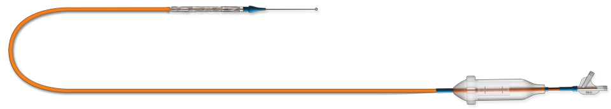







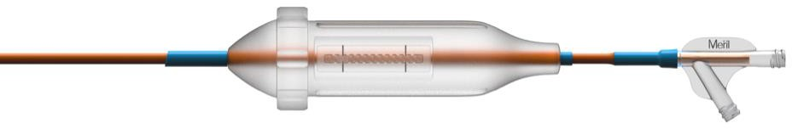





Navigator THV Delivery System
0.035” guide wire
Usable catheter length 120 cm
Proximal Shaft with Rotatory Handle for Hi-Flexion
14F
Clock-wise rotation to achieve distal end flexion
Proximal Shaft with Rotatory Handle for Hi-Flexion
0.035” Guide wire exit port
J
Un-deflected Catheter
position (straight)
Maximum deflection
catheter position
Balloon inflation port
Navigator – THV Delivery System has been indigenously developed by Meril Life Sciences Pvt. Ltd.

Slide 6
MyVal-1 Study Design
First-in-man Safety and Efficacy study of MyVal THV in subjects with severe symptomatic native aortic valve stenosis in 30 pts
Clinical follow-up
6-
month
N = 30 30-days
1-year 2- 5 years
CLINICAL FOLLOW-UP | 30 | 30 | 30 | 30
ECHO TTE or TEE | 30 | 30 | 30 | 30
6 Min Walk Test | 30 | 30 | 30 | -
Device Sizes – 20, 23, 26 and 29 mm 14 Investigating Sites in India
Echo Core Lab – CRF, NY, USA
Dr. Samin Sharma – Chairman Dr. Ashok Seth – PI
Dr. Praveen Chandra – Coordinating PI
Dr. Ravindra Rao – Co-PI

Slide 7
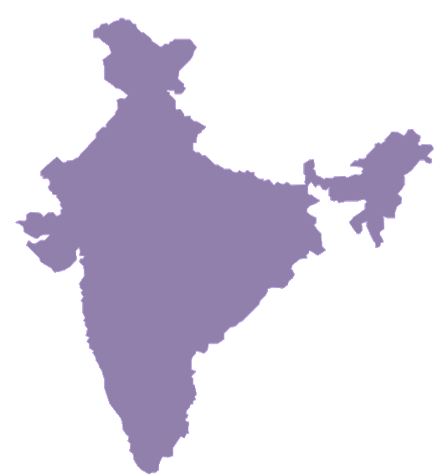
Investigating Sites
30 Subjects, 14 Investigating Sites
Investigator Name | Site Name and City | # Enrollment
Dr. Ashok Seth | Fortis Escorts, New Delhi | 3
Dr. Praveen Chandra | Medanta, Gurugram | 1
Dr. Ravinder Singh Rao | Eternal Heart, Jaipur | 7
Dr. Amit Kumar Chaurasia | BLK Hospital, Delhi | 1
Dr. Pravin Kumar Goel | SGPGI, Lucknow | 4
Dr. Rishi Sethi | Lari Cardio, Lucknow | 1
Dr. Prashant Bharadwaj | MHCTC, Pune | 4
Dr. Ajaykumar U. Mahajan | Sion Hospital, Mumbai | 2
Dr. C N Manjunath | Sri Jayadeva, Bengaluru | 1
Dr. Sanjay Mehrotra | NH, Bengaluru | 1
Dr. George Joseph | CMC, Vellore | 2
Dr. G. Sengottuvelu | Apollo Hospital, Chennai | 1
Dr. Rajpal K Abhaichand | GKNM, Coimbatore | 1
Dr. Ajith Kumar | Sree Chitra, Kerala | 1
 | Total | 30

Slide 8
Key Eligibility Criteria
Inclusion:
  Subjects > 18 years
  Must have co-morbidities such that the heart team concur that the predicted risk of operative mortality is ≥ 4% and/or a minimum STS score of ≥ 4
  Senile degenerative aortic valve stenosis with echo- cardiographically derived criteria : mean gradient > 40mmHg or jet velocity greater than 4.0 m/s or an initial aortic valve area (AVA) of < 0.8 cm2
  Subject is symptomatic from aortic valve stenosis as demonstrated by NYHA Functional Class III & IV
Exclusion:
  AMI < 1 month prior to Tx
  Unicuspid, bicuspid or non- calcified
  Mix aortic valve disease
(AS+AR) with AR >3+
  Pre-existing prosthetic HV in any position, prosthetic ring
  Untreated significant CAD requiring revascularization
  Hemodynamic instability
  LVEF <20%
  Native aortic annulus <18mm or > 28mm by echo
  Renal insufficiency, ESRD,
dialysis
  Significant aortic disease

Slide 9
Key Demographics
Characteristic | MyVal – THV (N=30)
Age (Years) | 75.54±6.72
Gender (Male) | 22 (73.33%)
STS score (%) | 6.42±1.78
NYHA Class III | 24 (80.00%)
NYHA Class IV | 6 (20.00%)
Coronary artery disease | 13 (43.33%)
Previous Myocardial Infarction | 4 (13.33%)
CABG | 5 (16.66%)
PCI | 4 (13.33%)
Balloon aortic valvuloplasty | 0 (0.0%)
Cerebral vascular disease | 1 (3.33%)
Peripheral vascular disease | 3 (10.00%)

Slide 10
Co-morbid Risk Factors
Co-morbid Risk Factors (N=30)
COPD | 14 (46.66%)
Creatinine >2 mg/dl | 2 (6.66%)
Atrial Fibrillation | 6 (20.00%)
Permanent pacemaker | 0 (0.00%)
Pulmonary hypertension | 5 (16.66%)
Frailty (Kartz Index ≤ 4) | 2 (6.66%)
Extensively calcified aorta | 2 (6.66%)
Chest-wall deformity | 0 (0.0%)
Liver disease | 1 (3.33%)

Slide 11
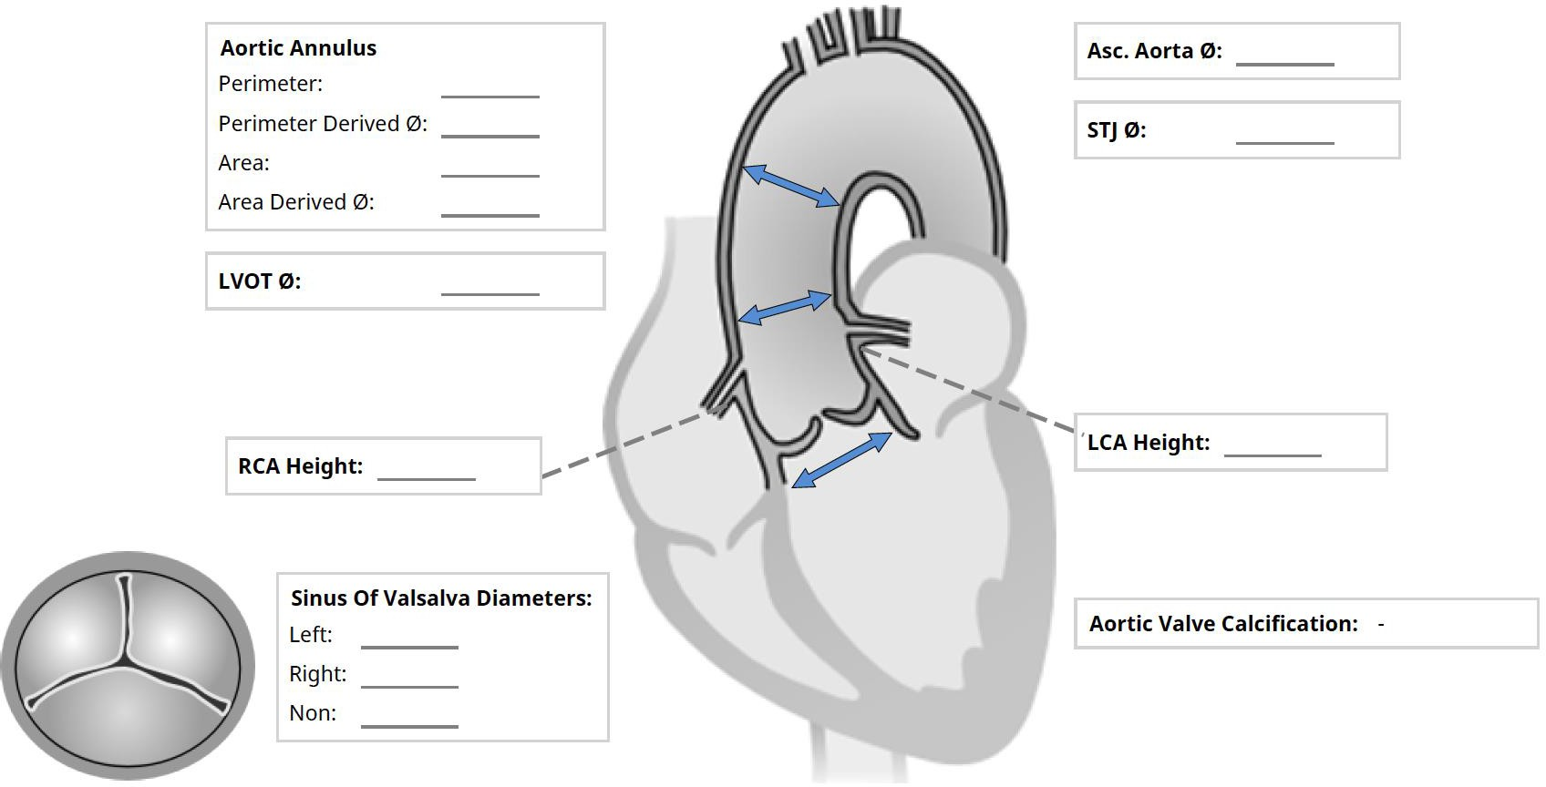
Aortic Root Analysis N=30
34.86±3.45
23.96±1.87
29.28±2.39
23.58±1.91
21.78±2.01
12.92±1.63
13.63±1.35
28.76±1.82
28.67±1.52
31.08±2.43
Horizontal annulus, n (%) 2 (6.66%)
All Values in mm. Mean±SD
Analysis done using CT images and 3mensio software

Slide 12
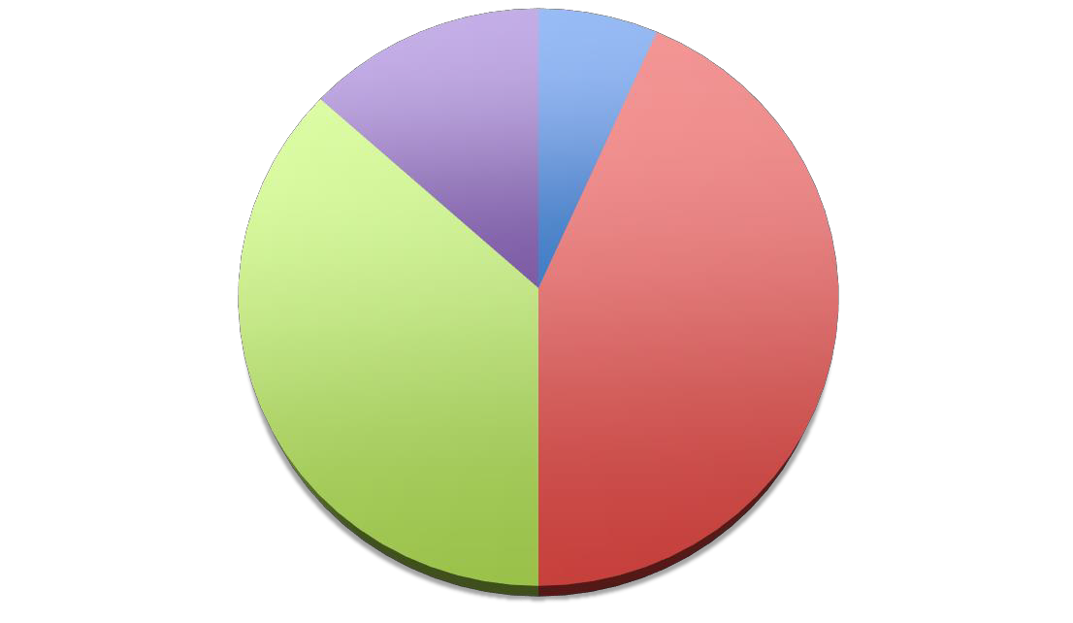
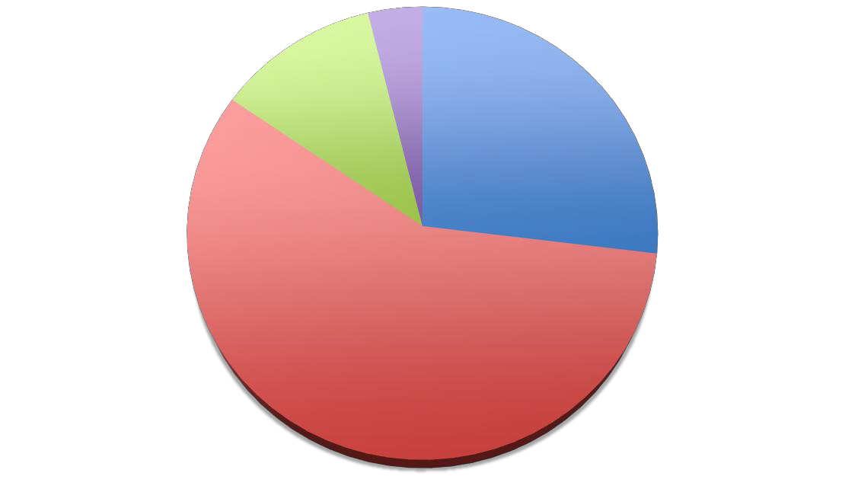
Device & Treatment Details
Pre-dilatation BAV Size Details n=26, 86.7%
25 mm
1 (3.8%)
23 mm
MyVal Size Details n=30
20 mm
2 (6.66%)
29 mm
4 (13.22%)
3 (11.5%)
16 mm
7 (26.3%
23 mm
13 (43.33%)
26 mm
11 (36.66%)
20 mm
15 (57.7%)
Study Device Details | MyVal N = 30
Femoral Access Right Common Femoral Artery Left Common Femoral Artery | 22 (73.33%) 8 (26.66%)
Procedural Anaesthesia General Anaesthesia Conscious Deep Sedation | 18 (60.00%) 12 (40.00%)

Slide 13


Echocardiographic Results
Echocardiographic findings
Parameters | Baseline (N=30) | Post Procedure (N=30) | 30 Days (N=29)
Mean aortic-valve gradient (mm Hg) | 47.43±8.79 | 5.83±2.67 | 6.03±2.54
Peak aortic-valve gradient (mm Hg) | 71.70±12.98 | 8.40±2.40 | 8.68±2.81
Trans Aortic Velocity (m/s) | 4.47±0.41 | 1.88±0.44 | 1.85±0.38
Mean LVEF (%) | 45.52±11.48 | 47.84±11.06 | 48.62±8.87
Moderate or severe mitral regurgitation | 2 (6.66%) | 2 (6.66%) | 2 (6.89%)
Aortic Regurgitation | - | 0 (0%) | 0 (0%)
Mild Paravalvular Leak | - | 2 (6.66%) | 2 (6.89%)
Moderate/Severe PVL |  | 0 (0.00%) | 0 (0.00%)

Slide 14
Primary Endpoint - MACCRE
Major Adverse Cardiac, Cerebral & Renal Event (MACCRE) | Results
Zero Mortality Due To Study Device | Post Procedure N=30 | 30 Days N=29
All Cause Death | 1* | 0
Cardiovascular Death | 0 | 0
Repeat Hospitalization | ₃$ | ₁#
Stroke/TIA | 0 | 0
Renal Failure | 1* | 0
All Access Site Complication | 4 | 0
Permanent Pacemaker | 0 | 0
Myocardial Infraction | 0 | 0
* Non-cardiac and non-device related death. Mortality due acute kidney failure.
$ 1 patient had gastroenteritis and 2 patients had access site vascular complication
# Patient re-admitted due to access site infection

Slide 15


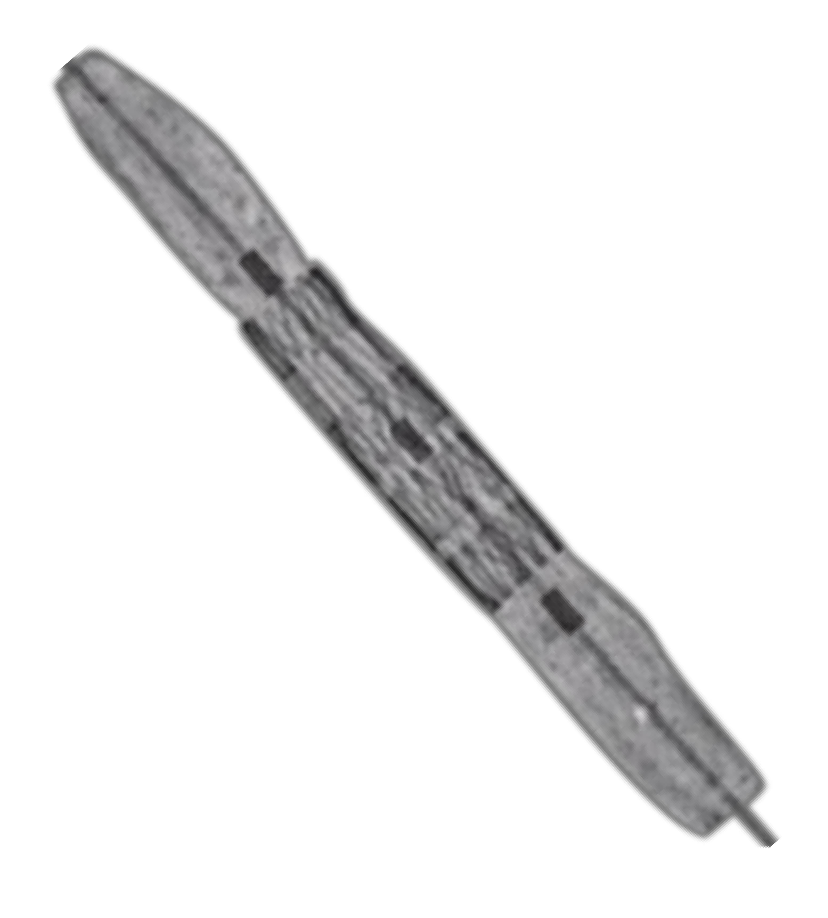
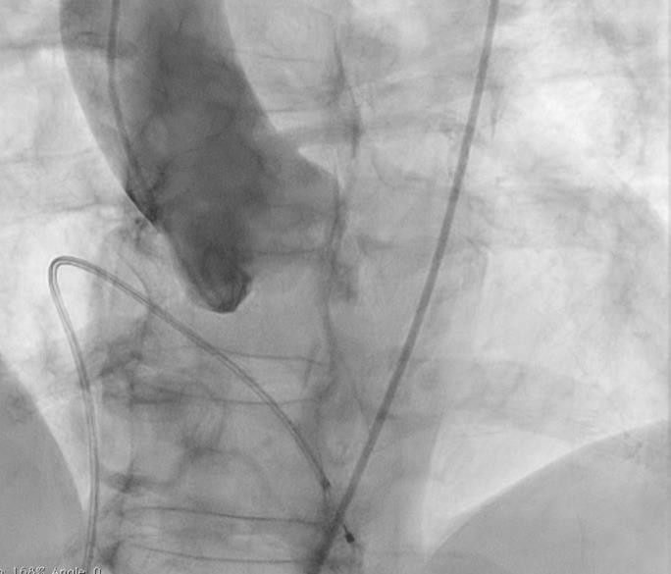

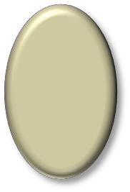




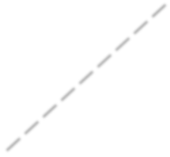









MyVal THV – Precise Placement
2nd Dense Row Landing Zone
Prox. balloon marker
Mid balloon marker 2nd Light Band
Annular Plane
2nd Dense Row
1st Light Band
1st Dense Row
Upon Crimping-
Alternating V-folds & vertical connectors give MyVal a unique appearance on fluoro for ease of positioning
Distal End
Towards Ventricle
Dist. balloon marker
Schematic of Crimped MyVal on Navigator Balloon

Slide 16

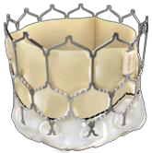

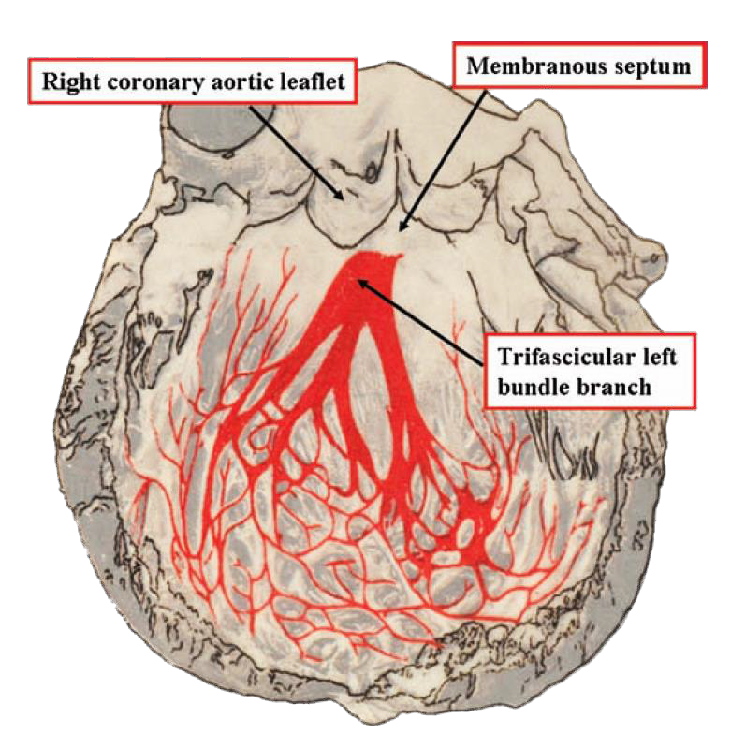
Post Procedure Re-intervention
Unique crimping geometry of MyVal ensures precise orthotopic device placement without any deep throating into the LVOT
Precise annular placement ensures that there is no conduction system disturbances thus eliminating need for a new pace maker as seen with previous technologies.
Reintervention | Post Procedure (N=30) | 30-Days (N=29)
Balloon aortic valvuloplasty | 0 | 0
Repeat TAVI | 0 | 0
Aortic-valve replacement | 0 | 0
Endocarditis | 0 | 0
New atrial fibrillation | 0 | 0
New pacemaker | 0 | 0
Open surgical HV replacement | 0 | 0
Tawara et al. JACC CardioVascular Interventions 2008; 1:310-316

Slide 17
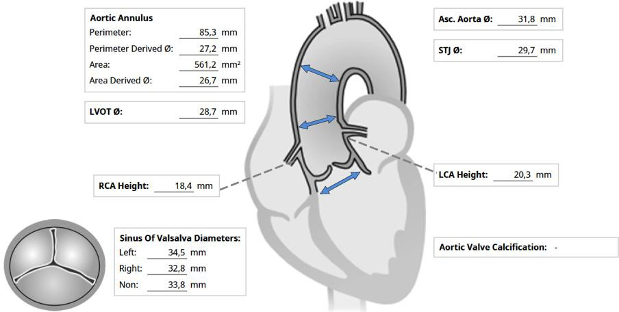
MyVal Case Example
73 Year/Male | Symptomatic AS | NYHA class IV | Hist. of chronic lung disease |
Hist. of heart failure | LV function 25% | Mild pulmonary hypertension | No coronary disease | STS score: 8.2%
Parameters | Values
Valve Type | Tri-leaflet
Peak Trans-aortic Velocity | 3.6 m/s
Mean Trans-aortic Gradient | 43 mmHg
Peak Gradient | 70 mmHg
Parameters | Values
Calculated EOA | 0.6 cm²
Severity of AR | Mild
Severity of MR | Mild
Ejection Fraction | 25%

Slide 18

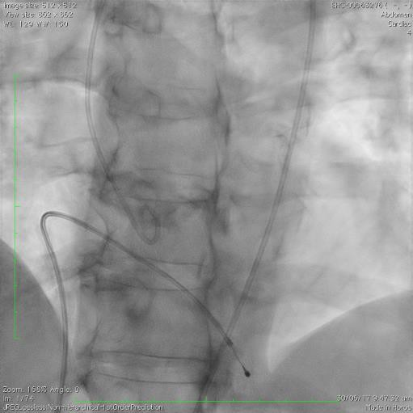
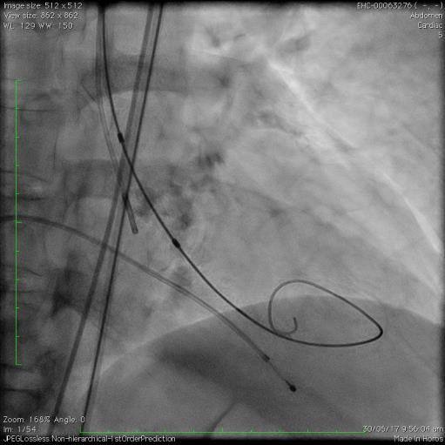
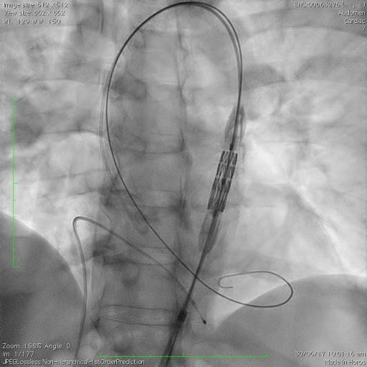
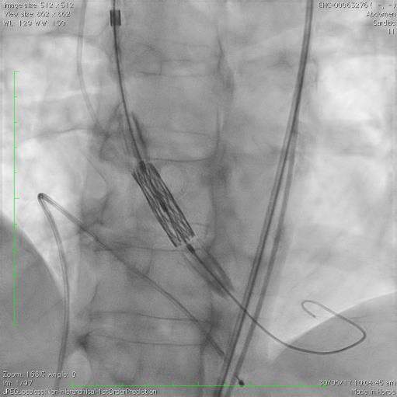
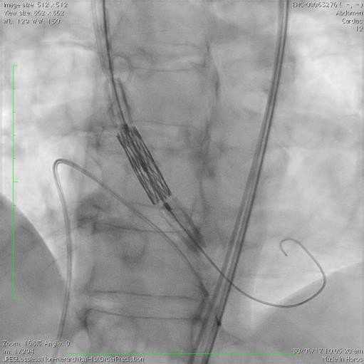
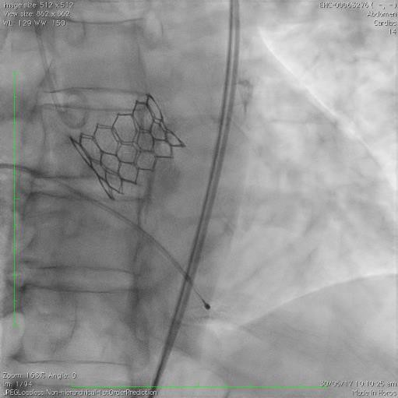
MyVal Case Example
Procedure done under conscious sedation
Baseline Aortogram
Pre-Diltn. 23mm BAV Navigation across arch
Position across annulus
MyVal 29mm
Post Procedure

Slide 19
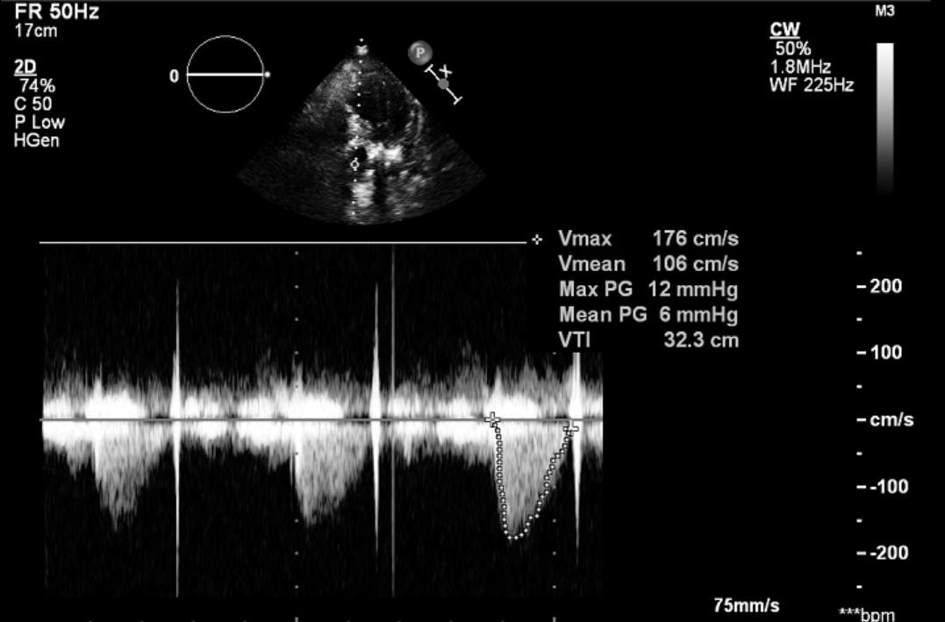
30-Days Follow-up Echo Report
30-Days Echo Results – Case Ex-1 297 Days / 10 months Since Tx
Parameters | Values
Valve Type | Tri-leaflet Valve
Peak Trans-aortic Velocity | 1.8 m/s
Peak Trans-aortic Gradient | 12 mmHg
Mean Trans-aortic Gradient | 6 mmHg
Calculated EOA | -
Severity of AR | -
Severity of MR | Mild
Ejection Fraction | 25%
Annulus Diameter | -

Slide 20
MyVal-1 Clinical Trial Conclusions
MyVal-1 FiM has successfully completed the primary endpoint demonstrating high safety at 30-days
100% device success
High clinical safety 0% device related death
High clinical efficacy
  Mean aortic gradient 47.43±8.79 mmHg reduced to 5.83±2.67 mmHg
    Maintained at 6.03±2.54 mmHg at 30-day follow-up
  Peak aortic gradient 71.70±12.98 mmHg reduced to 8.40±2.40 mmHg
    Maintained at 8.68±2.81 mmHg at 30-day follow-up
  Peak Aortic Velocity 4.47±0.41 m/s reduced to 1.88±0.44 m/s
    Maintained at 1.85±0.38.54 m/s at 30-day follow-up
Improvement in NYHA Class
0% peri and post procedure stroke/TIA or MI.
  Sustained up to follow-up
0% new pace maker implantations

