Slide 1
Prevalence of Cardiovascular Disease and Risk Factors among NFL Alumni and their Family Members:
Results from the HUDDLE Study
Dr. Michael Amponsah
On behalf of the HUDDLE Investigators

Slide 2
Disclosures: Michael Amponsah, MD
Edwards Lifesciences

Slide 3
Background
CV risk factors like high systolic BP are associated with significant morbidity and contribute to premature CV mortality, yet many live with uncontrolled HTN
Early CV screening helps reduce the burden of undiagnosed disease and potentially mitigate disease progression
Guidelines rely on risk scores, which may not provide a complete clinical picture and overlook special populations who may benefit from basic CV testing
Despite perceived healthy living habits, professional athletes may be at significant risk for CV disease (CVD) both at a younger age and after they retire
CVD prevalence estimates in retired athletes are lacking

Slide 4
Objectives
The HUDDLE study aimed to:
Assess CVD and risk factor prevalence in a representative sample of former NFL players, coaches, and family
Quantify the knowledge gap of actual vs perceived CVD and risk factors and engage with participants through education
Identify opportunities for inclusive screening to mitigate the consequences of undiagnosed and under-treated CVD

Slide 5
Study Design
Multi-city, cross-sectional study to assess the prevalence of CVD and related risk factors in a representative population through cardiac screening and participant questionnaires
NFL Alumni Association Members (former players or coaches) and family
aged ≥ 50 years
CVD screening event (3 components)
Participant health history questionnaire
Non-invasive
cardiac screening
EKG* BP† TTE*
Interactive
educational session
30-day phone visit to discuss screening results and recommendations for further follow up
*Reviewed by independent core lab
†An average BP measurement was recorded for participants who received ≥2 readings

Slide 6
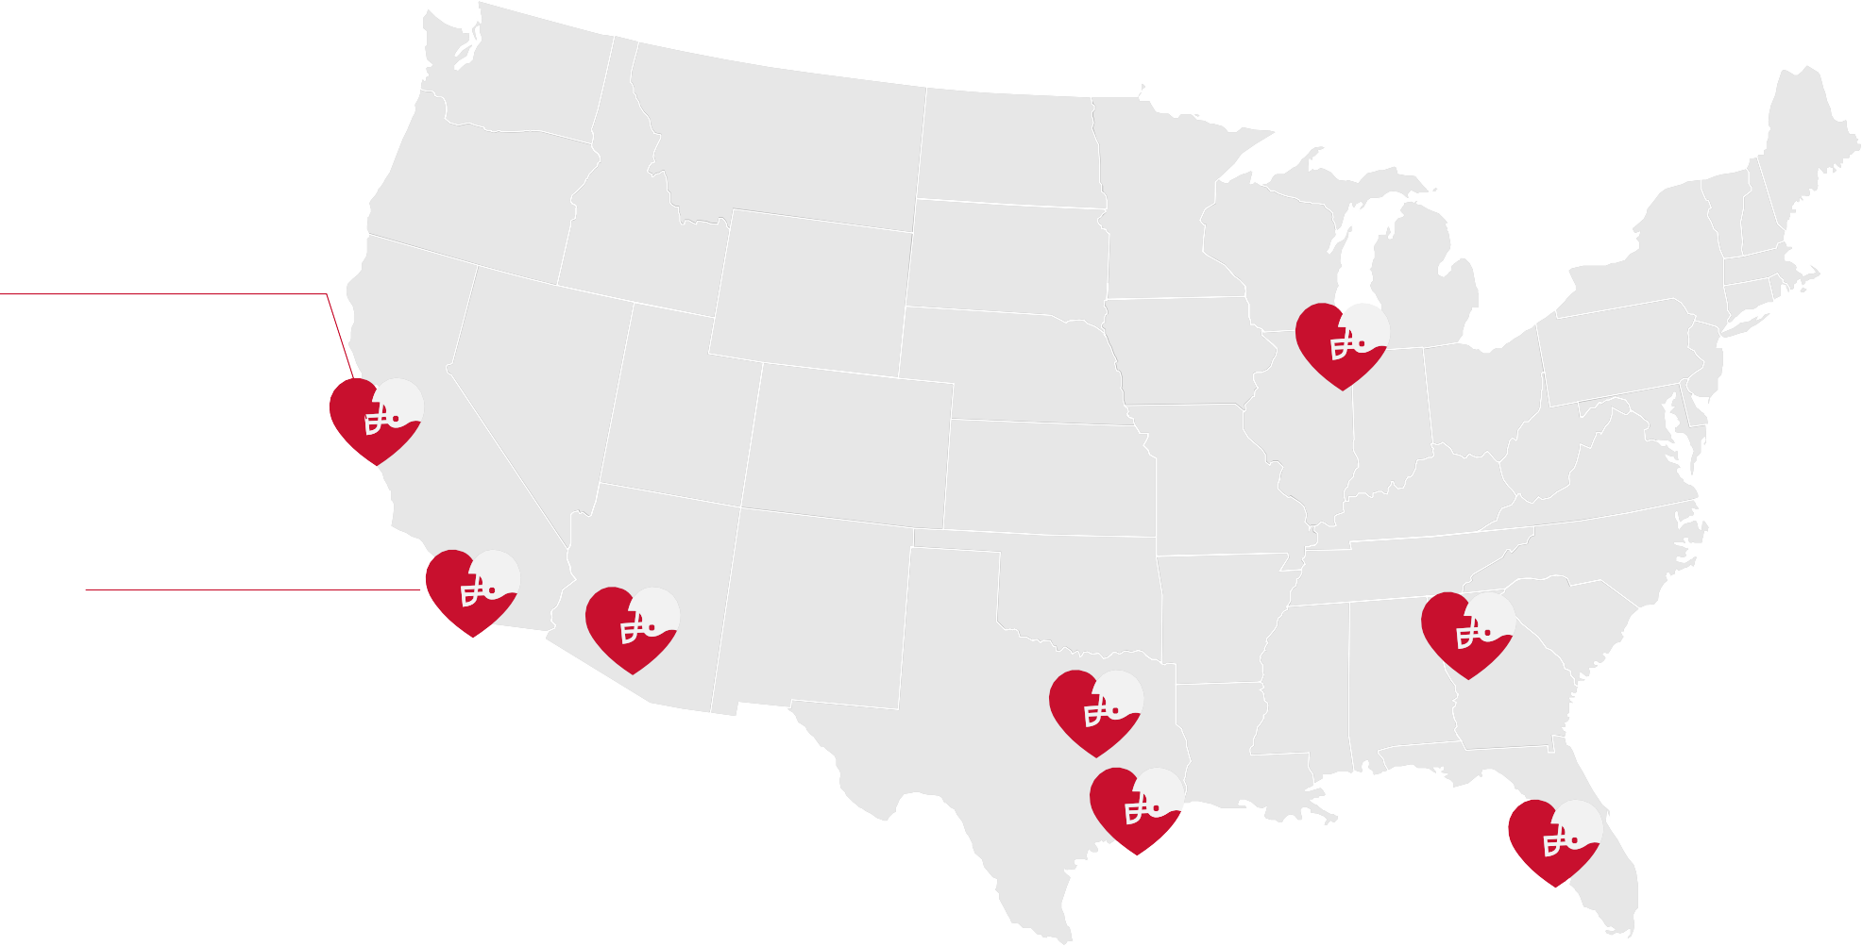
Screening Event Cities and Investigators
Palo Alto, CA (n=61)
Drs. Lee Rice, Shannon Cheffet, &
Mehul Patel
Chicago, IL (n=56)
Drs. Lee Rice, Clifford Kavinsky, & Marlon Everett
Irvine, CA (n=69)*
Drs. Lee Rice & Shannon Cheffet
Atlanta, GA (n=79)
Drs. Lee Rice,
Shannon Cheffet, Alexis Okoh, & Druenell Linton
Phoenix, AZ (n=58)
Drs. Lee Rice, Michael Amponsah, & David Carfagno
Dallas, TX (n=58)
Tampa, FL (n=58)
Houston, TX (n=59)
Drs. Lee Rice, Mehul Patel, & Robert Dimeff
Drs. Lee Rice, Mehul Patel, & David Braunreiter
Drs. Lee Rice,
Phillips Harrington, & Fred Brennan
*2 events held in Irvine with same PIs: 1 pilot event (n=22 ), 1 screening event (n=47)

Slide 7
Study Definitions: HTN Prevalence and Control
HTN Prevalence and Control | Numerator | Denominator
Prevalence | Participants with a history of HTN OR with a BP ≥130/80 mmHg at screening OR reported taking medication used to treat HTN | All screened participants
Unaware | Participants with a BP ≥130/80 mmHg at screening | Participants who did not report a history of HTN
Uncontrolled | Participants with a history of HTN AND with a BP ≥130/80 mmHg at screening | Prevalence
Controlled | Participants with a BP<130/80 mmHg at screening | Prevalence

Slide 8
Study Definitions: Abnormal EKG and TTE
If ≥1 of the following prognostic EKG findings per clinical expertise were present, a participant was considered to have an abnormal EKG:
Investigator –defined clinically relevant EKG abnormalities
• Afib or flutter • Atrial Enlargement/Dilatation • Pathological Q-Wave
• Atrial Arrhythmia • LV Hypertrophy • Inverted or Depressed T-Wave
• AV block* • LA fascicular block • Non-Specific T-Wave Abnormality
• LBBB or RBBB • LP fascicular block • Q-Wave V1-V2
If ≥1 of the following structural abnormalities per TTE were observed based on ASE sex-specific cutoffs*, a participant was considered to have an abnormal TTE:
ASE Guidelines
• LVEF <52/54% • IVS ED Thickness ≥1.3/1.2 cm • AV Mean Gradient ≥20 mmHg
• LVMI >115/95 g/m² • LVPW ED Thickness ≥1.3/1.2 cm • AVA ≤1.4 cm²
• LVEDD ≥6.3/5.6 cm • LA Diameter (AP) ≥4.6/4.2 cm • AV Peak Velocity ≥3.0 m/sec
• LVESD ≥4.3/3.8 cm • Wall Motion Abnormalities • TV Peak Gradient ≥10 mmHg
• RVD ≥41 mm • Valvular Stenosis ≥Mild • TR Peak Velocity ≥2.9 m/s
• RV Dysfunction • Valvular Regurgitation ≥Moderate
*ASE cutoffs from Lang et al. 2015; DOI: 10.1016/j.echo.2014.10.003; Cutoffs that varied by sex are denoted Male/Female; singular values are provided for cutoffs that were not sex-specific

Slide 9
Statistical Analysis
The following variables with prognostic implications for mortality were selected a priori as possible predictors of structural TTE changes
Age (continuous)
Race (White vs. Non-white)
BMI, kg/m² (categorical)
Obese vs Normal
Overweight vs Normal
Sex* (female vs. male)
Reported CV Rx usage (Yes vs. No)
HTN at Screening, BP ≥130/80 mmHg (Yes vs No)
Abnormal EKG† (Yes vs No)
Covariates were chosen for multivariable model inclusion if they were significant at the 0.1 level based on univariate testing
Models were run in the overall population and by former NFL player status
*Not tested for NFL players only
†Based on the presence of 1 or more prognostic EKG findings

Slide 10
Study Flow
Participants enrolled in the HUDDLE trial
N = 552
Exited study: N=54
Voluntarily withdrew consent (n=7)
Unable to attend
event/unknown (n=47)
Attended 1 of 9 CVD screening events in 8 US cities from 2021-2022
N = 498
Completed a 30-day follow-up phone visit
 | N = 498 (100%)

Slide 11
Participant Demographics
Characteristic | All Screened N=498 | Former NFL Player N=285 | Former Coach/Family N=213
Age, y | 63.0 ± 7.6 | 63.1 ± 7.3 | 63.0 ± 8.1
Male Sex | 66.5% (331) | 100% (285) | 21.6% (46)
Ethnicity*
Hispanic or Latino | 6.4% (31) | 3.6% (10) | 10.1% (21)
Not Hispanic or Latino | 85.5% (417) | 86.5% (243) | 84.1% (174)
Unknown or prefer not to say | 8.2% (40) | 10.0% (28) | 5.8% (12)
BMI, kg/m² | 29.7 ± 5.2 | 31.2 ± 4.7 | 27.7 ± 5.2
Race
African American or Black | 63.0% (313) | 67.6% (192) | 56.8% (121)
White | 29.6% (147) | 26.4% (75) | 33.8% (72)
Native Hawaiian or Pacific Islander | 1.6% (8) | 1.4% (4) | 1.9% (4)
American Indian or Alaska Native | 0.6% (3) | 1.1% (3) | 0%
Asian | 0.6% (3) | 0.0% (0) | 1.4% (3)
Other | 2.2% (11) | 2.5% (7) | 1.9% (4)
Multiple | 2.4% (12) | 1.1% (3) | 4.2% (9)
Values presented as mean ± SD (N) or % (n)
*10 participants did not provide ethnicity information

Slide 12
Participant Demographics
Characteristic | All Screened N=498 | Former NFL Player N=285 | Former Coach/Family N=213
Age, y | 63.0 ± 7.6 | 63.1 ± 7.3 | 63.0 ± 8.1
Male Sex | 66.5% (331) | 100% (285) | 21.6% (46)
Ethnicity*
Hispanic or Latino | 6.4% (31) | 3.6% (10) | 10.1% (21)
Not Hispanic or Latino | 85.5% (417) | 86.5% (243) | 84.1% (174)
Unknown or prefer not to say | 8.2% (40) | 10.0% (28) | 5.8% (12)
BMI, kg/m² | 29.7 ± 5.2 | 31.2 ± 4.7 | 27.7 ± 5.2
Race
African American or Black | 63.0% (313) | 67.6% (192) | 56.8% (121)
White | 29.6% (147) | 26.4% (75) | 33.8% (72)
Native Hawaiian or Pacific Islander | 1.6% (8) | 1.4% (4) | 1.9% (4)
American Indian or Alaska Native | 0.6% (3) | 1.1% (3) | 0%
Asian | 0.6% (3) | 0.0% (0) | 1.4% (3)
Other | 2.2% (11) | 2.5% (7) | 1.9% (4)
Multiple | 2.4% (12) | 1.1% (3) | 4.2% (9)
Values presented as mean ± SD (N) or % (n)
*10 participants did not provide ethnicity information

Slide 13
Participant Demographics
Characteristic | All Screened N=498 | Former NFL Player N=285 | Former Coach/Family N=213
Age, y | 63.0 ± 7.6 | 63.1 ± 7.3 | 63.0 ± 8.1
Male Sex | 66.5% (331) | 100% (285) | 21.6% (46)
Ethnicity*
Hispanic or Latino | 6.4% (31) | 3.6% (10) | 10.1% (21)
Not Hispanic or Latino | 85.5% (417) | 86.5% (243) | 84.1% (174)
Unknown or prefer not to say | 8.2% (40) | 10.0% (28) | 5.8% (12)
BMI, kg/m² | 29.7 ± 5.2 | 31.2 ± 4.7 | 27.7 ± 5.2
Race
African American or Black | 63.0% (313) | 67.6% (192) | 56.8% (121)
White | 29.6% (147) | 26.4% (75) | 33.8% (72)
Native Hawaiian or Pacific Islander | 1.6% (8) | 1.4% (4) | 1.9% (4)
American Indian or Alaska Native | 0.6% (3) | 1.1% (3) | 0%
Asian | 0.6% (3) | 0.0% (0) | 1.4% (3)
Other | 2.2% (11) | 2.5% (7) | 1.9% (4)
Multiple | 2.4% (12) | 1.1% (3) | 4.2% (9)
Values presented as mean ± SD (N) or % (n)
*10 participants did not provide ethnicity information

Slide 14
CVD and Risk Factor History
Characteristic | All Screened N=498 | Former NFL Player N=285 | Former Coach/Family N=213
High Blood Pressure (HTN) | 41.6% (207) | 37.5% (107) | 46.9% (100)
High Cholesterol | 31.9% (159) | 32.6% (93) | 31.0% (66)
Diabetes | 11.8% (59) | 12.6% (36) | 10.8% (23)
Abnormal Heart Rhythm | 16.3% (81) | 19.3% (55) | 12.2% (26)
Heart Murmur | 11.8% (59) | 12.3% (35) | 11.3% (24)
Enlarged Heart | 5.4% (27) | 9.5% (27) | 0%
Stroke/TIA | 4.8% (24) | 5.3% (15) | 4.2% (9)
Coronary Artery Disease | 4.6% (23) | 6.3% (18) | 2.3% (5)
Permanent Pacemaker* | 1.9% (9) | 1.9% (5) | 1.9% (4)
Congenital Heart Disease | 1.8% (9) | 2.8% (8) | 0.5% (1)
Heart Attack | 1.6% (8) | 2.1% (6) | 0.9% (2)
Heart Failure | 1.4% (7) | 2.1% (6) | 0.5% (1)
Values presented as % (n)
*Pacemaker was not collected for pilot cohort (n=22)

Slide 15
BP Stratified by History – All Screened
60
Normotensive 7.4% (n=37)
Elevated 8.9% (n=44)
Hypertensive 83.7% (n=416)
No Known HTN Known HTN
% of Participants
40
31.0%
28.2%
23.5%
13.5
20
18.3
14.7
7.4%
8.9%
17.5
1.8
5.6
6.0
2.8
9.9
8.9
0.6
1.0% 0.4
0
<120/80
≥120/80;
<130/80
≥130/80;
<140/90
≥140/90;
<150/100
≥150/100;
<200 systolic
≥200 systolic
BP at Screening* (mmHg)
*BP was unmeasurable in 1 participant because his arm was too large for available cuff sizes; he reported a history of HTN

Slide 16
BP Stratified by History – Former NFL Players
60
Normotensive Elevated 4.6% (n=13) 11.6% (n=33)
Hypertensive 83.8% (n=238)
No Known HTN Known HTN
% of Participants
40
34.2%
27.5%
21.5%
15.1
20
11.6%
20.8
15.1
4.6%
3.5
8.1
3.5
19.0
1.1
6.7
6.3
0.7%
0
<120/80
≥120/80;
<130/80
≥130/80;
<140/90
≥140/90;
<150/100
≥150/100;
<200 systolic
≥200 systolic
BP at Screening* (mmHg)
*BP was unmeasurable in 1 participant because his arm was too large for available cuff sizes; he reported a history of HTN

Slide 17
HTN Prevalence and Control
100
80
60
40
20
0
All Screened Former NFL Player
89.3
89.8
% of Participants
80.1
81.5
41.2
36.5
6.3
6.7
[444/497] [255/284]
[233/291] [145/178]
[183/444]
[93/255]
[28/444]
[17/255]
Prevalence | Unaware | Uncontrolled | Controlled
Known HTN, BP ≥130/80 mmHg at screening, or taking HTN medication / all screened
BP ≥130/80 mmHg at screening / those who reported no history of HTN
Known HTN AND BP ≥130/80 mmHg at screening / prevalence
BP <130/80 mmHg at screening / prevalence
*BP was unmeasurable in 1 participant because his arm was too large for available cuff sizes; he reported a history of HTN

Slide 18
Abnormal EKGs and TTEs (Core Lab)
Characteristic | All Screened N=498 | Former NFL Player N=285 | Former Coach/Family N=213
Abnormal EKG* | 37.5% (186) | 46.1% (131) | 25.9% (55)
Abnormal TTE | 55.0% (274) | 61.8% (176) | 46.0% (98)
Critical TTE Findings: Ascending Aortic Aneurysm (N=1)
Participant was a former NFL player, aged 67 years with no known history of CVD or HTN (BP 133/87mmHg at event)
Participant underwent surgery for AAA
*EKGs were unevaluable in 1 former NFL player and 1 family member, so denominators are 496, 284, and 212, respectively

Slide 19
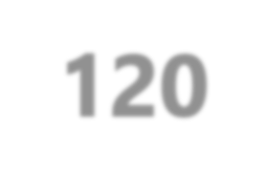
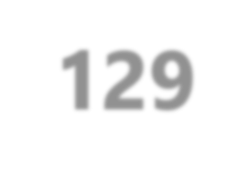
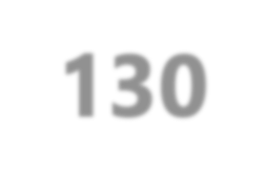
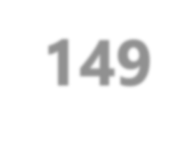
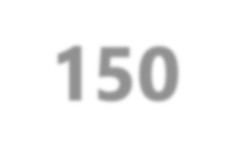
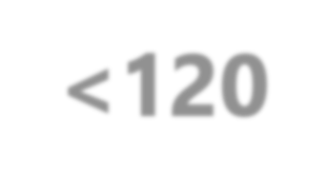
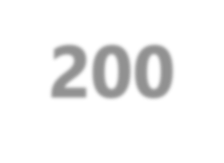
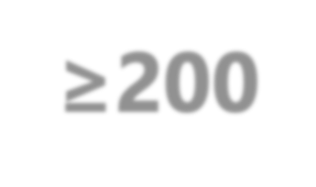
Structural Changes on TTE by Systolic BP
% w/ an Abnormal TTE
100
80
60
40
20
0
All Screened Former NFL Player
80.0
64.7
68.4
60.7
63.3
51.9
50.0
52.4
50.0
43.1
N=51 N=17
<120
N=79 N=48 N=212 N=122
120-129 130-149
N=150 N=95
150-200
N=5 N=2
≥200
Systolic BP at Screening* (mmHg)
*BP was unmeasurable in 1 participant because his arm was too large for available cuff sizes; he reported a history of HTN; Of 11 NFL players w/ structural changes and a systolic BP<120mmHg, 10 had CVD or risk factor history

Slide 20
Structural Changes on TTE – All Screened
% w/ an Abnormal TTE
100
80
60
40
20
0
Yes No
60.5
64.5
58.1
48.8
47.1
49.0
N=334 N=164
Known CVD History
N=294 N=204
CVD Medication Usage
N=186 N=310
Abnormal EKG
Participant History and Screening Results

Slide 21
Structural Changes on TTE – Former NFL
% w/ an Abnormal TTE
100
80
60
40
20
0
Yes No
64.7
66.3
67.2
55.8
55.2
56.9
N=190 N=95
Known CVD History
N=169 N=116
CVD Medication Usage
N=131 N=153
Abnormal EKG
Participant History and Screening Results

Slide 22
Investigator Recommended Follow up
Attended screening event
N = 476*
Known history of CVD or risk factors
N = 318 (66.8%)
No known history of CVD or risk factors
N = 158 (33.2%)
Further follow-up for CVD and/or risk factors recommended N = 242 (76.1%)
Follow-up not recommend based on screening results
N = 76 (23.9%)
Further follow-up for CVD and/or risk factors recommended N = 89 (56.3%)
Follow-up not recommend based on screening results
N = 69 (43.7%)
Investigator recommended follow-up† at 30 days for:
Investigator recommended follow-up† at 30 days for:
Hypertension
Abnormal EKG
Abnormal TTE
Hypertension
Abnormal EKG
Abnormal TTE
N = 153 (63.2%)
N = 75 (31.0%)
N = 114 (47.1%)
N = 36 (40.4%)
N = 28 (31.5%)
N = 53 (59.6%)
*N=22 participants from the pilot study were excluded; specific follow-up reason not collected
†Participants could have multiple abnormal findings warranting follow-up

Slide 23
Multivariable Analysis Results – All Screened
Predictors of a clinically-significant structural abnormality per TTE OR [95% CI] P-value
Age, years (continuous) 1.05 [1.02, 1.08] 0.001
BMI: Obese vs. Normal 1.72 [0.93, 3.19] 0.08
BMI: Overweight vs. Normal 0.94 [0.51, 1.71] 0.83
Sex (Female vs. Male) 0.61 [0.38, 0.97] 0.04
Abnormal EKG (Yes vs. No) 1.56 [1.03, 2.37] 0.04
CVD Medication Usage (Yes vs. No) 1.33 [0.87, 2.01] 0.18
HTN at screening (Yes vs. No) 1.63 [0.97, 2.75] 0.06
0
1
2
3
4

Slide 24
Multivariable Analysis Results – Former NFL
Predictors of a clinically-significant structural abnormality per TTE OR [95% CI] P-value
Age, years (continuous)
1.03 [1.00, 1.07]
0.08
Abnormal EKG (Yes vs. No)
1.68 [1.00, 2.81]
0.05
CVD Medication Usage (Yes vs. No)
1.37 [0.80, 2.36]
0.25
HTN at screening (Yes vs. No)
2.02 [1.03, 3.96]
0.04
0
1
2
3
4

Slide 25
Limitations
Inherent issues with participant-reported data, including recall and social desirability bias
Geographic representation was largely from the south, which may affect generalizability
Variation in recommended follow-up based on clinician judgement was possible
Lack of long-term follow-up

Slide 26
Summary (1)
CVD and risk factor prevalence estimates were high in the
overall cohort and when stratified by former NFL players:
HTN ➔ 89% and 90%
Abnormal EKG ➔ 38% and 46%
Structural abnormalities on TTE ➔ 55% and 62%
There was a significant discrepancy between participants’ awareness and observed disease prevalence
Overall, 80.1% of participants reported no history of HTN but had a BP ≥130/80 mmHg at time of screening

Slide 27
Summary (2)
Age, male sex, and abnormal EKG findings were predictive of clinically-relevant structural pathology on TTE among all screened participants
When stratified, HTN was predicative in former NFL players
After a holistic examination of all screening results, study investigators most commonly recommended participants for further follow-up due to HTN and abnormal TTEs

Slide 28
Conclusions
The surprisingly high prevalence of CVD and risk factors in this population, especially among former professional athletes with perceived healthy habits, signifies a need to increase awareness of CVD and develop sustainable strategies to ameliorate risk
Early TTE screening may offer a significant benefit for this over 50 population by assessing for structural pathologies, facilitating timely referrals, and mitigating the consequences of undiagnosed CVD

Slide 29
Just Published in JACC!
Prevalence of Cardiovascular Disease and Risk Factors among Former National Football League Players

Slide 30
Thank you!
Our gratitude to the participants and investigators of the HUDDLE Trial

