Slide 1
A Multicenter Prospective Randomized Study
Comparing the Incidence of Periprocedural Cerebral Embolisms Caused by Catheter
Ablation of Atrial Fibrillation between
Cryoballoon and Radiofrequency Ablation (Embo-Abl study)
Kengo Kusano, MD, PhD
Dept of Cardiovascular Medicine,
National Cerebral and Cardiovascular Center, Japan https://twitter.com/NCVC_official

Slide 2
Dr Koji Miyamoto reports funding/grants received from Medtronic, Biosense Webster, and Abbott and speakers' bureaus from Medtronic, Biosense Webster, and Abbott outside the submitted work. Dr Akinori Wakamiya reports speakers' bureaus from Medtronic, Biosense Webster, and Abbott outside the submitted work. Dr Nobuhiko Ueda reports speakers' bureaus from Medtronic outside the submitted work. Kenzaburo Nakajima reports speakers' bureaus from Medtronic, and Biosense Webster outside the submitted work. Dr Tsukasa Kamakura reports speakers' bureaus from Medtronic, Biosense Webster, and Abbott outside the submitted work. Dr Kohei Ishibashi reports speakers' bureaus from Medtronic and Abbott outside the submitted work. Dr Satoshi Nagase is affiliated with a department endowed by Medtronic outside the submitted work. Dr Naoya Kataoka reports funding/grants received from Medtronic and speakers' bureaus from Medtronic, Biosense Webster, and Abbott outside the submitted work. Dr Masahiko Takagi reports funding/grants received from Medtronic, Biosense Webster, and Abbott and speakers' bureaus from Medtronic, Biosense Webster, and Abbott outside the submitted work. Dr Kengo Kusano reports funding/grants received from Medtronic, Biosense Webster, and Abbott and speakers' bureaus from Medtronic and Biosense Webster outside the submitted work.

Slide 3
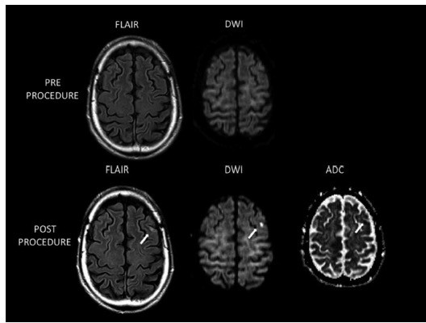
Introduction
・Pulmonary vein isolation (PVI) by catheter ablation (CA) for atrial fibrillation (AF), representing a standard therapeutic approach,
・However, CA of AF carries a modest yet noteworthy serious risk of complications., Thromboembolisms: 0.5% to 1%.
Silent cerebral embolisms (SCE): 10% to 40%.
・Two different energy source for CA Cryoballoon (CB) Radiofrequency (RF)
Circulation 2010
・There is a paucity of prospective data comparing the incidence of cerebral embolism following CA of AF between CB and RF ablation.

Slide 4
Methods：Embo-Abl study

Slide 5
The Embo-Abl study was a prospective, multicenter, randomized, parallel-group, open-label, noninferiority
trial designed to compare the incidence of periprocedural cerebral embolisms between CB and RF ablation of AF.
Inclusion Criteria
Subjects must meet all the following criteria:
Diagnosed with AF with at least 1 episode documented (≥ 30 seconds) in accordance with the 2023 AHA/ACC/HRS guidelines
Planned cryoballoon or radiofrequency catheter ablation of AF
Age 20 - 85 years
Capable of complying with the protocol and providing written informed consent
Exclusion Criteria
Those who meet any of the following criteria are ineligible for the study:
History of AF ablation or cardiac surgery
Left atrial dimension >55 mm (parasternal long-axis view in transthoracic echocartiography)
Inability to undergo a brain magnetic resonance imaging
Women currently or possibly pregnant
Concomitant participation in another intervention study
Patients in whom doctors responsible for this study judge to be inappropriate

Slide 6
The primary endpoint of the Embo-Abl study:
Endpoints
the incidence of MRI-detected silent cerebral events (SCEs) within 1 to 3 days post-CA of AF. The major secondary endpoints
the occurrence of silent cerebral lesions (SCLs) detected by brain MRI within 1 to 3 days post-CA of AF
the number of microembolic signals (MESs) observed during CA of AF
the complications following CA of AF.
SCE = diffusion positive (DWI hyperintense) + ADC reduced + FLAIR negative
SCL = diffusion positive (DWI hyperintense) + ADC reduced + FLAIR positive
Statistical analysis
The study aimed to assess whether CB ablation was noninferior to RF ablation in terms of the incidence of SCEs post-CA of AF. Assuming a 20% rate of MRI-detected SCEs after CA of AF in both groups, with a noninferiority absolute risk difference margin of 15%, a sample size of 112 patients per group was calculated to achieve an 80% power at a significance level of 5%. To account for the potential failure to conduct MRI, 230 patients (115 per group) were enrolled.

Slide 7
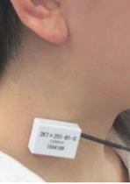
Subjects
Patients with Atrial Fibrillation
Informed Consent Randomization 1:1
Cryoballoon Ablation Group Radiofrequency Ablation Group N = 115 N = 115
Withdrew consent,
No Evaluation of due to a Complicat
Randomization
Trial Arms
N = 1
MRI/Echography ion, N = 1
Real-Time Microemboli Monitoring via Transcarotid Echography during Catheter Ablation
Secondary Endpoint
Primary Endpoint
3-Tesla MRI-Detected Silent Cerebral Embolism
1 to 3 Days after Catheter Ablation

Slide 8
Results

Slide 9
Patient Characteristics
 | Available N | CB group (N = 115) | RF group (N = 114)
Age, y | 229 | 69 (61-77) | 68 (60-74)
Female, n (%) | 229 | 33 (28.7) | 37 (32.5)
AF type | 229
Paroxysmal AF, n (%) |  | 80 (69.6) | 80 (70.2)
Persistent AF, n (%) |  | 20 (17.4) | 22 (19.3)
Long-standing persistent AF, n (%) |  | 15 (13.0) | 12 (10.5)
Hypertension, n (%) | 229 | 71 (61.7) | 66 (57.9)
Diabetes mellitus, n (%) | 229 | 21 (18.3) | 13 (11.4)
Stroke/TIA, n (%) | 229 | 10 (8.7) | 3 (2.6)
Structural heart disease, n (%) | 229 | 15 (13.0) | 10 (8.8)
Congestive heart failure, n (%) | 228 | 16 (14.0) | 14 (12.3)
Vascular disease, n (%) | 229 | 15 (13.0) | 8 (7.0)
CHADS₂ score, Median (IQR) | 228 | 1 (0-2) | 1 (0-2)
CHA₂DS₂-VASc score, Median (IQR) | 228 | 2 (1-4) | 2 (1-3)
LA diameter, mm | 229 | 39 (35-43) | 40 (36-44)
LV ejection fraction, % | 228 | 62 (55-65) | 61 (56-66)
Anticoagulation | 229
Dabigatran, n (%) |  | 7 (6.1) | 10 (8.8)
Rivaroxaban, n (%) |  | 20 (17.4) | 20 (17.5)
Apixaban, n (%) |  | 41 (35.7) | 31 (27.2)
Edoxaban, n (%) |  | 41 (35.7) | 52 (45.6)
Warfarin, n (%) |  | 4 (3.5) | 1 (0.9)
None, n (%) |  | 2 (1.7) | 0 (0.0)

Slide 10
Brain MRI
 | Available N | CB group (N = 115) | RF group (N = 113) | P value
Symptomatic embolism, n (%) | 228 | 0 (0.0) | 0 (0.0)
Silent cerebral events, n (%) | 228 | 16 (13.9) | 11 (9.7) | 0.33
Silent cerebral lesions, n (%)* | 228 | 6 (5.2) | 3 (2.7) | 0.50
Number of silent cerebral events* | 27 |  |  | 1.00
1 lesion, n (%) |  | 12 (75.0) | 8 (72.7)
≥2 lesions, n (%) |  | 4 (25.0) | 3 (27.3)
Number of silent cerebral lesions* | 9 |  |  | 0.23
1 lesion, n (%) |  | 5 (83.3) | 1 (33.3)
≥2 lesions, n (%) |  | 1 (16.7) | 2 (66.7)
Microbleeds, n (%) | 228 | 19 (16.5) | 11 (9.7) | 0.13
Noninferiority margin
CB group (N = 115)
RF group (N = 113)
Risk difference (95% CI), %
P-Value
for noninferiority
Primary endpoint
Silent cerebral events, n (%)
Secondary endpoint
Silent cerebral lesions, n (%)
16/115 (13.9)
11/113 (9.7)
4.18 (-4.18–12.5)
0.02
6/115 (5.2)
3/113 (2.7)
2.56 (-2.47–7.59)
0.002
-20 -15 -10 -5 0
CB better
5 10 15 20
RF better
Risk difference (95% CI)

Slide 11
Brain MRI
 | SCE/SCL (-) (N = 194) | SCE/SCL (+) (N = 34) | OR (95% CI) | P value
Age, y | 68 (60-75) | 70 (66-75) | 1.02 (0.98– 1.06) | 0.27
Female, n (%) | 58 (29.9) | 12 (35.3) | 1.28 (0.59–2.76) | 0.53
AF type
Paroxysmal AF, n (%) | 135 (69.6) | 24 (70.6) | ref
Persistent AF, n (%) | 35 (18.0) | 7 (20.6) | 1.13 (0.45–2.82) | 0.80
Long-standing persistent AF, n (%) | 24 (12.4) | 3 (8.8) | 0.70 (0.20–2.52) | 0.59
Stroke/TIA, n (%) | 12 (6.2) | 1 (2.9) | 0.46 (0.06–3.65) | 0.46
Congestive heart failure, n (%) | 27 (14.0) | 3 (8.8) | 0.59 (0.17–2.08) | 0.42
CHADS₂ score, Median | 1 (0-2) | 1 (0-2) | 0.94 (0.67–1.31) | 0.70
CHA₂DS₂-VASc score, Median | 2 (1-3) | 3 (1-4) | 1.07 (0.86–1.33) | 0.55
LA diameter, mm (%) | 40 (36-44) | 39 (35-42) | 0.94 (0.87–1.01) | 0.09
LV ejection fraction, % | 61 (56-65) | 62 (59-66) | 1.02 (0.97– 1.07) | 0.41
Spontaneous echo contrast, n (%) | 13 (6.9) | 4 (12.1) | 1.86 (0.57– 6.09) | 0.31
Cryoballoon | 94 (48.5) | 21 (61.8) | 1.72 (0.81–3.63) | 0.16
Cardioversion during ablation, n (%) | 78 (40.2) | 16 (47.1) | 1.32 (0.64–2.75) | 0.46
Total procedure time, min | 130 (90-178) | 129 (96-166) | 1.00 (0.99–1.00) | 0.53
LA dwell time, min | 102 (64-145) | 94 (70-137) | 1.00 (0.99–1.00) | 0.44
Mean ACT during ablation | 366 (342-378) | 358 (332-374) | 0.99 (0.98–1.01) | 0.34
RF, Total RF application time, s | 1563 (1160-2096) | 1260 (992-2057) | 1.00 (1.00–1.00) | 0.64
CB, Total freeze cycles for all PVs, n | 5 (4-6) | 5 (4-6) | 0.95 (0.69–1.32) | 0.77
CB, Total freeze time for all PVs, s | 780 (720-1007) | 720 (658-988) | 1.00 (1.00– 1.00) | 0.83
Transcarotid echography during CA procedure
Microembolic signals, n | 270 (173-485) | 175 (96-346) | 1.00 (1.00–1.00) | 0.34
High intensity transient signals (microparticles), n | 49 (26-83) | 32 (14-71) | 1.00 (1.00–1.01) | 0.41
Microbubbles, n | 210 (135-367) | 132 (81-262) | 1.00 (1.00–1.00) | 0.21
Laboratory data
eGFR, ml/min/1.73m² | 60 (52-70) | 65 (51-75) | 1.01 (0.99–1.04) | 0.31
BNP, pg/ml | 70.5 (24.0-125.9) | 100.9 (22.6-158.0) | 1.00 (1.00–1.00) | 0.80
D-dimer, µg/ml | 0.4 (0.4-0.5) | 0.4 (0.4-0.6) | 0.75 (0.21–2.64) | 0.66
Thrombin-Antithrombin. III Complex, ng/ml | 0.7 (0.5-1.0) | 0.7 (0.4-1.0) | 0.94 (0.69–1.27) | 0.67
Soluble fibrinmonomer complex, µg/ml | 0.8 (0.3-2.2) | 0.8 (0.3-2.8) | 0.94 (0.83–1.07) | 0.36

Slide 12
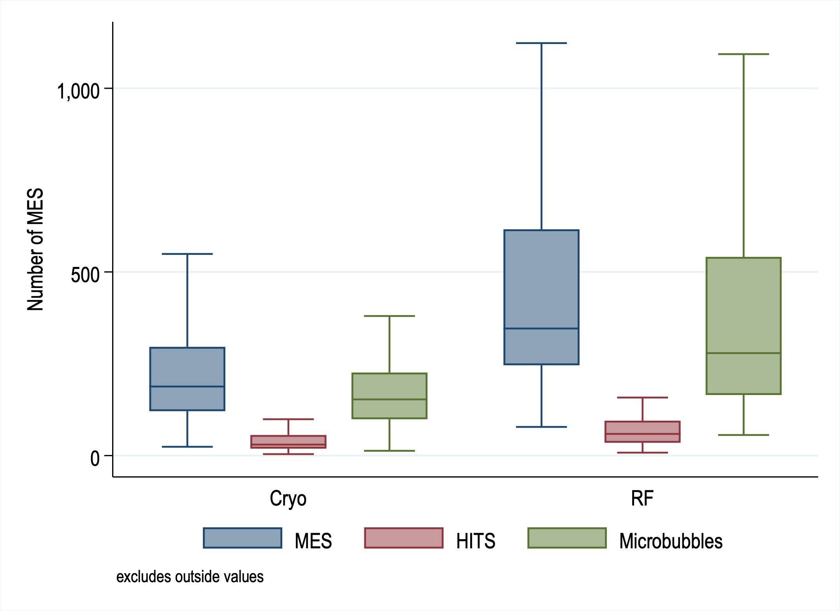
Real-Time Microemboli Monitoring via Transcarotid Echography during CA
P <0.001
P <0.001
1,000
Number of MES*
P <0.001
500
0
CB group
RF group
*MESs: Microembolic signals
*HITS: High-intensity transient signals
MES*
HITS*
Microbubbles
Exclude outside values

Slide 13
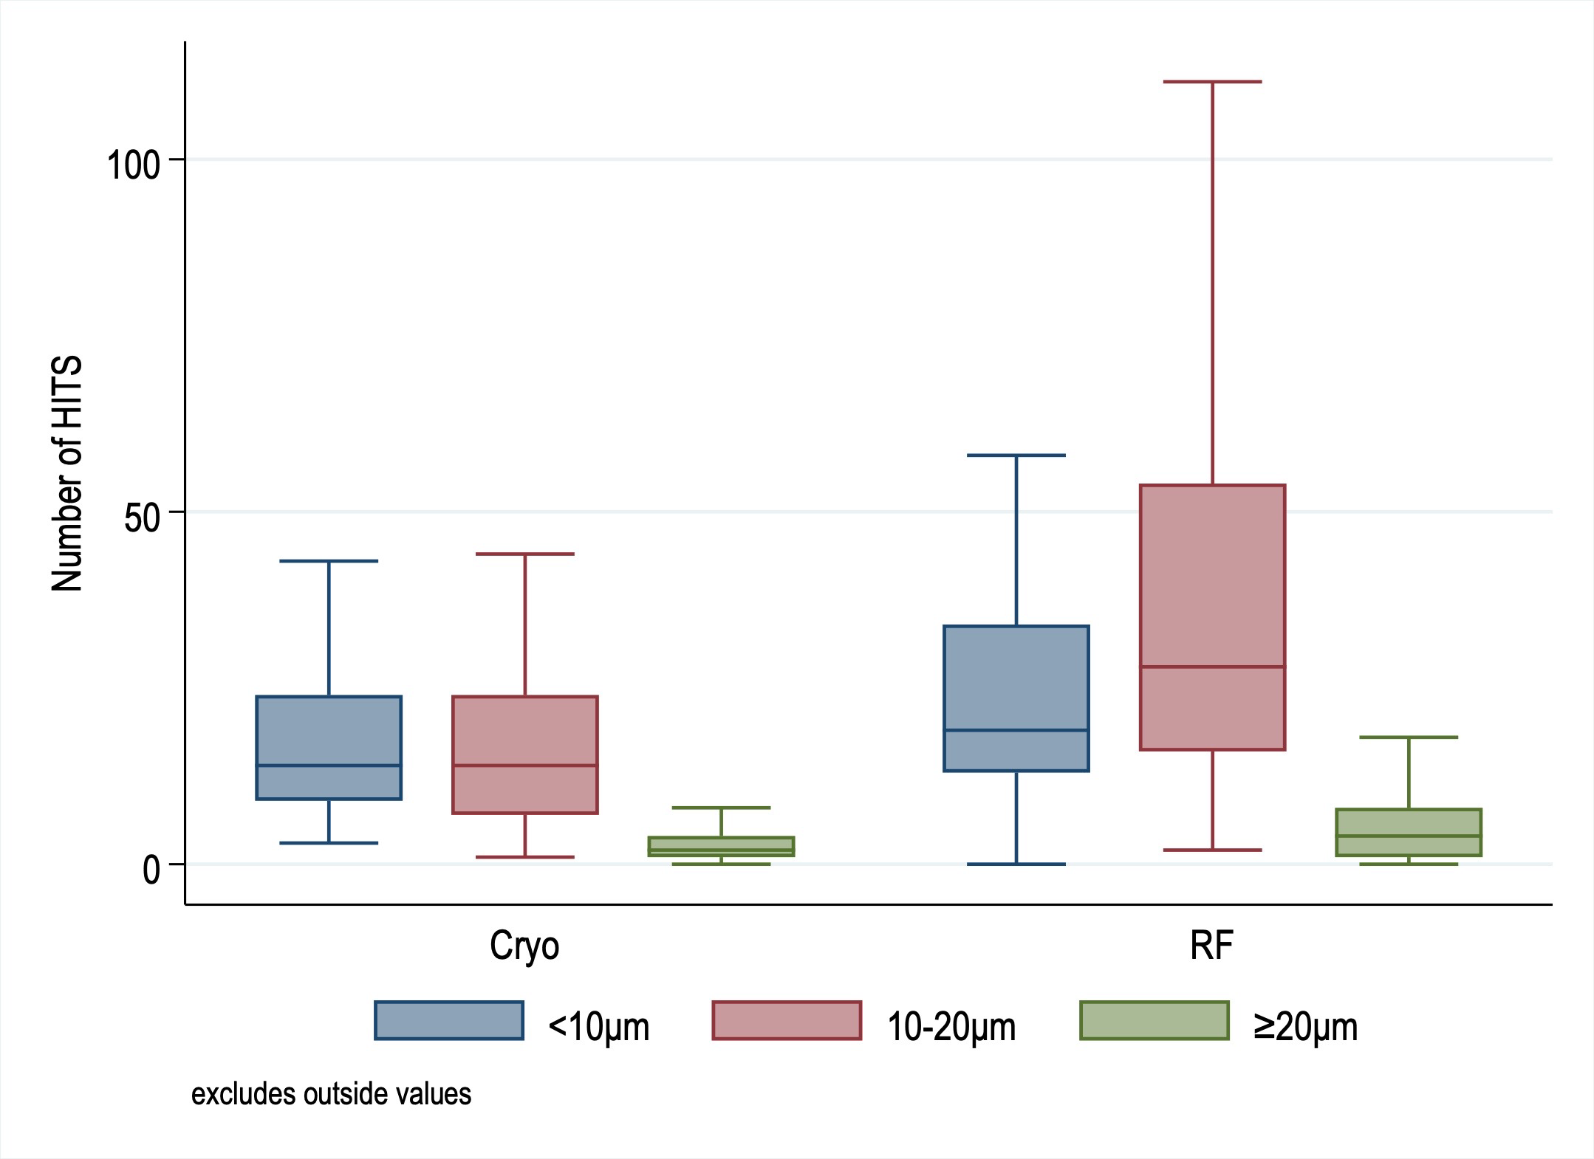
Real-Time Microemboli Monitoring via Transcarotid Echography during CA
P <0.001
1,00
P = 0.039
Number of HITS
P = 0.007
50
0
CB group
RF group
<10μm
10-20μm
≥20μm
Exclude outside values

Slide 14
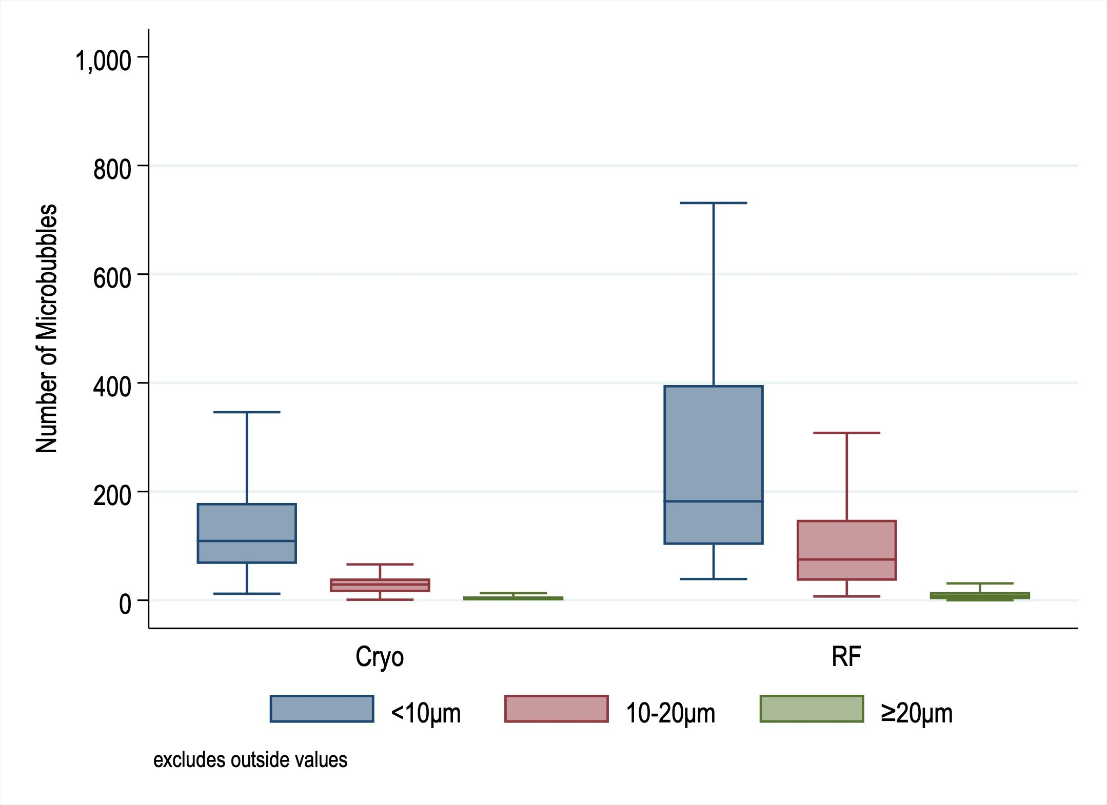
Real-Time Microemboli Monitoring via Transcarotid Echography during CA
1,000
P <0.001
800
 | 600 400 200
P<0.001
Number of Microbubbles
P <0.001
0
CB group
RF group
<10μm
10-20μm
≥20μm
Exclude outside values

Slide 15
Complications of the Catheter Ablation
 | Available N | CB group (N = 115) | RF group (N = 114) | P value
Complications, n (%)* | 229 | 3 (2.6) | 3 (2.6) | 1.00
Cerebral infarction, n (%) | 229 | 0 (0.0) | 0 (0.0)
Transient ischemic attack, n (%) | 229 | 0 (0.0) | 0 (0.0)
Air embolism, n (%) | 229 | 0 (0.0) | 0 (0.0)
Cardiac tamponade requiring drainage, n (%)* | 229 | 0 (0.0) | 1 (0.9) | 0.50
Pericardial effusion not requiring drainage, n (%)* | 229 | 0 (0.0) | 2 (1.8) | 0.25
Cerebral hemorrhage, n (%) | 229 | 0 (0.0) | 0 (0.0)
Transient phrenic nerve paralysis, n (%) | 229 | 0 (0.0) | 0 (0.0)
Prolonged phrenic nerve paralysis, n (%)* | 229 | 1 (0.9) | 1 (0.9) | 1.00
Severe pulmonary vein stenosis, n (%) | 229 | 0 (0.0) | 0 (0.0)
Angina pectoris/Acute myocardial infarction, n (%) | 229 | 0 (0.0) | 0 (0.0)
Hematoma requiring blood transfusion at the puncture site, n (%) | 229 | 0 (0.0) | 0 (0.0)
Pseudoaneurysm at the puncture site, n (%) | 229 | 0 (0.0) | 0 (0.0)
Arteriovenous fistula, n (%) | 229 | 0 (0.0) | 0 (0.0)
Gastric hypomotility, n (%)* | 229 | 1 (0.9) | 0 (0.0) | 1.00
Atrio-esophageal fistula, n (%) | 229 | 0 (0.0) | 0 (0.0)
Others, n (%)* | 229 | 2 (1.7) | 0 (0.0) | 0.50
Death, n (%) | 229 | 0 (0.0) | 0 (0.0)

Slide 16
Summary
・We investigated the hypothesis of noninferiority of CB ablation compared to RF ablation concerning the incidence of SCEs detected on brain DWI MRI following CA in a prospective, multicenter, randomized,
parallel-group, open-label, noninferiority trial fashion at three Japanese centers between May 2021 and January 2024.
・A total of 230 AF patients undergoing CA were enrolled. Patients were randomly assigned in a 1-to-1 fashion to undergo either CB (N = 115) or RF ablation (N = 115).
・CB ablation demonstrated noninferiority compared to RF ablation for the primary endpoint, defined as the incidence of SCEs detected on post-CA brain DWI-MRI (risk difference, 4.18% [95% confidence interval, -4.18% to 12.5%]; P
= 0.02 for noninferiority).
・Microembolic signals (MESs) detected by real-time microemboli monitoring with transcarotid echography during the CA procedure were significantly higher in CB ablation than in RF ablation; however, the number of MESs, high- intensity transient signals, and micro-bubbles during the CA procedure were not associated with the incidence of cerebral embolisms detected on brain DWI-MRI within 1 to 3 days post-CA of AF.
・No independent patient-related, procedure-related, or MESs during CA-related risk factors were identified for cerebral embolisms detected by brain MRI following CA.

Slide 17
Conclusions
In a prospective, multicenter, randomized, parallel-group, open-label study involving patients with AF who underwent CA, CB ablation demonstrated noninferiority to RF ablation in terms of the incidence of SCEs detected by brain DWI-MRI following the CA procedure.
Additionally, no independent patient-related, procedure-related, or MESs during CA-related risk factors were identified for cerebral embolisms detected by brain MRI
following the CA.

Slide 18
Thank you !
Acknowledgement
Embo-Abl study member:
Koji Miyamoto, MD, PhD^{#1}, Koshiro Kanaoka, MD, PhD^{#2}, Yasutoshi Ohta, MD, PhD^{#3}, Masue Yoh, MD, PhD^{#4}, Hiroki Takahashi, MD, PhD^{#4}, Rena Tonegawa- Kuji, MD^{#2}, Yuichiro Miyazaki, MD^{#1}, Akinori Wakamiya, MD, PhD^{#1}, Nobuhiko Ueda, MD, PhD^{#1}, Kenzaburo Nakajima, MD, PhD^{#1}, Tsukasa Kamakura, MD, PhD^{#1}, Mitsuru Wada, MD^{#1}, Kohei Ishibashi, MD, PhD^{#1}, Yuko Inoue, MD, PhD^{#1}, Satoshi Nagase, MD, PhD^{#1}, Takeshi Aiba, MD, PhD^{#1}, Hironobu Ichikawa^{#5},
Akihisa Narai^{#5}, Tomohiro Nakase^{#5}, Masatoshi Koga, MD, PhD^{#6}, Tetsuya Fukuda, MD^{#3}, PhD, Naoya Kataoka, MD, PhD^{#7}, Masahiko Takagi, MD, PhD^{#4}
#1. Department of Cardiovascular Medicine, National Cerebral and Cardiovascular Center, Suita, Japan
#2. Department of Medical and Health Information Management, Open Innovation Center, National Cerebral and Cardiovascular Center, Suita, Japan #3. Department of Radiology, National Cerebral and Cardiovascular Center, Suita, Japan
#4. Department of Medicine II, Kansai Medical University, Moriguchi, Japan
#5. New Development Group, Hashimoto Electronic Industry Co.,Ltd., Matsusaka, Japan
#6. Department of Cerebrovascular Medicine, National Cerebral and Cardiovascular Center, Suita, Japan #7. Second Department of Internal Medicine,University of Toyama, Toyama, Japan

