Slide 1

Coronary Tools and Tricks to Treat Paravalvular Leak
Nahid El Faquir, Anne-Marie Maugenest,
Mihai Strachinaru, Peter PT de Jaegere,
Nicolas M van Mieghem
Erasmus University Medical Center,
Rotterdam, The Netherlands

Slide 2

Nahid El Faquir, MD
I have no relevant financial relationships

Slide 3
Learning objectives
To illustrate coronary tools and tricks for paravalvular leak closure

Slide 4
Clinical Presentation
57 year old male
Medical history:
  1981 Hodgkin’s Lymphoma
  09-2016 Severe aortic stenosis:
  SAVR Mechanical prosthesis 25mm
Current:
  NYHA III
  Holodiastolic murmur parasternal left ICS 3
  Normal kidney function, mild hemolysis and anemia (Hb 6,9 mmol/L)

Slide 5
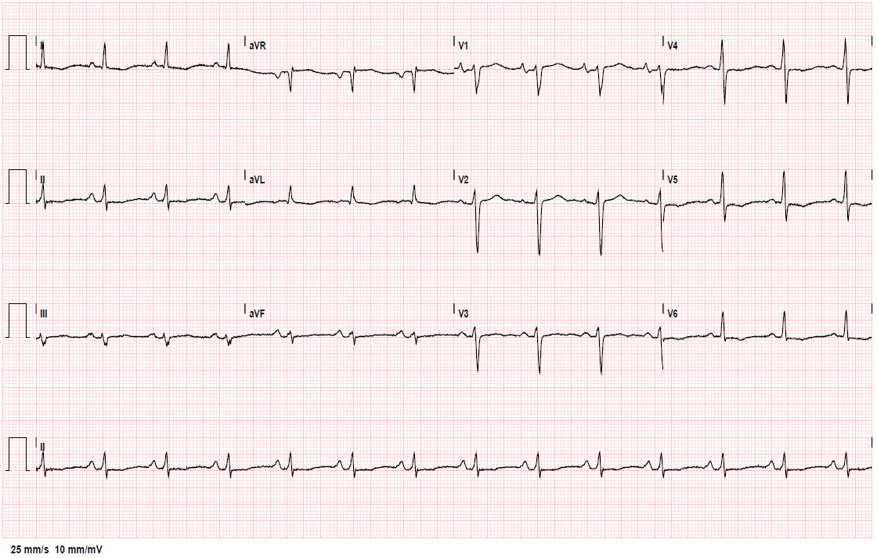
EKG

Slide 6
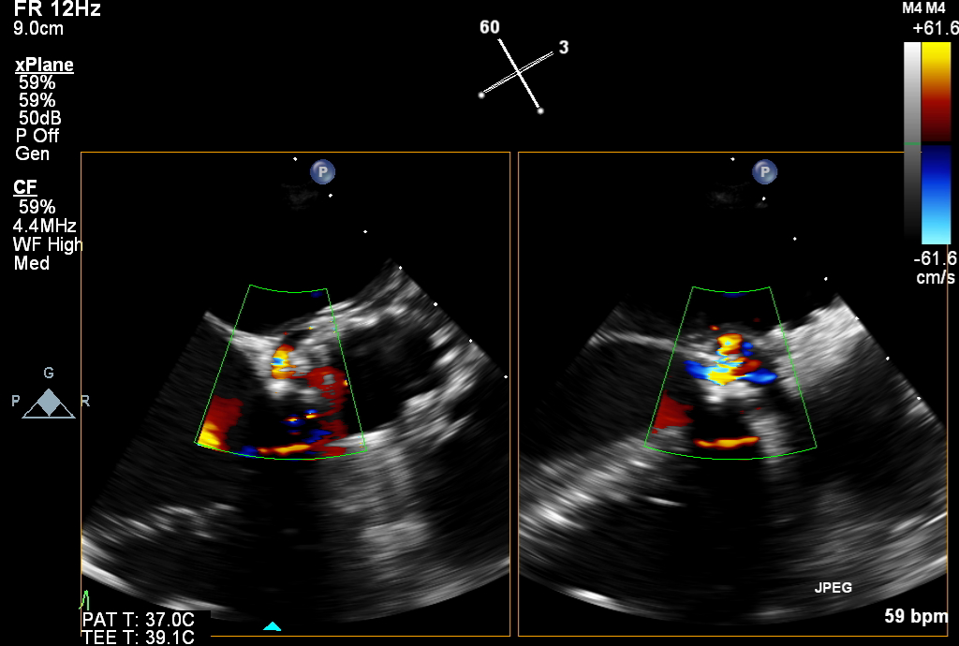
TEE - PVL after SAVR

Slide 7
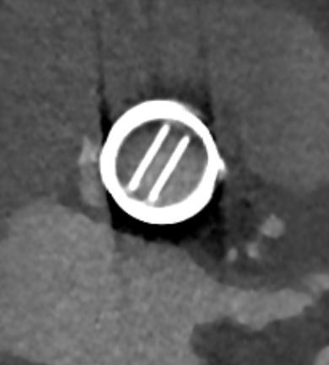
CT – Periprosthetic PVL space

Slide 8
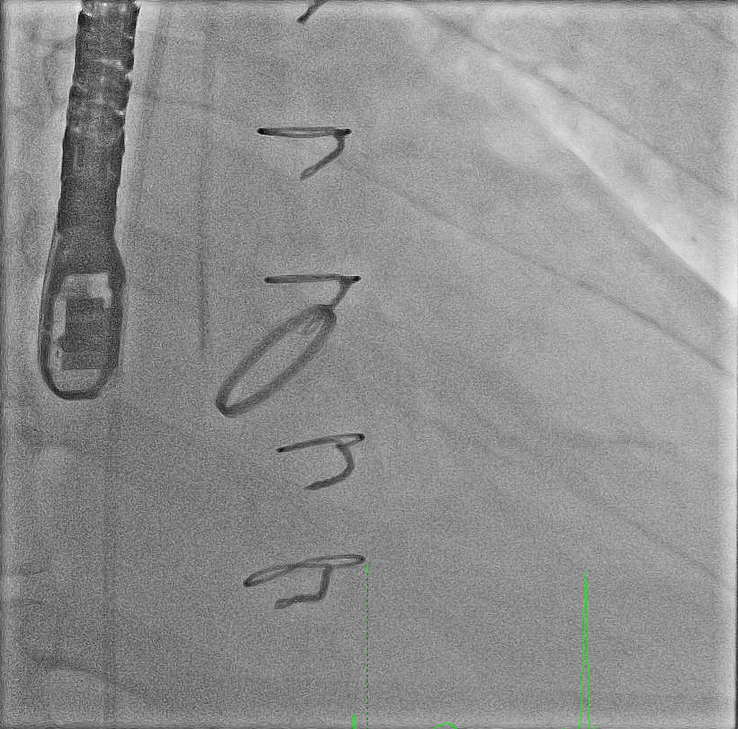
Diagnostic 6F MP catheter & coronary wire

Slide 9
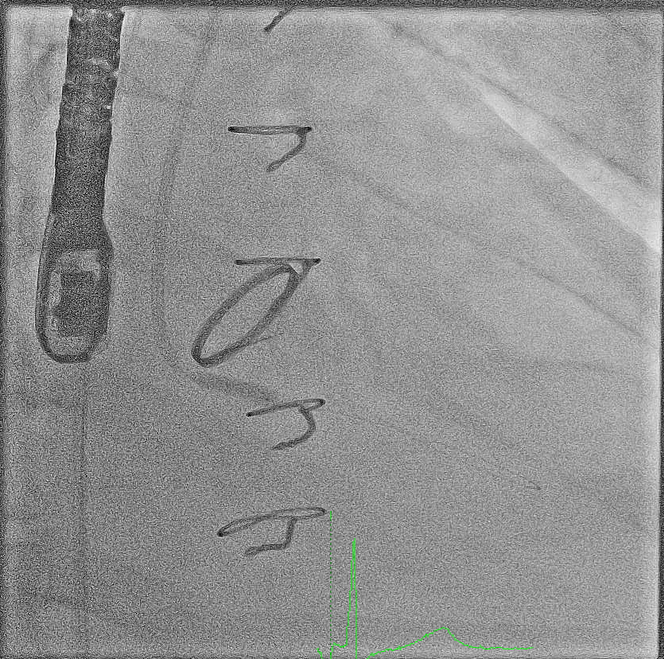
Coronary balloon facilitated PVL crossing
Notes:
Through diagnostic MP 6F

Slide 10
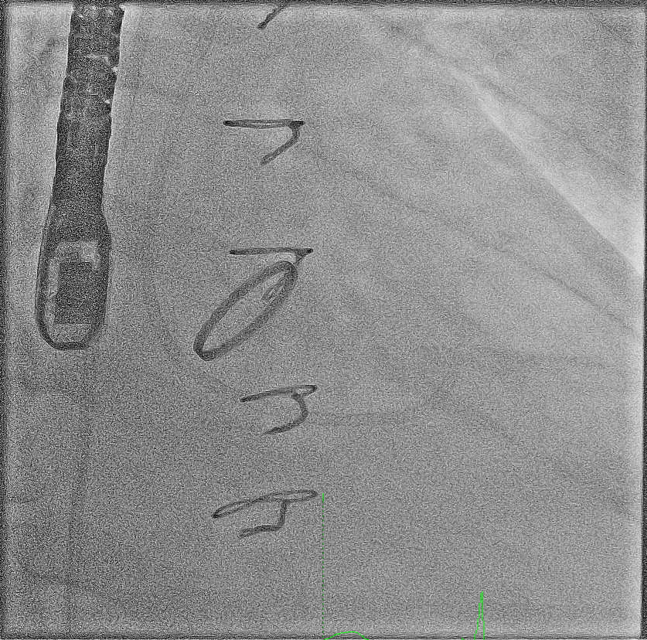
Introducing pre-shaped Safari guide wire
Notes:
To exchange the sheathless 7,5F JR4

Slide 11
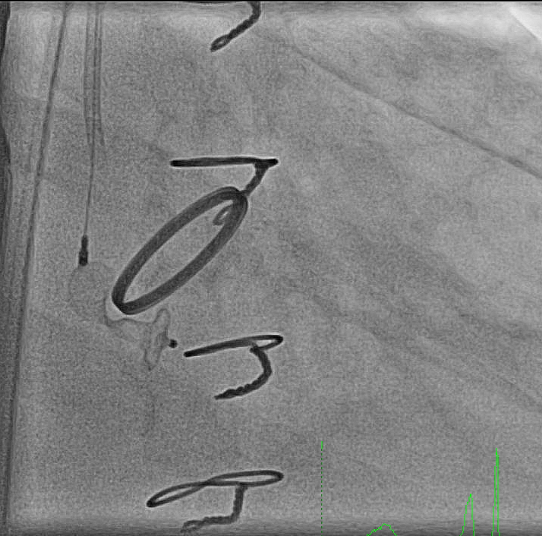
AV-Plug positioning through sheathless catheter
Notes:
Plug positioning through sheathless 7,5F guide

Slide 12
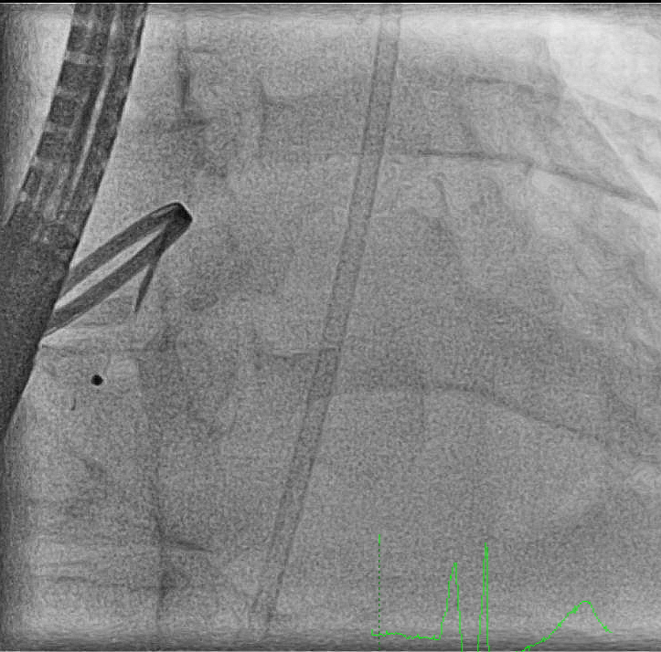
Final angio

Slide 13
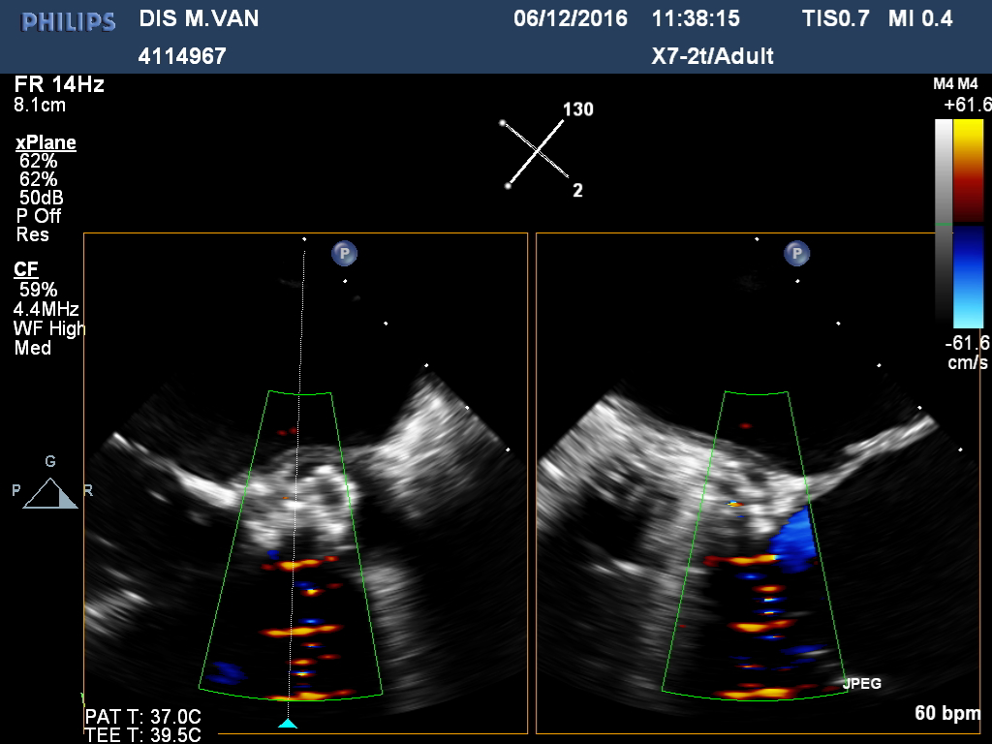
TEE - post AV-Plug implantation

Slide 14
Take Home Messages
Coronary wires can simplify crossing paravalvular leak
Coronary balloons can provide additional support to help advance catheters through challenging (serpentine) PVL
Sheathless 7,5F guiding catheters can be excellent platforms to deliver plugs in PVL

