Slide 1
Oral Anticoagulation With vs Without Single Antiplatelet Therapy in Patients With Atrial Fibrillation Beyond One Year After Coronary Stent Implantation
Yukiko Nakano, Satoshi Shizuta, Akihiro Komasa, Takeshi Morimoto, Hisaki Masuda, Hiroki Shiomi, Kentaro Nakai, Satoru Suwa, Takeshi Aoyama, Mamoru Takahashi, Yuko Onishi, Toshiaki Mano, Mitsuo Matsuda, Makoto Motooka, Hirofumi Tomita,
Moriaki Inoko, Takatoshi Wakeyama, Nobuhisa Hagiwara, Masaharu Akao, Kenji Ando, Yutaka Furukawa, Yoshihisa Nakagawa, Kazushige Kadota, Kazuya Kawai, and Takeshi Kimura: On behalf of the OAC-ALONE Study Investigators

Slide 2
Disclosure Statement of Financial Interest
I, Yukiko Nakano, DO NOT have a financial interest/arrangement or affiliation with one or more organizations that could be perceived as a real or apparent conflict of interest in the context of the subject of this presentation.
This study was founded by Daiichi Sankyo.

Slide 3
Antithrombotic Therapy
in AF Patients Undergoing PCI-Stenting
The ESC guidelines have consistently recommended oral anticoagulation (OAC) alone without antiplatelet therapy (APT) beyond 1 year after stenting.
The North-American expert consensus documents also recommend OAC alone in patients with low ischemic/thrombotic and high bleeding risk.
However, No RCT has evaluated this OAC alone strategy.
Aim: To evaluate non-inferiority of OAC alone to a combination of OAC and .
single APT (SAPT) in AF patients beyond 1 year after coronary stenting

Slide 4
Study Flow Chart
Prospective, multicenter, open-label, randomized, non-inferiority trial
696 patients with AF beyond 1 year after stenting
treated with OAC (Warfarin/DOAC) and SAPT (Aspirin/Clopidogrel)
Between Nov 2013 and Dec 2016 at 111 centers in Japan
Withdraw SAPT
Randomization 1:1
OAC Alone (N=347)
Combined OAC and SAPT (N=349)
Withdraw consent N=3
N=3 Withdraw consent
OAC Alone (N=344)
Combined OAC and SAPT (N=346)
ITT Analysis
N=42 (12.2%) Crossover N=31 (9.0%)
Lost to follow-up N=5
N=5 Lost to follow-up
Complete follow-up : N=680 (98.6%) Median follow-up interval: 2.5 (1.8-3.4) years
Final follow-up data were collected between Oct 2017 and May 2018

Slide 5
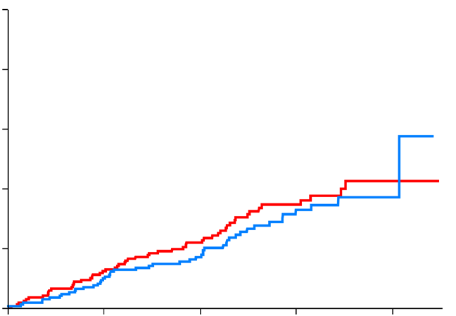
Primary Endpoint
Death, MI, Stroke, or SE
25
HR 1.16 (95% CI, 0.79-1.72) P superiority=0.45
P non-inferiority=0.20
 | 15.7% (N=54)
 |  |  | 13.6% (N=47)
50
OAC Alone
Combined OAC and SAPT
Crude incidence rate (%)
20
Cumulative incidence (%)
40
Log-rank P=0.46
15
30
10
20
5
10
0
0
OAC alone
Combined OAC and SAPT
0
1
2
Interval (Years)
3
4
Non-inferiority margin: HR 1.5

Slide 6
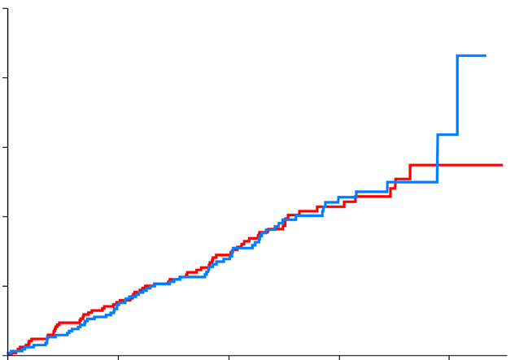
Major Secondary Endpoint
Primary Endpoint (Death/MI/Stroke/SE) or ISTH major bleeding
HR 0.99 (95% CI, 0.71-1.39)
25
P superiority=0.96 P non-inferiority=0.016
 | 19.5% (N=67) |  | 19.4% (N=67)
50
OAC Alone
Combined OAC and SAPT
Crude incidence rate (%)
20
Cumulative incidence (%)
40
Log-rank P=0.96
15
30
10
20
5
10
0
0
OAC alone
Combined OAC and SAPT
0
1
2
Interval (Years)
3
4
Non-inferiority margin: HR 1.5

Slide 7
Individual Outcomes
OAC alone Combined OAC and SAPT
P=0.62 P=0.23 P=0.15 P=0.29
15
P=0.27
11.6%
P=0.22
P=0.07
Crude incidence rate (%)
10.4%
10
9.0%
7.8%
8.4%
5.8%
5.5%
4.9%
4.9%
5
3.8%
2.3%
1.2%
0.58%
0
0.0%
Death
CV death
MI
Stent thrombosis
Stroke/SE
ISTH TIMI
major bleeding
Ischemic Cardiac Events
Bleeding Events

Slide 8
Conclusions
Non-inferiority of OAC alone to combined OAC and SAPT was NOT established for the composite primary endpoint of Death, MI, Stroke, or SE due to insufficient sample size.
Therefore, the primary hypothesis of the present study was inconclusive.
However, the non-inferiority for the major secondary endpoint (a composite of primary endpoint or major bleeding) was achieved with a trend toward fewer major bleeding in the OAC alone group, indicating that combined OAC and SAPT is unlikely to provide net clinical benefit over OAC alone.
Thus, OAC alone might be reasonable for AF patients beyond 1 year after coronary stenting.

