Slide 1
Navigating Complex Vessels and Guidewire Selection
Rajesh Dave, MD
Chief, Department of Cardiology
Holy Spirit Hospital
Camp Hill, PA

Slide 2
Disclosures
Abbott Vascular: Speaker, Proctor

Slide 3
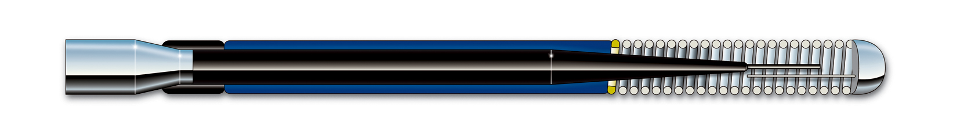
Guide Wire Components
Core Diameter
Core Material
Core Taper/Grind
Coatings
Coils & Covers
Tip Style
Lanzer, P., (2006) Mastering Endovascular Techniques: A Guide to Excellence. Lippincott Williams & Wilkins, Chapter 8: 226-235

Slide 4
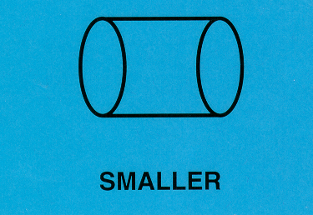
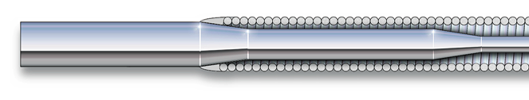
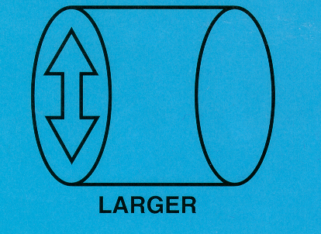
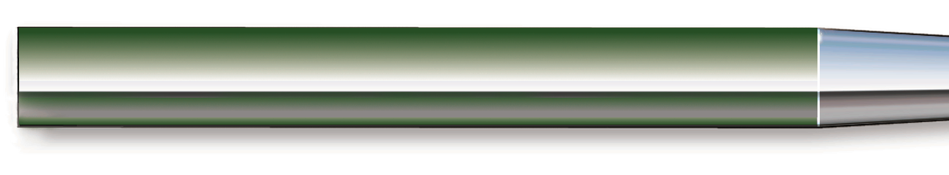
Core Diameter
Diameter affects flexibility, support and torque
Smaller Diameter = More Flexibility
Larger Diameter = More Support & Torque

Slide 5
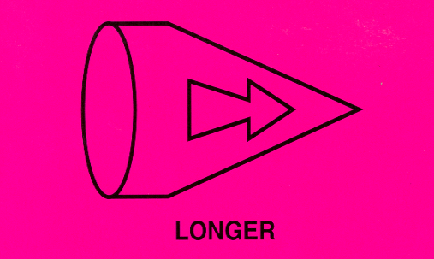
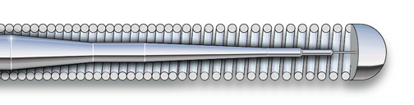
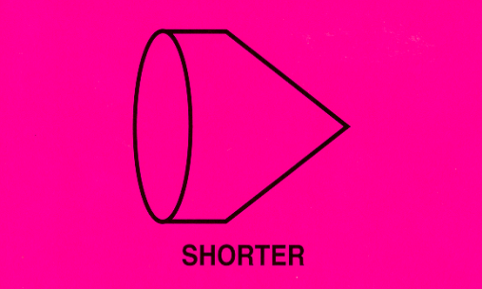
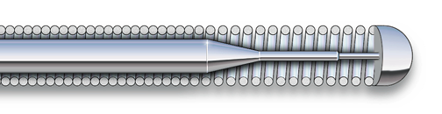
Core Taper
Tracking
    Ability of wire body to follow tip around bends
Degree of support
Longer taper = More Support
Shorter taper = More Flexibility

Slide 6
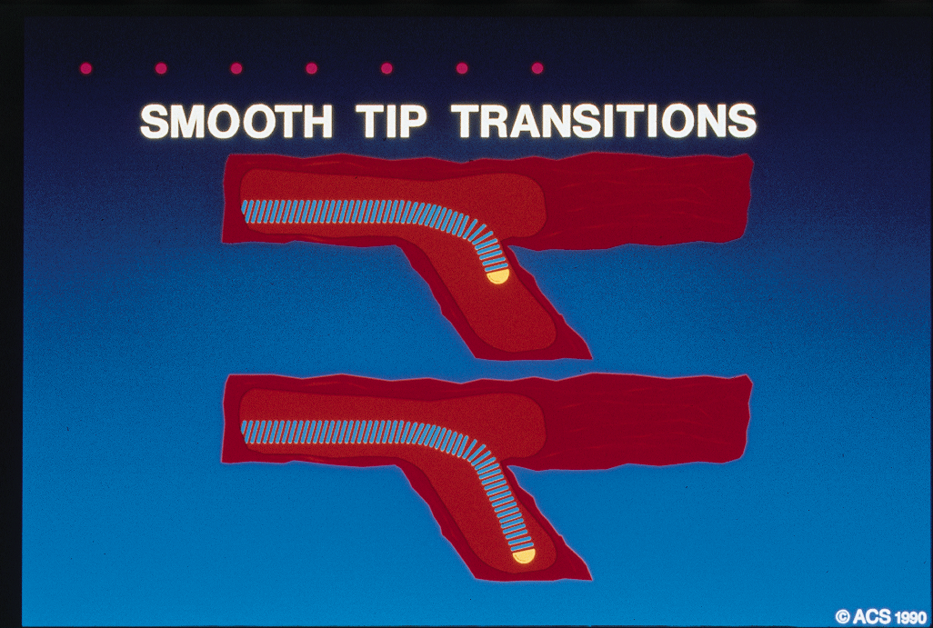
Core Taper
Broad, gradual or long tapers produce a core which offers greater support and wire, which tracks successfully
Abrupt or short tapers produce a core which has a greater tendency to prolapse
Prolapse
Lanzer, P., (2006) Mastering Endovascular Techniques: A Guide to Excellence. Lippincott W. & W., 8: 226-235; Kähler J. et al. Initial Experience With a Hydrophilic-Coated GW for Recanalization of Chronic Coronary Occlusions. Catheterization and Cardiovascular Interventions 49:45–50 (2000)

Slide 7
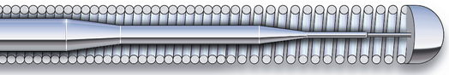
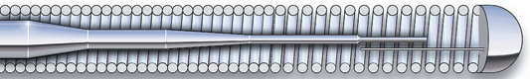
Tip Style
  Affects steering
  Design options
Core-to-tip
  Precise steering and tip control
  Soft (gentle)
  Stiffer to assist with resistant lesions
Shaping Ribbon
  Flexible
  Softer tip, gentle
  Allows shape retention

Slide 8
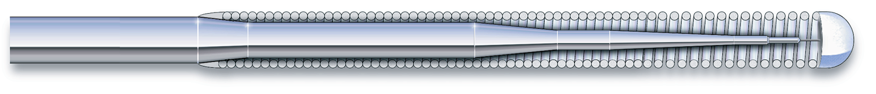
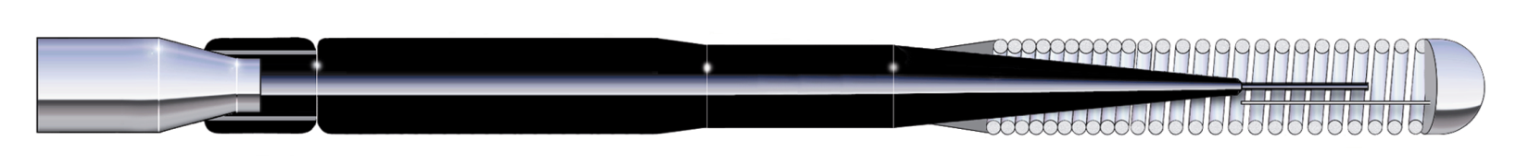
Coils
  Affect support, steering, tracking and visibility
  Impact dimension of wire
  Affect tactile feedback
Outer Coils
Tip Coils Only

Slide 9
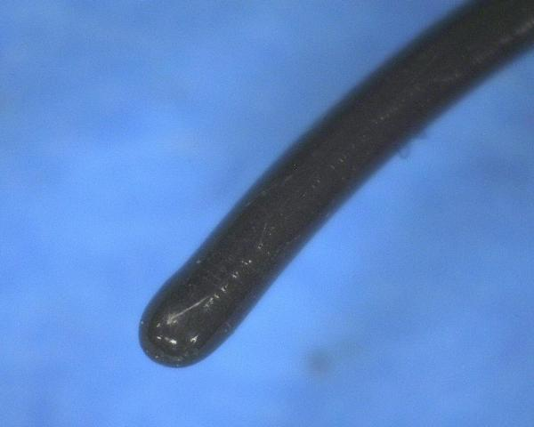
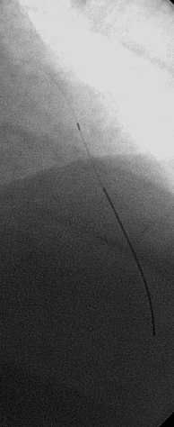
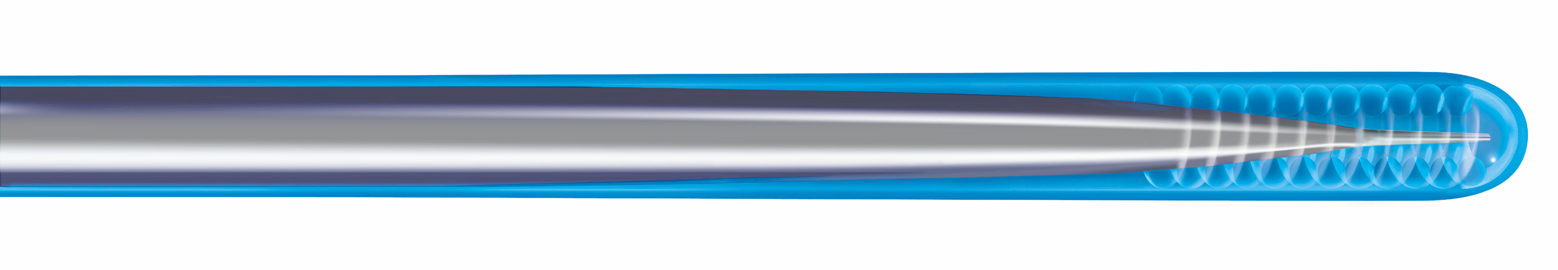
Covers
  Polymer or plastic
  Provide lubricity
  Smooth tracking through tortuosity
  Radiopacity for visualization
Glidewire® Polymer Tip
Polymer Cover
Tip Coils

Slide 10
How Each Component Impacts Wire Performance
Each component affects a technical attribute and each attribute in turn has an impact on performance properties of the wire
All leading to the goal of Reaching the Lesion, Crossing the Lesion, and Deliver the Treatment Device
Component
Core diameter
Core taper/grind
Core material
Tip style
Coils & covers
Coatings
Technical
Support ↔ Flexibility
Torque Response
Lubricity
Radiopacity
Force Transmission
Properties
Steerability
Trackability
Pushability
Crossability
Visibility
Durability
Tactile Feedback

Slide 11
Guidewire Platforms
Personal preference vs. different wire for different purposes?
  0.035 platform
  0.018 platform
  0.014 platform
  Different wire platforms have different advantages and disadvantages
    Properties of the wires
    Devices over which these wires can be delivered

Slide 12
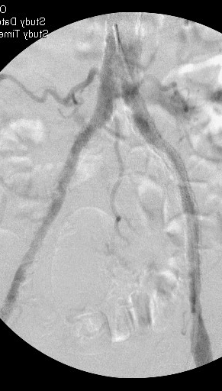
0.035 Guidewire Uses
Access and Sheath placement
Contralateral sheath placement
Delivery of 035 system devices
Recanalization of heavily calcified vessels
0.035 Supracore is my lab’s workhorse

Slide 13
Patient History
53 year old male
Diabetes, Hypertension, Hyperlipidemia
Left Lower Extremity severe claudication

Slide 14
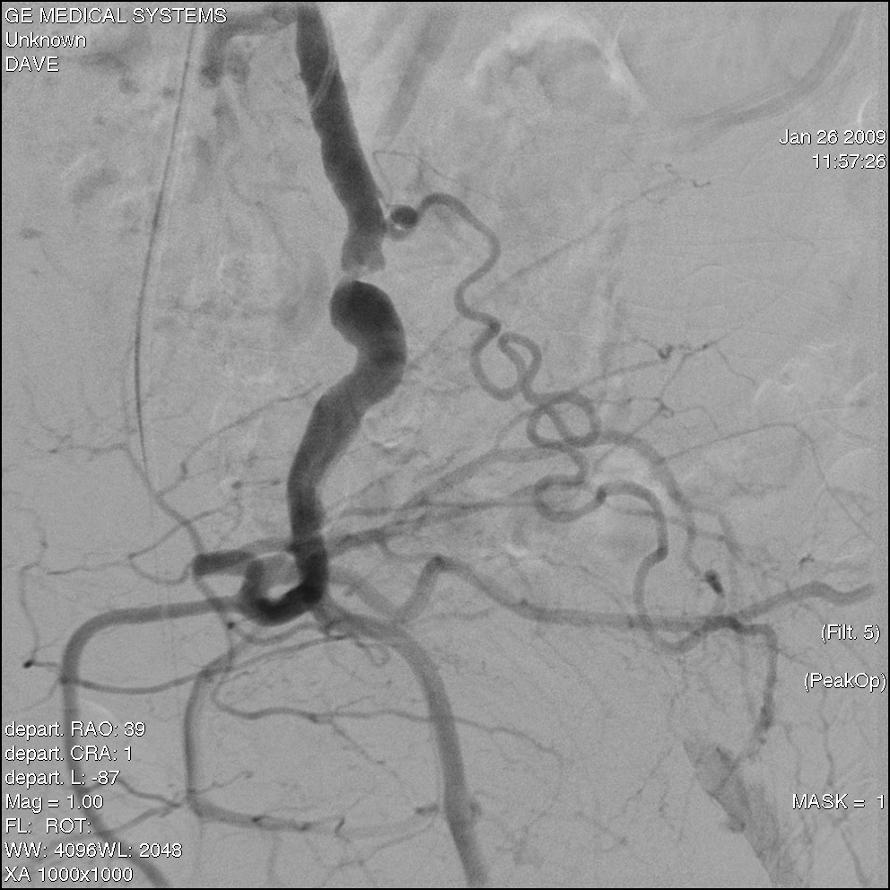

Slide 15
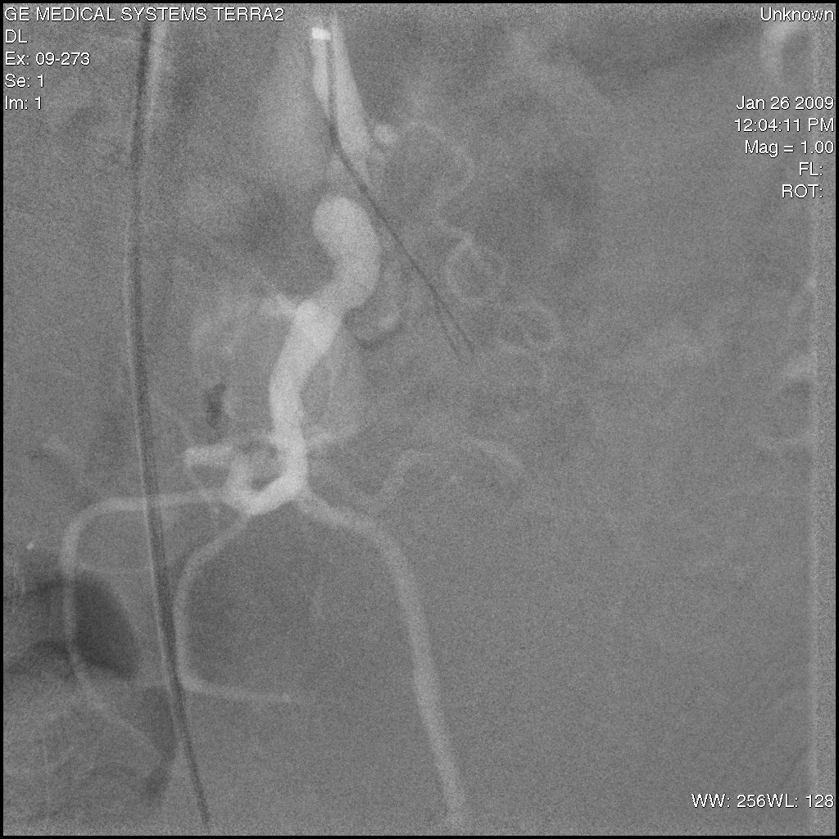

Slide 16
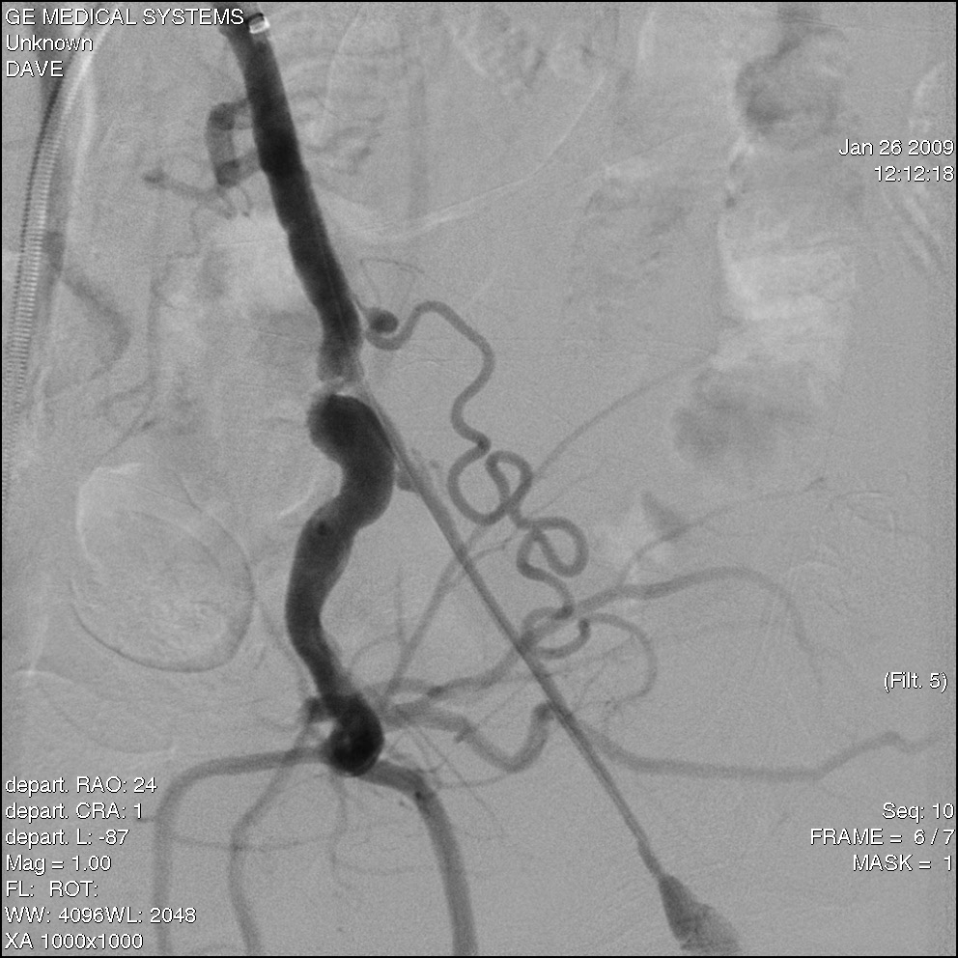
This is an excellent place for
Use of supracore
Atraumatic soft tip allows wire handling
From Brachial approach without
Risk of perforation distally

Slide 17
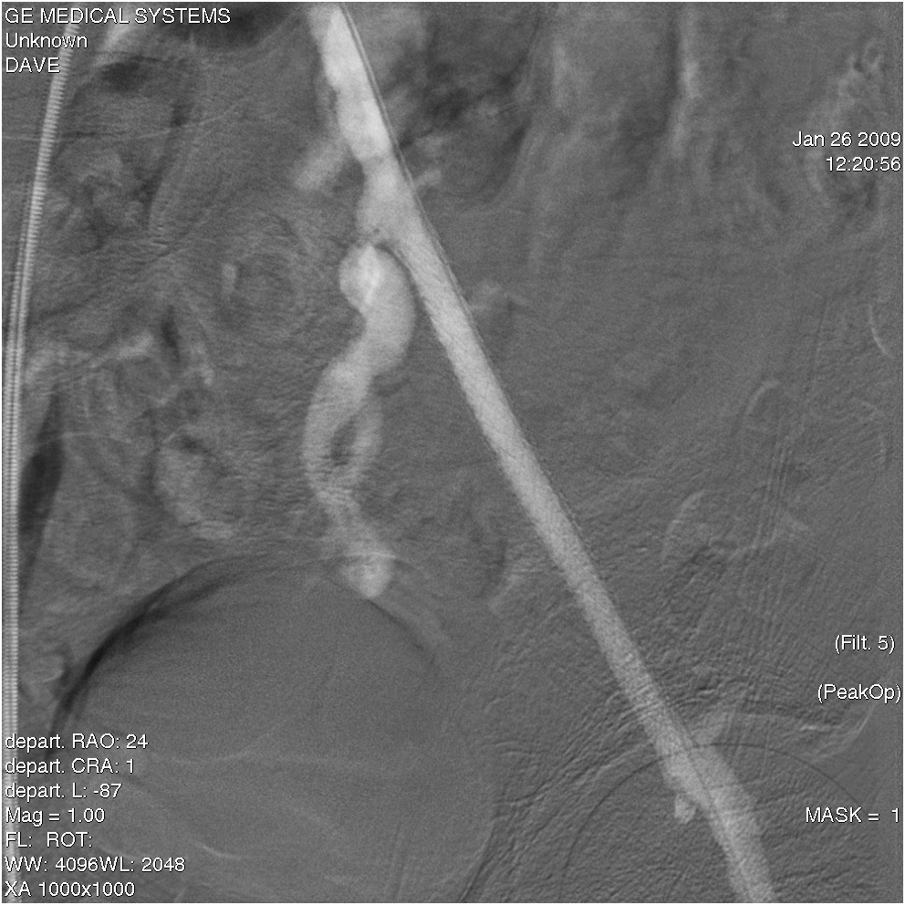

Slide 18
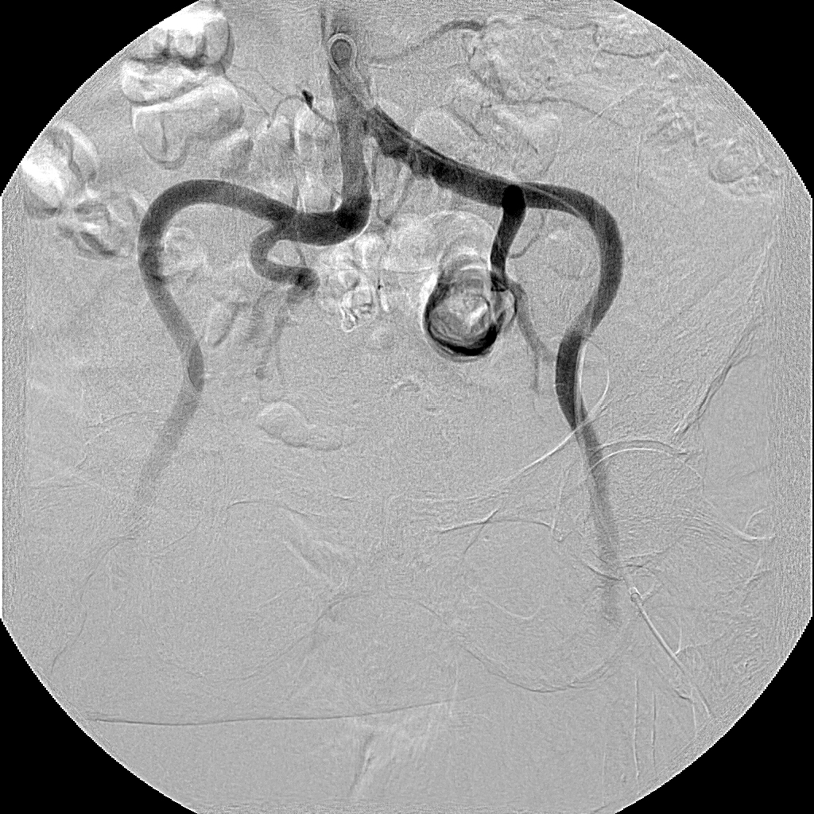
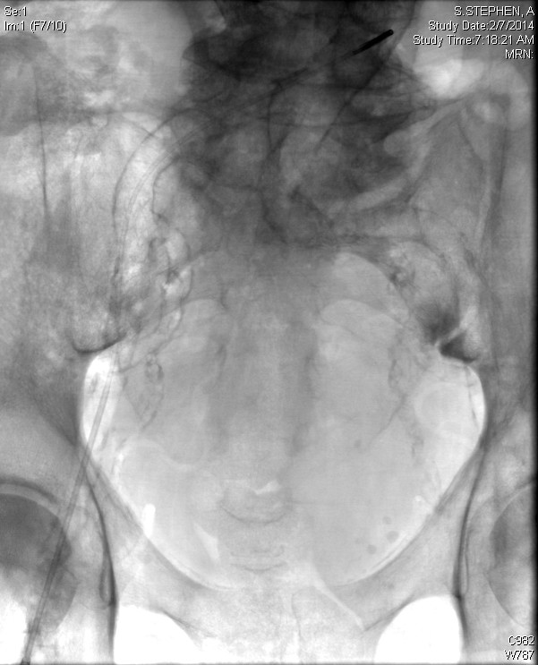
0.035 Guidewire Uses
Escalating approach to contralateral sheath placement:
    Bentson® cerebral wire
    HT Versacore® / Wholey® wire
    Stiff Angled Glidewire®
    Amplatz® Super Stiff wire
    HT Supracore® wire
Crossing heavily calcified / tortuous iliacs:
Switch out to floppier wire to reduce friction along greater / lesser curves of iliac vessels
In my Lab 95% cases are being done by Supracore Wire for last 18 years

Slide 19
0.018” Guidewire Platform
19

Slide 20
0.018 Guidewire Platform
  Advantages
  Support (> than 014 platform)
  Relatively low profile
  Potential to function as “workhorse”
  Penetration Power
  Disadvantages
  Relatively few wire options available until recently
  Lack of familiarity
Examples: HT Connect® HT Connect® Flex HT Connect® 250T
V-18® Control Treasure-12® Astato® 30
0.018 Wires offer excellent balance between profile, support, and applicability for specialty applications

Slide 21
0.018 Guidewires
Low profile tip combined with high gram tip load leads to increased penetration power and increased ability to locate and utilize the microchannels present in most complex lesions
Wire | Make | Core | Tip Load | Support | Penetration
Victory® | Boston | Stainless | 12, 18, 30gm | ++ | ++/+++
HT Connect® | Abbott | Stainless | 4gm | ++ | ++
HT Connect® Flex | Abbott | Stainless | 12gm | + | +
HT Connect® 250T | Abbott | Stainless | 30gm | +++ | +++
Astato® 30 | Asahi | Stainless | 30gm | +++ | +++
Treasure® 12 | Asahi | Stainless | 12gm | ++ | ++

Slide 22
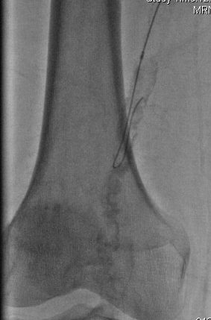
Sub-intimal Dissection for Femoropopliteal Occlusions
Some of these newer 0.018 wires have durable enough tips along with the added support compared to 0.014 wires that allow them to be reasonably good wires for SFA sub-intimal dissections:
    Hi-Torque Connect®
    Hi-Torque Connect® Flex
    V-18® Control
Sub-intimal wire loop with 0.018 wire

Slide 23
0.014” Guidewire platform
23

Slide 24
0.014 Guidewire Platform
  Advantages
  Familiarity
  Lower profile device systems
  Less tissue trauma
  Finesse
  Variety
  Disadvantages
  Lack of support
  Tip shaft deformability
  Durability
Examples: HT Command® HT Command® ES HT Spartacore®
Confianza® Grand Slam® Miracle® Bros HT Fielder® XT
HT BMW® HT Ironman® V-14®

Slide 25
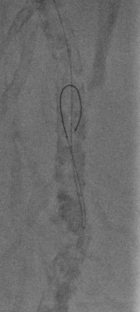
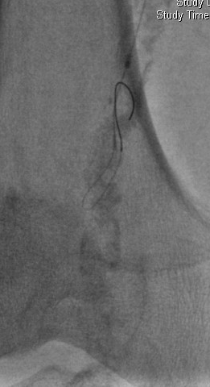

HT Command® Use
HT Command® ES

Slide 26
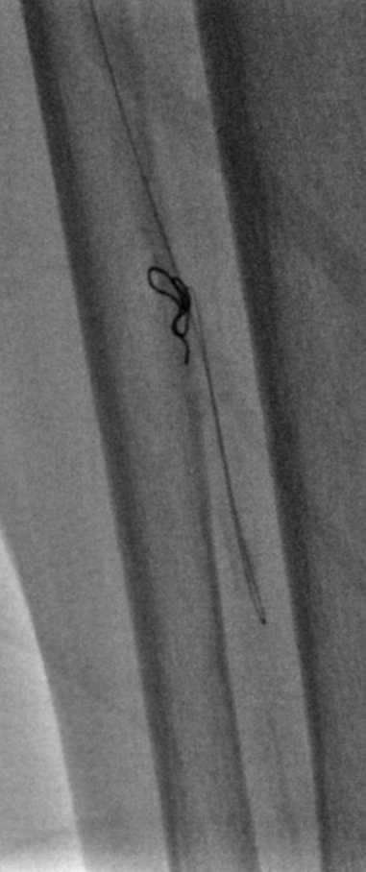
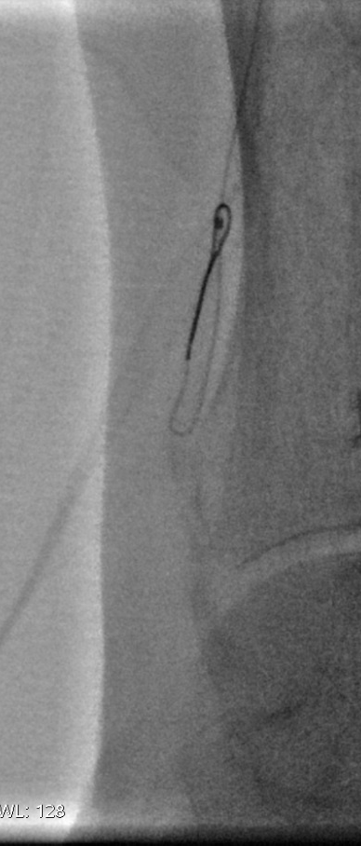
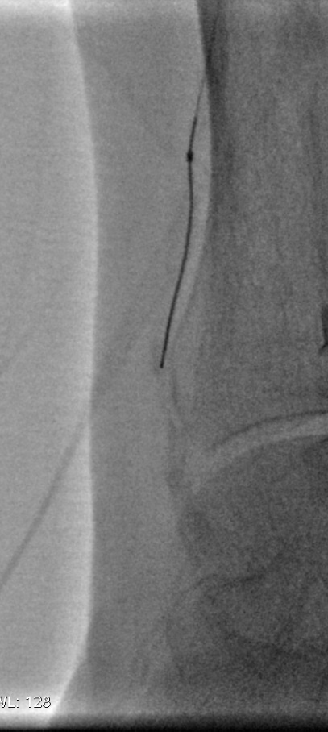
HT Command® Use
Tight guide wire loop in Hi-Torque Command® wire prevents large dissection channel
Durable polymer-coated Nitinol wire tip reforms into steerable floppy tip

Slide 27
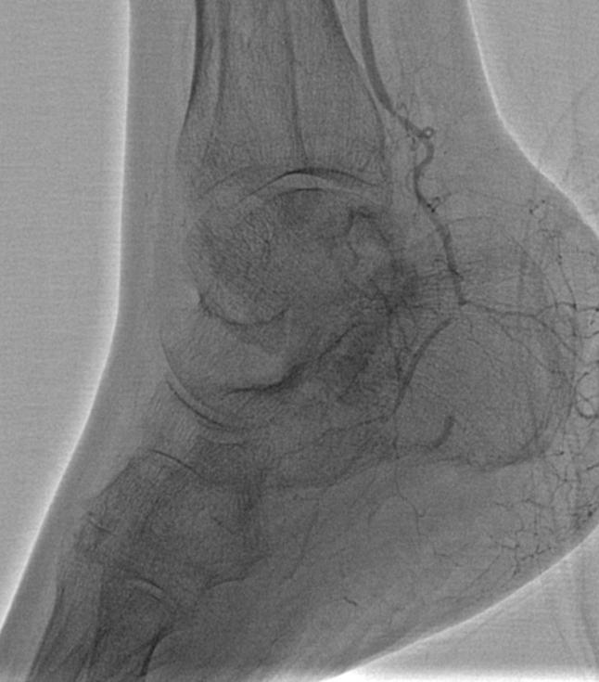
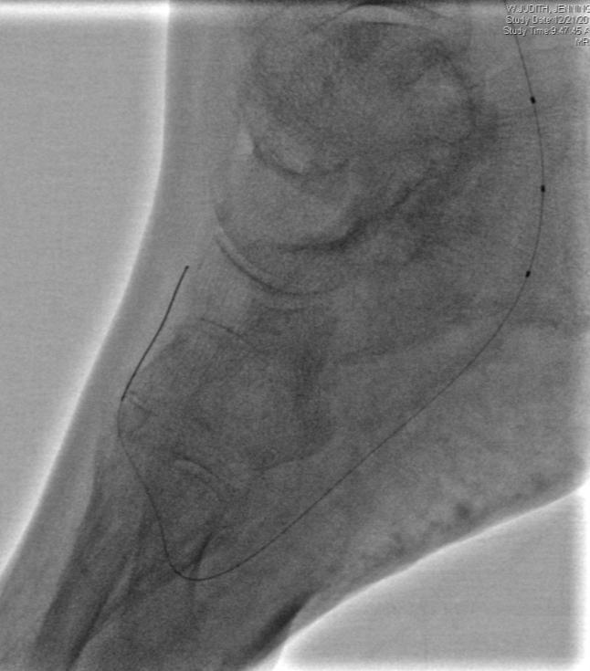
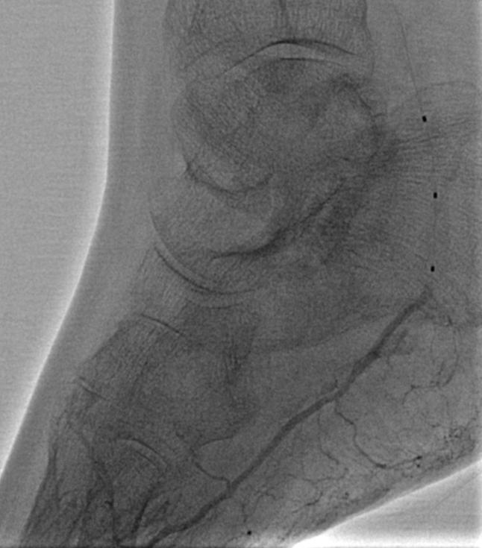
Plantar Arch Case
Lesion in lateral plantar artery and absence of plantar arch
0.014” support catheter + Hi-Torque Command® followed by 2 x 100 0.014” balloon
Restoration of lateral plantar artery with communication to plantar arch and tarsal arteries

Slide 28
Summary & Conclusions
Guide wire selection depends on lesion, location, and strategy
An increasing array of available wires has increased our ability to cross lesions and delivery therapy
Understanding wire construction leads to an increased understanding of a specific wire’s performance properties, and helps us choose the proper wire for the specific goal.

