Slide 1

Closing the Racial Disparity in PAD Care and Amputations
Paradigm for Parity
Foluso Fakorede, MD
Interventional Cardiologist
Follow us on Facebook at Cardiovascular Solutions of Mississippi
Follow us on Instagram @ padadvocate

Slide 2
Disclosure Statement of Financial Interest
Within the past 12 months, I or my spouse/partner have had a financial interest/arrangement or affiliation with the organization(s) listed below.
Affiliation/Financial Relationship
Company
Grant/Research Support
Consulting Fees/Honoraria
Ownership/Founder
Medicure Pharma, Inc
Association of Black Cardiologist, Inc
Bard Peripheral Vascular, Inc
Biotronik, Inc
BlackHagen Design
Cardiovascular Systems, Inc;
Janssen Scientific Affairs, LLC
Cardiovascular Solutions of Central Mississippi, LLC
Fusion Vascular LLC

Slide 3
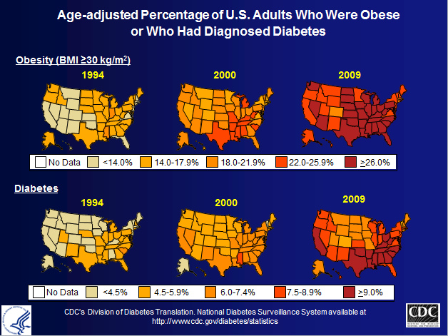
The Perfect Storm
Notes:
3

Slide 4



REGIONAL VARIABILITY IN DELIVERY OF CARE

Slide 5
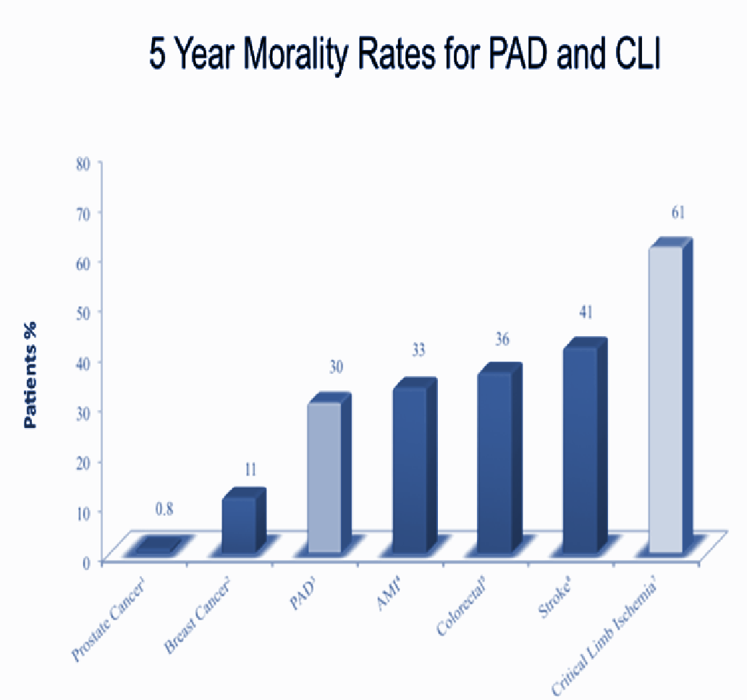
Amputation Lottery: It’s not a game
Probability of major amputation depends on:
  Who you are and where you live
  Race/Ethnicity
Hospital-related costs account for the majority of total costs
Majority undergoing amputations are Medicaid/Medicare recipients
Economic burden of PAD / CLI exceeds diabetes and all cancers
5 of 21
5

Slide 6
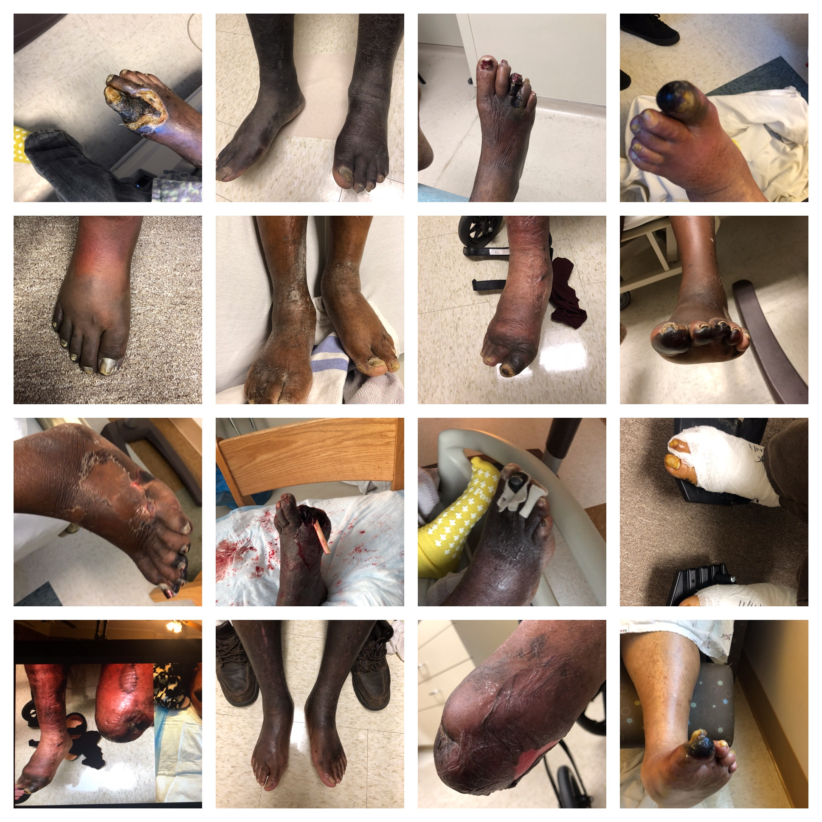
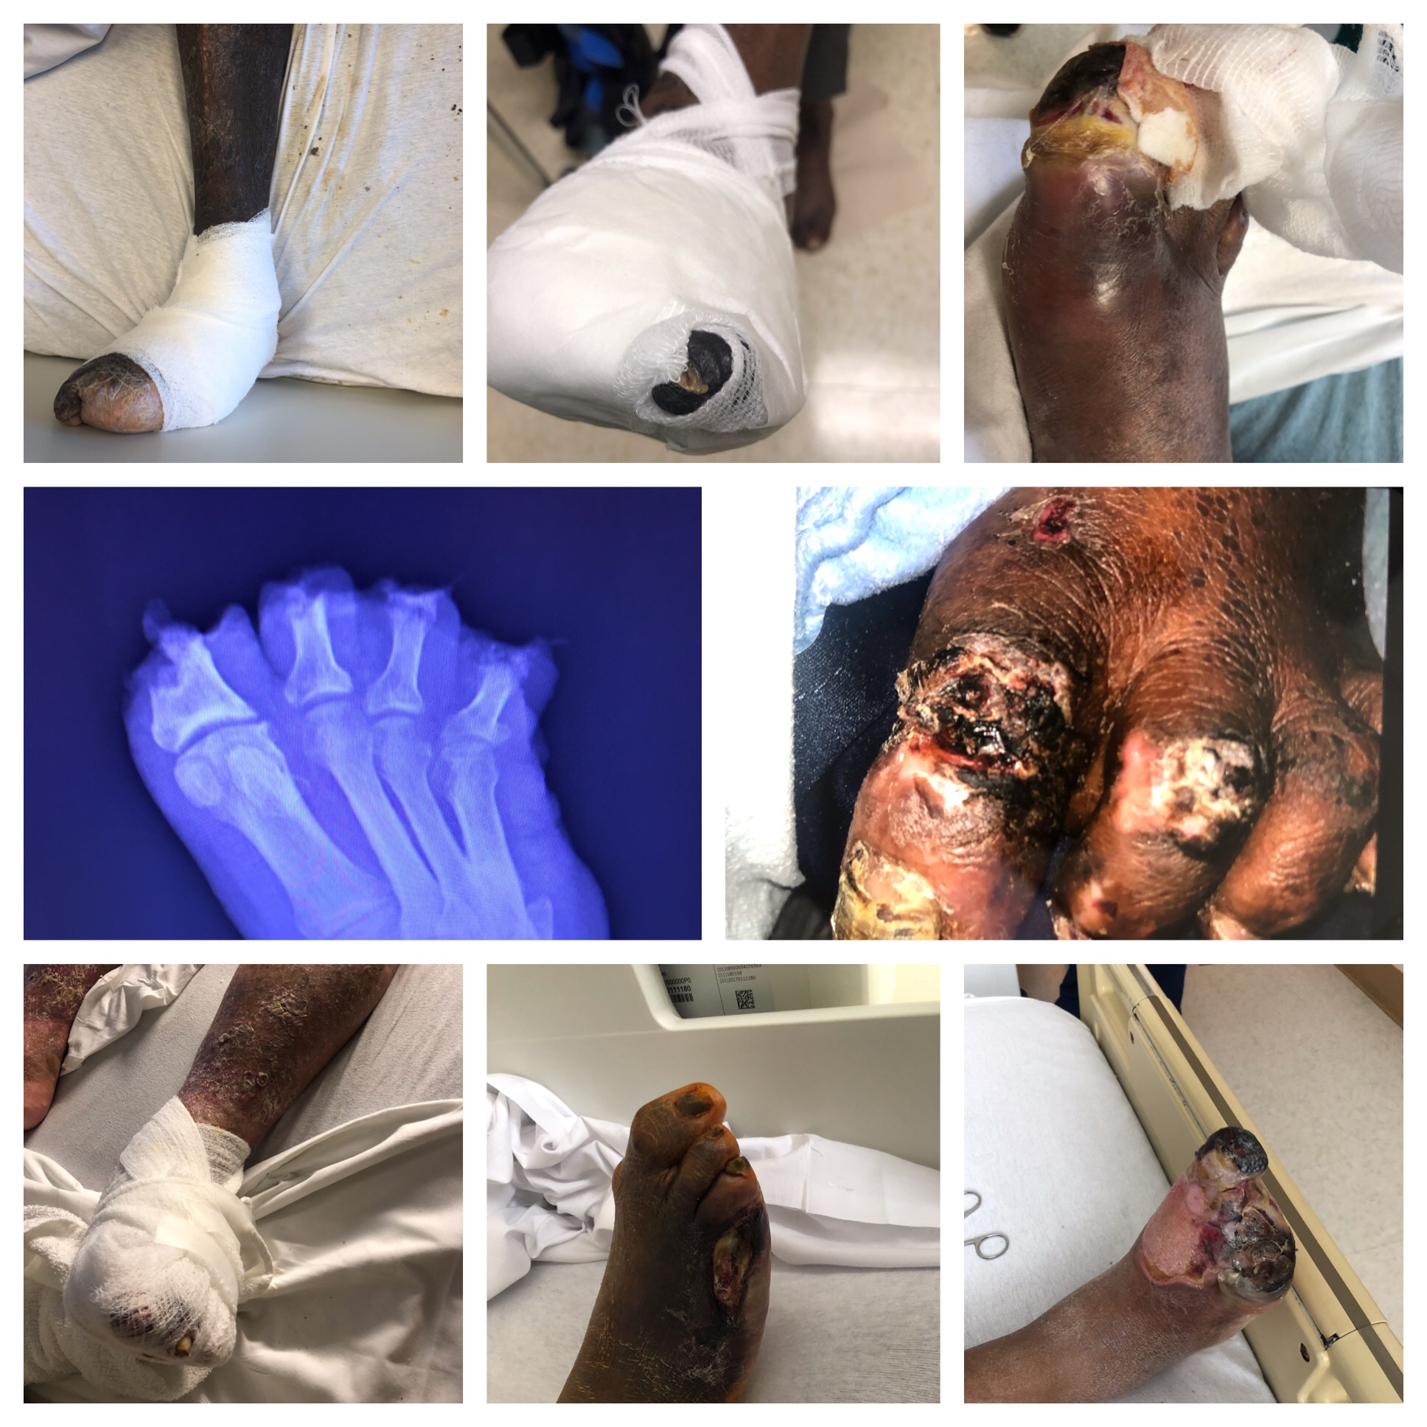

Slide 7
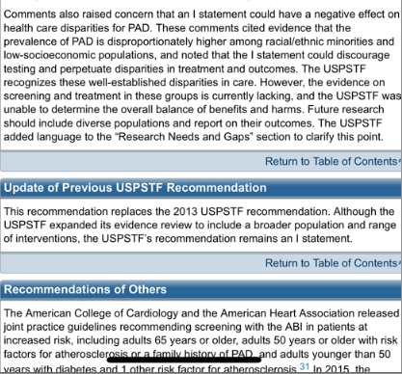
USPSTF SCREENING AND RISK ASSESSMENT- (I) NO TO ASYMPTOMATIC SCREENING!
Notes:
Today, the goal of many in the medical community is to avoid amputation as a first-line treatment for CLI patients. To facilitate this goal, it is necessary to elucidate the predictors of amputation risk in order to design an effective, alternative treatment algorithm. A holistic approach to identifying such risk factors, both physiological and socioeconomic, affords the greatest opportunity for the medical community to recognize and intervene for these patients.
7

Slide 9
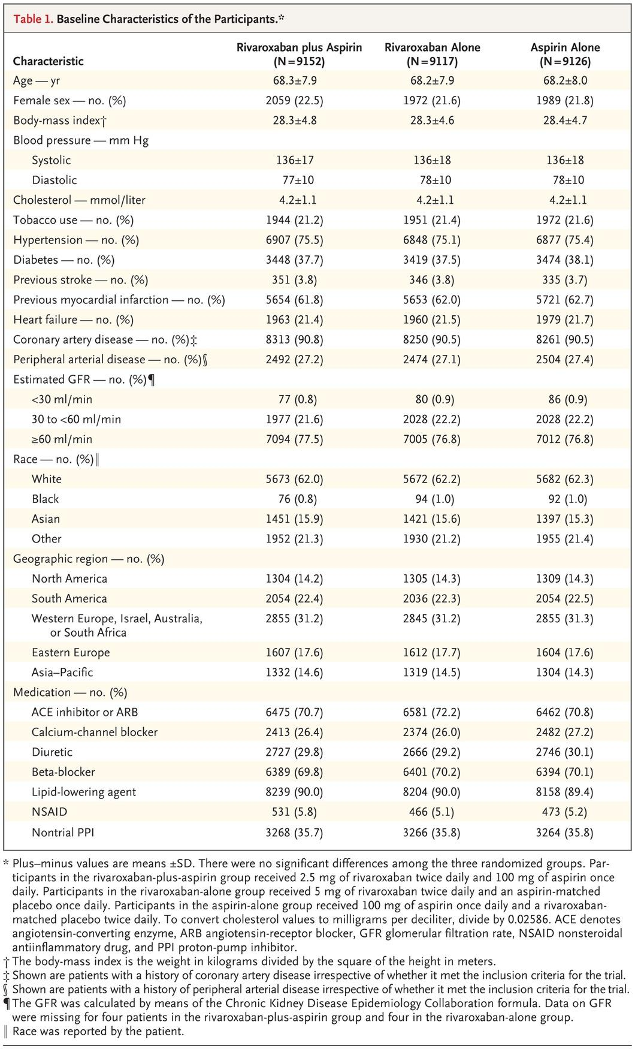

Baseline Characteristics of the Participants.
Baseline Characteristics of the Participants.
Eikelboom JW et al. N Engl J Med ;377:1319-1330
Eikelboom JW et al. N Engl J Med ;377:1319-1330

Slide 10
Mississippi Delta Miracle
Angiographic Screening Yields Dramatic
Reduction in Amputations
Foluso A. Fakorede, MD; Bynthia M. Anose, PhD; Mary L. Yost, Brad J. Martinsen, PhD
Goal: avoid amputation as first-line treatment for CLI patients. To facilitate this goal, it is necessary to:
  elucidate the predictors of amputation risk
  design an effective, alternative treatment algorithm
  take a holistic approach to identifying such risk factors, both physiological and socioeconomic (address biases and misconceptions)
Cardiovascular Solutions of Central Mississippi
  Our treatment approach and results
in conjunction with CSI

Slide 11
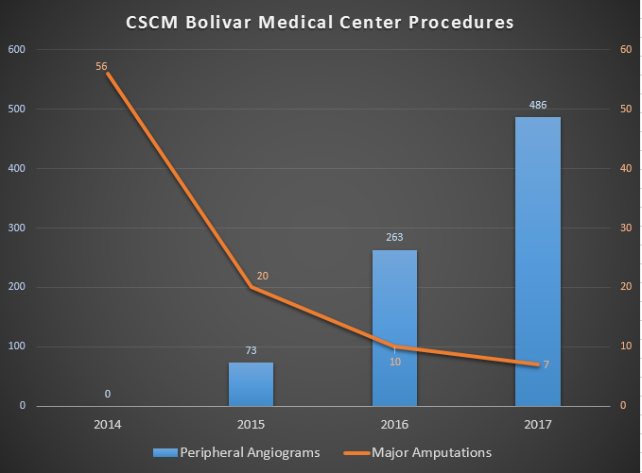
CVSCM Bolivar Medical Center Procedures

Slide 12



Slide 13


Slide 14
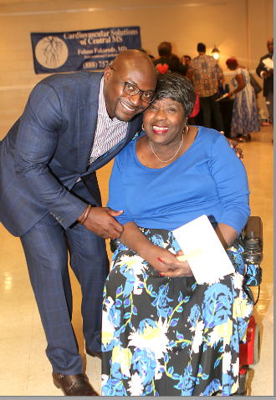
POPULATION SCREENING/EDUCATIONAL AWARENESS
Ms. Gwendolyn Hughes
Military wife for 40 years and worked as a technician for the pentagon. Husband retired from service to care for her.
Diagnosed with CVA & diabetes, but wheelchair bound due to undiagnosed PAD.
Screened in August 2017 (despite USPSTF saying not to screen “atypical” patients)

Slide 15
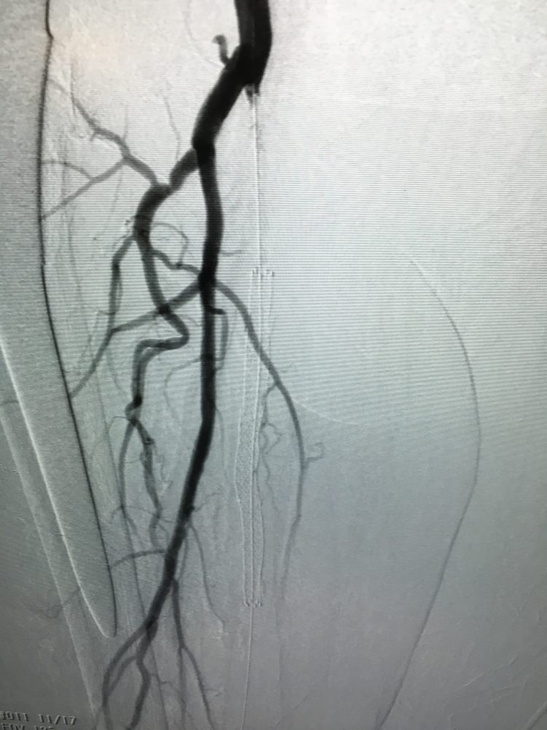
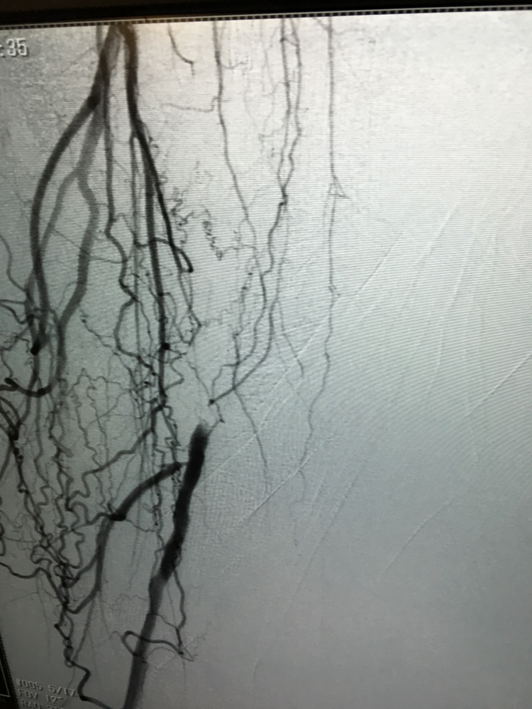
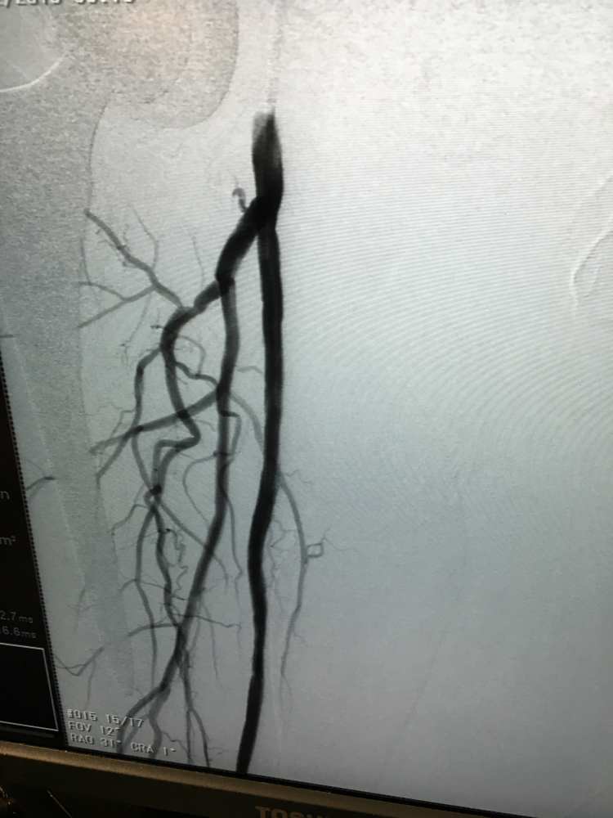
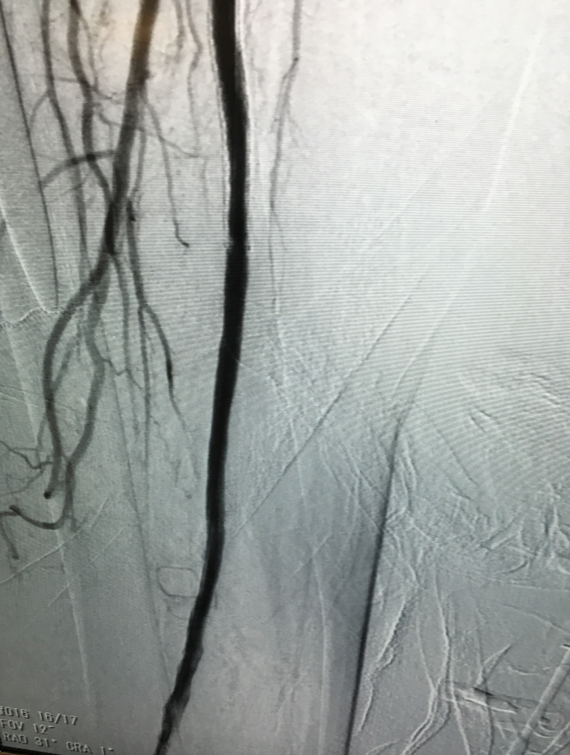
TIMELY SCREENING AND INTERVENTION IS KEY
?
?
BEFORE
AFTER

Slide 16
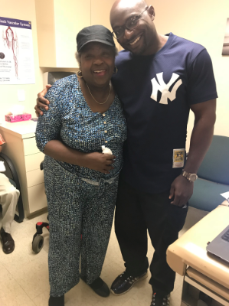
2 WEEKS POST REVASCULARIZATION
16

Slide 17
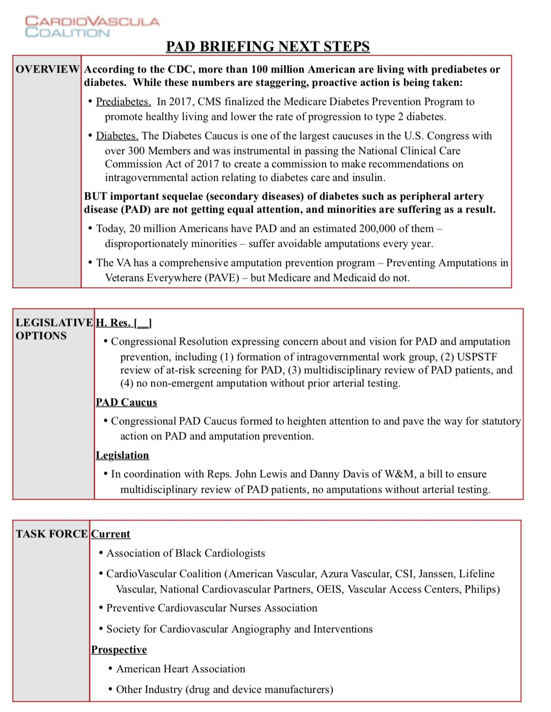
PAD POLICY ACTION

Slide 18
Conclusion
Research should be done to incorporate a higher representation of minorities/women regarding best evidence-based treatment and longitudinal community research.
Awareness campaigns that parallel that of oncology/celebrity-led messages at appropriate scientific literacy levels
DIS-INCENTIVIZE amputations and publicize amputation rates in all hospitals-Policy action.
Revamping our PAD curriculums in all professional and allied professional training programs.
Patient, providers, policy and community navigators understand social determinants of health, loss of productivity to society and economic cost of death.
Recruitment and retention of multi-disciplinary specialists to the epicenters of PAD/CLI. Benefit of regionalized centers to address fragmentation of protocols?
18

