Slide 1
LDL Cholesterol Lowering with Evolocumab and Outcomes in Patients with Peripheral Artery Disease: Insights from the FOURIER Trial
Marc P. Bonaca, Patrice Nault, Robert P. Giugliano, Anthony C. Keech, Armando Lira Pineda, Estella Kanevsky, Julia Kuder, Sabina A. Murphy,
J. Wouter Jukema, Basil S. Lewis, Lale Tokgozoglu, Ransi Somaratne,
Peter S. Sever, Terje R. Pedersen, Marc S. Sabatine
for the FOURIER Steering Committee & Investigators
American Heart Association – Annual Scientific Session Late-Breaking Science in Prevention
November 13, 2017
An Academic Research Organization of
Brigham and Women’s Hospital and Harvard Medical School

Slide 2
Trial Design
27,564 high-risk, stable patients with established CV disease
(prior MI, prior stroke, or symptomatic PAD)
Screening, Lipid Stabilization, and Placebo Run-in High or moderate intensity statin therapy (± ezetimibe)
LDL-C ≥70 mg/dL (1.8 mmol/L) or
non-HDL-C ≥100 mg/dL (2.6 mmol/L)
Evolocumab SC
140 mg Q2W or 420 mg QM
RANDOMIZED DOUBLE BLIND
Placebo SC
Q2W or QM
Follow-up Q 12 weeks Median f/up 2.2 yrs
PEP: CVD, MI, Stroke, UA, Coronary Revascularization Key Secondary EP: CVD, MI, Stroke
An Academic Research Organization of
Brigham and Women’s Hospital and Harvard Medical School
Sabatine MS et al. Am Heart J 2016;173:94-101

Slide 3
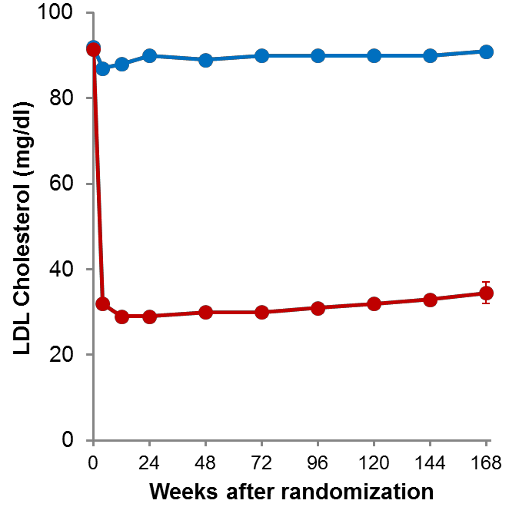
Summary of Effects of
PCSK9i Evolocumab
↓ LDL-C by 59% to a median of 30 mg/dL
↓ CV outcomes in patients on statin
Safe and well-tolerated
Placebo
HR 0.85 (0.79-0.92)
P<0.0001
15
14.6
12.6
HR 0.80 (0.73-0.88)
P<0.0001
59% reduction
P<0.00001
KM Rate (%) at 3 Years
9.9
10
Absolute  56 mg/dl
7.9
5
Evolocumab
(median 30 mg/dl, IQR 19-46 mg/dl)
0
CVD, MI, stroke UA, cor revasc
CVD, MI, stroke
An Academic Research Organization of
Brigham and Women’s Hospital and Harvard Medical School
Sabatine MS et al. NEJM 2017;376:1713-22

Slide 4
Background & Objectives
Patients with lower extremity PAD are at heightened risk of adverse cardiovascular (MACE) and limb events (MALE)
Statin vs. Placebo reduces CV risk and peripheral revascularization & observational studies suggest reductions in amputations
In patients with PAD on statins:
Does further reducing LDL-C reduce CV risk?
Does lowering LDL-C reduce the risk of MALE?
We investigated:
CV risk and the absolute benefit of evolocumab in patients with PAD
MALE risk and whether it was modified by evolocumab
An Academic Research Organization of
Brigham and Women’s Hospital and Harvard Medical School
Heart Protection Study Collaborative Group J Vasc Surg 2007; Kumbhani DJ et al. EHJ 2014

Slide 5
Methods
Patients qualified with PAD if either:
Intermittent claudication and ABI < 0.85
Prior peripheral revascularization or amputation for ischemia
Primary analysis in prespecified PAD subgroup with sensitivity excluding patients with prior MI or stroke to see if benefits extend to PAD alone
MALE defined as composite of acute limb ischemia (ALI), major amputation (AKA or BKA), or urgent revascularization; MACE defined as composite of CVD, MI or stroke
An Academic Research Organization of
Brigham and Women’s Hospital and Harvard Medical School

Slide 6
Patients with Peripheral
Artery Disease
69%
Intermittent Claudication & ABI < 0.85 at Baseline
57%
Peripheral Revascularization (Median 3.7 years prior)
27,564
Patients with Atherosclerosis Randomized
3,642
Patients with Symptomatic Lower Extremity Peripheral Artery Disease
42%
1517
26%
955
27%
1,044
1,505
Patients with Symptomatic Lower Extremity Peripheral Artery Disease and no prior MI or Stroke
27
19 41
39
4%
Amputation for
Ischemia
An Academic Research Organization of
Brigham and Women’s Hospital and Harvard Medical School

Slide 7
Baseline Characteristics
 |  | MI or Stroke and no PAD N=23,922 | PAD N=3,642
 | Age, median (IQR) | 63 (56, 69) | 64 (58, 69)
 | Female sex (%) | 24 | 28
 | History Hypertension (%) | 79 | 85
 | Current Smoker (%) | 27 | 36
 | History of Diabetes (%) | 36 | 43
 | History of Stroke/TIA (%) | 21 | 19
 | History of Myocardial Infarction (%) | 86 | 50
 | Statin, High/Moderate (%) | 69 / 30 | 69 / 31
 | Antiplatelet therapy (%) | 93 | 89
 | Anticoagulant therapy (%) | 8 | 11
 | ACE-I or ARB use at baseline (%) | 78 | 76
 | All p-values < 0.05 except statin use/intensity (p=0.57) Statin dose at baseline missing in 10 (0.0%) without PAD and 3 (0.1%) with PAD
An Academic Research Organization of
Brigham and Women’s Hospital and Harvard Medical School

Slide 8
Peripheral Artery Disease and Risk in Placebo Patients
PAD N=1784
MI or Stroke and no PAD N=11996
PAD with MI/Stroke N=1036 PAD no MI/Stroke N=748
MI or Stroke and no PAD N=11996
14.9%
16%
16%
14%
13.0%
14%
Adjusted HR
1.81
(1.53 – 2.14) P<0.001
P=0.0028
12%
12%
CVD / MI / Stroke
10.3%
CVD / MI / Stroke
10%
10%
P=0.0001
8%
7.6%
8%
7.6%
6%
6%
4%
4%
2%
2%
0%
0%
0 180 360 540 720 900
0 180 360 540 720 900
Days from Randomization
Days from Randomization
An Academic Research Organization of
adjusted age, sex, race, BMI, diabetes, hypertension, smoking, eGFR, CHF, prior MI,
Brigham and Women’s Hospital and Harvard Medical School
CABG/PCI, and history of stroke or TIA.

Slide 9
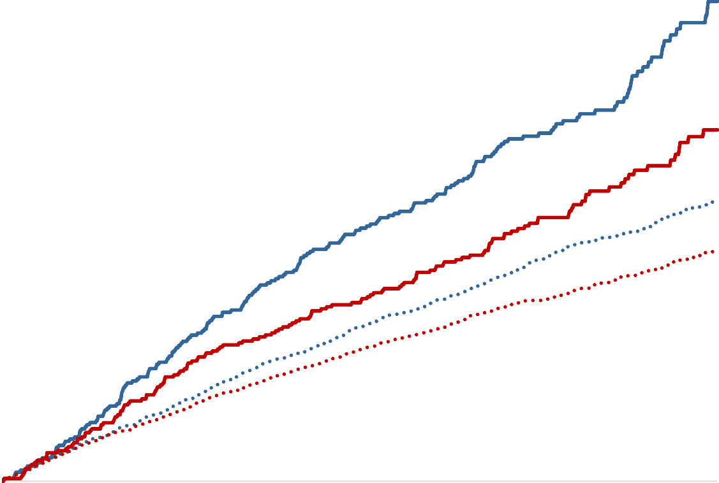
CV Death, MI or Stroke in Patients with and without Peripheral Artery Disease
Placebo Evolocumab
PAD
N=3,642
14%
13.0%
27% RRR
12%
PAD 3.5% ARR
NNT_{2.5y} 29
CV Death, MI or Stroke
HR 0.73
(0.59 – 0.91) P=0.0040
10%
9.5%
8%
7.6%
No PAD 1.4% ARR
NNT_{2.5y} 72
6%
6.2%
No PAD N=23,922
4%
HR 0.81
95% CI (0.73 – 0.90)
P<0.001
p-interaction = 0.41
90 180 270 360 450 540 630 720 810 900
2%
0%
0
Days from Randomization
An Academic Research Organization of
Brigham and Women’s Hospital and Harvard Medical School

Slide 10
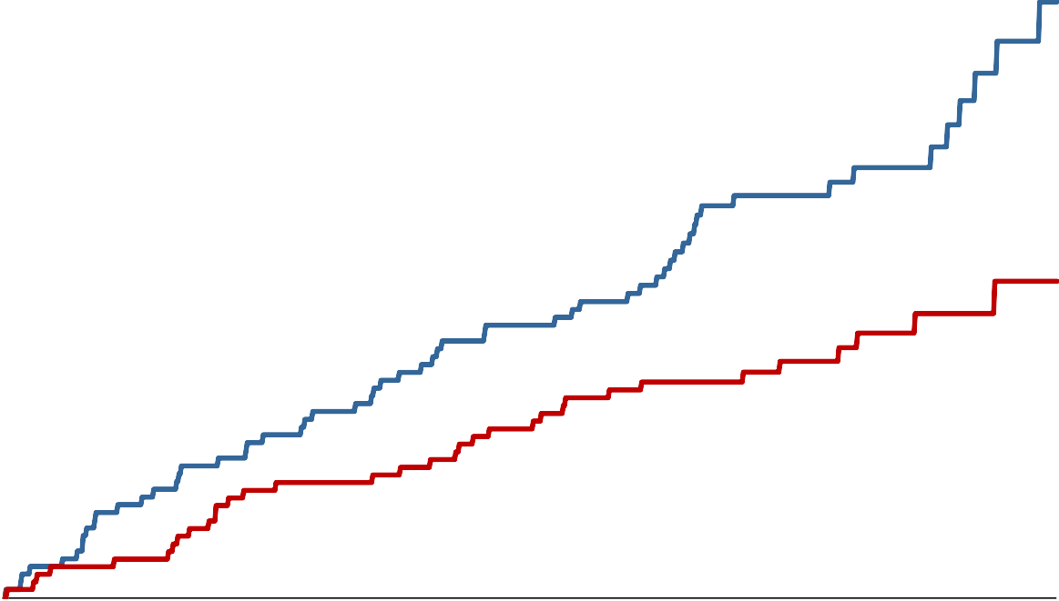
CV Death, MI or Stroke in Patients with PAD and no MI or Stroke
Placebo Evolocumab
PAD
(no MI/stroke, N=1505)
12%
43% RRR
CV Death, MI or Stroke
10.3%
10%
HR 0.57
(0.38 – 0.88) P=0.0095
PAD
4.8% ARR
NNT 21
8%
6%
5.5%
4%
2%
0%
Outcome | HR | 95% CI
MACE | 0.57 | (0.38-0.88)
CV Death | 0.78 | (0.39–0.57)
MI | 0.66 | (0.38–1.14)
Stroke | 0.30 | (0.11–0.82)
0
90 180 270 360 450 540 630 720 810 900
Days from Randomization
An Academic Research Organization of
Brigham and Women’s Hospital and Harvard Medical School

Slide 11
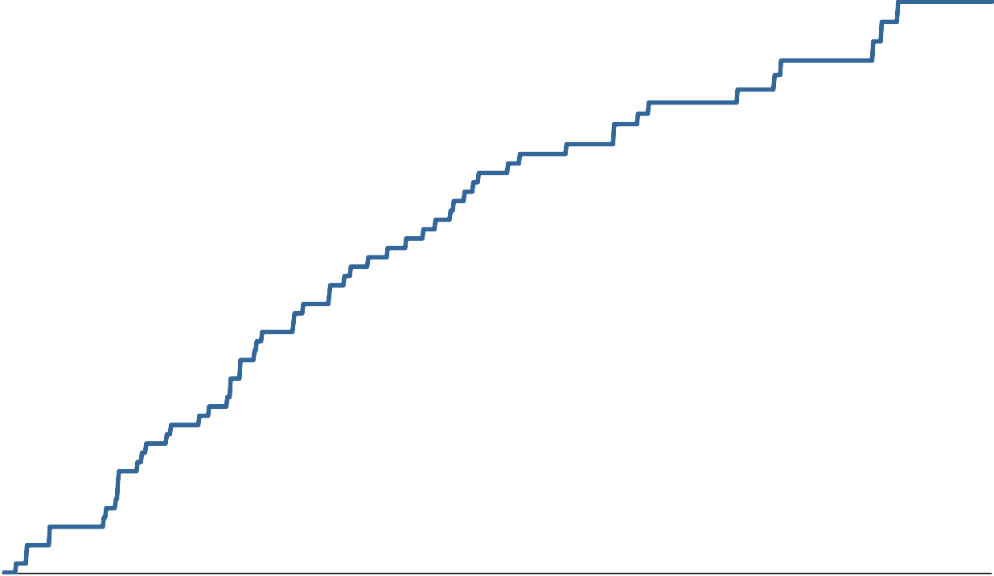
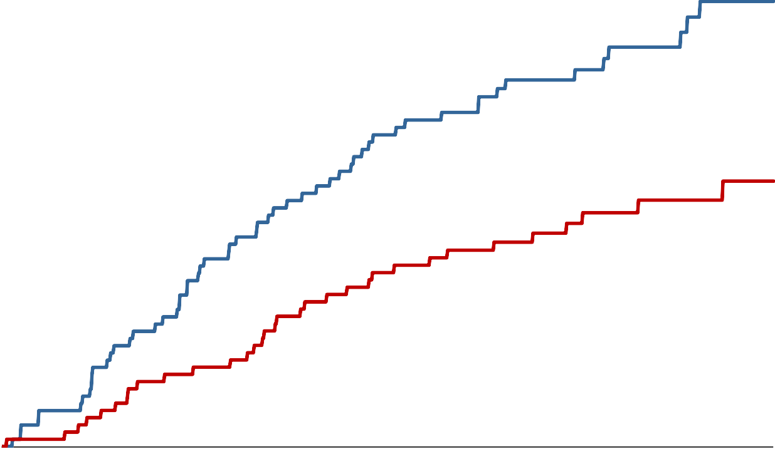
Major Adverse Limb Events
Placebo
Evolocumab
All Patients
N=27,564
0.5%
42% RRR
0.45%
Major Adverse Limb Events
HR 0.58
(0.38 – 0.88) P=0.0093
0.4%
0.3%
0.27%
0.2%
Outcome | HR | 95% CI
MALE | 0.58 | (0.38-0.88)
ALI or major amputation | 0.52 | (0.31–0.89)
ALI | 0.55 | (0.31–0.97)
Major amputation | 0.57 | (0.17–1.95)
Urgent revascularization | 0.69 | (0.38–1.26)
0.1%
0.0%
0
90 180 270 360 450 540 630 720 810 900
_{Days from Randomization} Restricting to those on High Intensity Statin
An Academic Research Organization of
Brigham and Women’s Hospital and Harvard Medical School
only HR 0.56 (0.33 – 0.93), P=0.022

Slide 12
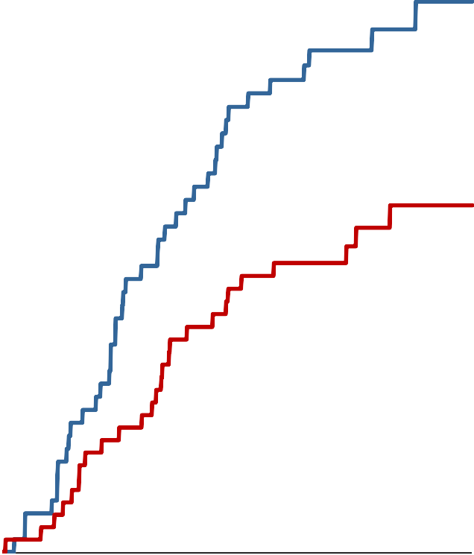
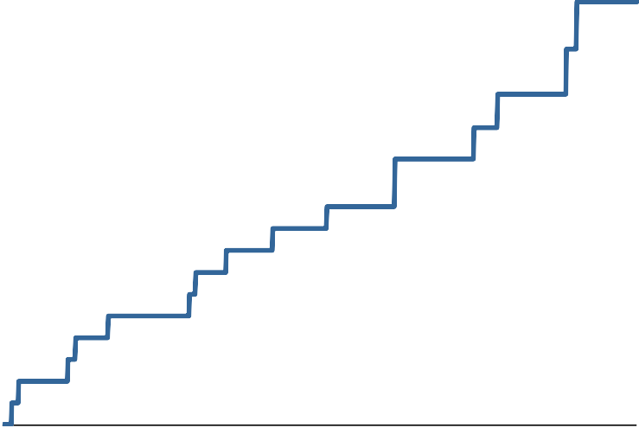
Major Adverse Limb Events in
Patients with and without Known PAD
Known PAD HR 0.63
95% CI (0.39 – 1.03)
P-interaction 0.29
No Known PAD HR 0.37
95% CI (0.16 – 0.88)
2.5%
2.4%
0.25%
Major Adverse Limb Events
2.0%
0.20%
0.16%
1.5%
1.5%
0.15%
1.0%
0.10%
0.076%
0.5%
0.05%
0.0%
0
0.00%
0
180 360 540 720 900
180
360 540
Placebo
Evolocumab
720
900
Days from Randomization
An Academic Research Organization of
Brigham and Women’s Hospital and Harvard Medical School

Slide 13
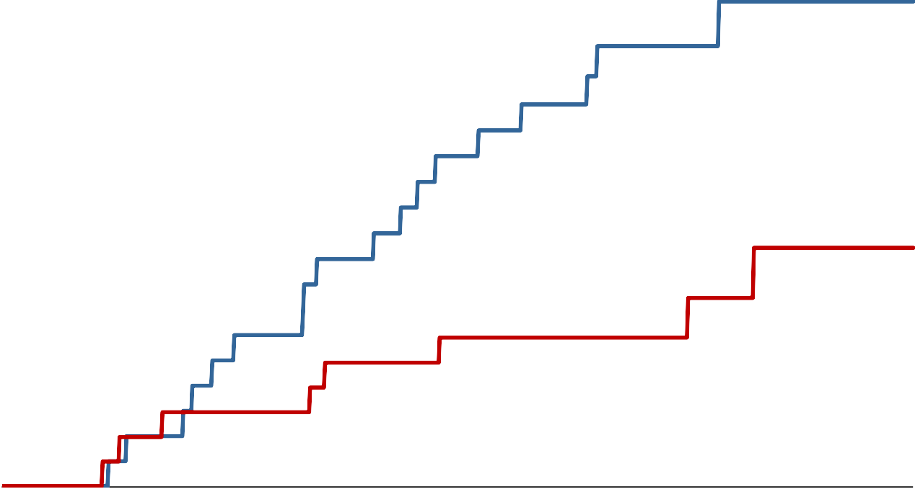
Major Adverse Limb Events in Patients
with PAD and no MI or Stroke
Placebo Evolocumab
PAD
(no MI/stroke, N=1505)
3.0%
57% RRR
Major Adverse Limb Events
HR 0.43
(0.19 – 0.99) P=0.042
2.6%
2.5%
2.0%
1.3% ARR
1.5%
1.3%
1.0%
0.5%
0.0%
0 90 180 270 360 450 540 630 720 810 900
Days from Randomization
An Academic Research Organization of
Brigham and Women’s Hospital and Harvard Medical School

Slide 14
Achieved LDL-C and Major
Adverse Limb Events
p-value = 0.0257 for slope
p-value = 0.0257 for slope
0.0125
P=0.026 for beta coefficient
Adjusted Event Rate (probability)
0.0100
0.0075
0.0050
0.0025
0
50
100
LDL-C (mg/dL) at 1 month
150
adjusted for significant (p<0.05) predictors of LDL-C cholesterol at 1 month after randomization including age,
An Academic Research Organization of
BMI, LDL-C at baseline, male sex, race, randomized in North America, current smoker, high intensity statin.
Brigham and Women’s Hospital and Harvard Medical School

Slide 15
MACE or MALE
In Patients with and without PAD
Placebo Evolocumab
PAD
N=3,642
16%
PAD
N=3,642
HR 0.73
95% CI (0.60 – 0.88) P=0.0014
27% RRR
15.0%
PAD
4.1% ARR
NNT 25
14%
PAD 4.1% ARR
NNT_{2.5y} 25
HR 0.73
(0.60 – 0.88) P=0.0014
12%
MACE or MALE
10.9%
10%
No PAD 1.5% ARR
NNT_{2.5y} 67
8%
7.8%
No PAD
1.5% ARR
NNT 67
6%
6.3%
4%
No PAD N=23,922 HR 0.80
95% CI (0.72 – 0.89)
P<0.001
p-interaction = 0.39
0 90 180 270 360 450 540 630 720 810 900
2%
0%
Days from Randomization
An Academic Research Organization of
Brigham and Women’s Hospital and Harvard Medical School

Slide 16
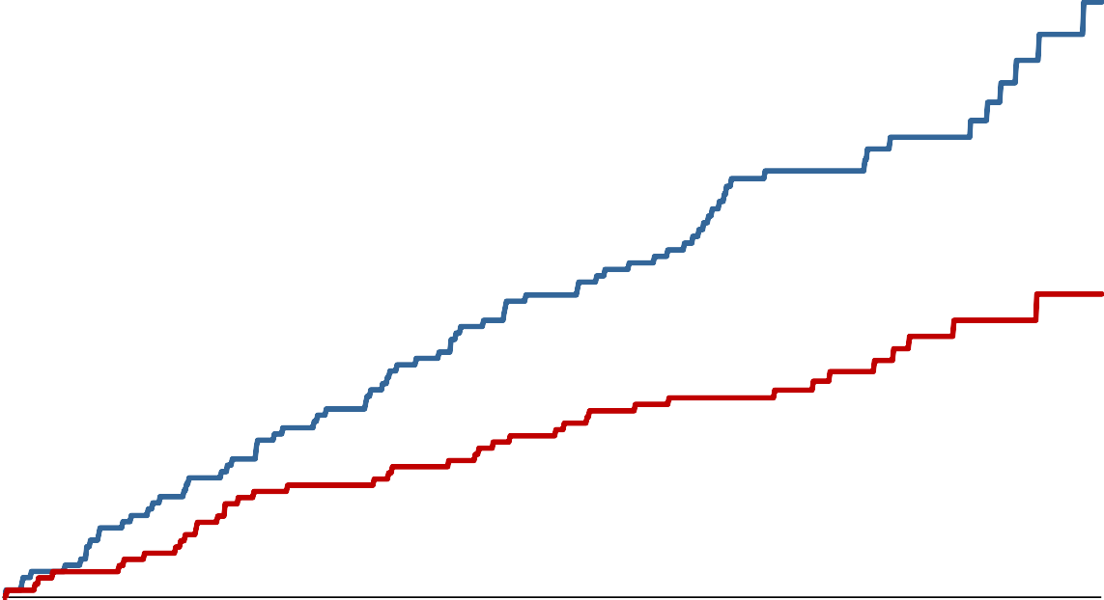
MACE or MALE
In Patients with PAD and no MI or Stroke
Placebo Evolocumab
PAD
(no MI/stroke, N=1505)
14%
48% RRR
12.8%
12%
HR 0.52
(0.35 – 0.76)
P=0.0006
PAD
6.3% ARR
NNT_{2.5y} 16
MACE or MALE
10%
8%
6.5%
6%
4%
2%
0%
0
90 180 270 360 450 540 630 720 810 900
Days from Randomization
An Academic Research Organization of
Brigham and Women’s Hospital and Harvard Medical School

Slide 17
Summary
Patients with PAD are at heightened risk of
MACE and MALE
LDL-C lowering with evolocumab in patients
with PAD:
Reduces major adverse CV events with robust ARR
Reduces major adverse limb events
Benefits extend to PAD without prior MI or stroke with an ARR for MACE or MALE of 6.3% (NNT 16) at 2.5 years
An Academic Research Organization of
Brigham and Women’s Hospital and Harvard Medical School

Slide 18
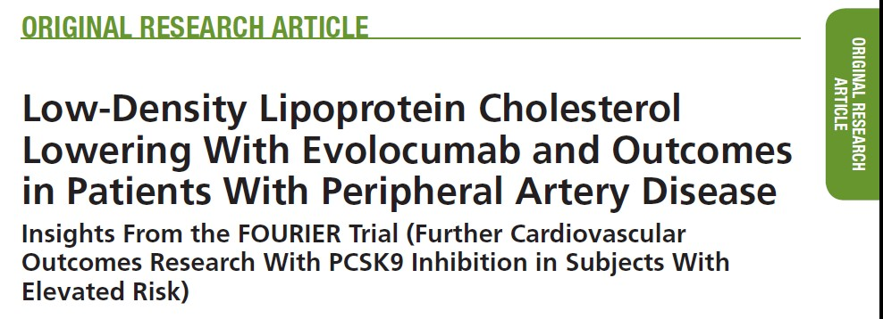
Conclusion
LDL-C reduction to very low levels should be considered in patients with PAD, regardless of history of MI or stroke, to reduce the risk of MACE and MALE
For more information see simultaneous publication in:
An Academic Research Organization of
Brigham and Women’s Hospital and Harvard Medical School

