Slide 1
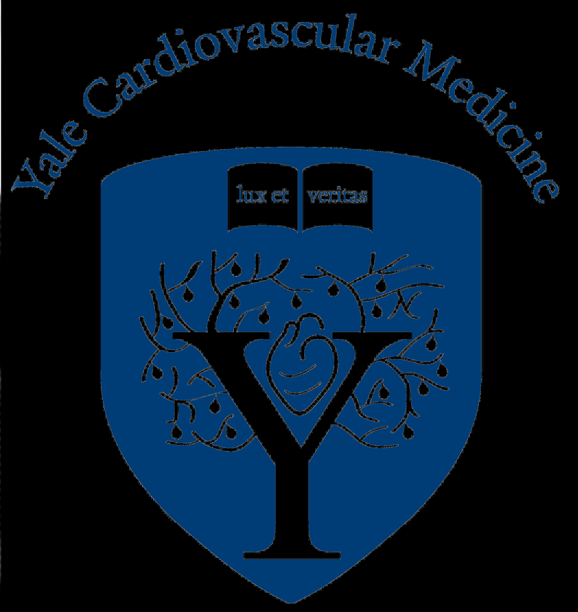
Utilization and Outcomes of Impella vs IABP Among Patients with AMI Complicated by Cardiogenic Shock Undergoing PCI
EMBARGOED for 9am ET 11-17-19
Sanket S. Dhruva, MD, MHS; Joseph S. Ross, MD, MHS; Bobak Mortazavi, PhD; Nate Hurley; Harlan M. Krumholz, MD, SM; Jeptha P. Curtis, MD; Alyssa Berkowitz, MPH; Frederick A. Masoudi, MD, MSPH; John C. Messenger, MD; Craig S. Parzynski, MS; Che Ngufor, PhD; Saket Girotra, MD, SM; Amit P. Amin, MD, MSc; Nilay D. Shah, PhD; Nihar R. Desai, MD, MPH
Notes:
On behalf of my co-investigators, I thank the AHA Scientific Sessions Program Committee for the opportunity to present our work, entitled “Utilization and Outcomes of Impella vs IABP Among Patients with AMI Complicated by Cardiogenic Shock Undergoing PCI.”

Slide 2
Funding Support
This work was supported in part by a Center of Excellence in Regulatory Science and Innovation (CERSI) grant to Yale University and Mayo Clinic from the US Food & Drug Administration (U01FD005938). Its contents are solely the responsibility of the authors and do not represent the official views of the Department of Heath and Human Services or the US Food and Drug Administration.
This research was supported by the American College of Cardiology’s National Cardiovascular Data Registry (NCDR). The views expressed in this presentation represent those of the author(s) and do not necessarily represent the official views of the NCDR or its associated professional societies identified at CVQuality.ACC.org/NCDR
Notes:
“This study was supported by FDA and ACC’s NCDR, but the contents and views are solely those of the authors and do not represent those of the Department of Health and Human Services, FDA, or NCDR.”

Slide 3
Background
Cardiogenic shock occurs in about 10% of patients with acute MI and is associated with substantial morbidity and mortality.
In addition to timely reperfusion and medical therapy, mechanical circulatory support (MCS) devices may be used to provide hemodynamic support, but guideline recommendations are limited
Impella® devices provide greater hemodynamic support than IABP.¹
Impella® has been marketed in the U.S. since 2008, but with limited randomized clinical trial evidence in cardiogenic shock.
Only 2 RCTs enrolling 74 total patients have compared Impella® vs IABP.
No difference in 30-day mortality, but higher bleeding with Impella® use.^{1,2}
¹Seyfarth M, Sibbing D, Bauer I, et al. J Am Coll Cardiol 2008. ²Ouweneel DM, Eriksen E, Sjauw KD, et al. J Am Coll Cardiol 2017.
Notes:
“Read verbatim.”

Slide 4
Study Aims
Assess MCS device utilization over time among patients with AMI complicated by cardiogenic shock (AMI-CS) undergoing PCI.
Apply propensity score matching to examine clinical outcomes among patients receiving Impella® or IABP
Primary effectiveness outcome: in-hospital death
Primary safety outcome: in-hospital major bleeding

Slide 5
Methods: Data Source
Identified patients with AMI-CS undergoing PCI between 10/1/2015 and 12/31/2017.
Linked cohort of the NCDR® CathPCI Registry® (>1500 US hospitals) and Chest Pain - MI Registry™ (>1000 US hospitals).
Standardized data elements: demographics, history, labs, procedural data
Robust data quality standards, including auditing.
Cardiogenic shock: SBP < 90 mm Hg and/or cardiac index <2.2 L/min/m² for ≥ 30 minutes secondary to ventricular dysfunction, and/or requirement for inotropic, vasopressor, or MCS device therapy.
Notes:
“We identified patients with AMICS…
We generated a linked cohort in our data source, the….
Combining these registries allowed us to obtain standardized data elements, including demographics, clinical history, labs, procedural data. These registries have robust data quality standards, including auditing.
Cardiogenic shock is defined in these registries as…”

Slide 6
Methods: Cohort Construction
NCDR®
CathPCI Registry®
n=1,600,032
NCDR
Chest Pain - MI Registry™
n=455,212
Patients in Linked Registries with AMI Undergoing PCI
n=269,303
Matched Patients With AMI-CS Undergoing PCI
n=28,304
Impella® Only
n=1,768 (6.2%)
IABP Only
n=8,471 (29.9%)
Medical Therapy Only
n=16,227 (57.3%)
Other MCS Devices or Multiple Devices
n=1,838 (6.5%)
Notes:
We linked patients in these two registries, which led to a population of 28,304 patients with AMI-CS undergoing PCI. We then stratified these patients into those receiving Impella only, IABP only, medical therapy only, and other MCS devices or a combination of multiple devices.

Slide 7
Characteristics of Patients with AMI-CS Undergoing PCI
Characteristic | Impella® Only (n=1,768) | IABP Only (n=8,471) | Medical Therapy Only (n=16,227)
Age, mean (SD) years | 64.2 (12.0) | 65.2 (12.4) | 65.3 (12.8)
Male sex, % | 71.3 | 69.2 | 64.8
Transferred from outside facility, % | 27.3 | 23.8 | 24.8
Prior MI, % | 22.3 | 20.7 | 22.0
Cerebrovascular disease, % | 10.8 | 10.4 | 11.7
Peripheral artery disease, % | 9.7 | 7.6 | 10.0
Diabetes, % | 36.5 | 33.7 | 31.5
Cardiac arrest at first medical contact, % | 25.4 | 24.3 | 23.4
STEMI, % | 78.2 | 84.4 | 79.7
Anterior infarction, % | 50.6 | 47.4 | 32.1
Left main and/or proximal LAD disease, % | 62.6 | 54.7 | 33.5
Multivessel disease, % | 66.2 | 63.5 | 48.6
Notes:
These are the characteristics of our pt population. The mean age was approximately 65 years, approximately one-fourth had suffered cardiac arrest at first medical contact, and about 80% had ST elevation myocardial infarction.

Slide 8
MCS Device Utilization Over Time
Impella® Use Increased from 3.5% to 8.7% (p<0.001)
Notes:
This figure shows change in utilization of MCS devices from the fourth quarter of 2015 to 2017.
*Animation*
Impella use, shown in blue, had a statistically significant increase from 3.5% to 8.7%.

Slide 9
Methods: Propensity Matching
NCDR®
CathPCI Registry®
n=1,600,032
NCDR
Chest Pain - MI Registry™
n=455,212
Patients in Linked Registries with AMI Undergoing PCI
n=269,303
Matched Patients With AMI-CS Undergoing PCI
n=28,304
Impella® Only
n=1,768 (6.2%)
IABP Only
n=8,471 (29.9%)
Medical Therapy Only
n=16,227 (57.3%)
Other MCS Devices or Multiple Devices
n=1,838 (6.5%)
Propensity Matched Patients Receiving Impella® vs IABP
n=1,680 pairs
(total n=3,360)
95% of Impella® patients successfully matched
Notes:
Here is our initial cohort.
*Animation*
We then propensity matched patients 1 to 1 receiving Impella only with those receiving IABP only, for a total of 1680 pairs and a total 3360 patients.
*Animation*
Our approach was successful in matching approximately 95% of Impella patients

Slide 10
Characteristics of Propensity-Matched Cohort
Characteristic | Impella® Only (n=1680) | IABP Only (n=1680)
Age, mean (SD) years | 64.3 (11.9) | 64.0 (11.9)
Male sex, % | 71.1 | 71.3
Transferred from outside facility, % | 27.4 | 26.8
Medical History, %
Prior MI | 22.9 | 22.7
Cerebrovascular disease | 11.8 | 13.6
Peripheral artery disease | 10.7 | 10.3
Diabetes | 34.2 | 34.8
Clinical Characteristics, %
Cardiac arrest at first medical contact | 25.1 | 27.1
STEMI | 78.8 | 79.0
Anterior infarction | 50.4 | 52.3
Left main and/or proximal LAD disease | 61.7 | 62.3
Multivessel disease | 66.1 | 66.1
Standardized mean difference was <0.10 for all 75 variables used for propensity score matching: demographics, clinical history and presentation, infarct location, coronary anatomy, and clinical laboratory data
Notes:
These are the characteristics of our propensity-matched cohort. The mean age was 64 years, 71% were male. Approximately 26% suffered cardiac arrest at first medical contact, 79% with STEMI, 51% with anterior MI, and 62% with left main or proximal LAD disease.
The standardized mean difference was <0.10 for all 75 variables used for propensity score matching

Slide 11
In-Hospital Clinical Outcomes
Death
Major Bleeding
Absolute Risk Difference = 10.9 percentage points
(95% CI, 7.6 to 14.2)
Absolute Risk Difference = 15.4 percentage points
(95% CI, 12.5 to 18.2)
IABP
Impella®
IABP
Impella®
Notes:
These are our in-hospital outcomes in our propensity-matched cohort.
*Animation*
34.1% of patients treated with IABP died in hospital.
*Animation*
Compared to 45.0% of patients treated with Impella.
*Animation*
This is an absolute risk difference of 10.9 percentage points higher in-hospital death among patients treated with Impella, with a 95% confidence interval of 7.6% to 14.2%.
For in-hospital major bleeding
*Animation*
16.0% of patients with IABP had major bleeding
*Animation*
Compared to 31.3% of patients treated with Impella.
*Animation*
This is an absolute risk difference of 15.4 percentage points higher in-hospital bleeding among patients treated with Impella, with a 95% confidence interval of 12.5 to 18.2%.
Transfusion rates. were 37.7% in Impella vs 18.8% in IABP.

Slide 12
In-Hospital Outcomes, Stratified by Timing of Device Placement
MCS Placement Prior to or During PCI
n=573 matched pairs
MCS Placement Post-PCI
n=662 matched pairs
Death
Major Bleeding
Death
Major Bleeding
Absolute Risk Difference
8.7 percentage points
(95% CI 3.1 to 14.4)
Absolute Risk Difference
10.8 percentage points
(95% CI 6.1 to 15.6)
Absolute Risk Difference
11.8 percentage points
(95% CI 6.6 to 17.0)
Absolute Risk Difference
18.7 percentage points
(95% CI 14.2 to 23.3)
IABP
Impella®
IABP
Impella®
IABP
Impella®
IABP
Impella®
Notes:
To test the robustness of our approach, we also examined these outcomes with matching based on the timing of device placement.
*Animation*
Our results were consistent with higher death and major bleeding for patients receiving Impella compared to IABP both before or during PCI and post-PCI.
*Animation*

Slide 13
Limitations
Residual confounding
Robust propensity match: standardized difference <0.10 for all 75 variables.
95% of patients treated with Impella®-only were successfully matched.
Results consistent across multiple sensitivity analyses (timing of device placement; hospitals using both IABP and Impella®; excluding transfers)
Clinical severity of AMI-CS patients in NCDR®
Registry definition similar to trials.
High event rate consistent with contemporary clinical trials and registries.
Inability to distinguish different types of Impella® devices.
Results primarily pertain to Impella® 2.5 and CP because 5.0 requires surgical cutdown, and patients receiving multiple devices were excluded.
Notes:
Our study should be considered within the context of several possible limitations.
“As with other observational analyses, there may be concern for residual confounding.
*Animation*
However, we had a robust propensity match using 77 detailed variables.
95% of all Impella-only treated patients were matched.
And our results were consistent across multiple sensitivity analyses, including when limiting to hospitals using both devices and when excluding transfer patients.
*Animation*
Another question could have been the clinical severity of shock in patients with cardiogenic shock seen in clinical practice. However, the registry definition used in our study is similar to clinical trials and the high event rate is consistent with contemporary trials and registries.
*Animation*
We were also unable to distinguish between different types of Impella devices. However, these findings pertain to the Impella 2.5 and CP, because the 5.0 requires a surgical cutdown and is unlikely to be the first support device used and we excluded patients receiving multiple devices.

Slide 14
Conclusions
This large, national, real-world study of patients with AMI-CS undergoing PCI demonstrates:
A significant 2.5-fold increase in the utilization of Impella® devices.
Impella® was associated with significantly higher rates of in-hospital death and bleeding compared to IABP.
These data provide important insights into the performance of MCS devices in routine clinical practice, and outcomes in RCT settings may differ.
Better evidence and guidance are needed regarding the optimal management of patients with AMI-CS as well as the role of MCS devices in general, and Impella® in particular.

