Slide 1
Getting the Most from CT For TAVR
Gaby Weissman MD
Medstar Heart & Vascular Institute
Georgetown University School of Medicine
gaby.weissman@medstar.net

Slide 2
Financial Relationship: Corelab
Boston Scientific
NeoVasc
Ancora Heart
HDL - Therapeutics

Slide 3
Outline
CT as a predictor of outcomes after TAVR
Paravalvular regurgitation
Aortic Valve Calcium
Annular rupture
CT in challenging Cases

Slide 4
CT as Predictor of Outcome

Slide 5
Paravalvular regurgitation
Correct valve sizing is important

Slide 7
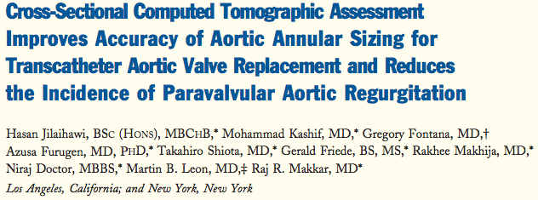

Slide 8
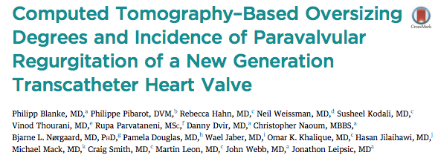
CT for Prediction of Outcomes

Slide 9
Aortic Valve Calcification

Slide 10
Aortic Valve Calcium & Outcome Under Medical Management
Clavel MA. J Am Coll Cardiol 2014:1202-13.

Slide 11
Aortic Valve Calcium & Outcome Under Medical Management
Non Severe AS
Severe AS
Clavel MA. J Am Coll Cardiol 2014:1202-13.

Slide 12
Aortic Annular Rupture

Slide 13
Aortic Root Rupture & Balloon Expandable TAVR: Predictors
Sub annular/LVOT calcium
Agatston score
181.2 vs. 22.5
Higher frequency of aortic annular area oversizing >20%.
79.4 vs. 29.0%
Balloon Post dilation
22.6 vs. 0.0%
Barbanti M. Circulation 2013:244-253.

Slide 14
CT for Guiding Complex Cases

Slide 15
Access Issues

Slide 17
Challenging Femoral Access

Slide 19
TransCaval Approach

Slide 21
Subclavian/ Carotid Access

Slide 22
Access: Other Issues

Slide 23
CT Tips For Access
CT heart
Needs to cover the heart and proximal Ascending Aorta
Must have systolic phases available
Clear image quality for annular evaluation
Contrast
Arrhythmia
Access CT
Cover from the subclavian to the femoral arteries
Gated vs. Non Gated
Contrast dose issues
Low dose injections
Intra arterial injections
Global evaluation
e.g. Aortic arch evaluation

Slide 24
Challenging Situations
CT can help plan ahead
Avoid surprises in the procedure
Help direct the patient to the correct procedure

Slide 25
Aortic Angulation

Slide 27
Aortic Root Replacement

Slide 28
Valve Morphology

Slide 30
LVOT Issues

Slide 31
Conclusions
CT has become an essential tool in the planning of transcatheter aortic valve procedures
CT can predict high risk features for worse outcomes
CT can help plan the appropriate transcatheter intervention & device
CT still carries the risk of radiation and contrast administration.

