Slide 1
Novel laser-based catheter for atherectomy: 6-month Results from the Eximo Medical B-Laser™ IDE study
For the EX-PAD-03 Study Investigators
Nicolas W Shammas, MD, MS, FACC, FSCAI
President and Research Director
Midwest Cardiovascular Research Foundation
Adjunct Clinical Associate Professor of Medicine, Univ of Iowa

Slide 2
EX-PAD-03 IDE Pivotal Study Investigators
John Rundback, Holy Name Medical Center, Teaneck, USA (national PI)
Nicolas W. Shammas, Midwest Cardiovascular Research Foundation, Davenport, IA
Pradeep Chandra, St. Louis Heart and Vascular, St Louis, MO, USA,
Marianne Brodmann, Medical University of Graz, Graz, Austria
Barry Weinstock, Orlando Heart Specialists, Orlando, FL, USA
Gino Sedillo, Cardiovascular Solutions Institute, Bradenton, USA
Ian Cawich, Arkansas Heart Hospital , Little Rock, AR, USA
Antonio Micari, Maria Cecilia Hospital, Cotignola, Italy and Gavazzeni Humanitas Hospital, Bergamo
Arthur Lee, North Florida Regional Medical Center, Gainesville, FL, USA
Chris Metzger, Wellmont CVA Heart Institute, Kingsport, USA
Luis Mariano Palena, Policlinico Abano Terme, Abano Terme, Italy
For the EX-PAD-03 Investigators

Slide 3
Nicolas W Shammas, MD, MS, FACC, FSCAI
Research and Educational Grants
Bard
Boston Scientific
Intact Vascular
VentureMed Group
Advisory Board/Consultant
Intact Vascular
Speaker Bureau
Boston Scientific
Janssen
Boehringer Ingelheim
Novartis
Intact Vascular
Bard

Slide 4
Basic Technology
The B-Laser™ is a solid-state short pulsed (10-25ns) 355nm laser. Main differences between B-Laser™ and Excimer laser:
Small and light solid-state Nd:YAG laser
355 nm wavelength
Short pulse width (~10-25 ns)
Four sizes of catheters (4, 5, 6, and 7Fr), large catheters with aspirations, largest catheter with off-centering mechanism
Three-fold affinity to lesion type tissue vs artery’s endothelium
ATK and BTK including calcified lesions, ISR, CTO
No calibration and no warm-up time for laser system
No need to eliminate contrast media
Notes:
Neodymium-doped Yttrium Aluminum Garnet (Nd: YAG) laser is a solid state laser

Slide 5
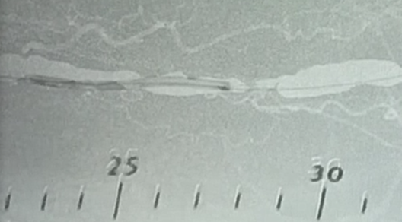
B-Laser™ Line of Catheters
EXIMO B-Laser™ offers a full line of laser catheters with capabilities that open new market opportunities in PAD
B-Laser™ catheters come
in a range of diameters
from 0.9 to 2.35 mm

Slide 6
Eximo B-Laser™ Atherectomy
Safe and effective line of laser catheters designed to treat various types of lesions (Highly Calcified - Thrombotic - CTO - ISR - Fibrotic and Soft Plaque)
Eximo Laser System
For ATK
For BTK
No calibration/warm-up
Standard power outlet
Minimal Maintenance
Simple to Use and Operate
Lightweight, easy transport
Low Acoustic noise
Safe to use with contrast
~1/10 of the energy required
2.0 mm and 2.35 mm Catheters
“Off -Center” mechanism (2.35 mm):
Tx Large Vessels and Eccentric Lesions
Active Aspiration (2.0 mm & 2.35 mm)
Decrease Embolic Risk & Thrombectomy solution
Tissue selectivity
Indifferent to CM
Designed for single pass
1.5 mm & 0.9 mm catheters
Effective in calcified lesions
Tissue selectivity
Designed for single pass
Indifferent to CM
6

Slide 7
B-Laser™ Typical angiographic view 5 cm CTO in SFA, 2.35 mm with “off-centering”
Before
After B-Laser™
After B-Laser™ + Balloon

Slide 8
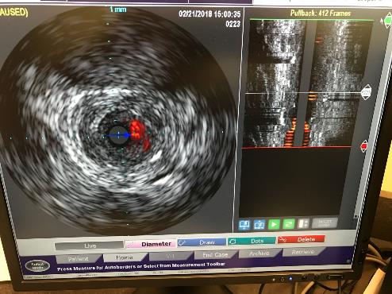
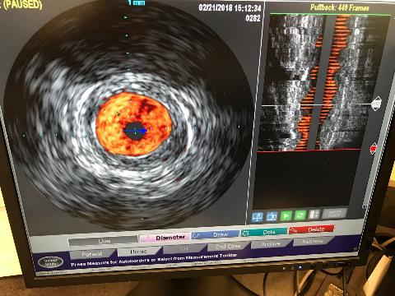
IVUS images (1.5 mm in 5.5 mm vessel)
Before Laser
After Laser
A lumen much larger than the nominal catheter diameter was achieved

Slide 9
EX-PAD-03
Objective: To Assess the Safety and Effectiveness of the Eximo Medical B-Laser™ in subjects with symptomatic infrainguinal peripheral artery disease
Prospective, single arm, multicenter, multinational clinical study
Angiographic core laboratory (SynvaCor, Springfield, IL, USA)
Duplex ultrasound patency (PSVR <2.5), was evaluated by Vascore, Boston, MA core lab at 30 days and 6 months.
CEC and DSMB committees
Patients (Rutherford 2-4) were included if they have an infrainguinal lesion of ≥70% in a native artery and excluded if lesion length >15 cm (in ISR up to 25cm)

Slide 10
Primary Endpoint Definitions
Primary Effectiveness: General average reduction in residual diameter stenosis of greater than 20% from baseline prior to any adjunctive therapy achieved by the B-Laser™ catheter alone, as assessed quantitatively by an angiographic core laboratory
Primary Safety- Major adverse events: cardiovascular death, amputation above the ankle and clinically driven target lesion revascularization (CD- TLR) at 30 days.

Slide 11
Secondary Endpoint Definitions
Secondary Effectiveness: Clinical outcome of Rutherford, ABI and WIQ at 30 days and 6 months compared to baseline, as well as patency at 6 months (PSVR<2.5) by core lab
Secondary Safety- Perioperative complications by core lab, and other complications up to 30 months

Slide 12
EX-PAD-03 Baseline Characteristics
PATIENTS | n (%)
Subjects (male/female) | 97 (51/46)
HTN | 89 (91.8%)
Dyslipidemia | 83 (85.6%)
DM | 41 (42.3%)
Active or prior smoking | 78 (80.4%)
Rutherford grade
R2 | 31 (32%)
R3 | 57 (59%)
R4 | 9 (9%)
ABI< 0.9 | 73/88 (82.9%)
WIQ <39 | 75/88 (85.2%)
LESIONS & TREATMENT
n | 107
Length (mean +/- SD), cm | 5.4 ± 4.3
Baseline stenosis (mean +/- SD) | 85.7 ± 12.2
Moderate – severe calcification | 41 (38.3%)
CTO | 23 (21.5%)
Restenosis/ISR | 22 (20.6%)
Location
Femoral | 79 (73.8%)
Popliteal | 9 (8.4%)
Tibial | 19 (17.8%)
Adjunctive inflow treatment | 19 (17.8%)
POBA alone/DCB | 46/60*
* 1 patient did not receive balloon angioplasgty
Shammas NW, et al. Cardiovasc Revasc Med. 2018 Nov 29. pii: S1553-8389(18)30565-7. doi: 10.1016/j.carrev.2018.11.022. [Epub ahead of print]

Slide 13
EX-PAD-03 Procedure Results
 | n (%)
Baseline stenosis (mean +/- SD) | 85.7 ± 12.2
Stenosis post B-Laser (mean +/- SD) | 52.1 ± 14.6
Final stenosis after PTA (mean +/- SD) | 17.7 ± 11.0
Stenosis post B-laser in moderate-severe calcification (mean +/- SD) | 54.3 ± 12.6
Stenosis post B-laser in severe calcification (mean +/- SD) | 53.4 ± 13.3
Embolization | 0 (0%)
Grade A/B dissection | 16 (14.9%)
Grade C-E dissection | 0 (0%)
Bail-out stenting | 1 (0.9%)
Shammas NW, et al. Cardiovasc Revasc Med. 2018 Nov 29. pii: S1553-8389(18)30565-7. doi: 10.1016/j.carrev.2018.11.022. [Epub ahead of print]

Slide 16
6-month Results
Duplex restenosis (PSV>2.5) | 13 (14.4%)
CD-TLR
Per subject (n=91) | 3 (3.3%)
Per lesion (n=101) | 3 (2.9%)
Rutherford class
R0 | 44 (50%)
R1 | 31 (35%)
R2 | 9 (10%)
R3 | 2 (2%)
R4 | 1 (1%)
R5/6 | 1 (1%)
ABI<0.9 | 40/85 (47.1%)
WIQ<39 | 34/81 (42.0%)

Slide 17
IDE - Clinical Outcome Rutherford

Slide 18
IDE - Clinical Outcome WIQ

Slide 19
IDE - Clinical Outcome ABI

Slide 20
Conclusion
The EXIMO B-Laser™ is safe and effective in reducing residual diameter stenosis in all infrainguinal arterial lesion subtypes including CTO, calcium and In-stent restenosis
Patency and fCD-TLR (per lesion) at 6 months were 85.6% and 97.1% respectively
No distal embolization or grade C-E dissections were reported, per core lab.
Bail out stenting recorded in 0.9%

Slide 21
Thank You!!
Before Laser
After Laser

