Slide 1
Inter-Atrials Shunts for Reduction of LA and RA Hypertension
Washington, March 2019
Hans R. Figulla, MD
Professor of Medicine (Emeritus)
Friedrich Schiller University
Jena - Germany

Slide 2
Disclosures Statement of Financial Interest
Cofounder/shares of JenaValve
Cofounder/shares of Occlutech
Cofounder/shares of DEVIEmed
Consultant Translumina/P&F

Slide 3
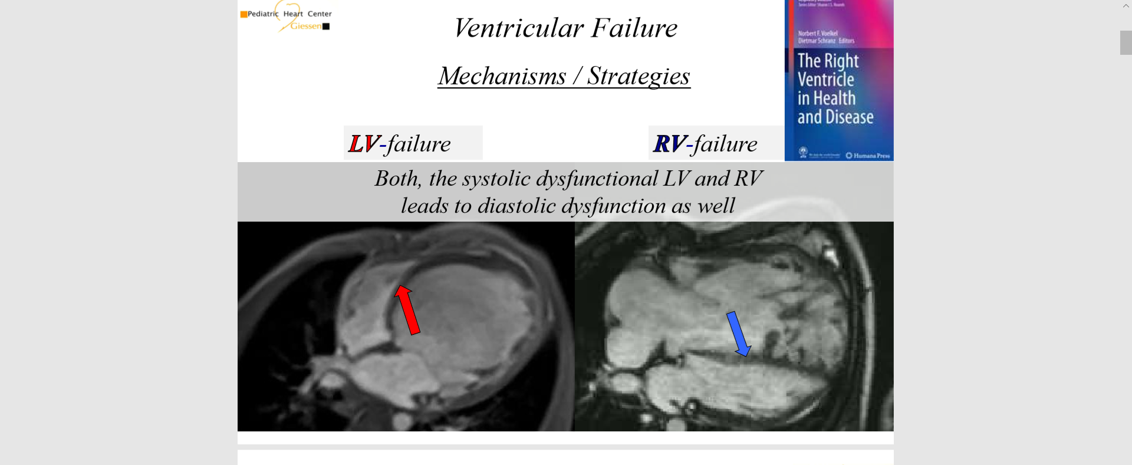

Slide 4
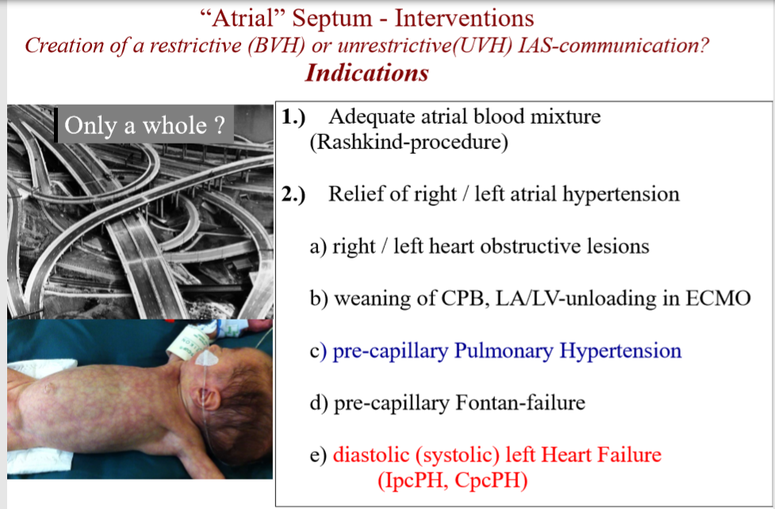
Atriale Septum –Interventions
Indications

Slide 5
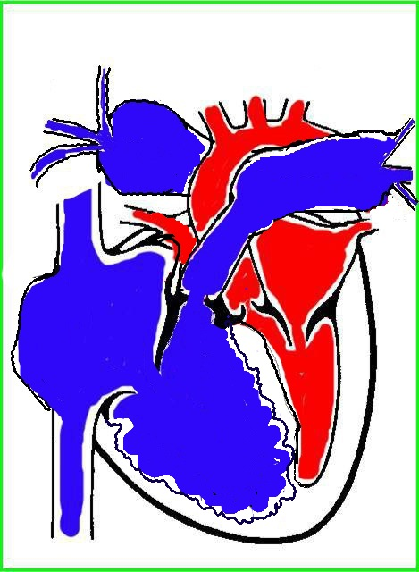
Decompensation: Following Pulmonary Hypertension
extremely high resistance
Systemic pressure
Right atrial decompensation
Liver congestion
Aszites, etc.
Left heart underfilled
Low cardiac output
Right heart dilatation
Low cardiac output

Slide 6
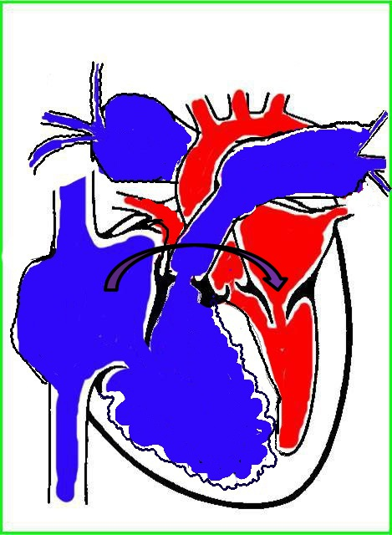
Creation of an interatrial shunt

Slide 7
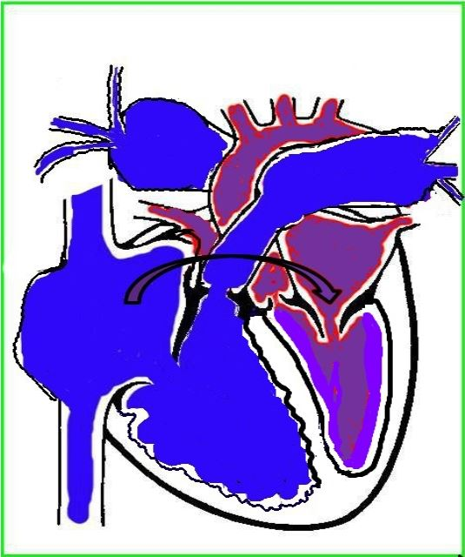
Hemodynamic effect
Right atrial decompression
Mild cyanosis
Left heart refilled
Higher cardiac output
-> improved oxygen/energy delivery to the body

Slide 8
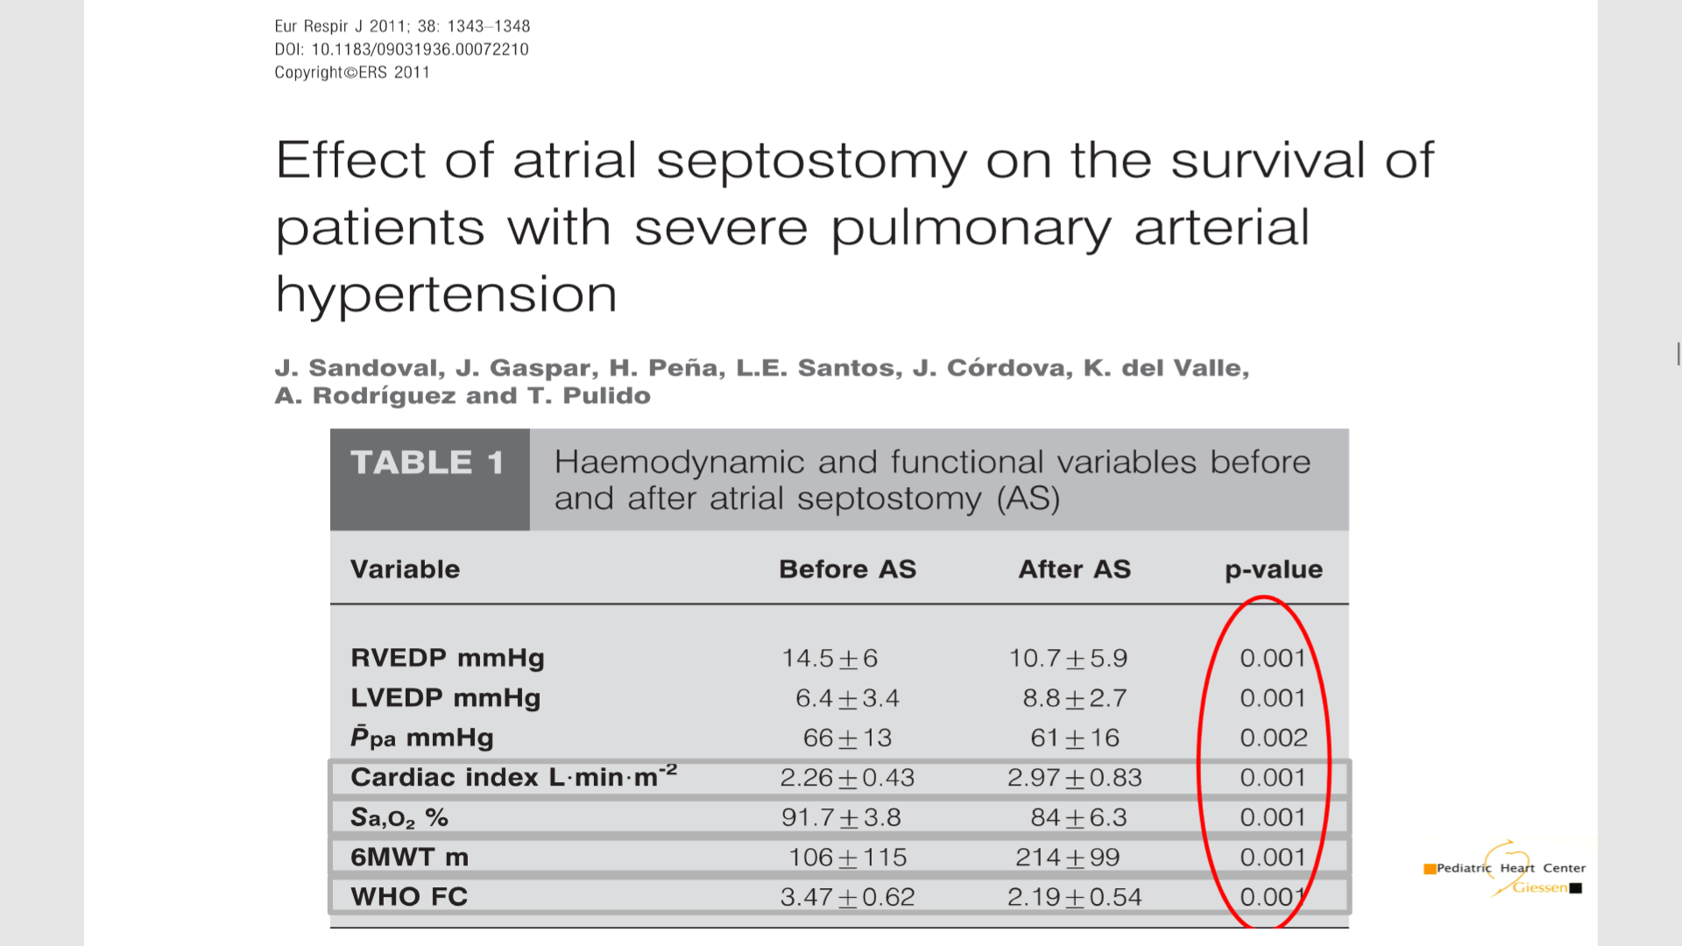

Slide 9
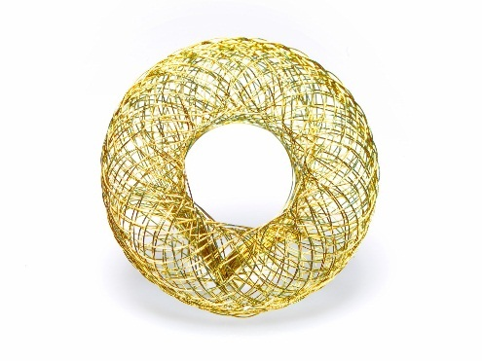
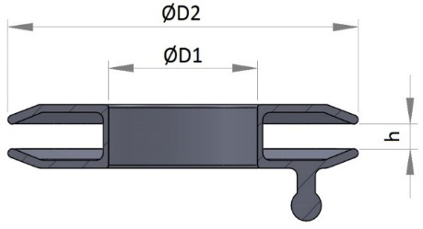
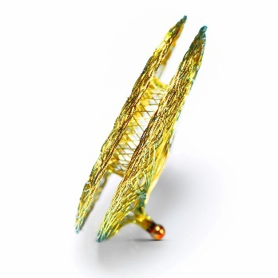
Occlutech AFR – Dimensions & Compatibility Chart
Sizes available in; 4, 6, 8, 10 mm fenestration with 2, 5 and 10 mm waists
AFR Article No | D1 [mm] | D2 [mm] | h [mm] | Introducing System Size
 |  |  |  | ODS*
65AFR04 | 4 | 16 | 2 | 8F
65AFR06 | 6 | 18 | 2 | 10F
65AFR08 | 8 | 21 | 2 | 12F
65AFR10 | 10 | 23 | 2 | 14F
65AFR04M | 4 | 16 | 5 | 8F
65AFR06M | 6 | 18 | 5 | 10F
65AFR08M* | 8 | 21 | 5 | 12F
65AFR10M* | 10 | 23 | 5 | 14F
65AFR04L | 4 | 16 | 10 | 8F
65AFR06L | 6 | 18 | 10 | 10F
65AFR08L* | 8 | 21 | 10 | 12F
65AFR10L* | 10 | 23 | 10 | 14F
* 4 sizes are currently used in clinical trials; 8, 10mm fenestrations with 5, 10mm waists
CAUTION–Investigational Device. Limited by United States Law to Investigational Use

Slide 10
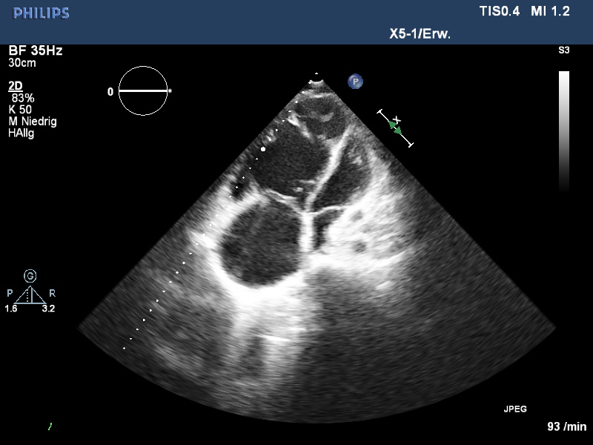
Notes:
Abkürzungen: VSD, Ventrikelseptumdefekt; ASD II, Vorhofseptumdefekt, Sekundum Typ; PS, valvuläre
Pulmonalstenose; PDA , persistierender Ductus arteriosus; CoA, Aortenisthmusstenose; UVH, univentrikuläres
Herz; HLHS, hypoplastisches Linksherzsyndrom; AVSD, Atrioventrikulärer Septumdefekt; ToF, Fallot'sche
Tetralogie; AS, valvuläre Aortenstenose; D-TGA, komplette Transposition der großen Arterien; DORV, Double
Outlet Right Ventricle ; PA/VSD, Pulmonalatresie mit Ventrikelseptumdefekt; TAPVC, totale
Lungenvenenfehlmündung; TAC, Truncus arteriosus communis; PAPVR, partielle Lungenvenenfehlmündung; LTGA,
angeboren-korrigierte Transposition der großen Arterien; IAA, unterbrochener Aortenbogen; PA/IVS,
Pulmonalklappenatresie mit intaktem Ventrikelseptum

Slide 11
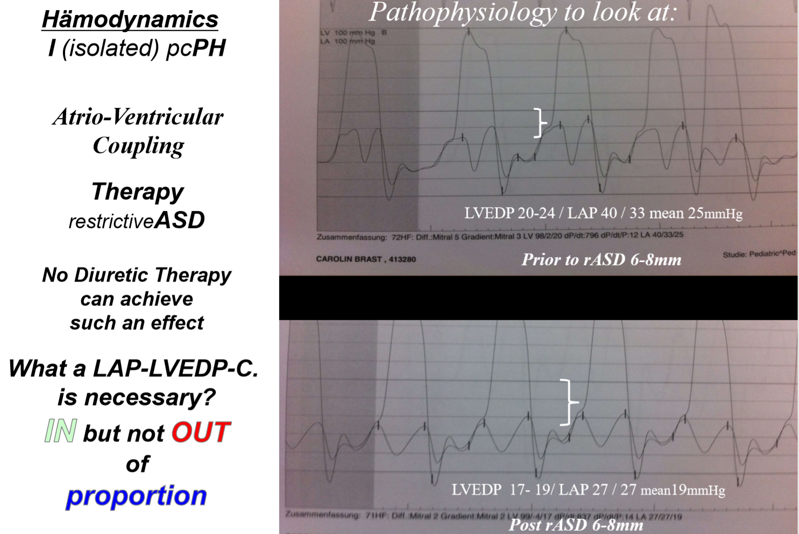

Slide 12
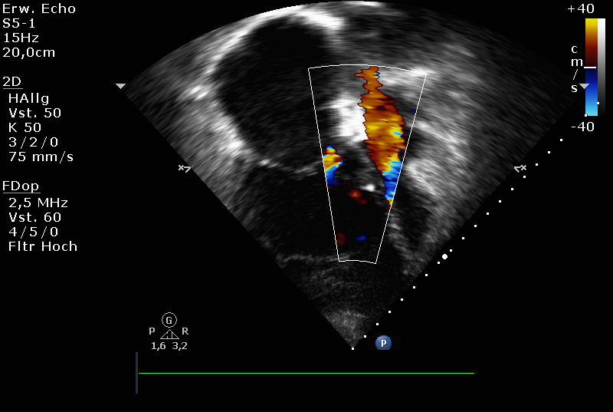
Notes:
Abkürzungen: VSD, Ventrikelseptumdefekt; ASD II, Vorhofseptumdefekt, Sekundum Typ; PS, valvuläre
Pulmonalstenose; PDA , persistierender Ductus arteriosus; CoA, Aortenisthmusstenose; UVH, univentrikuläres
Herz; HLHS, hypoplastisches Linksherzsyndrom; AVSD, Atrioventrikulärer Septumdefekt; ToF, Fallot'sche
Tetralogie; AS, valvuläre Aortenstenose; D-TGA, komplette Transposition der großen Arterien; DORV, Double
Outlet Right Ventricle ; PA/VSD, Pulmonalatresie mit Ventrikelseptumdefekt; TAPVC, totale
Lungenvenenfehlmündung; TAC, Truncus arteriosus communis; PAPVR, partielle Lungenvenenfehlmündung; LTGA,
angeboren-korrigierte Transposition der großen Arterien; IAA, unterbrochener Aortenbogen; PA/IVS,
Pulmonalklappenatresie mit intaktem Ventrikelseptum

Slide 13
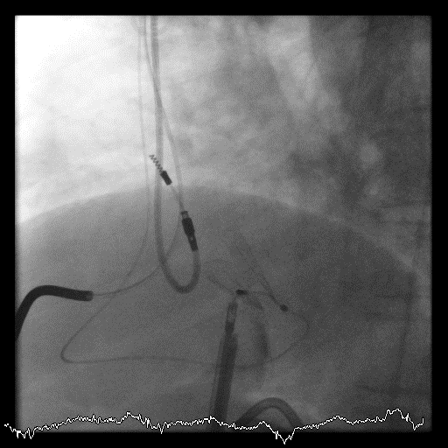

Slide 14
Occlutech® AFR Publication
Sivakumar et al, 2017
A total of 12 patients aged 28.3±8.5 years (15–39 years) were recruited from August 2016 to April 2017
The size of the fenestration in AFR was 8 mm in three patients with markedly elevated right atrial pressures and 10 mm in the rest.
The AFR device was deployed in a single attempt in all patients
CAUTION–Investigational Device. Limited by United States Law to Investigational Ue

Slide 15
Occlutech® AFR Publication
Sivakumar et al, 2017
Results
100% procedural success
Significant fall in right atrial pressures by 4.08±3.2 mmHg (2–13 mmHg) immediately after the AFR implantation
All patients had relief of syncope
  None of the patients had a recurrence of syncope (from all to none)
Significant improvement at the cardiac index and systemic oxygen transport
100% device patency at a median follow up of 6 months
Resulted hypoxia tolerated well
The cardiac index and systemic oxygen transport (product of cardiac index and aortic oxygen content) improved significantly in all patients
CAUTION–Investigational Device. Limited by United States Law to Investigational Use

Slide 16
Occlutech® AFR Publication
Sivakumar et al, 2017
Results
Significant improvement on 6-minute walking distance from 377m to 423m
One bedridden ortopneic patient was able to perform 6MWT at 1 mth folow up (from 0m to 180m)
CAUTION–Investigational Device. Limited by United States Law to Investigational Use

Slide 17
NYHA Classification before and after AFR
Occlutech® AFR Publication
Sivakumar et al, 2017
Results
NYHA IV
NYHA III
CAUTION–Investigational Device. Limited by United States Law to Investigational Use

Slide 18

Effect of the interatrial shunt
Decompression of the left atrium
Regression of pulmonary congestion
Improved clinical symptoms
Left to right shunt
More workload of the right heart

Slide 19
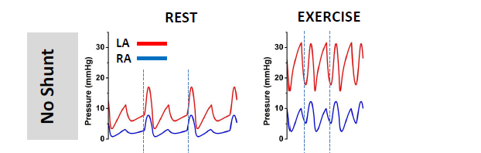

Hemodynamics in HFpEF without and with shunt
Effect of LR shunt:
Reduction of LA pressure
Reduction of pulmonary congestion
Relieve of shortness of breath under exercise

Slide 20
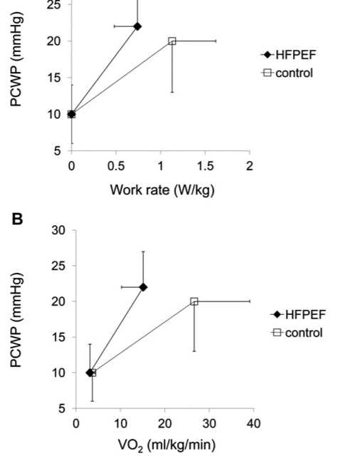
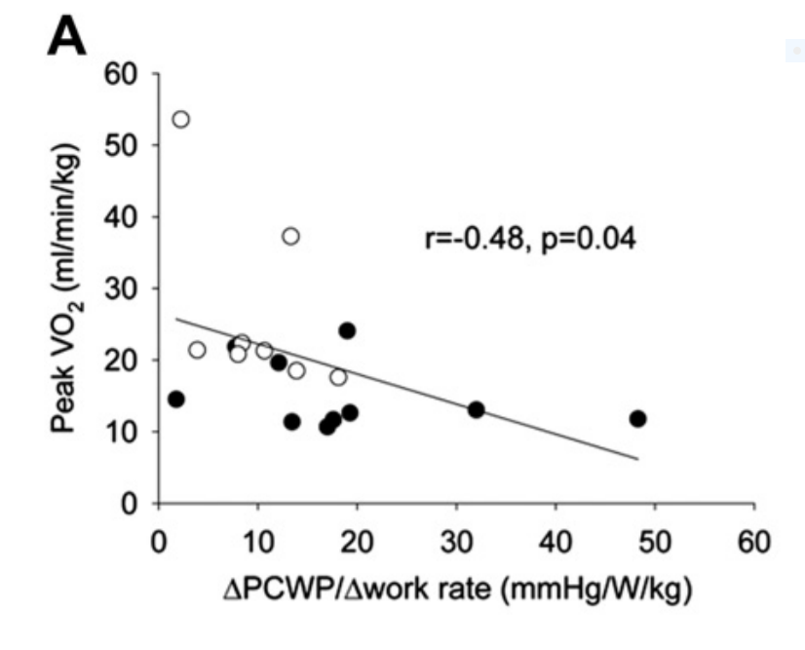
Steep PCWP induces less VO2max:
PCWP reduction more VO2max?
Maeder MT et al, J.Card. Fail, 2012

Slide 21
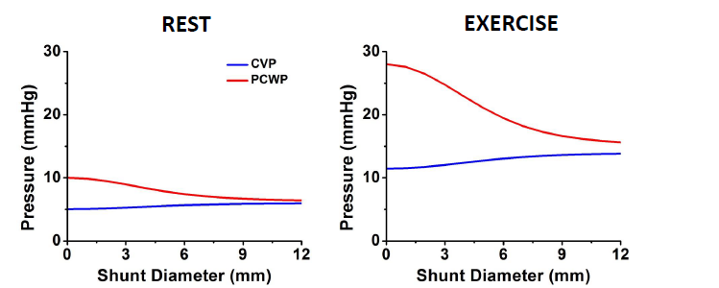
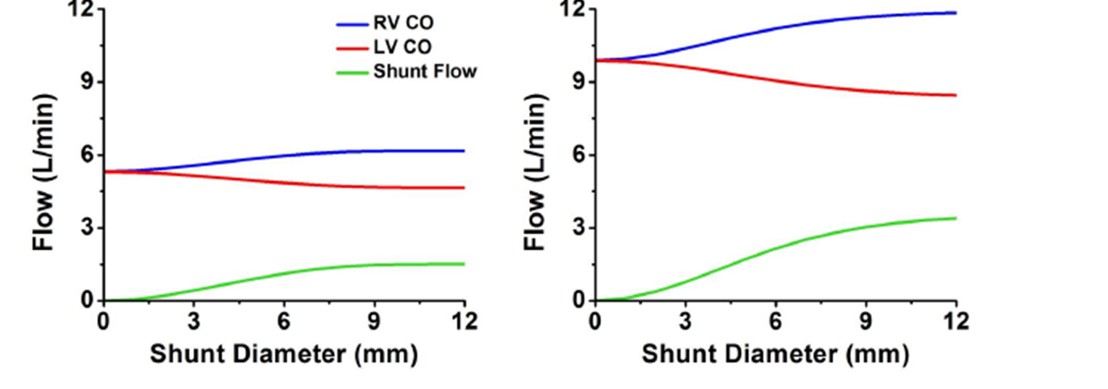
Hemodynamic depending on shunt diameter

Slide 22
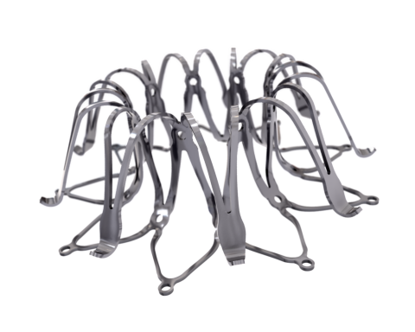
Corvia IASD Systems

Slide 23
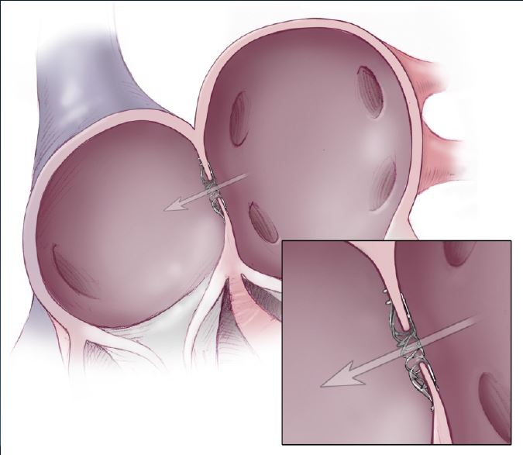
Corvia IASD Systems

Slide 24
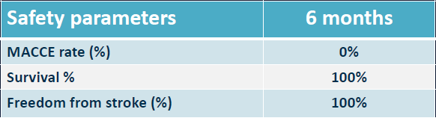
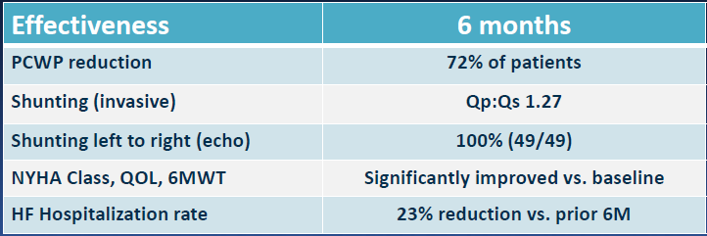
CE –Mark Study

Slide 25
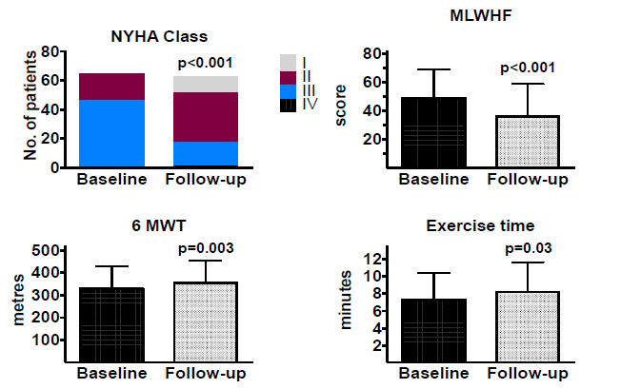
CE –Mark Study (n=64)

Slide 26
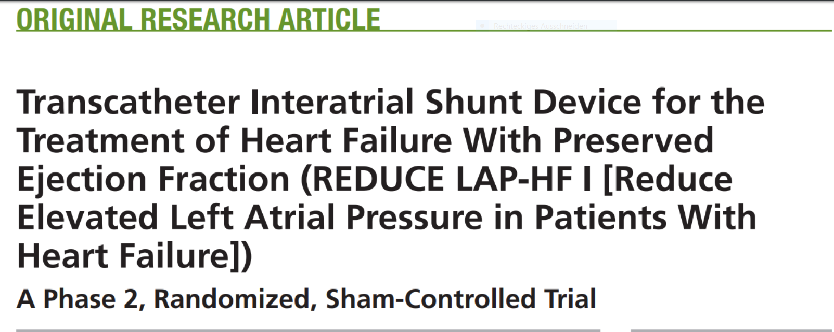

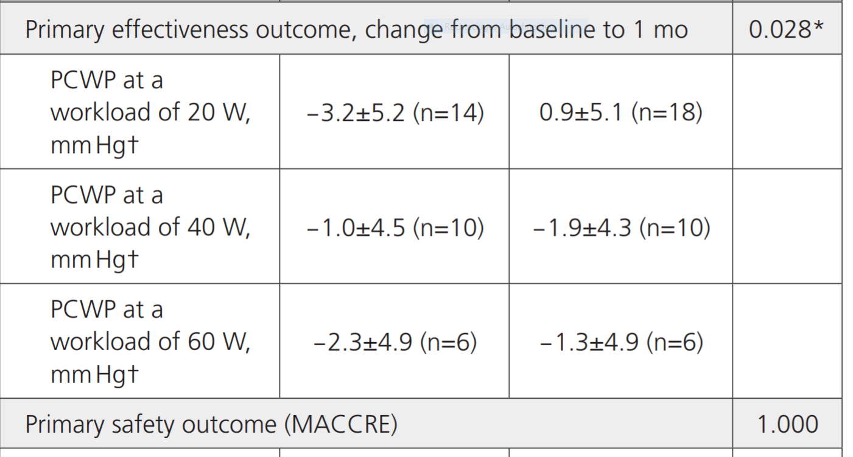
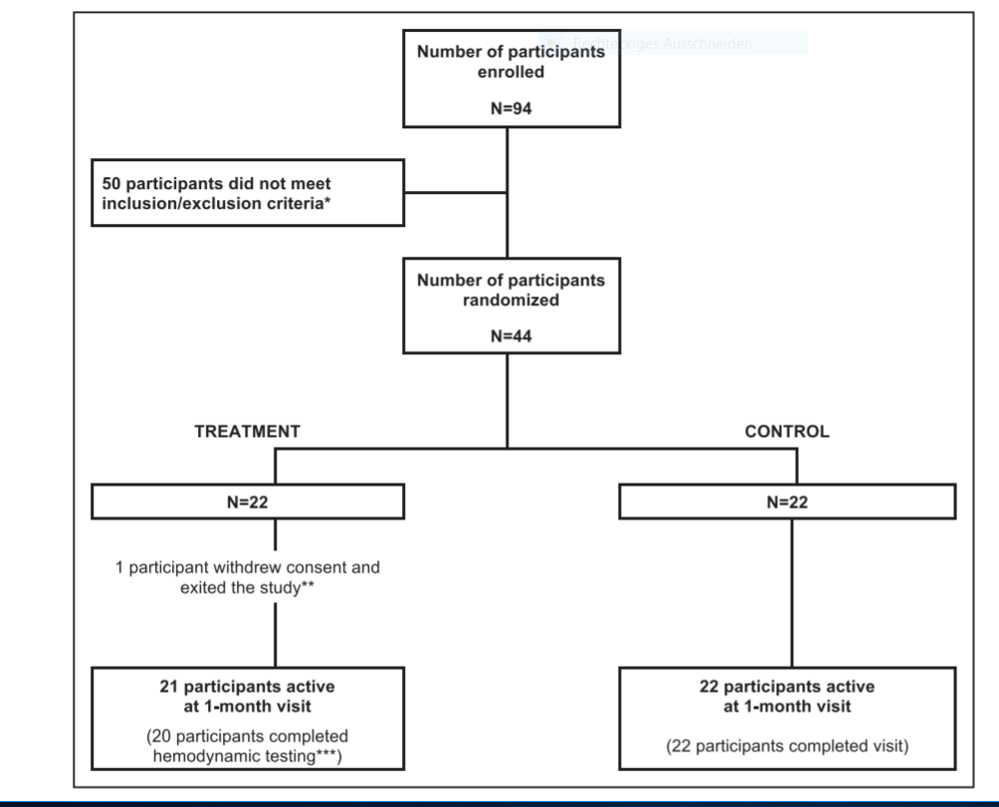
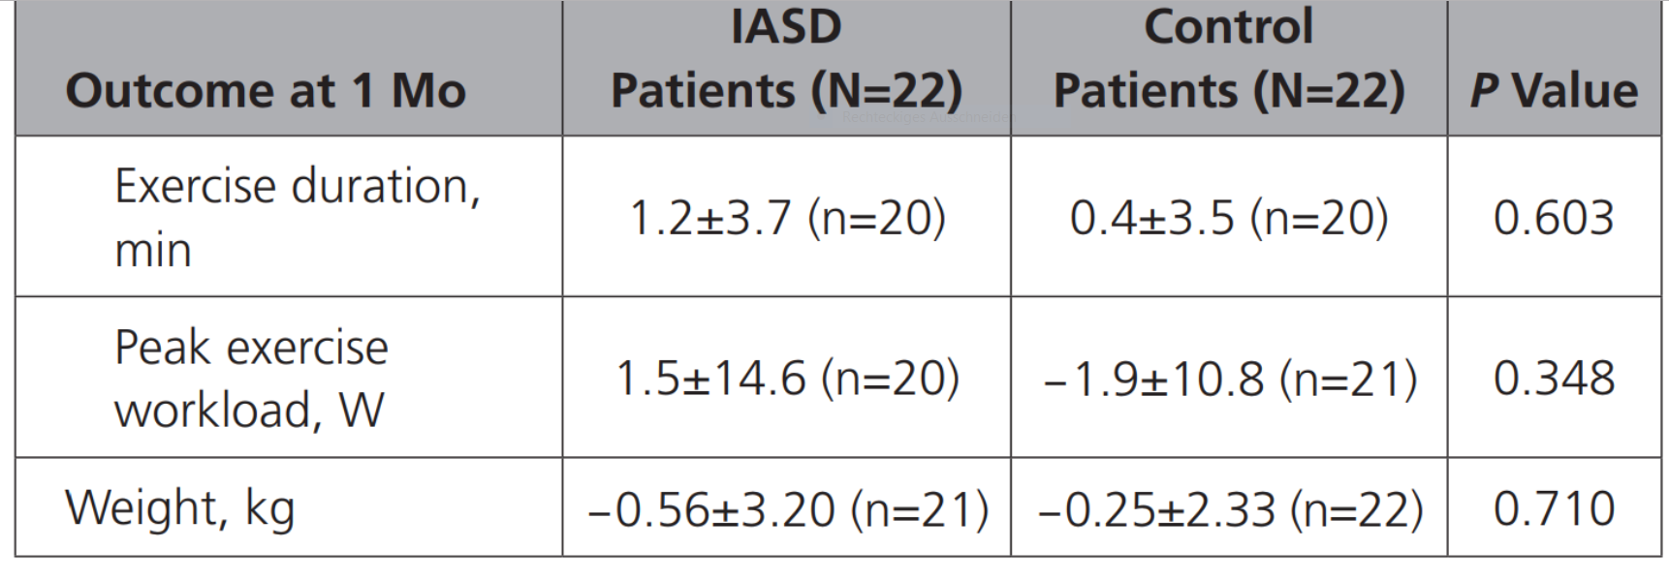
Feldmann T et.al, Circulation 2018, 137,364
Secundary outcome

Slide 27
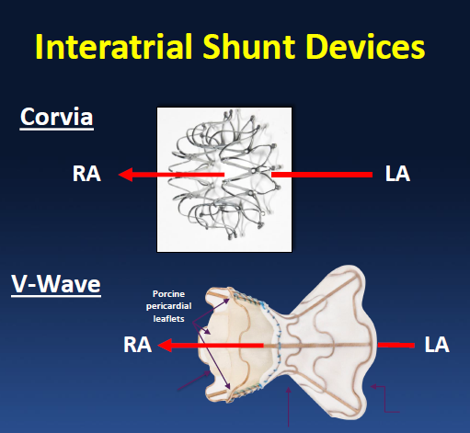
HFpEF
HFrEF

Slide 28
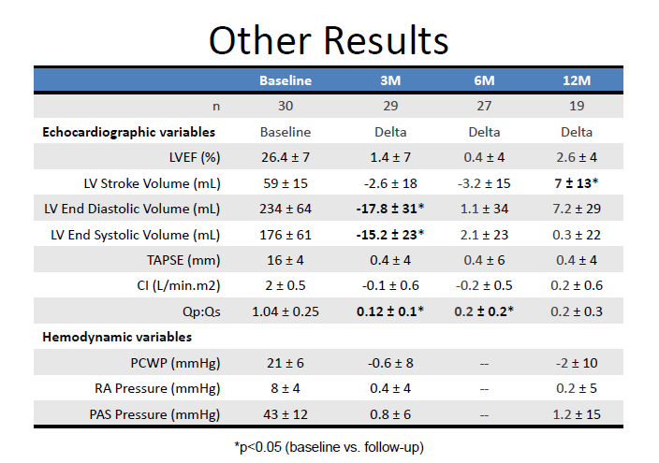
V-Wave in HFrEF

Slide 29
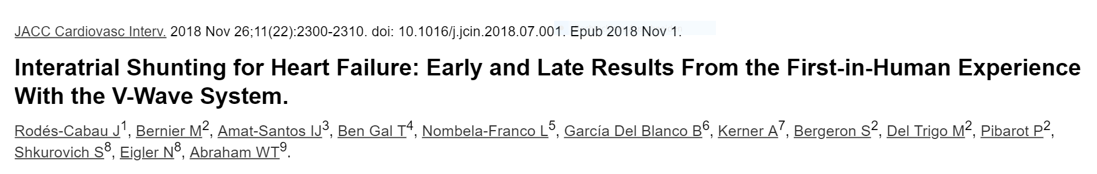
NHYA III-IV
N=30 HFrEF
Improvements:
NYHA, 6 Min WT,LWHF Questiare, PCWP
N=8 HFpEF
After 12 months:
50% obstructed

Slide 30
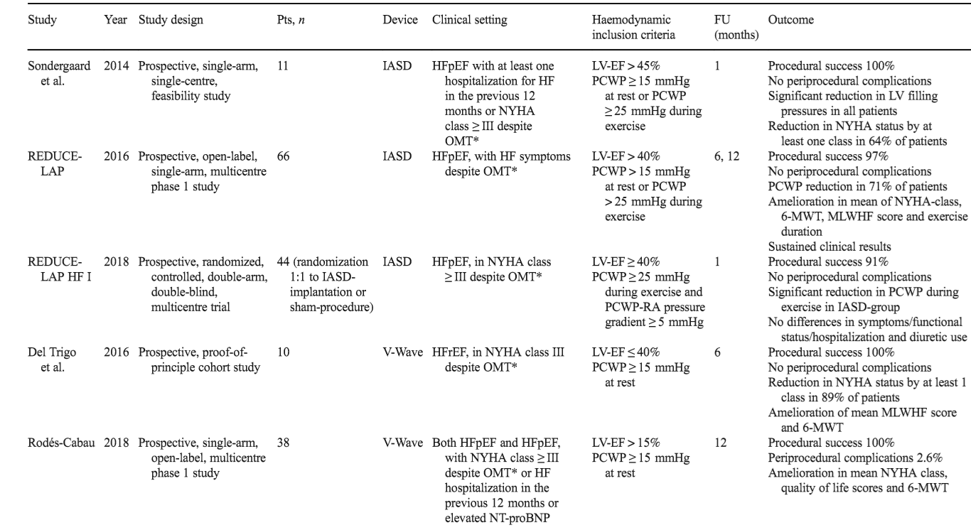
L/R Shunt in HF: Trials

Slide 31
Conclusions
Theoretically appealing concept
Safe
Little data in HFrEF
Promising data in HFpEF
Shunt device with valve showed obstruction
Shunt devices without valve stay open
In compassionate PAH impressive improvements

Slide 32


Slide 33


Slide 34
AFR – Results
Summary
Slightly improvement in 6-MWD
No NYHA classification of class II and worse after 6-M-FU
No cases of worsening of NYHA classification
Disappearance of syncope effects after implantation
Moderate improvement with respect to cardiac index, Qp/Qs ratio and PVR/SVR
No influence on NT-pro-BNP levels
Moderate elevation of mean oxygen saturation over time
CAUTION–Investigational Device. Limited by United States Law to Investigational Use

Slide 35
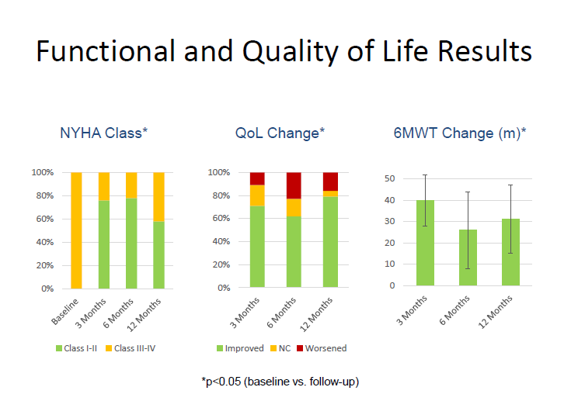

Slide 36

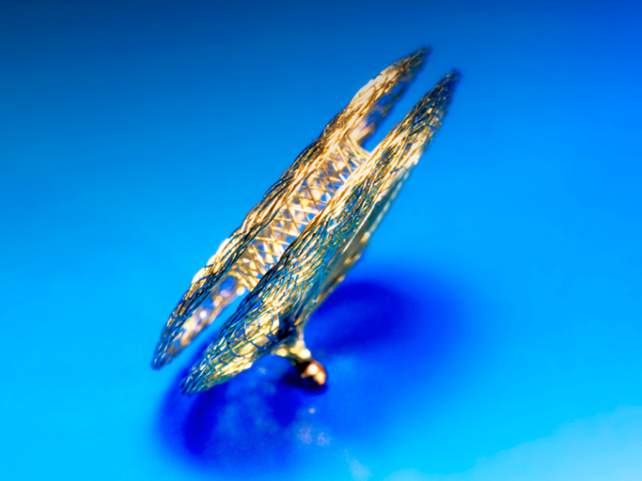

Atrial Flow Regulator from
The atrial flow regulator
Potential use in:
Right atrial congestion
Right heart failure for PHT
Left atrial congestion
Diastolic left heart failure
Systolic left heart failure
Congenital heart defects

Slide 37
AFR – Patient Cohort
Implantations 02/2016 – 10/2017
AFR Implantations (n = 47)
Pulmonary Hypertension (PH) (n = 34)
Other indication (n = 13)
Data not available n = 13 thereof n_{died}= 1
PH due to congenital anomaly n = 1
Pulmonary Arterial Hypertension (PAH)
(n = 20)
Baseline
n = 20
Implantation
n = 19
Death n = 2
10 day FU
n = 13
1 month FU
n = 15
3 month FU
n = 14
6 month FU
n = 9

Slide 38
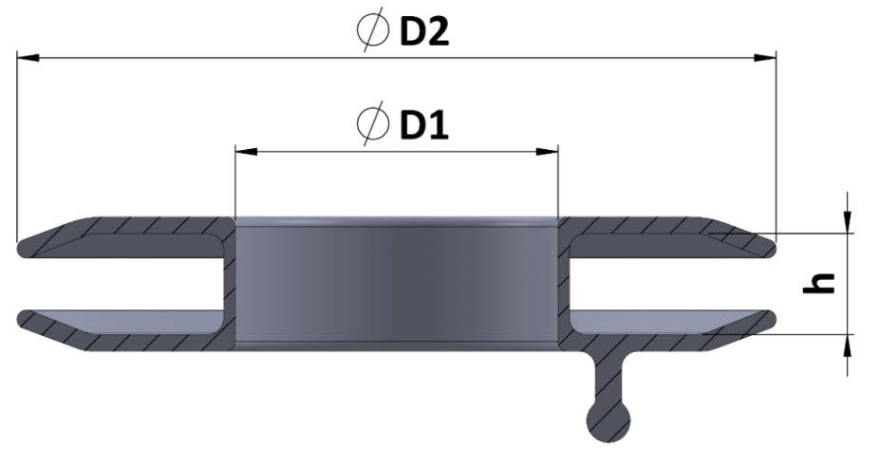
AFR Results
Procedual data
a)
b)
Attempts to implant (n=20)
  90%→ 1 attempt
  10% → 2 attempts
Device selection (n=20)
  Waist height (h): 5 mm (all implantations)
  Fenestration (D1): 6, 8 or 10 mm (see fig. 1)
 | N | Range | Mean ± SD
Overall procedure time [min] | 20 | 12-146 | 35±38
BAS procedure [min] | 14 | 0.3-10.5 | 1.3±0.3
AFR implantation time [min] | 15 | 6-9 | 8±1
Fluoroscopy time [min] | 20 | 6-50 | 22±12
Fig 1:
AFR device
Distribution fenestration size.
CAUTION–Investigational Device. Limited by United States Law to Investigational Use

Slide 39
Decompensation: Following Pulmonary Hypertension
extremely high resistance
Systemic pressure
Right atrial decompensation
Liver congestion
Aszites, etc.
Left heart underfilled
Low cardiac output
Right heart dilatation
Low cardiac output

Slide 40
AFR Results PAH
Demographical Data
Parameter | n | range | mean±SD
Age | 20 | 6-47 | 27±10
6 MWD | 17 | 140-450 | 342±83
PA dias pressure [mmHg] | 11 | 35-68 | 54±12
PA mean pressure [mmHg] | 10 | 51-98 | 77±15
PA systolic pressure [mmHg] | 11 | 65-180 | 116±31
RV pressure [mmHg] | 9 | 80-130 | 116±15
RV EDP [mmHg] | 9 | 6-25 | 16±6
AO sO2 [%] | 14 | 93-98 | 97±2
IVC sO2 [%] | 9 | 63-82 | 72±5
PA sO2 [%] | 9 | 60-72 | 66±4
CAUTION–Investigational Device. Limited by United States Law to Investigational Use

Slide 41
AFR Results
6-minutes-walking-distance
Baseline: 342±83 m; range 140-450 m
6-M-FU: 444±52 m; range 390-540 m
CAUTION–Investigational Device. Limited by United States Law to Investigational Use

Slide 42
AFR- Results
NYHA classification before and after implantation
CAUTION–Investigational Device. Limited by United States Law to Investigational Use

Slide 43
AFR – Results
NYHA improvement between implantation and Follow-up
CAUTION–Investigational Device. Limited by United States Law to Investigational Use

Slide 44
AFR – Results
Evaluation of hemodynamic data and syncope effects
No post-procedure syncope episodes have been reported in contrast to syncope episodes before procedure (n=14)
Parameter | N | Baseline |  | 6-M-FU
 |  | mean±SD | range | mean±SD | range
PA dias [mmHg] | 11 | 54±2 | 35-68 | 57±17 | 35-90
PA syst [mmHg] | 11 | 116±31 | 65-180 | 124± 21 | 100-160
PA mean [mmHg] | 10 | 77±5 | 51-98 | 83±16 | 65-118
Cardiac index | 9 | 2.96±0.57 | 2.1-3.84 | 2.67±0.80 | 1.77-4.20
Qp/Qs | 11 | 1.06±0.06 | 1.00-1.20 | 0.78±0.21 | 0.33-1.14
PVR/SVR | 9 | 0.91±0.22 | 0.59-1.22 | 0.51±0.06 | 0.41-0.59
CAUTION–Investigational Device. Limited by United States Law to Investigational Use

Slide 45
AFR – Results
O₂Saturation
CAUTION–Investigational Device. Limited by United States Law to Investigational Use

Slide 46
AFR – Results
NT-pro-BNP-levels
CAUTION–Investigational Device. Limited by United States Law to Investigational Use

Slide 47
AFR – Safety data
No report of device-performance related events
No reports of shunt closure
sPO2 never reached critical levels and patients tended to compensate over time
3 non device related fatal events
CAUTION–Investigational Device. Limited by United States Law to Investigational Use

