Slide 1
RNA Interference Targeting Hepatic Angiopoietin-Like Protein 3 Results in Prolonged Reductions in Plasma Triglycerides and LDL-C in Human Subjects
EMBARGOED for 9am ET 11/18/19
Scientific Sessions 2019
Gerald F Watts, DSc PhD DM FRCP FRACP, presenting on behalf of the AROANG1001 study investigators
Gerald F Watts, University of Western Australia, Royal Perth Hospital; Christian Schwabe, Auckland Clinical Studies; Russell Scott, Christchurch Hospital; Patrick Gladding, Auckland City Hospital; David R Sullivan, Royal Prince Alfred Hospital; John Baker, Middlemore Hospital; Peter Clifton, University of South Australia; James Hamilton, Bruce Given, Stacey Melquist, Arrowhead Pharmaceuticals; Josh Knowles, Stanford University Medical Center, FALK CVRC; Robert A Hegele, Robarts Research Institute; Christie M Ballantyne, Baylor College of Medicine

Slide 2
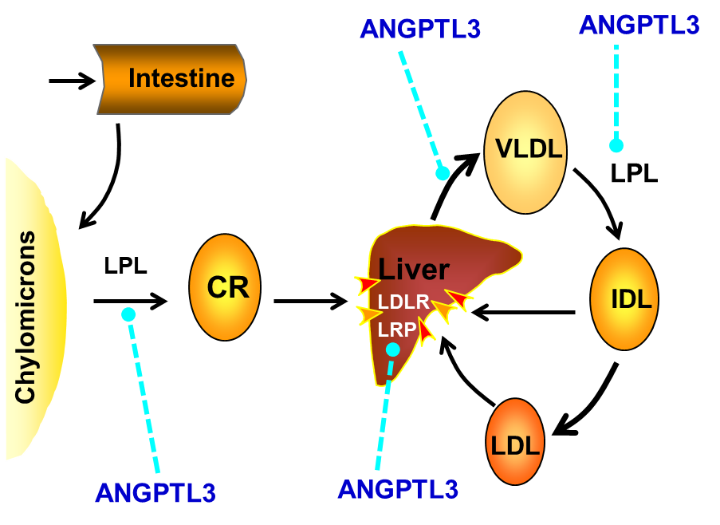
ANGPTL3 as a Target to Treat Dyslipidemia
Dyslipidemia is a major risk factor for cardiovascular disease (CVD), and residual risk of CVD persists even with current standard of care (including PCKS9 inhibitors)
ANGPTL3 is a key regulator of lipid and lipoprotein metabolism with multiple potential nodes of action
Loss-of-function mutations in ANGPTL3 lead to low LDL-C, VLDL-C, HDL-C and triglycerides (TG)
Reduced risk of CVD based on GWAS
No known adverse phenotype associated with genetic deficiency in ANGPTL3
Potential Regulatory Nodes of Action of ANGPTL3
ScientificSessions.org
#AHA19

Slide 3
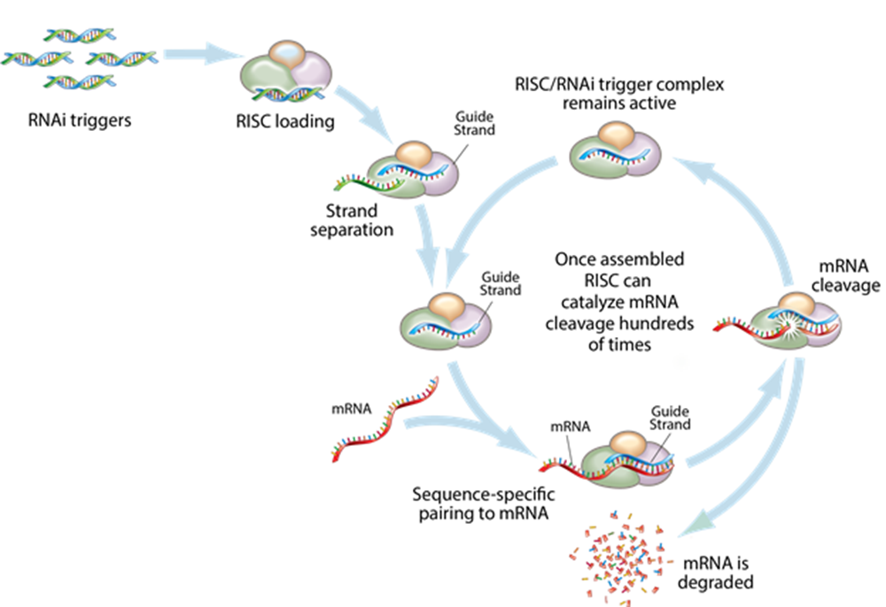
Silencing ANGPTL3 with ARO-ANG3 by RNA interference
ANGPTL3 is primarily synthesized in hepatocytes
Ideal target for gene silencing therapy with a specific siRNA derived from Arrowhead’s TRiM™ platform
ARO-ANG3 is a SC administered siRNA targeted at the liver, where it specifically inhibits and degrades the mRNA for ANGPTL3
This induces deep and durable silencing of the ANGPTL3 gene while avoiding off-target effects
ARO-ANG3
Stabilization Chemistries
Linker
Chemistries
ASGPr targeting ligand
ANGPTL3
mRNA
↓ ANGPTL3 mRNA,
↓ ANGPTL3 protein
ANGPTL3
mRNA
Degraded
ScientificSessions.org
#AHA19

Slide 4
AROANG1001 Study Design: Phase 1/2a Clinical Study
Primary Objective: Safety and Tolerability
Secondary/Exploratory Objectives: PK/PD
Single & Multiple Dose PK of ARO-ANG3 in healthy volunteers.
Reduction in fasting serum ANGPTL3 from baseline
Changes in fasting serum lipids and lipoprotein levels and other metabolic indices
Cohort Descriptions:
Single Dose:
Cohorts 1-4 : Normal Healthy Volunteers (NHV) with TG >100 mg/dL and LDL-C >70 mg/dL (6 active, 4 placebo (PBO) per cohort)
Multiple Dose (2 monthly doses):
Cohort 2b-4b: NHV, open label, 4 subjects per cohort
Cohort 5: NAFLD, (6 active: 3 PBO)
Cohort 6: LDL-C >70 mg/dL on stable statin regimen, (6 active: 3 PBO)
Cohort 7, 7b, 7c: HoFH or HeFH, genetically confirmed or Dutch Lipid score of ≥ 8 with LDL-C > 100 mg/dL, (Open label, up to 6 subjects per cohort)
Cohort 8: Severe hypertriglyceridemia, TG ≥ 500 mg/dL (Open label, up to 6 subjects)
ScientificSessions.org
#AHA19

Slide 5
Cohorts 1-4: Baseline Characteristics
Mean (range) Fasting values | Cohort 1 (35 mg) n = 10 (6 active: 4 PBO) | Cohort 2 (100 mg) n = 10 (6 active: 4 PBO) | Cohort 3 (200 mg) n = 10 (6 active: 4 PBO) | Cohort 4 (300 mg) n = 10 (6 active: 4 PBO)
Age (years) | 36.1 (19-58) | 47.4 (24-61) | 42.2 (32-56) | 47.4 (26-64)
% Male | 50% | 70% | 80% | 90%
BMI (kg/m²) | 28.1 (22.5 – 33.0) | 27.8 (22.6 – 36.6) | 31.4 (26.6 – 35.8) | 26.7 (23.0 – 32.2)
ANGPTL3 (ng/mL) | 76.2 (61-104.1) | 75.5 (54.6-130.2) | 83.6 (45.5-120.9) | 73.1 (47.1-96.7)
Triglycerides (mg/dL) | 172 (62-779) | 140 (80-310) | 202 (115-354) | 169 (97-390)
VLDL-C (mg/dL) | 20 (12-43)* | 28 (15-62) | 40 (23-70) | 34 (19-77)
LDL-C (mg/dL) (direct assay) | 148 (54-220) | 168 (101-263) | 151 (85-205) | 143 (112-217)
HDL-C (mg/dL) | 48 (23-58) | 49 (35-66) | 43 (27-54) | 42 (31-66)
* TG too high to calculate VLDL-C in a single subject, not included in mean
ScientificSessions.org
#AHA19

Slide 6
Durable, Dose-Dependent Reduction in ANGPTL3
Data Cutoff: 05 Nov 2019
ARO-ANG3 or Placebo given on Day 1
Mean ± SEM
Mean maximum reduction from baseline in ANGPTL3 (ELISA) ranged from 55% (50 ng/mL) [35 mg] (p<0.0001) to 83% ( 63 ng/mL) [300 mg] (p<0.0001)
Reductions in ANGPTL3 were maintained through end of study, with week 16 mean reductions of 43% (42 ng/mL) [35 mg] to 75% (57 ng/mL) [300 mg]
ScientificSessions.org
#AHA19

Slide 7
Dose-Dependent Reductions in Triglycerides and VLDL-C
Data Cutoff: 05 Nov 2019
ARO-ANG3 or Placebo on Day 1
Mean maximum TG reduction from baseline of 31% (38 mg/dL)[35 mg] (p=0.06) to 66% (167 mg/dL) [200 mg] (p=0.0002)
Mean maximum VLDL-C reduction from baseline of 30% (8 mg/dL)[35 mg] (p=0.006) to 65% (33 mg/dL) [200 mg] (p <0.0001)
Reduction in TG and VLDL-C maintained through end of study in 200 mg and 300 mg cohorts, with week 16 mean reductions of 47% to 53% for TG, and 49% to 51% for VLDL-C
ScientificSessions.org
#AHA19

Slide 8
Reductions in LDL-C and HDL-C with ARO-ANG3
Data Cutoff: 05 Nov 2019
ARO-ANG3 or Placebo given on Day 1
Mean maximum LDL-C reduced by 9% (16 mg/dL) [200 mg] (p=0.40) to 30% (48 mg/dL) [300 mg] (p=0.0004 )
LDL-C mean reductions at week 16 of up to 28% (46 mg/dL) [100 mg] after single dose
Mean maximum HDL-C reduced by 8% (4 mg/dL) [35 mg] (p=0.02) to 26% ( 12 mg/dL) [300 mg] (p<0.0001)
HDL-C mean reductions at week 16 of up to 16% (7 mg/dL) [200 mg]
ScientificSessions.org
#AHA19

Slide 9
Reductions in LDL-C with ARO-ANG3 (Single/Multiple Dose)
Data Cutoff: 05 Nov 2019
Mean maximum reduction in LDL-C with 200 mg single dose blunted by two subjects in this cohort with increasing LDL-C post-dose
These two subjects had highest baseline triglycerides in cohort (336 and 354 mg/dL (3.8 and 4.0 mmol/L))
Multi-dose data with 200 mg demonstrates similar reductions to 100 mg and 300 mg at 6 weeks (33-46% reduction from baseline, p<0.0001 for all dose levels)
ScientificSessions.org
#AHA19

Slide 10
AROANG1001 Summary Safety Results (NHV cohorts 1-4)
Safety Data Cutoff: 18 Oct 2019
40 subjects enrolled received single ascending doses (24 active, 16 placebo)
No Serious AEs or drop outs in subjects on drug
No significant abnormalities in platelet counts or renal biochemistry
Two AEs of mild transient elevations in ALT (one active, one placebo). No other AEs from lab abnormalities in subjects on drug
ALT elevation in one subject on ARO-ANG3 confounded by concomitant ingestion of herbal supplement with known liver toxicity (Peak ALT 192 U/L Day 99, normal by Day 113).
1 mild drug related Local Injection Site Reaction
LISR defined based on MedDRA; erythema resolved after 48 hours.
ScientificSessions.org
#AHA19

Slide 11
Conclusions
Loss-of-function mutations in ANGPTL3 are associated with improved CV outcomes with no adverse clinical phenotype.
The lipid phenotype includes reductions in triglycerides, VLDL-C, LDL-C and HDL-C.
In normal volunteers, this single ascending dose study of ARO-ANG3, a RNAi therapeutic that specifically silences ANGPTL3 mRNA in the liver, has shown:
Dose-dependent reductions in fasting serum ANGPTL3.
Reductions in fasting TG, VLDL-C, LDL-C and HDL-C, similar to those reported in ANGPTL3 loss-of-function carriers.
A favorable safety and tolerability profile.
Multi-dose studies in patients with NAFLD, hyperlipidemia on statins , familial hypercholesterolemia, and severe hypertriglyceridemia are underway.
ANGPTL3 inhibition is a new mechanism for potentially addressing residual risk of CVD in patients with dyslipidemias.
ScientificSessions.org
#AHA19

Slide 12
Thank you!
ScientificSessions.org
#AHA19

