Slide 1

How to transition from
TAVR to TMVR:
Challenges
Steven F. Bolling, MD
Professor of Cardiac Surgery
University of Michigan
COI :Pipeline, Edwards, Millipede, Abbott – IP / Royalty / Equity

Slide 2

Disclosures
IP/Equity
Pipeline,
Millipede
Consultant
Edwards, Abbott, Medtronic

Slide 3
TAVR to TVMR
Mitral valve is not the Aortic valve
Active closure
Determines LV function

Slide 4
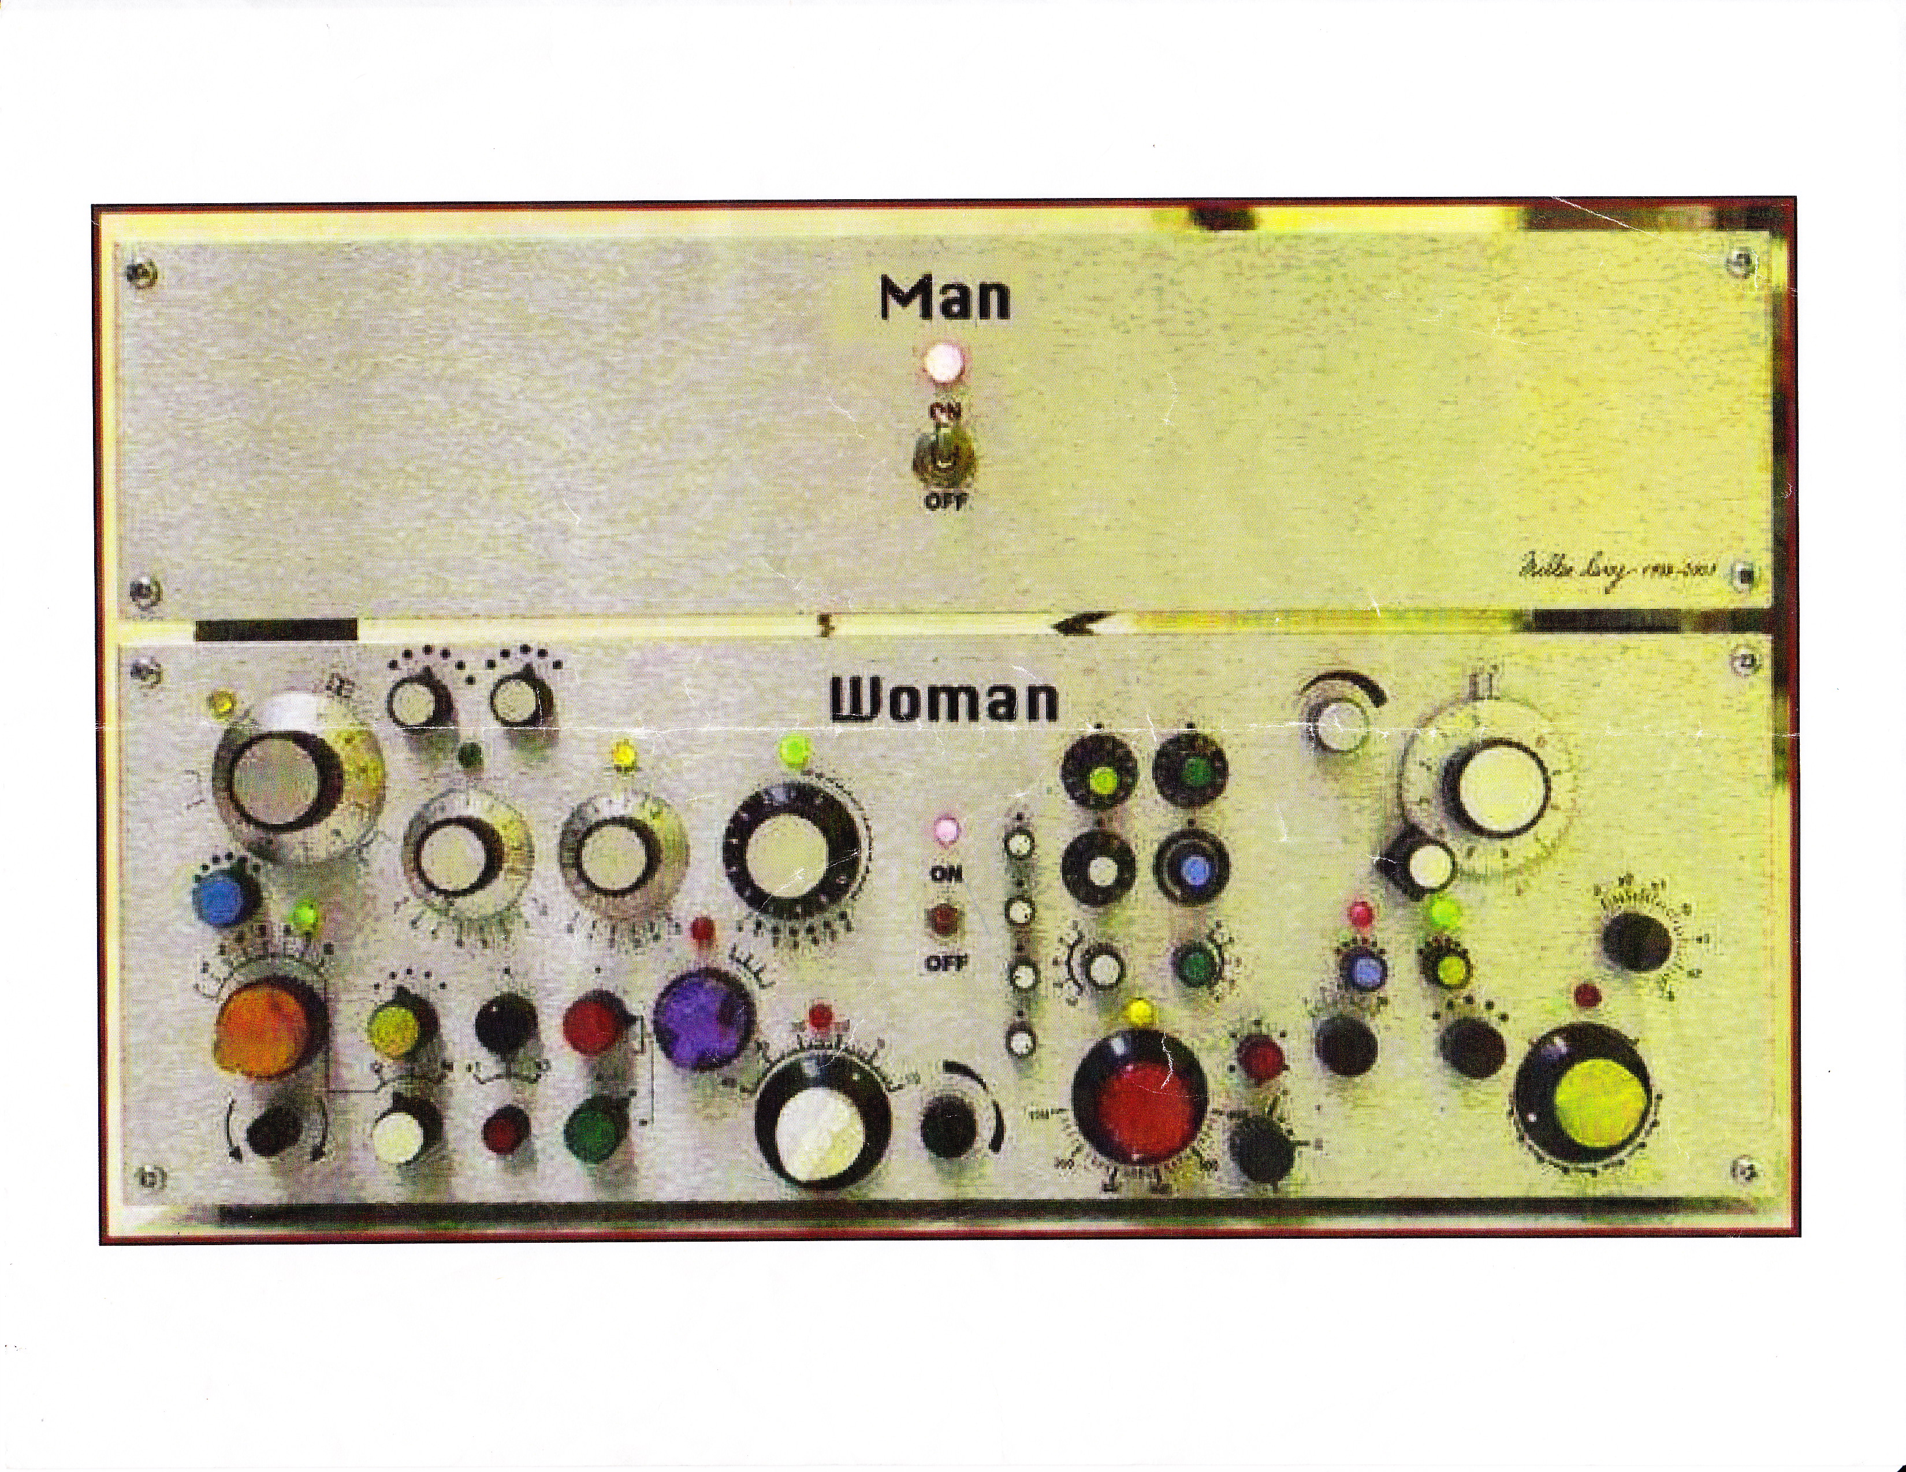
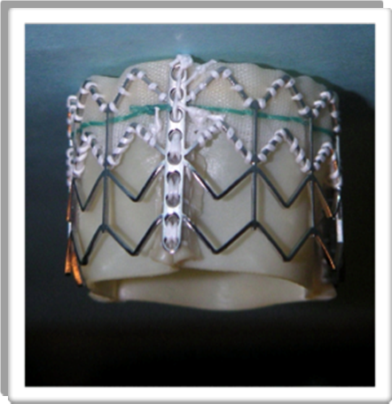
Aortic Valve
Mitral Valve
Mitral valve is complex

Slide 5
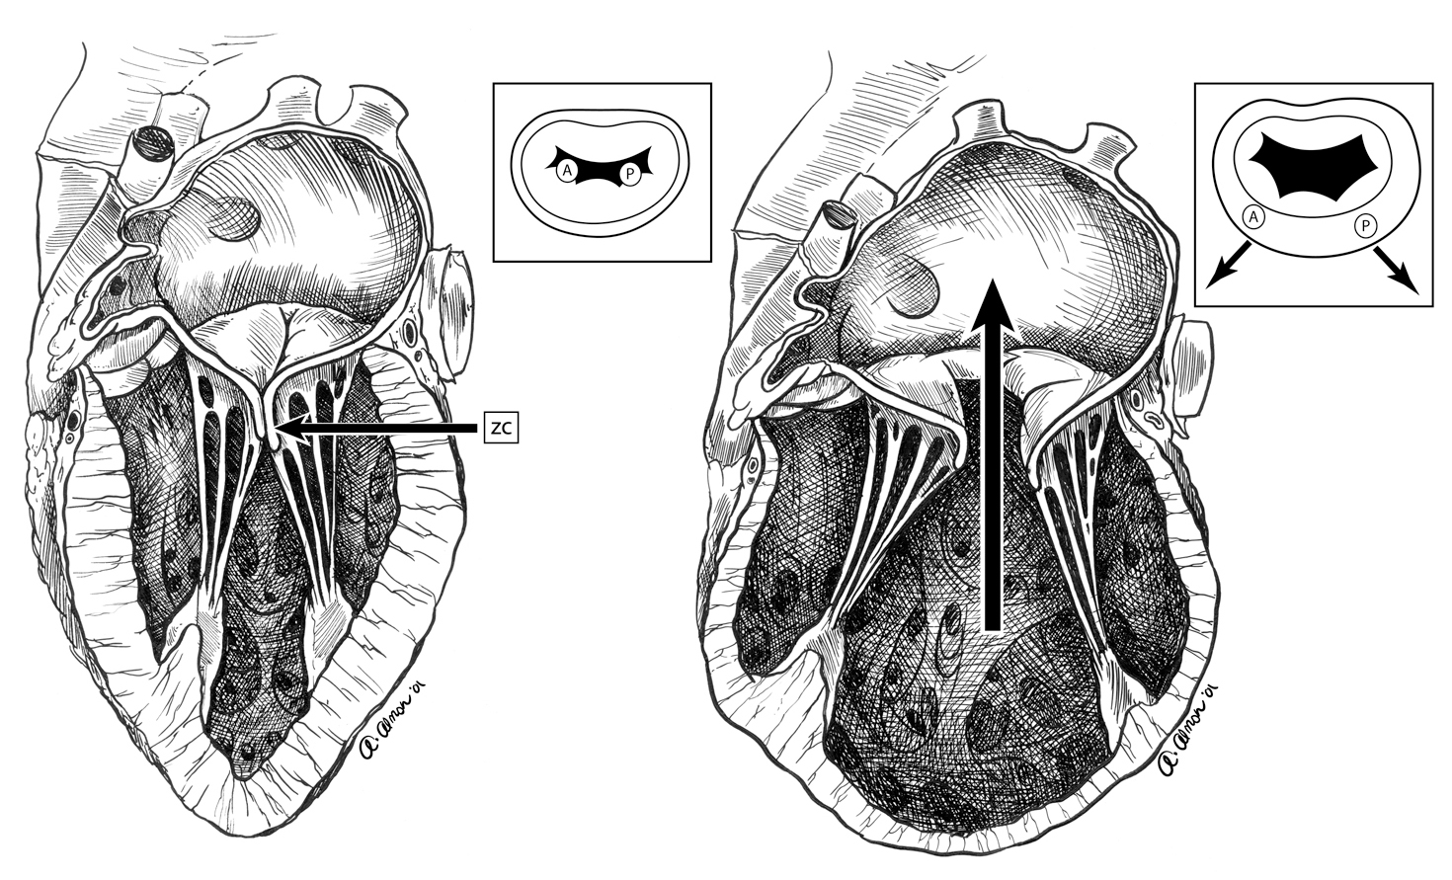
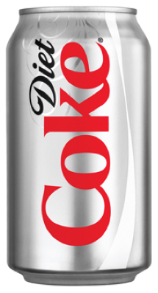
LV power and MV :Ventricular Geometry
Badhwar, Bolling , chapter in: Advances in Heart Failure, 2004

Slide 6
TAVR to TVMR
“Upside down” TAVR won’t work !

Slide 7
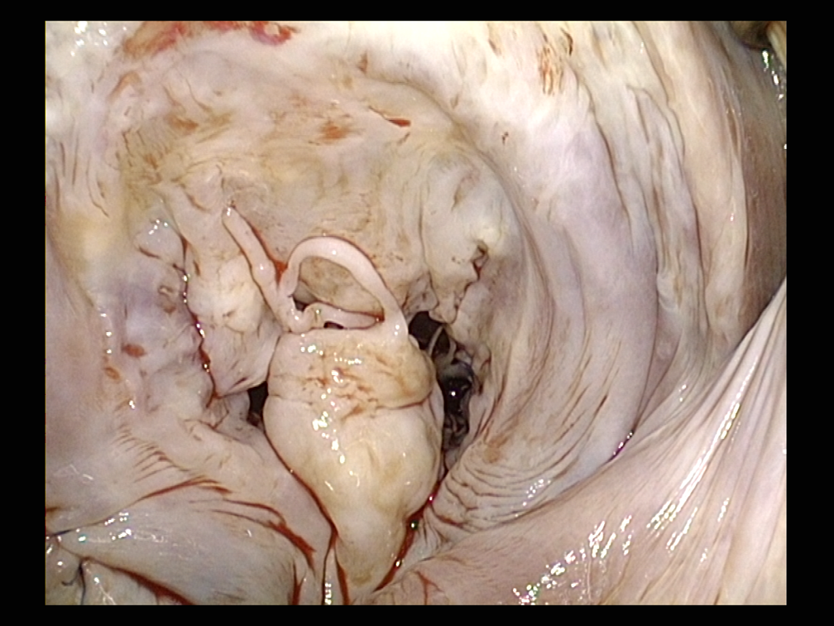
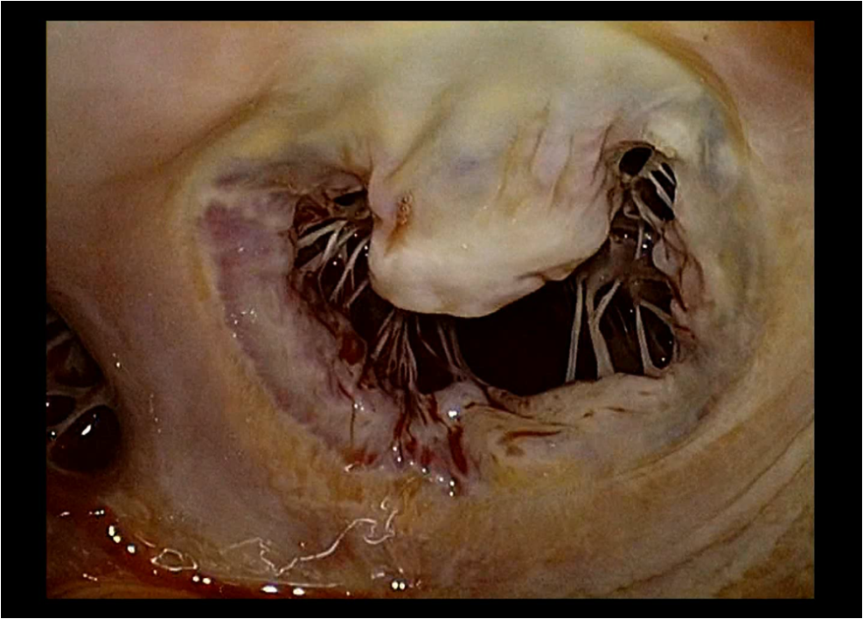
Degenerative MR is not Functional MR
That’s a Challenge !

Slide 8
TAVR to TMVR
Mitral valve is not the Aortic valve
DMR is not FMR
Extremely high “bar” in degenerative mitral disease

Slide 9
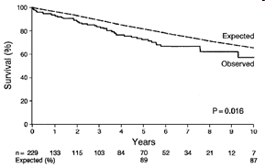
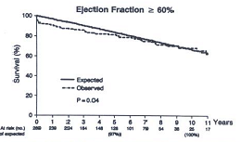
Repair DMR!
68%
Survival (%)
General Population
52%
Repair
Replacement
p = 0.0004
Enriquez Sarano et al. Circulation 1995;91:1022
Cure MR!
Time (Years)

Slide 10
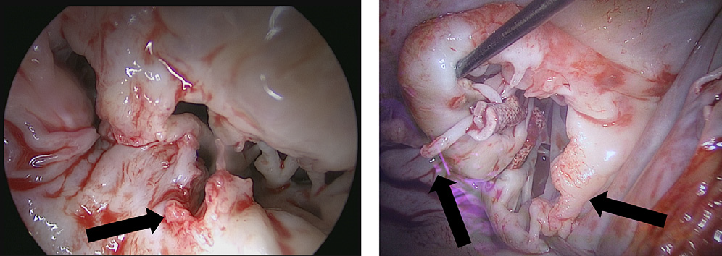
Percutaneous TMVR complications
“Bridges burned” for DMR !

Slide 11
TAVR to TMVR
Mitral valve is not the Aortic valve
DMR is not FMR
FMR is CHF
Not AS “mortality trial”
FMR patients do “poorly slowly”
Small FMR is bad !

Slide 12

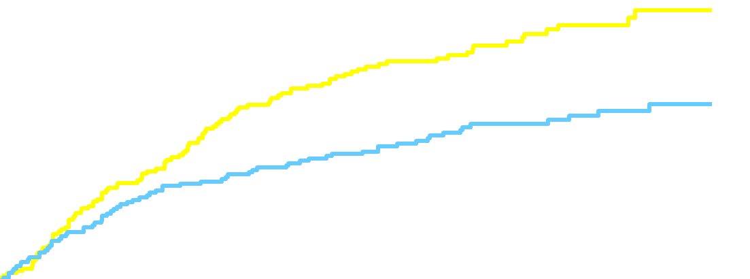
TAVR for AS :
They politely die on schedule!
Standard Rx
  HR [95% CI] =
  0.54 [0.38, 0.78]
  P (log rank) < 0.0001
TAVI
All-cause mortality (%)
Months
Numbers at Risk
TAVI | 179 | 138 | 122 | 67 | 26
Standard Rx | 179 | 121 | 83 | 41 | 12
Notes:
12

Slide 13
FMR / CHF patients do poorly slowly !
survival
MR grade No.
None 9,405
Mild 2,062
Moderate 210
Severe 171
Years
Hickey et al: Circulation 78:1-51, 1988

Slide 14
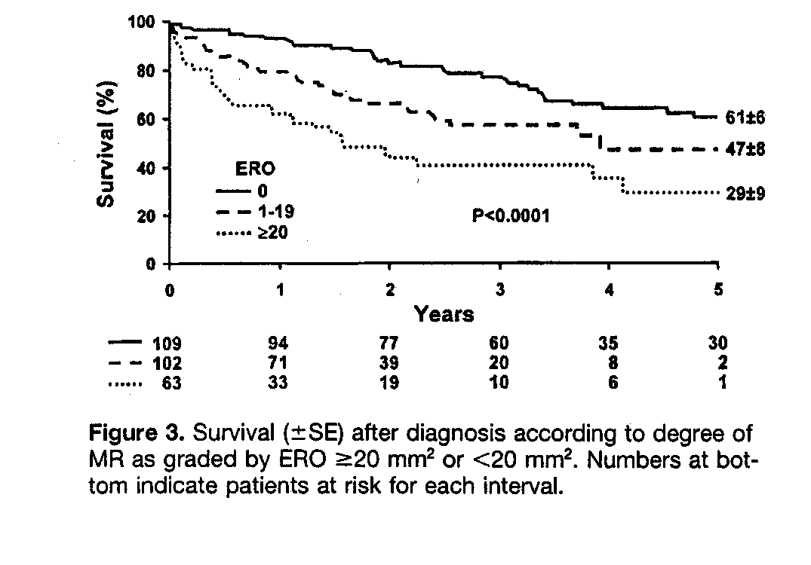
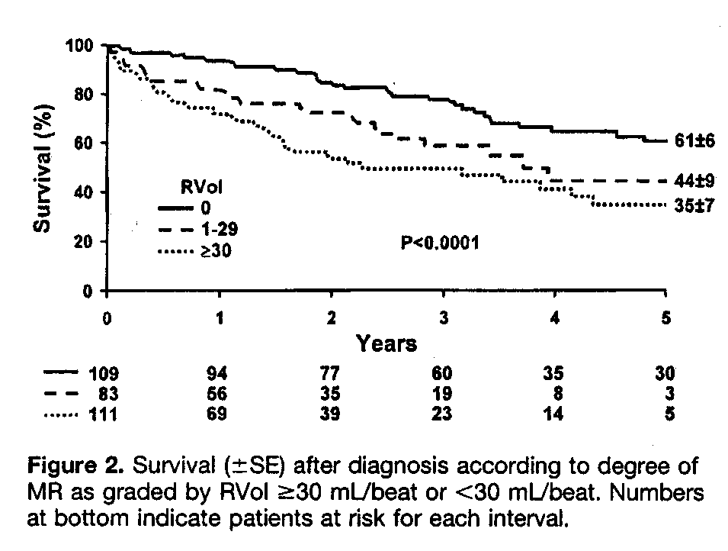
Challenge… but even leaving
small FMR is problematic!
ERO
RVol
Grigioni et al: Circulation 103:1759, 2001

Slide 15
TAVR to TMVR
Mitral valve is not the Aortic valve
MR is CHF
DMR is not FMR
Mitral repair is complex
- one “size” or technique does NOT fit all

Slide 16
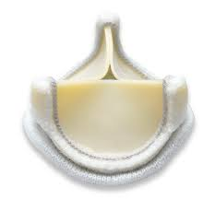
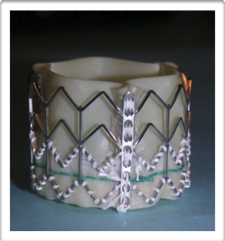
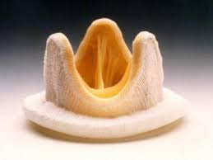
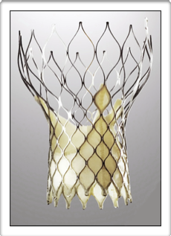
AS : TAVR easier and works the same
Even looks the same

Slide 17
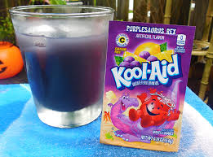
Mitral Valve Repair is complex
Ring Annuloplasty alone
with Leaflet excision
Leaflet plication
Leaflet patch
Artificial chordae
Cleft closure
Sliding plasty
Some other stuff
More other stuff…

Slide 18
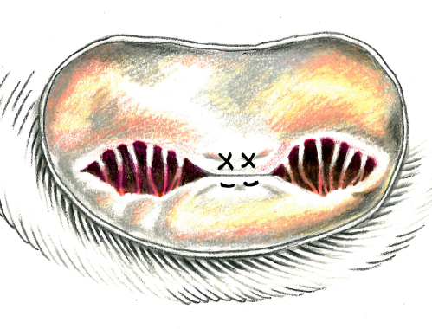
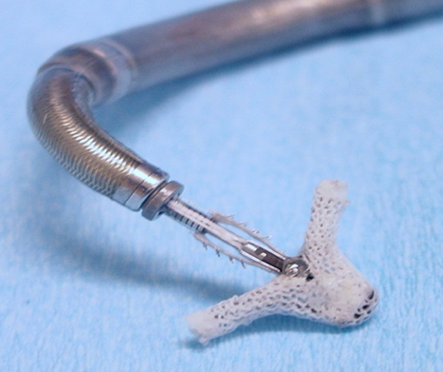
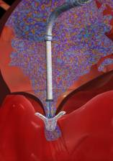
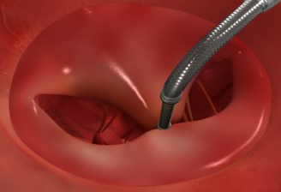
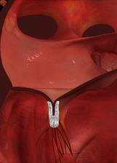
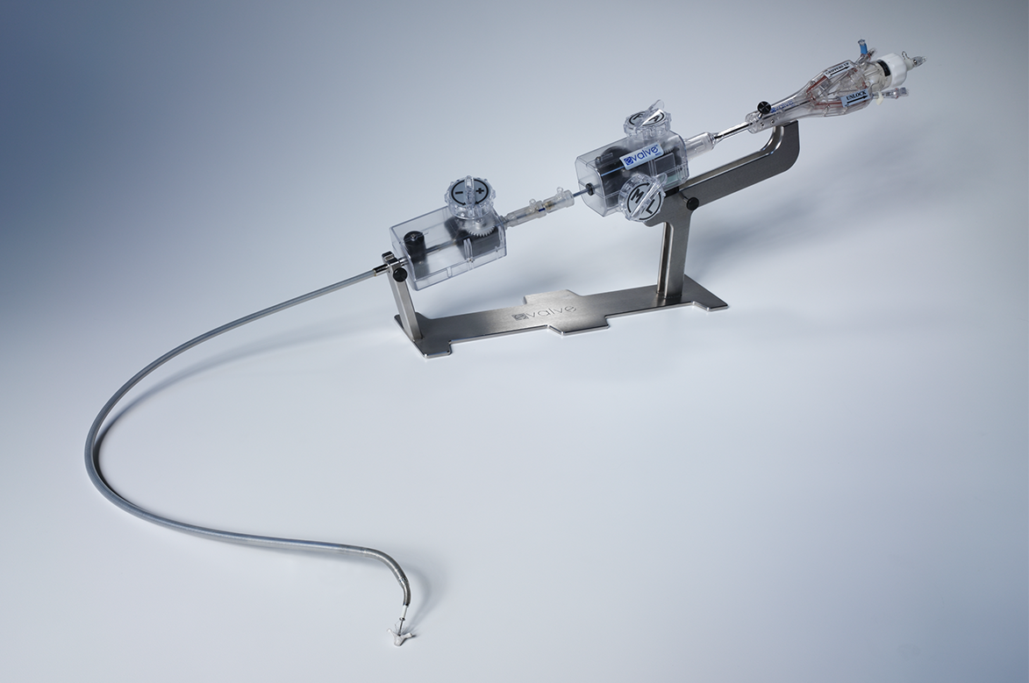
Catheter-Based Mitral Valve Repair
MitraClip
Challenge !

Slide 19
MR Reduction to 1+
Surgery better than CLIP, but…
p<0.0001
2+
1+-2+
1+
2+
0+
36.1%
75.6 %
3+
1+-2+
3+
1+
2+
1+-2+
4+
3+
4+
2+
4+
3+
(n=124)
(n=124)
(n=67)
(n=67)
Device
Surgery
p-value compares the distribution of MR grade in device with the distribution of MR grade in control at 12 months (Fishers’ Exact test)
Notes:
P-value: Fishers’ Exact used

Slide 20
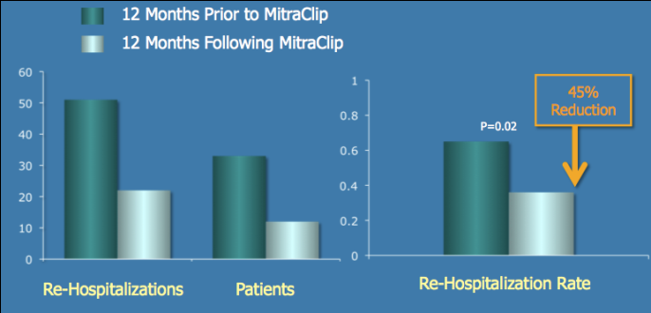
MitralClip and CHF / FMR n=78 1 year outcomes
Decreased CHF rehosp by 45%: COAPT/ReShape

Slide 21
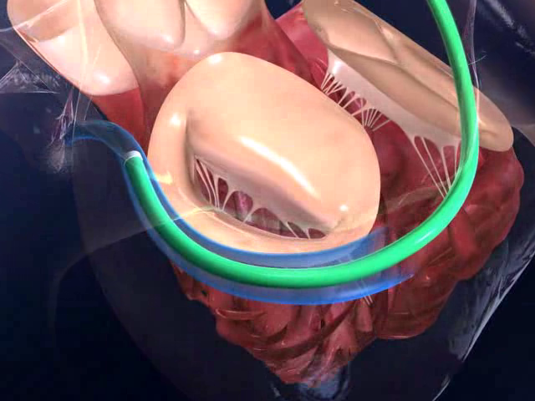
“Non - surgical”
Coronary Sinus Annuloplasty

Slide 22
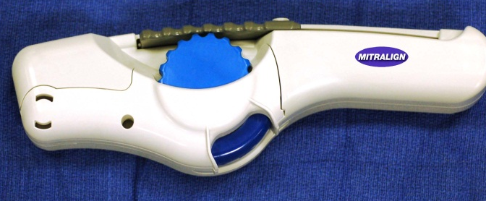
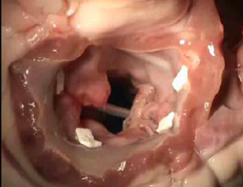
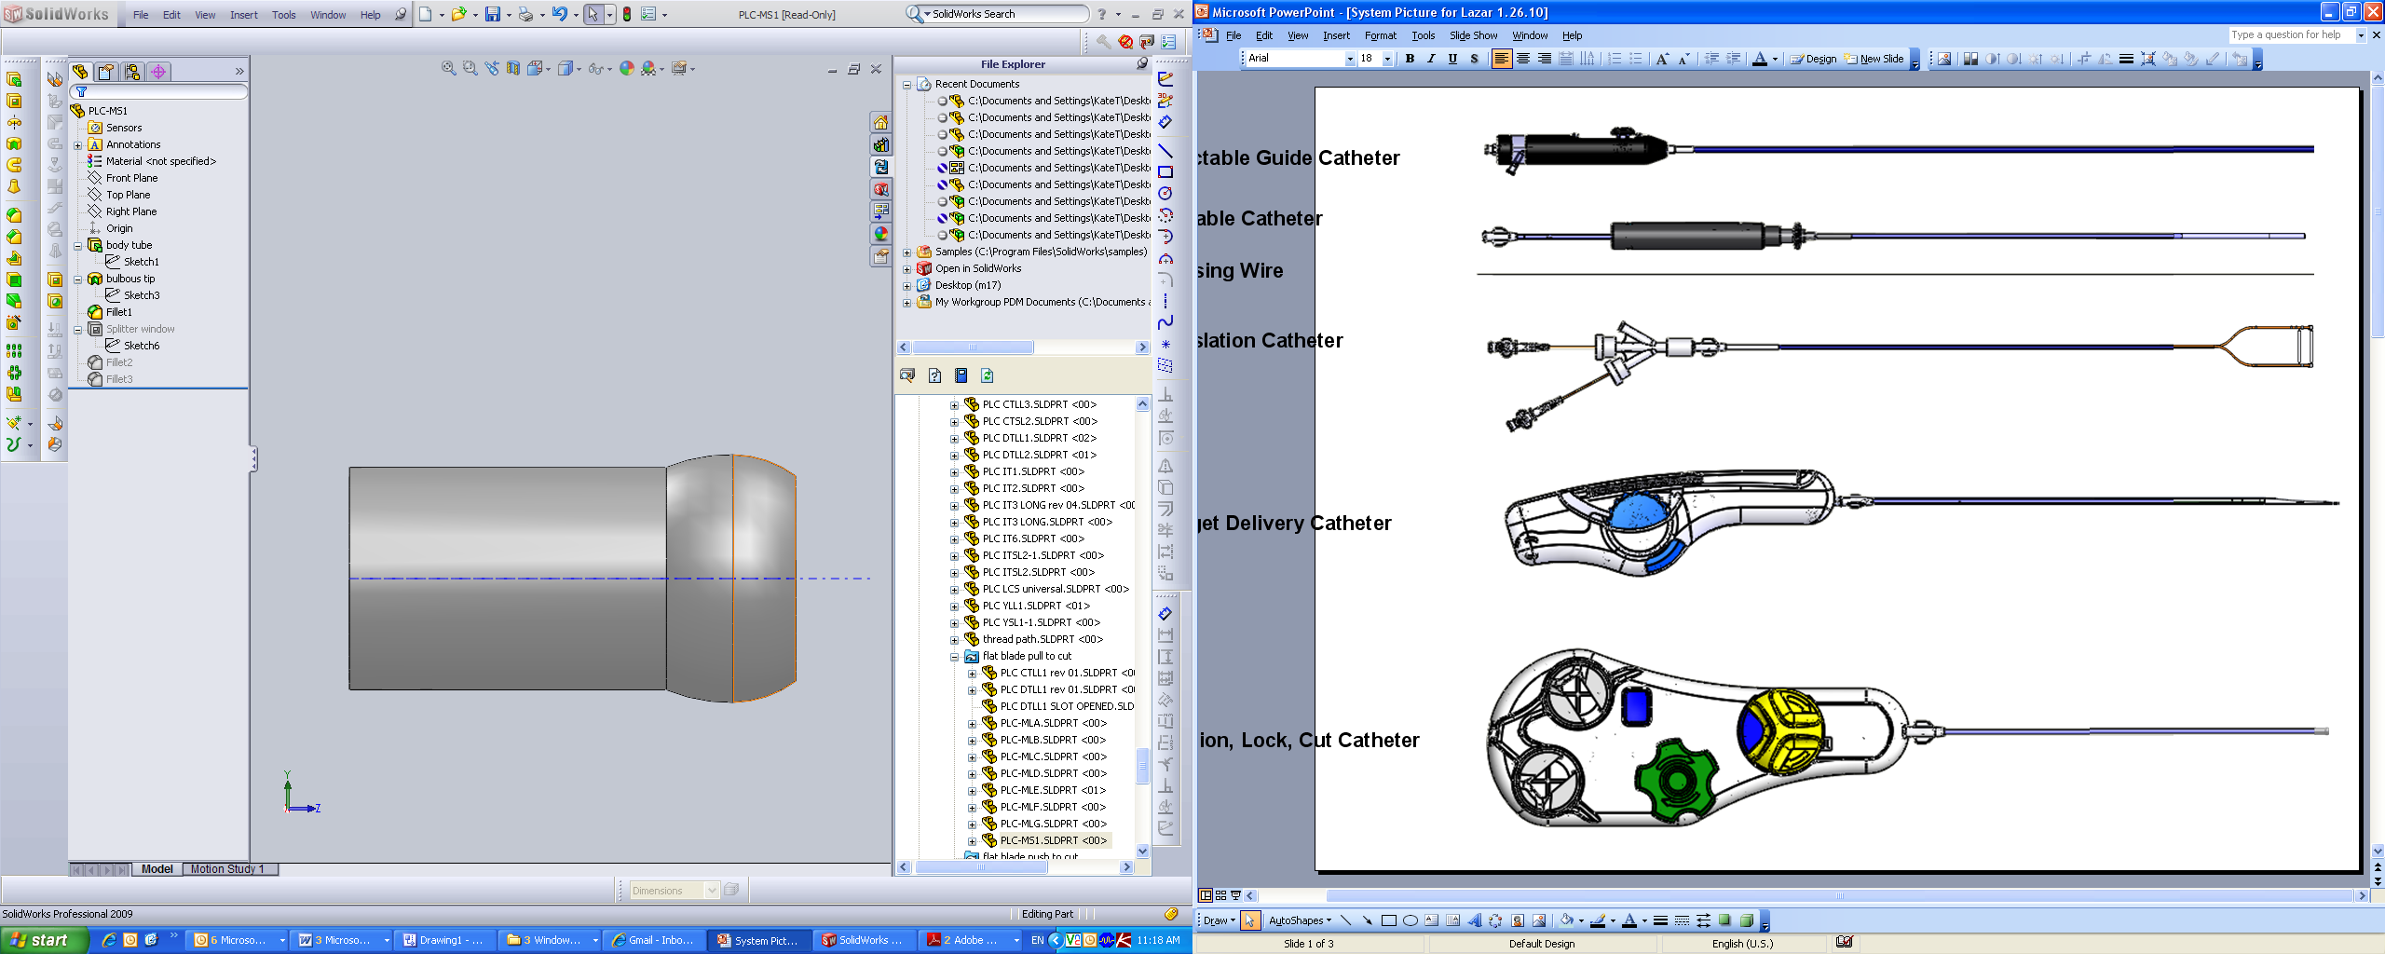
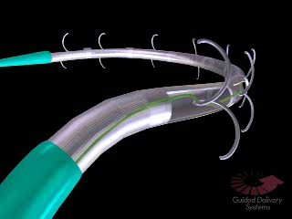
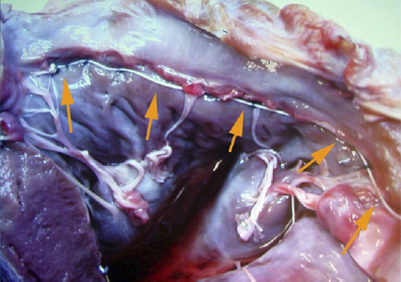
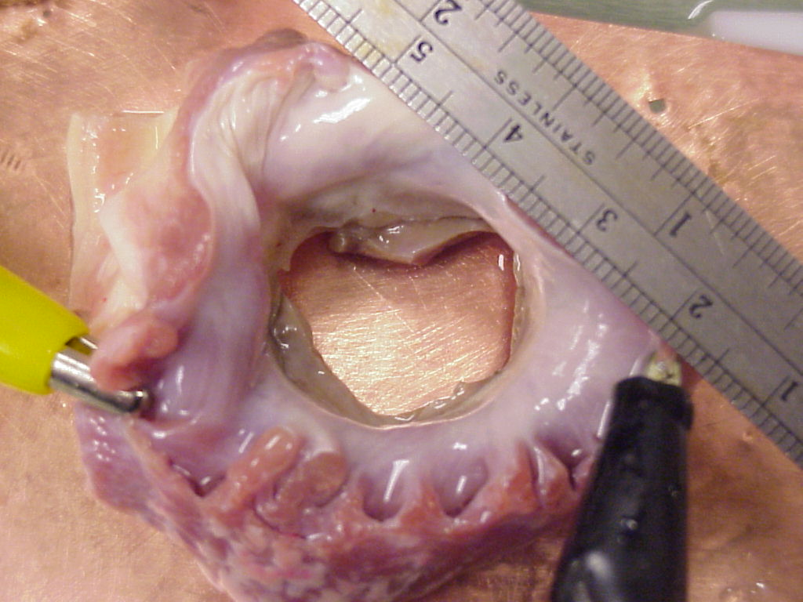
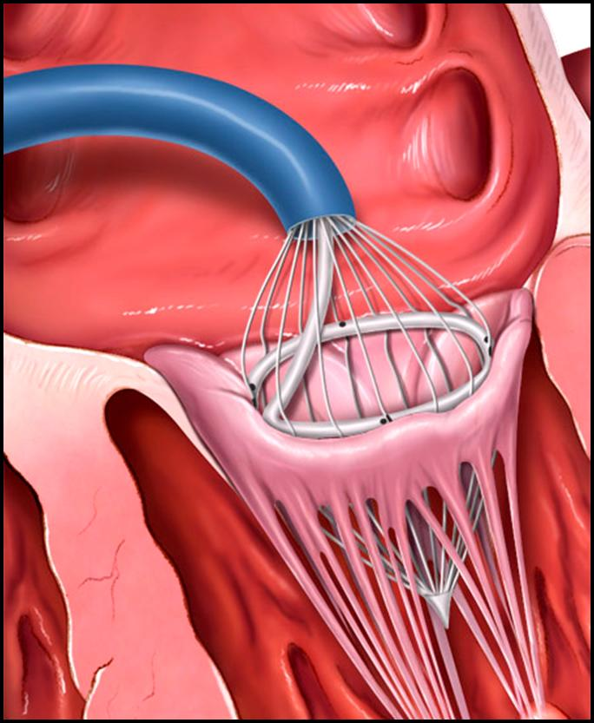
Bident
Accucinch
Boa RF
INDIRECT ANNULAR OR LV REMODELING DEVICES

Slide 23
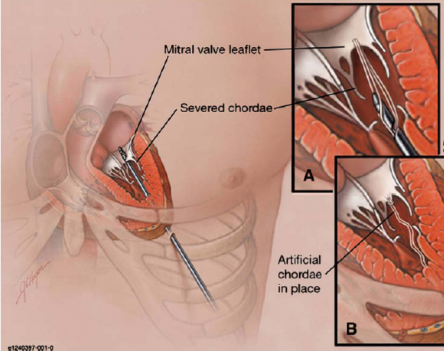
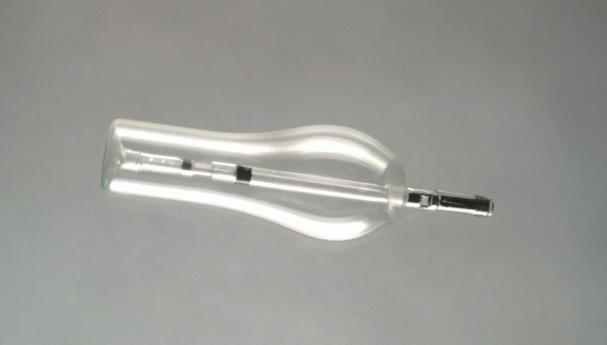
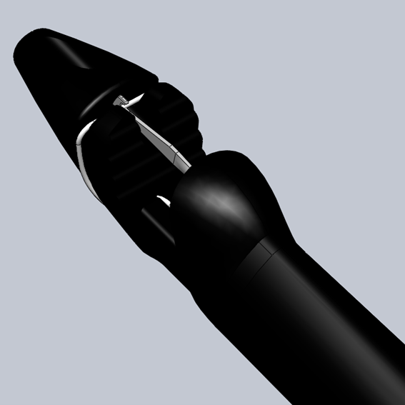
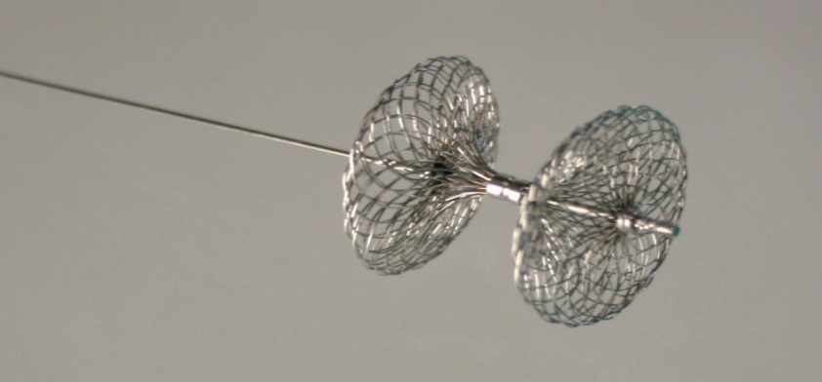
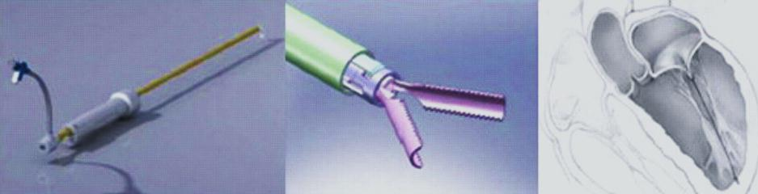
Mitra-Spacer
Neochord
Mitra-Flex

Slide 24
TAVR to TMVR Gold Standard
Aortic - Replace
Mitral - Ring,
Leaflet Thing,
…Replace

Slide 25
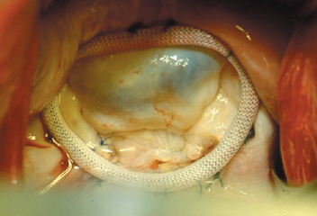
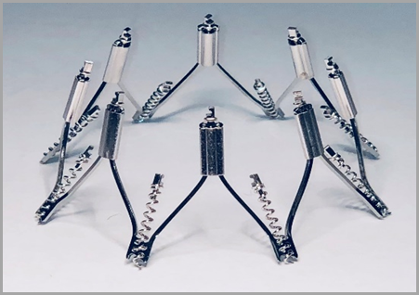
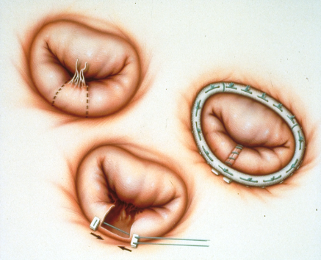
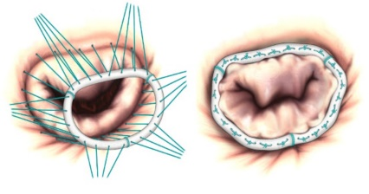
Surgical Gold Standard:
Mitral Ring Annuloplasty
Primary MR
Repair
Secondary MR
Annuloplasty
Reduces annular circumference
…and septal-lateral diameter

Slide 26
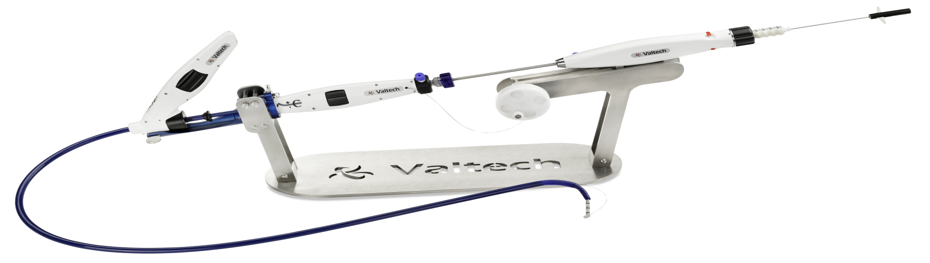
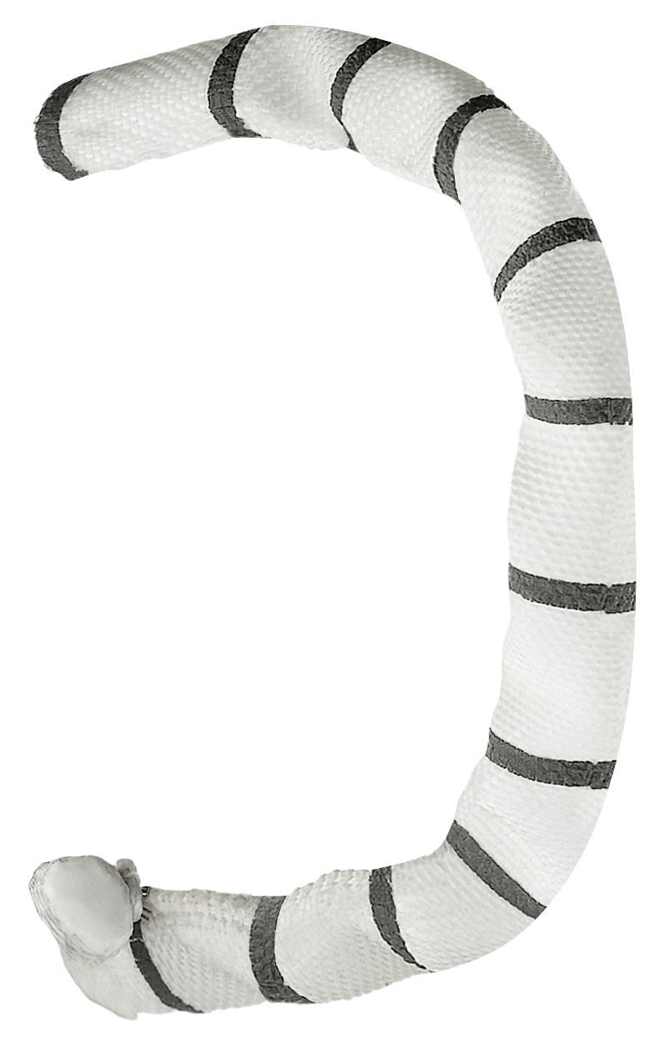
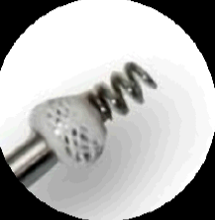
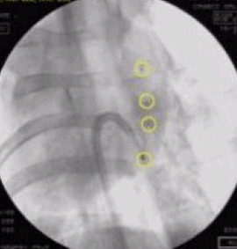
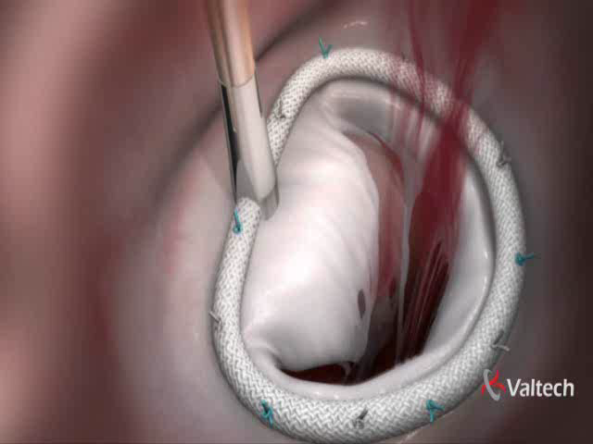
Cardioband Mitral Annuloplasty Ring

Slide 27
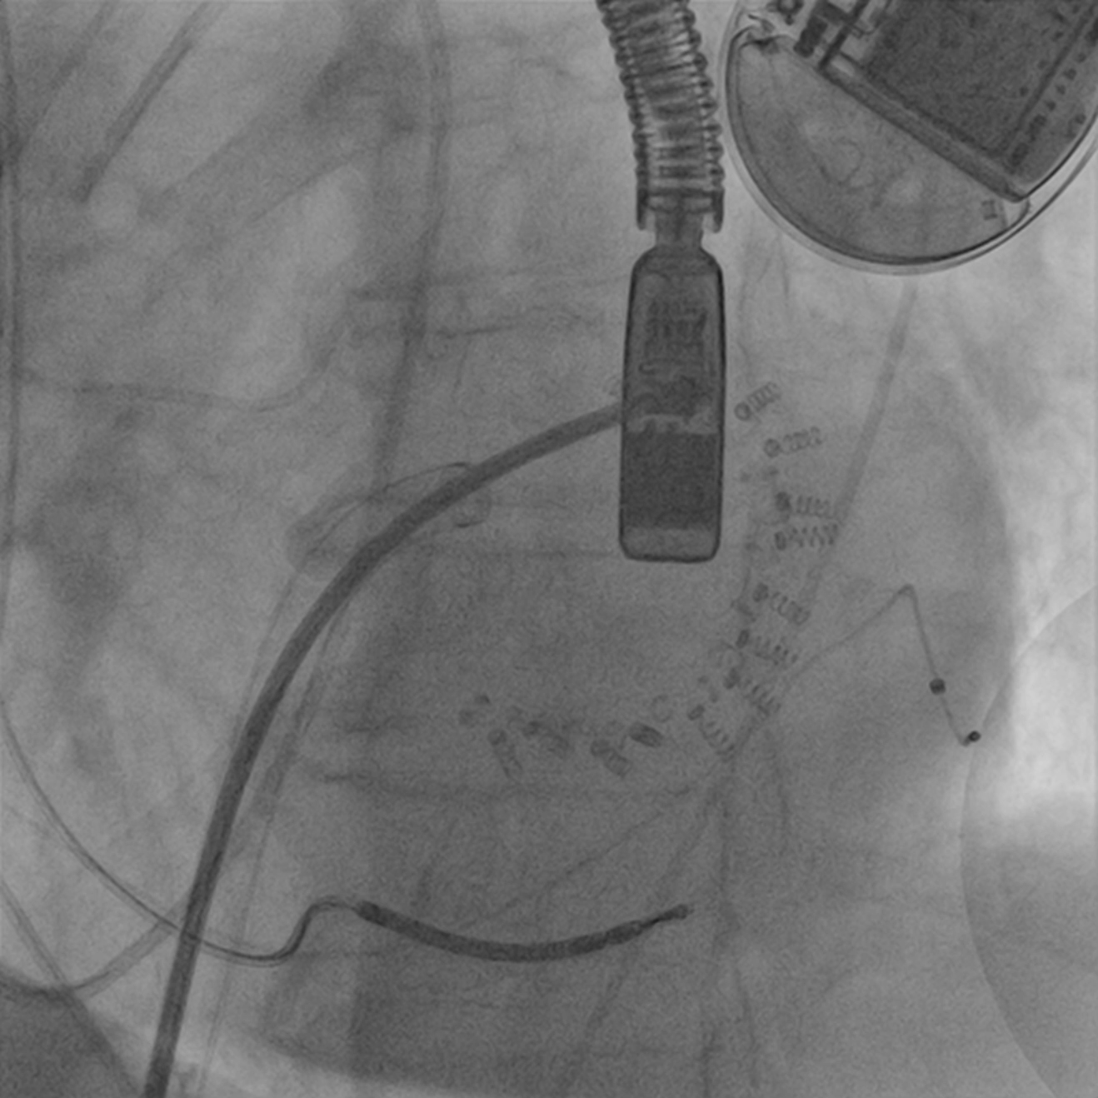
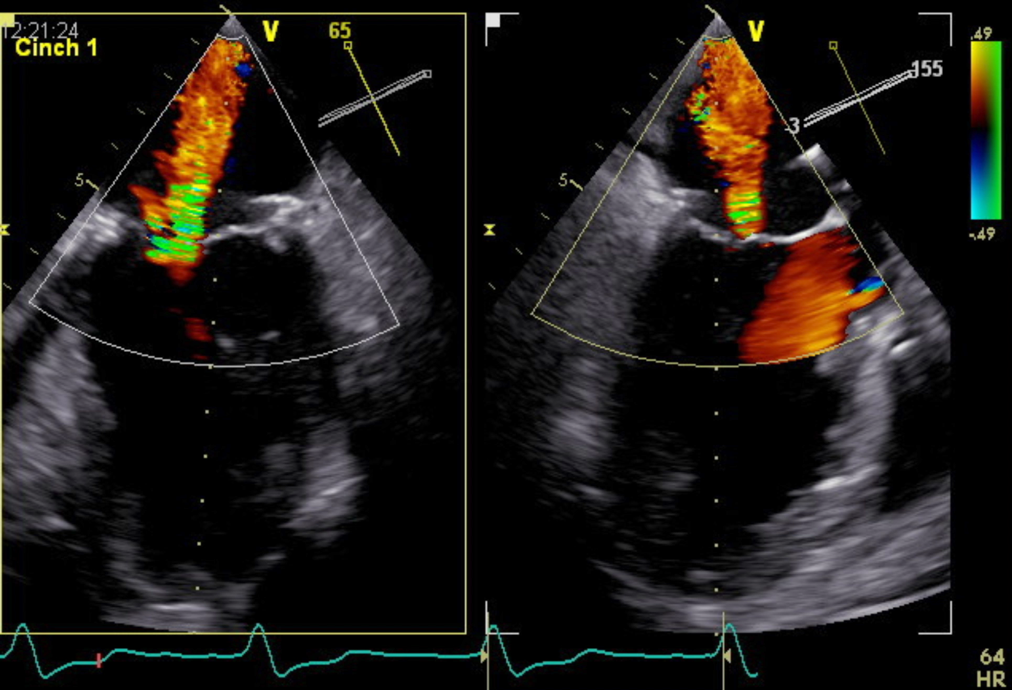
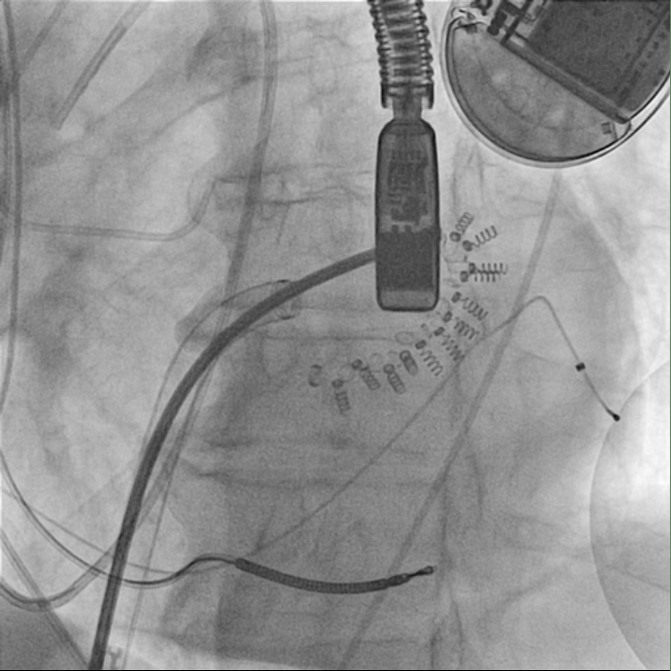
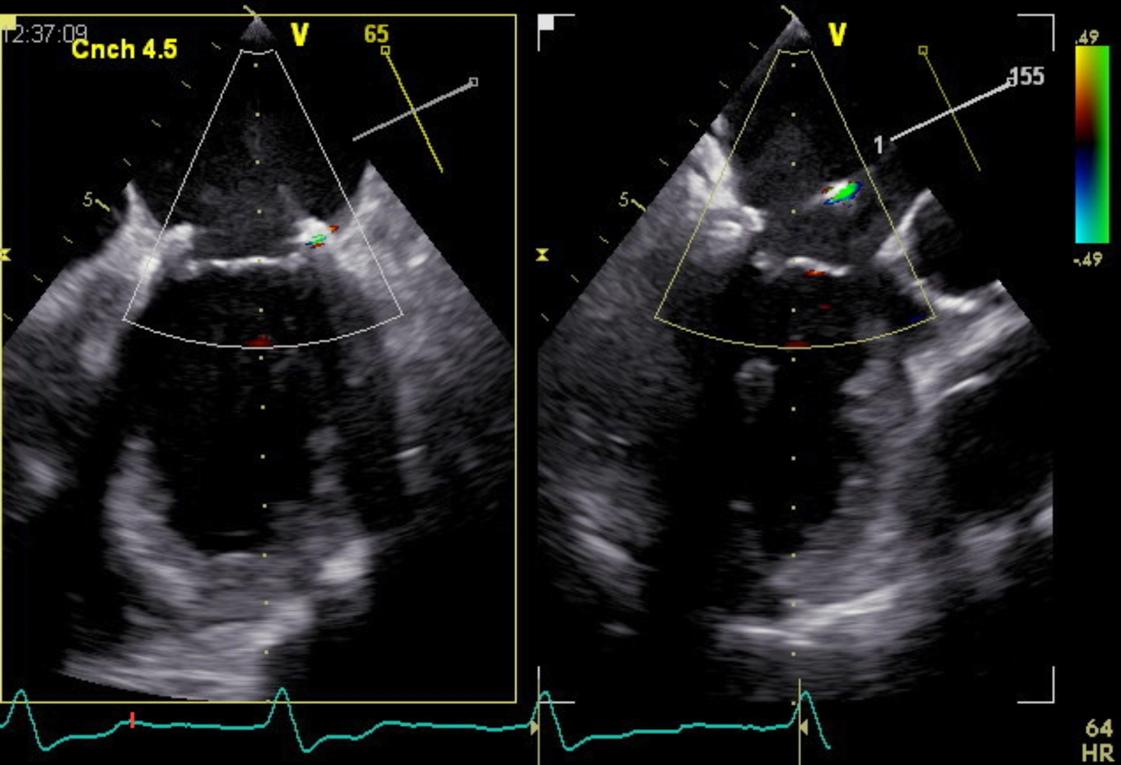
Reduction of MR
Baseline
Final size Post Adjustment

Slide 28

MR Grade at Endpoints
93% MR ≤ 2+
at Discharge
89% MR ≤ 2+
at 1 Month
88% MR ≤ 2+
at 6 Month
2+
0-1+
0-1+
0-1+
3-4+
2+
2+
2+
3-4+
3-4+
3-4+
N=30
N=28
N=27
N=16

Slide 29
Reduction in Septo Lateral Dimension (N=30)
*P<0.01
36± 4
(28-50)
20% average reduction in A-P
29 ±6
(17-43)

Slide 30
TAVR to TMVR
Mitral valve is not the Aortic valve
MR is CHF
DMR is not FMR
Mitral repair is complex
MV visualization is hard
Can’t be seen on flouro!
It’s all echo

Slide 31
Mitral Annuloplasty
Surgical Visualization

Slide 32





MitraClip Procedure
Driven by Echo
Echocardiography
(Primary Imaging)
Fluoroscopy
(Secondary Imaging)

Slide 33

Mitral Annulus – not calcified !
Percutaneous Visualization
GPS, robotic, laser, CT, MRI, 4D/ICE echo
…but not fluoro !

Slide 34
TAVR to TMVR
Mitral valve is not the Aortic valve
MR is CHF
DMR is not FMR
Mitral repair is complex
MV visualization is hard
FTR is important
FTR doesn’t fix itself !

Slide 35
FTR is important !
Decreased CO
  Fatigue, decreased exercise tolerance
“Right-sided” Heart Failure
  Ascites, edema, decreased appetite, fullness
FTR patients feel terrible
Valve repair for functional tricuspid valve regurgitation:
anatomical and surgical considerations
Rogers JH, Bolling SF Semin Thorac Cardiovasc Surg. 2010 ;22(1):84-9

Slide 36

…and FTR patients die !
FTR increases Mortality
Severe and MOD TR increase mortality independent of PASP, LVEF, IVC size, RV size/ function.
Nath. JACC 2004;43:405.
Notes:
TR is a marker of advanced stage heart disease
Without treatment, TR may become worse over time leading to severe symptoms, biventricular heart failure and death.(15) It has been shown in a large retrospective echocardiographic analysis of 5223 Veterans Administration patients by Nath et al., that independent of echo-derived pulmonary artery systolic pressure, left ventricular ejection fraction, inferior vena cava size, and right ventricular size and function, survival is worse for patients with moderate and severe TR than for those with no TR (TR graded using Framingham Heart Study criteria).(16) In this series, the prevalence of TR was: no TR, 11.5%; mild TR, 68.8%; moderate TR, 11.8%; and severe TR, 3.8%. A major limitation of this study is that the presence of mitral regurgitation was not included as a covariate in the survival analysis.

Slide 37
TAVR to TMVR
Mitral valve is not the Aortic valve
MR is CHF
DMR is not FMR
Mitral repair is complex
MV visualization is hard
FTR is important
MV replacement is difficult
- probably not as good ?

Slide 38




Perc MV replacement
BIG ! : LVOTO, LV distortion, apical

Slide 39
Percutaneous TMVR
CardiAQ, Tendyne, Caisson, Highlife, Fortis, Tiara, Twelve
250ish patients

Slide 40




2018 Percutaneou$ Mitral Land$cape
Leaflet Repair
Leaflet
Clip
Evalve/Abbott MitraClip
Neochord
Cardiosolutions
inDirect Annular Shape Change
Annular
Reshaping
Mitralign
Guided Delivery Systems
Quantum Cor
Cardioband
Millipede
Coronary Sinus Annuloplasty
Coronary Sinus
Reshaping
Carillon
Mitral Valve Cerclage
Mitral Valve Replacement
Endovalve
CardiAQ
Medtronic
Other
MV
Replacement

Slide 41

We will make MEXICO pay for this MITRAL STUFF !

Slide 42


TMVR

Slide 43
TAVR to TMVR
Skill set - same
Trans - septal
Calm - LA safe
Trans - venous

Slide 44
TAVR to TMVR
MR is BAD
“The biology of MR will not change
with the method of therapy”

Slide 45
TAVR to TMVR
Technology
Technique

