Slide 1

Interatrial Shunting for Treating Heart Failure: Early and Late Results of the First-in-Human Experience With the V-Wave Interatrial Shunt System
Josep Rodés-Cabau, MD
Quebec Heart & Lung Institute, Laval University
on behalf of V-Wave’s FIM/SAP Investigators
Medstar Washington Hospital Center: Cath Conference
December 5, 2018

Slide 2
Disclosures
Consultant for and institutional research grants from V-Wave Ltd.

Slide 3
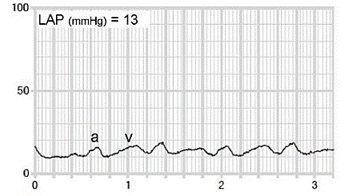
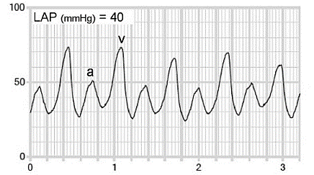
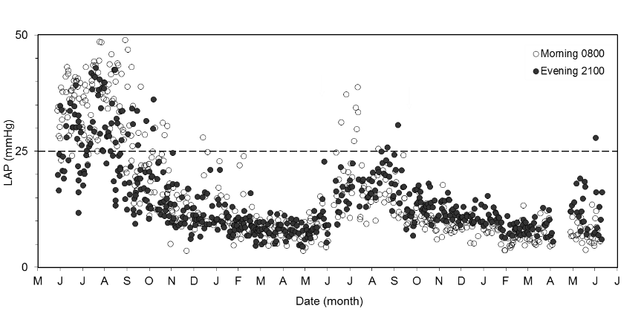
Elevated LAP: The Cause of Lung Congestion in ADHF
Precipitant
Sympathetic
activation
Renal and
dietary
Venous
redistribution
(fast)
Fluid
retention
(slow)
↑LAP
Lung Congestion
LAP often highly variable over the course of a day
Increase of LAP precedes clinical events, averaging >25 mmHg for several days before admission or death
ADHF / hospitalization
HOMEOSTASIS: Ritzema. Circulation 2010

Slide 4
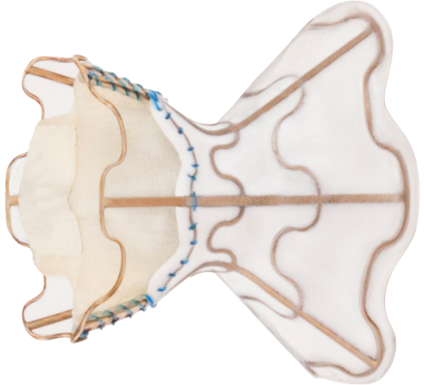
The V-Wave Shunt
Interatrial septum
Self-expanding Nitinol frame
Right Atrium
Left Atrium
Porcine pericardial leaflets
  Minimizes R to L shunting
  and risk of paradoxical embolization
ePTFE encapsulation
  Channels flow
  Impedes luminal obstruction due to tissue ingrowth
Hourglass shape
  secure and atraumatic septal retention
  minimal ID 5.1 mm

Slide 5
Objective
First-in-human prospective multicenter open-label experience to assess the feasibility, safety and exploratory efficacy of interatrial shunting with the V-Wave system in patients with chronic heart failure (reduced and preserved left ventricular ejection fraction)

Slide 6
Outcomes
Primary
  Safety: device/procedure-related major adverse cardiovascular and neurological events (MACNE), defined as death, stroke, device embolization, pericardial effusion requiring intervention, re-intervention or surgery at 3- and 12-month follow-up
  Procedural success: successful device implantation with no periprocedural death
Secondary
  Safety: all-cause MACNE, all serious adverse events (SAEs) and serious adverse device effects (SADEs)
  Exploratory efficacy: changes in NYHA Class, quality of life, and 6MWT distance at 3- and 12-month follow-up

Slide 7
Main Inclusion/Exclusion Criteria
Inclusion Criteria
Exclusion Criteria
Chronic HF of ischemic or non-ischemic etiology, HFrEF or HFpEF
NYHA Class III or ambulatory Class IV
On guideline driven maximally tolerated medical and device therapy
HF-hospitalization in the prior 12 months or elevated NT-proBNP
LVEF<15%
Isolated right-sided HF
Moderate-severe RV dysfunction
  TAPSE < 11mm
Severe pulmonary hypertension
  PASP > 70mmHg
Stroke or thromboembolism past 6 months
eGFR < 25mL·min⁻¹·1.73m⁻²

Slide 8
Procedures and Assessments
Procedures/Follow-Up
  Transfemoral venous approach, general anesthesia, TEE guidance
  Anticoagulation for at least 3 months
  Study follow-up (1, 3, 6, 12m and yearly to 5 y)
Assessments
  NYHA Class
  6MWT
  Quality of Life (KCCQ, MHLF)
  Right heart cath (3, 12m)
  NT-proBNP
  TTE
  TEE (1-3, 12m)

Slide 9
Patient Population
SAP
Special Access Program
22 patients enrolled at 1 center in Canada
FIM
First-In-Man Multicenter Feasibility Study
16 patients enrolled in 5 centers in Israel and Spain
Follow-up
38 patients implanted (30 HFrEF, 8 HFpEF)
Median follow-up: 28 months (range: 18-48 months)

Slide 10
Baseline Demographics
Variable | Patients (n=38)
Demographics
Age, years | 66±9
Male gender | 35 (92)
Body mass index, kg/m2 | 30±6
Medical history
NYHA class, % | III (97), IV (3)
Ischemic cardiomyopathy | 30 (79)
Myocardial infarction | 26 (68)
Atrial fibrillation | 20 (53)
Hypertension | 32 (84)
Diabetes | 26 (68)
Chronic kidney disease | 23 (61)
Stroke | 4 (11)
Treatment history
ACE/ARB, : mg enalapril eq. | 27 (71): 21±18
β Blocker, : mg carvedilol eq. | 38 (100): 30±19
MRA, : mg spironolactone eq. | 26 (68): 15±6
Loop Diuretic, : mg furosemide eq. | 33 (87): 123±135
CRT-D or ICD | 28 (74)
CRT | 15 (39)
Variable | Patients (n=38)
Laboratory / Echocardiography
eGFR, mL·min⁻¹·1.73 m⁻² | 54 ± 20
NT-proBNP, pg/ml | 2640 ± 2301
Ln NT-proBNP, pg/ml | 7.5 ± 0.9
LVEF ≥ 0.40 | 21.1
LVEF, % (HFrEF) | 26 ± 7
LVEF, % (HFpEF) | 50 ± 9
6-Minute Walk Distance, m | 289 ± 112
Hemodynamics
Systolic BP, mmHg | 116 ± 19
Diastolic BP, mmHg | 66 ± 9
Heart Rate, bpm | 69 ± 9
Pulmonary wedge pressure, mmHg | 21 ± 5
Right atrial pressure, mmHg | 8 ± 4
Pulmonary artery systolic pressure, mmHg | 44 ± 11
Pulmonary artery mean pressure, mmHg | 30 ± 7
Pulmonary vascular resistance, Wood Units | 2.8 ± 1.6
Cardiac output, L·min-1 | 4.4 ± 0.9
Cardiac index, L·min-1·m-2 | 2.2 ± 0.4

Slide 11
Procedural and Safety Outcomes
 | Patients (n=38)
Procedural/In-hospital
Successful device implantation | 38 (100)
Shunt patency at procedural TEE | 38 (100)
Device embolization/dislocation | 0
Need for a 2nd device | 0
Procedural time, min | 72 ± 24
Hospitalization days (median, IQR) | 1, 1-2
Device/procedure-related MACNE
Cardiac tamponade | 1 (2.6%)
Safety outcomes (full 12-month follow-up)
Cumulative device/procedure-related MACNEs
Death | 0
Stroke | 0
Cardiac tamponade | 1 (2.6)
Device embolization | 0
Device infection | 0
Reintervention or surgery | 0
Overall device/procedure-related MACNE | 1 (2.6)
Cumulative all-cause MACNEs
Death | 2 (5.2)
Stroke | 0
Systemic embolism | 0
Ventricular tachycardia | 1 (2.6)
Myocardial infarction | 0
Shunt successfully implanted in 38/38 patients.
Device or procedure related MACNE at 3M and 12M: 2.6%.
All cause MACNE at 12M: 7.9%.

Slide 12
Functional, Echo and Hemodynamic Parameters
Variable | Baseline (n=38) | 3 Months (n=36) | 12 months (n=36) | p-value
Functional Status/Quality-of-Life
NYHA III-IV | 38 (100) | 8 (22) | 14 (39) | <0.001
NYHA I-II | 0 (0) | 28 (78) | 22 (61)
KCCQ/MLHFQ (improve ≥5 points) | - | 27 (74) | 26 (73) | <0.001
6-MWT (m) | 290±112 | 340±94 | 324±105 | 0.012
Laboratory parameters
Ln NT-pro BNP (pg/mL) | 7.5 ± 0.9 | 7.4 ± 1.0 | 7.5 ± 0.9 | 0.83
eGFR (ml·min⁻¹·1.73 m⁻²) | 54± 20 | 55 ± 23 | 53 ± 22 | 0.92
Echocardiographic variables
LVEF (HFrEF, %) | 26 ± 7 | 27 ± 9 | 28 ± 8 | 0.54
LVEF (HFpEF, %) | 50 ± 9 | 52 ± 10 | 54 ± 9 | 0.74
MR Grade | 3.9 ± 1.5 | 3.5 ± 1.2 | 3.5 ± 1.3 | 0.51
LAVI (ml/m²) | 42 ± 13 | 42 ± 13 | 41 ± 15 | 0.84
TAPSE (mm) | 16 ± 4 | 17 ± 4 | 16 ± 4 | 0.94
Qp/Qs | 0.99 ± 0.11 | 1.17 ± 0.12 | 1.10 ± 0.13 | 0.005
Hemodynamics
PCWP (mmHg) | 21 ± 5 | 20 ± 7 | 19 ± 7 | 0.49
RAP (mmHg) | 8 ± 4 | 9 ± 5 | 9 ± 4 | 0.51
PAP, mean (mmHg) | 30 ± 7 | 29 ± 8 | 30 ± 10 | 0.97
CI (L/min/m²) | 2.2 ± 0.4 | 2.4 ± 0.4 | 2.3 ± 0.5 | 0.27
PVR (Wood Units) | 2.8 ± 1.6 | 2.6 ± 1.1 | 2.8 ± 1.9 | 0.73

Slide 13
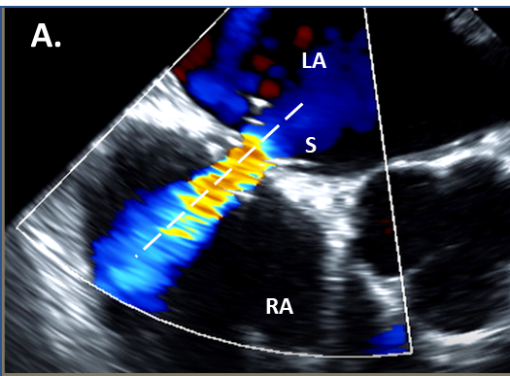
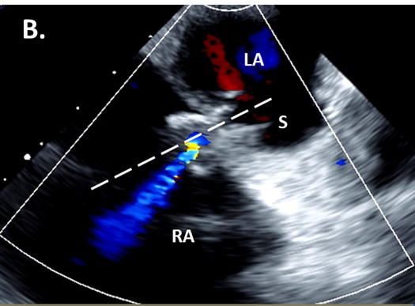
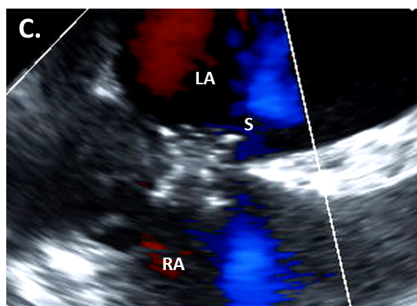
Shunt Patency at 1-3 and 12 Months (TEE)
Shunt patency at 1-3 months: 36/36 (100%)
12-month shunt occlusion: 5/36 (14%)
12-month shunt stenosis (TEE Color Doppler vena contracta in valve region narrowed/skewed): 13/36 (36%)
No thrombus, no shunt migration, no erosion of adjacent structures
A. Widely Patent Shunt B. Stenotic Shunt; narrowed/skewed C. Occluded Shunt
 | Patent | Stenotic | p
Vena Contracta | 3.3±0.6 mm | 1.5±1.5 mm | 0.001
Qp:Qs | 1.17±0.12 mm | 1.05±0.12 mm | 0.023
Notes:
In this slide you can see the early and late TEE data. As you can see, all shunts were patent at 1-3 month follow-up. However, at 12-month follow-up 5 shunts were occluded, and 13 additional shunt were found stenotic (defining stenosis as >50% narrowing of the vena contracta with respect to the device neck. Importantly, there were no cases of thrombus, shunt migration or erosion of adjacent structures.

Slide 14
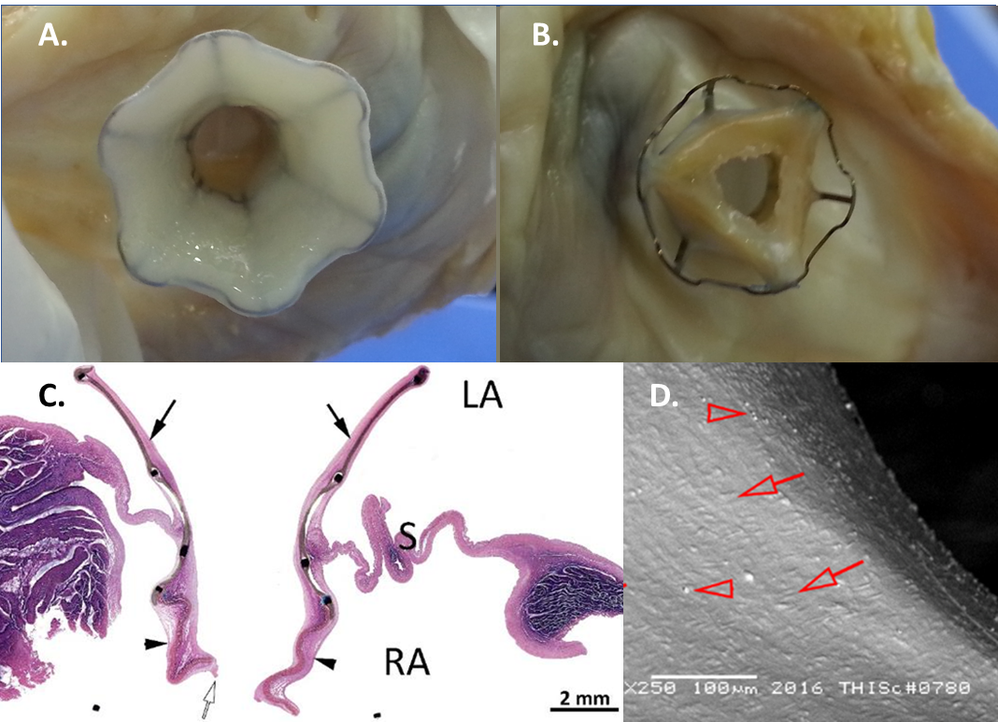
Pathological Examination (Stenotic Shunt)
2.5 year explant specimen from transplanted patient
LA view. Orifice widely patent.
RA view. Pannus thickening with stenosis of bioprosthetic leaflets.
Axial Section (H&E). Fibrocellular neoendocardium (pannus) infiltration of leaflets.
SEM. Full endothelialization of lumen (CD31+)

Slide 15
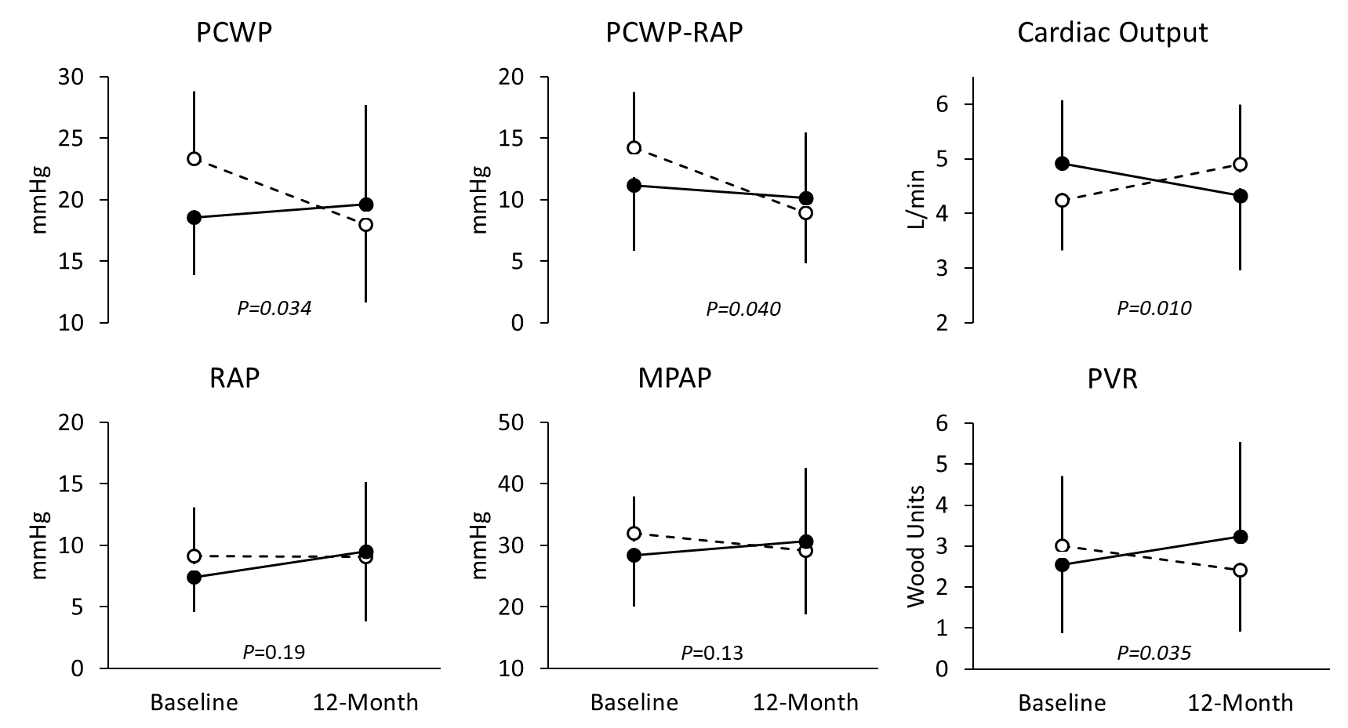
Hemodynamic Changes Grouped by Shunt Patency at 1-Year Follow-Up
At baseline, patients with patent shunts were:
Older
↑ AF
↓ eGFR
↓ 6MWT
↑ PCWP, ↓ CO
Patent ○ Stenotic/Occluded ●

Slide 16
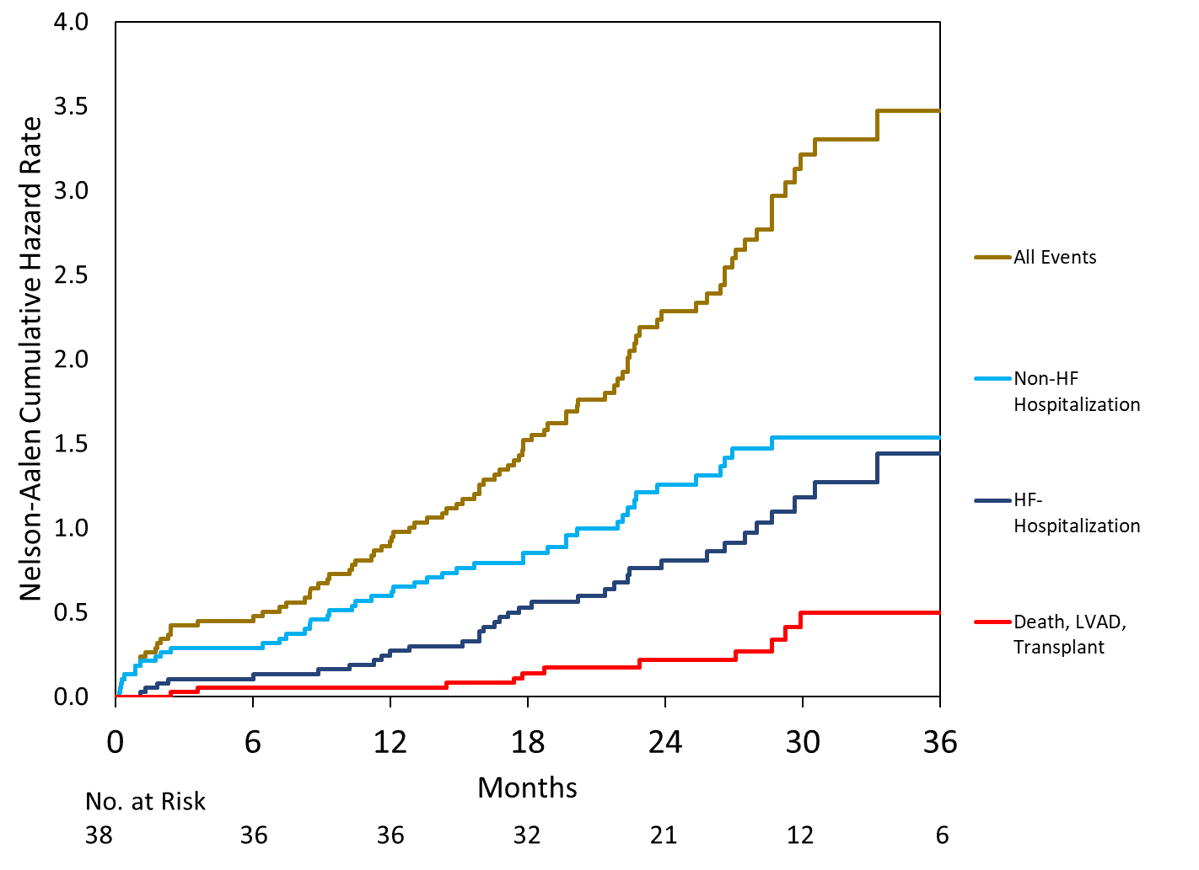
Cumulative Clinical Events (all patients)

Slide 17
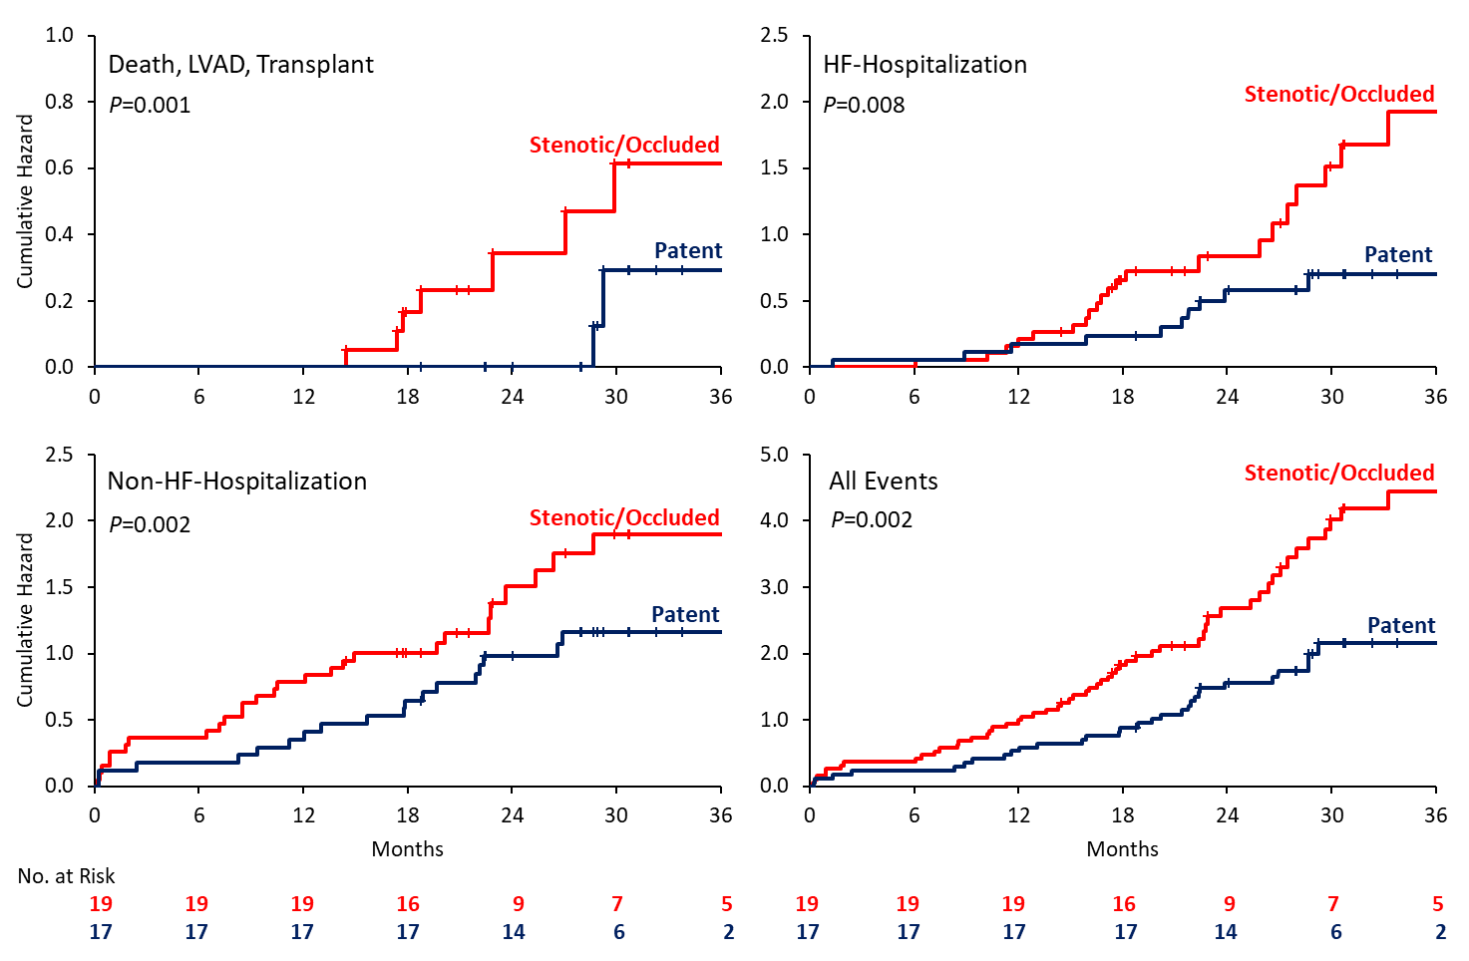
Long-term Clinical Outcomes Grouped by Shunt Patency

Slide 18
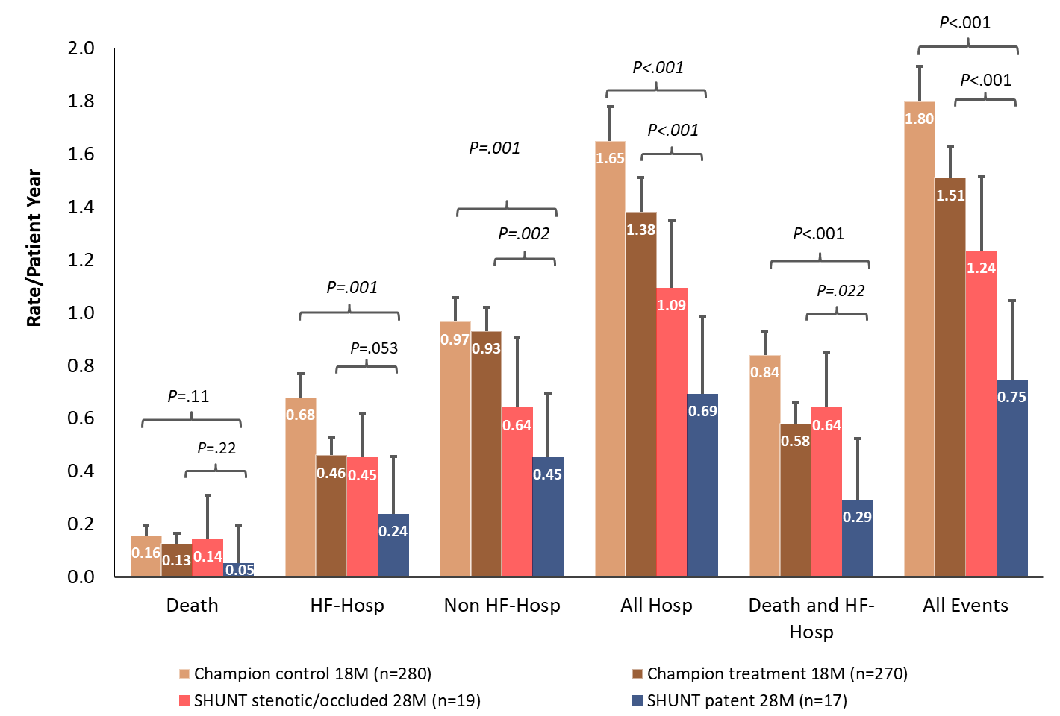
Comparison with CMEMs Champion Study
Studies had similar:
eligibility criteria
baseline characteristics including hemodynamics
use of medical and device therapies including dosing

Slide 19
Conclusions
Interatrial shunting with the V-Wave system for treating patients with HFrEF and HFpEF was feasible, safe, and associated with promising efficacy data in terms of functional improvement and reduction of cardiovascular events
There was a high frequency of shunt stenosis/occlusion at 1-year follow-up, likely secondary to pannus infiltration of the bioprosthetic leaflets, which associated with poorer hemodynamic and longer-term clinical outcomes
Shunt patency was associated with sustained low morbidity and mortality
Implementing modifications to improve device patency over time while maintaining hemodynamic and functional benefits is worthwhile prior to launching a randomized trial to confirm these findings

Slide 20
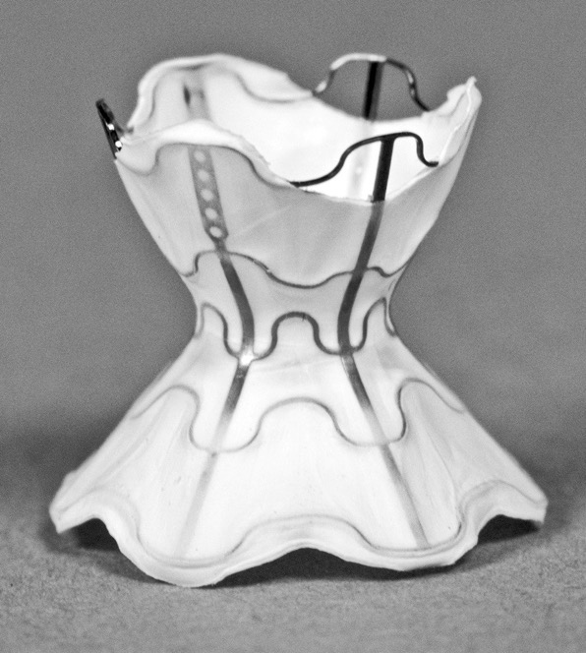
The Path Forward: V-Wave Valveless Shunt

Slide 21
RELIEVE-HF RELIEVE HF Pivotal Clinical Study
Design
  RCT, double-blind (patient and HF team), adaptive design
  400 randomized and ∼100 roll-in patients at 60 sites (40 US + 20 OUS)
Patient population
  NYHA class III or ambulatory class IV on GDMT (Eligibility Committee review)
  HFrEF or HFpEF – no specific LVEF criteria
  Hospitalization or ED visit for worsening HF within 1 year or elevated BNP/NT-proBNP
Endpoints
  Effectiveness: Hierarchical comparison of mortality, transplant/LVAD, HF hospitalization, and 6MWD using Finkelstein-Schoenfeld
  Safety: Device-related MACNE at 30 days (performance criteria)
  Health economic metrics
https://www.clinicaltrials.gov/ct2/show/NCT03499236

