Slide 1

A randomized trial evaluating On-line three-dimensional OFDI guided PCI vs. angiography guided in bifurcation lesions
Yoshinobu Onuma, Yosuke Miyazaki, Takashi Muramatsu, Norihiro Kogame, Kuniaki Takahashi, Yohei Sotomi, Shimpei Nakatani, Hiroyuki Kyono, Yukio Ozaki, Patrick W. Serruys, Takayuki Okamura
On behalf of the OPTIMUM investigators

Slide 2
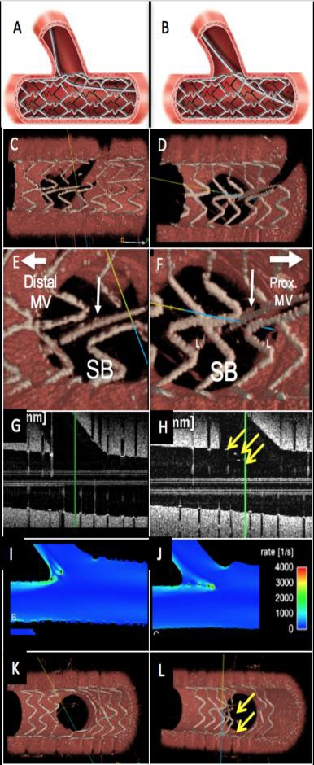
Why this study?
In bifurcation PCI, re-crossing the distal cell with a wire after main vessel stenting is important to avoid creating a de novo metal carina¹. Those protruded/malapposed struts result in lower strut coverage of the side branch ostium and more overhanging metal into the main branch over time after implantation of the stent².
Angiography guided PCI is limited in recognizing the recrossing position, while intra coronary image guided PCI has a potential to guide PCI by confirming the recrossing point.
The feasibility of off-line optical coherence tomography (OCT) guidance in bifurcation (either with 2-dimensional or 3-dimensional images) and its potential benefits were demonstrated in retrospective studies^{3,4}.
However, the feasibility and efficacy of 3-D OFDI guidance PCI in bifurcation
lesion has not yet been investigated prospectively.
Lassen JF, et al. EuroIntervention 2016;12(1):38-46.
Onuma Y, Okamura T et al. EuroIntervention 2015;11 Suppl V:V71-4.
Okamura, et al. EuroIntervention. 2014 Dec;10(8):907-15.
Alegría-Barrero, et al. EuroIntervention. 2012 Jun 20;8(2):205-13.
2

Slide 3
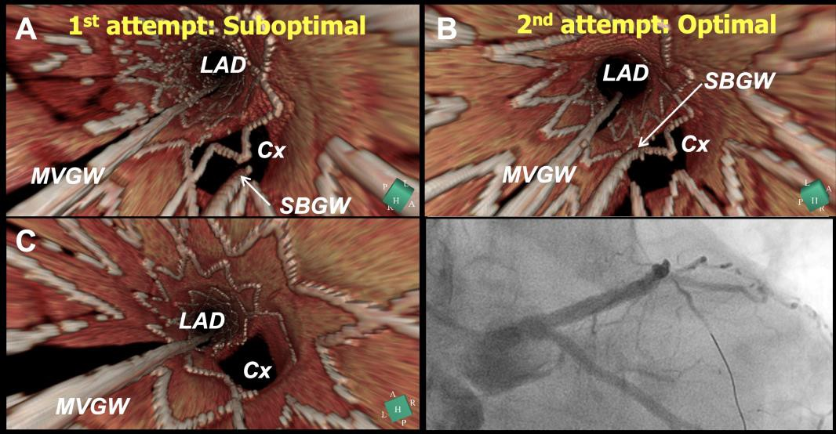
What did we study?
To determine whether bifurcation stenting guided by on-line three-dimensional optical frequency domain imaging (3D- OFDI) is superior to that with angiographic guidance in terms of incomplete stent apposition (ISA) in the bifurcation segment.
Okamura T, Onuma Y et al. EuroIntervention 2014;10:907-915

Slide 4
How was the study executed?
Design
A multi-centre, open-label, prospective randomized investigator-driven
trial
Primary endpoints
Post-procedural percentage of malapposed struts assessed by OFDI in bifurcation segment.
Major eligibility criteria
Patients who undergoes bifurcation PCI with evidence of ischemia,
excluding patients presented with STEMI
With a sidebranch of >2.0mm in diameter
Angiographically significant stenosis (>50%) in de novo, native, previously unstented bifurcation lesion(s) including left main lesion, which is appropriate to be treated by PCI with a single stent strategy

Slide 5









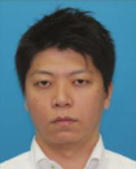



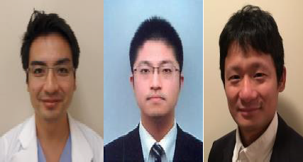


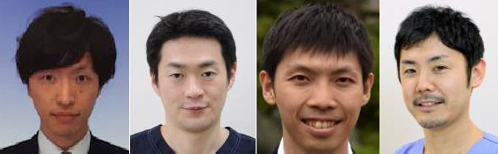

How was the study executed?
Study Chairmen of the OPTIMUM study
Patrick W. Serruys, MD, PhD
Imperial College London, London, United Kingdom
Yukio Ozaki, MD, PhD
Fujita health university hospital, Toyoake, Japan
Principle Investigators
Yoshinobu Onuma, MD, PhD
Erasmus Medical Center/Cardialysis, Rotterdam, NL
Fujita Health University School of Medicine, Toyoake, Japan
Takayuki Okamura, MD, PhD
Yamaguchi University Graduate School of Medicine, Ube, Japan
Executive Committee
Takashi Muramatsu
Fujita health university hospital, Toyoake, Japan
Yohei Sotomi
Shimpei Nakatani
Osaka police hospital, Osaka, Japan
Rotterdam Academic team
Taku Asano, Yosuke Miyazaki, Yuki Katagiri, Norihiro Kogame, Kuniaki Takahashi, Hidenori Komiyama, Hideyuki Kawashima, Masafumi Ono
CRO: Meditrix, Tokyo, JP
Imaging OFDI Corelab: Cardialysis, Rotterdam, NL
Grant Giver: TERUMO
4 Japanese Centres

Slide 6
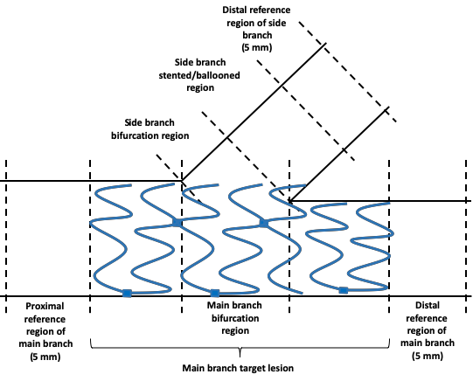
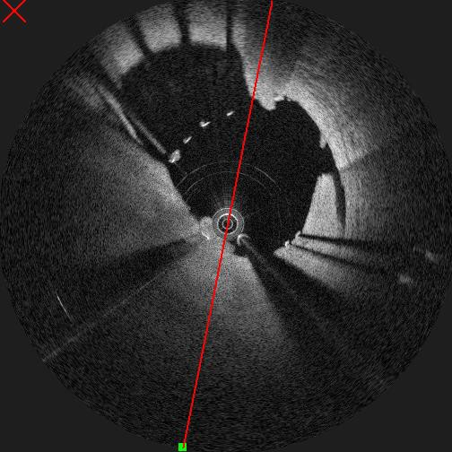
How was the study executed?
Sample size calculation
Assumptions for sample size determination are based on previous registries ^{1, 2}.
1. Okamura, et al. EuroIntervention. 2014 Dec;10(8):907-15.
Assumption:
2. Alegría-Barrero, et al. EuroIntervention. 2012 Jun 20;8(2):205-13.
Malapposition rate in bifurcation by angio-guidance is 26%.
3D-OFDI guidance reduces malapposition by 50%
Malapposition rate in bifurcation by 3D-OFDI guidance: 13%
Common standard deviation: 20%
Sample size:
Alpha = 0.05 (2-sided)
Power 90%
5% of insufficient quality OFDI
N= 53 x 2
Bifurca
tion segment
Stented region
106 subjects are to be randomized.

Slide 7
Study Flow Chart
Bifurcation PCI with provisional single stent strategy n = 110
3D OFDI guidance arm
56 pts with 57 lesions
Angio guidance arm
54 pts with 54 lesions
R
Implantation of
Ultimaster stent
Implantation of
Ultimaster stent
POT
POT
3D OFDI guidance wire recross
Wire recross
Primary endpoint
Acute ISA at bifurcation

Slide 8
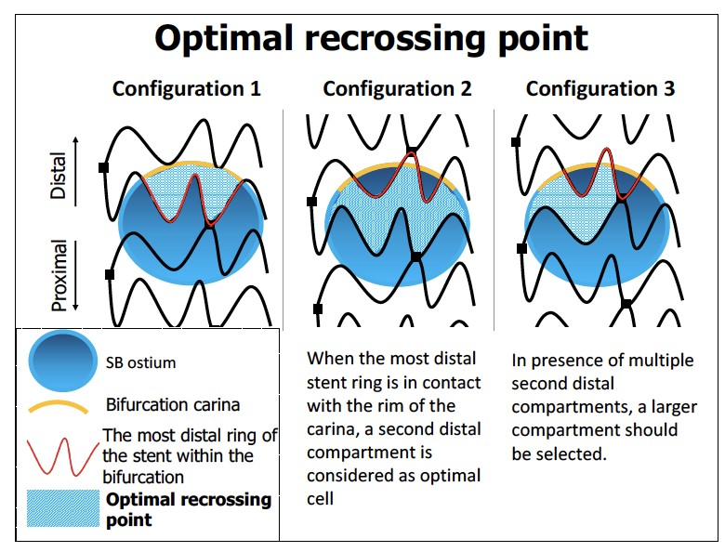
Study Flow Chart
Bifurcation PCI with provisional single stent strategy n = 110
3D OFDI guidance arm
56 pts with 57 lesions
Angio guidance arm
54 pts with 54 lesions
R
Implantation of
Ultimaster stent
Implantation of
Ultimaster stent
POT
POT
3D OFDI guidance wire recross
Wire recross
Onuma Y, Katagiri Y, et al. EuroIntervention 2018.
Primary endpoint
Acute ISA at bifurcation

Slide 9
Study Flow Chart
Bifurcation PCI with provisional single stent strategy n = 110
3D OFDI guidance arm
56 pts with 57 lesions
Angio guidance arm
54 pts with 54 lesions
R
Implantation of
Ultimaster stent
Implantation of
Ultimaster stent
POT
POT
3D OFDI guidance wire recross
1: OFDI was not able to be performed due to wire stuck
1: OFDI was not able to cross the lesion
Wire recross
Final KBD
Final KBD
OFDI
L = 57
OFDI
L = 52
Primary endpoint
Acute ISA at bifurcation

Slide 10
Study Flow Chart
Bifurcation PCI with provisional single stent strategy n = 110
3D OFDI guidance arm
56 pts with 57 lesions
Angio guidance arm
54 pts with 54 lesions
R
Implantation of
Ultimaster stent
Implantation of
Ultimaster stent
POT
POT
3D OFDI guidance wire recross
1: OFDI was not able to be performed due to wire stuck
1: OFDI was not able to cross the lesion
Wire recross
Final KBD
Final KBD
OFDI
L = 57
OFDI
L = 52
2: insufficient quality of OFDI
2: insufficient
quality of OFDI
Primary endpoint
Acute ISA at bifurcation
ISA was analyzable
L = 50
ISA was analyzable L = 55

Slide 11
Baseline characteristics
 | OFDI-guided PCI N=56 | Angio-guided PCI N=54 | p value
Age | 68.9 ± 10.2 | 69.4 ± 11.6 | 0.83
Male | 79% | 74% | 0.58
Medical history
Diabetes mellitus | 52% | 46% | 0.56
Hypertension | 77% | 74% | 0.74
Hypercholesterolemia | 86% | 85% | 0.94
Current smoker | 55% | 59% | 0.68
Previous MI | 16% | 15% | 0.86
Previous PCI | 4% | 0% | 0.26
Previous CABG | 21% | 35% | 0.06
Serum creatinine, mg/dL | 0.79 (0.70-0.95) | 0.81 (0.70-0.99) | 0.78
Ejection fraction, % | 60.8 ± 14.3 | 59.7 ± 11.8 | 0.67
Clinical presentation
Non-STEMI | 2% | 2% | 0.74
Unstable angina | 7% | 4% | 0.36
Stable angina | 36% | 32% | 0.64
Data are mean ± SD, median (IQ1,3) or percentage.

Slide 12
Procedural characteristics
 | OFDI L=57 | Angio L=54 | p value
Target bifurcation
LMT or LAD-Dx | 75% | 67% | 0.31
LCx-OM or PL | 16% | 15% | 0.89
RCA PD-PL | 9% | 19% | 0.13
Medina classification
(1, 1, 1) or (0, 1, 1) | 14% | 6% | 0.14
Ultimaster stent implantation | 100% | 100% | NA
Size, mm | 2.76 ± 0.38 | 2.72 ± 0.33 | 0.51
Length, mm | 30.0 ± 7.3 | 28.8 ± 7.3 | 0.36
POT was performed | 98% | 98% | 0.74
Balloon size, mm | 3.29 ± 0.47 | 3.30 ± 0.54 | 0.94
Pressure, atm | 13.6 ± 3.2 | 13.9 ± 3.8 | 0.58
Data are mean ± SD or percentage.

Slide 13
Procedural characteristics
 | OFDI N=57 | Angio N=54 | p value
Vascular access site
Radial | 31 (55) | 35 (65) | 0.311
Femoral | 23 (41) | 17 (32) | 0.296
Brachial | 2 (4) | 2 (4) | 0.677
GC size
6F | 30 (54) | 28 (52) | 0.857
7F | 24 (43) | 26 (48) | 0.577
8F | 2 (4) | 0 (0) | 0.257
Target bifurcation
LMT or LAD-Dx | 43(77) | 35(67) | 0.24
LCx-OM or PL | 7 (13) | 8 (15) | 0.724
RCA PD-PL | 5 (9) | 10 (19) | 0.143
 | OFDI N=57 | Angio N=54 | p value
Medina classification
(1, 1, 1) | 5 (9) | 3 (6) | 0.379
(1, 1, 0) | 28 (50) | 35 (65) | 0.116
(1, 0, 1) | 3 (5) | 1 (2) | 0.323
(1, 0, 0) | 5 (9) | 4 (7) | 0.523
(0, 1, 1) | 2 (4) | 0 (0) | 0.257
(0, 1, 0) | 13 (23) | 10 (19) | 0.545
(0, 0, 1) | 0 (0) | 1 (2) | 0.491
Calcified lesion | 19 (34) | 18 (33) | 0.947
Thrombotic lesion | 1 (2) | 1 (2) | 0.743
Rotablator | 6 (11) | 8 (15) | 0.519
DCA | 2 (4) | 0 (0) | 0.257
Data are mean ± SD or counts (percentage).

Slide 14
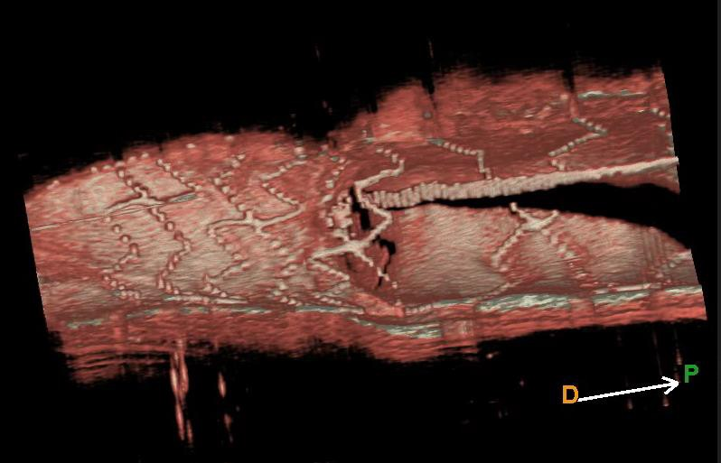
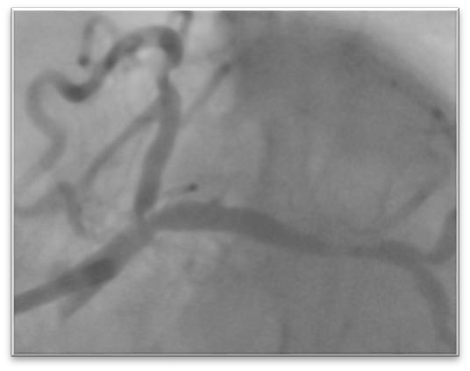
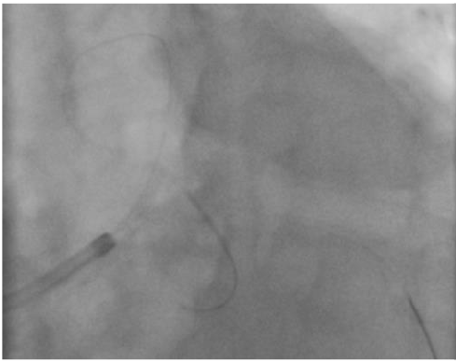
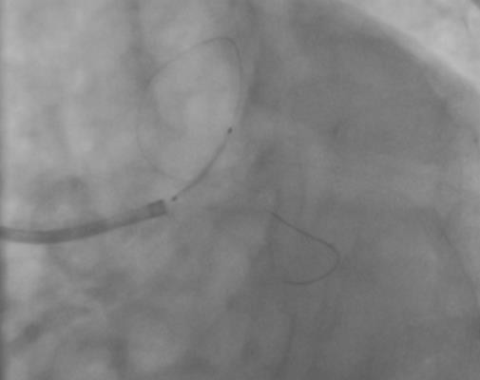
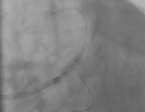
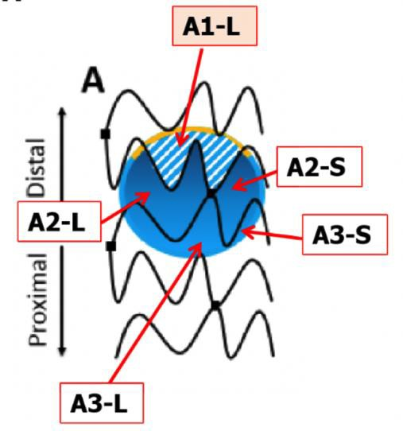
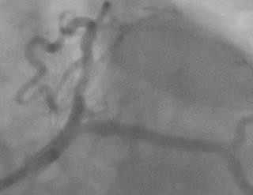
A Case of Angio-guided PCI
LM bifurcation with Medina 010
3D OCT after final KBT
Wire re-cross
 | after POT
Stent implantation
Ultimaster 3.0x15 mm
pre PCI
DS 58%
Distal
Proximal
A1-L
post FKBD
A2-L
Ultimaster 3.0x15 mm POT 4.0 mm
Wire crossed through A2-L segment
14

Slide 15

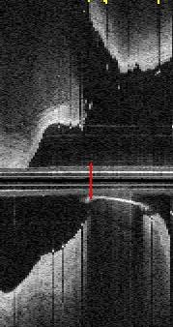


A Case of Angio-guided PCI
LM bifurcation with Medina 010
SB
3D OCT after final KBT
Distal Proximal
A1-L
A2-L
Wire crossed through A2-L segment
pre PCI
DS 58%
post PCI
MB
%ISA:33.9%
Ultimaster 3.0x15 mm POT 4.0 mm
15

Slide 16
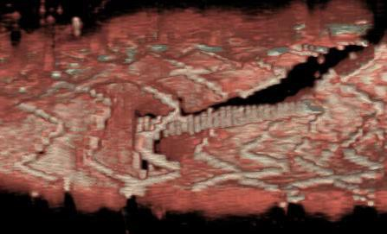
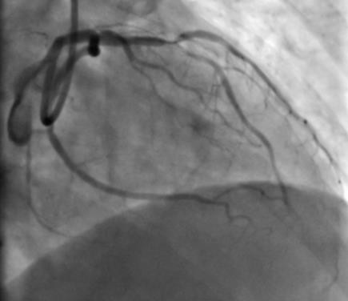
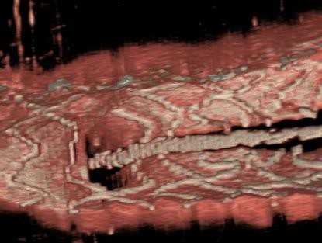
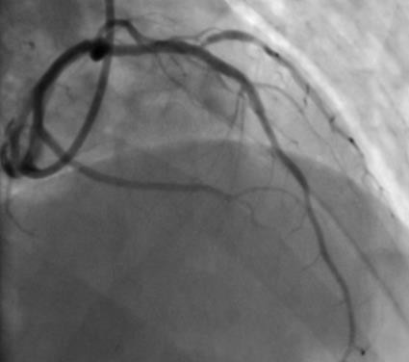
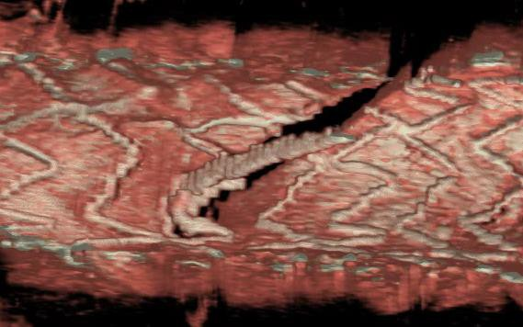
A Case of OFDI-guided PCI
LAD bifurcation with Medina 111
A2-S
3D OCT after final KBT
Distal
Proximal
pre PCI
3D OFDI guided Wire-recross
A1-L
Distal
Proximal
Achieved optimal result!
post PCI
Ultimaster 3.0x28 mm
Distal
Proximal
16

Slide 17
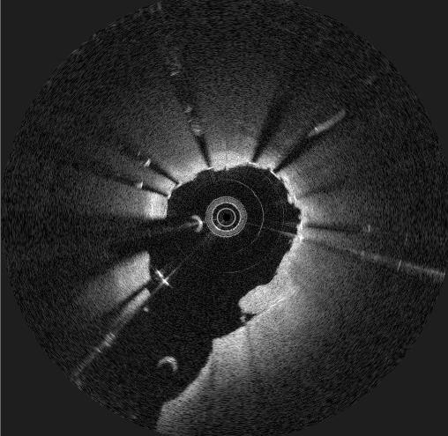
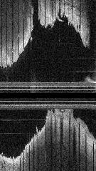


A Case of OFDI-guided PCI
LAD bifurcation with
SB
Medina 111
pre PCI
A2-S
3D OCT after final KBT
Distal Proximal
3D OFDI guided Wire-recross
^{A1-L} _{Distal} Proximal
Achieved optimal result!
Distal Proximal ¹⁷
MB
post PCI
Ultimaster 3.0x28 mm

Slide 18
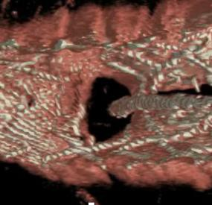
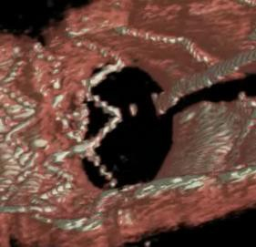

Incomplete Stent Apposition at bifurcation
Primary endpoint:
P=0.008
27.5%
19.5%
3D-OFDI guidance was superior to angio-guidance in acute incomplete strut apposition (creation of metal carina) of the bifurcation segment
3D-OFDI guided Angio guided
L=55 L=50
Incidence of ISA (%)

Slide 19
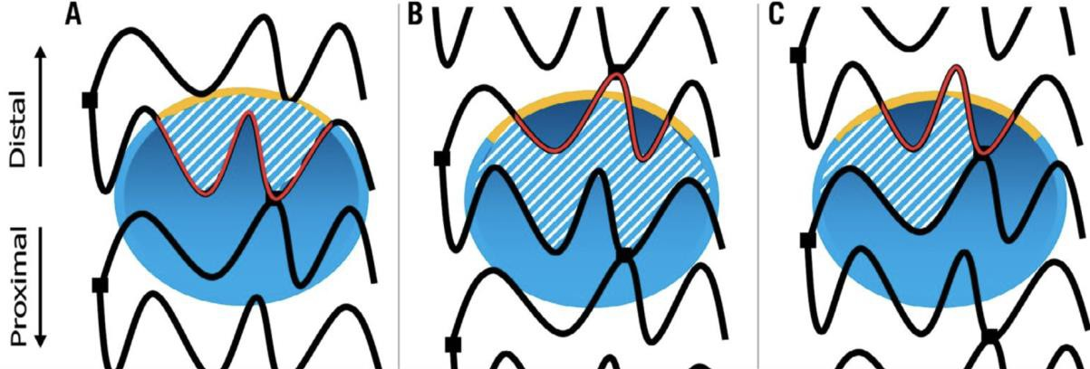
Summary of 3-D OFDI guided wire recrossing
Feasibility of on-line 3D-OFDI:
- 56/57 (98%)
Number of OFDI runs required for optimal wire recrossing:
- 1 (Median, IQ: 1 to 3)
Optimal wire recrossing identified by OFDI
- 56/56 (100%)
Distribution of configurations of overhanging struts
No ring at carina Ring at carina
45% of patients required 2nd attempt
Number of OFDI runs required for optimal recrossing
Lesions
1: 31 (55%)
2: 7 (13%)
≥3: 18 (32%)
Ring at carina
with multiple 2nd distal compartments
11 (19%)
22 (39%)
23 (40%)
 | OFDI, N=56 | Angio, N=54 | p value
Contrast volume, ml (Median) | 175.0 (146.3-210.0) | 175.0 (125.0-230.0) | 0.87

Slide 20
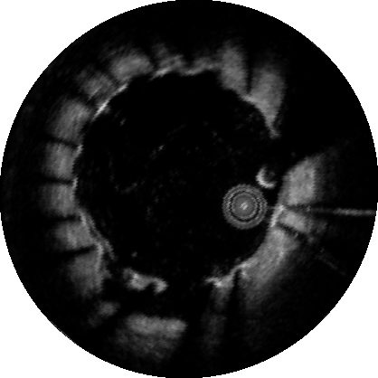
Secondary OCT endpoints
In stent region
 | OFDI L=55 | Angio L=50 | p value
Mean intrastent defect attached to/free from the vessel wall, mm2 | 0.11 ± 0.09 | 0.09 ± 0.06 | 0.15
Mean ISA area, mm2 0.23 ± 0.20 0.27 ± 0.27 0.39
Mean stent area, mm2 6.48 ± 1.61 6.20 ± 1.65 0.38
Minimum flow area, mm2 4.72 ± 1.36 4.63 ± 1.24 0.70
Mean flow area, mm2 6.85 ± 1.63 6.67 ± 1.78 0.60

Slide 21
Conclusion
3D-OFDI guided bifurcation PCI demonstrated superiority to angio guided PCI in terms of incidence of acute ISA (creation of metal carina) in bifurcation segment.
Online 3D-OFDI demonstrated excellent feasibility in the present prospective trial (98%, only one case).
In 3D-OFDI guided arm, 45% of lesions required 2nd
attempt to redirect the wire to the optimal cell.

Slide 22
m By and Foe you
PCRonline.com

