Slide 1
Contemporary Arterial Access in the Cardiac Catheterization Laboratory: The Case for Ultrasound-Guided Access
MedStar Washington Hospital Center Cath Conference
Yader Sandoval, M.D.
Interventional Cardiologist, Mayo Clinic
Assistant Professor of Medicine
January 31st, 2018

Slide 2
Objectives
Background
Femoral access: data and technique
Radial access: data and technique

Slide 3
Access Site Bleeding and Mortality
5 studies
Patients with bleed: 31,795
Patients with no bleed: 261,676
Mortality: RR 1.71 (1.37-2.13)
Kwok CS et al. Access and non-access site bleeding after percutaneous coronary intervention and risk of subsequent mortality and major adverse cardiovascular events: systematic review and meta-analysis. Circ Cardiovasc Interv 2015; 8. pii: e001645

Slide 5
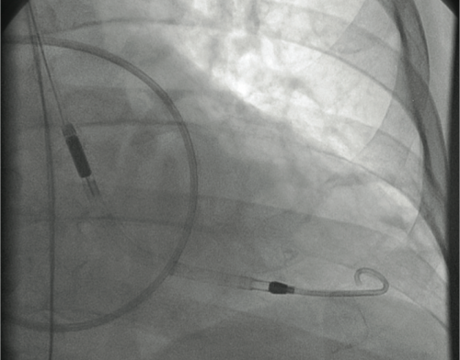
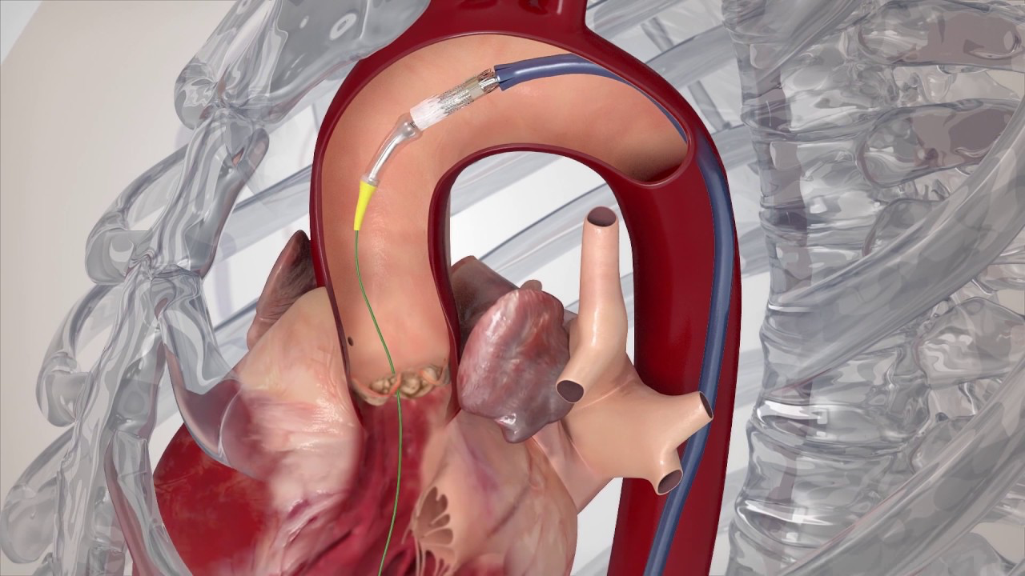
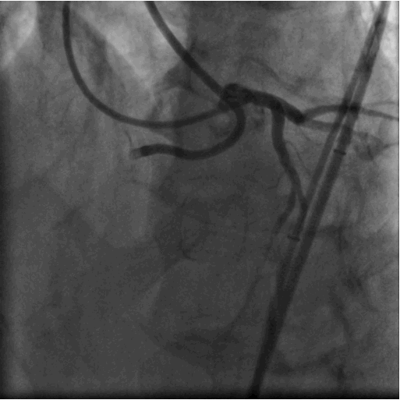
Is femoral arterial access still relevant in 2018?

Slide 6
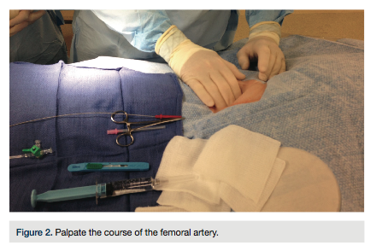
Palpate-and-Stick: Time for Change?
Back to Basics: Femoral Artery Access and Hemostasis. Cath Lab Digest 2013 Volume 21 Issue 10
Gilchrist IC. Palpate-and-Stick, Still the Femoral Access Technique of Choice: Time for Change. JACC Cardiovasc Interv 2017; 10: 2280-2282

Slide 7
Palpate-and-Stick: Time for Change?
Pulse palpation preferred transfemoral access technique by 60% operators
US and/or Fluoroscopy and/or Palpation: 27%
Damluji et al. JACC: Cardiovascular Interventions 2017; 10: 226979

Slide 8
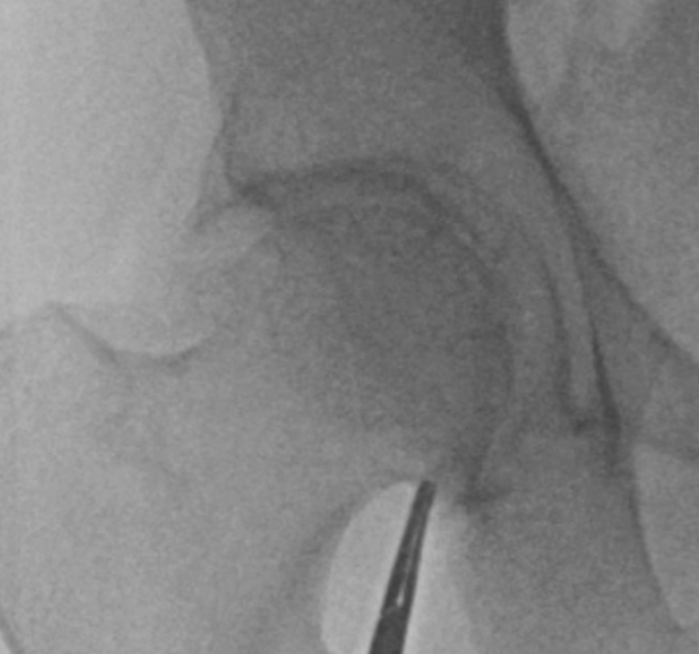
Contemporary Femoral Access in 2018
Fluoroscopy
Ultrasound
Micropuncture
Fluoroscopy
Femoral angiography
Sandoval Y et al. Contemporary arterial access in the cardiac catheterization laboratory. J Am Coll Cardiol Intv 2017; 10: 2233-41

Slide 9
Courtesy Dr. Arnold Seto

Slide 10
Courtesy Dr. Arnold Seto

Slide 11
Courtesy Dr. Arnold Seto

Slide 12
Courtesy Dr. Arnold Seto

Slide 13
US-guided femoral access meta-analysis
~ 49% ️⬇️ overall complications
~ 42% ⬆️likelihood of 1st attempt success
Total complication rate
Sobolev M et al. Ultrasound-guided catheterization of the femoral artery: a systematic review and meta-analysis of randomized controlled trials. J Invasive Cardiol 2015; 318-323.

Slide 14
1. Identify the lower edge of the femoral head
Hemostat
Fluoroscopy
Mark*
Marking the site can be helpful to to avoid losing relationship to the femoral head when performing US scanning
Sandoval Y et al. Contemporary arterial access in the cardiac catheterization laboratory. J Am Coll Cardiol Intv 2017; 10: 2233-41

Slide 15
2. Subcutaneous local anesthetic
Operator’s choice:
With or without ultrasound guidance

Slide 16
3. Ultrasound scanning
Maintain straight probe position
CFA
Bifurcation
Depth ~4.3 cm works well for most cases
May need to adjust depth to 5.1 cm in higher BMI cases
Adjust gain as necessary to optimize visualization
Sandoval Y et al. Contemporary arterial access in the cardiac catheterization laboratory. J Am Coll Cardiol Intv 2017; 10: 2233-41

Slide 17
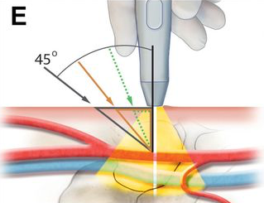
4. Access with MP (or standard gauge) needle under US guidance
Keep the US probe straight
Do not tilt the probe
Triangulate
Sandoval Y et al. Contemporary arterial access in the cardiac catheterization laboratory. J Am Coll Cardiol Intv 2017; 10: 2233-41

Slide 18
5. Confirm entry site & advance under fluoroscopic guidance
Sandoval Y et al. Contemporary arterial access in the cardiac catheterization laboratory. J Am Coll Cardiol Intv 2017; 10: 2233-41

Slide 19
Always advance MP wire under fluoroscopic guidance
Ben-Dor I et al. A novel, minimally invasive access technique versus standard 18-gauge needle set for femoral access. Catheter Cardiovasc Interv 2012; 79: 1180-5.
Sandoval Y et al. Contemporary arterial access in the cardiac catheterization laboratory. J Am Coll Cardiol Intv 2017; 10: 2233-41

Slide 20
6. Routine femoral angiography
30 degree ipsilateral angulation
Preferably at the beginning of case
Sandoval Y et al. Contemporary arterial access in the cardiac catheterization laboratory. J Am Coll Cardiol Intv 2017; 10: 2233-41

Slide 21
Contemporary Femoral Arterial Access
@yadersandoval
Sandoval Y et al. J Am Coll Cardiol Intv 2017; 10: 2233-41

Slide 22
Ultrasound for Radial Access
Can a case be made for routine US guided radial access?

Slide 23
Information that cannot be obtained by palpation
Dual radial artery: 4.4%
Ulnar artery larger (≥20%) than the radial artery in 6.5% of cases
Baumann F, Robert JS. J Interv Cardiol 2015; 28: 574-82

Slide 24
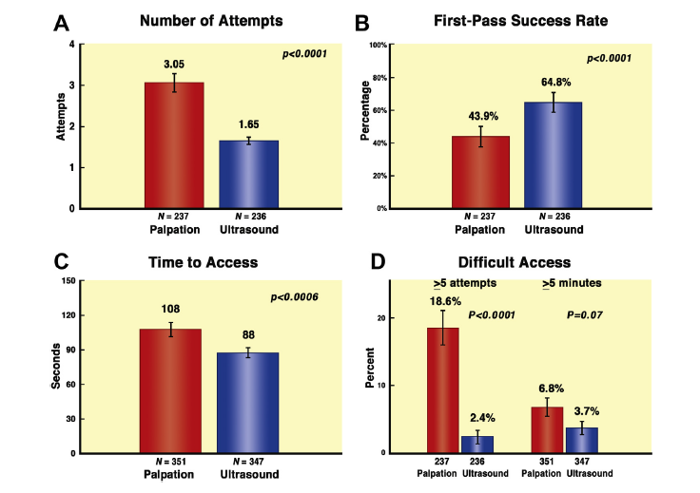
RAUST Trial: US-guided radial access
351 palpation vs. 347 US
Seto AH et al. Real-time ultrasound guidance facilitates transradial access: RAUST (Radial Artery access with Ultrasound Trial).
JACC Cardiovasc Interv 2015; 8: 283-291.

Slide 25
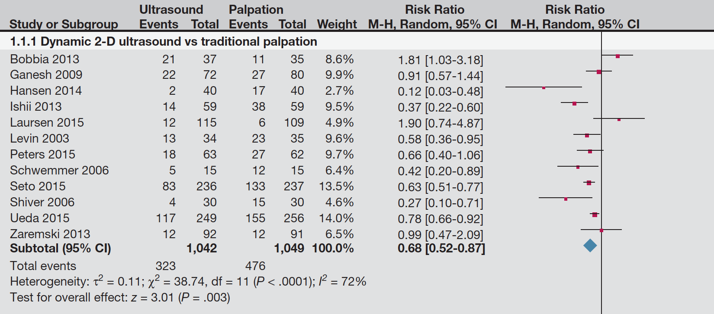
US guided radial access meta-analysis
~ 32% ️⬇️ 1st attempt failure
~ 1.3% ️⬇️ mean attempts to success
~ 43 seconds ️⬇️ to success
Gu WJ et al. Ultrasound guidance facilitates radial artery catheterization: A Meta-Analysis with Trial Sequential Analysis of Randomized Controlled Trials.
Chest 2016; 149: 166-79.

Slide 27
Courtesy Dr. Arnold Seto

Slide 28
Conclusions
Ultrasound guidance should be routinely used to obtain femoral access.
For radial access, the use of ultrasound can facilitate the procedure and aid in the identification of features not identifiable by palpation alone.
All cardiac catheterization laboratories should have ultrasound available to guide vascular access.
For large-bore access, patients may benefit even more from contemporary access techniques using ultrasound guidance, but further study is needed.

Slide 29
Thank you! Questions
sandoval.yader@mayo.edu
@yadersandoval

