Slide 1
Propensity-Score Matched Comparison of Evolut R Transcatheter Aortic Valve Replacement with Surgery in Intermediate-Risk Patients A Sub-Analysis from the SURTAVI Trial
Steven J. Yakubov, MD, Jeffrey J. Popma, MD, Nicolas M. Van Mieghem, MD, PhD, Patrick W. Serruys, MD, PhD, Arie-Pieter Kappetein, MD, PhD, Michael J. Reardon, MD
John H. McConnell Chair of Advanced Structural Heart Disease
System Chief, OhioHealth Structural Heart Disease
Medical Director, OhioHealth Research Institute
Riverside Methodist Hospital, Columbus, OH

Slide 2
Disclosures
Medical Advisory Board: Medtronic
Medical Advisory Board: Abbott Vascular
Medical Advisory Board: Boston Scientific
Steering Committee Member/ Proctor: Medtronic
Advisory Board/ Equity Interest: BioStar Ventures
Consultant: SentreHeart
Consultant: Foldax

Slide 3
SURTAVI Trial Propensity-Score Match Analysis
Background
The randomized SURTAVI trial demonstrated that transcatheter aortic valve replacement (TAVR) using a self-expanding valve is non-inferior to surgical aortic valve replacement (SAVR) for the primary endpoint of all-cause mortality or disabling stroke at 2 years in patients at intermediate risk.
The Evolut R device was FDA-approved as SURTAVI was enrolling.
The CoreValve device was implanted in 84% of the TAVR patients, while the remaining 16% received an Evolut R device.
A continued access study (CAS) was initiated after SURTAVI was fully enrolled to allow study of TAVR using the Evolut R device in intermediate risk patients.

Slide 4
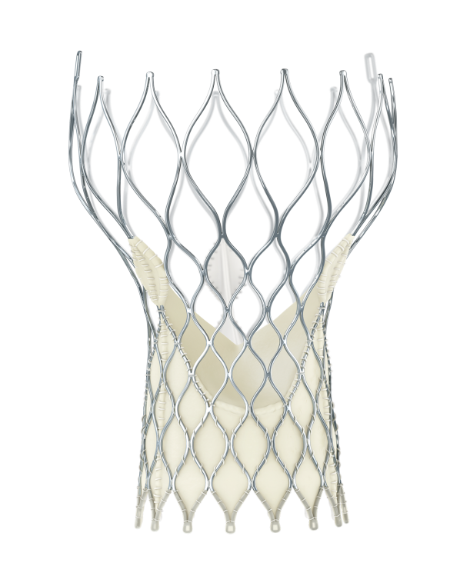
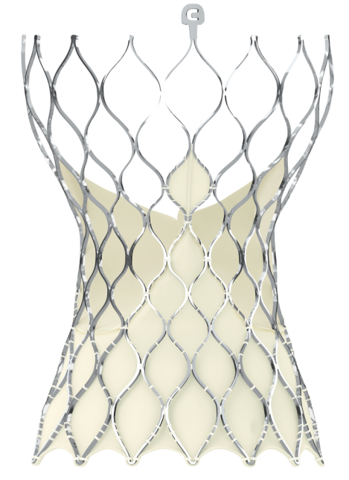
Self-Expanding Valve Platform Design Evolution
Evolut R design goals
CoreValve
Evolut R
Control During Deployment
Recapturability
Lower Delivery Profile
Improved Hemodynamics
Enhanced Sealing with More Conformable Frame
More Consistent Radial Force
Optimized Oversizing
Extended Skirt
Supra-Annular Valve
Porcine Pericardial Tissue
Self-Expanding Frame
Pericardial Skirt
Cell Size Enables Coronary Access

Slide 5
SURTAVI Trial and Continued Access Study Patient Flow
Randomized Controlled Trial (RCT)
1746 patients
Continued Access Study (CAS)
290 patients
TAVR ITT group: N=879
SAVR ITT group: N=867
15 not attempted:
- 2 died
- 2 withdrew consent
- 11 physician withdrew
15 not attempted:
4 died
6 withdrew consent
5 physician withdrew
71 not attempted:
4 died
43 withdrew consent
23 physician withdrew
1 lost to follow-up
TAVR mITT* group:
N=864
SAVR mITT* group:
N=796
TAVR attempted implant: N=275
2 not implanted
1 went to SAVR
2 surgical patients received TAVR
1 not implanted
2 went to TAVR
1 TAVR patient received SAVR
1 not implanted
TAVR implanted group: N=863
SAVR implanted group: N=794
TAVR implanted group: N=274
*The modified intention-to-treat (mITT) population includes all subjects with an attempted procedure

Slide 6
SURTAVI Trial and Continued Access Study Timeline
2012 | 2013 | 2014 | 2015 | 2016 | 2017 | 2018 | 2019
June
June
Sept
Jul
Aug
SURTAVI First Patient Enrolled
April 2015
CoreValve: 23, 26, 29 mm (US)
Evolut R (US)
CoreValve: 23, 26, 29 mm (CAN, EU)
CoreValve: 31 mm (US, CAN, EU)
May 2014
Inclusion Criteria:
STS 4 – 8%
Inclusion Criteria:
Risk of 30-Day Mortality ≥3% and <15%
SURTAVI Enrollment Complete
CAS First Patient Enrolled
Evolut R: 23, 26, 29 mm
CoreValve: 31 mm
Complete CAS Enrollment
Complete SURTAVI
1-Year Follow-up
Complete CAS
1-Year Follow-up

Slide 7
SURTAVI Trial and Continued Access Study Key Inclusion Criteria
Severe aortic valve stenosis: initial aortic valve area of ≤1.0 cm² or aortic valve area index <0.6 cm²/m², AND a mean gradient >40 mmHg or Vmax >4 m/sec, at rest or with dobutamine provocation in patients with a LVEF <55%, or Doppler velocity index <0.25 by resting echocardiogram
NYHA functional class II or greater
Criteria for “Intermediate Risk”
SURTAVI Protocol Versions 8 - 12
(Patients enrolled May 2014 – June 2016)
Continued Access Study
SURTAVI Protocol Versions 1 - 7
(Patients enrolled June 2012 – May 2014)
Predicted 30-day surgical mortality risk is ≥4% and <10% based on STS PROM
Heart team agreement that predicted 30-day surgical mortality risk is ≥3% and <15% based on STS PROM and overall clinical status including frailty, disability and comorbidity factors

Slide 8
SURTAVI Trial and Continued Access Study Stroke Assessment
Stroke assessment was consistent throughout SURTAVI and the Continued Access Study
All the patients were seen by a trained neurologist or stroke specialist at baseline.
Follow-up neurological assessments were done at discharge, 30 days, 6, 12, 18 and 24 months.
Neurologic events were adjudicated by a neurologist on the CEC.
Stroke was defined according to the VARC-2 criteria.
Disabling stroke was defined as a modified Rankin score of ≥2 at 90 days and an increase in at least 1 mRS category.

Slide 9
SURTAVI Trial Impact of Changing Inclusion Criteria

Slide 10
SURTAVI Trial Propensity-Score Match Analysis Objective
To compare 1-year outcomes with Evolut R in intermediate risk patients to those from a comparable SAVR cohort

Slide 11
SURTAVI Trial Propensity-Score Match Analysis Methods
SURTAVI Continued Access Study
Evolut R mITT Population
N=255
Randomized SURTAVI SAVR Arm
mITT Population
N=796
Patients treated prior to Protocol V.8*
N=322
Annular diameter >26 mm
N=156
Evolut R 34 mm
N=3
Evolut R mITT Population
N=252
SAVR mITT Population
N=318
Propensity Matching
(22 variables)
Evolut R Patients
N=197
SAVR Patients
N=197
*To ensure consistent inclusion criteria
mITT = modified intention to treat

Slide 12
SURTAVI Trial Propensity-Score Match Analysis Baseline Characteristics
 | Before Matching |  |  |  | After Matching
Characteristic % or mean ± SD | Evolut R N=252 | SAVR N=318 | Absolute Standardized Difference |  | Evolut R N=197 | SAVR N=197 | Absolute Standardized Difference
Age, years | 79.1 ± 6.2 | 78.8 ± 5.8 | 5.2% |  | 79.1 ± 6.1 | 79.1 ± 5.8 | 0.4%
STS PROM, % | 4.1 ± 1.5 | 3.8 ± 1.3 | 22.1% |  | 4.0 ± 1.5 | 3.9 ± 1.3 | 7.4%
Male | 42.1 | 40.9 | 2.4% |  | 40.6 | 41.1 | 1.0%
NYHA III/IV | 45.6 | 54.1 | 17.0% |  | 47.7 | 46.7 | 2.0%
Body Mass Index | 30.7 ± 7.1 | 29.3 ± 5.9 | 21.9% |  | 30.4 ± 7.0 | 29.9 ± 6.2 | 6.6%
Need for revascularization | 11.5 | 18.6 | 19.8% |  | 11.7 | 12.2 | 1.6%
5m gait speed >6 sec or wheelchair bound | 46.8 | 51.5 | 9.3% |  | 47.7 | 49.2 | 3.1%
Falls in the past 6 months | 8.3 | 10.7 | 8.1% |  | 8.6 | 7.6 | 3.7%
KATZ Score, ≥1 deficit | 9.5 | 6.6 | 10.7% |  | 9.1 | 7.6 | 5.5%
Diabetes controlled by insulin | 10.3 | 9.7 | 1.9% |  | 9.6 | 9.1 | 1.7%
Peripheral vascular disease | 26.2 | 20.4 | 13.6% |  | 26.4 | 23.9 | 5.9%

Slide 13
SURTAVI Trial Propensity-Score Match Analysis Baseline Characteristics
 | Before Matching |  |  |  | After Matching
Characteristic % or mean ± SD | Evolut R N=252 | SAVR N=318 | Absolute Standardized Difference |  | Evolut R N=197 | SAVR N=197 | Absolute Standardized Difference
Prior Stroke | 5.2 | 6.3 | 4.9% |  | 5.1 | 3.6 | 7.5%
Coronary artery disease | 56.3 | 55.0 | 2.7% |  | 53.8 | 52.8 | 2.0%
Pre-existing IPG/ICD | 6.0 | 6.6 | 2.7% |  | 4.6 | 6.1 | 6.8%
Congestive heart failure | 82.9 | 94.0 | 35.3% |  | 92.4 | 90.9 | 5.5%
Atrial fibrillation / flutter | 22.6 | 18.9 | 9.3% |  | 20.3 | 23.4 | 7.4%
Moderate / severe chronic lung disease | 17.5 | 11.0 | 18.6% |  | 12.7 | 14.2 | 4.5%
Home oxygen | 0.8 | 2.5 | 13.6% |  | 1.0 | 1.0 | 0.0%
LVEF, % | 64.4 ± 8.4 | 62.8 ± 9.3 | 17.8% |  | 64.0 ± 8.6 | 64.4 ± 8.4 | 4.3%
Mean gradient, mmHg | 44.3 ± 12.1 | 48.7 ± 14.5 | 33.2% |  | 45.7 ± 11.9 | 45.5 ± 12.0 | 1.1%
Aortic regurgitation ≥mild | 40.1 | 44.6 | 9.2% |  | 38.1 | 38.6 | 1.0%
Mitral regurgitation, mod / severe | 4.8 | 2.2 | 13.9% |  | 4.1 | 3.6 | 2.7%

Slide 14
SURTAVI Trial Propensity-Score Match Analysis All-Cause Mortality or Disabling Stroke
1-year KM % | 95% CI
4.1% | 1.8, 9.3
8.2% | 5.1, 13.1
P-value (log-rank) =0.08
No. at risk
Evolut R |  | 197 |  | 193 | 189 | 125
SAVR |  | 197 |  | 182 | 177 | 175

Slide 15
SURTAVI Trial Propensity-Score Match Analysis All-Cause Mortality
30-day KM % | 95% CI |  | 1-year KM % | 95% CI
0.0% | -- |  | 3.6% | 1.4, 8.6
2.6% | 1.1, 6.0 |  | 5.7% | 3.2, 10.1
O:E Ratio Evolut R 0.0
SAVR 0.67
P-value (log-rank) =0.31
No. at risk
Evolut R |  | 197 |  | 194 | 190 | 125
SAVR |  | 197 |  | 187 | 182 | 180

Slide 16
SURTAVI Trial Propensity-Score Match Analysis Disabling Stroke
1-year KM % | 95% CI
1.0% | 0.2, 5.6
3.1% | 1.3, 6.9
P-value (log-rank) =0.15
No. at risk
Evolut R |  | 197 |  | 193 | 189 | 125
SAVR |  | 197 |  | 182 | 177 | 175

Slide 17
SURTAVI Trial Propensity-Score Match Analysis Clinical Outcomes
 | 30 Days |  |  |  | 1 Year
% (Kaplan-Meier Estimates) | Evolut R N=197 | SAVR N=197 | P-value |  | Evolut R N=197 | SAVR N=197 | P-value
All-cause mortality or disabling stroke | 0.5 | 5.1 | <0.01 |  | 4.1 | 8.2 | 0.08
All-cause mortality | 0.0 | 2.6 | 0.02 |  | 3.6 | 5.7 | 0.31
All stroke | 2.5 | 6.6 | 0.05 |  | 5.3 | 6.6 | 0.50
Disabling stroke | 0.5 | 3.1 | 0.06 |  | 1.0 | 3.1 | 0.15
Non-disabling stroke | 2.0 | 3.6 | 0.35 |  | 4.8 | 3.6 | 0.62
Transient ischemic attack | 0.0 | 1.5 | 0.08 |  | 2.0 | 1.5 | 0.73
Myocardial infarction | 0.5 | 0.5 | >0.99 |  | 1.5 | 0.5 | 0.33
Aortic valve reintervention | 0.0 | 0.0 | -- |  | 1.0 | 0.5 | 0.58
Aortic valve hospitalization | 1.5 | 3.6 | 0.19 |  | 4.6 | 6.8 | 0.33
Permanent pacemaker implantation | 13.2 | 6.2 | 0.01 |  | 15.3 | 7.8 | 0.02
Atrial fibrillation | 13.7 | 35.8 | <0.01 |  | 18.3 | 37.4 | <0.01

Slide 18
SURTAVI Trial Propensity-Score Match Analysis Hemodynamics*
Evolut R had significantly better valve performance over SAVR at all follow-up visits (P<0.01)
Aortic Valve Area, cm²
AV Mean Gradient, mm Hg
* Core lab adjudicated

Slide 19
SURTAVI Trial Propensity-Score Match Analysis Total Aortic Regurgitation*
* Core lab adjudicated

Slide 20
Randomized SURTAVI Trial vs. Propensity-Score Match Analysis All-Cause Mortality or Disabling Stroke
1-year KM % | 95% CI
4.1% | 1.8, 9.3
8.2% | 5.1, 13.1
7.8% | 6.2, 9.8
8.5% | 6.8, 10.8
No. at risk
Evolut R |  | 197 |  |  |  | 125
SAVR |  | 197 |  |  |  | 175
RCT TAVR |  | 864 |  |  |  | 786
RCT SAVR |  | 796 |  |  |  | 698

Slide 21
SURTAVI Trial Propensity-Score Match Analysis Conclusions
All-cause mortality or disabling stroke, at 1 year, were less with TAVR compared to SAVR
The TAVR group had less aortic valve or heart failure hospitalization and less atrial fibrillation than the SAVR group at 1 year
There was more need for permanent pacemaker implantation in the TAVR group
The Evolut R TAV demonstrated excellent hemodynamic performance
These results were achieved compared to a propensity-score matched SAVR group with low STS scores.
Advancements in catheter design technology may help drive greater success for intermediate-risk patients with severe, symptomatic aortic stenosis.

Slide 22
Thank You

