Slide 1
Incidence, Predictors, and Outcomes of Prosthesis-Patient Mismatch
in 62,125 TAVR Patients
An STS/ACC TVT Registry Report
Howard C. Herrmann, MD University of Pennsylvania Philadelphia

Slide 2
Disclosure Statement of Financial Interest
Within the past 12 months, I or my spouse/partner have had a financial interest/arrangement or affiliation with the organization(s) listed below.
Institutional Grant/Research Support
Consulting Fees/Honoraria
Abbott Vascular Bayer
Boston Scientific Corvia
Edwards Lifesciences St. Jude Medical Medtronic
Edwards Lifesciences Medtronic
Siemens Healthineers

Slide 3
Background
Prosthesis-Patient Mismatch (PPM) was first defined by Rahimtoola in 1978 to describe the mismatch between the hemodynamics of a valve prosthesis and a patient’s requirements for cardiac output.
It is defined based on the effective valve orifice area indexed to body surface area (EOAI).
Studies of surgical aortic valve replacement (SAVR) have demonstrated associations between PPM and mortality and hospital readmission, as well as adverse effects on functional improvement, exercise tolerance, left ventricular mass regression, and late structural valve deterioration.
Transcatheter AVR (TAVR) has been shown to result in larger EOA compared with SAVR, but the associations of PPM with outcomes following TAVR have only been studied in small series or with limited follow up.

Slide 4
Objective
Examine the incidence, predictors, and associations with 1-year outcomes of PPM after TAVR in the large TVT registry of commercial US procedures

Slide 5
Methods
STS/ACC Transcatheter Valve Registry
Goals of facilitating device and procedure surveillance, promoting quality assurance and improvement, and conducting studies that help with access to new therapies and expand device labelling through evidence development
Participating centers use standardized definitions to collect patient-specific data on demographics, morbidities, functional status, quality of life, hemodynamics, procedural details and outcomes (in- hospital, 30-day, and 1-year)
All registry patients treated commercially from Jan 2014 through March 2017 were included in the present investigation
TVT enrollees > 65 years of age at the time of their procedure and with Fee-for-Service Medicare were linked to claims data by CMS using unique patient identifiers (name and social security number) to assess 1-year survival, stroke, and rehospitalization for heart failure.

Slide 6
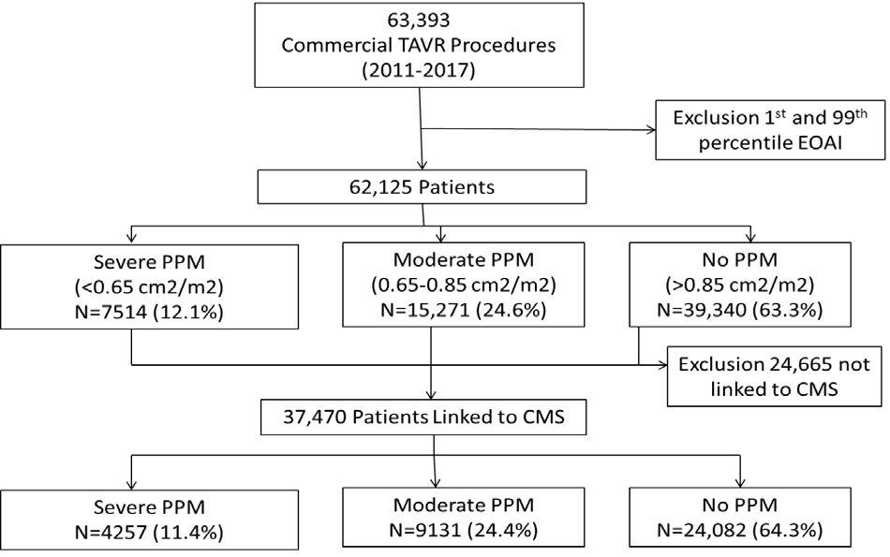
Study Population
4
1.0±0.3 cm²/m²
[0.4 - 2.1]
3
Percent
(2014-2017)
2
1
0
0.5
1.0 1.5
Histogram of EOAI (cm²/m²)
2.0
EOAi excluding 1st and 99th percentile

Slide 7
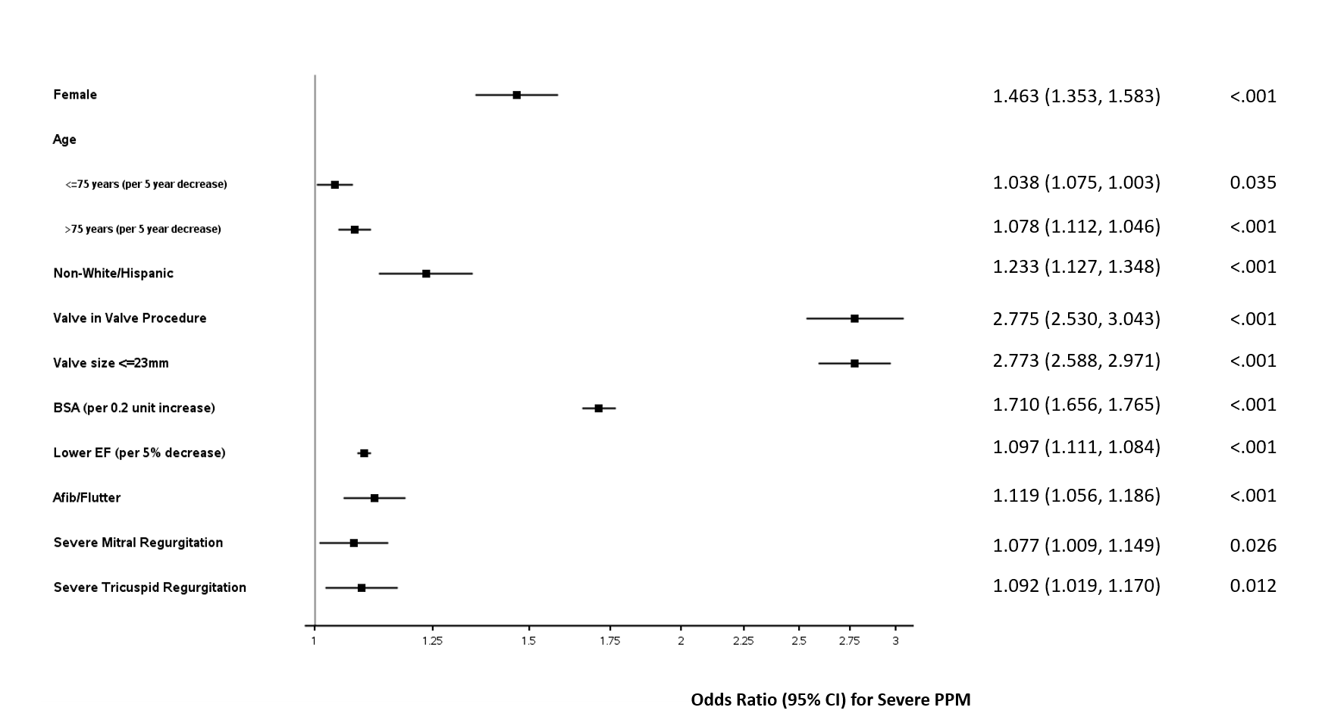
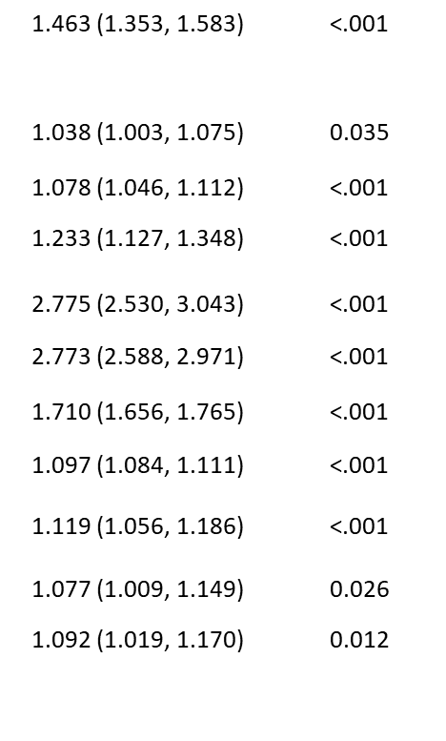
Odds Ratios (95% CI) for Multivariate Model Predictors of Severe PPM
Female Age
<75 yr (per 5 yr decrease)
>75 yr (per 5 yr decrease) Non-White/Hispanic
Valve-in-Valve Procedure Valve size <23 mm
BSA (per 0.2 unit increase) Lower EF (per 5% decrease) Afib/Flutter
Severe MR Severe TR

Slide 8
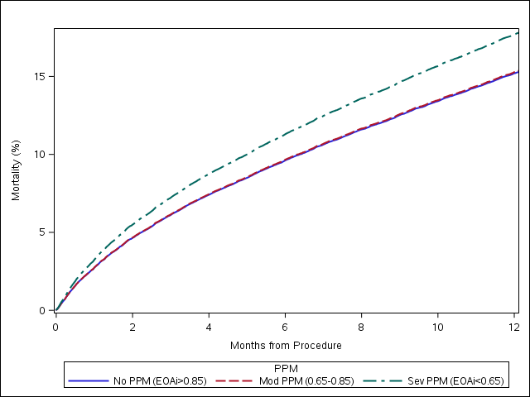
Mortality (%)
17.2% Severe
15.8% Moderate/None
Adjusted HR (95% CI)
1.19 (1.09-1.31) p<0.001

Slide 9
HF Rehospitalization (%)
Death or HF Rehosp. (%)
Stroke (%)
Event Rates (severe vs not severe PPM):
14.7% vs 12.2% 26.8% vs 24.2%
HR 95% CI (severe vs not severe PPM):
1.12 (1.02-1.24) p=0.017 1.13 (1.06 – 1.22) p<0.001
3.8% vs 4.2%
0.98 (0.82-1.16)
p=0.798

Slide 10
Summary and Conclusions
This is the largest study to date of prosthesis-patient mismatch (PPM) after TAVR and demonstrates that severe and moderate PPM are common, occurring in 12% and 24% of patients, respectively.
Severe PPM is related to prosthesis and patient factors, including small diameter valve prosthesis, valve-in-valve procedure, larger BSA, female sex, and younger age.
Severe PPM is associated with increased 1-year mortality and heart failure re- hospitalization when compared with patients with moderate or no PPM. We did not find an association between PPM and stroke or QOL (KCCQ score) at 1 year.
Our findings suggest that efforts should be made to identify and limit the risk for PPM after TAVR

Slide 11
Prosthesis-Patient Mismatch in 62,125 Patients Following Transcatheter Aortic Valve Replacement
From the STS/ACC TVT Registry
H-•d C. Hl!rtlllmn ,MD,• Samutl A. Dmoshvar, ldD.•enu c.Fon•-·•m,•AmmdaSceltins,MJll!,•
S-b..b Vmai)Jpali,&m.• llmnb D. Dnal. •m.·O.vtd J.Mii•'*> , MD.. YInod H.lbaw:ull •m..
Hnllfn Rynur. MD,< Andnirl s.lloslnsld, PIO'
.,.at•01.WD ----nt""""*"(Pftl)2't.,"'9'<J l ......,v•• t1A-..OfotlotllC<- I•
--·---l,_,,.htWAVA(TAVIOana-.0• . .-ondlbollfecuo(
-afW TAVll •eltu wtil <tuciood.
oa-='llYU 11>1..--11ws-,.°'lllar¥lc5"'91Df"'-""""CG1it9o°' ca.-gyTVT IT,....1111<.,
V•e l'f9'IUY IO ...tnlno tht fftqutnty.predlctoft.anda-mWitll ...-of--TAVlInQ.125 pltilllts nailed blew..., 2014 and 2017.
CUU6od••-twl<0.6Son'/•"'· ...(0.65 IDO.IL5 on'/rri'),OA -(>O.ascm•/m'). ........,-199'.....
..-,..,..,..ml1DuamiJ10prodittond•-- ..""'1..•4u<Rdoo.tamK.tndudngmcrt.lllly .t..t,.._
M DS OntN-oltbo-9"......tf1<1lloev•e--""t o IUfl""'•...-....
lulaleMX. y-ogo, ---,_,,_rljtc:tl09 •UIfte<tll'-ancl --...,,..,,
CHF> D\<ld.e,aod o(llfe,a11y ..tnl7,4lO--•pottnUMll_..._
-..1.11.n -.n1-...,,..,.••_,1-.g TAVA lll,,.ond l5,.o(pitimU,mpK1H.­
o( ..,..,.,...ft1l.ded ,,,.,I"2J...,m ciomoterl .......,.-.wlvt-C.wlv• .,.-n.llrgor llOlly !Ufa ....
•'*""!*I '"9'"9Ullon. Al 1ie•.m-.,Y Wlll 172'1., 15.6"'Md 15.9'1' •_..,.--.•rd,., PPll palns.
tly (p - 0.01). HF,.,.,....,._ hid oa:ul'Oll tn 14.12."" and 119" d po •• w1t11 --·"'ad­
·-·and Nl"""'rt<pCllv<ly(p <0.0001 Ttwtww..Nl-UOno(_.,. ,...,.'Ith<IJOl<OOA .,.uty d ti•
at1,.ar.
COMCU..IOMS so...-.,..,TAVll --•In12'1. o( paitflts and w•-lidw.U. llghtt Ol-.,Y ard HF -=.pd-& 1)e•.Funhor tnva'91tlool II •-lnlOthe prw.,llon o(-l'tPPMlo pilt.,_,IS -­ goln9 TAVlt.U Am C<il tardiol 20•,U-12) Cl JOll by IboA-c..lqol C.ddogy -
STS
National Database'·
Using data to drive quality

Slide 12
Back-up Slides

Slide 13
Baseline Variable |  | All (N=62125) |  | Severe PPM (N=7514) | Moderate PPM (N=15271) |  | None (N=39340) | p
Age (mean + SD) | 80.8 + 8.6 |  | 77.9 + 9.4 |  | 79.9 + 8.9 | 81.8 + 8.2 |  | <0.0001
Gender (%male) | 53.7 |  | 53.7 |  | 55.0 | 53.2 |  | 0.0007
Race (%African-American) | 3.8 |  | 5.2 |  | 4.3 | 3.3 |  | <0.0001
Prior CABG (%) | 25.5 |  | 29.4 |  | 26.3 | 24.5 |  | <0.0001
Prior Stroke (%) | 11.9 |  | 11.2 |  | 11.7 | 12.1 |  | NS
DM (%) | 38.3 |  | 46.5 |  | 41.8 | 35.4 |  | <0.0001
CLD (mod/severe) | 26.1 |  | 30.4 |  | 27.6 | 24.7 |  | <0.0001
CKD (Stage 3,GFR <60) (%) | 48.3 |  | 50.3 |  | 49.7 | 47.4 |  | <0.0001
LV EF (mean+SD) | 54.1+13.7 |  | 51.9+14.2 |  | 53.3+13.7 | 54.8+13.5 |  | <0.0001
NYHA III/IV (%) | 79.6 |  | 82.4 |  | 80.2 | 78.9 |  | <0.0001
AF/Fl (%) | 40.0 |  | 42.6 |  | 41.2 | 39.0 |  | <0.0001
BSA (M2, mean+SD) | 1.88+0.26 |  | 1.99+0.27 |  | 1.93+0.25 | 1.83+0.24 |  | <0.0001
Mean aortic gradient (mmHg) | 43.1+14.6 |  | 42.8+14.9 |  | 43.2+14.2 | 43.2+14.6 |  | NS
VIV procedure (%) | 5.6 |  | 14.7 |  | 6.1 | 3.6 |  | <0.0001
Prosthesis <23mm diam (%) | 27.9 |  | 40.0 |  | 32.1 | 24.0 |  | <0.0001
Post AVA (cm2, mean+SD) | 1.83+0.57 |  | 1.11+0.20 |  | 1.46+0.21 | 2.12+0.50 |  | <0.0001
LOS (days, mean+SD) | 5.9+9.4 |  | 6.6+17.0 |  | 5.8+8.2 | 5.7+7.6 |  | <0.0001

Slide 14
Subgroup (Interaction) Analyses (Severe vs Not Severe PPM)
 | Mortality Effect estimate (95% CI)
Age
Age <83 years | 1.123 (0.999, 1.261)
Age >83 years | 1.285 (1.129, 1.463)
Gender
Male | 1.153 (1.020, 1.303)
Female | 1.252 (1.104, 1.420)
LVEF
LVEF <40% | 1.082 (0.904, 1.294)
LVEF >40% | 1.250 (1.127, 1.385)
BMI
BMI <30 kg/m2 | 1.149 (1.031, 1.281)
BMI >30 kg/m2 | 1.277 (1.115, 1.464)
Mean AV Gradient
AV Gradient <40 mmHg | 1.227 (1.084, 1.387)
AV Gradient >40 mmHg | 1.147 (1.022, 1.288)
Afib/Flutter
With A Fib/Flutter | 1.193 (1.065, 1.337)
No Fib/Flutter | 1.193 (1.048, 1.358)
Interaction P-value
0.113
0.352
0.171
0.204
0.409
0.995

Slide 15
KCCQ Overall Score
100
90
80
70
Multivariable Analysis of Severe vs Not Severe (1-year)¹:
Overall score
OR 0.72 (0.06-8.12) p=0.8
Favorable outcome
(alive with KCCQ score >60 and <10 point decrease from baseline)
OR 0.99 (0.81-1.20) p=0.9
60
Severe
*
50
40
Moderate
None
30
*p<0.0001
20
10
0
Baseline
30 day
1 year
¹To avoid the bias of missing non-random KCCQ measurements due to worse baseline health status, sites reporting less than 50% completeness of measurements were excluded. To ensure that the cohort of patients represented the overall TAVR population, we used inverse probability weighting to increase the weight of patients who were most like those with missing KCCQ measurements.

Slide 16
Differences between the CMS linked and non-linked patients
Medicare population, hence linked patients older, more female, more co-morbidities
Similar incidence severe and moderate PPM
Baseline Variable |  | All (N=62125) | Not Linked to CMS (N=24,655) | Linked to CMS (N-37,470) | p
Age (mean + SD) | 80.8 + 8.6 |  | 78.7 + 10.3 | 82.2+7.0 | <0.0001
Gender (%male) | 53.7 |  | 54.6 | 53.0 | <0.0001
Race (%African- American) | 3.8 |  | 5.0 | 3.0 | <0.0001
Prior pacemaker (%) | 14.9 |  | 13.3 | 15.9 | <0.0001
Prior CABG (%) | 25.5 |  | 25.5 | 25.5 | NS
Prior Stroke (%) | 11.9 |  | 12.2 | 11.7 | 0.049
PAD (%) | 29.7 |  | 29.5 | 29.9 | NS
HTN (%) | 90.2 |  | 89.6 | 90.5 | 0.0015
DM (%) | 38.3 |  | 40.9 | 36.6 | <0.0001
CLD (mod/severe) | 26.1 |  | 27.0 | 25.6 | 0.0006
CKD (Stage 3,GFR <60) (%) | 48.3 |  | 46.5 | 49.4 | <0.0001
STS PROM (mean) | 7.6 |  | 7.2 | 7.8 | <0.0001
LV EF (mean) | 54.1 |  | 53.8 | 54.2 | 0.0032
Prior MI (%) | 24.1 |  | 24.7 | 23.8 | 0.008
NYHA III/IV (%) | 79.6 |  | 80.1 | 79.3 | <0.0001
AF/Fl (%) | 40.0 |  | 37.1 | 41.8 | <0.0001
Baseline KCCQ Score (mean+SD) | 43.3+24.3 |  | 42.8+24.4 | 43.6+24.2 | <0.0001
BSA (M2, mean+SD) | 1.88+0.26 |  | 1.89+0.27 | 1.87+0.25 | <0.0001
Procedural Variable
VIV procedure (%) | 5.6 |  | 6.6 | 4.9 | <0.0001
Prosthesis <23mm diam (%) | 27.9 |  | 27.9 | 27.9 | NS
Post AVA (cm2, mean+SD) | 1.83+0.57 |  | 1.83+0.58 | 1.83+0.56 | NS
Post mean gradient (mmHg, mean+SD) | 10.2+5.7 |  | 10.5+5.9 | 10.1+5.6 | <0.0001
LOS (days, mean) | 5.9 |  | 6.0 | 5.8 | NS

Slide 17
Landmark analysis of survivors at 30 days:
 | Unadjusted |  | Adjusted
 | Hazard Ratio (95% CI) | P-value | Hazard Ratio (95% CI) | P-value
Death
EOAI Overall |  | <0.001 |  | <0.001
EOAI <0.85 | 1.72 (1.23 - 2.41) | 0.002 | 2.10 (1.56 - 2.83) | <0.001
EOAI > 0.85 | 1.23 (1.08 - 1.40) | 0.001 | 1.20 (1.06 - 1.37) | 0.005
PPM Overall |  | 0.074 |  | 0.003
Moderate PPM vs Severe PPM | 0.98 (0.91 - 1.05) | 0.501 | 0.99 (0.92 - 1.07) | 0.805
No PPM vs Severe PPM | 1.11 (1.00 - 1.22) | 0.043 | 1.18 (1.07 - 1.30) | <0.001
HF Hospitalization
EOAI Overall |  | <0.001 |  | 0.112
EOAI <0.85 | 1.69 (1.28 - 2.22) | <0.001 | 1.44 (1.02 - 2.04) | 0.038
EOAI > 0.85 | 1.11 (1.00 - 1.23) | 0.051 | 1.04 (0.90 - 1.20) | 0.581
PPM Overall |  | 0.005 |  | 0.069
Moderate PPM vs Severe PPM | 1.02 (0.97 - 1.08) | 0.373 | 1.01 (0.94 - 1.09) | 0.772
No PPM vs Severe PPM | 1.14 (1.05 - 1.23) | 0.001 | 1.13 (1.02 - 1.25) | 0.022
Stroke
EOAI Overall |  | <0.001 |  | 0.085
EOAI <0.85 | 1.47 (1.10 - 1.96) | 0.009 | 1.12 (0.61 - 2.09) | 0.710
EOAI > 0.85 | 1.26 (1.12 - 1.42) | <0.001 | 1.30 (1.03 - 1.65) | 0.030
PPM Overall |  | 0.268 |  | 0.476
Moderate PPM vs Severe PPM | 0.96 (0.90 - 1.02) | 0.178 | 0.93 (0.81 - 1.07) | 0.325
No PPM vs Severe PPM | 1.04 (0.95 - 1.13) | 0.433 | 0.91 (0.76 - 1.10) | 0.345
PPM reference group for hazard ratio estimate and 95% CI is No PPM (EOAI >0.85) Hazard ratio estimate and 95% CI for EOAI are reported in a one unit change

Slide 18
Previous studies of PPM after TAVR:
Reference | N | Severe/Moderate (%) | Follow-up (months) | Effects of PPM
Tzikas, 2010 (16) | 74 | 16/23 | 6 | No effect on mortality, functional status
Ewe, 2011 (17) | 165 | 18 | 6 | Less left ventricular mass regression and symptomatic improvement
Pibarot, 2014 (10) | 2211 | 28/32 | 12-24 | Reduced survival, less left ventricular mass regression
Thyregod, 2016 (13) | 145 | 14/36 | 24 | Trends to more major adverse cardiovascular events, hospitalizations and reduced functional status
Zorn, 2016 (11) | 389 | 7/19 | 12 | Reduced survival, less left ventricular mass regression, higher acute kidney injury
Miyasaka, 2018 (14) | 1558 | 1/9 | 12 | No effect on mortality

Slide 19
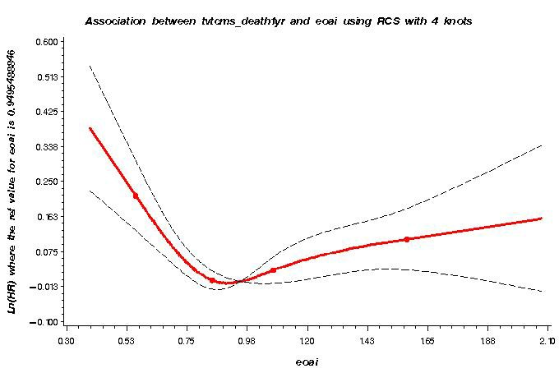
Association between adjusted mortality and EOAI.
The figure displays the log hazard ratio of EOAi and one year mortality adjusting for the pre-specified covariates. Modeling EOAI as a cubic spline resulted in a global chi-square test statistic of 2589.75. When the measurement was modeled as a linear spline with the inflection point at 0.85 cm2/m2, the global chi-square test statistic is 2602.52.

Slide 20
Limitations
This is an observational registry study and has the inherent limitations associated with retrospective analyses, including residual measured and unmeasured confounding.
Data is site-reported, but the ACC NCDR warehouse and DCRI data analysis center both implement data quality checks, including feedback reports, and examine data ranges and consistency to optimize completeness and accuracy. Sites receive data dictionaries and use standard definitions. Third party audits are randomly conducted at 10% sites annually.
EOAI was calculated from individual patient-measured hemodynamics at hospital discharge.
It is possible that these measurements could be influenced by peri-procedural issues and might be more accurate if obtained at a later time point. However, a separate analysis of 30- day survivors did not suggest an effect on our conclusions.
Furthermore, our measured values for EOAI are consistent with prior studies and more accurate than those obtained by projection or geometric measurement.

Slide 21
Discussion Questions and Answers
What can be done to avoid severe PPM?
Surgery
Root enlargement or replacement
Prostheses with thinner sewing rings, supra-annular valves, sutureless valves
Transcatheter
High SE placement
Larger prosthesis based on annulus area/perimeter and shape
Different hemodynamics of the same manufacturer labelled valve size (supra-annular SE)
Fracture of surgical prosthesis for VIV
Consider surgery for appropriate patients

Slide 22
Discussion Questions and Answers
Why increase in HF hosp, but no improvement in QOL?
First study to use quantitative assessment of QOL for PPM after AVR (surgical and transcatheter)
Reasons for discrepancy:
Missing QOL data at 1 year (~1/4 had KCCQ, 2/3 of these had > 50% completeness at 1 year)
Statistical methods: imputing with inverse probability weighting
Self-reported perception of QOL (improved in all patients)
Changes in therapy after a HF hospitalization
Survival bias
Why exclude 1st and 99th percentile of EOAI?
Account for data entry and measurement errors
Include as many patients/data as possible

Slide 23
Discussion Questions and Answers
Why are the effects of PPM after SAVR inconsistent?
Many studies use predicted EOAI (manufacturer’s data, literature-derived values, measured geometry), not in-vivo data
Some studies only use gradient
Some studies do not adjust for other co-variates
Largest study (Fallon et al) used manufacturer data (? Overly optimistic EOA) and had very high rate of moderate ( 54%) PPM and ?low rate of severe PPM
Why not adjust PPM cut-offs for BMI?
Rationale: CO requirements may be greater in large patients, though they may exercise less.
The effect of severe PPM varies: higher in lower BMI (Mohty) or lower BMI (Fallon) , hence a lower EOAI may be appropriate (VARC2: severe <0.6 (instead of 0.65) cm2/m2 for BMI >30 kg/m2)
However, CO requirements do not increase linearly with BMI, and may differ by age and ratio of fat- free muscle mass to fat mass
Surgical studies have differed on effects of severe PPM based on BMI
Mohty et al (JACC): increased effect of severe PPM on mortality with lower BMI
Fallon et al (JTCVS): enhanced effect of severe PPM on mortality with higher BMI
Bridges et al (JTCVS): lower operative mort with increasing BSA when EOA constant
We did not find an interaction with BMI:
Overall BMI by Severe PPM Interaction | 1.611 | 0.204
Severe PPM vs No Severe PPM BMI <30 kg/m2 | 1.149 (1.031, 1.281)
Severe PPM vs No Severe PPM BMI >=30 kg/m2 | 1.277 (1.115, 1.464)

