Slide 1
A naturally randomized trial evaluating the potential clinical benefit of triglyceride lowering therapies on the risk of coronary heart disease
Brian A. Ference MD, MPhil, MSc, John J. P. Kastelein MD, PhD, Kausik K. Ray MD, MPhil, Henry N. Ginsberg MD, M. John Chapman PhD, DSc, Chris J. Packard DSc, Ulrich Laufs MD, PhD, Adam S. Butterworth PhD, Emanuele Di Angelantonio, MD, John Danesh FRCP, DPhil, Stephen J. Nicholls MBBS, PhD, Deepak L. Bhatt, MD, MPH, Marc S. Sabatine MD, MPH, and Alberico L. Catapano PhD

Slide 2
Declaration of Interest
Research Grants: Merck, Novartis, Amgen, Esperion Therapeutics, Ionis Pharmaceuticals Consulting Fees, Advisory Boards, Honoraria: Merck, Amgen, Pfizer, Regeneron, Sanofi, Ionis Pharmaceuticals, dalCOR, The Medicines Co; CiVi Pharma; KrKa Phamaceuticals, Medtronic, Celera, Quest Diagnostics, American College of Cardiology, European Atherosclerosis Society

Slide 3
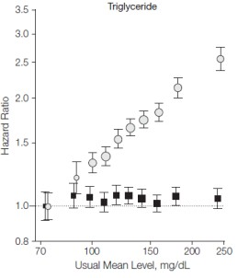
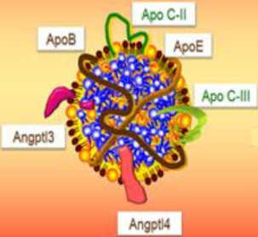
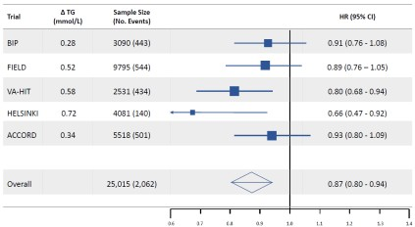
Background: Triglycerides and risk of CHD
Observational epidemiology
LPL pathway genetic variants
Fibrate randomized trials
Emerging Risk Factors Collaboration. JAMA. 2009;302(18):1993-2000.
BIP: Circulation. 2000;102:21-27; Field: Lancet 2005; 366: 1849–61; VA-HIT: N Engl J Med 1999;341:410-8; Helsinki: N Engl J Med 1987;317:1237-45; ACCORD: N Engl J Med 2010;362:1563-74.

Slide 4
Objectives
To estimate the potential clinical benefit of lowering triglycerides through the LPL pathway
By comparing the effect of lipoprotein lipase (LPL) genetic variants that mimic therapies that lower triglyceride through the LPL pathway with the effect of LDL receptor (LDLR) variants that mimic the effect of therapies that lower LDL-C through up-regulation of the LDL receptor on the risk of cardiovascular events

Slide 5
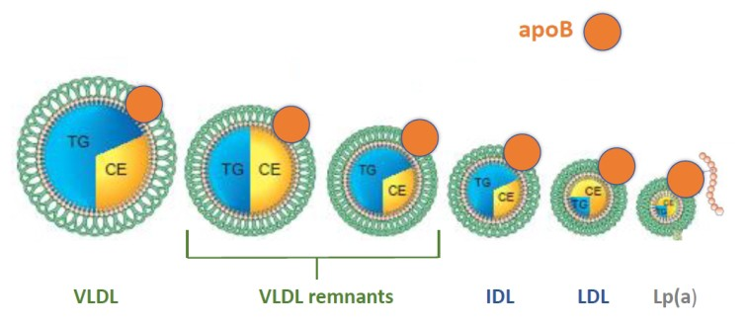
Directly comparing effect of lowering triglycerides and LDL-C on CHD
Triglyceride-rich VLDL and their remnants particles, and LDL particles each have one apoB100
Therefore, the effect of lowering triglycerides on the risk of cardiovascular events can be directly compared with the effect of lowering LDL-C by comparing their effects per unit change in apoB

Slide 6
Study Design
Naturally Randomized Trial
triglyceride lowering via LPL
Naturally Randomized Trial
LDL-C lowering via LDLR
Eligible Population
Eligible Population
LPL variants associated with lower triglycerides
(Naturally Random Allocation of Alleles)
LDLR variants associated with lower LDL-C
(Naturally Random Allocation of Alleles)
Lower triglyceride Allele
(Treatment Arm)
Other Allele
(Usual Care Arm)
Lower LDL-C Allele
(Treatment Arm)
Other Allele
(Usual Care Arm)
Δ triglycerides, LDL-C, apoB
Δ LDL-C, triglycerides, apoB
Incident Major Cardiovascular Events
Incident Major Cardiovascular Events

Slide 7
Primary Outcomes and Study Sample
Primary clinical outcome: coronary heart disease (CHD) defined as the first
occurrence of non-fatal MI, coronary revascularization or coronary death
Primary biochemical outcomes: changes in plasma triglycerides, LDL-C and apoB levels determined by LPL and LDLR genetic scores
Study population: 654 783 participants from 63 studies (91 129 cases of CHD)
Individual participant data: 470 478 participants (including UK Biobank), 328 cases of CHD
30
Summary level data: 184,305 participants (CARDIoGRAMplusC4D Consortium), 60 801 cases of CHD

Slide 8
Baseline Characteristics
Baseline Characteristic Mean (SD or IQR)
Sample Size (individual participant data) 470,478
No. Included Studies 15
CHD cases 30,328
Age (years) 63.9 (± 7.8)
Women (%) 54.2%
Systolic Blood Pressure (mmHg) 132.1 (± 18.2)
Diastolic Blood pressure (mmHg) 80.9 (± 9.3)
Body mass index (kg/m2) 27.5 (± 4.9)
Prevalent Diabetes (%) 4.6
Current smoker (%) 9.2
total cholesterol (mg/dl) 206.6 (± 39.4)
Low density lipoprotein cholesterol (mg/dl) 129.7 (± 32.1)
High density lipoprotein cholesterol (mg/dl) 52.0 (± 15.4)
Triglycerides (mg/dl) 117.6 (84 - 163)
Non-high density lipoprotein cholesterol (mg/dl) 154.9 (± 38.3)
Apolipoprotein B (mg/dl) 101.4 (± 27.3)

Slide 9
LPL and LDLR genetic scores
LPL genetic score
_{SNP} Effect |  | Effect Allele | Sample _{TG (mg/dl) P} LDL-C _{P}
 | Allele | frequency | Size (n) |  |  | (mg/dl)
rs1801177 | G | 0.987 | 304,596 | -15.01 | 1.97E-61 | -0.29 | 0.374
rs268 | A | 0.982 | 290,452 | -18.79 | 9.60E-126 | -0.59 | 0.074
rs301 | C | 0.237 | 305,699 | -9.14 | 2.08E-336 | 0.11 | 0.273
rs326 | G | 0.305 | 305,699 | -14.91 | 3.80E-388 | 0.01 | 0.867
rs328 | G | 0.098 | 305,699 | -9.37 | 1.97E-203 | 0.40 | 0.005
LDLR genetic score
Effect Allele
SNP
Effect
Sample
TG (mg/dl)
p
LDL-C (mg/dl)
P
 | Allele | frequency | Size (n)
rs6511720 | T | 0.1086 | 295,826 | -3.12 | 0.128 | -6.7657 | 3.69E-538
rs1122608 | T | 0.2266 | 262,102 | -1.67 | 0.015 | -2.1179 | 2.02E-86
rs688 | C | 0.5586 | 166,792 | -0.29 | 0.229 | -1.728 | 3.04E-48

Slide 10
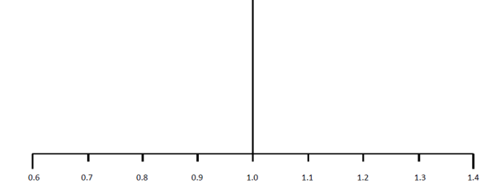
Effect of LPL and LDLR scores on lipids & CHD per unit change apoB
Genetic Score
∆ triglycerides, mg/dL ∆ LDL-C, mg/dL (95%CI) (95%CI)
OR _{CHD} (95% CI)
per 10 mg/dl lower apoB
-69.9 (-68.3, -71.6)
p = 7.1x10 ⁻¹³⁶³
0.7 (0.0, 1.4)
p = 0.039
0.771 (0.741 - 0.802)
p = 3.9x10 ⁻³⁸
LPL score
-1.9 (-0.1, -3.9)
p = 0.036
-14.2 (-13.6, -14.8)
p = 1.4x10 ⁻⁴⁶⁵
0.773 (0.747 - 0.801)
p = 1.1x10 ⁻⁴⁶
LDLR Score
Effects on lipids and CHD for a common 10 mg/dL decrease in apoB-containing lipoproteins

Slide 11
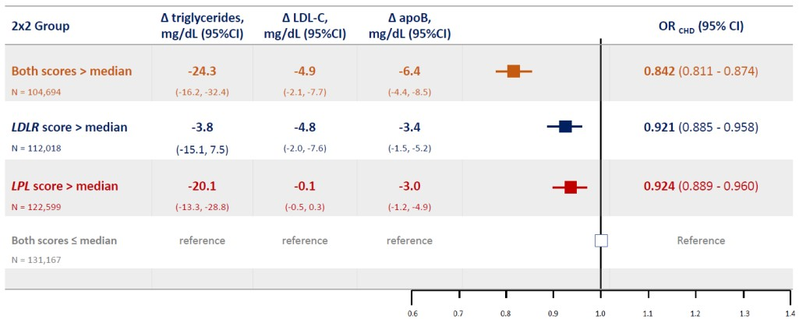
Combined effect of LPL and LDLR scores on lipids & CHD
2 x 2 factorial analysis

Slide 12
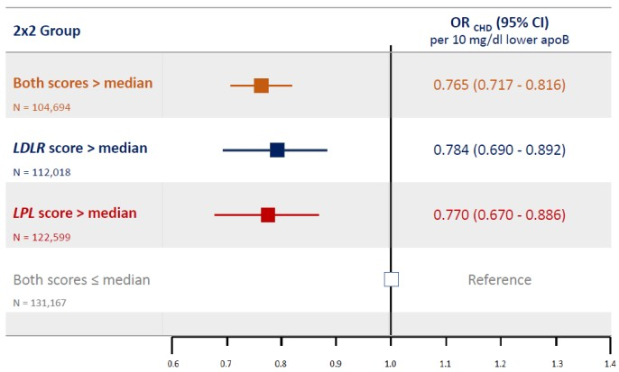
Combined effect of LPL and LDLR scores on lipids & CHD
Per 10 mg/dl lower apoB

Slide 13
Conclusions
Despite very different effects on plasma lipid levels, triglyceride lowering LPL variants and LDL-C lowering LDLR variants had the same effect on the risk of CHD per unit change in apoB – suggesting that all apoB100-containing lipoproteins have the same effect on the risk of CHD
Therefore, the clinical benefit of triglyceride lowering therapies (particularly those acting through the LPL pathway) should be proportional to the absolute reduction in apoB, not the change in plasma triglyceride concentration
More generally, the clinical effect of any lipid lowering therapy, or combination of TG and LDL lowering therapies, on the risk of cardiovascular events should be proportional to the absolute change in apoB, regardless of the change in triglycerides or LDL-C

