Slide 1
Long Term Effect of Bioresorbable Scaffolds and Metallic Drug Eluting Stents on Human Coronary Hemodynamics. Results of the Absorb II Randomized Trial Physiology Substudy
Javier Escaned MD PhD, on behalf of the Absorb II Physiology Substudy investigators

Slide 2
Javier Escaned MD PhD
I have the following potential conflicts of interest to report in the field of this presentation:
Speaker at educational events and/or consultancies: Abbott, Boston Scientific, Opsens, Philips Healthcare

Slide 3
Background
The long-term effect of bioresorbable vascular scaffold (BRS) on epicardial coronary vessels and the subtended microcirculation, compared to implanted metallic stents, remains largely unknown.
This missing information is key in supporting the overall concept of vascular restoration therapy and, thereby informing further advancement in this technology.

Slide 4
Study design
In this sub-study of the ABSORB II trial we compared long-term physiologic status after BVS or EES implantation. ¹
Patients undergoing scheduled follow-up angiography at 3 ABSORB II centres in The Netherlands underwent physiological interrogation of the treated vessel with intracoronary flow velocity and pressure.
Obtained tracings were analysed at a core laboratory, blinded to randomisation, clinical and angiographic data. A per-vessel analysis was performed.
1) Serruys PW et al. Lancet 2016;388:2479-2491.

Slide 5
A glossary of physiological indices used
Index | Type of information
Epicardial conductance¹ | Effective blood transportation through the epicardial vessel
Microcirculatory conductance² | Degree of microvascular structural remodelling
Zero flow pressure³ | Extravascular compression of capillaries
Forward waves distal to PCI site⁴ | Viscoelasticity of PCI-treated segment
Backward expansion wave⁵ | Capillary density downstream treated vessel
Van de Hoeven N et al. EuroIntervention. 2019:14:e1593-e1600.
Escaned J et al. Circulation 2009: 20(16):1561-8
Teunissen PF et al. Circ Cardiovasc Interv. 2015;8:e001786.
4) Davies JE et al Am J Physiol Heart Circ Physiol. 2006;290:H878-85.
5) Broyd C et al. Eur Heart J. 2018;39:1807-1814

Slide 6
Physiological interrogation / Coronary conductance
IHDVPS Pd
IHDVPS Pa
C_{micro} = IHDVPS_{Pd}
Pressure (Pa, Pd)
Flow velocity (cm/s)
IHDVPS_{Pd} x IHDVPS_{Pa}
C_{epi} =
IHDVPS_{Pd} - IHDVPS_{Pa}
Flow velocity
IHDVPS: Instantaneous hyperemic diastolic velocity pressure slope
Pressure (Pa, Pd) (mm Hg)
EKG, hyperemic pressure (Pa and Pd) and flow velocity were used to generate pressure-velocity loops. From these, diastolic conductance of the epicardial vessel (C_{epi}) and the microcirculation (C_{micro}) were calculated separately. Zero flow pressure (Pzf, red circle) was also calculated
Van de Hoeven N et al. EuroIntervention. 2019:14:e1593-e1600.

Slide 7
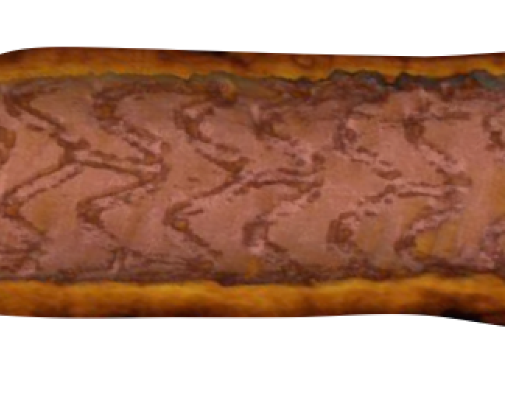
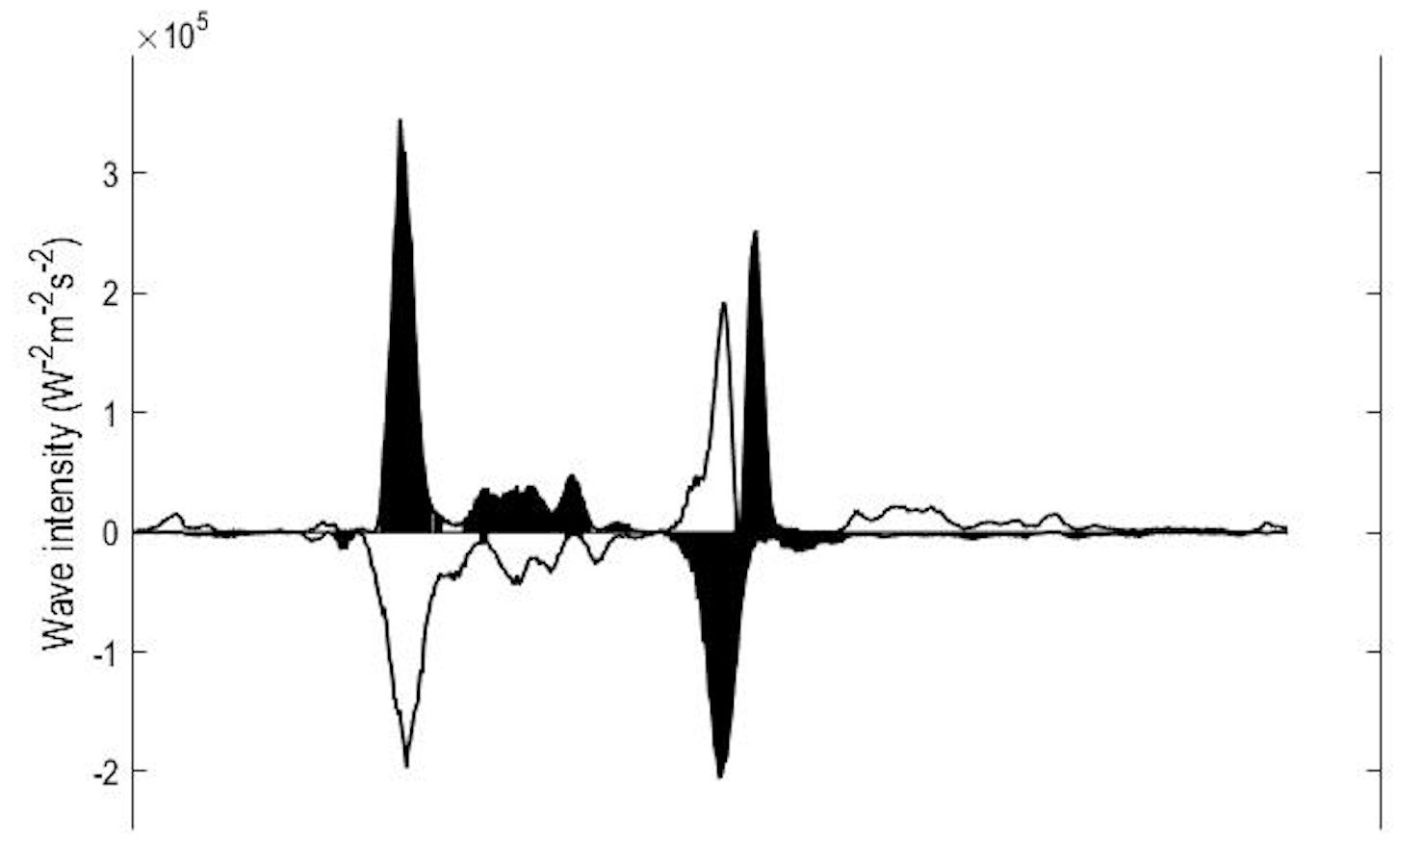
Physiological interrogation / Wave intensity
Forward wave
EKG, resting pressure (Pa and Pd) and flow velocity were used to perform wave intensity analysis. From this, forward and backward waves in the coronary circulation were calculated separately.
Davies J et al Circulation. 2006;113(14):1768-78.

Slide 8
Study population
31 patients /32 vessels initially included
3 patients excluded due to suboptimal physiological tracings.
Study population: 28 patients / 29 vessels
No significant diferences in age, gender, cardiovascular risk factors, renal function or treated vessel between EES- and BRS-treated patients.

Slide 9
Pre-procedural and post-PCI data
 | BRS (n=13) | EES (n=16) | P value
Diameter stenosis (%) | 61 ± 9 | 62 ± 12 | 0.850
Lesion length (mm) | 13 ± 5 | 11 ± 3 | 0.259
Reference vessel (mm) | 2.7 ± 0.4 | 2.5 ± 0.3 | 0.310
Device diameter (mm) | 3.1 ± 0.2 | 3.0 ± 0.2 | 0.139
In-stent diameter stenosis after PCI (%) | 16 ± 6 | 8 ± 6 | 0.004

Slide 10
3-year angiographic and FFR results
 | BRS (n=13) | EES (n=16) | P value
Reference vessel (mm) | 2.74 ± 0.40 | 2.58 ± 0.31 | 0.333
In-stent MLD (mm) | 2.13 ± 0.46 | 2.26 ± 0.35 | 0.478
In-stent diameter stenosis (%) | 22 ± 9 | 13 ± 7 | 0.01
Late loss (mm) | 0.24 ± 0.25 | 0.18 ± 0.28 | 0.601
FFR | 0.91 ± 0.04 | 0.91 ± 0.07 | 0.902

Slide 11
Physiological findings in epicardial vessels (3Y FU)
Epicardial conductance
Fwd compression wave
Fwd expansion wave

Slide 12
Rationale for improved wave transmission in BRS
BEW
BEW

Slide 13
Physiological findings in the microcirculation (3Y FU)
Microcirculatory conductance
Zero flow pressure
Backward expansion wave

Slide 14
Conclusions
In the long-term, implantation of BRS results in better epicardial vessel function than EES, with
a) better epicardial conductance
b) preserved viscoelastic properties and transmission of flow waves
In the long-term, BRS use was not associated to better microvascular function than EES.
These findings support the existence of favourable long-term differences in vascular mechanics of BRS-treated vessels, as compared with those treated with metallic stents.

Slide 15
ABSORB II Physiology Substudy Team
Principal Investigator: Patrick W. Serruys – Rotterdam, NL
Co-Principal Investigator: Bernard Chevalier – Massy, FR
Physiology substudy PIs: Javier Escaned – Madrid, ES
Yoshinobu Onuma - Rotterdam, NL
Patrick W. Serruys – Rotterdam, NL
Jan Piek – Amsterdam, NL
Physiology substudy site PIs: Rene van der Schaaf – Amsterdam, NL
Robert Jan van Geuns – Rotterdam, NL
Jan Piek – Amsterdam, NL
Physiology substudy team members: A Quiros, T Asano, HJ Lee, C Broyd, Y Katagiri, T van der Hoef, M Echavarría-Pinto, N Gonzalo, N van der Hoeven, J Davies
Imaging Core Laboratory: Cardialysis – Rotterdam, NL
Sponsor: Abbott Vascular – Santa Clara, USA

