Slide 1

Structural and Hemodynamic Valve Deterioration Following Surgical AVR
Philippe Pibarot, DVM, PhD, FACC, FAHA, FASE, FESC
Canada Research Chair in Valvular Heart Diseases
Université
LAVAL

Slide 2
Structural Valve Deterioration (SVD)
SVD is the Achille’s heel of biologic AVR
In SAVR, the incidence of SVD has been established on the basis reoperation for valve failure.
This approach grossly underestimates the true incidence of SVD
Recent recommendations and position statements have proposed to identify SVD on the basis of imaging: echo and CT

Slide 3
No SVD
Morphological SVD
Moderate
Hemodynamic SVD
Severe
Hemodynamic SVD
Dvir D, Boiurguignon T, Otto C, et al. Standardized Definition of Structural Valve Degeneration for Surgical and Transcatheter Bioprosthetic Aortic Valves. Circulation 2018

Slide 4
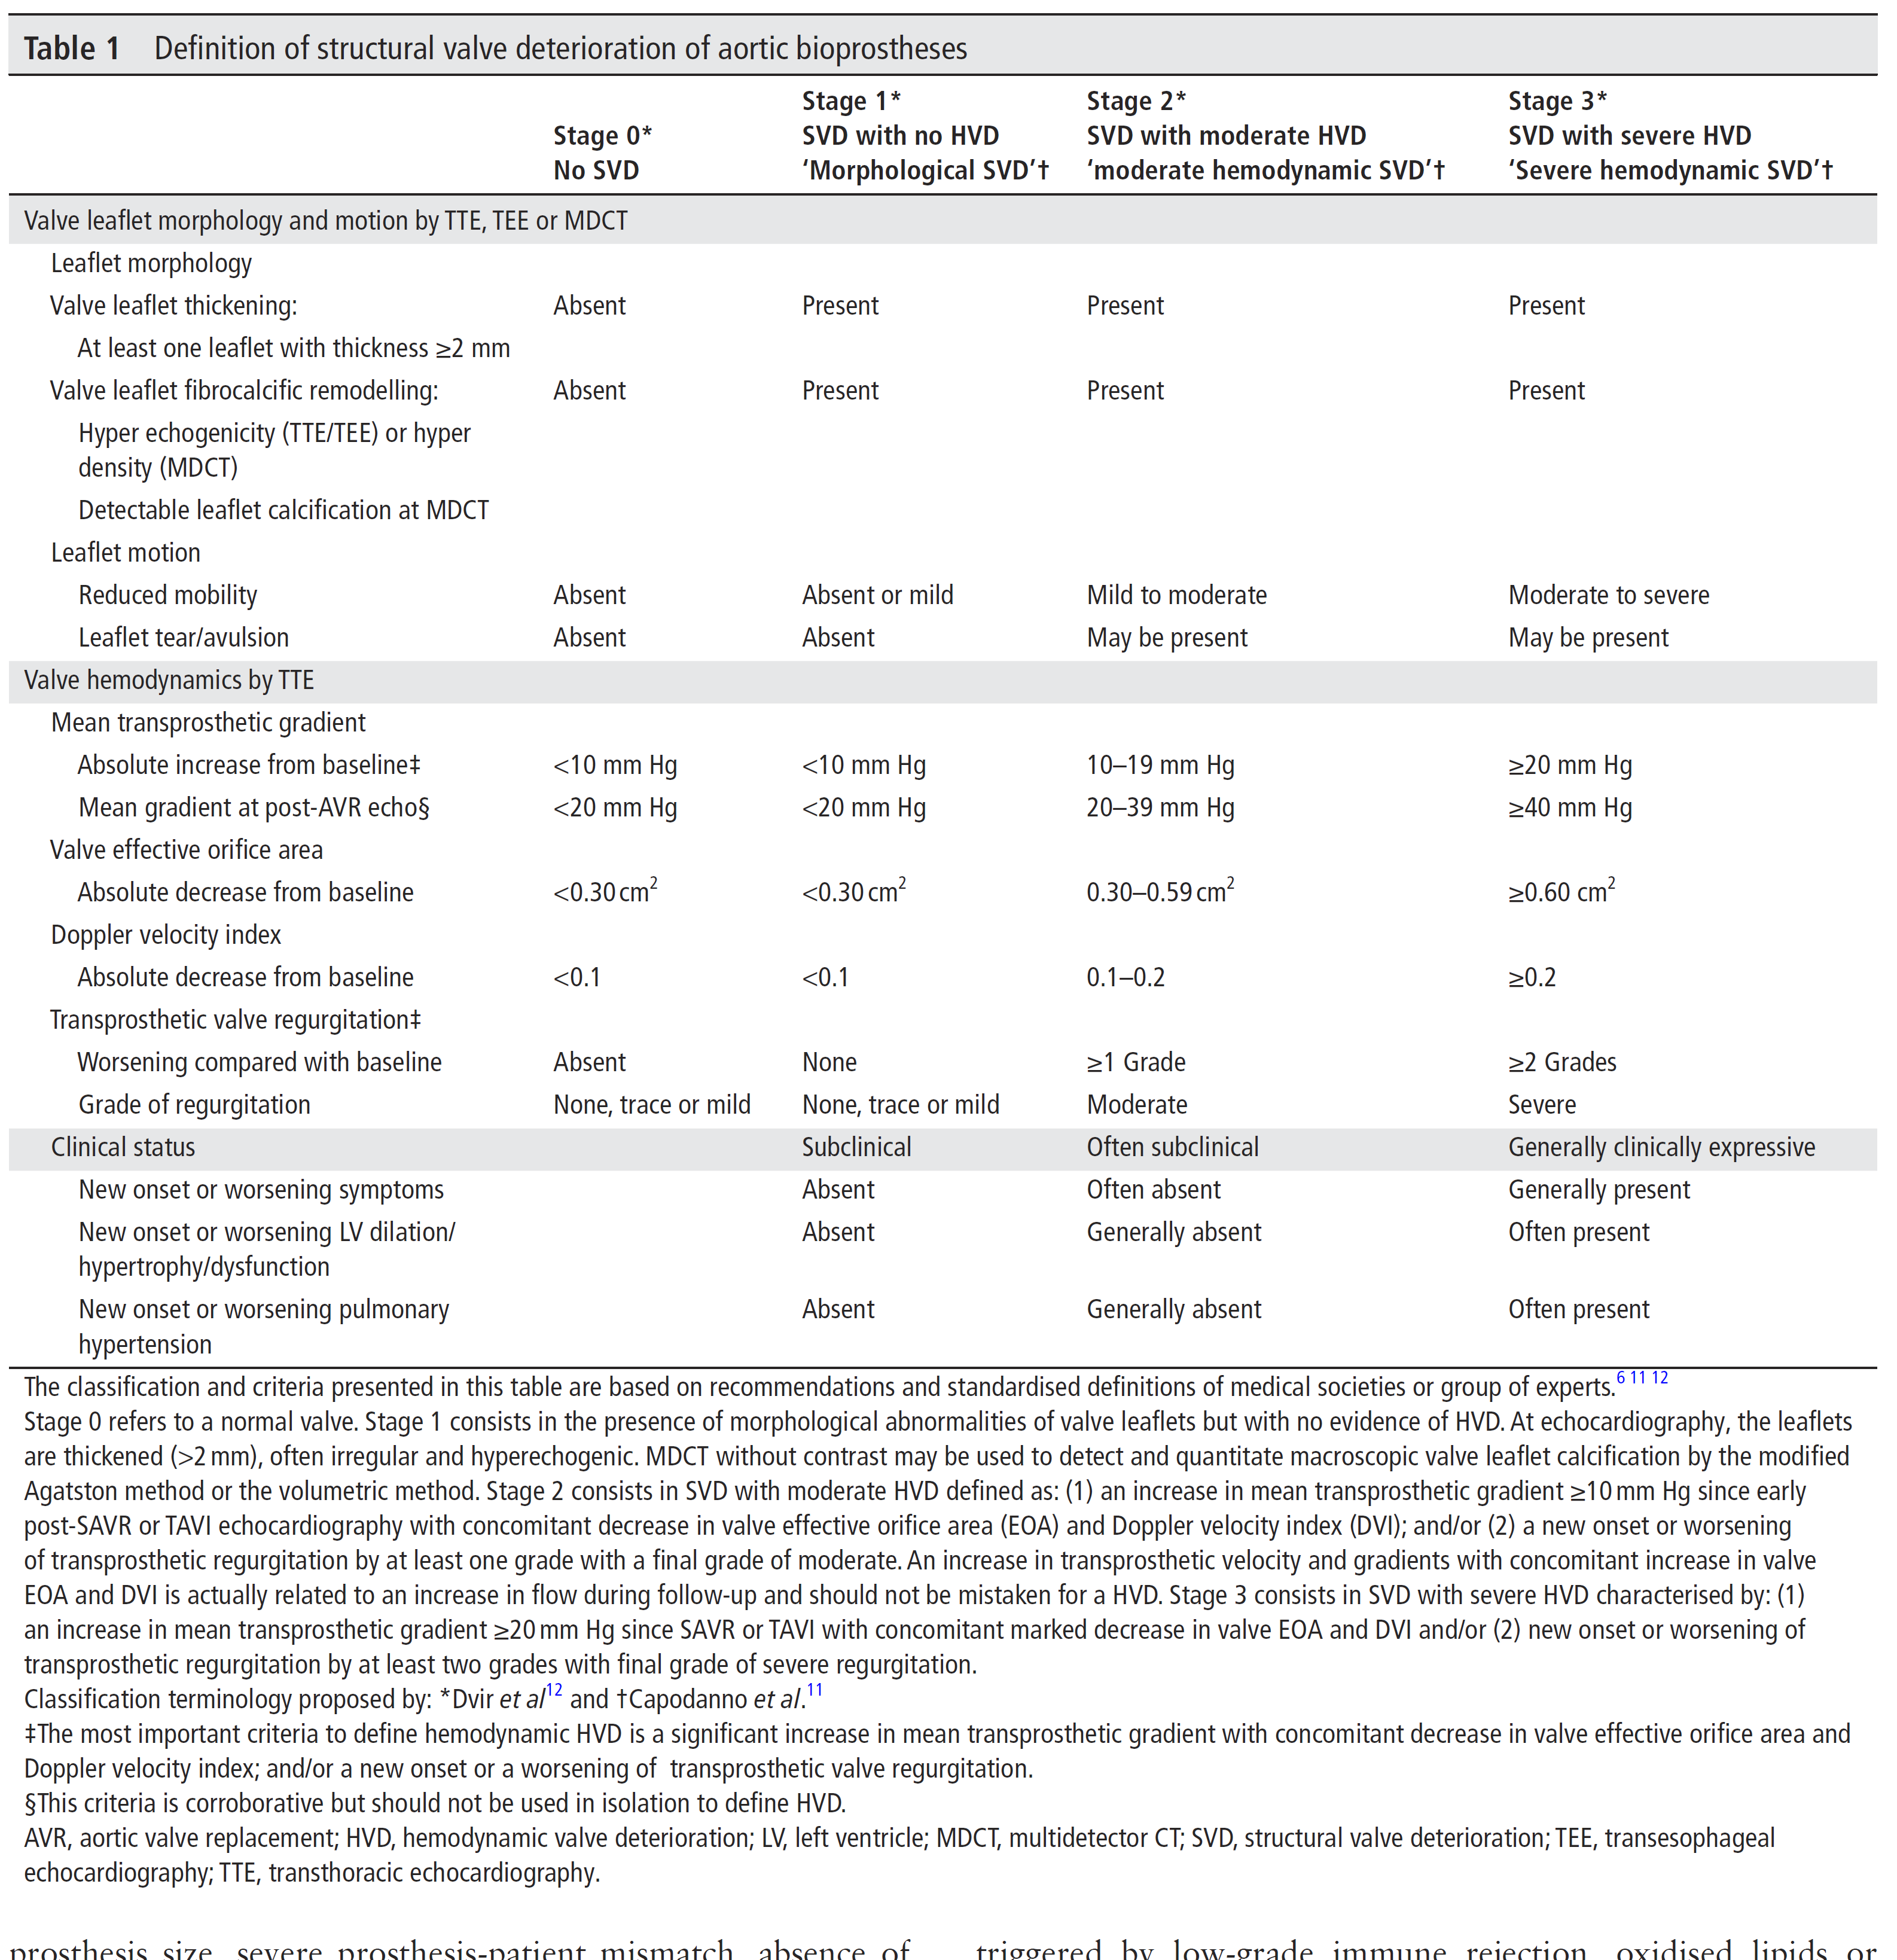
Salaun et al. Heart 2018

Slide 5
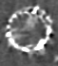
Non-contrast MDCT to assess bioprosthetic valve mineralization
Stented BP
Stented BP
Stentless BP
BE THV

Slide 7
Study Design and Follow-up
HVD: ≥ Stage 2 SVD

Slide 9
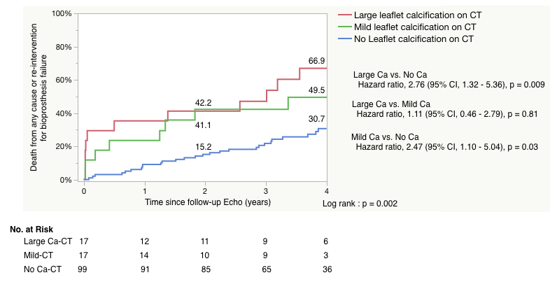
Impact of Leaflet Calcification at MDCT on Clinical Outcomes
Any degree of Leaflet Ca vs. No Ca
Large vs. Small vs. No Leaflet Ca

Slide 10
Impact of Hemodynamic SVD (≥Stage 2): i.e. HVD on Clinical Outcomes

Slide 12
Multivariable Analysis of the Factors Associated with the Primary Clinical End-Point

Slide 13
Conclusions
HVD of bioprosthetic aortic valves is often echocardiographically evident approximately 7 years post-op and is a strong predictor of adverse clinical outcomes.
Leaflet calcification identified by MDCT is an early and sensitive marker of SVD with prognostic implications additive to the hemodynamic assessment by Doppler echocardiography.
Insulin resistance and increased levels of Lp-PLA2 or PCSK9 are associated with HVD of BP aortic valves. Future studies are needed to determine whether modification of these factors can improve the durability of these prostheses.

