Slide 1
The PRECISION Trial
Prospective Randomized Evaluation of Celecoxib Integrated Safety versus Ibuprofen or Naproxen
Steven E. Nissen MD MACC
Disclosure
Study Sponsor: Pfizer
Consulting: Many pharmaceutical companies
Clinical Trials: Abbvie, Amgen, AstraZeneca, Cerenis, Eli Lilly, Esperion, Novartis, Novo Nordisk, Medtronic, The Medicines Company, and Pfizer. Companies are directed to pay any honoraria, speaking or consulting fees directly to charity so that neither income nor tax deduction is received.

Slide 2
Background
Non-steroidal anti-inflammatory drugs (NSAIDs) are amongst the most widely prescribed class of drugs in the world with 100 million prescriptions in the US in 2013.
NSAIDs inhibit cyclooxygenase (COX), which reduces pain and inflammation through inhibition of prostaglandins, but also has important vascular effects.
The withdrawal of the selective COX-2 inhibitor, rofecoxib, raised questions about CV safety of these drugs, including the sole remaining COX-2 inhibitor in USA, celecoxib.

Slide 3
Objectives of the PRECISION Trial
The primary objective was non-inferiority assessment of the cardiovascular risk of celecoxib vs. two widely used non-selective NSAIDs, naproxen and ibuprofen, in osteoarthritis and rheumatoid arthritis patients.
Other objectives included comparative safety of celecoxib vs. these two NSAIDs for all-cause mortality, gastrointestinal and renal adverse events

Slide 4
Executive Committee
Steven E. Nissen MD Cardiology (Study Chair)
Jeffrey Borer MD Cardiology
David Y. Graham MD Gastroenterology
M. Elaine Husni MD MPH Rheumatology
Peter Libby MD Cardiology
Michael Lincoff MD Cardiology
Thomas F. Lüscher MD Cardiology
Daniel H. Solomon MD MPH Rheumatology
Neville D. Yeomans MD Gastroenterology
Michael Gaffney PhD Sponsor (non-voting)
All members of the Executive Committee agreed not to accept payments for related work on NSAIDs from any maker of these drugs

Slide 5
PRECISION Trial Design
Osteoarthritis or rheumatoid arthritis patients with established CV disease or increased risk who required NSAIDs for ≥ 6 months for symptom relief
Celecoxib 100 mg b.i.d
Ibuprofen 600 mg t.i.d
Naproxen 375 mg b.i.d.
Esomeprazole 20-40 mg
Option to increase dosage for unrelieved symptoms to the maximum approved by local regulatory authorities
Event driven trial with a minimum follow up of 18 months

Slide 6
Adjudicated Endpoints
For noninferiority, the primary analyses used the APTC endpoint: cardiovascular death, including hemorrhagic death; nonfatal myocardial infarction or nonfatal stroke.
Superiority comparisons:
Major adverse cardiovascular events –APTC endpoint plus revascularization, hospitalization for unstable angina or TIA.
Major gastrointestinal events, including iron deficiency anemia of GI origin (HCT drop >10%, Hgb > 2 gms).
Major renal events (including hospitalization for renal failure).
Hospitalization for hypertension or CHF

Slide 7
Study Milestones and Drug Exposure
31,857 patients screened and 24,081 randomized at 926 global centers beginning October 23, 2006
Drug exposure (all now generic in USA):
Celecoxib mean daily dose, 104 mg b.i.d.
Ibuprofen mean daily dose, 681 mg t.i.d.
Naproxen mean daily dose, 426 mg b.i.d.
Mean drug exposure 20.3 months and mean follow up 34.1 months.

Slide 8
Noninferiority Criteria
To establish noninferiority, the trial design required pairwise comparison of the drugs to meet four criteria:
An upper 97.5% confidence interval (CI) ≤1.33 for intention-to-treat (ITT) analysis
An upper 97.5% CI ≤ 1.40 for on-treatment analysis (defined as events occurring while the patient taking study drug and 30 days thereafter)
A HR ≤ 1.12 for both ITT and on-treatment populations

Slide 9
Rationale for ITT and On-Treatment Analyses
Intention-to-treat (ITT) analysis is preferred in efficacy studies because it preserves the integrity of randomization and represents a conservative assessment of benefits.
However, ITT analysis can dilute safety signals by including events occurring after patients stop the therapy.
On-treatment analysis offers complementary insights in safety studies because it includes events occurring only while patients are actually taking study drugs.
To ensure a rigorous safety assessment, we prespecified achieving noninferiority using both approaches.

Slide 10
Selected Baseline Characteristics
Characteristic | Celecoxib N=8072 | Ibuprofen N=8040 | Naproxen N=7969
Age (years) | 63.0 | 63.2 | 63.3
Female Gender | 64.1% | 64.4% | 63.9%
White | 75.0% | 74.5% | 74.4%
Osteoarthritis | 89.9% | 89.6% | 90.1%
Rheumatoid Arthritis | 10.1% | 10.4% | 9.9%
Secondary Prevention | 23.1% | 22.8% | 22.4%
Prior aspirin use | 45.8% | 46.2% | 45.8%
Diabetes | 35.2% | 35.9% | 34.7%
Current smoker | 20.9% | 20.9% | 20.5%
Systolic BP (mm Hg) | 125.3 | 125.4 | 125.0

Slide 11
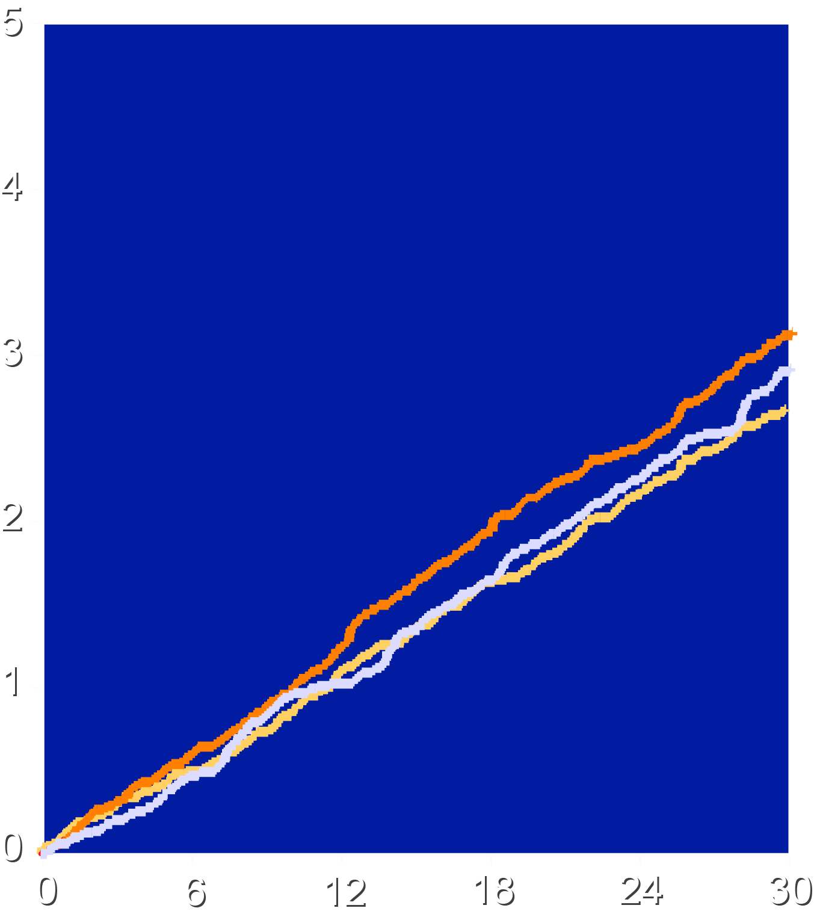
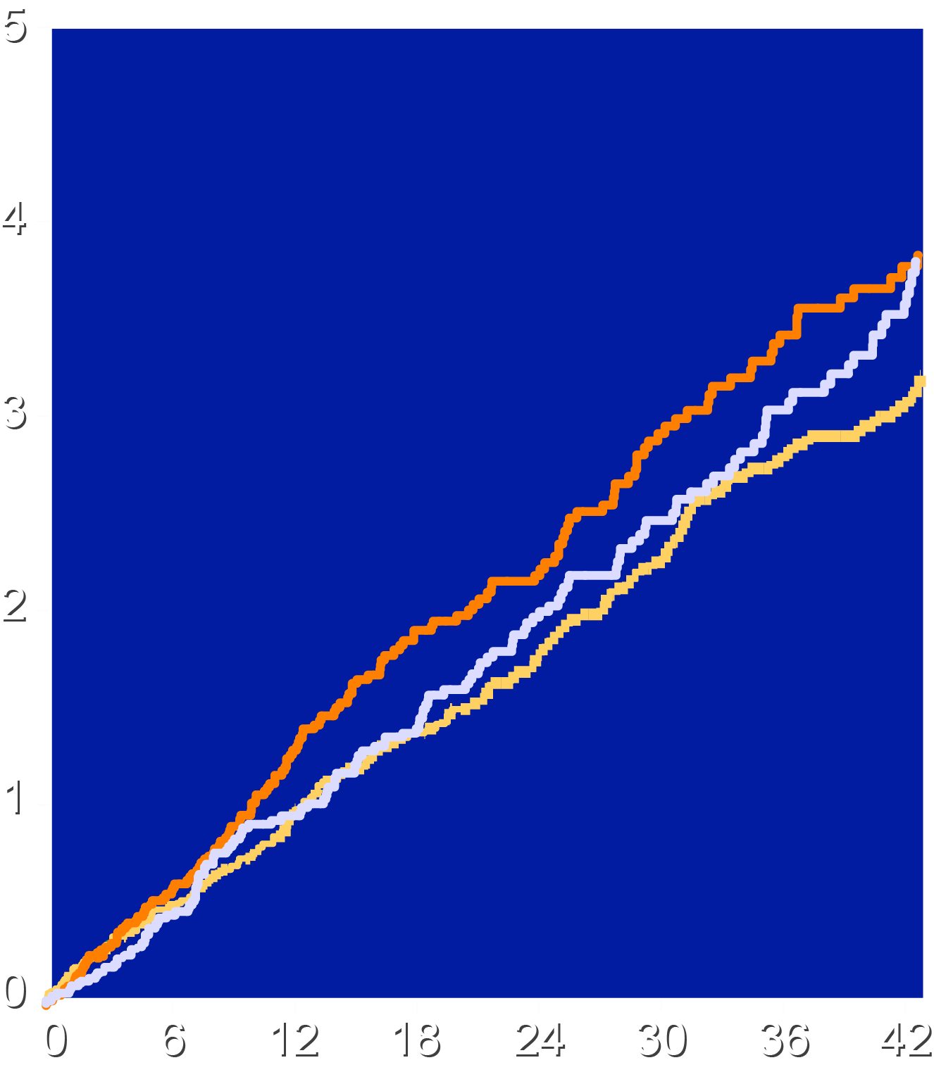
Noninferiority Analysis for Primary APTC Endpoint
Intention-to-Treat
On-Treatment
Cele vs. Ibu, HR 0.85 (0.70-1.04), P<0.001* Cele vs. Nap, HR 0.93 (0.76-1.12), P<0.001* Ibu vs. Nap, HR 1.08 (0.90-1.31), P<0.02*
Cele vs. Ibu, HR 0.81 (0.65-1.02), P<0.001* Cele vs. Nap HR 0.90 (0.71-1.15), P<0.001* Ibu vs. Nap HR 1.12 (0.89-1.4), P<0.025*
Patients with an Event (%)
Ibuprofen
Naproxen
Celecoxib
Ibuprofen
Naproxen
Celecoxib
*Noninferiority p values
Months Since Randomization
Months Since Randomization

Slide 12
Superiority Analyses of Secondary Endpoints
Secondary and tertiary analyses should be viewed as hypothesis-generating, rather than conclusive, and are not adjusted for multiplicity.
We will present the ITT analyses as primary, but for completeness, also report on-treatment HRs and 95% CIs (without P values) as a sensitivity analysis.

Slide 13
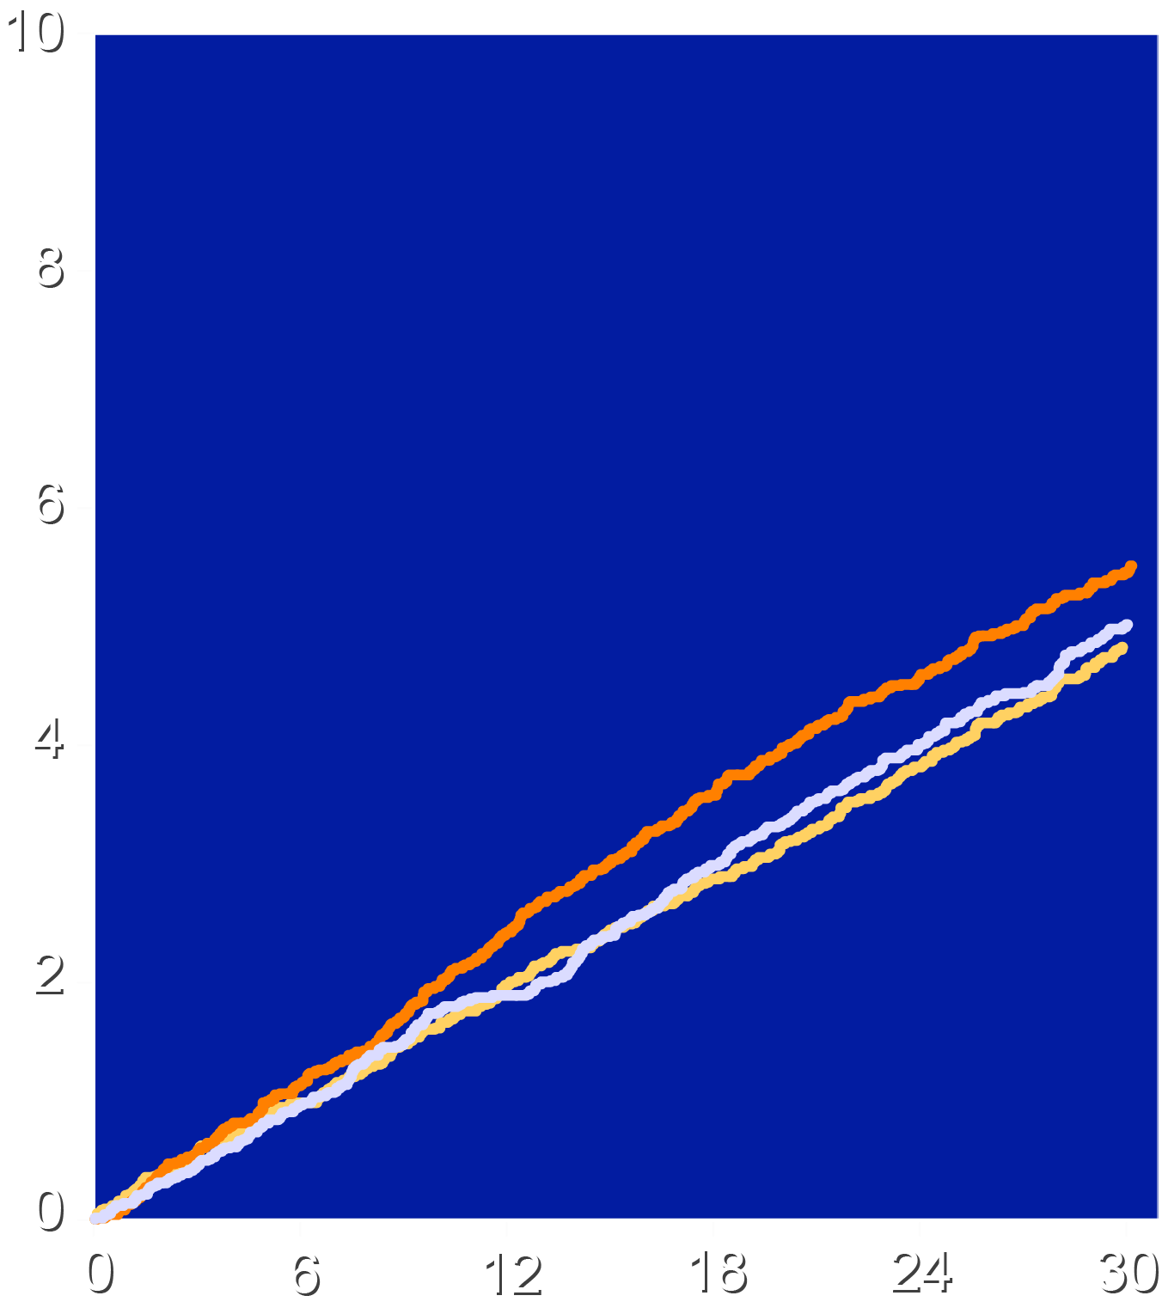
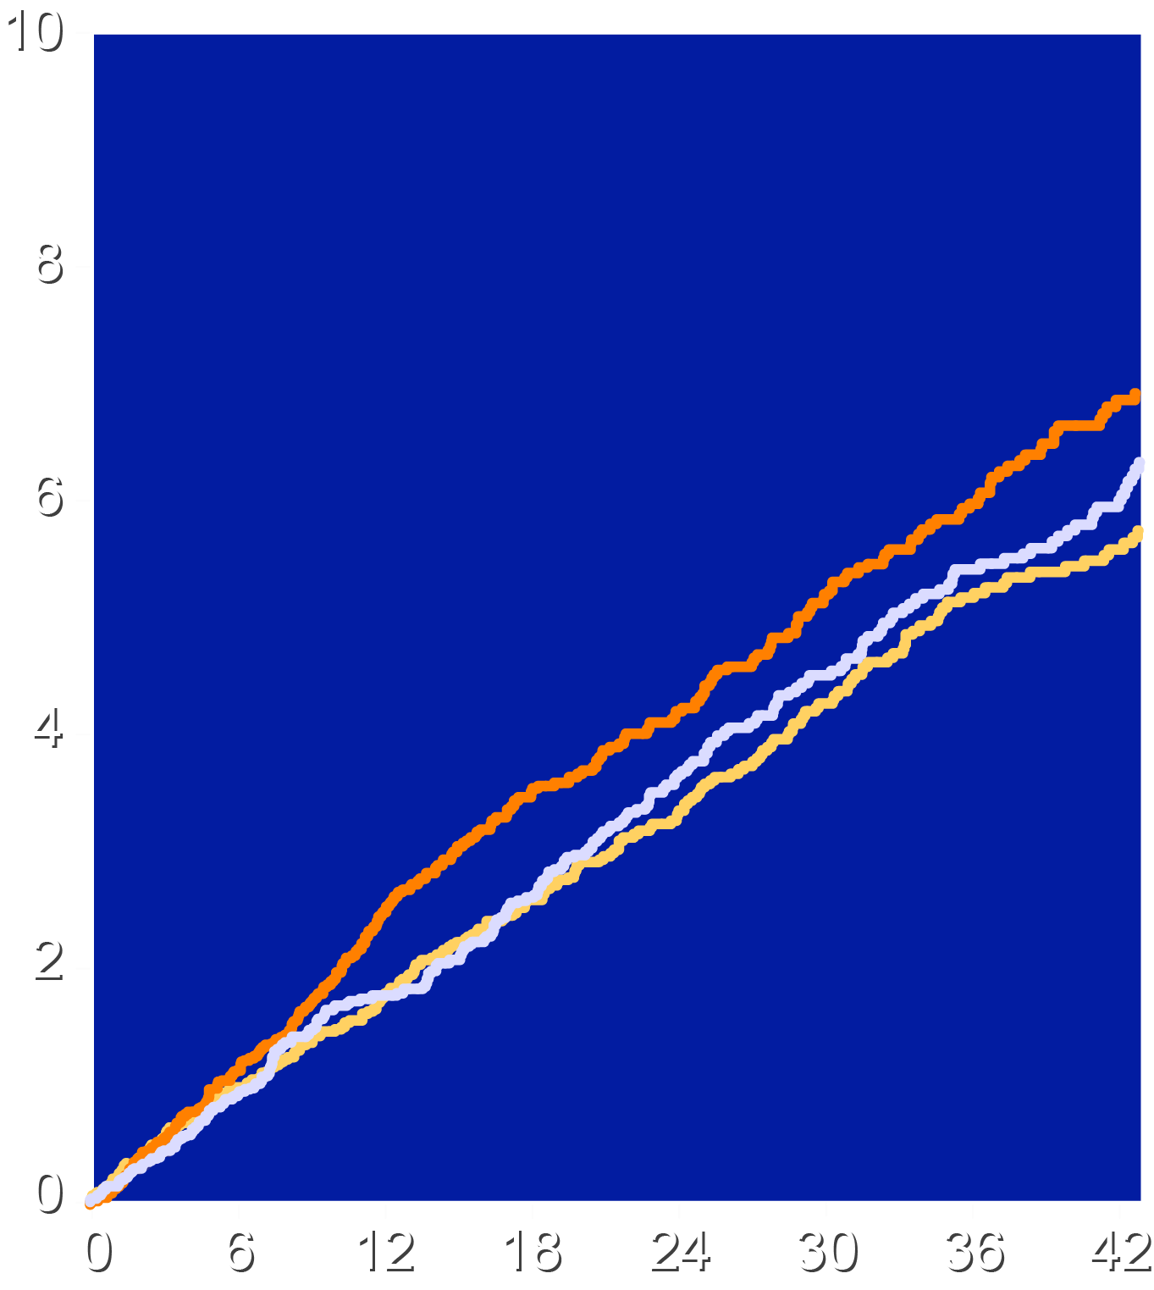
Time-to-Major Adverse Cardiovascular Event
Intention-to-Treat
On-Treatment
Cele vs. Ibu, HR 0.87 (0.75-1.01), P=0.06
Cele vs. Ibu, HR 0.82 (0.69-0.97)
Cele vs. Nap, HR 0.97 (0.83-1.12), P=0.64
Cele vs. Nap, HR 0.95 (0.80-1.13)
Ibu vs. Nap, HR 1.11 (0.96-1.29), P=0.15
Ibu vs. Nap, HR 1.17 (0.99-1.38)
Ibuprofen 15% higher
(borderline significant)
Patients with an Event (%)
Ibuprofen
Naproxen
Celecoxib
Ibuprofen
Naproxen
Celecoxib
Months Since Randomization
Months Since Randomization

Slide 14
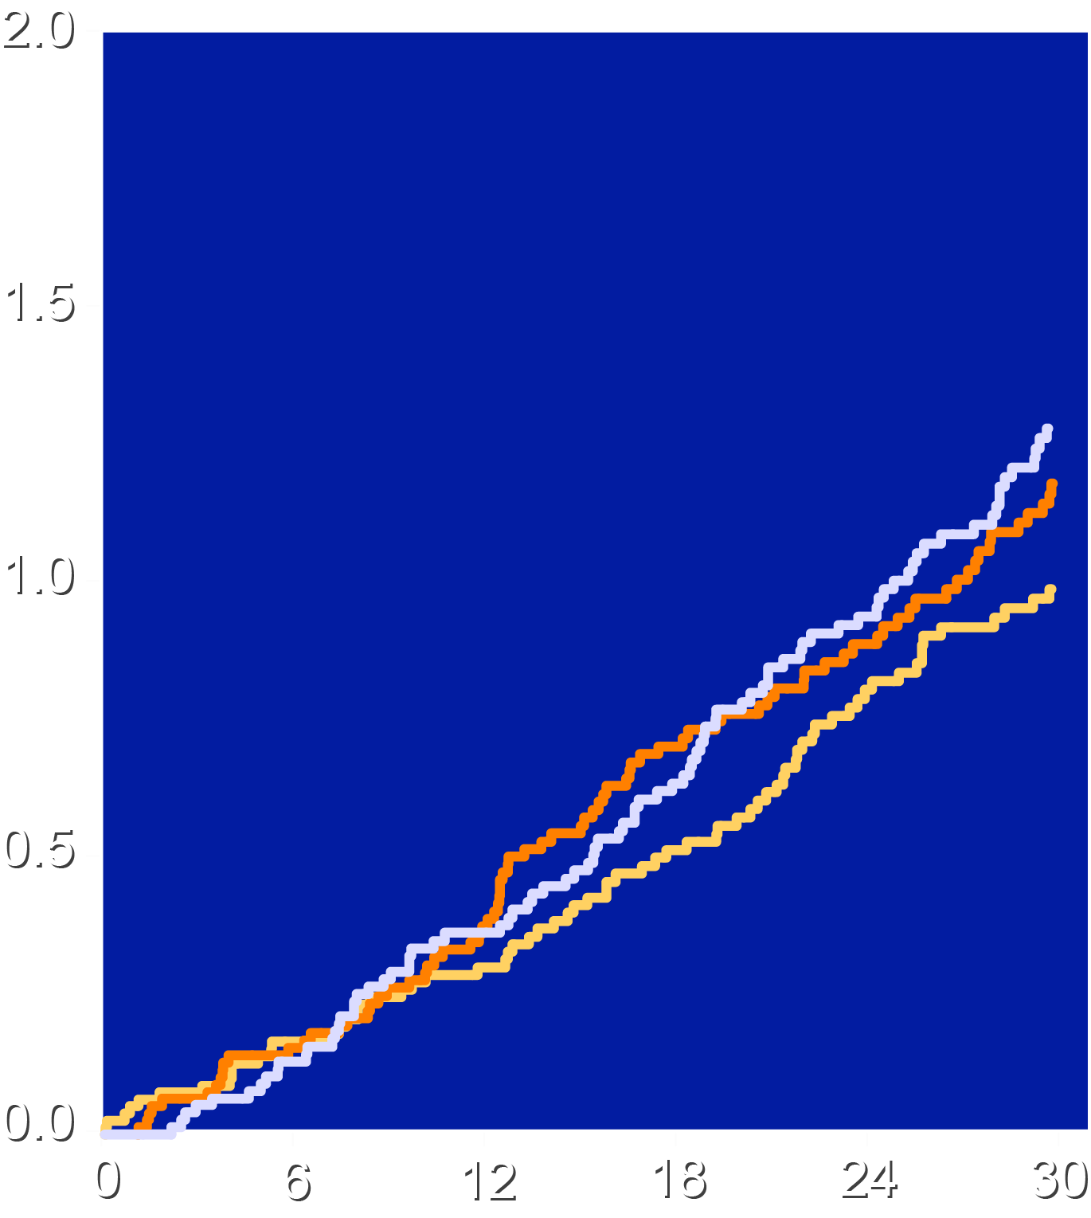
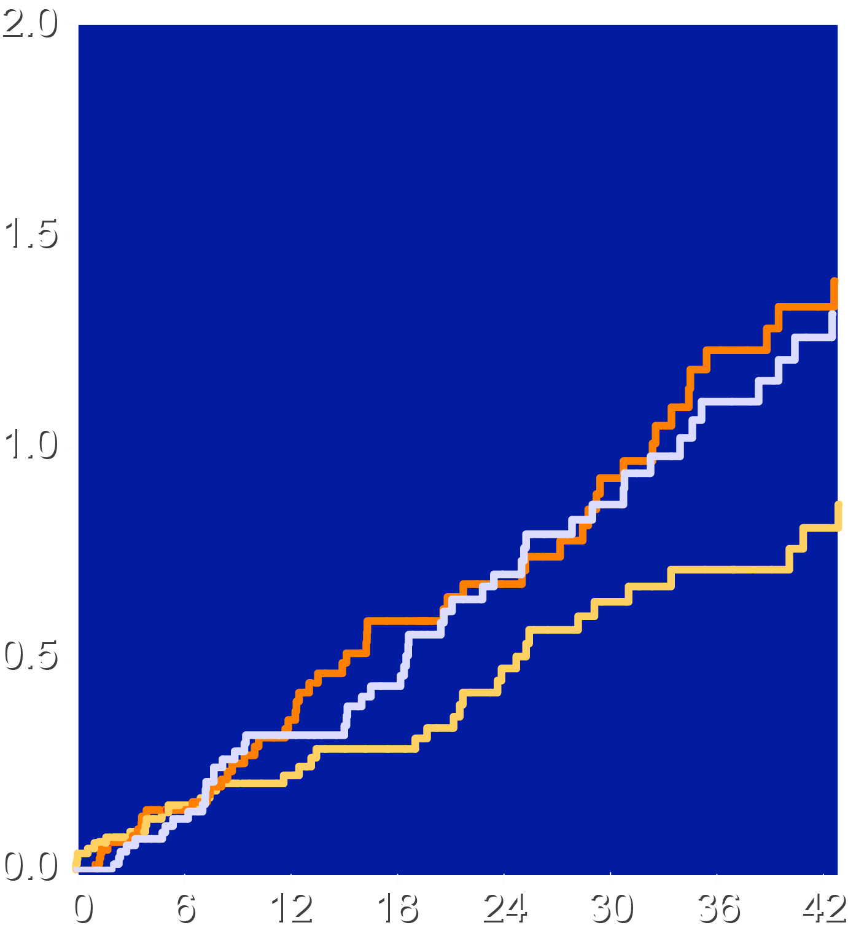
Time-to-Death from Cardiovascular Causes
Intention-to-Treat
On-Treatment
Cele vs. Ibu, HR 0.84 (0.61-1.16), P=0.30 Cele vs. Nap, HR 0.78 (0.57-1.07), P=0.13 Ibu vs. Nap, HR 0.93 (0.69-1.26), P=0.64
Cele vs. Ibu, HR 0.64 (0.42-0.99) Cele vs. Nap, HR 0.69 (0.45-1.07) Ibu vs. Nap, HR 1.08 (0.73-1.60)
Patients with an Event (%)
Ibuprofen
Naproxen
Celecoxib
Ibuprofen
Naproxen
Celecoxib
Months Since Randomization
Months Since Randomization

Slide 15
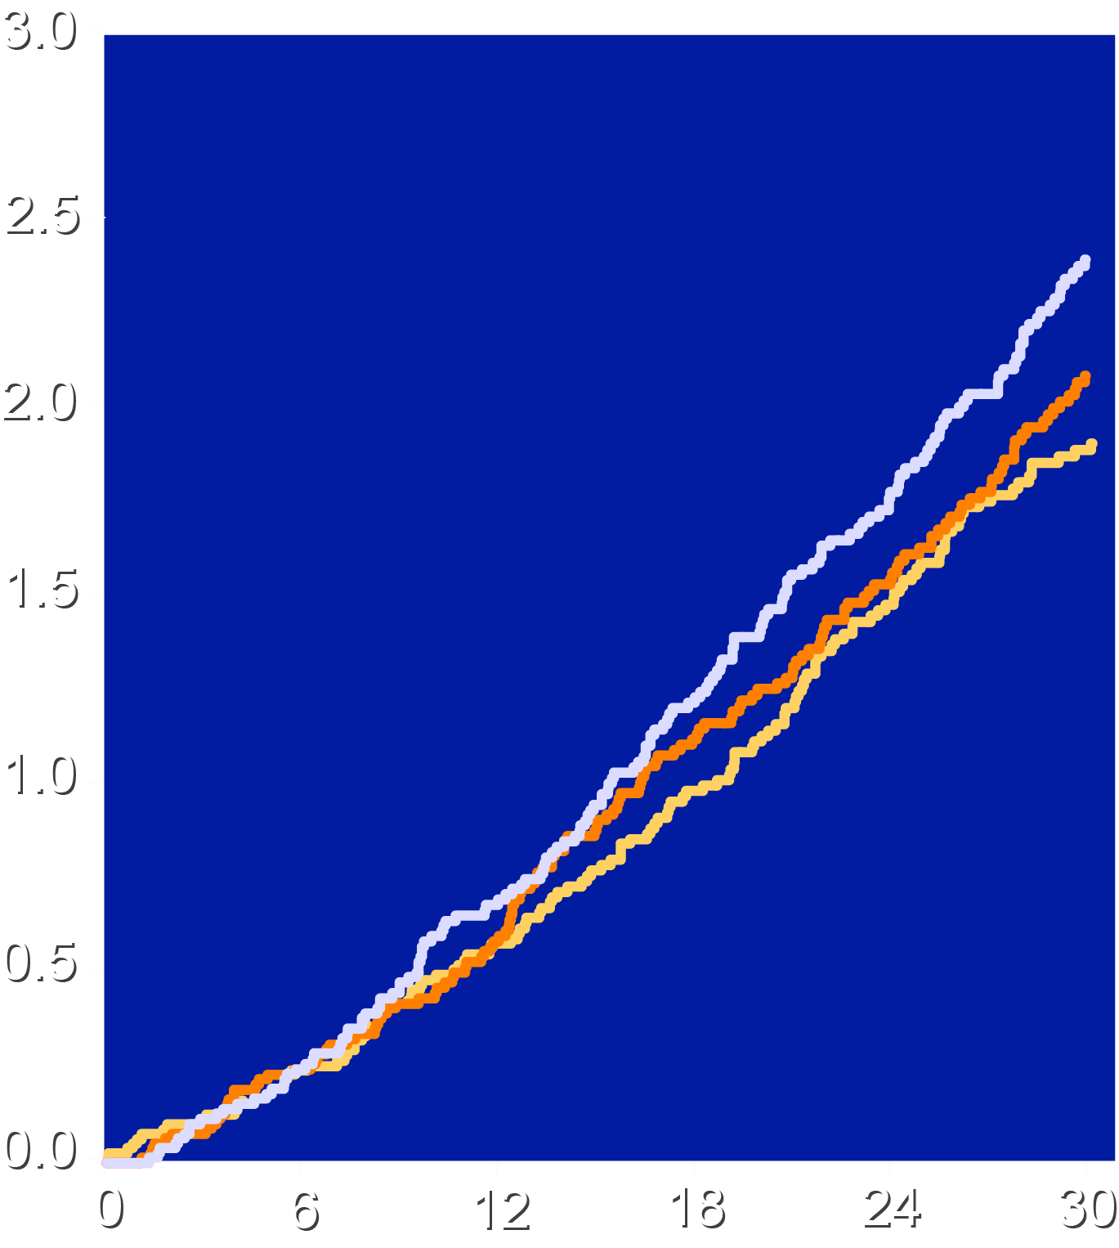
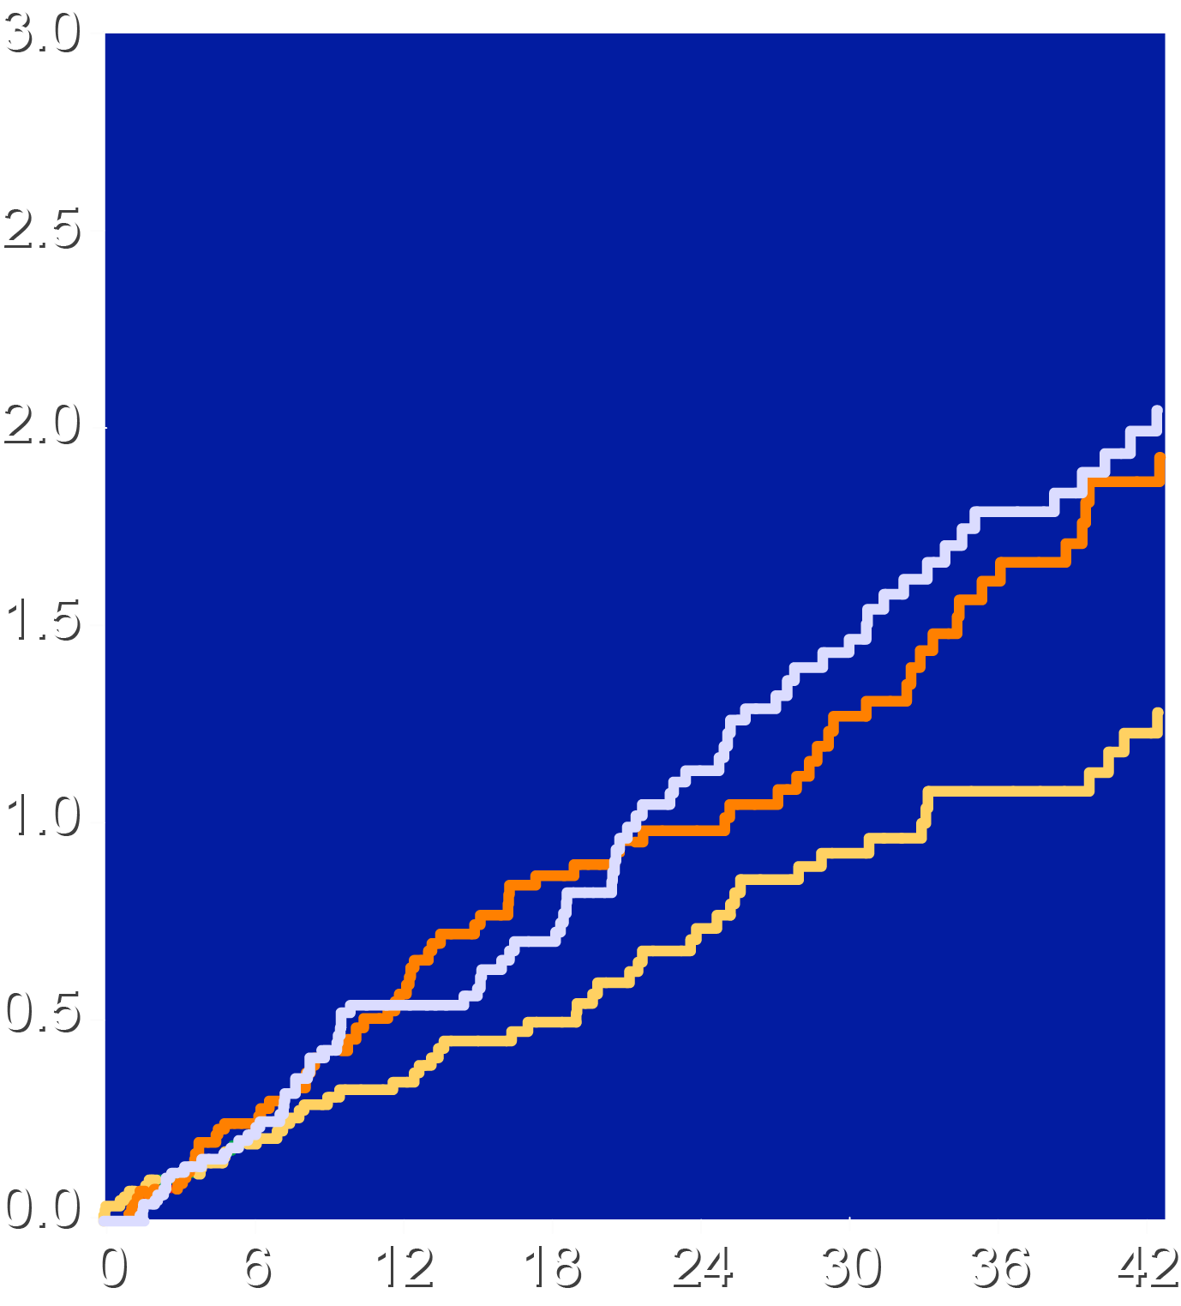
Time from Randomization to All-Cause Mortality
Intention-to-Treat
On-Treatment
Cele vs. Ibu, HR 0.92 (0.73-1.17), P=0.49 Cele vs. Nap, HR 0.80 (0.63-1.00), P=0.052 Ibu vs. Nap, HR 0.87 (0.70-1.09), P=0.22
Cele vs. Ibu, HR 0.68 (0.48-0.97) Cele vs. Nap, HR 0.65 (0.46-0.92) Ibu vs. Nap, HR 0.96 (0.70-1.31)
Naproxen 25% higher
(borderline significant)
Patients with an Event (%)
Ibuprofen
Naproxen
Celecoxib
Ibuprofen
Naproxen
Celecoxib
Months Since Randomization
Months Since Randomization

Slide 16
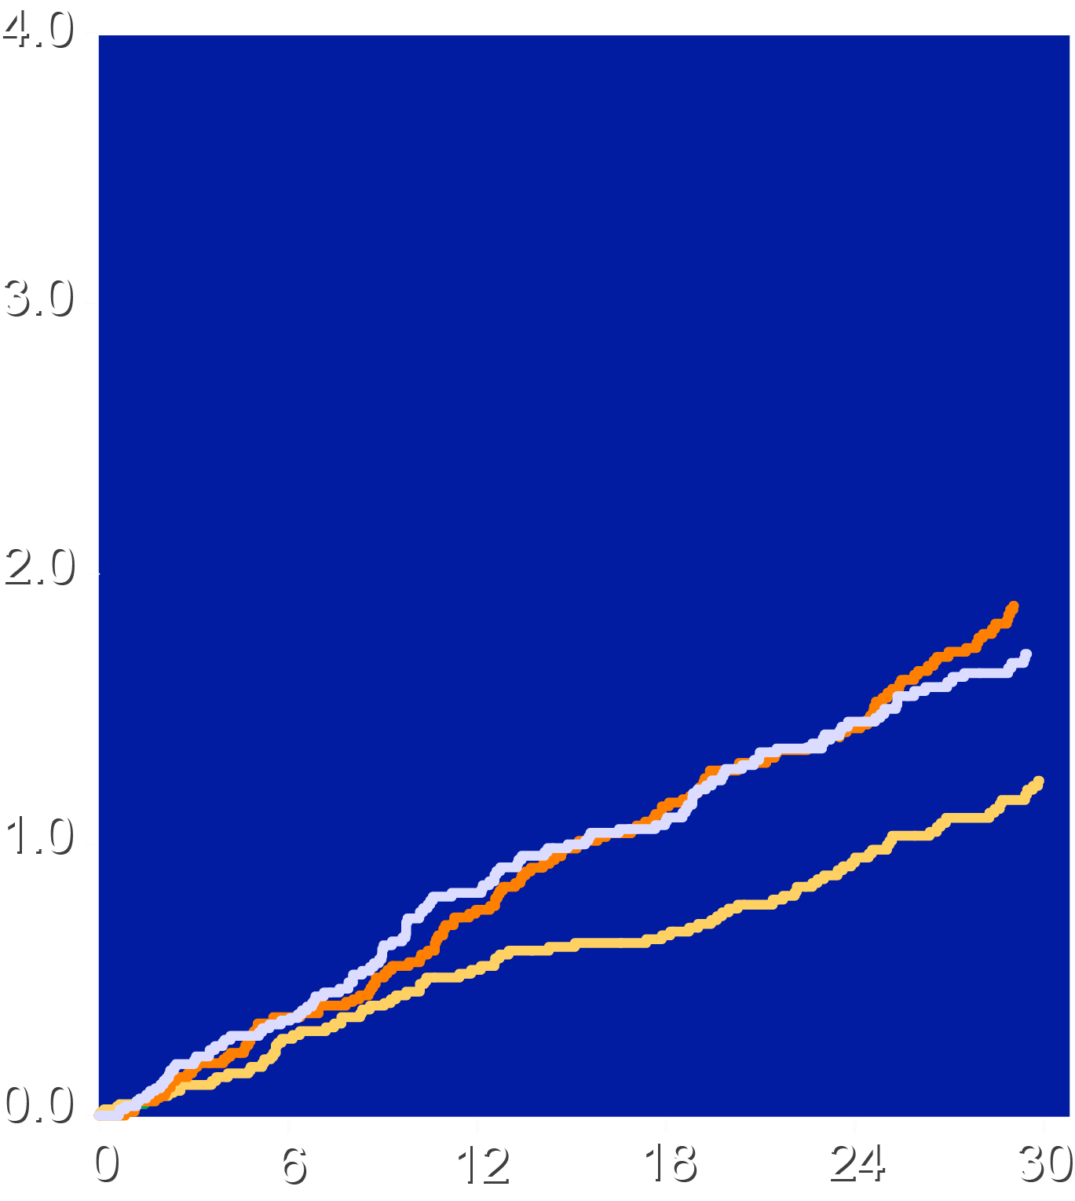
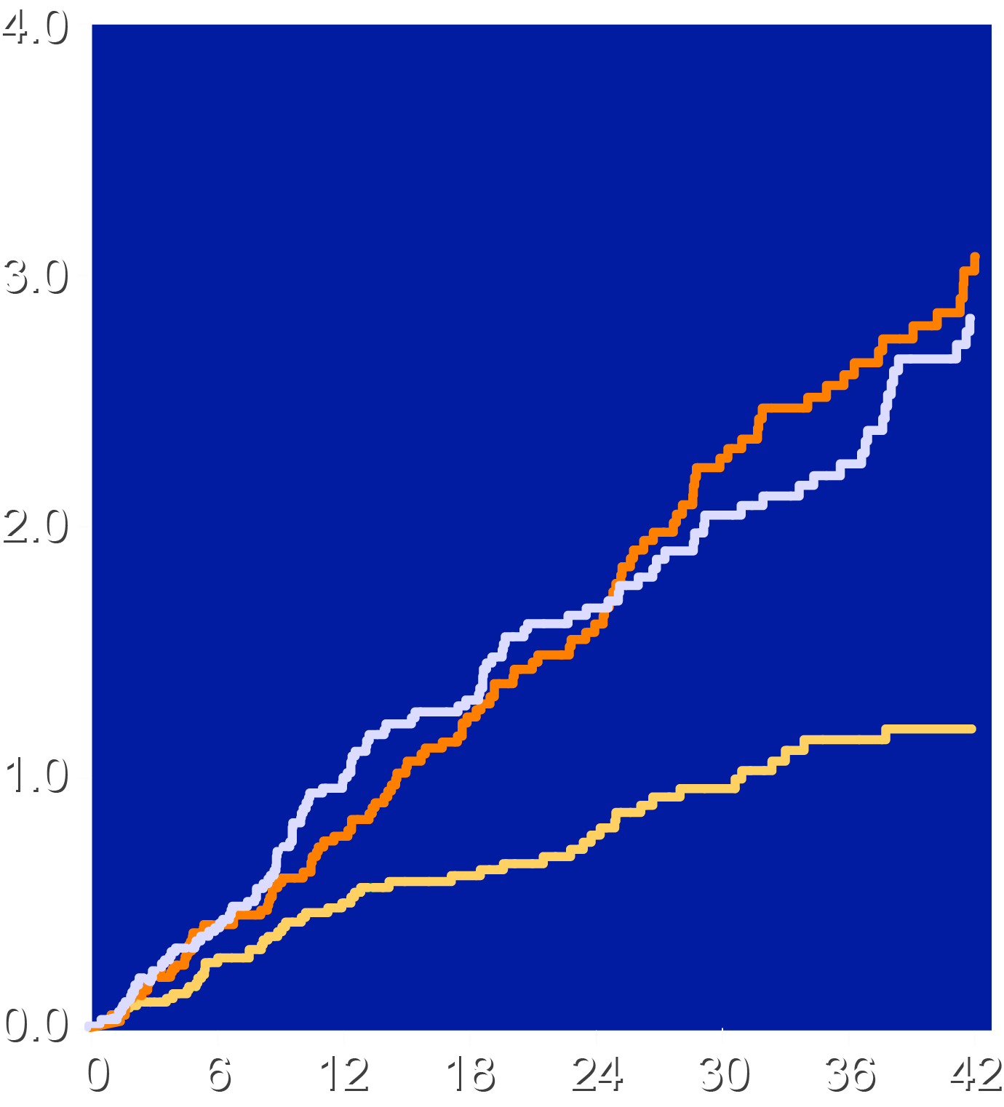
Time-to-Major Gastrointestinal Event
Intention-to-Treat
On-Treatment
Cele vs. Ibu, HR 0.65 (0.50-0.85), P=0.002 Cele vs. Nap, HR 0.71 (0.54-0.93), P=0.01 Ibu vs. Nap, HR 0.1.08 (0.85-1.39), P=0.53
Cele vs. Ibu, HR 0.44 (0.32-0.61) Cele vs. Nap, HR 0.45 (0.33-0.63) Ibu vs. Nap, HR 1.03 (0.80-1.34)
Ibuprofen 54% higher
Patients with an Event (%)
Naproxen 41% higher
Ibuprofen Naproxen Celecoxib
Ibuprofen Naproxen Celecoxib
Months Since Randomization
Months Since Randomization

Slide 17
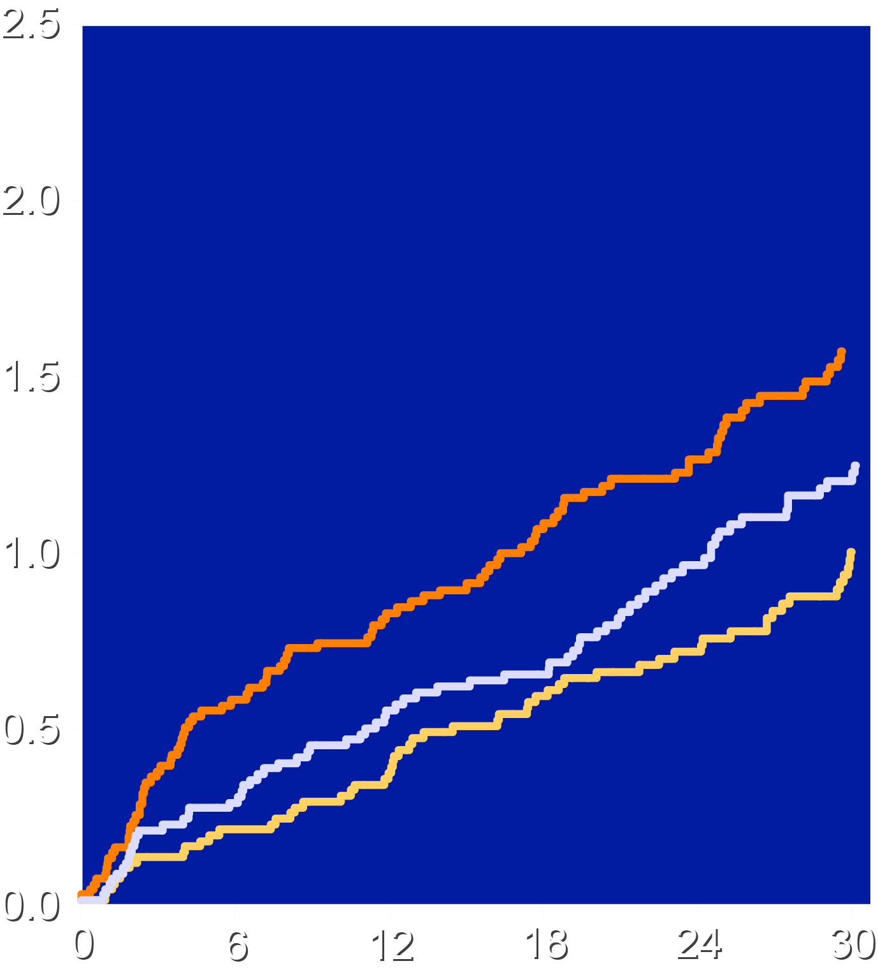
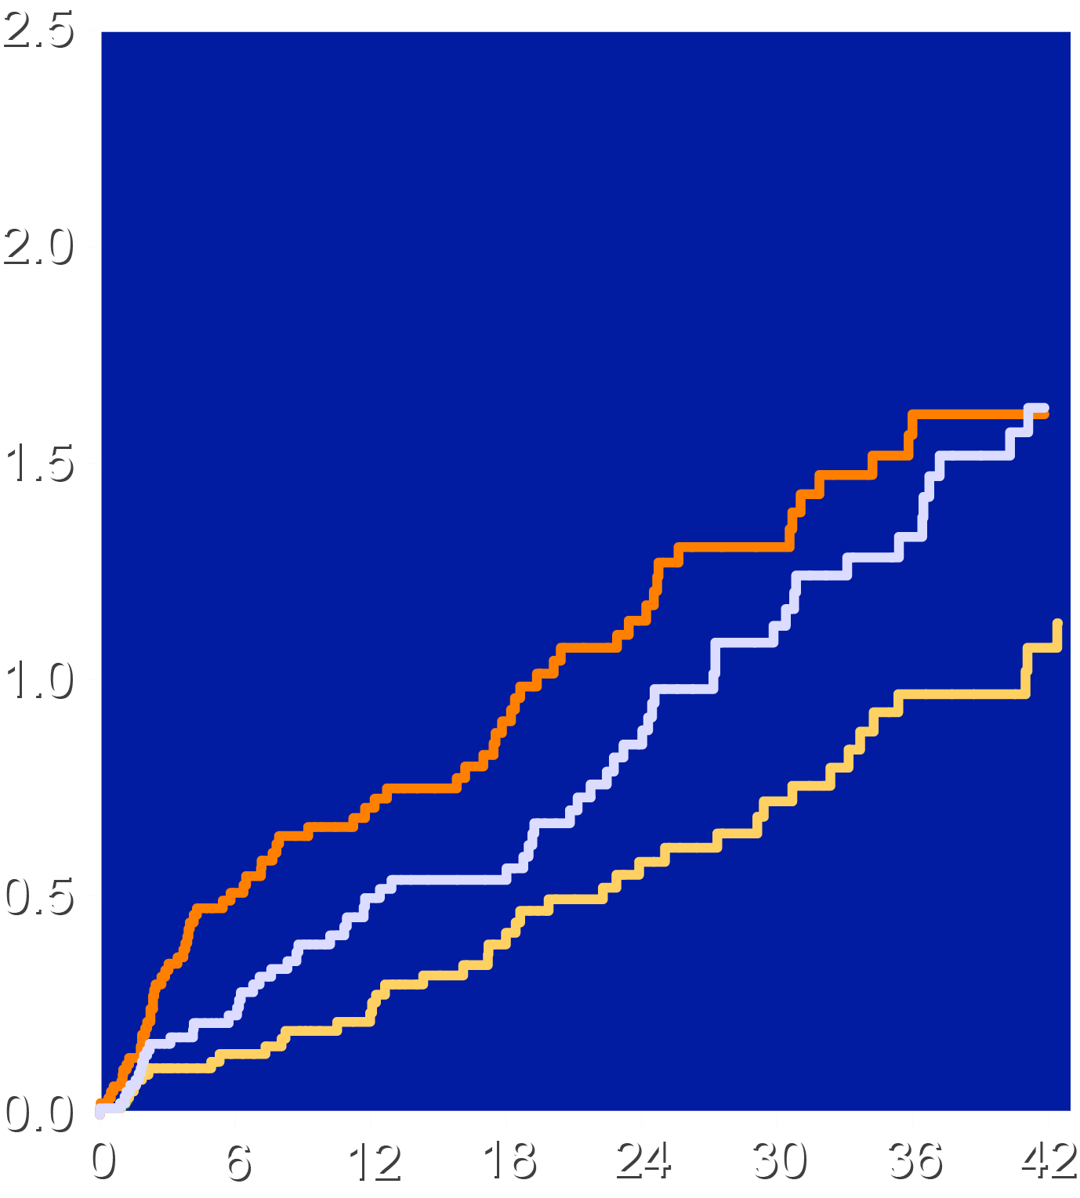
Time from Randomization to Serious Renal Event
Intention-to-Treat
On-Treatment
Cele vs. Ibu, HR 0.61 (0.44-0.85), P=0.004 Cele vs. Nap, HR 0.79 (0.56-1.12), P=0.19 Ibu vs. Nap, HR 1.29 (0.95-1.76), P=0.10
Cele vs. Ibu, HR 0.54 (0.37-0.80) Cele vs. Nap, HR 0.66 (0.44-0.97) Ibu vs. Nap, HR 1.21 (0.86-1.70)
Ibuprofen 64% higher
Patients with an Event (%)
Ibuprofen Naproxen Celecoxib
Ibuprofen Naproxen Celecoxib
Months Since Randomization
Months Since Randomization

Slide 18
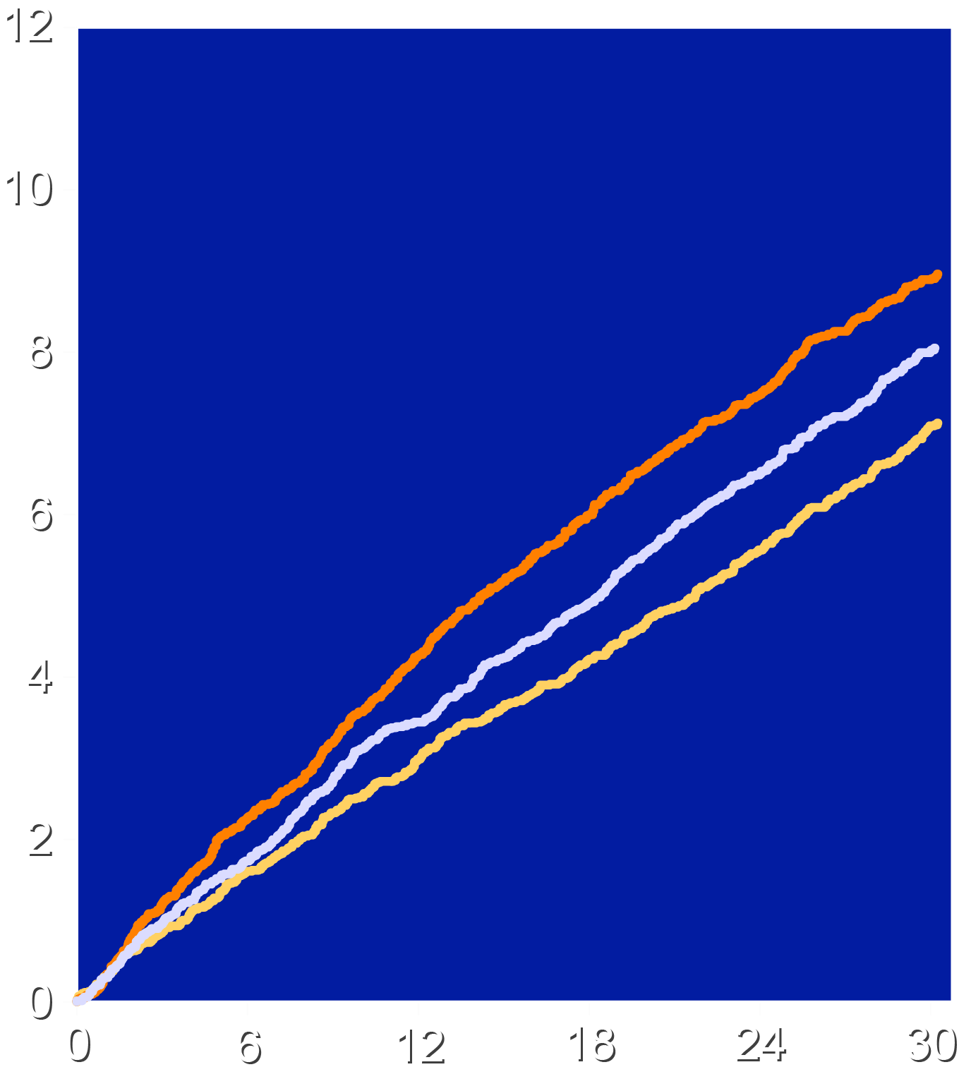
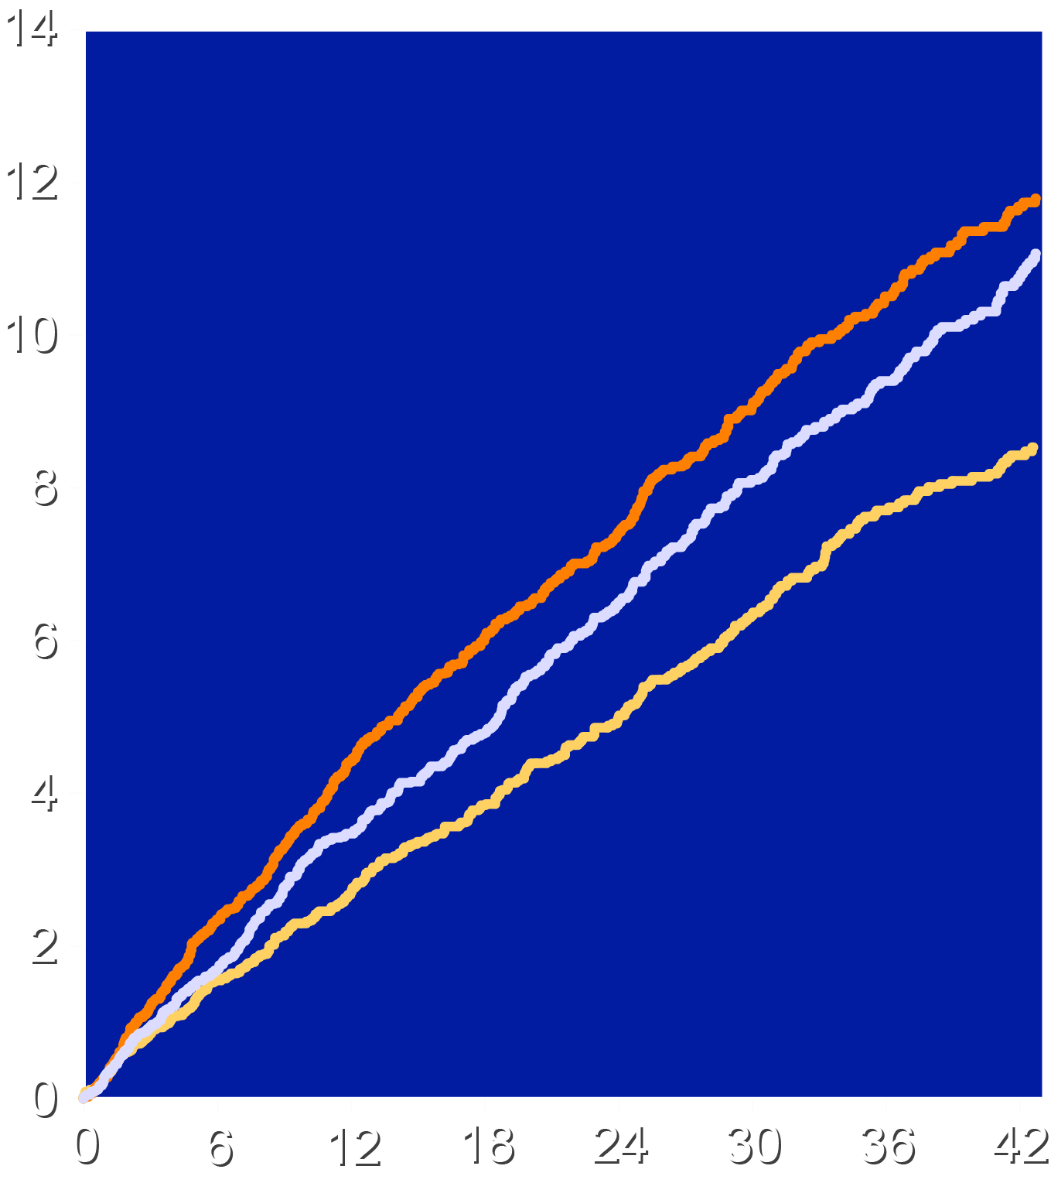
Post Hoc: Any Adjudicated CV, GI or Renal Event
Intention-to-Treat
On-Treatment
Cele vs. Ibu, HR 0.78 (0.69-0.87), P<0.001 Cele vs. Nap, HR 0.87 (0.77-0.99), P=0.03 Ibu vs. Nap, HR 1.13 (1.01-1.26), P=0.04
Cele vs. Ibu, HR 0.69 (0.61-0.79) Cele vs. Nap, HR 0.78 (0.68-0.90) Ibu vs. Nap, HR 1.13 (0.997-1.28)
Ibuprofen 28% higher (NNH - 59)
Patients with an Event (%)
Naproxen 15% higher
(NNH - 117)
Ibuprofen
Naproxen
Celecoxib
Ibuprofen
Naproxen
Celecoxib
Months Since Randomization
Months Since Randomization

Slide 19
APTC Endpoint: Aspirin Subgroup ITT Population
Celecoxib
N=8030
N
Ibuprofen
N=7990
N
Interaction P value
Subgroup
HR (95% CI)
Not taking low-dose Aspirin
Taking low-dose Aspirin
0.78 (0.58, 1.04)
0.93 (0.71, 1.20)
81
107
102
116
0.40
Celecoxib better
Ibuprofen better
Celecoxib
N=8030
N
Naproxen
N=7933
N
HR (95% CI)
Not taking low-dose Aspirin
Taking low-dose Aspirin
0.83 (0.61, 1.11)
1.03 (0.79, 1.35)
81
107
97
104
0.29
Celecoxib better
Naproxen better
Ibuprofen
N=7990
N
Naproxen
N=7933
N
HR (95% CI)
Not taking low-dose Aspirin
Taking low-dose Aspirin
1.06 (0.80, 1.40)
1.09 (0.86, 1.45)
102
116
97
104
0.80
Ibuprofen better
Naproxen better

Slide 20
Selected Investigator-Reported Adverse Effects
Characteristic | Celecoxib N=8030 | Ibuprofen N=7992 | Naproxen N=7933 | Celecoxib vs. Ibuprofen P value | Celecoxib vs. Naproxen P value | Ibuprofen vs. Naproxen P value
Anemia | 2.8% | 5.5% | 4.2% | <0.001 | <0.001 | <0.001
Increased BP | 2.3% | 3.1% | 2.5% | 0.001 | 0.29 | 0.03
Hypertension | 9.7% | 13.0% | 11.0% | <0.001 | 0.006 | <0.001
Increased creatinine | 1.8% | 3.4% | 1.9% | <0.001 | 0.65 | <0.001
Constipation | 3.4% | 4.3% | 5.2% | 0.003 | <0.001 | 0.02
Diarrhea | 8.0% | 6.8% | 7.2% | 0.004 | 0.05 | 0.38
Psychiatric disorders | 3.6% | 3.4% | 2.8% | 0.45 | 0.006 | 0.04
Dyspnea | 2.4% | 3.2% | 3.0% | 0.003 | 0.01 | 0.64
Adjudicated hospitalization for hypertension, celecoxib vs. ibuprofen HR 0.60 (0.36-0.99), P=0.04

Slide 21
Limitations-1
Adherence and retention were lower than most CV outcome trials (although similar to other pain studies):
Patients with chronic painful conditions frequently experience unrelieved symptoms and switch therapies or leave the trial.
The dose of celecoxib was moderate (100 mg twice daily).
The trials that provided signals suggesting harm studied supratherapeutic doses of celecoxib (up to 800 mg daily)

Slide 22
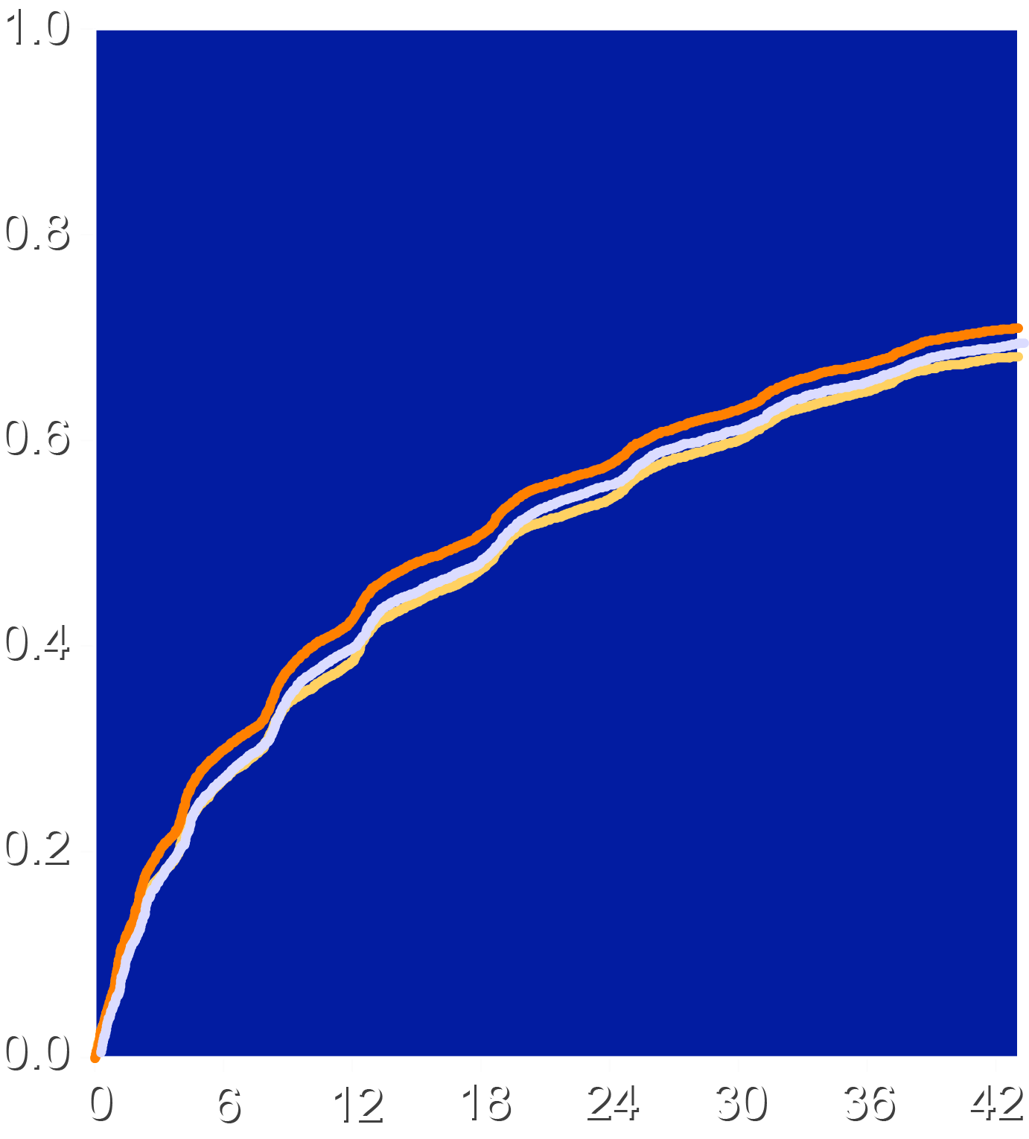
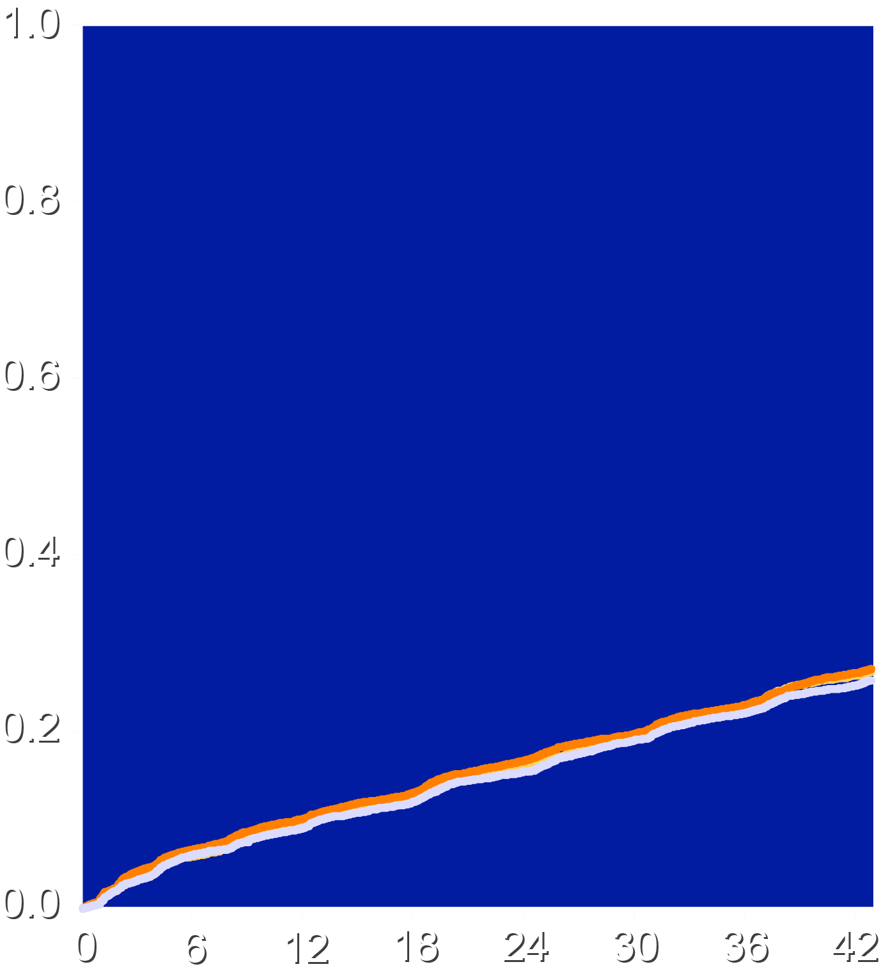
Rates of Drug Discontinuation and Non-Retention
Patients Discontinuing Treatment
Patients Discontinuing Follow up
Ibuprofen
Naproxen
Celecoxib
Ibuprofen
Naproxen
Celecoxib
68.8%
Percentage of Patients (%)
Percentage of Patients (%)
27.4%
Months Since Randomization
Months Since Randomization

Slide 23
Limitations-2
The results reflect the relative safety of these 3 drugs and not the more than 20 other currently-marketed NSAIDs.
No direct inferences are possible regarding the effects of NSAIDs compared with placebo.
These data do not provide conclusive evidence regarding the safety of intermittent treatment or use of low-dose over-the-counter preparations.

Slide 24
Conclusions: Celecoxib vs. Naproxen
Numerically fewer APTC events occurred with celecoxib than naproxen, meeting all 4 noninferiority criteria (P<0.001)
In ITT analyses, chronic treatment with prescription doses of naproxen, compared with celecoxib, was associated with:
Higher rates of gastrointestinal adverse events and a borderline significant increase in all-cause mortality.
In the on-treatment sensitivity analysis, naproxen showed:
Higher rates of all-cause mortality and major gastrointestinal and renal events.

Slide 25
Conclusions: Celecoxib vs. Ibuprofen
Numerically fewer APTC events occurred with celecoxib than ibuprofen, meeting all 4 noninferiority criteria (P<0.001)
In ITT analyses, chronic treatment with prescription doses of ibuprofen, compared with celecoxib, was associated with:
Higher rates of gastrointestinal and renal adverse events
In the on-treatment sensitivity analysis, ibuprofen showed:
Higher rates of MACE, cardiovascular death, all-cause mortality and major gastrointestinal and renal events.

Slide 26
Additional Conclusions
These findings challenge the widely-held view that naproxen provides superior cardiovascular safety.
Results were consistent regardless of baseline administration of aspirin. Gastrointestinal safety differences were evident despite prophylactic use of esomeprazole.
Between drug differences should be viewed as hypothesis-generating, rather than conclusive, given multiplicity issues and the challenges of adherence and retention in the trial.
These findings will require careful review by global health authorities to determine what changes in labeling or regulatory status of these drugs are warranted.

Slide 27
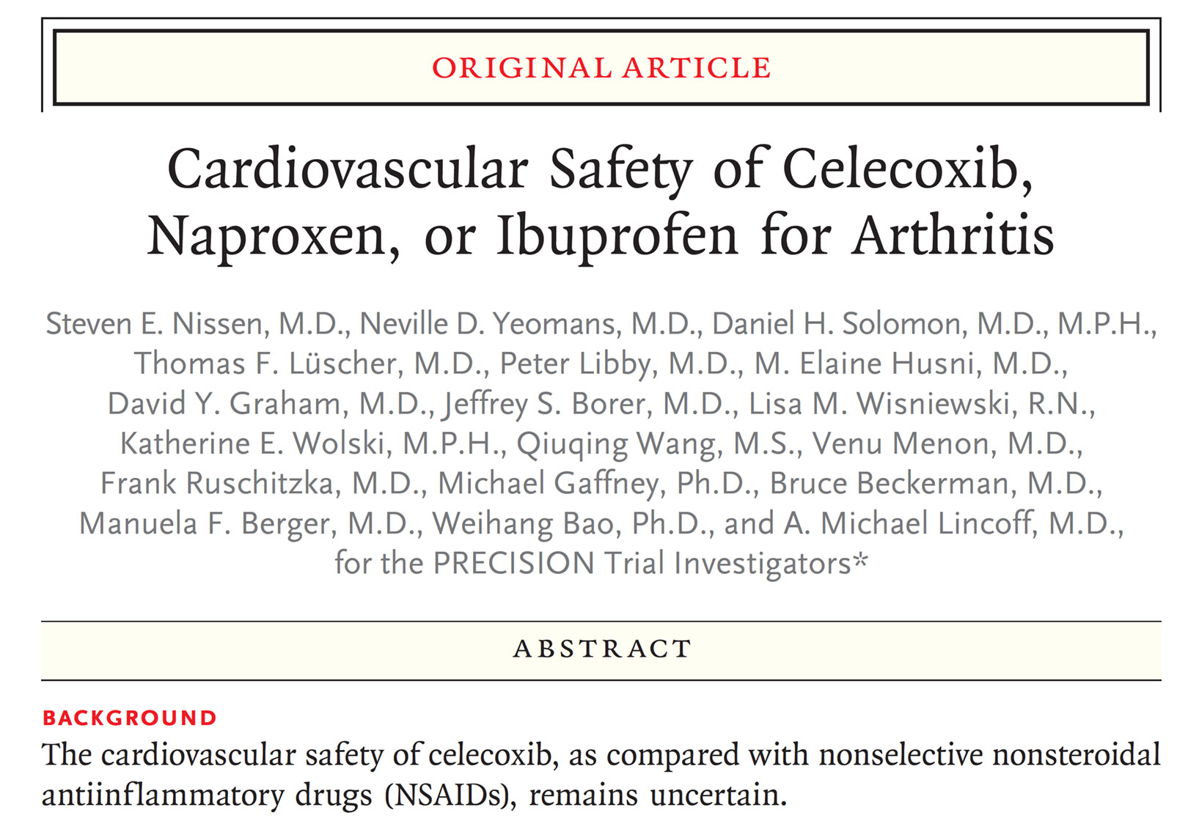

Slide 28
A Final Thought
After the withdrawal of rofecoxib, there ensued a rush to judgment about the cardiovascular safety of COX-2 inhibitors. Fueled by the controversy, investigators and some expert commentary used observational data, small RCTs and theoretical concerns to “confirm” what they expected. The PRECISION trial demonstrates the hazards inherent in prejudgment about the risks and benefits of therapies based upon expectations and indirect methods. These findings serve as an important warning to the medical community that we may arrive at erroneous conclusions when we fail to follow a systematic and unbiased approach to scientific and public health questions.

