Slide 1

Future Development of the Closer™ VSS, a Novel Resorbable Transfemoral Vascular Access Sealing System: Results of The CLOSER Trial & What’s Next?
S. Chiu Wong MD
Professor of Medicine
Weill Cornell Medicine
Director, Cardiac Catheterization Laboratories
NY Presbyterian Hospital – Cornell Campus
CRT 2018 March 3rd 2:35PM – 2:45 PM
Omni Sheraton Washington DC

Slide 2
The CLOSER Trial – US Multicenter Experience on the Closer™ VSS
Disclosure
S. Chiu Wong MD:
Institutional Research Grant from Rex Medical LP

Slide 3
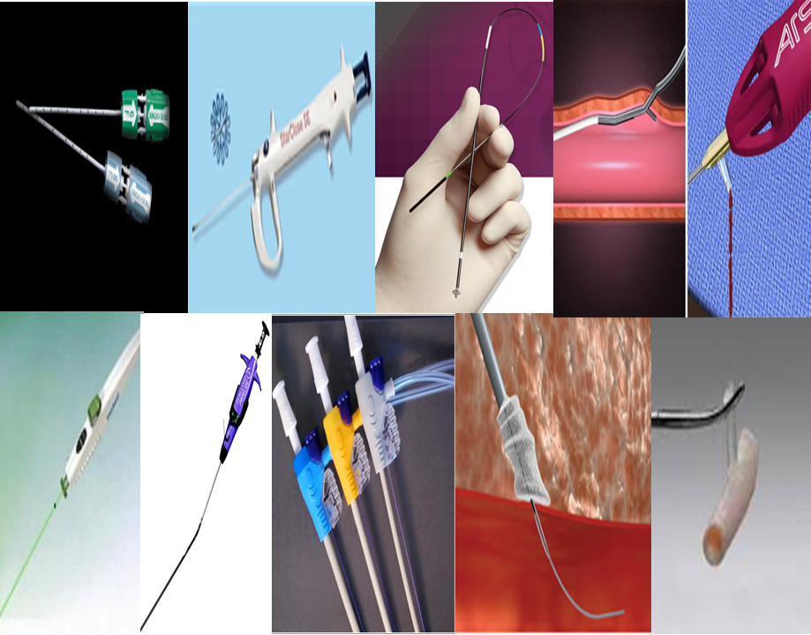
The CLOSER Trial – US Multicenter Experience on the Closer™ VSS
BACKGROUND (1)
Compared to manual compression, the inconsistent safety outcomes, learning curve and costs following VCD implantations, particularly with early generation devices, have hampered their use as a default management strategy following trans-femoral invasive procedures. The CloserTM VSS (Rex Medical, LP; Conshohocken, PA) was developed to address these deficiencies by providing consistent, reliable and easy to use invasive active intraluminal arterial closure in a novel All synthetic rebsorbable platform.
Wong SC et al Catheter Cardiovasc Interv. 2017 Nov 1;90(5):798-805

Slide 4
The CLOSER Trial – US Multicenter Experience on the Closer™ VSS
BACKGROUND (2)
The Closer™ VSS device consists of a 8.6 x 3 x 1.2 mm resorbable poly lactic-co-glycolic acid [PLGA] intraluminal patch & the two resorbable 2.3mm extravascular PLGA spheres, joined via two resorbable sutures composed of polydioxanone. All components are fully resorbable.

Slide 5
The CLOSER Trial – US Multicenter Experience on the Closer™ VSS
METHODS (1): Trial Design & Study Endpoints
The CLOSER Trial was a prospective single-arm, US multicenter, non-blinded study compared the clinical outcomes in patients undergoing 5-7 Fr transfemoral diagnostic or interventional procedures with their access sites managed with Closer™ VSS against pre-specified performance goals derived from published data on the manual compression arms of 6 previous vascular closure device IDE studies.
The primary endpoints were time to hemostasis (TTH) and major access site closure-related complications; secondary endpoints included time to ambulation (TTA), time to discharge eligibility (TTDE), time to discharge (TTD), minor access site closure-related complications, procedure success and device success.
Wong SC et al Catheter Cardiovasc Interv. 2017 Nov 1;90(5):798-805

Slide 6
The CLOSER Trial – US Multicenter Experience on the Closer™ VSS Results(1) Patient Characteristics
A total of 220 subjects (49.5% interventional) were enrolled at 11 sites.
 | Diagnostic |  | Interventional |  | Total / %
N (%) | 111 | % | 109 | % | 220 | %
Demographics
Age, yrs | 63.2±10.3 |  | 64.7±8.7 |  | 63.9±9.5
Body mass index (kg/m2) | 30.8±5.7 |  | 29.8±4.9 |  | 30.3±5.3
Women | 45 | 40.5% | 25 | 22.9% | 70 | 31.8%
Medical history
Hypertension | 88 | 79.3% | 84 | 77.1% | 172 | 78.2%
Atherosclerotic disease | 63 | 56.8% | 91 | 83.5% | 154 | 70.0%
Coronary artery disease | 57 | 51.4% | 71 | 65.1% | 128 | 58.2%
Peripheral vascular disease | 12 | 10.8% | 25 | 22.9% | 37 | 16.8%
Carotid disease | 10 | 9.0% | 17 | 15.6% | 27 | 12.3%
Diabetes mellitus | 35 | 31.5% | 37 | 33.9% | 72 | 32.7%
Wong SC et al Catheter Cardiovasc Interv. 2017 Nov 1;90(5):798-805

Slide 7
The CLOSER Trial – US Multicenter Experience on the Closer™ VSS
Results (2): Procedural Findings
 | Diagnostic/ % |  | Interventional/% |  | Total / %
N | 111 | % | 109 | % | 220 | %
Procedure type
Coronary | 94 | 84.7 | 79 | 72.5 | 173 | 78.6%
Peripheral | 6 | 5.4 | 23 | 21.1 | 29 | 13.2%
Other¹ | 11 | 9.9 | 7 | 6.4 | 18 | 8.2%
Sheath size
5 Fr | 60 | 54.1 | 1 | 0.9 | 61 | 27.7%
6 Fr | 49 | 44.1 | 68 | 62.4 | 117 | 53.2%
7 Fr | 2 | 1.8 | 40 | 36.7 | 42 | 19.1%
Anti-platelet, anti-coagulation agents
Any oral anti-platelet medication | 101 | 91.0 | 108 | 99.1 | 209 | 95.0%
Aspirin | 98 | 88.3 | 108 | 99.1 | 206 | 93.6%
> 2 oral anti-platelet agents | 22 | 19.8 | 91 | 83.5 | 113 | 51.4%
Bivalirudin (Angiomax) | 2 | 1.8 | 71 | 65.1 | 73 | 33.2%
Any GP IIb/IIIa inhibitors | 0 | 0.0 | 1 | 0.9 | 1 | 0.5%
ACT (seconds, n, mean, ±SD )² | 8 | 211.6 ±51.4 | 36 | 249.1 ±34.1 | 44 | 242.3 ±39.9
1 Other include neuro, carotid and subclavian procedure. 2 ACT in subjects receiving unfractionated heparin only
Wong SC et al Catheter Cardiovasc Interv. 2017 Nov 1;90(5):798-805

Slide 8
The CLOSER Trial – US Multicenter Experience on the Closer™ VSS Results (3): Primary Effectiveness Endpoint [ITT]
Time to Hemostasis (minutes) | Diagnostic (n = 111) | Interventional (n = 109) | Total (n = 220)
Mean ± Standard Dev (95% C.I.) | 0.58 ± 2.94 (0.03, 1.13) | 3.01 ± 10.58 (1.00, 5.01) | 1.78 ± 7.81 (0.74, 2.82)
Median (95% C.I.) | 0.00 (0.00, 0.00) | 0.00 (0.00, 0.00) | 0.00 (0.00, 0.00)
Range (Min, Max) | (0.00, 28.32) | (0.00, 85.28¹) | (0.00, 85.28¹)
Performance Goal - minutes (p-value) | 17 (< 0.0001) | 24 (< 0.0001) | 17 diagnostic 24 interventional (Stratified p< 0.0001)
1. The outlier TTH of 85 minutes was experienced by an interventional subject who did not have the patch deployed due to user error. The mean TTH was 0.98 min ± 3.71 min. in the PP cohort.
Wong SC et al Catheter Cardiovasc Interv. 2017 Nov 1;90(5):798-805

Slide 9
The CLOSER Trial – US Multicenter Experience on the Closer™ VSS
Results (4): Key Secondary Effectiveness Endpoints
Time to Ambulation (hours) | Diagnostic (n = 111) | Interventional (n = 109) | Total (n = 220)
Mean ± Standard Dev (95% C.I.) | 1.92 ± 0.67 (1.80, 2.05) | 3.09 ± 1.05 (2.89, 3.29) | 2.50 ± 1.05 (2.36, 2.64)
Median (95% C.I.) | 1.95 (1.80, 2.00) | 2.90 (2.80, 3.01) | 2.24 (2.14, 2.49)
Range (Min, Max) | (1.01, 6.02) | (1.99, 8.08) | (1.01, 8.08)
Performance Goal (hours) (p-value) | 6 (< 0.0001) | 11 (< 0.0001) | 6 diagnostic, 11 interventional (Stratified p< 0.0001)
Time to Discharge Eligibility (hours) | Diagnostic (n = 111) | Interventional (n = 109) | Total (n = 220)
Mean ± Standard Dev (95% C.I.) | 2.17 ± 0.67 (2.04, 2.29) | 3.50 ± 1.86 (3.15, 3.85) | 2.83 ± 1.54 (2.62, 3.03)
Median (95% C.I.) | 2.16 (1.97, 2.25) | 3.19 (3.01, 3.29) | 2.51 (2.42, 2.75)
Range (Min, Max) | (1.22, 6.05) | (2.24, 19.32) | (1.22, 19.32)
Time to Discharge (hours) | Diagnostic (n = 111) | Interventional (n = 109) | Total (n = 220)
Mean ± Standard Dev (95% C.I.) | 4.57 ± 6.35 (3.38, 5.77) | 21.83 ± 18.93 (18.24, 25.43) | 13.12 ± 16.49 (10.93, 15.32)
Median (95% C.I.) | 2.97 (2.65, 3.36) | 22.66 (20.86, 23.59) | 4.74 (4.04, 6.64)
Range (Min, Max) | (1.44, 53.01) | (2.29, 122.01) | (1.44, 122.01)
Wong SC et al Catheter Cardiovasc Interv. 2017 Nov 1;90(5):798-805

Slide 10
The CLOSER Trial – US Multicenter Experience on the Closer™ VSS RESULTS (5): Other Key Findings
In 80.5% of ITT subjects, immediate hemostasis [median TTH time = 0 minutes] was achieved. Thirty-day follow-up was completed on 219 subjects (99.5%). There were no major access site closure-related complications. The overall procedure success was 100%, and device success was 99.1% in diagnostic and 97.2% in interventional subjects. The 5- 7 Fr Closer™ VSS received FDA approval in 2016.
Wong SC et al Catheter Cardiovasc Interv. 2017 Nov 1;90(5):798-805

Slide 11
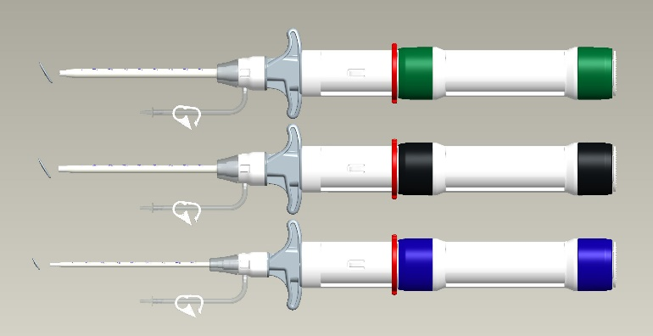
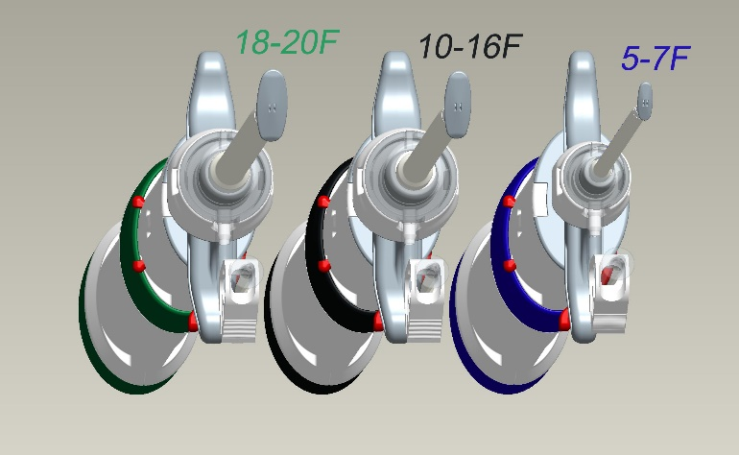
What’s Next? Large Bore Closer™ VSS
Large Bore Closer™ VSS Construct
Develop Larger Bore Closer™ VSS identical in functionality to PMA approved small bore system
Closer™ 5Fr – 7Fr
  8.6mm x 3.0mm x 1.2mm Patch / 2.3mm Spheres
Large Bore Closer™ 10Fr - 16Fr
  15mm x 5.6mm x 1.7mm Patch / 3.8mm Spheres
Large Bore Closer™ 18Fr - 20Fr
  16mm x 6.4mm x 1.7mm Patch / 3.8mm Spheres
Delivery System Components
  Each Closer™ Delivery System has its own dedicated delivery sheath

Slide 12
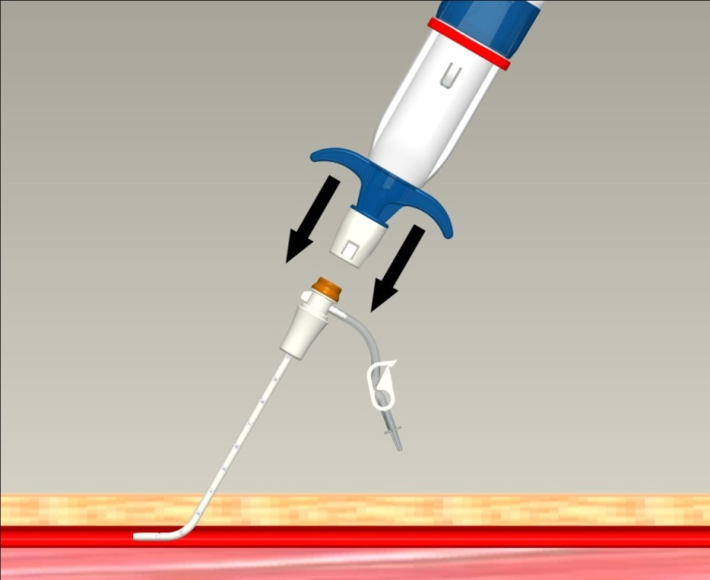
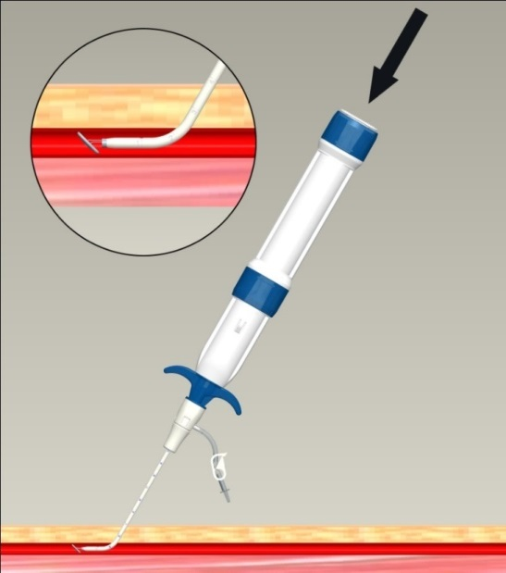
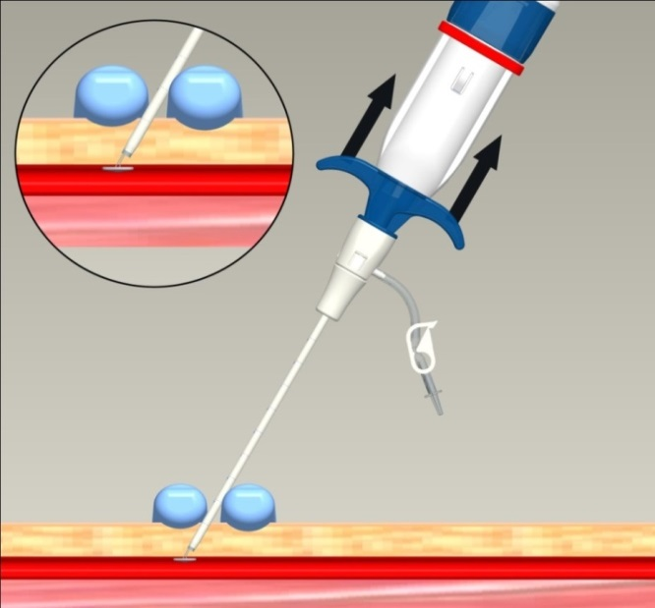
Large Bore Closer™ VSS
Deployment Steps
ATTACH
PLUNGE
PULL
The large bore Closer™ VSS deployment steps are identical to the 5-7Fr system except that the 5 - 7 Fr Closer™ sheath is included with large bore Closer™ VSS device for determining the femoral artery entry depth at the beginning of the procedure prior to large index procedural sheath placement.

Slide 13
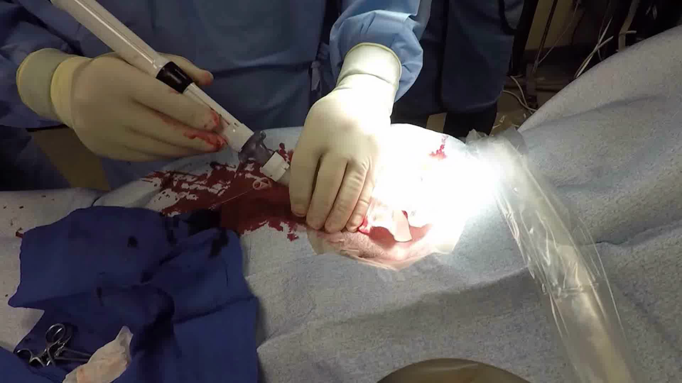
Large Bore Closer™ VSS
GLP Animal Study (10-16Fr Closer™ VSS)
GLP study on 26 sheep on 12/19/2017, all pre-treated with 50 units/kg Heparin following access site entry & pre-dilated with an 18Fr dilator: 14 sheep received 16 large bore 16 Fr devices (6 with 30-day & 8 with 90-day F/U. 2 of the 8 animals for 90-day FU had 2 large bore devices implanted, 1 in each femoral artery). Two 6Fr Perclose Proglide® devices were used for access site closure as control for 12 sheep (6 @ 30-day & 6 @ 90-day FU). All implants were successful and no complication was noted @ 30-day. The 90-day FU is scheduled on 3/18/2018. Of the 16 large bore Closer™ implants, 11 achieved instant hemostasis vs. 2 in 12 Perclose cases. The mean TTH was 4.69 minutes compared to Perclose TTH of 5.33 minutes

Slide 14
Thank You!!

Slide 15
The CLOSER Trial – US Multicenter Experience on the Closer™ VSS
Turi Classification of Current VCDs
1. Invasive (I) or noninvasive (N); devices placed inside tissue track are invasive.
2. Active approximation (A) or passive (P); devices are active approximators if they mechanically approximate the arteriotomy edges, or creat a sandwich holding arteriotomy edges together.
3.Within the active approximation subgroup: intraluminal (IL) vs extraluminal (E) refers to the presence of a foreign body w/in the artery
4. Clot inducing (C), sealant (S), or neither (0)
5. Permanent (P), temporary (T), or no foreign body (0)
 | Invasive/ Non- invasive | Active/ Passive Approximation | Intraluminal/ Extraluminal | Thrombosing /Sealing | Temporary/ Permanent or no Foreign Body
AngioSeal | Invasive | Active | Intraluminal | Thrombosing | Temporary
Perclose | Invasive | Active | Intraluminal | No | Permanant
StarClose | Invasive | Active | Extraluminal | No | Permanant
Vascade | Invasive | Passive |  | Thrombosing | Temproary
Mynx | Invasive | Passive |  | Sealing | Temporary
ExoSeal | Invasive | Passive |  | Sealing | Temporay
FemoSeal | Invasive | Active | Intraluminal | No | Temporary
Turi Z G APRIL April 2005 ENDOVASCULAR TODAY, Cardiac Intervention Today July/August 2008

Slide 16
The CLOSER Trial – US Multicenter Experience on the Closer™ VSS
Access Site and VCD Landscape
Despite the continued increase in radial approach in PCIs, femoral access still dominates in US¹. Data from ACC NCDR registry reported over 1.4 million invasive coronary procedures of which 71.1% were transfemoral and 28.5% transradial in 2014. In the transfemoral patients, majority (57%) of femoral access sites were still managed with either manual or mechanical compression and about a third femoral access sites were managed with closure devices².
1. Feldman DN et al Circulation 2013;127:2295-2306
2. ACC NCDR CathPCI Registry Outcomes Report. https://www.ncdr.com/WebNCDR. Accessed November 30th, 2015

Slide 17
Large Bore Closer™ VSS
GLP Animal Study (16Fr)
14 sheep : 6 with 30 day f/u and 8 with 90 day f/u. The Perclose device was used as a control for 12 sheep (6 at 30d and 6 at 90d). The other 2 animals at 90d have 2 Large Bore devices, one implanted in each femoral artery. We used PMI in San Carlos for the study.
Any midterm results or these are all acute animal studies?
The GLP was successfully performed at Day 0 (implantation) and the follow up at Day 30. The 90d follow up is scheduled for next month. Of the 16 Large Bore Closer deployments, 11 achieved instant hemostatis and the average TTH was 4.69 minutes compared to Perclose TTH of 5.33 minutes.

Slide 18
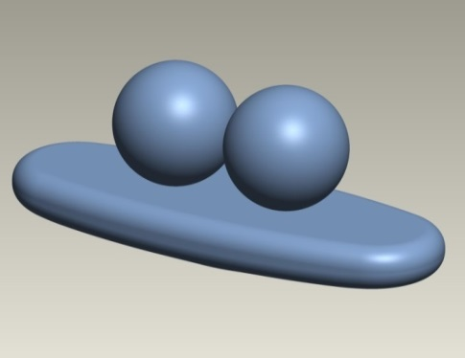
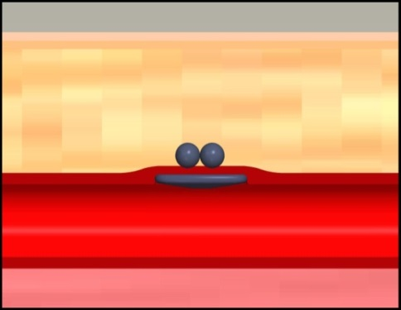
Large Bore Closer™ VSS
Device Construct (2)
Vessel Sealing Patch
Self aligning
Fully resorbable (poly-lactic-co-glycolic acid)
Intravascular sealing mechanism
Retention Spheres
  Spheres are attached to the patch via suture
  Fully resorbable (poly-lactic-co-glycolic acid)
  Low extravascular profile
Suture
  Fully resorbable (poly dioxanone) monofilament

Slide 19
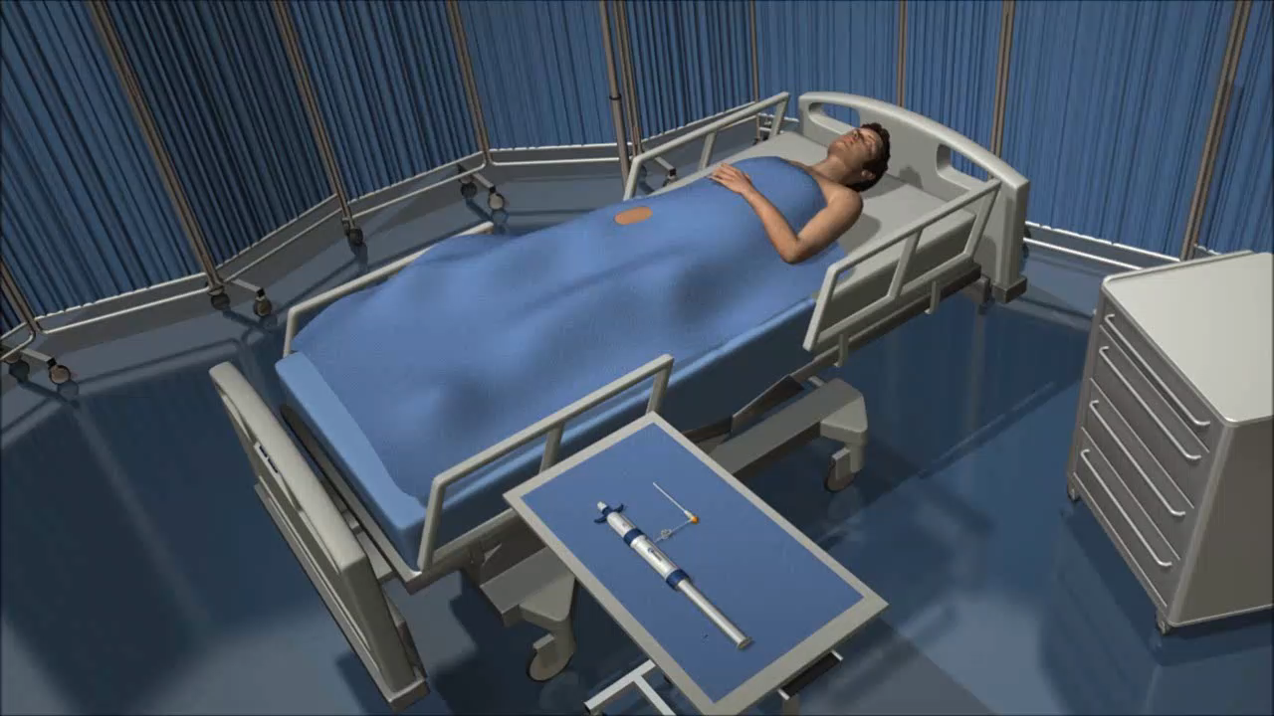
Large Bore Closer™ VSS
Deployment Animation

Slide 20
The CLOSER Trial – US Multicenter Experience on the Closer™ VSS CONCLUSIONS
In this multicenter single arm study on Closer™ VSS in access site sealing following 5-7 Fr transfemoral invasive procedures:
the PGs for the primary and key secondary effectiveness endpoints were met.
Both the primary and secondary safety endpoints of access site closure-related major and minor complications with pre-determined clinically acceptable levels, were achieved.
Immediate hemostasis was achieved in the majority of patients without major complication.

Slide 21
The CLOSER Trial – US Multicenter Experience on the Closer™ VSS
METHODS (2): Inclusion & Exclusion Criteria
Inclusion:
Patients from 18 and 80 years of age undergoing a non-urgent 5-7 Fr diagnostic or interventional transfemoral procedures.
Exclusion:
Femoral artery access site < 5mm in diameter, previous surgical repair, VCD use within the past 90 days, or if significant (> 50%) stenosis, severe calcification, implanted stent, or vessel morphological abnormalities at the access site.
Patients with active systemic infection or immunodeficiency disorder, pregnancy, morbid obesity (BMI > 45 kg/m2), and known allergies to PLGA or PDO polymers.
Previous lower extremity amputation or inability to ambulate, and severe peripheral vascular disease or existing nerve damage in the index leg.
Wong SC et al Catheter Cardiovasc Interv. 2017 Nov 1;90(5):798-805

Slide 22
The CLOSER Trial – US Multicenter Experience on the Closer™ VSS METHODS (3): Inclusion & Exclusion Criteria
Exclusion (cont’d):
Procedural complications, contamination at the access site
Sheath placement at or distal to the femoral artery bifurcation
Bleeding diathesis or coagulopathy
Administration of low molecular weight heparin within past 8 hours, or ACT > 350 seconds in subjects receiving unfractionated heparin or > 250 seconds in subjects receiving adjunct GP IIb/IIIa inhibitors
Systolic BP > 180 mmHg or < 90 mmHg at time of sheath removal
Planned endovascular or surgical procedure within next 30 days, or an ipsilateral femoral arteriotomy within the past 30 days or planned within the next 90 days
Wong SC et al Catheter Cardiovasc Interv. 2017 Nov 1;90(5):798-805

