Slide 1
Prone Transradial Access for Multiple Single-Session Procedures
Jeffrey Forris Beecham Chick, MD, MPH, DABR; Casey Branach, JD, MS;
Bill S. Majdalany, MD; J. Matthew Meadows, MD; Douglas A. Murrey, MD;
Wael A. Saad, MBBCh, FSIR; Minhaj S. Khaja, MD, MBA; Kyle J. Cooper, MD;
Matthew L. Osher, MD; Ravi N. Srinivasa, MD
Suggested Presenter: Casey Branach, JD, MS

Slide 2
Disclosures
None

Slide 3
Brief Description
A 75-year-old male with rectal carcinoma status post abdominoperineal resection and external beam radiation complicated by radiation-associated pelvic sarcomatoid carcinoma presented with pelvic pain.
Computed tomography (CT) of the abdomen and pelvis with contrast demonstrated multiple conglomerate pelvis sidewall masses measuring 1.7 x 3.4 cm, 2.8 x 2.8 cm, and 1.4 x 2.0 cm consistent with known radiation-associated sarcomatoid carcinoma as well as new moderate left hydronephrosis.
A decision was made to perform combined single-session prone transradial transarterial embolization, cryoablation, and nephrostomy tube placement without repositioning.

Slide 4
History
A 75-year-old male with rectal carcinoma status post abdominoperineal resection and external beam radiation complicated by radiation-associated pelvic sarcomatoid carcinoma presented with pelvic pain.
CT of the abdomen and pelvis with contrast demonstrated multiple conglomerate pelvis sidewall masses measuring 1.7 x 3.4 cm, 2.8 x 2.8 cm, and 1.4 x 2.0 cm consistent with known radiation-associated sarcomatoid carcinoma as well as new moderate left hydronephrosis.

Slide 5
Prone Transradial Access
Schematic diagram showing prone transradial catheterization for single-session combined transarterial embolization, ablation, and nephrostomy placement

Slide 6
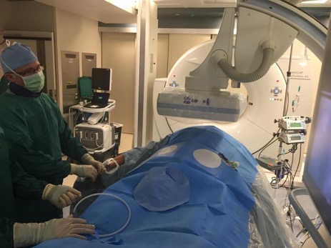
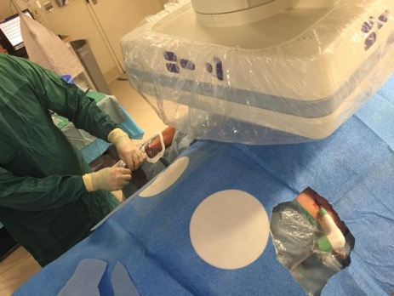
Prone Transradial Access
Use of the prone transradial technique to perform simultaneous embolization, ablation, and nephrostomy placement in a hybrid CT and angiography suite

Slide 7
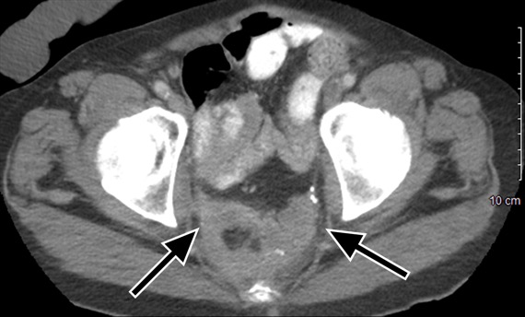
CT of the Pelvis with Contrast
Contrast-enhanced CT demonstrates enhancing tumor within the pre-sacral space compatible with sarcomatoid carcinoma (arrows)

Slide 8
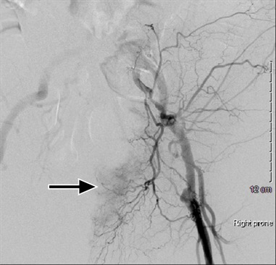
I: Internal Iliac Embolization
Selective left internal iliac arteriography from a prone transradial transarterial approach demonstrates tumoral arterial hypervascularity (arrow); these branches were embolized with particles

Slide 9
II: Cryoablation
Fluoroscopic image after positioning of six cryoablation probes within the tumor under CT-guidance; cryoablation probes are seen within the tumor during active cryoablation; ice-ball is visualized as a hypodense sphere encompassing the tumor (arrow)

Slide 10
III: Nephrostomy Placement
Due to obstructive nephropathy, a left nephrostomy tube was also able to be successfully placed from a prone position without having to reposition the patient

Slide 11
Supine Transradial Access
Supine transradial access offers the potential for improved post-procedure hemostasis and patient satisfaction and decreased hemorrhagic complications, sedation requirements, recovery times, and procedure-related costs.
Supine transradial approaches are problematic, however, when needing to perform additional procedures from a posterior-approach because it require mid-procedure repositioning, leading to increased procedural times and potential for complications.

Slide 12
Prone Transradial Access
In addition to decreased hemorrhagic complications and improved patient satisfaction, prone transradial access allow single-session embolization, ablation, and completion of genitourinary procedures and others that require prone positioning, with decreased preparation time (transitioning from a supine to prone position) and overall decreased procedural time. Such a technique may lead to an overall increased procedural efficiency and decreased financial costs.
Although additional studies are needed to refine the applicability, technique, and long-term efficacy, prone transradial catheterization provides a rational approach to facilitate combined single-session transarterial embolization, ablation, and genitourinary procedures, among others, from a posterior-approach without repositioning.

Slide 13
References
Fischman AM, Swinburne NC, Patel RS. A Technical Guide Describing the Use of Transradial Access Technique for Endovascular Interventions. Tech Vasc Interv Radiol. 2015 Jun;18(2):58-65.
Biederman DM, Marinelli B, O'Connor PJ, Titano JJ, Patel RS, Kim E, Tabori NE, Nowakowski FS, Lookstein RA, Fischman AM. Transradial access for visceral endovascular interventions in morbidly obese patients: safety and feasibility. J Vasc Access. 2016 May 7;17(3):256-60.
Roy AK, Garot P, Louvard Y, Neylon A, Spaziano M, Sawaya FJ, Fernandez L, Roux Y, Blanc R, Piotin M, Champagne S, Tavolaro O, Benamer H, Hovasse T, Chevalier B, Lefèvre T, Unterseeh T. Comparison of Transradial vs Transfemoral Access for Aortoiliac and Femoropopliteal Interventions: A Single-Center Experience. J Endovasc Ther. 2016 Aug 24.
Bishay VL, Biederman DM, Ward TJ, van der Bom IM, Patel RS, Kim E, Nowakowski FS, Lookstein RA, Fischman AM. Transradial Approach for Hepatic Radioembolization: Initial Results and Technique. AJR Am J Roentgenol. 2016 Nov;207(5):1112-1121.

Slide 14
Thank You
Jeffrey Forris Beecham Chick, MD, MPH, DABR
chickj@med.umich.edu
Casey Branach, JD, MS
casey.branach@ttuhsc.edu
Ravi N. Srinivasa, MD
rnsriniv@med.umich.edu

