Slide 1


Left Versus Right Radial Access
Ion S Jovin, MD
McGuire VAMC/VCU
Richmond, VA, USA
March 3, 2018

Slide 2

Ion S Jovin, MD
I have no relevant financial relationships

Slide 3
Transradial catheterization and intervention
Can be done from both the right and left side
The right side is more similar to the traditional transfemoral access for the operator
The left side is slightly less comfortable for the patient

Slide 4
Left Versus Right Radial Access: a Meta-Analysis
12 randomized controlled studies; 6450 patients
Endpoints:
Cross over rate or procedure failure
Procedure duration, fluoroscopy time, contrast volume
Subclavian tortuosity and complications

Slide 5
Cross Over Rate or Procedure Failure
L vs R radial
Shah R et al. CCI 2016

Slide 6
Cross Over Rate or Procedure Failure
L vs R radial
No statistically significant difference in cross over rate of procedure failure between left versus right radial

Slide 7
Procedure Duration
L vs R radial
Shah R et al. CCI 2016

Slide 8
Procedure Duration
L vs R radial
No statistically significant difference between left versus right radial
Procedure duration about the same with left versus right radial

Slide 9
Fluoroscopy Time
L vs R radial
Shah R et al. CCI 2016

Slide 10
Fluoroscopy Time
L vs R radial
Statistically significant but clinically not relevant difference between left versus right radial
Slightly longer fluoroscopy time with the right radial approach

Slide 11
Contrast Volume
L vs R radial
Shah R et al. CCI 2016

Slide 12
Contrast Volume
L vs R radial
Statistically significant but clinically not relevant difference between left versus right radial
Slightly more contrast used with the right radial approach

Slide 13
Subclavian Tortuosity, Vascular and Embolic Complications L vs R radial
Shah R et al. CCI 2016

Slide 14
Subclavian Tortuosity, Vascular and Embolic Complications L vs R radial
Shah R et al. CCI 2016

Slide 15
Subclavian Tortuosity, Vascular and Embolic Complications L vs R radial
Shah R et al. CCI 2016

Slide 16
Subclavian Tortuosity, Vascular and Embolic Complications
L vs R radial
Significantly more tortuosity of the right versus the left subclavian artery
No significant difference in terms of vascular or embolic complications

Slide 17
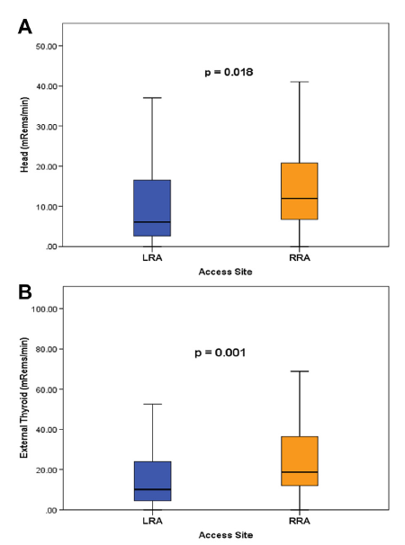
Radiation to the operator L versus R radial
Guzman L et al. JACC Cardiovasc Interv 2014

Slide 18
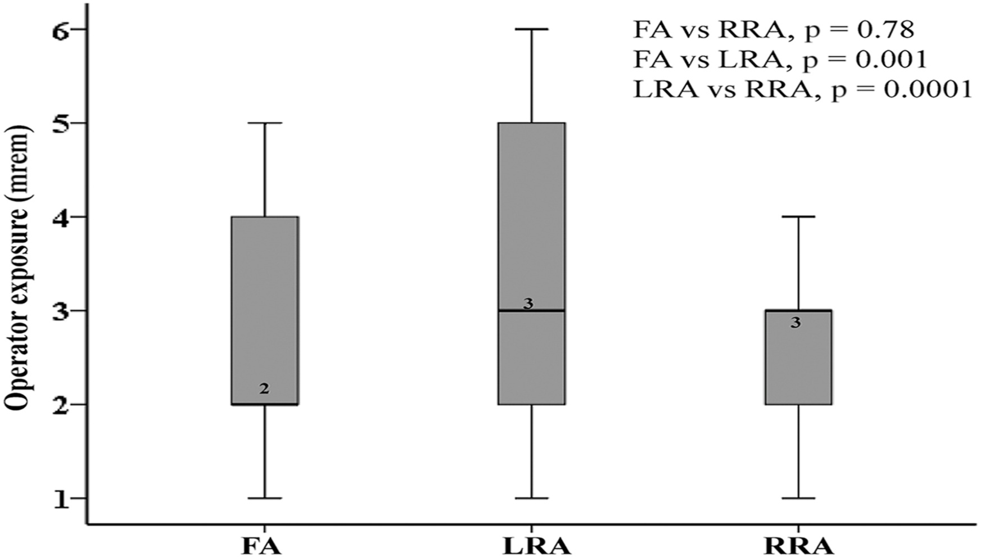
Radiation to the operator L versus R radial (REVERE)
Pancholy S et al. JACC Cardiovasc Interv 2015

Slide 19
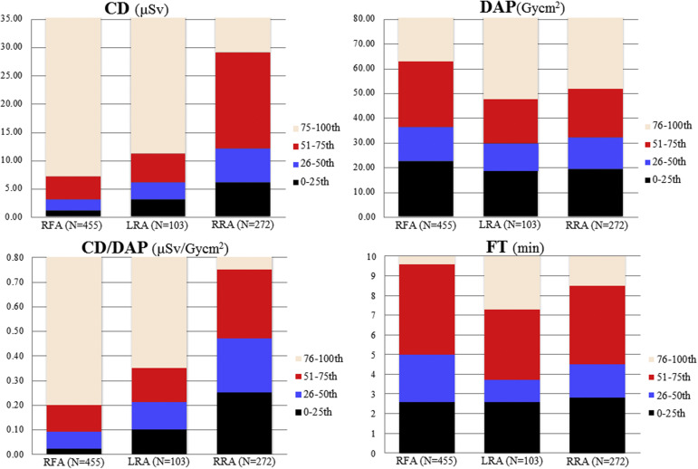
Radiation to the operator L versus R radial
Goy JJ et al. Am J Cardiol 2016

Slide 20
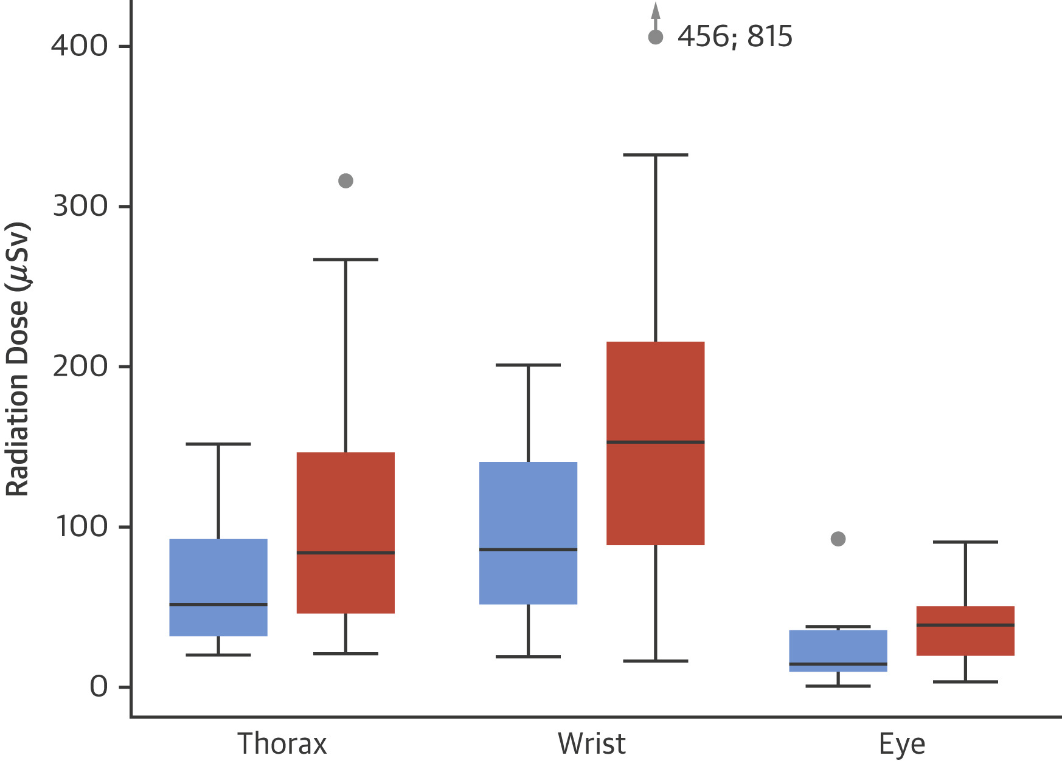
Radiation to the operator L versus R radial (RAD-Matrix)
Schiahbasi A et al. JACC 2017

Slide 21
Conclusions
Left radial and right radial access for coronary angiography and intervention are both viable alternatives
In our meta-analysis there were slight advantages for left radial access but the clinical relevance of the findings is uncertain
Radiation to the operator is probably not significantly different but the jury is still out

Slide 22
Thank you

Slide 23
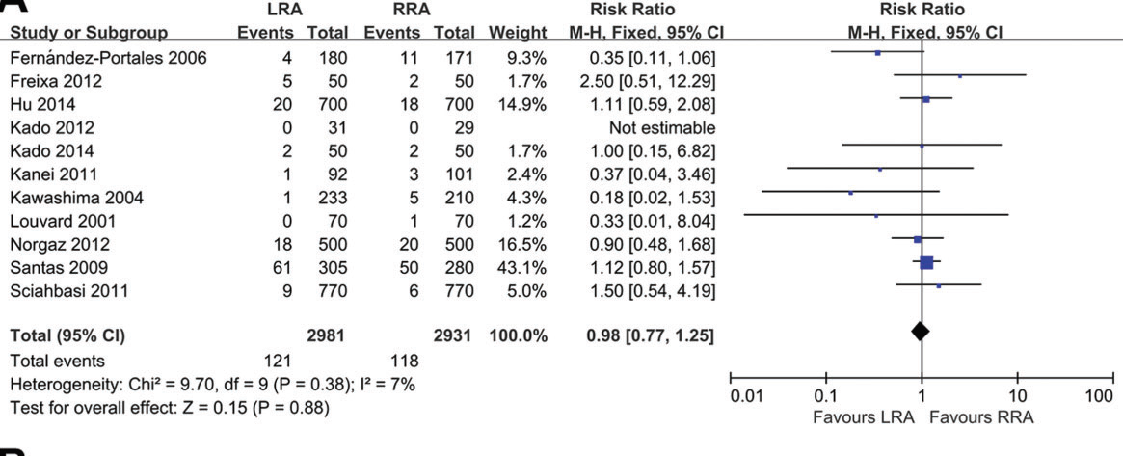
Xia SL et al. Braz J Med Biol Res 2015

Slide 24
Radiation (DAP)
L vs R radial
Guo X et al. PLoS One 2013

