Slide 1
PHYSICIAN OPTIMISED POSTPARTUM HYPERTENSION treatment (pop-ht) RANDOMISED trial

Slide 2
BACKGROUND

Slide 15
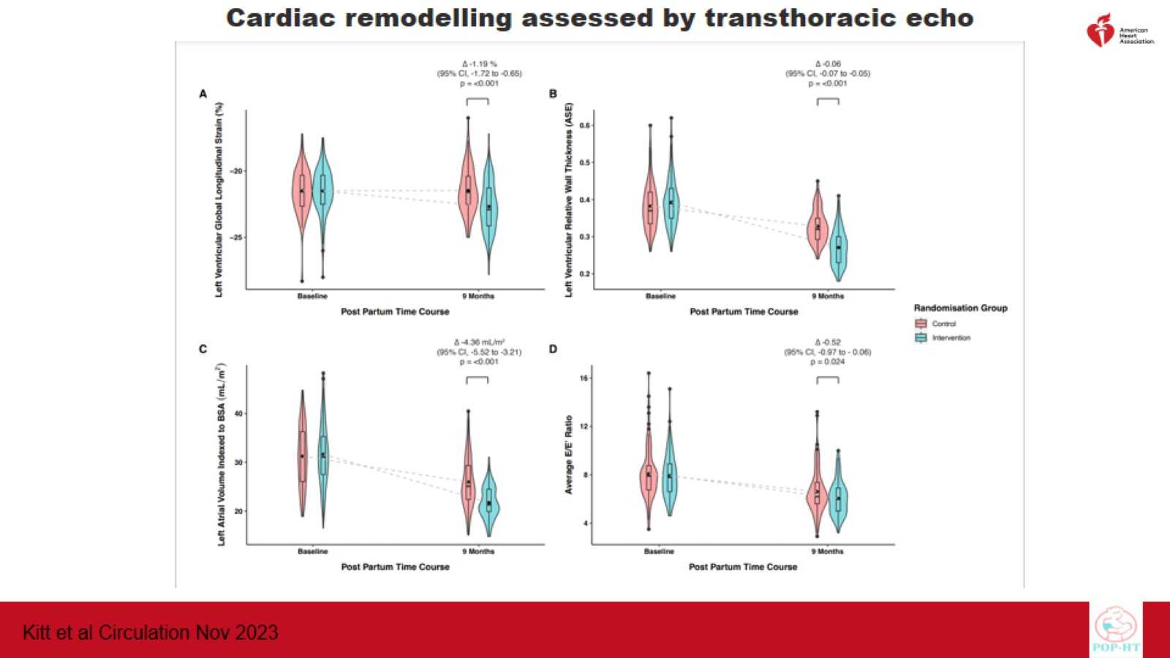

Slide 16
Conclusions

Slide 17
SUMMARY

Slide 18
THANK YOU

Slide 19
Doi FOR JAMA & CIRCULATION PAPERS

