Slide 1
Effectiveness of Blood Pressure Lowering Intervention on Risk of Total Dementia among Patients with Hypertension
A Cluster-Randomized Effectiveness Trial
Jiang He, Chuansheng Zhao, Shanshan Zhong, Nanxiang Ouyang, Lixia Qiao, Ruihai Yang, Chunxia Zhao, Huayan Liu, Weiyu Teng, Xu Liu, Jessica Spat-Lemus, Chung-Shiuan Chen, Clara Li, Jeff D. Williamson, and Yingxian Sun
No conflicts of interest to declare.

Slide 2

Background
It is estimated that the global number of individuals living with dementia would increase from 57.4 million in 2019 to 152.8 million in 2050.
In the absence of curative treatment, the primary prevention of dementia through risk factor reduction, such as blood pressure lowering, becomes a public health priority.
Previous randomized controlled trials have lacked sufficient duration or sample size and reported a nonsignificant reduction in dementia associated with antihypertensive treatment in patients with hypertension or a history of stroke.

Slide 3
Objectives
To test the effectiveness of intensive blood pressure intervention compared to usual care in reducing the risk of all-cause dementia and cognitive impairment among patients with hypertension over a 48-month intervention period.

Slide 4
Enrollment, Randomization, and Follow-up
326 villages selected from 3 provinces in China
46,740 patients assessed for eligibility
12,745 excluded
8,856 blood pressure
671 other reasons
3,218 declined consent
326 villages randomized
163 villages randomized to intervention
163 villages randomized to usual care
17,407 patients enrolled to intervention
16,588 patients enrolled to usual care
1,435 lost to follow-up
1,516 lost to follow-up
15,972 completed 48-month follow-up
15,072 completed 48-month follow-up
17,407 included in data analysis
16,588 included in data analysis

Slide 5
Study Participants
Men and women aged ≥40 years with a mean untreated systolic BP ≥140 mmHg and/or diastolic BP ≥90 mmHg or mean treated systolic BP ≥130 mmHg and/or diastolic BP ≥80 mmHg from six measures on two different days were eligible for this trial.
In addition, patients with a history of CVD, CKD, or diabetes and mean systolic BP ≥130 mmHg and/or diastolic BP ≥80 mmHg were eligible.
Participants were required to be enrolled in the China New Rural Cooperative Medical Scheme, which covers 99% of rural residents for basic healthcare services.

Slide 6
Village Doctor-led Intervention
A simple stepped-care protocol for hypertension treatment was implemented to achieve a target systolic BP <130 mmHg and diastolic BP <80 mmHg.
Village doctors initiated and titrated antihypertensive medications based on the treatment protocol, delivered discounted and free medications to patients, conducted health coaching on lifestyle modification and medication adherence, and instructed patients on home BP monitoring.
Primary care physicians and hypertension specialists provided training, supervision, and consultation.

Slide 7
Data Collection
At the 48-month follow-up visit, trained and certified neurologists, who were blinded to randomization assignments, collected data on:
  Medical and psychiatric history and risk factors for dementia
  Neurological assessment, including a mental status evaluation
  The Mini-Mental State Examination (MMSE): a 30-point questionnaire widely used to screen for cognitive impairment.
  The Functional Activities Questionnaire (FAQ): a 10-item questionnaire measures instrumental activities of daily living. It has been widely used for differentiating functional independence in patients with dementia and mild cognitive impairment.
  The Quick Dementia Rating System (QDRS): a 10-domain questionnaire validly and reliably differentiates individuals with and without dementia and accurately stages dementia.

Slide 8
Study Outcomes
Primary outcome is all-cause dementia defined according to the Recommendations from the National Institute on Aging-Alzheimer’s Association workgroups on diagnostic guidelines for Alzheimer’s disease.
Main secondary outcome is cognitive impairment no dementia (CIND).
Other secondary outcomes included a composite outcome of dementia or CIND, and a composite outcome of dementia or deaths.
The final diagnosis of all-cause dementia or CIND was made by an expert adjudication panel who were blinded to the intervention assignment.

Slide 9
Statistical Analysis
Intention-to-treat analyses were conducted.
Poisson regression with a robust error variance was used to calculate the relative risk and 95% CI of dementia and secondary outcomes associated with intervention, stratified by village, town, county, and province.
In a secondary analysis, we adjusted for age, sex, education, cigarette smoking, history of major cardiovascular disease, use of antihypertensive medication, body mass index, systolic blood pressure, low-density lipoprotein cholesterol, and fasting plasma glucose at baseline.
We also conducted predefined subgroup analyses by age, sex, education, smoking, BMI, SBP, and fasting plasma glucose at baseline.

Slide 10
Baseline Characteristics of Study Participants
Characteristics | Intervention (n=17,407) | Control (n=16,588)
Age, years, mean (SD) | 62.8 (9.3) | 63.3 (9.2)
Female sex, no. (%) | 10,603 (60.8) | 10,222 (61.6)
Less than primary school, no. (%) | 3,617 (21.6) | 3,848 (23.8)
Current smoking, no. (%) | 3,690 (21.4) | 3,609 (22.0)
Use of antihypertensive medications, no. (%) | 10,574 (60.4) | 8,990 (54.3)
Body mass index, kg/m², mean (SD) | 26.0 (3.9) | 25.8 (3.9)
Systolic blood pressure, mmHg, mean (SD) | 157.0 (18.0) | 155.4 (17.4)
Low-density lipoprotein cholesterol, mg/dL, mean (SD) | 105.4 (31.8) | 104.7 (31.6)
Plasma glucose, mg/dL, mean (SD) | 111.3 (37.0) | 110.9 (35.7)
10-yr risk for atherosclerotic CVD, %, mean (SD) | 14.7 (11.9) | 14.5 (11.6)

Slide 11
Systolic and Diastolic BP in the Intervention and Usual Care Groups over 48 Months of Follow-up
-7.2 (-8.3, -6.1)
-6.1 (-6.6, -5.6)
-15.4 (-15.9, -15.0)
-29.2 (-30.1, -28.3)

Slide 12
Blood Pressure Control and Use of Antihypertensive Medications at 48 Months of Follow-up
 | Mean or proportion (95% CI) |  | Net difference (95% CI) | p value
 | Intervention | Usual care
Proportion of patients with BP <130/80 mm Hg, % | 67.7 (65.8, 69.6) | 15.0 (13.7, 16.4) | 52.7 (50.4, 55.0) | <0.0001
Mean antihypertensive medications, number/patient | 3.0 (3.0, 3.1) | 1.2 (1.1, 1.2) | 1.9 (1.8, 1.9) | <0.0001
Use of angiotensin-converting-enzyme inhibitors, % | 50.3 (47.4, 53.2) | 6.3 (5.5, 7.0) | 44.0 (41.0, 47.1) | <0.0001
Use of angiotensin II receptor blockers, % | 30.1 (27.5, 32.7) | 32.3 (30.3, 34.4) | -2.2 (-5.5, 1.1) | 0.19
Use of calcium channel blockers, % | 86.8 (85.8, 87.9) | 53.3 (51.1, 55.4) | 33.6 (31.2, 36.0) | <0.0001
Use of diuretics, % | 63.8 (61.7, 65.9) | 10.8 (9.6, 12.1) | 53.0 (50.5, 55.4) | <0.0001
High adherence to antihypertensive medication, % | 88.0 (86.8, 89.2) | 66.4 (64.3, 68.6) | 21.6 (19.1, 24.0) | <0.0001

Slide 13
Effectiveness of Blood Pressure Lowering on Primary, Secondary, and Safety Outcomes
Study outcomes | Intervention |  | Usual care |  | Relative risk (95% CI) | p value
 | No. of events | Rate per year, % | No. of events | Rate per year, %
Primary outcome (all cause dementia) | 668 | 1.12 | 734 | 1.31 | 0.85 (0.76, 0.95) | 0.0035
Cognitive impairment no dementia | 2506 | 4.19 | 2808 | 5.02 | 0.84 (0.80, 0.87) | <0.0001
Dementia or cognitive impairment | 3174 | 5.31 | 3542 | 6.34 | 0.84 (0.81, 0.87) | <0.0001
Dementia or deaths | 1908 | 3.04 | 2092 | 3.54 | 0.86 (0.81, 0.92) | <0.0001
Serious adverse event | 6201 | 9.16 | 6329 | 9.86 | 0.94 (0.91, 0.98) | 0.0006
Injurious falls resulted in seeking medical care | 166 | 0.25 | 157 | 0.24 | 1.01 (0.80, 1.28) | 0.92
Syncope resulted in seeking medical care | 127 | 0.19% | 102 | 0.16% | 1.20 (0.87, 1.66) | 0.27

Slide 14
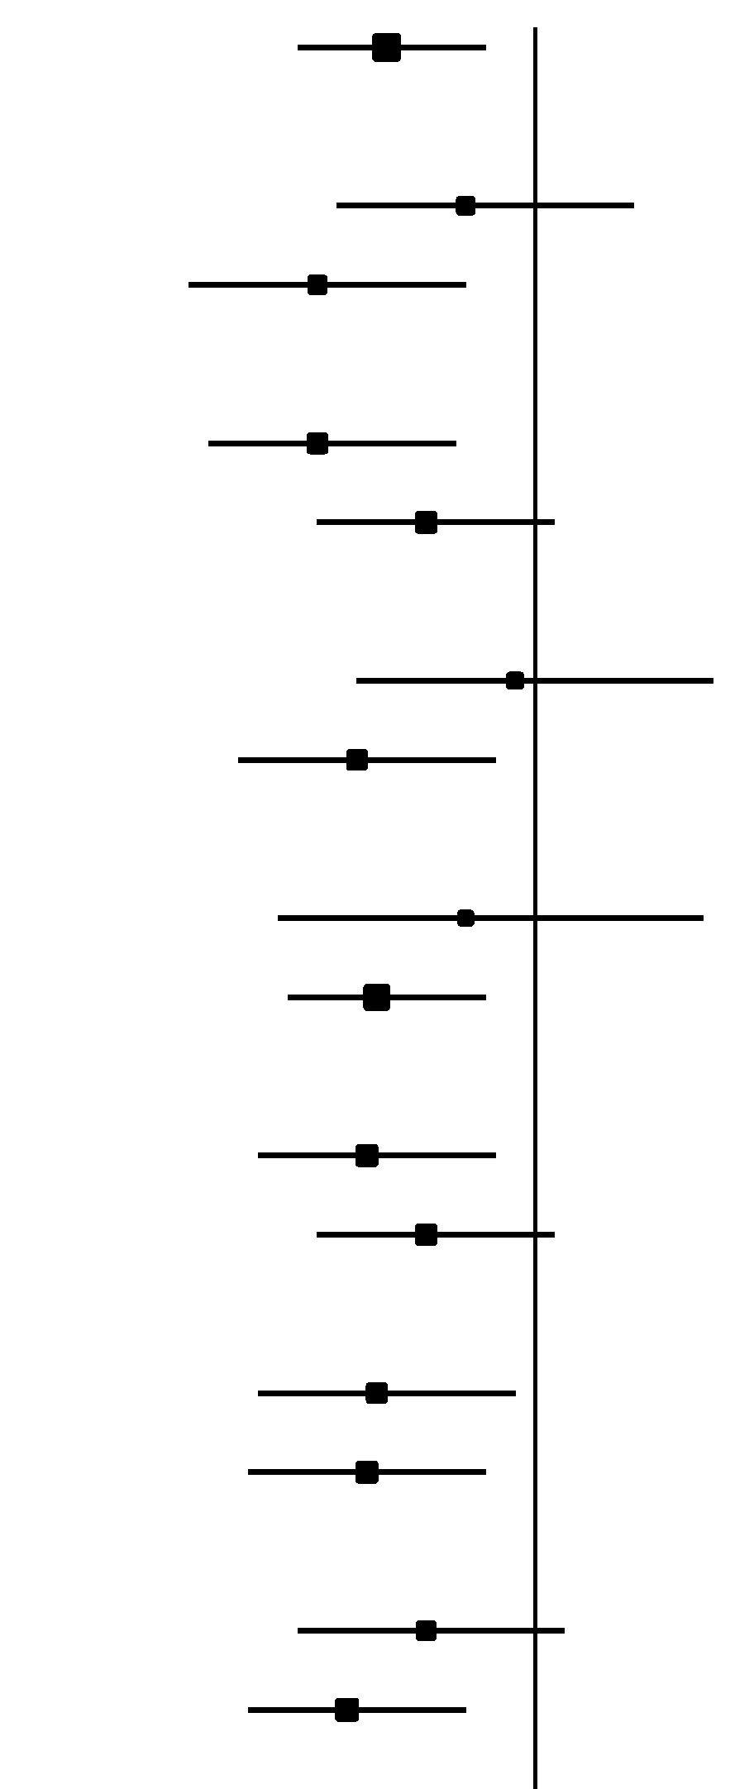
Forest Plot of Primary Outcome According to Subgroups
 | Intervention | Usual care | Relative risk (95% CI) |  | P value for interaction
Number of patients with dementia/total number
Overall | 668/14541 | 734/13594 |  | 0.85 (0.76, 0.95)
Age
≥69 years | 382/ 3670 | 390/ 3532 |  | 0.93 (0.80, 1.10) | 0.11
<69 years | 286/10871 | 344/10062 |  | 0.78 (0.65, 0.93)
Sex
Male | 217/ 5508 | 253/ 5035 |  | 0.78 (0.67, 0.92) | 0.25
Female | 451/ 9033 | 481/ 8559 |  | 0.89 (0.78, 1.02)
Education
<Primary school | 307/ 2920 | 329/ 3059 |  | 0.98 (0.82, 1.18) | 0.09
≥Primary school | 359/11505 | 395/10393 |  | 0.82 (0.70, 0.96)
Cigarette smoking
Current | 130/ 2997 | 133/ 2855 |  | 0.93 (0.74, 1.17) | 0.44
Former or never | 535/11444 | 590/10600 |  | 0.84 (0.75, 0.95)
Body-mass index, kg/m²
≥24.6 | 329/ 9388 | 366/ 8518 |  | 0.83 (0.72, 0.96) | 0.29
<24.6 | 338/ 5111 | 367/ 5046 |  | 0.89 (0.78, 1.02)
Systolic blood pressure, mm Hg
≥157.2 | 351/ 6135 | 344/ 5139 |  | 0.84 (0.72, 0.98) | 0.73
<157.2 | 317/ 8406 | 390/ 8455 |  | 0.83 (0.71, 0.95)
Fasting plasma glucose, mg/dL
≥101.3 | 345/ 7085 | 360/ 6589 |  | 0.89 (0.76, 1.03) | 0.36
<101.3 | 323/ 7455 | 374/ 7002 |  | 0.81 (0.71, 0.93)
0.5 1.0 1.2

Slide 15
Summary
Over 48 months of follow-up, the net group differences in systolic and diastolic BP reduction were 22.0 and 9.3 mmHg (p<0.0001), respectively.
The primary outcome of all-cause dementia was significantly reduced by 15% in the intervention group compared to usual care. The secondary outcome of cognitive impairment no dementia was also significantly reduced by 16% in the intervention compared to usual care.
The effectiveness of BP reduction on all-cause dementia was consistent by subgroups of age, sex, education, cigarette smoking, body mass index, systolic blood pressure, and fasting plasma glucose at baseline.

Slide 16
Conclusion
Blood pressure reduction is effective in reducing the risk of dementia in patients with hypertension.
This proven-effective intervention should be widely scaled up to reduce the global burden of dementia.

Slide 17
Acknowledgements
The CRHCP was supported by the Ministry of Science and Technology of China (grant # 2017YFC1307600). The US investigators did not receive any financial support from this study.
We thank the CRHCP investigators, staff, primary care providers, village doctors, and patients for their contribution to this work.

