Slide 1
Needs in the Therapeutic Heart Failure Space
Todd J Brinton, MD

Slide 2
disclosure
Todd Brinton, MD
Chief Scientific Officer
Corporate Vice President
Edwards Lifesciences
Examples of relationships are: Advisory Board/Board Member, Consultant, Honoraria, Research Support, Speaker’s Bureau, Stockholder
Please list full company name

Slide 3
Two primary forms of heart failure
% of HF
Heart failure with persevered ejection fraction or diastolic heart failure (EF > 50%)
Associated with systemic inflammation driving arterial and myocardial stiffening
Associated with normal left ventricular volumes and evidence of diastolic dysfunction (eg, abnormal pattern of LV filling and elevated filling pressures)
More common in women than men
Associated with aging and complex comorbid profiles
No mortality signal observed in any pharma trials
% of HF
Heart failure with reduced ejection fraction or systolic heart failure (EF <40%-50%)
Driven by local cardiac injury (macro or microvascular) causing decreased cardiac output and pathologic compensatory pathways
Characterized by increased LV volumes and reduced EF
Higher likelihood with men
Associated with infarctions, uncontrolled hypertension, or cardiomyopathies
Pharma is the gold standard with several drugs with proven mortality benefit

Slide 4
Heart failure is the number one driver of death, hospitalizations, and costs in the Medicare population
Prevalence
6.2M >8M
(US) (By 2030)
Hospitalizations
~1M
US hospital admissions for Acute Decompensated Heart Failure (ADHF) as primary diagnosis
2.7M
Physician office visits with a primary diagnosis of HF
Mortality
22%
At 1 year
42.3%
At 5 years
$31B direct cost to the US health system → estimated to double to $70B by 2030
Source: Heart Disease and Stroke Statistics – 2019 Update, American Heart Association

Slide 5
Key risk factors for HF are contributory and causal
RARER OR UNKNOWN CAUSES
RARER OR UNKNOWN CAUSES
1°VHD
AFIB
1°VHD
HTN
AFIB
HTN
CAD
CAD
Heart failure
Heart failure
PAH
RV failure
HLD
PAH
RV failure
HLD
MI
MI
DIABETES
DIABETES
OBESITY
OBESITY
Key HF risk factor
CKD
CKD
Risk factor for HFpEF
Risk factor for HFpEF
Risk factor for HFrEF
Risk factor for HFrEF
In disease pathway
In disease pathway
Note: HTN, hypertension, HLD, hyperlipidemia, CAD, coronary artery disease, CKD, chronic kidney disease, MI, myocardial infarction, AFIB, atrial fibrillation, PAH, pulmonary arterial HTN

Slide 6
Despite different drivers, compensatory/perpetuating mechanisms similar in HF
HFrEF
HFpEF
Risk factors
Ischemic Heart disease
Valvular Disease
Obesity
Coronary Artery Disease
Hypertension
Congenital Heart Disease
Diabetes
Chronic Kidney Disease
Cardiomyopathy
Other (transplant, chemo, infection)
Atrial Fibrillation
Hypertension
Acute injury
Impaired Contractility
Systemic inflammation & endothelial dysfunction triggering
decreased NO-cGMP-pKG signaling
Increased afterload
Chronic pressure overload
Causal
LV dysfunction/remodeling
Driven by sarcomere depletion, glycogen deposition, pathological protein alterations
LV/LA stiffening/hypertrophy with decrease in vascular elasticity
Driven by ECM stiffness/degradation and myocyte protein dysfunction/hypertrophy
Reduced Cardiac Output
Compensatory or perpetuating
Compensatory Upregulated SNS
Sodium + water retention
Works
Against
Compensatory Upregulated RAAS
BNP
↑
Cardiac stretching
Vasoconstriction
HR
Cardiac demand
Volume overload
Arrhythmia
LV/LA remodeling
Myocardial fiorosis
Apoptosis
Myocyte hypertrophy
Intestitial Fibrosis
Elevated LA pressure
Structural sequelae
HFrEF risk
Endothelial
Cardiac
HFpEF risk
Cardiac Insult
Renal
Neurohormonal
LV= left ventricular, LA= left atrial, SNS = sympathetic nervous system, RAAS = renin-angiotensin-aldosterone system , HR = heart rate, BNP = brain natriuretic peptide, NO = nitric oxide, cGMP= cyclic guanosine monophosphate, PKG = protein kinase G, ECM = extracellular matrix

Slide 7
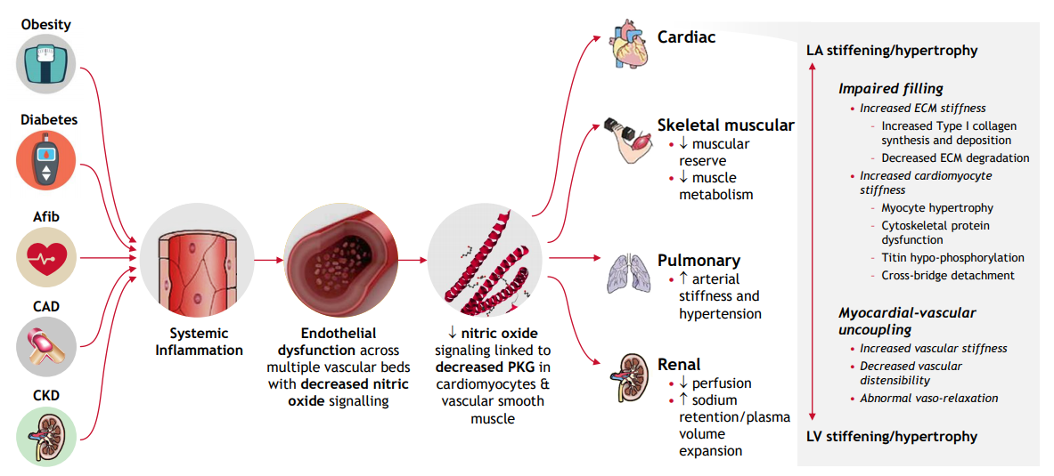
Multiple co-morbidities create an inflammatory state that leads to endothelial dysfunction that drives HFpEF
Source: BCG analysis (2018)

Slide 8
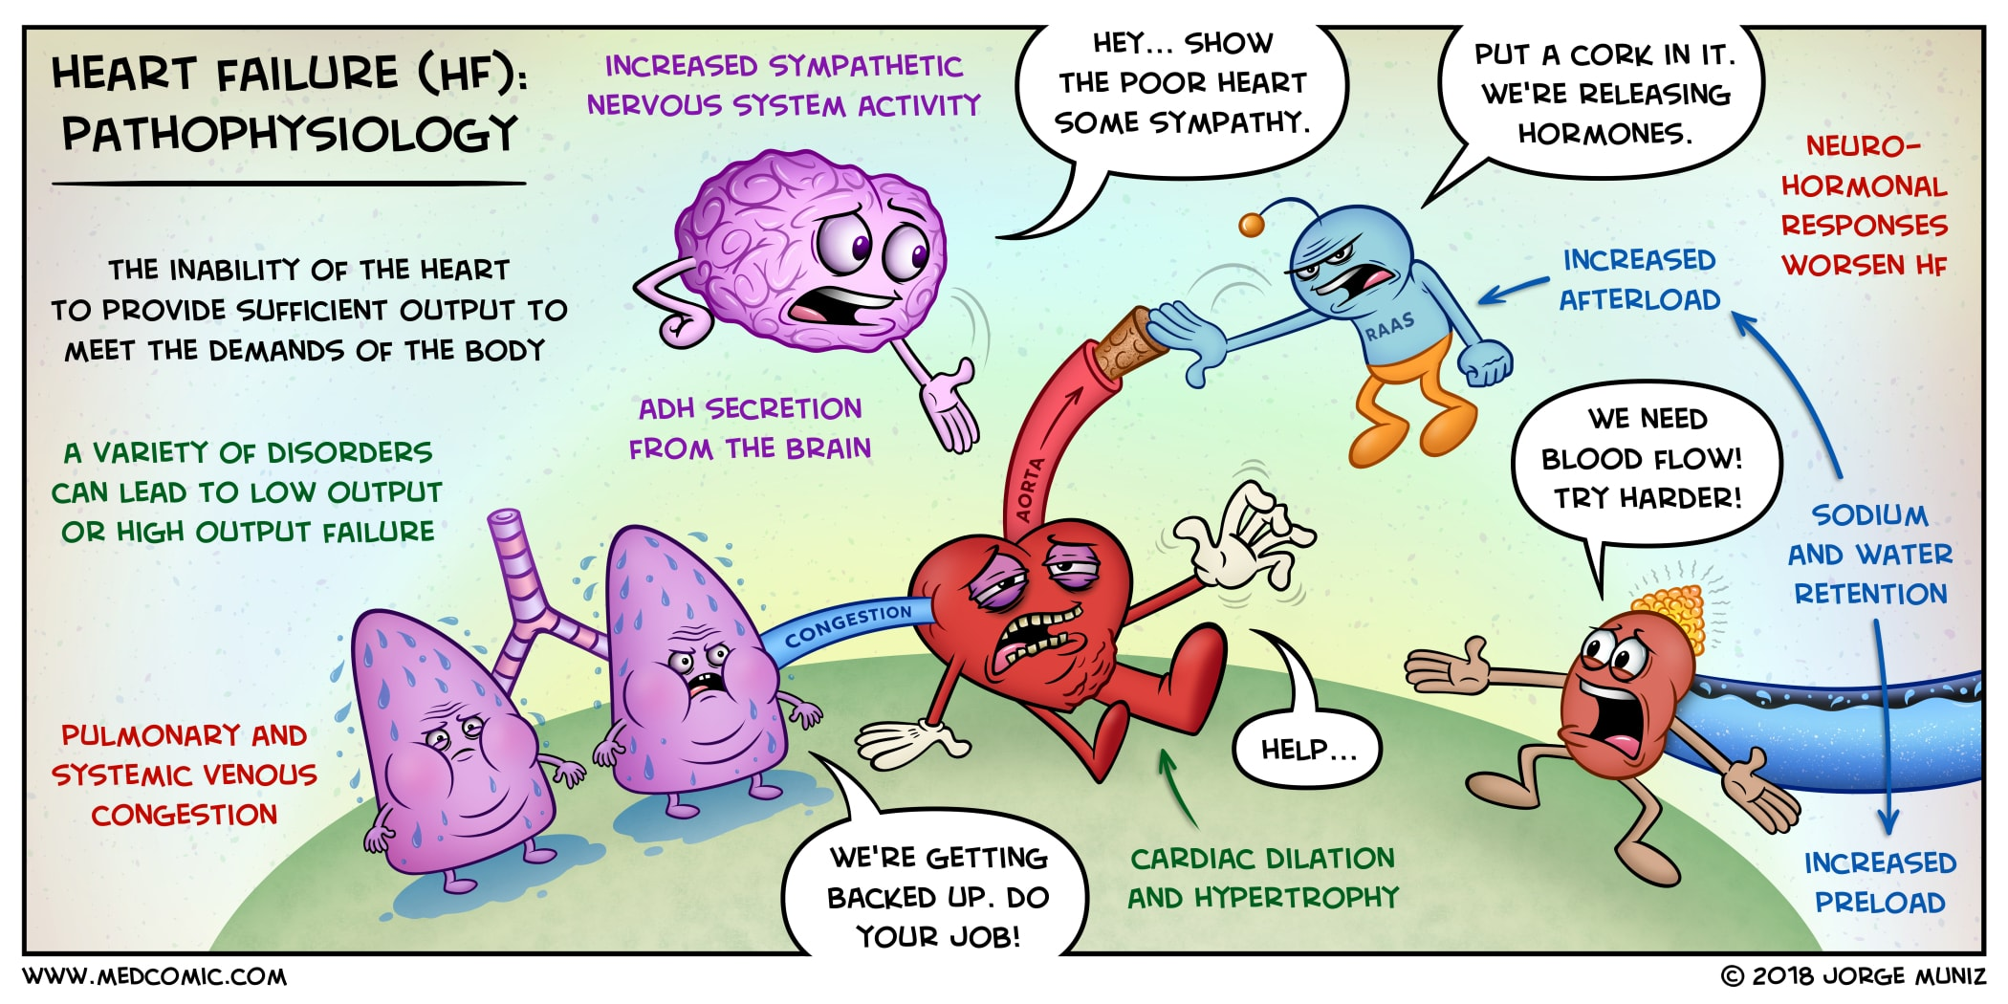

Slide 9
Current paradigm for clinical diagnosis leaves significant room for improvement
Framingham clinical criteria – key diagnostic
Clinical tests can support a HF diagnosis
Two sets of criteria for HF diagnosis
Assist in the diagnosis or exclusion of HF as a cause of symptoms (Class I recommendation)
Elevated levels also associated with other cardiac (i.e. VHD, afib, myocarditis, ACS) & non-cardiac causes (i.e. CKD, aging, anemia, OSA)
Gives some impression of severity although limited tie to changes in management
Major criteria
Minor criteria
Paroxysmal nocturnal dyspnea
Bilateral leg edema
Orthopnea
Nocturnal cough
Natiuretic peptide biomarkers
BNP (B-type natriuretic peptide) & NT-proBNP (N-terminal pro-B-type natriuretic peptide)
Elevated jugular venous pressure
Dyspnea on ordinary exertion
Supportive
Third heart sound
Hepatomegaly
Cardiomegaly on chest x-ray
Pleural effusion
Pulmonary edema on chest x-ray
Tachycardia (≥120 beats/min)
Weight loss ≥4.5kg in 5 days in response to diuretics
Weight loss ≥4.5kg in five days
Echocardiogram is not diagnostic
Diagnosis of HF requires two major or one major and two minor criteria cannot be attributed to another condition
Supportive
Source: 'Evaluation of patient with suspected heart failure' – Wilson S. Colucci (2018); '2017 ACC/AHA/HFSA Focused Update of the 2013 ACCF/AHA Guideline for the Management of Heart Failure' (2017)

Slide 10
Hospitalizations account for over half of the costs in Stage C/D HF and reducing them is a key priority
Heart Failure burden
Goals of Heart Failure Therapy
Physicians
$2.5
Hospitalizations
Drugs/Devices $3.2
Lost Productivity/ Mortality $4.1
Mortality
Quality of Life
Hospitalizations $20.9
Nursing Home $4.7
Home Healthcare $3.8
Source: Heart Disease and Stroke Statistics—2010 Update

Slide 11
HFpEF hospitalization rate rising relative to HFrEF due to an ageing population, lesser misdiagnosis and lack of therapies
Data from a large nationwide HF hospitalization study (n>110,000)
HFpEF hospitalization rates are on the rise compared to HFrEF
Some hypothesis include:
Higher prevalence of HFpEF in an increasingly aging population with co-morbidities e.g., diabetes, HTN
Lesser rates of HFpEF misdiagnosis
Lower availability of drug treatments in HFpEF
HFpEF
Proportion of hospitalized HF patients broken by EF
HFrEF
HFmrEF
Year
Source: Owan T et al. Trends in prevalence and outcome of heart failure with preserved ejection fraction. N Engl J Med. 2006; Get With the Guidelines-Heart Failure Registry (GWTG-HF)
Notes:
65% of HFH will be EF>40% and 50% will be EF>50% Proportion of patients hospitalized with HF who had HFpEF increased from 33 % in 2005 to 39 % in 2010.
Within the same time interval, the proportion of HF hospitalizations due to HFrEF decreased from 52 % to 47 %

Slide 12
High co-morbidities in HFpEF postulated to cause a higher % of non-cardiac deaths vs. HFrEF
Non-cardiac deaths
% of patients
HFpEF
HFrEF
38%
40%
20%
18%
16%
JCARE-CARD
Henkel et al
Adabag et al
CHARM
DIG
Source: Michelle M.Y. Chan, Carolyn S.P. Lam, EJHF. 2013
Notes:
HFpEF had more Renal disease, DM, Respiratory, GI
Cardiac death = stroke + CHF + Other CVD (pump failure, SCD / arrhythmia)

Slide 13
Cause-specific mortality in RCTs of HFpEF
Source: Vaduganathan M et al. Mode of Death in Heart Failure with Preserved Ejection Fraction. JACC 2017

Slide 14
Left Atrial Pressure is an early predictor of clinical decompensation
Clinical Signs & Symptoms
Hospitalization
Hypertensive crisis
Fluid Retention
Myocardial
ischemia
Left Atrial Pressure
Elevated LAP is the common denominator that precedes Heart Failure hospitalizations
Aortic / Mitral regurgitation
Time Preceding Hospitalization
Stable
Presymptomatic Congestion
Admission
Source: Adapted from Pathophysiology of the transition from chronic compensated and acute decompensated heart failure; Adamson PB, et al. Curr Heart Fail Reports 2009

Slide 15
Multitude of treatment options exist for HFrEF with a lack of standard of care for HFpEF
Stage C
Stage D
1st Line
ACEI/ARB
Beta blockers
Aldosterone Antagonist
Inotropes
Guideline directed medical therapy (GDMT) defined by heart failure subtype
GDMT in HFpEF: diuretics
GDMT in HFrEF: ACE/ARB/ANRI, beta blocker, and diuretics
HFpEF
No further recommended treatments until stage D
LVADs/ Heart transplant
Diuretics
1st Line
2nd and 3rd Line
4th and 5th line
LVEF <40%, can be monitored for Serum/potassium levels
Aldosterone antagonist
NYHA class II-III, no angioedema
ARNI
ACE or ARB or ARNI
Beta blocker
NYHA class III-IV, African-American
Hydral-Nitrates
Digoxin
HFrEF
NYHA class II-III, LVEF ≤35%;
ICD
TMVR/MVR
Diuretics
LVEF ≤35%, NSR, QRS ≥150 ms or LBBB
CRT
Mortality benefit
NYHA class II-III, LVEF ≤35%, NSR, heart rate ≥70 bpm
Ivabradine
Symptomatic benefit
Comorbidity benefit
No guideline recommendations for device/platform based patient monitoring
Notes:
Ivabradine—RHR > 70 BPM, in sinus rhythm, beta blockers at max dose/contraindicated
Hydralizine plus nitrate—black patients not responding to first line
MRA—on first line, LVEF still <40%, can be monitored for Serum/potassium levels
Criteria for ICD--heart failure cause (ischemic heart disease), LVEF < 30%
Criteria for CRT—QRS >150 (mechanism)

Slide 16
Progress made in HFrEF over the years has led to a decrease in morbidity and mortality
Positive HFrEF trials from 2001-2014
H-ISDN
ARB
MRA
Ivabradine
Beta-blocker
ICD/CRT
Devices
Sacubitril/valsartan (Entresto)
COMET
SENIORS
SHIFT
CHARM-Alt
HF- ACTION
PARADIGM-HF
CHARM-Add
EMPHASIS-HF
Val-HeFT
A-HeFT
HEAAL
2001 | 2002 | 2003 | 2004 | 2005 | 2006 | 2007 | 2008 | 2009 | 2010 | 2011 | 2012 | 2013 | 2014
COMPANION
RAFT
REMATCH
SCD-HeFT
MADIT-CRT
CARE-HF
Heart Mate II
H-ISDN: Hydralazine–isosorbide dinitrate; ARB: Aldosterone receptor blocker; MRA: Mineralocorticoid receptor antagonist; ICD: Implantable cardioverter defibrillator;
CRT: Cardiac resynchronization therapy
Notes:
COMET – Carvedilol v Metoprolol (Carve was better in all-cause mortality) CHARM ADD – Add Candesartan (ARB) to ACEi
CHARM ALT – Candesartan (ARB) to patients intolerant of ACEi
Val-HeFT – Valsartan A-HeFT - Isosorbide Dinitrate and Hydralazine SENIORS – Nebivolol (elderly) COMPANION – crt scd-hEft – Amiodarone or ICD HF-ACTION – Exercise – only some outcomes (HFREs) HEAAL – Losartan SHIFT – Ivabridine – HR>70bpm though (better version of BB) RAFT – CRT for mild to moderate HF EMPHASIS – Eplerenone PARADIGM - ARNI

Slide 17
However, HFrEF trials also saw a number of early disappointments: 1987 - 2013
CRT
ARB
Statin
Anti-arrhythmic
Inotrope
Beta-blocker
CCB
Dopaminergic
Alpha-blocker
ACE-NEP inhibitor
Endothelin antagonist
Anti-adrenergic
Anti-cytokine
Polyunsaturated fatty acids
Anti-adrenergic
Immune therapy
Warfarin
Erythropoietin stimulating agents
PRAISE
MOXCON⁵
VEST
OVERTURE³
CORONA
WARCEF¹⁰
MACH-1
ANDROMEDA
PROMISE
PRIME-2¹
PRAISE-2
RENEWAL⁶
GISSI-HF⁷
ELITE-2
GISSI-HF
1990
2000
2010
87 | 88 | 89 | 90 | 91 | 92 | 93 | 94 | 95 | 96 | 97 | 98 | 99 | 00 | 01 | 02 | 03 | 04 | 05 | 06 | 07 | 08 | 09 | 10 | 11 | 12 | 13 | 14
SWORD
PROFILE
ECHO-CRT
CAST
CAST-2
Urapadil trial²
BEST
ECHOS⁸
RED-HF¹¹
xamoterol
ACCLAIM⁹
CHF-STAT
DIAMOND-CHF
ENABLE⁴
Notes:
Compare timelines of HFpEF and rEF maybe we are learning more about pEF so hopefully trials will be successful

Slide 18
In comparison, HFpEF has been studied in fewer trials, with limited success

Slide 19
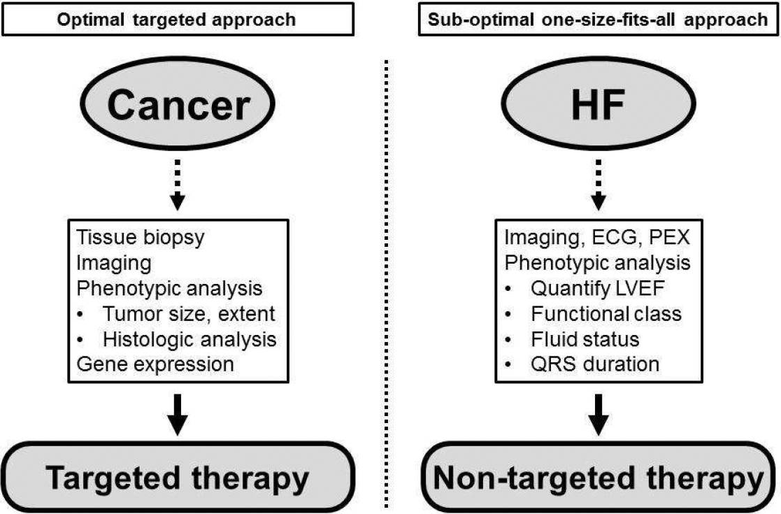
HFpEF’s diverse etiology is similar to cancer and may require a more targeted patient classification and therapy
Challenges of treating HFpEF
Diverse etiology and pathophysiology compared to HFrEF
Heterogeneity of HFpEF even in a single patient may explain failure of clinical trials
Improved / nuanced classification should lead to more targeted approaches and better outcomes
e.g., CRT
Source: Shah S et al, Heart Fail Clin.. 2014
Notes:
Less patients but better targeting and better efficacy; especially because QoL and survival (especially post hospitalization) in HFpEF is close to stage 3B cancer (as much need there) e.g., Cancer drugs – Herceptin (HER2), Tarceva (5-10% of lung cancers EGFR mutation) – response rate from 16% Chemo to 65% drug Key point – you have to find the cause / etiology per patient or if every patient has 7 causes then there needs to be a multi pronged approach or find a common denominator

Slide 20
Clinicians have proposed multiple HFpEF segmentations to better understand patient population
1
Clinical classification
2
3
4
5
Clinical phenotype
Latent-class analysis
Pheno-mapping
Presentation phenotype
Common themes amongst these classifications may help identify unmet needs and therapeutic opportunities
Notes:
Methods of classifications

Slide 21
So what does all this mean from a clinical trial standpoint?
1
Clinical classification I
2
3
4
5
Clinical phenotype
Latent-class analysis
Pheno-mapping
Presentation phenotype
“Garden-variety”
Ageing phenotype
Young males + CAD
BNP deficiency syndrome
Exercise-induced diastole dysfunction
CAD-HFpEF
Young females + low BNP
RHF-HFpEF
Obesity phenotype
Obesity + DM + CKD + anemia
Afib-HFpEF
Obesity-cardiometabolic phenotype
Volume overload
HCM-like HFpEF
Obese females
PH phenotype
High output
Older males + CAD
Valvular HFpEF
RV failure + cardiorenal phenotype
PH + RV failure
CAD phenotype
Old females + low BMI + Afib
Rare HFpEF
Notes:
Purely from a presentation standpoint (not etiology / pathophysiology)

Slide 22
Negative trials in HFpEF showcase the importance of matching patient segments with interventions and endpoints
Trial | Intervention | HFpEF patient type | Primary endpoint | Trial result | Commentary
ALDO-DHF | Spironolactone | Exercise-induced DD | Peak VO2 | Negative | Did not match Sprionolactone to “volume overload” patients (prior trials showed no change in exercise capacity)
ELANDD | Nerbivolol | Exercise-induced DD | 6MWT | Negative | Given vasodilation effects, maybe best suited for “volume overload” patients
J-DHF | Carvedilol (low-dose) | Exercise-induced DD | Death or HFH | Negative
RAAM-PEF | Eplerenone | Volume overload | 6MWT | Negative | Right drug, right patient, wrong end-point?
RELAX | Sildenafil | Volume overload | Peak VO2 | Negative | PDE5i has history of treating PAH; maybe better suited for RVD / PH patients
Source: Shah , JACC. 2013
Notes:
ALDO-DHF got the early stage ones J-DHF may have been worked with high-dose
Pause

Slide 23
Successful trials in HFpEF showcase the importance of matching patient segments with interventions and endpoints
Trial | Intervention | HFpEF patient type | Primary endpoint | Trial result | Commentary
Komsala et al. | Ivabradine | Exercise-induced DD | Peak VO2 | Positive | Ivabridine’s luscitropic effects best suited for improving exercise capacity
CHAMPION | CardioMEMS | Volume overload | HFH | Positive | Monitoring best suited to affect congestion
Guazzi et al. | Sildenafil | RHF / PH | Pulmonary Hemodynamics | Positive | PDE5 previously shown to be beneficial for PAH
Kitzman et al | Exercise testing | Exercise-induced DD | Peak VO2 | Positive | Focus on exercise in patient selection / endpoint
PARAMOUNT | ARNI | Volume overload | NT-proBNP | Positive | High BNP cutoff recruitment
Notes:
Ivabridine better suited than Spirinolactone for these (because former decreass HR without negative ionotropic effects)

Slide 24
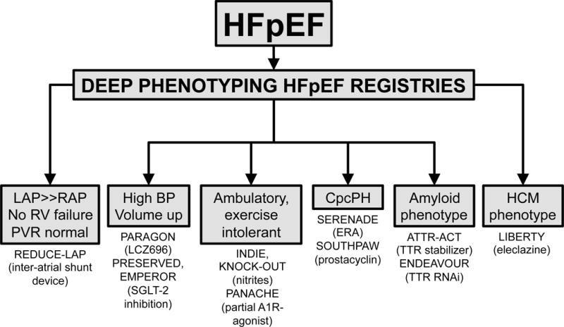
“Precision medicine” used in HFpEF registries: patients are deep-phenotyped and allocated to appropriate trials
Source: Shah S, JCTR. 2017
Notes:
Nitrates – improved activity in HFrEF but don’t know about HfpEF
SERENADE – Macitentan (Endothelial receptor antagonist for PAH)
PANACHE - Neladenoson SOUTHPAW - Treprostinil

