Slide 1
CorMicA
A Randomized Trial of Coronary Function Testing in Angina and Non Obstructive Coronary Disease
Tom Ford, MBChB (Hons) FRACP
On Behalf of the CorMicA Investigators

Slide 2
Disclosure Statement of Financial Interest
Within the past 12 months, I or my spouse/partner have had a financial interest/arrangement or affiliation with the organization(s) listed below.
Affiliation/Financial Relationship
Grant/Research Support
Company
Company Names
Consulting Fees/Honoraria
Major Stock Shareholder/Equity
Royalty Income
Ownership/Founder
Intellectual Property Rights
Other Financial Benefit
Company Names
Company Names
Company Names
Company Names
Company Names
Company Names
All TCT 2018 faculty disclosures are listed online and on the App.

Slide 3
Background
Ischemia without obstructive CAD - common
Invasive diagnostic tests are available
Practice guideline recommendations (ESC 2013) for therapy √
No randomized trials
No adoption in the clinic
Patient outcomes sub-optimal.

Slide 4
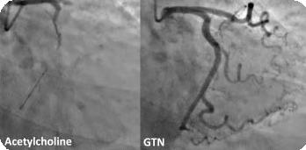
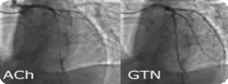
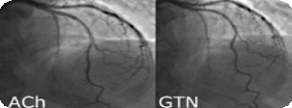
Invasive Diagnosis with Stratified Medicine
Microvascular Angina (MVA)
BB, CCB, Nicorandil, Ranolazine, Lifestyle
Vasospastic Angina (VSA)
CCB +/- Nitrate
Non-Cardiac (Normal Function)
Cease antianginal therapy +/- non-cardiac Ix

Slide 5
Hypothesis
Stratified medicine guided by an Interventional Diagnostic Procedure (IDP) improves angina and QOL in patients without obstructive CAD

Slide 6
CorMicA Trial
Primary Endpoint Angina Severity (SAQ)
Standard Care
Baseline Angiogram 6 Months
(Day 0)
Diagnostic procedure Stratified Therapy, n=75
No Obstructive CAD
SAQ
Randomise
Two Large Regional Hospitals (Pop^{n} 2.5m)
Consent
Record Treatment/ Diagnosis
EQ-5D
TSQM9
BIPQ
PHQ4
DS <50%
FFR >0.8
Referred for Invasive Coronary Angiogram
SAQ
EQ-5D-5L
TSQM9
BIPQ
PHQ4
Blind, Sham Procedure Standard Care , n=76

Slide 7
Primary Endpoint – 6 month SAQ Change
Between-Group
Difference
11.7 Units
95% CI, 5.0 to 18.4 P=0.001
14.5 Units
95% CI, 7.3 to 21.7 P<0.001
Physical Limitation
9.3 Units
(95% CI, 0.5 to 18.1) P=0.040
Angina Frequency
15
10
SAQ Units
Control Intervention
5
0
Summary Score
-5

Slide 8
Conclusions
CorMicA - the first randomised, sham-controlled trial of diagnostic strategy in angina and no obstructive CAD
Adjunctive IDP is routinely safe & feasible
Physician diagnosis changed, half of patients
Stratified medicine guided by the IDP improves health status at 6 months
↓ angina and ↑ quality of life.

Slide 9
Online in JACC, today

