Slide 1
PROTEIN AND EXERCISE TO REVERSE FRAILTY IN OLDER MEN AND WOMEN UNDERGOING TRANSCATHETER AORTIC VA LVE REPLACEMENT THE PERFORM- TAV R TRIAL
PERFORM-TAVR
Jonathan Afilalo, Sandra Lauck, Anita W. Asgar, Rakesh Arora, Jessica Forcillo, Rosie Fountotos, Giuseppe Martucci, Marco Spaziano, Remi Kouz, Harindra C.Wijeysundera, Andre Lamy, Mark David Peterson, Nicolas Noiseux, Marino Labinaz,Thais Coutinho, Marie-Claude Ouimet, Jopie Polderman, John G.Webb, Nicolo Piazza
American College of Cardiology Scientific Sessions LBCT Monday April 8th 2024

Slide 2
DISCLOSURES
PERFORM-TAVR
The PERFORM-TAVR Trial was funded by a peer-reviewed project grant from the Canadian Institutes of Health Research [CIHR] & academic support from the Lady Davis Institute for Medical Research at the Jewish General Hospital
The investigators reported no conflicts of interest relevant to this presentation
An independent Data Safety Monitoring Board oversaw the conduct of the Trial and was composed of Drs. Michael Rich [Chair,Washington University], James Brophy [McGill University], and Daniel Matlock [University of Colorado]

Slide 3
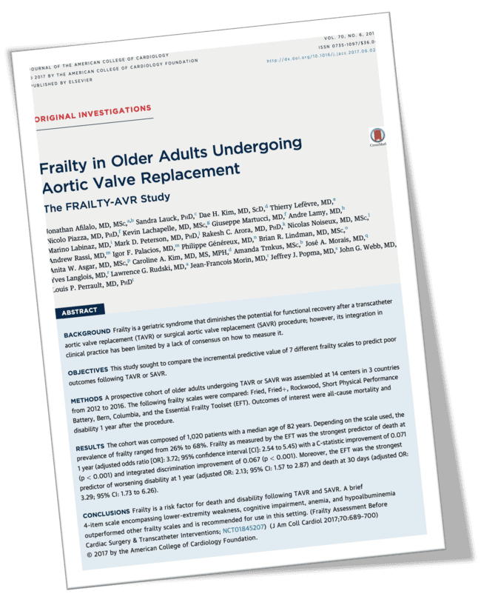
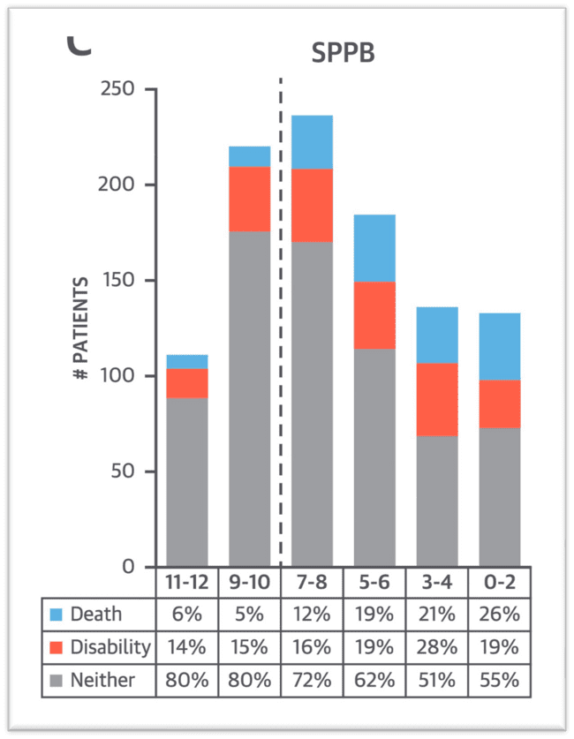
Rationale from the FRAILTY-AVR Prospective Cohort Study
Despite 96% technical success … 2 of 5 patients had “poor outcomes” Frailty was the #1 predictor of death or functional decline post-TAVR
poor outcome
low SPPB [frail]
Afilalo J. JACC 2017

Slide 4
CONCEPTUAL FRAMEWORK
PERFORM-TAVR
TAVR | AS
+
Poor
outcome
Frailty
Defrail
Favorable
outcome

Slide 5
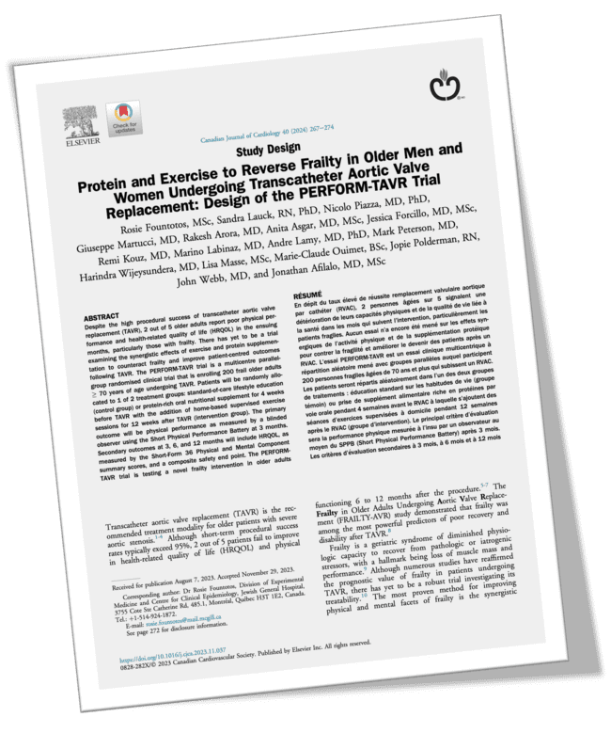
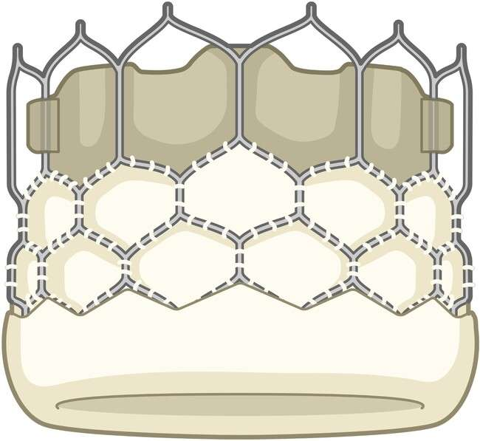
Screening [during clinic visit]
PERFORM-TAVR
Randomization [after clinic visit]
Baseline assessment by therapist [home visit]
-1 month
TRIAL DESIGN
Protein ONS
Usual care
TAVR
TAVR
Protein ONS
+
Exercise therapy
[home visits 2/wk]
Usual care
Randomized parallel-group clinical trial
Blinded ascertainment of outcomes 11 hospitals across Canada 2019-2022
Outcome assessment by blinded therapist [home visit]
3 months
Outcome assessment by blinded therapist [home visit]
6 months
Outcome assessment by research assistant [phone call]
12 months
Fountotos R. CJC 2024

Slide 6
PARTICIPANTS
PERFORM-TAVR
INCLUSION CRITERIA
Age ≥70 years
Undergoing TAVR
Physically frail
SPPB score ≤8, or SF-36 PF score ≤ 55
Informed written consent
EXCLUSION CRITERIA
Decompensated or non-ambulatory class IV
Uncontrolled diabetes
GFR <30 mL/min/1.73 m²
Cirrhosis
Allergy to ingredient in protein-rich ONS
Inability to walk without human assistance or high-risk of falls (≥2 falls in past year)
Moderate-to-severe cognitive impairment
Significant language barrier
COVID-19 positive or suspected

Slide 7
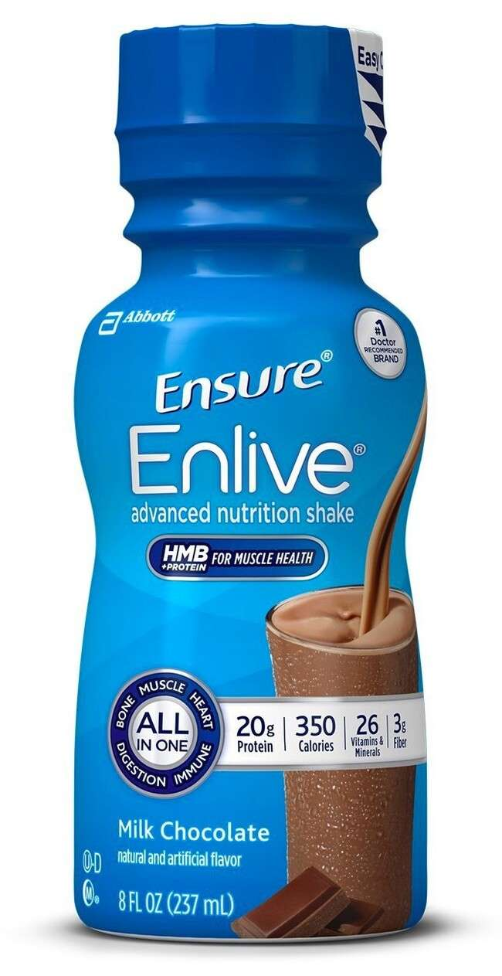
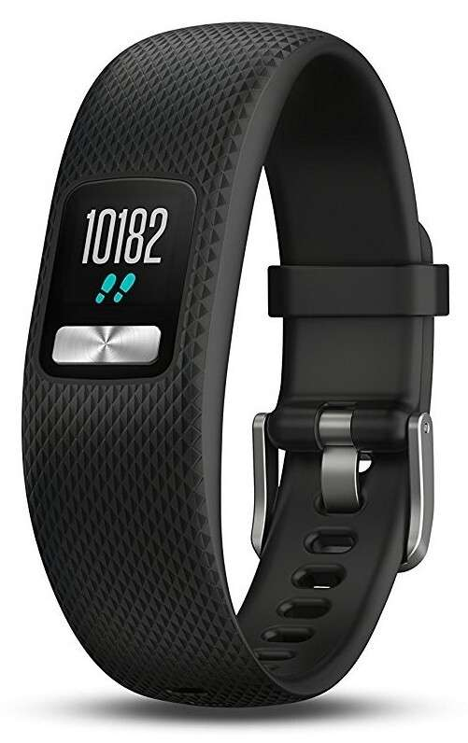
INTERVENTION
PERFORM-TAVR
INTERVENTION GROUP CONTROL GROUP
Lifestyle education
Guideline-recommended moderate intensity physical activity and a balanced healthy diet
Protein-rich oral nutritional supplement
Beverage containing 20 g protein and
1.5 g HMB twice daily after meals
Home-based exercise
Supervised WEBB program with a therapist at their home 1-hour 2 days per week
Unsupervised walking with an accelerometer to track step counts

Slide 8
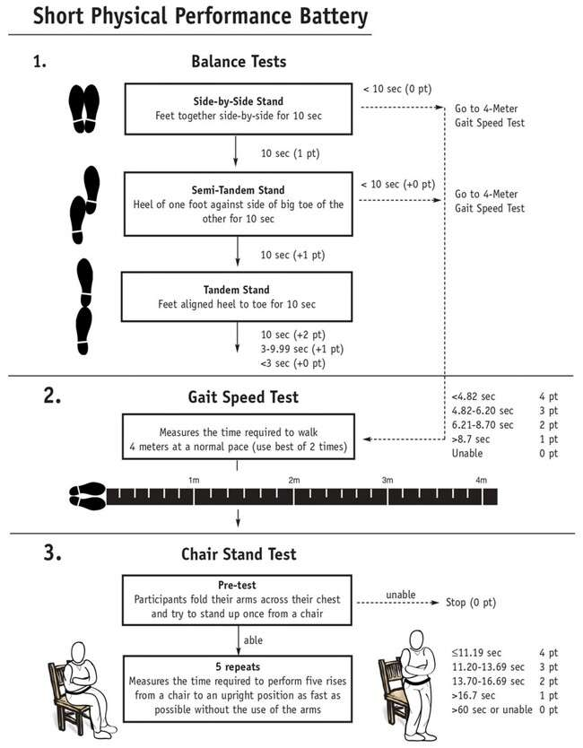
OUTCOMES
PERFORM-TAVR
SPPB SF-36 PCS SF-36 MCS
MoCA
Habitual physical activity Muscle mass & strength Clinical composite
----------------------------------
1 … 12 … 24 … 52 weeks
Total SPPB score: from 0 [worst] to 12 [best]

Slide 9
STATISTIC AL ANALYSIS
PERFORM-TAVR
Sample size calculation: N=200 was powered with a one-tailed alpha of 0.05 and a beta of 0.80 to detect a 1-point difference in final SPPB scores between the intervention and control groups (SD 2.5, dropouts ≤15%, crossover ≤5%)
Modified ITT: The intention-to-treat principle was modified to exclude those that were censored due to a competing risk or dropout before the 1st home visit
Analysis: Multivariable linear regression was used to determine the effect of our intervention on final SPPB scores after adjusting for baseline SPPB scores, age, sex, BMI, territory; multiple imputation by chained equations was used to impute missing SPPB scores (informed by physical performance questionnaires)

Slide 10
PERFORM-TAVR
Randomized (n=210)
TRIAL FLOW
Allocated to intervention (n=105)
Unable to obtain baseline assessment (n=10) Died: 1
Disenrolled prematurely: 7
Other reason: 1 (urgent CABG+SAVR)
Allocated to control (n=105)
Unable to obtain baseline assessment (n=3) Died: 0
Disenrolled prematurely: 2
Other reasons: 1 (urgent CABG+SAVR)
QC team (n=47)
Received the control (n=102) Lost to follow-up (n=0)
Discontinued participation (n=4) Died: 2 (2 in-hospital, 0 after)
QC team (n=51)
N=180 analyzed for primary outcome
Received the intervention (n=95) BC team (n=37) Lost to follow-up (n=0) MB team (n=9)
BC team (n=41) MB team (n=8) ON team (n=2)
Discontinued participation (n=10) ON team (n=2)
Died: 6 (4 in-hospital, 2 after)
Disenrolled prematurely: 4
Other reason: 1 (moved out of country)
Disenrolled prematurely: 3
Other reason: 2 (disabling stroke in-hospital)
Analyzed primary outcome (n=85) Analyzed 1-year vital status (n=91)
Analyzed primary outcome (n=95) Analyzed 1-year vital status (n=99)

Slide 11
Intervention
N=85
Control
N=95
Not analyzed
N=30
Age years
82.4 ± 5.4
83.3 ± 6.1
82.8 ± 5.1
PERFORM-TAVR
Female
40 (47%)
41 (43%)
18 (60%)
BMI kg/m²
29.7 ± 6.4
28.3 ± 6.3
29.7 ± 9.5
Heart failure
17 (20%)
21 (22%)
4 (14%)
Myocardial infarction
5 (6%)
7 (7%)
7 (25%)
BASELINE
CHARACTERISTICS
Prior PCI
21 (25%)
25 (26%)
6 (21%)
Prior cardiac surgery
12 (14%)
20 (21%)
4 (14%)
Diabetes
29 (34%)
21 (22%)
11 (39%)
Stroke
7 (8%)
9 (9%)
3 (11%)
70% octo-nonagenarians | 45% females
PAD
7 (8%)
8 (8%)
3 (11%)
COPD
19 (22%)
14 (15%)
5 (18%)
CKD
18 (21%)
15 (16%)
6 (21%)
GFR mL/min/1.73 m²
60.1 ± 14.4
59.0 ± 13.1
57.8 ± 14.9
Hemoglobin
126.6 ± 15.9
127.9 ± 16.1
126.4 ± 19.1
Albumin
38.5 ± 5.2
38.5 ± 4.1
40.6 ± 4
EFT score /5
1.8 ± 1.1
1.8 ± 1.2
2.1 ± 1.0
LVEF %
59.3 ± 9
57.2 ± 10.7
60.0 ± 9.7
PASP mmHg
37.0 ± 13
37.4 ± 11.7
39.7 ± 13
AVA cm²
0.79 ± 0.18
0.78 ± 0.22
0.79 ± 0.16

Slide 12
PROTOCOL ADHERENCE
PERFORM-TAVR
INTERVENTION ASSESSMENTS
Pre
TAVR
12w
 | Pre | 12w | 24w
Chair rise test | 175 | 134 | 124
Gait speed test | 137 | ? | 97
Balance test | 174 | 140 | 130
Questionnaires | 171 | 167 | 159
Protein suppl.
9 days
[IQR 3, 22]
99 days
[IQR 93, 112]
23 sessions
[IQR 22, 23]
20 min/day
[IQR 13, 32]
Supervised EX
111
?
Unsupervised EX
Step counts
2128 steps/day
[IQR 1041, 3220]

Slide 13
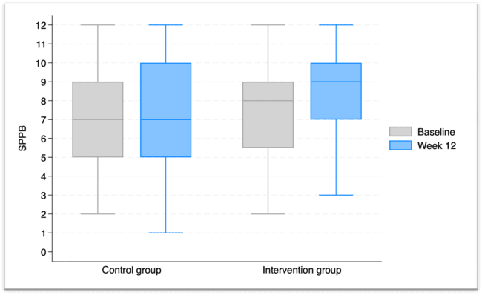
PERFORM-TAVR
PRIMARY OUTCOME
SPPB @ 12 WEEKS

Slide 14
PERFORM-TAVR
PRIMARY OUTCOME
SPPB @ 12 WEEKS
 | Coefficient | 95% CI | P-value
Intervention | 1.02 | 0.37, 1.66 | 0.002
Age per year | -0.11 | -0.17, -0.05 | 0.001
Female sex | -0.13 | -0.77, 0.52 | 0.70
Body mass index per kg/m2 | -0.04 | -0.09, 0.02 | 0.17
Territory Quebec British Columbia Ontario/Manitoba | Referent 0.06 -0.52 | -0.65, 0.76 -1.53, 0.49 | 0.88 0.31
Baseline SPPB per point | 0.55 | 0.43, 0.68 | <0.001
MULTIPLE IMPUTATION ANALYSIS
Model Linear regression with multiple imputation by chained equations
Dependent variable ordinal SPPB score at 12 weeks [N=180 analyzed]

Slide 15
PERFORM-TAVR
PRIMARY OUTCOME
SPPB @ 12 WEEKS
 | Coefficient | 95% CI | P-value
Intervention | 1.41 | 0.59, 2.23 | 0.001
Age per year | -0.11 | -0.18, -0.03 | 0.005
Female sex | -0.10 | -0.94, 0.73 | 0.81
Body mass index per kg/m2 | -0.04 | -0.11, 0.02 | 0.20
Territory Quebec British Columbia Ontario/Manitoba | Referent -0.59 -0.97 | -1.82, 0.63 -2.05, 0.11 | 0.34 0.08
Baseline SPPB per point | 0.58 | 0.42, 0.74 | <0.001
COMPLETE CASE ANALYSIS
Model Linear regression without imputation
Dependent variable ordinal SPPB score at 12 weeks [N=94 analyzed]

Slide 16
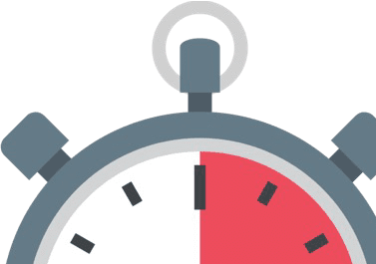
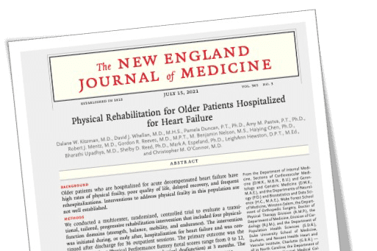
Walking one block
“Limited a lot” ➔ “Not limited at all”
PERFORM-TAVR
+1 SPPB POINT ➔ …
6-minute walk distance
⇧ 36 to 52 m
“Substantial meaningful change”
Death or readmission in HF
⇩ 14%
REHAB-HF Trial 1° outcome
8 vs. 7 @ 12 weeks
Perera S. JAGS 2006
Volpato S. J Gerontol 2011
Kitzman DW. NEJM 2021

Slide 17
PERFORM-TAVR
SECONDARY OUTCOME
SF36-PCS @ 12 WEEKS
 | Coefficient | 95% CI | P-value
Intervention | 5.8 | 0.14, 11.5 | 0.045
Age per year | -0.53 | -1.05, -0.01 | 0.048
Female sex | -3.46 | -8.89, 1.98 | 0.21
Body mass index per kg/m2 | -0.46 | -0.94, 0.13 | 0.06
Territory Quebec British Columbia Ontario/Manitoba | Referent -0.85 6.26 | -6.62, 4.91 -3.24. 15.77 | 0.77 0.19
Baseline SF36-PCS per point | 0.58 | 0.44, 0.72 | <0.001
MULTIPLE IMPUTATION ANALYSIS
Model Linear regression with multiple imputation by chained equations
Dependent variable ordinal SPPB score at 12 weeks [N=180 analyzed]

Slide 18
SAFETY
PERFORM-TAVR
SERIOUS ADVERSE EVENTS ALL-CAUSE MORTALITY
None related to the trial’s intervention
Intervention |  | Control
Pre-initiation | 2 | 0
Peri-TAVR | 3 | 2
1-11 weeks | ₂ * | 0
12+ weeks | 5 | 7
Total | 12 | 9
Arrhythmias
Ischemic events
HF exacerbations
Injurious falls
Acute kidney injuries
Hyperglycemic urgencies
Could not be analyzed for primary outcome since 12-week SPPB N/A
P=0.49
*1 Sudden cardiac death attributed to massive MI (last exercise 2d prior)
*2 Respiratory failure due to end-stage lung disease (last exercise 7w prior)

Slide 19
LIMITATIONS
PERFORM-TAVR
Pandemic ➔ home visits for therapy and assessment often not permitted
Virtual delivery of exercise therapy
Questionnaire-based physical performance helpful to impute missing SPPB scores
Results with vs. without imputations consistent
30 (14%) not analyzed due to early dropout or competing risk
Time between baseline visit and TAVR procedure unpredictable for prehab

Slide 20
CONCLUSIONS
PERFORM-TAVR
A home-based exercise intervention with protein supplementation was safe and improved physical performance at 12 weeks in frail TAVR patients
Despite high technical success and low procedural complications TAVR alone did not improve physical performance metrics of strength, mobility, and balance
This trial supports a shift towards a more holistic treatment paradigm that addresses frailty to optimize functioning and quality of life following TAVR

Slide 21
PARTICIPATING CENTERS
PERFORM-TAVR
# | Site | University | Location
1 | Jewish General Hospital | McGill University | Montreal, QC
2 | Royal Victoria Hospital |  | Montreal, QC
3 | St. Paul’s Hospital | University of BC | Vancouver, BC
4 | St. Boniface Hospital | University of Manitoba | Winnipeg, MB
5 | Montreal Heart Institute | University of Montreal | Montreal, QC
6 | Hôpital Sacré-Coeur |  | Montreal, QC
7 | Centre Hospitalier de l’UdeM |  | Montreal, QC
8 | Hamilton General Hospital | McMaster University | Hamilton, ON
9 | Ottawa Heart Institute | Ottawa University | Ottawa, ON
10 | Sunnybrook Research Institute | University of Toronto | Toronto, ON
11 | St. Michael’s Hospital |  | Toronto, ON
THANK YOU

Slide 22
FUNDING SOURCES
PERFORM-TAVR
THANK YOU

Slide 23
SUPPLEMENTAL SLIDES
PERFORM-TAVR

Slide 24
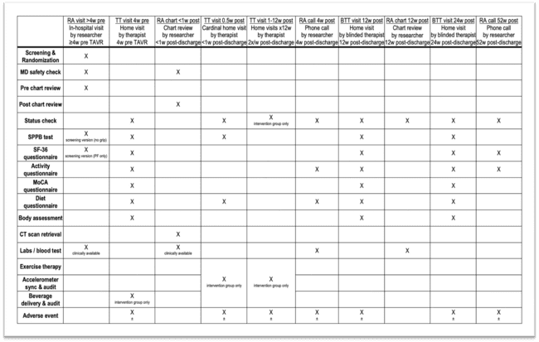

Slide 25
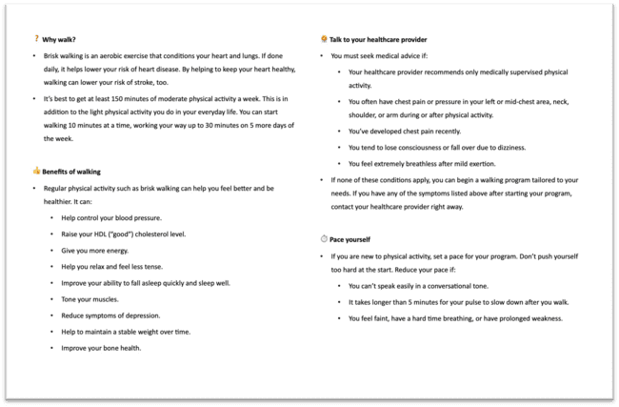
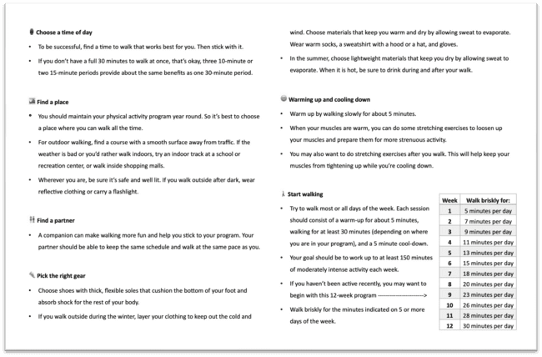
LIFESTYLE COUNSELING
ACTIVITY COMPONENT

Slide 26
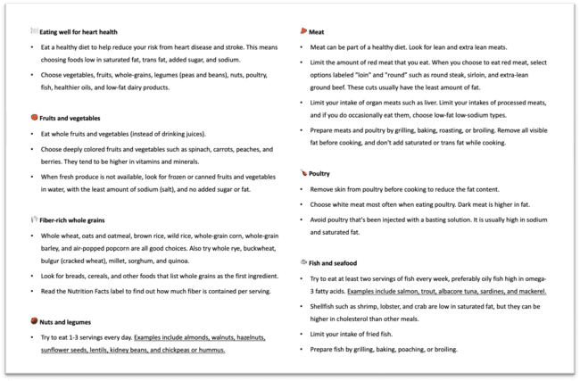
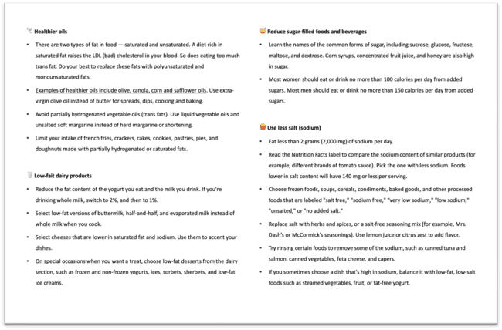
LIFESTYLE COUNSELING
NUTRITION COMPONENT

Slide 27
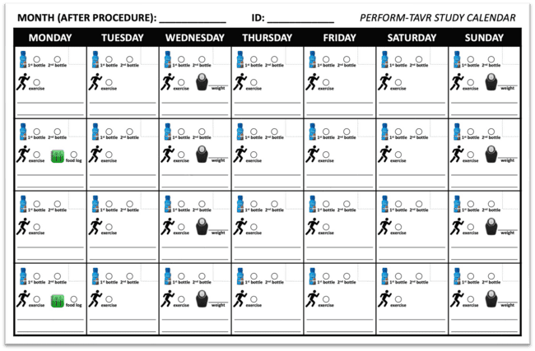
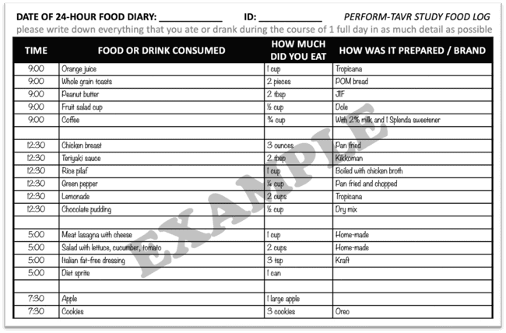
LIFESTYLE COUNSELING
PATIENT LOGS

