Slide 1
Comparison of BIomatrix and Orsiro Drug Eluting Stent in AngioGraphic Result in patients with All-comer Coronary Artery DisEase: A Multicenter, Randomized, Open Label Study (BIODEGRADE study)
In-Ho Chae, MD, PhD Cardiovascular center and Internal Medicine, Seoul National University Bundang Hospital
KOREA

Slide 2
Disclosures
I, In-Ho Chae, DO NOT have a financial interest/arrangement or affiliation with one or more organizations that could be perceived as a real or apparent conflict of interest in the context of the subject of this presentation.

Slide 3


Background
The disappointing results of fully bioresorbable scaffolds have led to a re-emerging interest in metal-based DESs that have a biodegradable polymer (BP) for the elution of antiproliferative agents.
 | Biomatrix stent | Orsiro stent
Metallic elements | 316L-stainless steel | Cobalt-chromium with a passive silicon carbide coating
Thickness of the stent strut | 120 μm | 60 or 80 μm
Biodegradable polymer | Polylactic acid | Poly-L-lactic polymer
Polymer location | Abluminal | Circumferential
Degradation time of the polymer | 9 months | Over 12-24 months

Slide 4

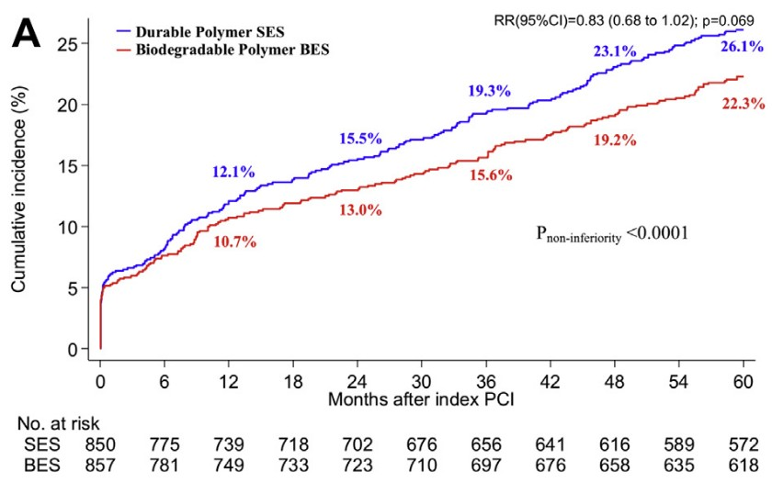
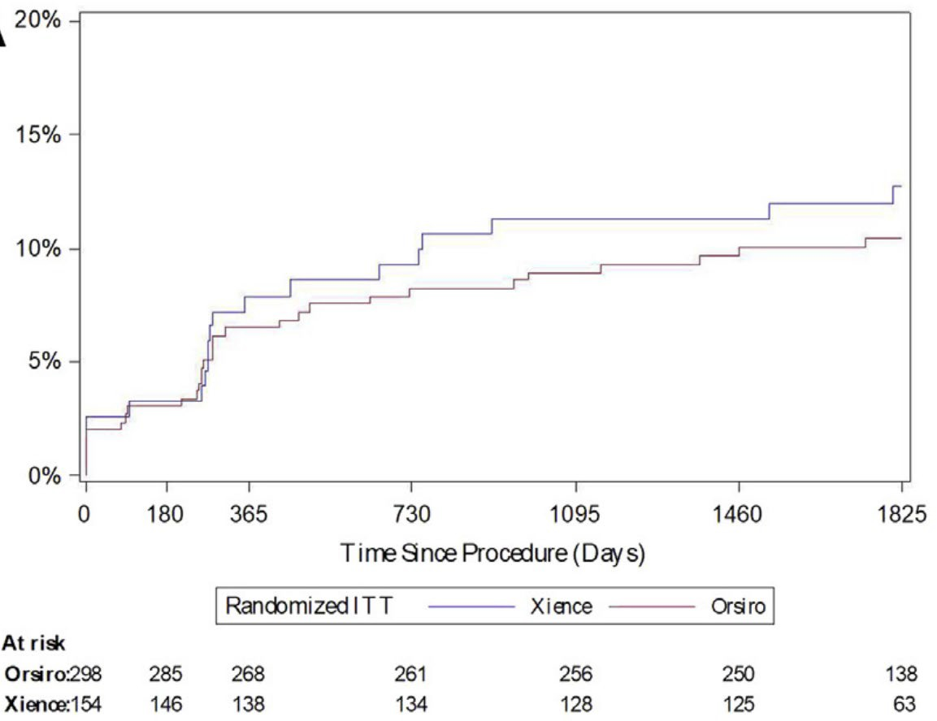

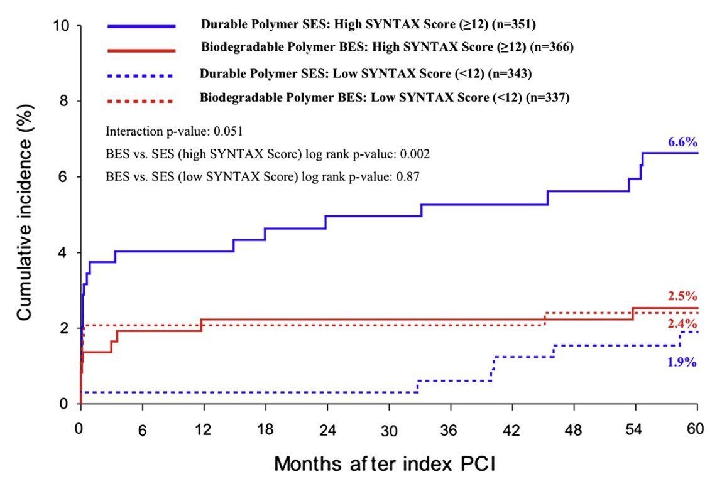
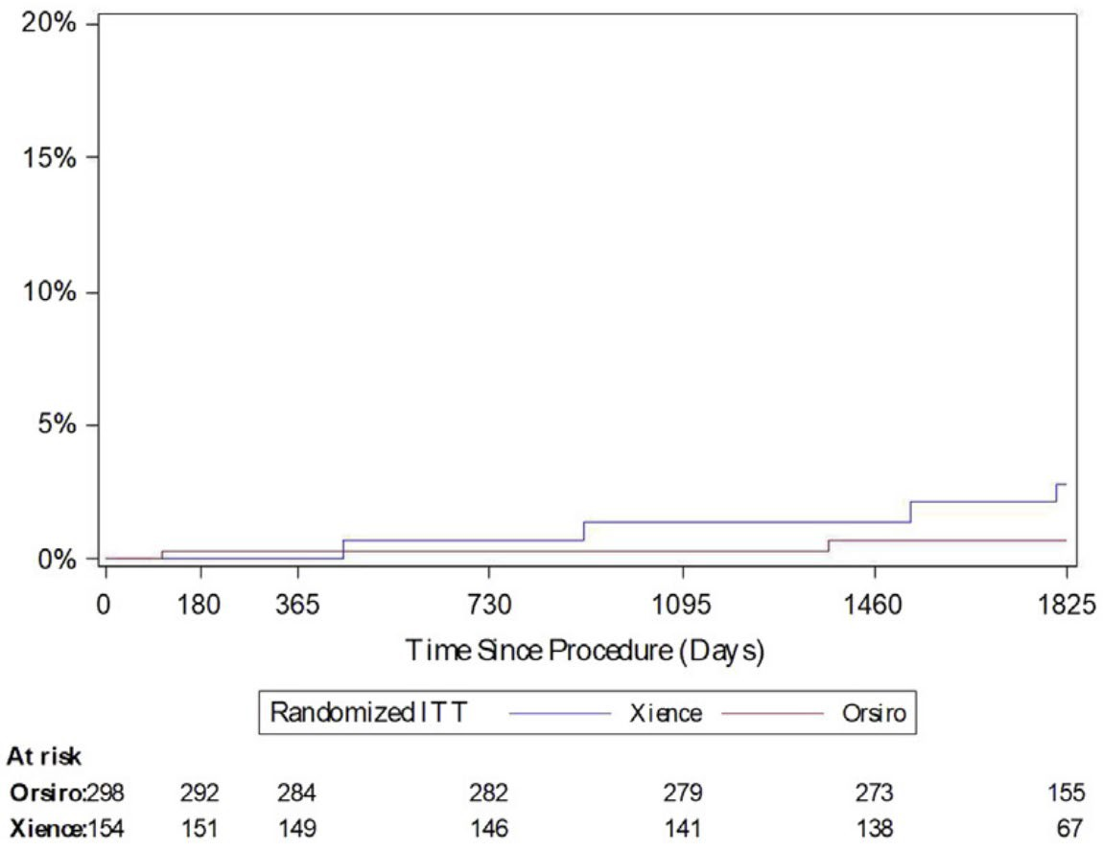
LEADERS trial (vs. Cypher stent)
Biomatrix stent | Orsiro stent
BIOFLOW II trial (vs. Xience stent)
5-year MACE
5-year TLF
5-year definite ST
5-year ST
No study to compare Biomatrix stent vs. Orsiro stent.

Slide 5


Objectives
v s.
[Hypothesis]
Orsiro stent is Non-Inferior to Biomatrix stent
Regarding Target Lesion Failure at 18 month

Slide 6







Study Design
Prospective, open-label, randomized multi-center trial
2,341 All Comers Receiving PCI
25 Centers in Korea
Coronary Angiography
Orsiro stent arm (N=1,175)
Biomatrix stent arm (N=1,166)
1 :1 Randomization
Percutaneous Coronary Intervention
Target Lesion Failure at 18 Months Post-PCI (Intention-To-Treat Analysis)

Slide 7



Enrollment Criteria
General Inclusion Criteria Exclusion Criteria
Age ≥ 20 years • Cardiogenic shock Ability to verbally confirm understandings • Symptomatic heart failure of risks, benefits and treatment • Life expectancy <1 year alternatives with written informed consent • Known hypersensitivity/contraindication prior to any study-related procedure to heparin, aspirin, clopidogrel, cilostazol, Significant lesion (>50% by visual biolimus, sirolimus, or contrast media estimate) in any of the coronary arteries, • Systemic (intravenous) Everolimus or venous or arterial bypass grafts Zotarolimus use ≤ 12 months Evidence of myocardial ischemia • Actively participating in another drug or or diameter stenosis > 70% device investigational study
Angiographic Inclusion Criteria Target lesion in coronary artery, venous or arterial bypass graft with diameter of ≥ 2.5 mm and ≤ 4.25 mm Target lesion amenable for PCI

Slide 8

Study Endpoints
Primary Endpoint: Target Lesion Failure at 18 Month (a composite of cardiac death, TV-related MI, and ischemia-driven TLR)
Secondary Endpoints
  Individual components of TLF: cardiac death, TV-related MI, ID-TLR
  Patient-oriented composite outcome
: all-cause death, all-cause MI, all repeat revascularization
  Definite or probable ST (according to ARC definition)

Slide 9



Statistical Assumption
Non-inferiority Design for Primary Endpoint (TLF at 18 Months)
Assumption : TLF
  5 % in Orsiro stent group
  5% in Biomatrix stent group
Non-inferiority Margin: Hazard Ratio 1.5 (1-sided)
  Type I error (1-sided α): 5%
  Sampling ratio = 2:1
  Attrition rate: 10%
  Primary Analysis: Intention-to-treat analysis
  Statistical power >90% (β<0.10)
➔ N=2,384

Slide 10





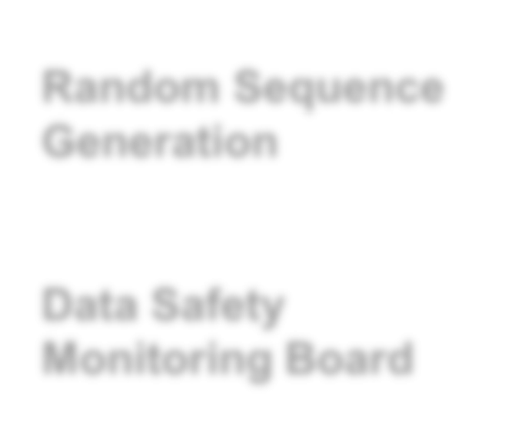


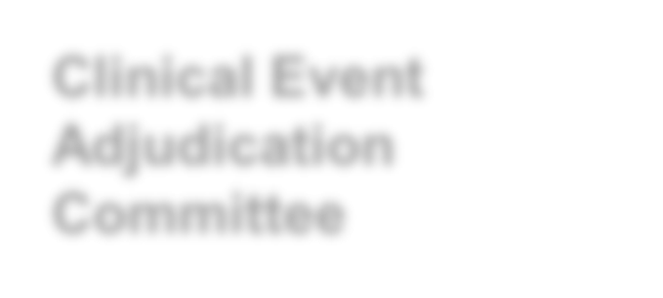

Trial Coordination
Principal Investigator
In-Ho Chae
Executive Committee
In-Ho Chae, Chang-Hwan Yoon,
Myeong-Kon Kim, Kwang Soo Cha, Seung-Hwan Lee
Data Management
T&W Inc. (contract research organization)
Random Sequence Generation
Web-based online randomization system
Data Safety Monitoring Board
Hee-Young Lee
Clinical Event Adjudication Committee
Min-Ho Lee, Dong-Ho Shin (blinded to treatment allocation)

Slide 11
Participating Centers
25 major hospitals in Republic of Korea
a. Seoul National University Bundang Hospital, Seongnam, Korea, Republic of
Yongnam University Medical center, Daegu, Korea, Republic of
Inje University Paik Hospital, Pusan, Korea, Republic of
Dankook University Hospital, Cheonan, Korea, Republic of
The Catholic University of St. Mary's Hospital, Bucheon, Korea,
Republic of
The Catholic University of St,Mary’s Hospital, Uijeongbu, Korea,
Republic of
Myongji Hospital, Goyangsi, Korea, Republic of
Hallym University Kangnam Sacred Heart Hospital, Seoul, Korea,
Republic of
Seoul Ansim Medical Clinic, Seoul, Korea, Republic of
Kosin University Gospel Hospital ,Pusan, Korea, Republic of
Kangwon National University Hospital, Chuncheon, Korea,
Republic of
Cha University Bundang Cha Medical Center, Seongnam, Korea,
Republic of
x. The Catholic University of St,Mary’s Hospital, Seoul, Korea, Republic of
b. Sejong General Hospital, Bucheon, Korea, Republic of
c. Catholic Kwandong University international St. Mary’s hospital, Incheon, Korea, Republic of
d. Pusan National University Hospital, Pusan, Korea, Republic of
e. Yonsei University Severance Hospital Wonju, Korea, Republic of
f. Yonsei University College of Medicine, Seoul, Korea, Republic of
g. Korea University Guro Hospital, Seoul, Korea, Republic of
h. Gacheon University Gil Medical Center, Incheon, Korea, Republic of
i. Chungnam National University Hospital, Daejeon, Korea, Republic of
j. Seoul Metropolitan Government Seoul National University Boramae Medical Center, Seoul, Korea, Republic of
k. Hallym university Kangdong sacred heart hospital, Seoul, Korea, Republic of
l. Kyoungpook National University hospital, Daegu, Korea, Republic of

Slide 12










Trial Flow
2,341 Patients Enrolled and Randomized
Allocated to Biomatrix N=1,166 (1,512 lesions)
Allocated to Orsiro N=1,175 (1526 lesions)
5 withdrew voluntarily 1 were lost to follow up
1 withdrew voluntarily
5 excluded by the criteria 2 were lost to follow up
Completed 18-Month F/U N=1,160 (1,510 lesions)
Completed 18-month F/U N=1,167 (1,520 lesions)

Slide 13
Baseline Characteristics
 | Total (n=2327) | BioMatrix (n=1160) | Orsiro (n=1167) | P
Age (years) | 63.5±10.9 | 63.6±11.1 | 63.4±10.7 | 0.583
Men | 1673 (71.9) | 838 (72.2) | 835 (71.6) | 0.746
Body mass index (kg/m²) | 25.1±3.3 | 25.1±3.3 | 25.1±3.3 | 0.644
Diabetes mellitus | 777 (33.4) | 393 (33.9) | 384 (32.9) | 0.650
Arterial hypertension | 1391 (59.8) | 706 (60.9) | 685 (58.7) | 0.307
Current smoker | 630 (27.1) | 306 (26.4) | 324 (27.8) | 0.327
Dyslipidemia | 1234 (53.0) | 625 (53.9) | 609 (52.2) | 0.437
Previous percutaneous coronary intervention | 282 (12.1) | 147 (12.7) | 135 (11.6) | 0.452
Previous coronary artery bypass grafting | 18 (0.8) | 10 (0.9) | 8 (0.7) | 0.803
Previous myocardial infarction | 116 (5.0) | 56 (4.8) | 60 (5.1) | 0.801
Previous cerebrovascular accident | 161 (6.9) | 83 (7.2) | 78 (6.7) | 0.710
Clinical diagnosis for percutaneous coronary intervention |  |  |  | 0.448
Silent Ischemia | 120 (5.2) | 65 (5.6) | 55 (4.7)
Stable Angina | 641 (27.6) | 313 (27.0) | 328 (28.1)
Unstable Angina | 848 (36.5) | 424 (36.6) | 424 (36.4)
Non–ST-segment–elevation myocardial infarction | 495 (21.3) | 257 (22.2) | 238 (20.4)
ST-segment–elevation myocardial infarction | 222 (9.5) | 101 (8.7) | 121 (10.4)
Atrial Fibrillation | 82 (3.5) | 47 (4.1) | 35 (3.0) | 0.389

Slide 14
Baseline Characteristics
 | Total (n=2327) | BioMatrix (n=1160) | Orsiro (n=1167) | P
Medication at discharge
Aspirin | 2302 (99.0) | 1147 (99.0) | 1155 (99.0) | >.999
Clopidogrel | 1922 (82.6) | 961 (82.9) | 961 (82.4) | 0.759
Ticagrelor | 292 (12.6) | 140 (12.1) | 152 (13.0) | 0.532
Prasugrel | 82 (3.5) | 43 (3.7) | 39 (3.3) | 0.709
Renin-angiotensin system inhibitors | 1475 (63.5) | 738 (63.7) | 737 (63.2) | 0.827
Beta-blocker | 1464 (63.0) | 720 (62.2) | 744 (63.8) | 0.457
Statin | 2195 (94.4) | 1096 (94.6) | 1099 (94.2) | 0.750

Slide 15
Lesion & Procedural Characteristics
 | Total (n=2327) | BioMatrix (n=1160) | Orsiro (n=1167) | P
Target lesion per patient |  |  |  | 0.590
1 | 1702 (73.14) | 848 (73.10) | 854 (73.18)
2 | 482 (20.71) | 236 (20.34) | 246 (21.08)
3 | 121 (5.20) | 62 (5.34) | 59 (5.06)
>3 | 22 (0.95) | 14 (1.21) | 8 (0.69)
Number per patient | 1.30 | 1.30 | 1.30
Target vessel location
LM (%) | 100 (3.3) | 57 (3.77) | 43 (2.83) | 0.175
LAD (%) | 1508 (49.8) | 775 (51.3) | 733 (48.2) | 0.095
LCX (%) | 685 (22.6) | 345 (22.9) | 340 (22.4) | 0.786
RCA (%) | 827 (27.3) | 386 (25.6) | 441 (29.0) | 0.037
Lesion type |  |  |  | 0.682
A | 224 (7.4) | 106 (7.0) | 118 (7.8)
B1 | 808 (26.7) | 395 (26.2) | 413 (27.2)
B2 | 774 (25.5) | 385 (25.5) | 389 (25.6)
C | 1224 (40.4) | 624 (41.3) | 600 (39.5)
Chronic total occlusion | 165 (4.5) | 72 (4.8) | 93 (6.1) | 0.119
Bifurcation lesion | 450 (14.9) | 219 (14.5) | 321 (15.2) | 0.627
Lesion length (mm) | 21.77±10.15 | 21.75±10.08 | 21.78±10.21 | 0.934
Reference vessel diameter (mm) | 2.50±0.72 | 2.50±0.71 | 2.50±0.74 | 0.916

Slide 16
Lesion & Procedural Characteristics
 | Total (n=2327) | BioMatrix (n=1160) | Orsiro (n=1167) | P
Direct stenting | 346 (11.4) | 174 (11.5) | 172 (11.3) | 0.842
Number of stents per patient | 1.46±0.75 | 1.45±0.74 | 1.47±0.76 | 0.477
Number of stents per lesion | 1.12±0.36 | 1.11±0.34 | 1.13±0.37 | 0.205
Total stent length per patient lesion | 35.03±21.39 | 34.71±21.14 | 35.35±21.64 | 0.470
Total stent length per lesion | 26.9±12.5 | 26.67±12.15 | 27.14±12.84 | 0.294
Stent diameter (mm) | 3.02±0.42 | 3.00±0.41 | 3.03±0.44 | 0.071
Maximal pressure (atm) | 10.72±3.64 | 10.07±3.68 | 11.36±3.48 | <.001
Minimal lumen diameter (mm) | 0.59±0.41 | 0.58±0.39 | 0.59±0.42 | 0.384
Diameter stenosis (%) | 77.68±14.18 | 77.69±14.06 | 77.67±14.30 | 0.970
Post stent minimal lumen diameter (mm) | 2.67±0.56 | 2.66±0.56 | 2.68±0.57 | 0.327
Post stent diameter stenosis (%) | 13.31±7.18 | 13.47±7.10 | 13.15±7.27 | 0.228
Acute gain (mm) | 2.08±0.61 | 2.08±0.62 | 2.09±0.61 | 0.826
Delivery failure | 1 (0.3) | 0 (0) | 1 (0.6) | 0.319

Slide 17
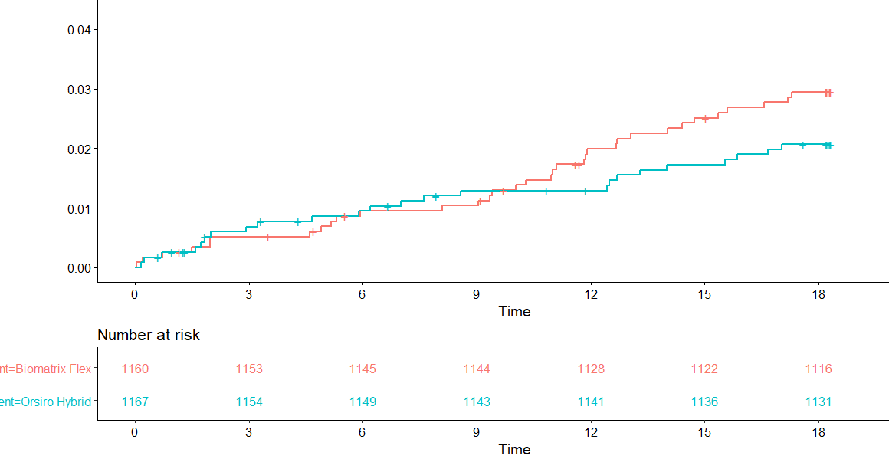
Target Lesion Failure
Composite of C-death, TV-related MI, ischemia-driven TLR
HR: 0.70 (0.42–1.18)
Non-Inferiority P-value (1-sided)<0.001 Superiority P-value=0.176
Target Lesion Failure
Biomatrix
Orsiro

Slide 18
Clinical Outcomes
 | BioMatrix (n=1160) | Orsiro (n=1167) | P-value
Target lesion failure | 34 (2.9) | 24 (2.1) | 0.222
Death
All cause death | 26 (2.2) | 24 (2.1) | 0.869
Cardiac death | 16 (1.4) | 12 (1.0) | 0.558
Noncardiac death | 10 (0.8) | 12 (1.0) | 0.679
Target vessel-related myocardial infarction | 0 (0.0) | 3 (0.3) | 0.250
Any myocardial infarction | 2 (0.2) | 9 (0.8) | 0.035
Ischemia-driven target lesion revascularization | 18 (1.6) | 10 (0.9) | 0.124
Ischemia-driven target vessel revascularization | 27 (2.3) | 23 (2.0) | 0.553
Any repeat revascularization | 47 (4.1) | 43(3.7) | 0.646
Stent thrombosis* | 0 (0.0) | 2 (0.2) | 0.500
Patient-oriented composite endpoint | 74 (6.4) | 69 (5.9) | 0.702
*Stent thrombosis: 1st case, definite late stent thrombosis leading to myocardial infarction;
2nd case, definite late stent thrombosis causing unstable angina

Slide 19
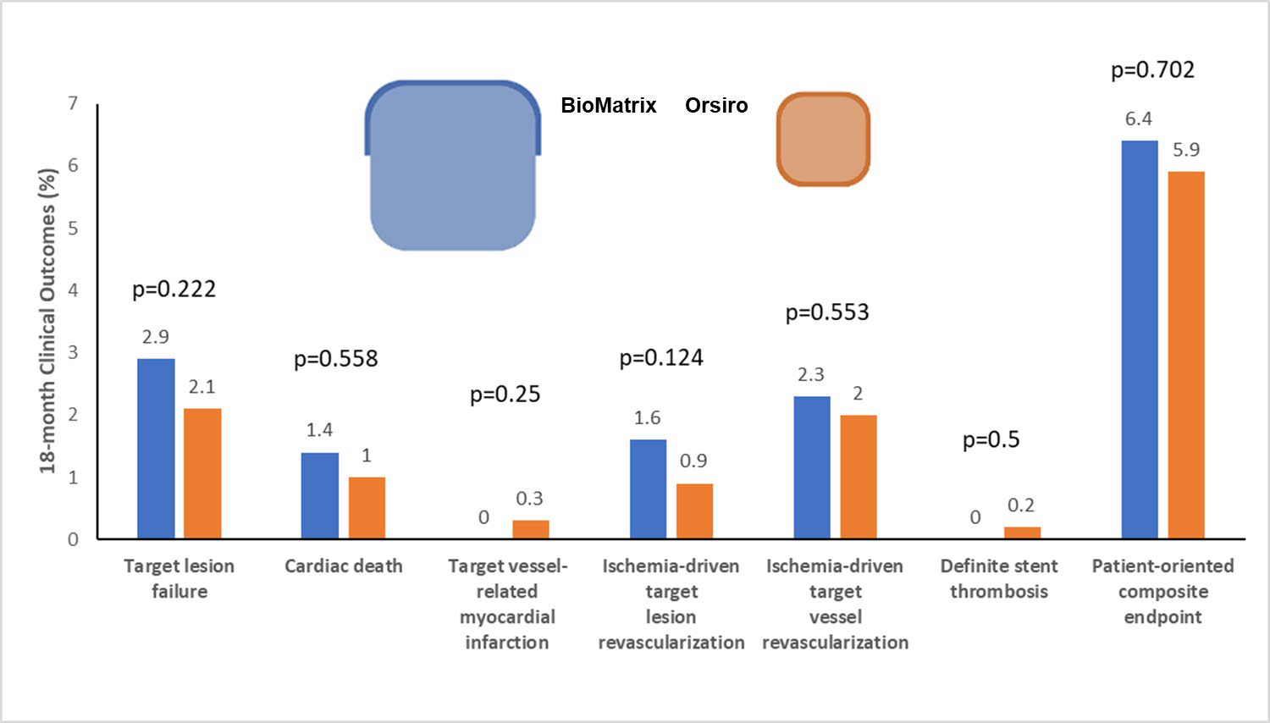
Clinical Events at 18 Months

Slide 20
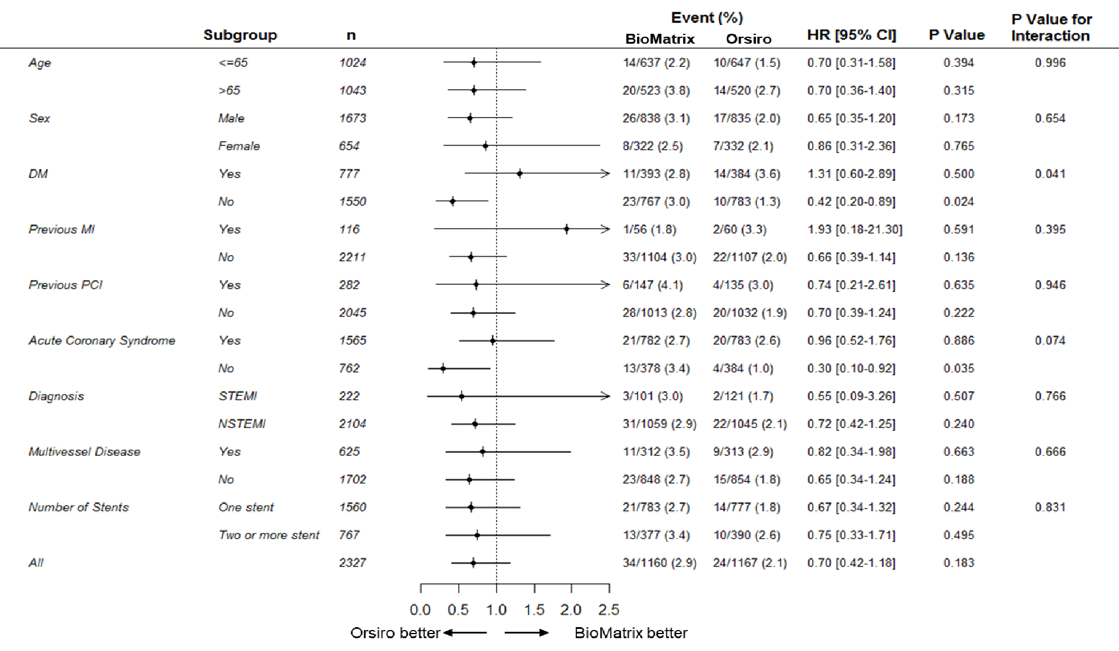
Subgroup Analysis

Slide 21
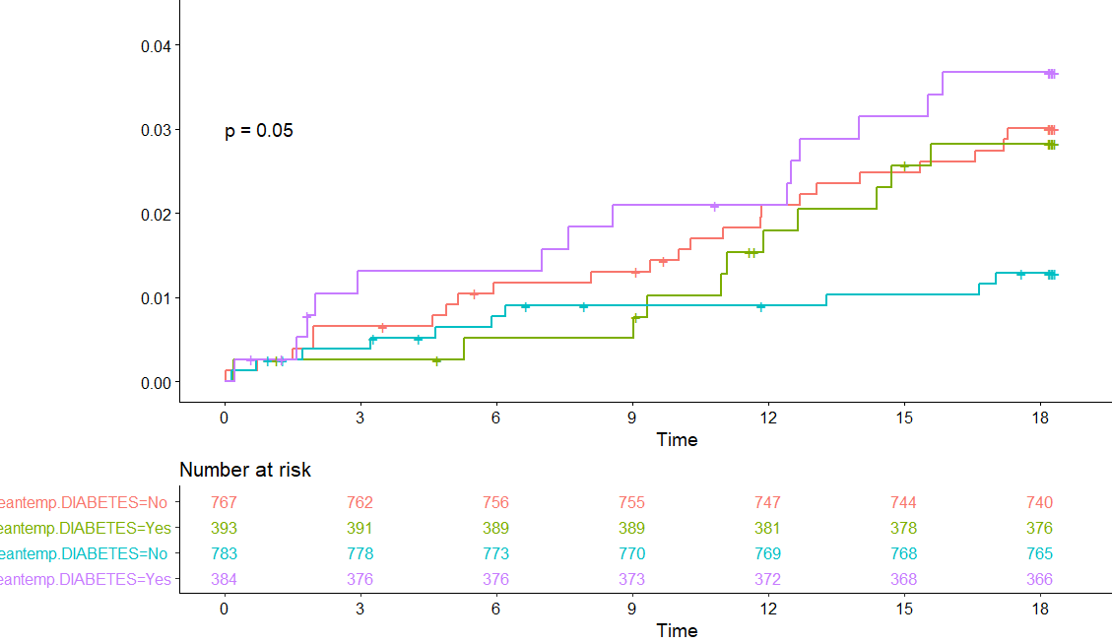





Subgroup Analysis – Interaction with Diabetes
Target Lesion Failure
Biomatrix-nonDM Biomatrix-DM Orsiro-nonDM Orsiro-DM

Slide 22





Limitations
Lower event rates than expected
  Expected rate of primary endpoint in the comparator: 5 %
  Actual event rate: 2.9%
  No routine measurement of postPCI cardiac enzyme
  Possible ethnic or genetic factors, as trials done in East Asian populations
Question of under-reporting
  Trials done in East Asian populations have reported lower event rates.
  This study was done with highest degree of scrutiny with periodic monitoring.
  F/U loss rate: 0.6%
Longer-term clinical follow-up required
  Clinical F/U will be continued up to 3 years

Slide 23

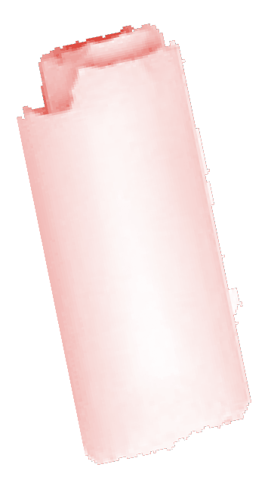



Conclusions
The Orsiro stent was non-inferior to the BioMatrix stent in all-comer patients with minimum exclusion criteria and high proportion of acute coronary syndrome.
Both biodegradable polymer- DESs showed excellent clinical outcomes.
The clinical efficacy of the BP-DES may not be dependent on the stent design including strut thickness.

Slide 24
Thank you !

