Slide 1
Lepodisiran: An Extended-Duration siRNA Targeting Lipoprotein(a)
Steven E. Nissen MD MACC
Disclosure
Consulting: Many pharmaceutical companies
Clinical Trials: AbbVie, Arrowhead, AstraZeneca, Bristol Myers Squibb, Eli Lilly, Esperion, Medtronic, Novartis, and Silence Therapeutics.
Companies are directed to pay any honoraria, speaking or consulting fees directly to charity so that neither income nor a tax deduction is received.
Notes:
Test

Slide 2
Co-Authors
Helle Linnebjerg PhD, Xi Shen PhD, Kathy Wolski, MPH, Xiaosu Ma PhD, Shufen Lim PhD, Laura F. Michael PhD, Giacomo Ruotolo, MD PhD, Grace Gribble MS, Ann Marie Navar MD PhD, and Stephen J. Nicholls MBBS PhD
Investigators
Dr. Ronan Phillip Kelly, DPhil, BM BCh, FRCP Lilly Centre for Clinical Pharm., Singapore
David Nguyen, MD Altasciences Clinical Los Angeles, Inc. USA
Ernesto Fuentes, MD Clinical Pharm. of Miami, LLC, Miami, USA
Hernan Alfonso Salazar, DO Endeavor Clinical Trials, LLC, San Antonio, USA
Martha Hernandez-Illas, MD QPS-MRA, LLC. South Miami, USA
Trial sponsor: Eli Lilly and Company, Indianapolis, IN, USA

Slide 3
Background
Lipoprotein(a) is an important genetically-determined risk factor for cardiovascular disease with no pharmacological treatments currently approved by regulatory authorities.
The LPA gene encodes apolipoprotein(a), an essential component required for hepatic synthesis of lipoprotein(a).
Lepodisiran is an siRNA designed to degrade the mRNA coding for apolipoprotein(a) thereby reducing translation of the LPA gene.
The current trial examined the safety and efficacy of this siRNA in participants followed for up to 48 weeks.

Slide 4
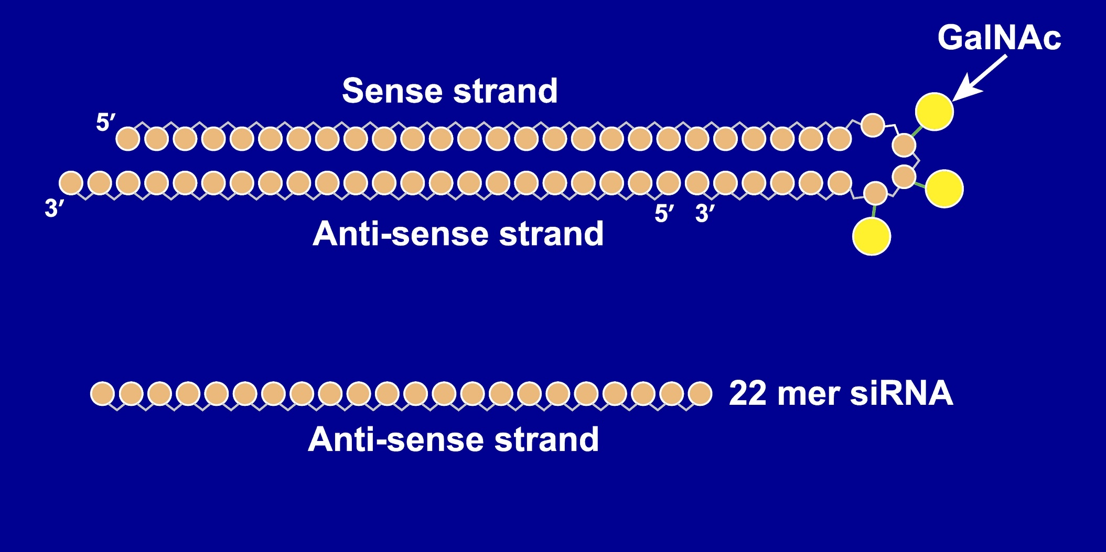
Lepodisiran: A Dicer-Substrate Tetraloop siRNA
Nucleotides chemically modified for resistance to degradation by ribonucleases

Slide 5
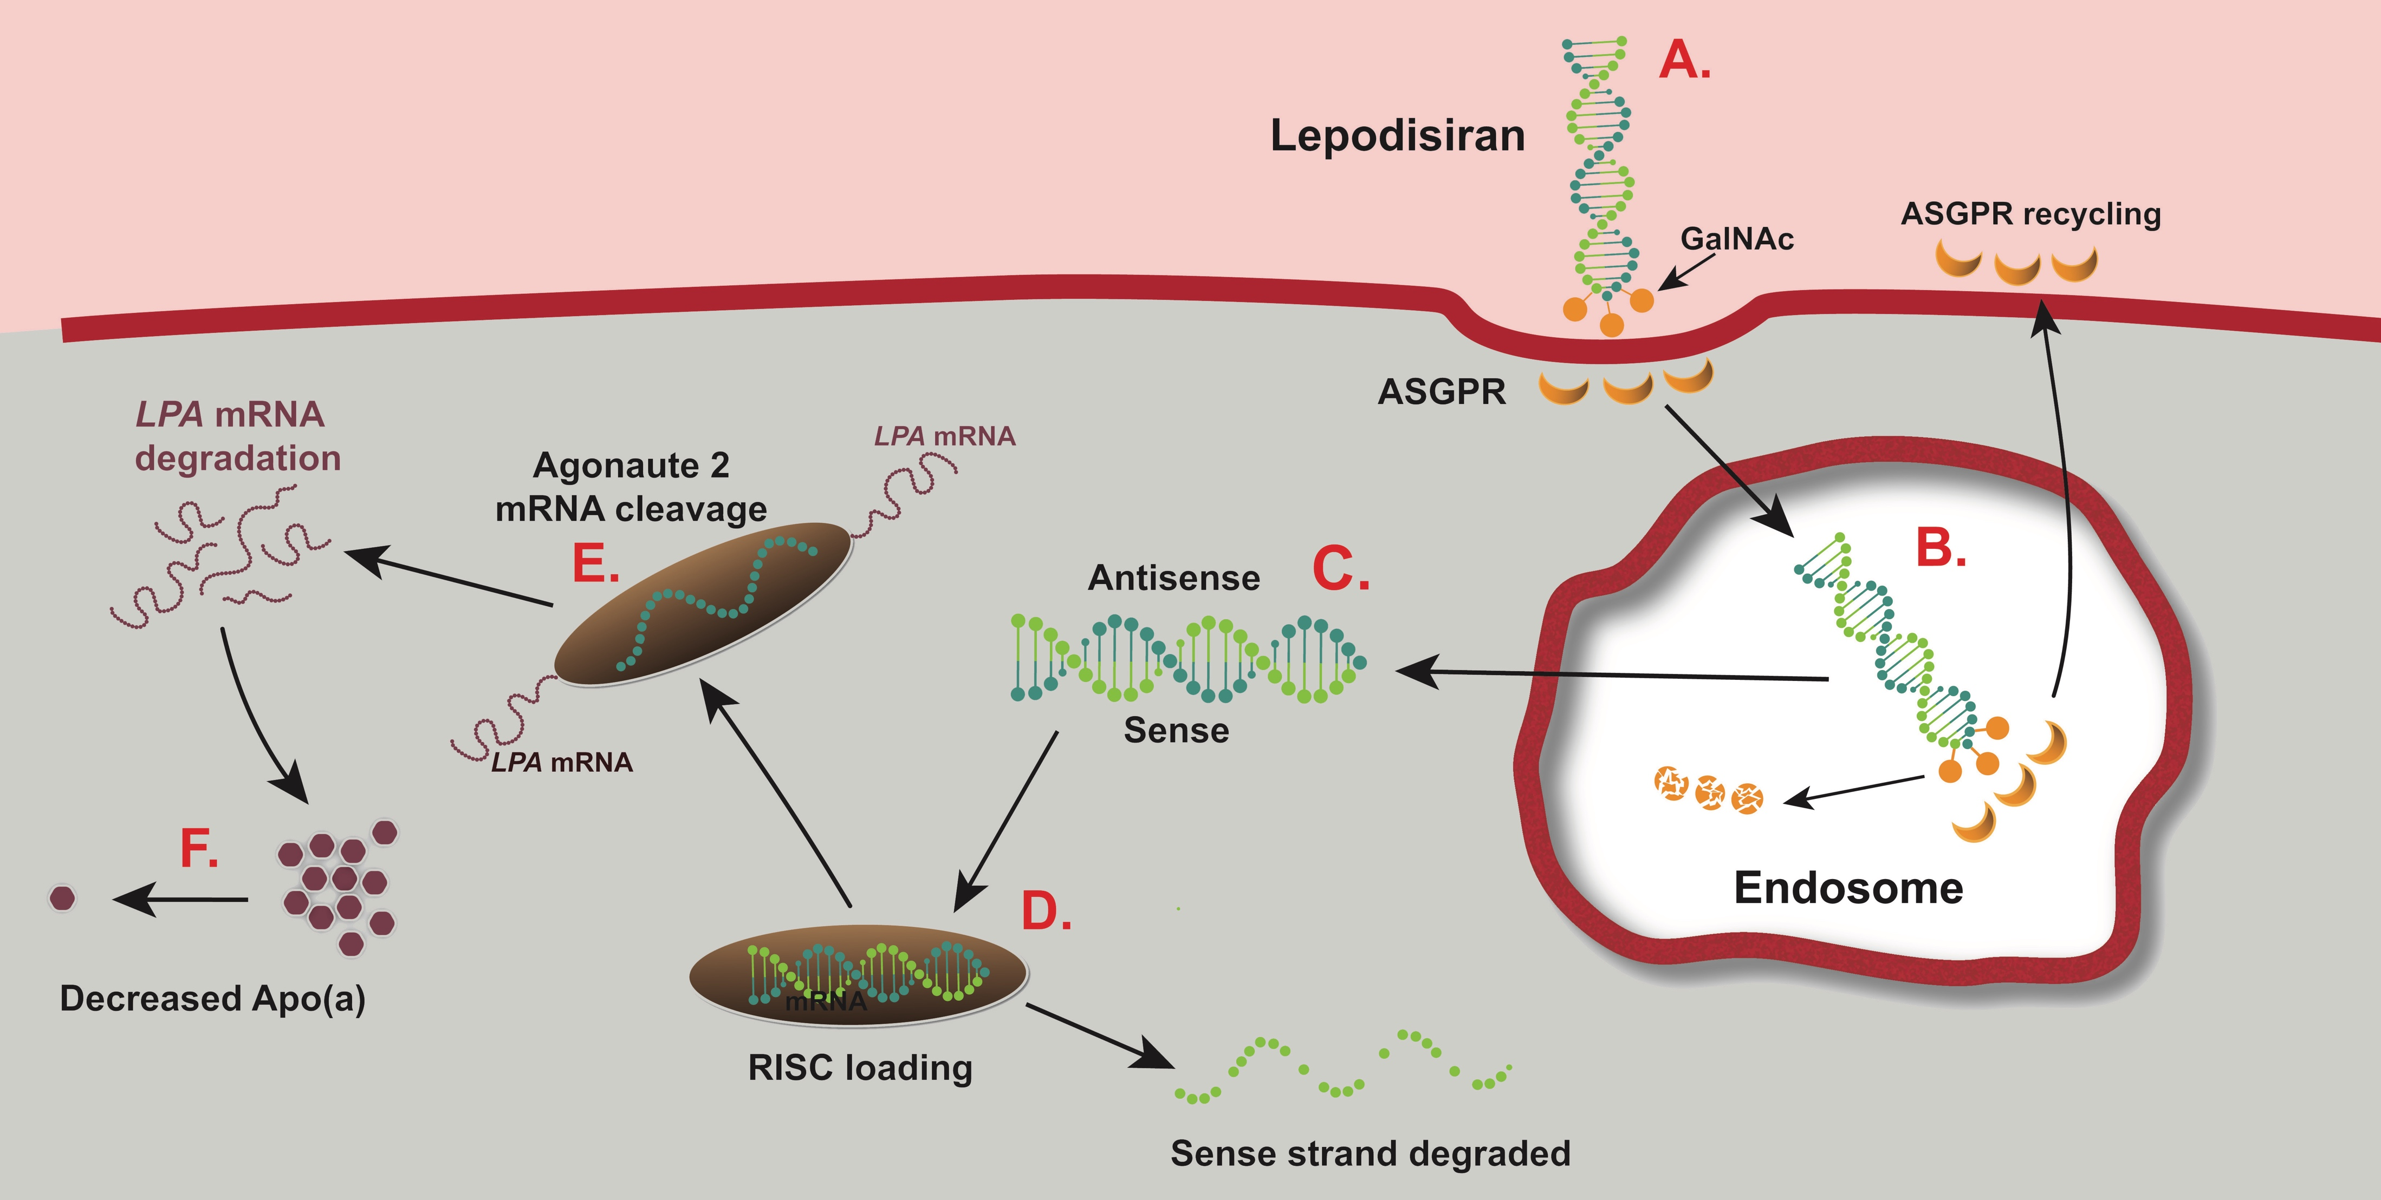
Mechanism for Lepodisiran Reduction of Lipoprotein(a)
Bloodstream
Hepatocyte
Adapted from https://doi.org/10.1016/j.ymthe.2020.06.015

Slide 6
Study Procedures
48 participants enrolled, 18-65 years in age, without known cardiovascular disease and Lp(a) concentration ≥75 nmol/L.
Participants admitted to a Clinical Research Unit 1 day prior to dosing and monitored for 3 days after drug administration.
Six participants randomized to a single doses of lepodisiran (4 mg,12 mg, 32 mg, 96 mg, 304 mg, or 608 mg) or placebo administered subcutaneously.
Visits and laboratory studies up to 48 weeks following dosing.

Slide 7
Primary Safety and Efficacy Outcomes
Safety:
Treatment emergent adverse events and injection site reactions
Safety laboratory parameters
Lepodisiran plasma concentrations through 48 hours
Effects on lipoprotein(a) serum concentrations through 337 days (48 weeks).

Slide 8
Selected Baseline Characteristics of Participants
 | Placebo (n=12) | 4 mg (n=6) | 12 mg (n=6) | 32 mg (n=6) | 96 mg (n=6) | 304 mg (n=6) | 608 mg N=6
Age (years) | 50.3 | 40.5 | 44.3 | 50.7 | 47.8 | 51.8 | 38.5
Male (%) | 50 | 83 | 50 | 50 | 50 | 66 | 83
Median Lp(a), nmol/L | 111 | 78 | 97 | 120 | 167 | 96 | 130
Mean LDL-C, mg/dL | 143 | 108 | 148 | 110 | 118 | 142 | 135
Mean ApoB, mg/dL | 90 | 117 | 93 | 97 | 114 | 108 | 116
hsCRP, mg/L | 1.3 | 3.5 | 1.3 | 2.0 | 1.4 | 1.7 | 0.8

Slide 9
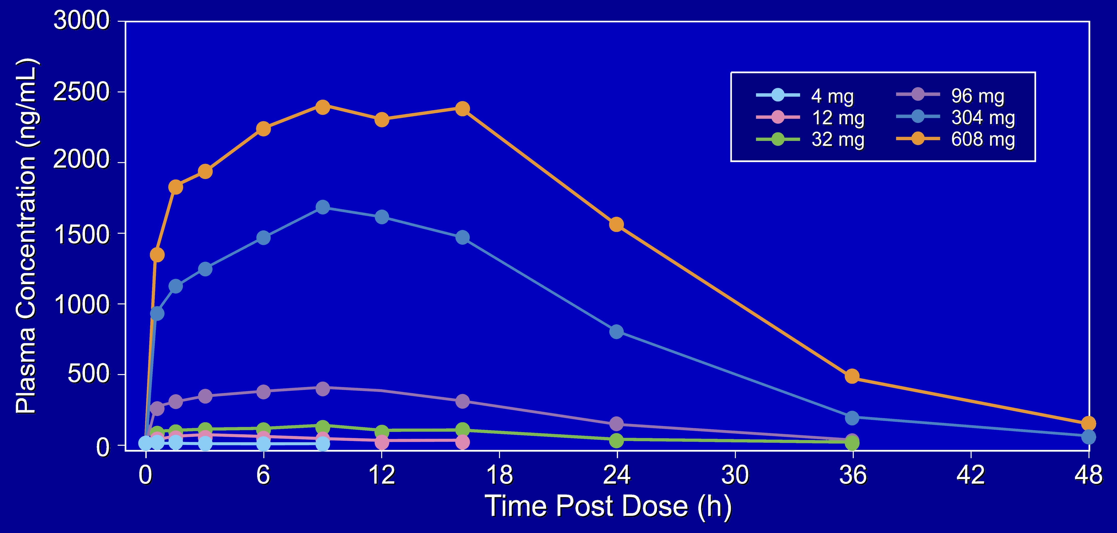
Lepodisiran Plasma Concentrations in the First 48 Hours

Slide 10
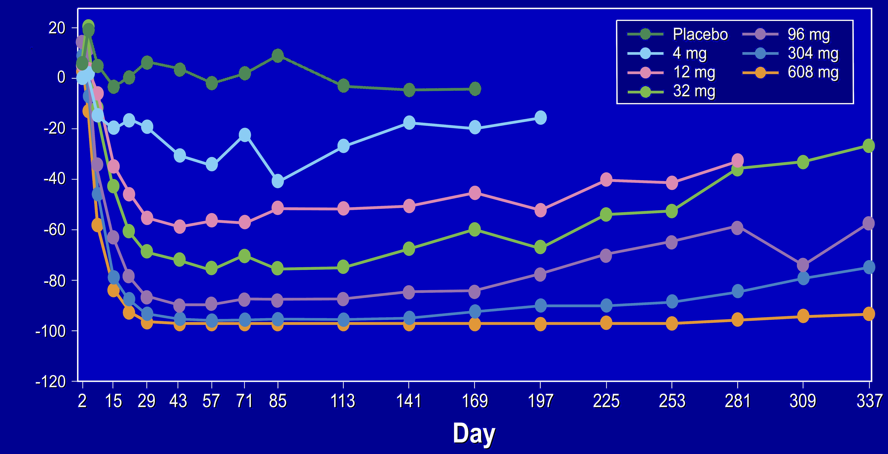
Median Percent Reduction in Lipoprotein(a) over Time
Percent Change from Baseline
-94%
Below lower limit of quantitation for 608 mg dose
9.4 months

Slide 11
Treatment Emergent Adverse Events & Lab Abnormalities
 | Placebo (n=12) | 4 mg (n=6) | 12 mg (n=6) | 32 mg (n=6) | 96 mg (n=6) | 304 mg (n=6) | 608 mg (n=6)
Treatment emergent adverse events in 3 or more participants, n (%)
COVID-19 | 1 | 0 | 1 | 0 | 2 | 1 | 1
Headache | 1 | 0 | 1 | 0 | 1 | 1 | 2
Rhinorrhea | 0 | 0 | 2 | 0 | 0 | 1 | 0
ECG Patch Erythema | 0 | 0 | 1 | 0 | 1 | 1 | 0
Laboratory abnormalities
CK > 5 x ULN | 0 | 2 | 0 | 0 | 0 | 0 | 1
hsCRP > 5 mg/L | 7 | 1 | 2 | 3 | 2 | 5 | 1

Slide 12
Investigator-Reported Injection Site Reactions
 | Placebo (n=12) | 4 mg (n=6) | 12 mg (n=6) | 32 mg (n=6) | 96 mg (n=6) | 304 mg (n=6) | 608ª (n=6) | 608^{b} (n=6)
Participants reporting an event | 2 | 0 | 3 | 2 | 2 | 3 | 3 | 4
Individual events reported
Erythema | 1 | 0 | 0 | 1 | 1 | 2 | 0 | 1
Induration | 0 | 0 | 0 | 0 | 0 | 0 | 0 | 0
Pain | 2 | 0 | 3 | 1 | 2 | 2 | 3 | 4
Pruritus | 0 | 0 | 0 | 0 | 0 | 0 | 0 | 0
Edema | 0 | 0 | 0 | 0 | 0 | 1 | 0 | 0
The 608 mg dose was administered as two injections of 304 mg, ªfirst injection, ^{b}second injection.

Slide 13
Limitations
This was a small, first-in-human Phase 1 trial enrolling 48 participants without known cardiovascular disease.
Safety cannot be comprehensively assessed in a trial of this size and duration.
The minimum entry criteria for lipoprotein(a) was moderate (75 nmol/L).
Single doses administered, although a Phase 2 multi-dose trial is underway.

Slide 14
Manuscript Now Accessible via jamanetwork.com

Slide 15
Conclusions
Subcutaneous injection of lepodisiran, an siRNA targeting mRNA for the LPA gene substantially lowered lipoprotein(a).
After the 608 mg dose, serum concentrations of lipoprotein(a) fell below the lower limit of quantitation from days 29 to 281 and remained >94% below baseline for 337 days (48 weeks).
There were no major safety issues, although low-grade, transient, injection site reactions occurred.
These findings support further development of this therapy.

Slide 16
A Final Thought
Elevation of lipoprotein(a) is a common risk factor responsible for considerable cardiovascular morbidity and mortality with no pharmacological therapies approved by regulatory authorities. Nucleic acid therapeutics offer a highly promising approach to treat this previously untreatable disorder. Cardiovascular outcomes trials will determine whether these therapies can reduce the incidence of MACE. Stay tuned.

