Slide 1
First-In-Man Testing of a Dedicated Closure Device for Transcaval Access for
Transcatheter Aortic Valve Replacement
(NCT03432494)
Toby Rogers, MD, PhD^{1,2}; Adam Greenbaum, MD^{3,4}; Vasilis Babaliaros, MD³; Annette Stine, RN¹; Jaffar Khan, MD^{1,2}; Lowell Satler, MD²; Marvin Eng, MD⁴; Gaetano Paone, MD⁴; Bradey Leshnower, MD³; Marcus Chen, MD¹;
and Robert J. Lederman, MD¹
¹Cardiovascular Branch, Division of Intramural Research, NIH/NHLBI, Bethesda, MD; ²MedStar Washington Hospital Center, Washington, DC; ³Emory University, Atlanta, GA; ⁴Henry Ford Hospital, Detroit, MI
toby.rogers@nih.gov

Slide 2
Disclosures
Toby Rogers, MD, PhD
Co-inventor on patent applications, assigned to NIH, on dedicated devices for transcaval access and closure
Proctor & Consultant: Medtronic
Proctor: Edwards Lifesciences
toby.rogers@nih.gov

Slide 3
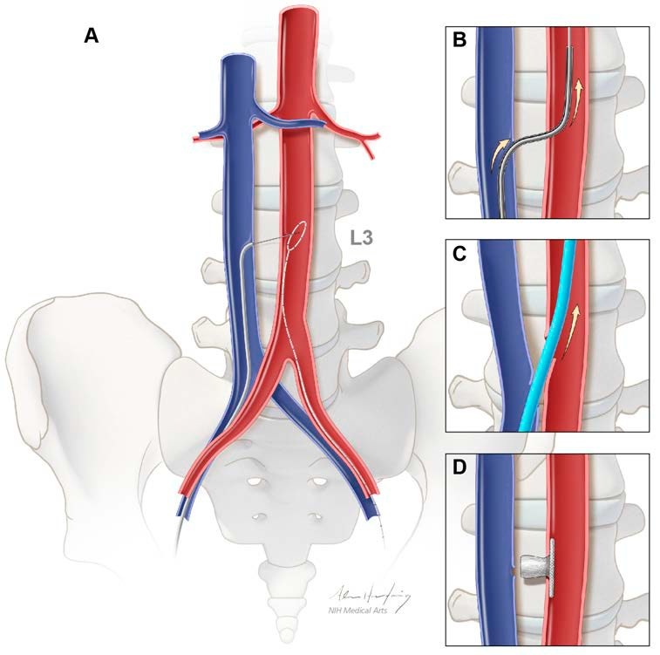
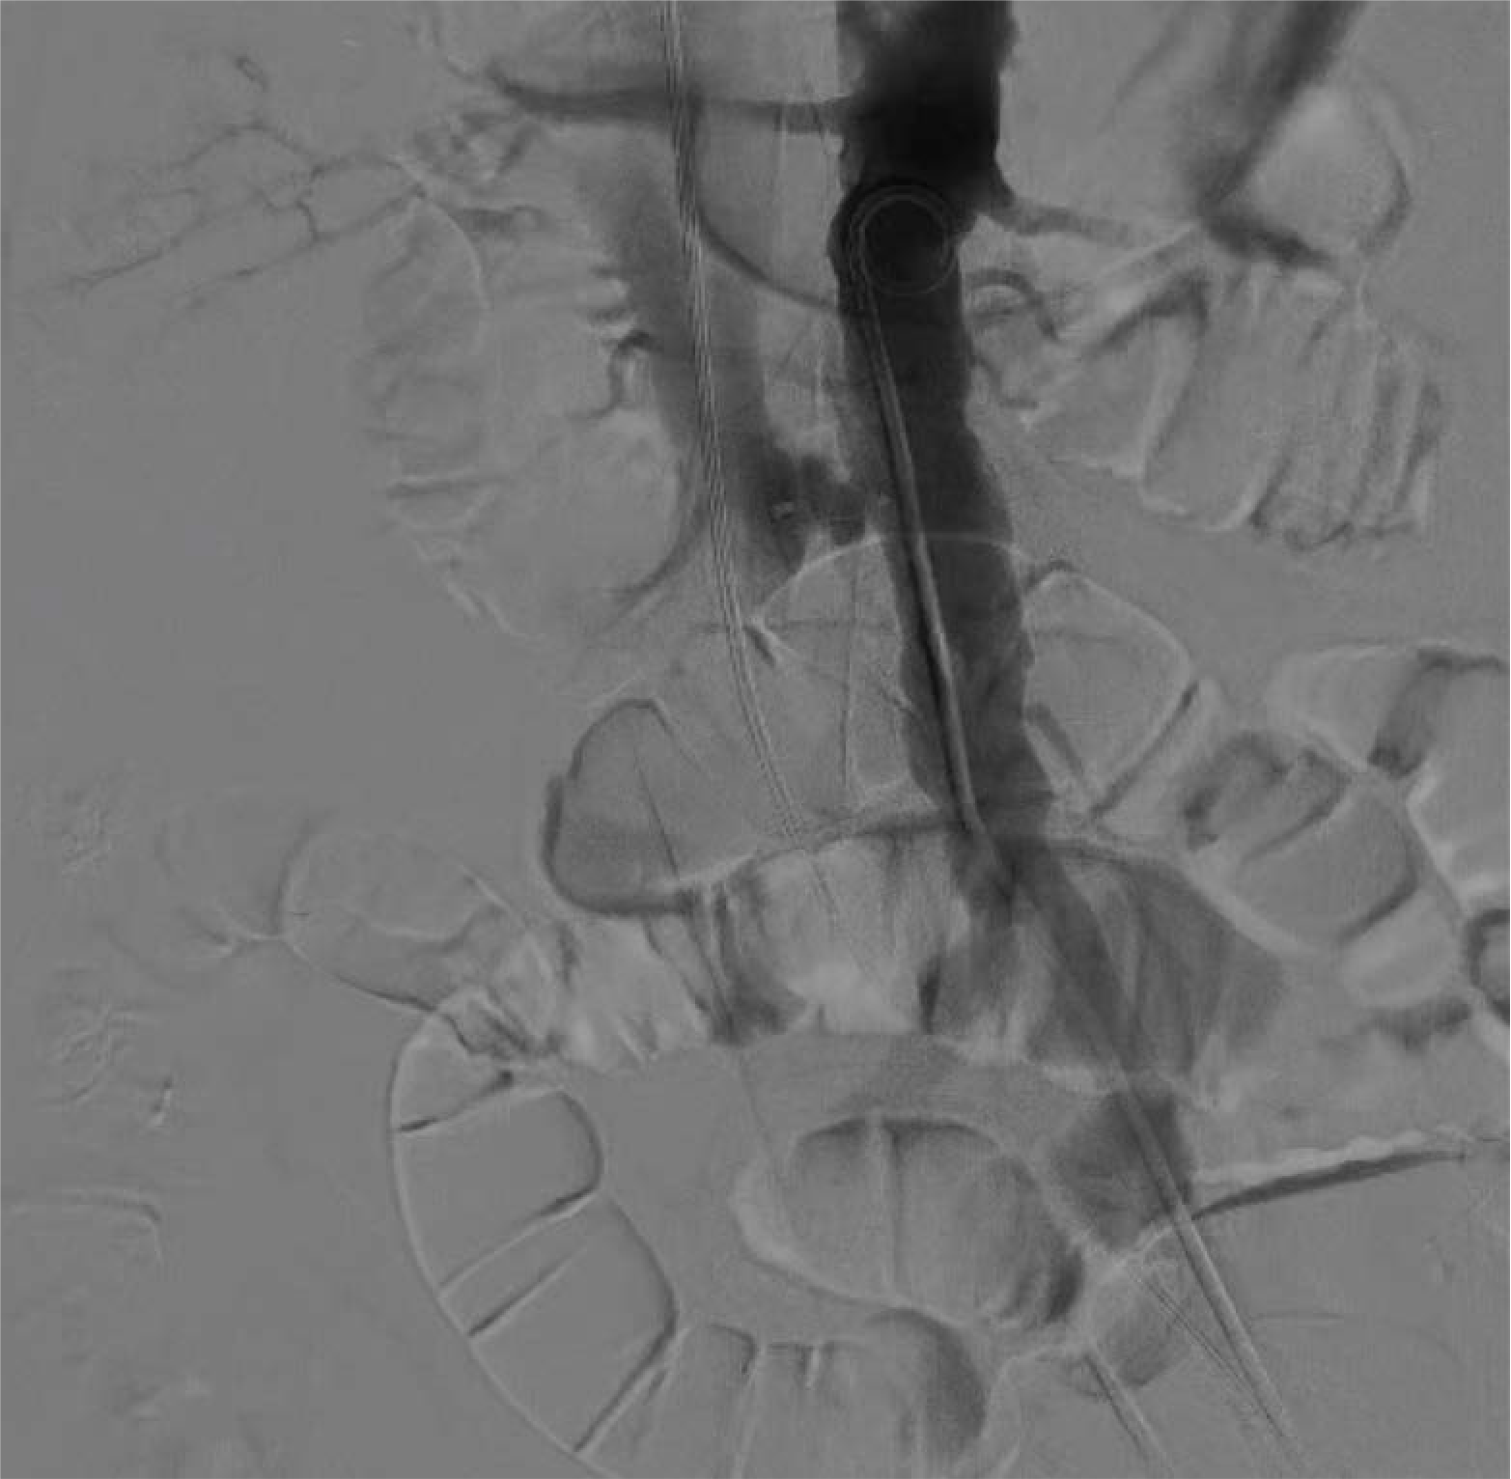
Transcaval access and closure
Greenbaum et al. JACC 2017 69(5):511-52.
toby.rogers@nih.gov

Slide 4
toby.rogers@nih.gov

Slide 5
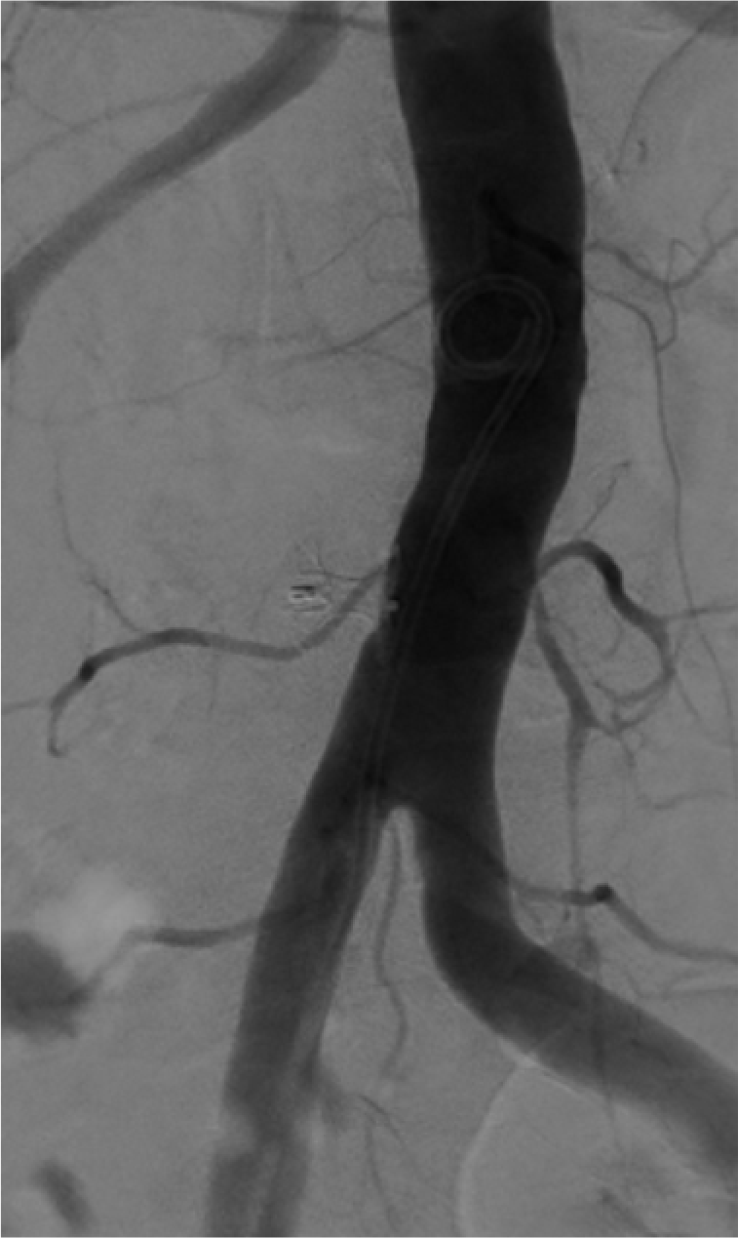
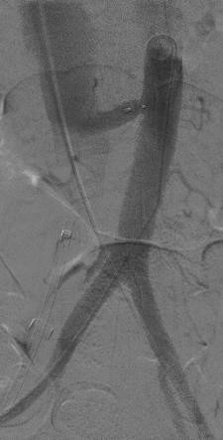
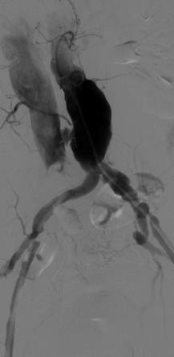
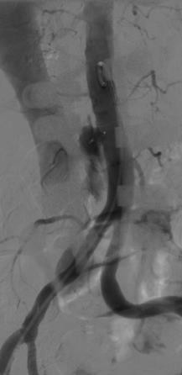




NHLBI Prospective Transcaval Study
0: Occluded
1: Funnel
2: Cruciform
3: Extravasation
34%
22%
42%
2%
Greenbaum et al. JACC 2017 69(5):511-52.
toby.rogers@nih.gov

Slide 6
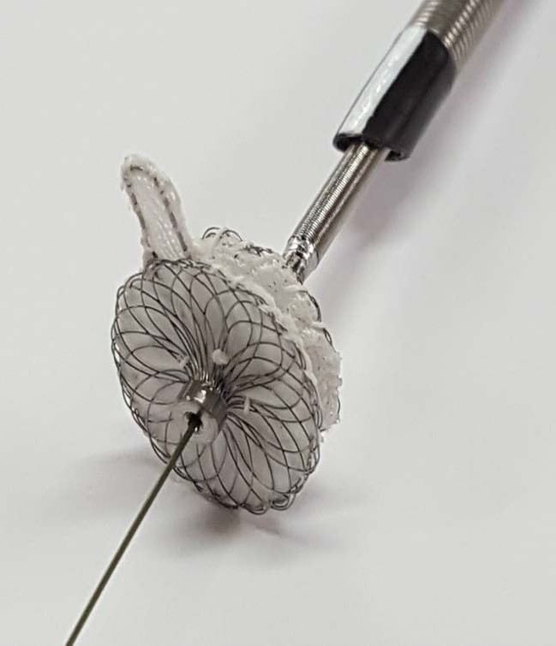
Transmural Systems Transcaval Closure Device (TCD)
Paddle
Intravascular Disk
Promotes rapid hemostasis
Resists pull through
Fully retrievable & repositionable
Central Guidewire lumen
toby.rogers@nih.gov

Slide 7
US Early Feasibility Study (EFS)
ClinicalTrials.gov identifier | NCT03432494
Objective | This is an early feasibility study (EFS) evaluation of a purpose-built closure device for transcaval access. The device, the Transcaval closure device(TCD) will be evaluated for safety and performance to close transcaval access sites in patients ineligible for femoral artery access for TAVR.
Primary endpoint | The primary endpoint is Technical success. This endpoint is measured at exit from the catheterization laboratory. All of the following must be present: Alive Successful delivery of the TCD, and retrieval of the TCD delivery system Deployment and correct positioning of a single intended TCD. Repositioning and recapture of the device, if needed, is not classified as failure No additional unplanned or emergency surgery or reintervention related to the TCD or delivery system Adjunctive balloon aortic tamponade is permissible and consistent with technical success.
toby.rogers@nih.gov

Slide 8
US Early Feasibility Study (EFS)
Number of subjects | 12 enrolled (February 2018 – April 2018)
Sites | MedStar Washington Hospital Center, Washington, DC Henry Ford Hospital, Detroit, MI Emory University, Atlanta, GA
Key inclusion criteria | Ineligible for femoral artery access for the selected transcatheter heart valve (THV) according to the THV manufacturer instructions for use. Eligible for transcaval access based on Core lab analysis of the baseline abdomen/pelvis CT indicating a calcium-free target window on the abdominal aorta; a target greater than or equal to 15mm from the lowest main renal artery or aorto-iliac bifurcation; no important interposed structures; a projected intravascular centerline distance from the lower femoral head to the target at least 5cm less than the intended THV introducer sheath; patient celiac or superior mesenteric artery.
Key exclusion criteria | High risk features on baseline CT including porcelain aorta (confluent calcification); pedunculated aortic atheroma; or leftward aortic angel greater than or equal to 20 degrees with regard to vertical. Renal dysfunction limiting follow-up contrast-enhanced CT
toby.rogers@nih.gov

Slide 9
Baseline characteristics
 | n=12
Age (years) | 81.5 ± 10.1
Male sex | 50% (6/12)
Body surface area (m²) | 1.7 ± 0.2
Diabetes | 25% (3/12)
Hypertension | 83% (10/12)
Severe pulmonary disease | 25% (3/12)
Coronary artery disease | 67% (8/12)
Atrial fibrillation | 17% (2/12)
Prior pacemaker/defibrillator | 8% (1/12)
Prior stroke/TIA | 8% (1/12)
Prior PCI | 25% (3/12)
 | n=12
STS score (%) | 4.7 ± 3.5
Operative risk | Extreme (2/12), High (6/12), Intermediate (4/12)
Frail | 25% (3/12)
Prior CABG | 25% (3/12)
Ineligible for TF access | 100% (12/12)
toby.rogers@nih.gov

Slide 10
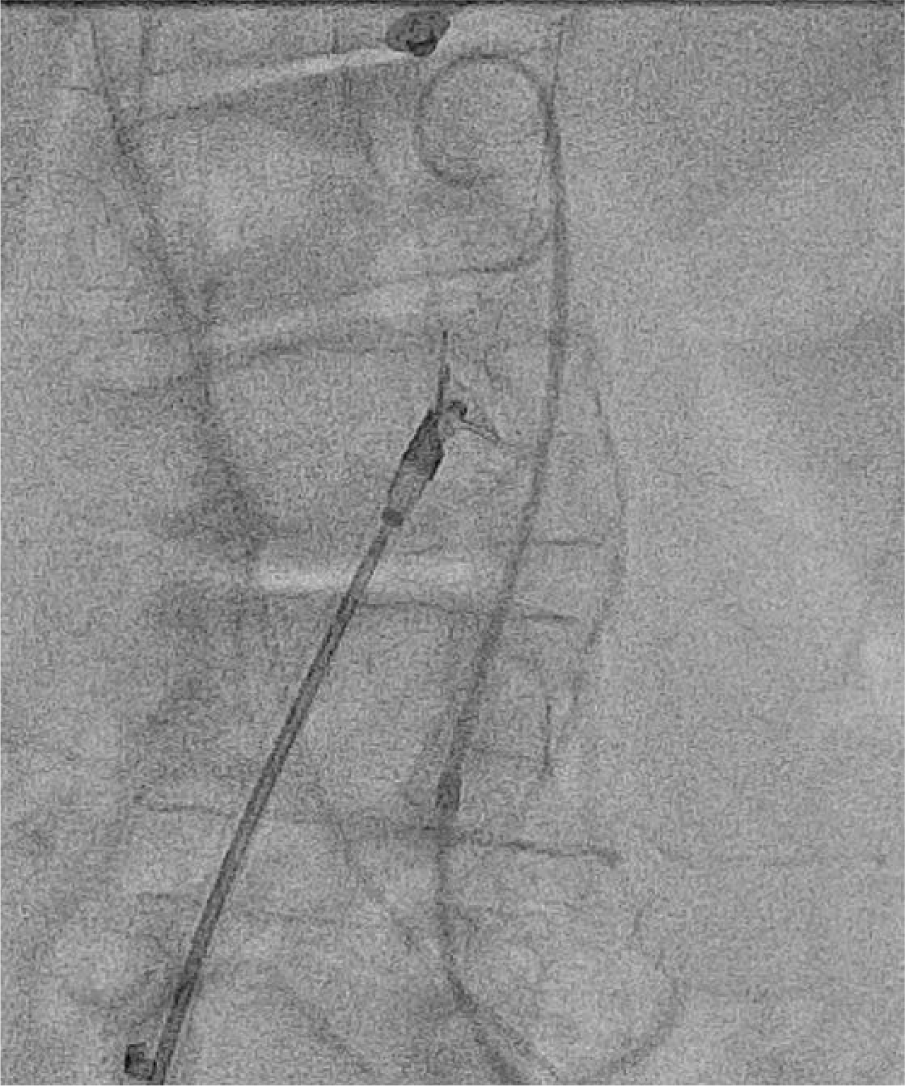

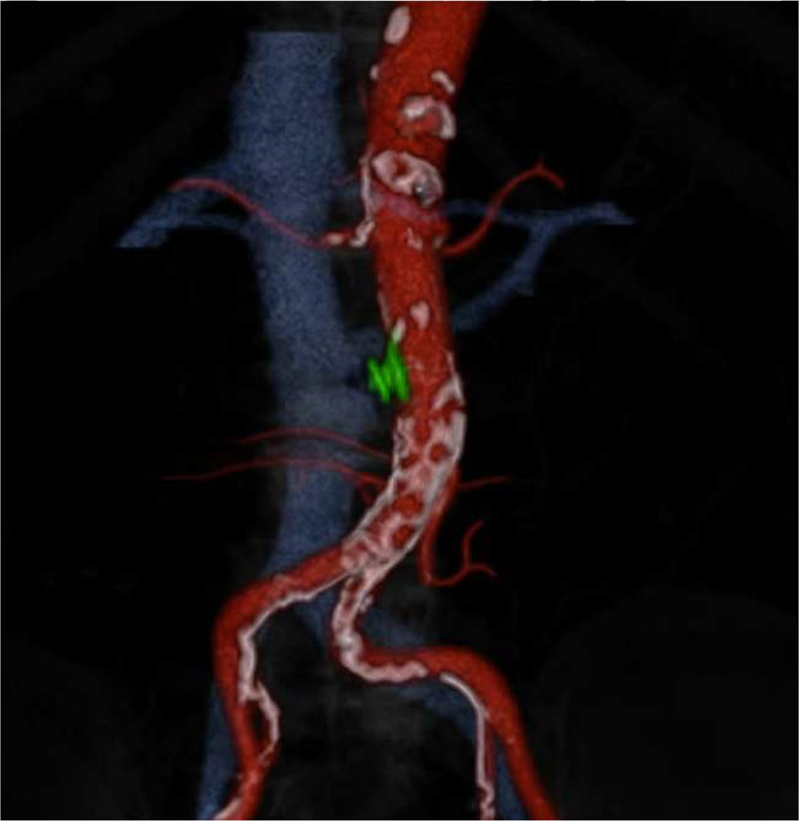
Transcaval Closure Device (TCD)
96 year old woman, severe AS, small & calcified iliofemoral arteries
toby.rogers@nih.gov

Slide 11
Procedural details
 | n=12
Moderate sedation | 75% (9/12)
Transcaval sheath nominal size (French) | 15.1 ± 2.3
Transcaval tract maximum diameter | 7.76mm (determined by valve type & size/sheath)
TAVR device | Edwards Sapien 3 - 83% (10/12) Medtronic CoreValve Evolut R - 17% (2/12)
Successful transcaval closure with a single TCD | 100% (12/12)
Aortic balloon tamponade | 1 subject
Covered stent | 0% (0/12)
Modified VARC-2 vascular complications | 0% (0/12)
VARC-2 bleeding complications | 1 subject had minor bleed (hematoma from contralateral femoral artery access site)
Median number of blood units transfused | 1 subject had 1 unit PRBC transfusion during TAVR procedure, but no overt bleeding - classified as not clinically indicated
toby.rogers@nih.gov

Slide 12
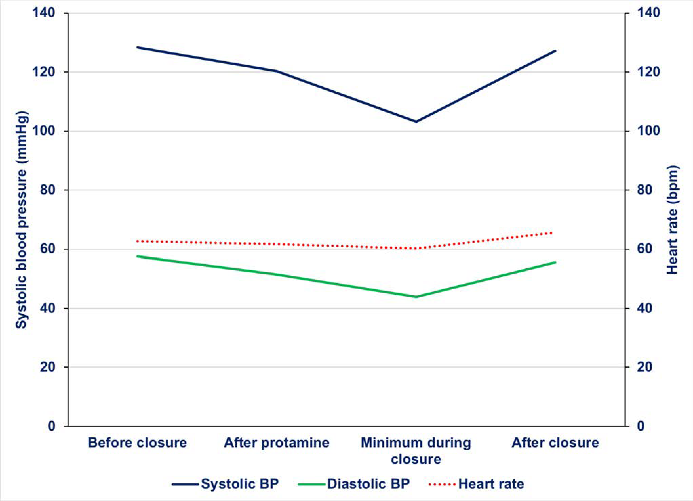
Hemodynamics
3/12 subjects dropped SBP to below 90mmHg during device deployment
12/12 subjects recovered SBP to above 100mmHg after device deployment
toby.rogers@nih.gov

Slide 13
Results
Primary endpoint
The primary endpoint (Technical success) was met in 100% (12/12) subjects enrolled and treated with the TCD implant
Secondary endpoint
The secondary endpoint (Device success) was met in 10/12 at 30 days including follow up CT
  One subject died on post-operative day 15 from underlying pulmonary disease
  One subject developed an ischemic leg on post-operative day 23, presumed embolic, possibly related to underlying atrial fibrillation (not on anticoagulation)
toby.rogers@nih.gov

Slide 14
30 day results
Outcome | n=12 | Relatedness to TCD*
Post-TAVR hospital length of stay | 2 (2,8) | —
Death
Cardiovascular | 0 | —
Non-cardiovascular | 1 | Unrelated
Stroke | 2 | Unrelated
Myocardial infarction | 1 | Unrelated
Acute kidney injury (stage II or III) | 0 | —
Transfusion | 1 (1 unit) | Unrelated
VARC-2 bleeding
Life-threatening | 0 | —
Major | 1 | Unrelated
VARC-2 vascular complications
Major | 0 | —
Minor | 2 | 1 unrelated / 1 possibly related
toby.rogers@nih.gov
* adjudicated by independent clinical events committee

Slide 15
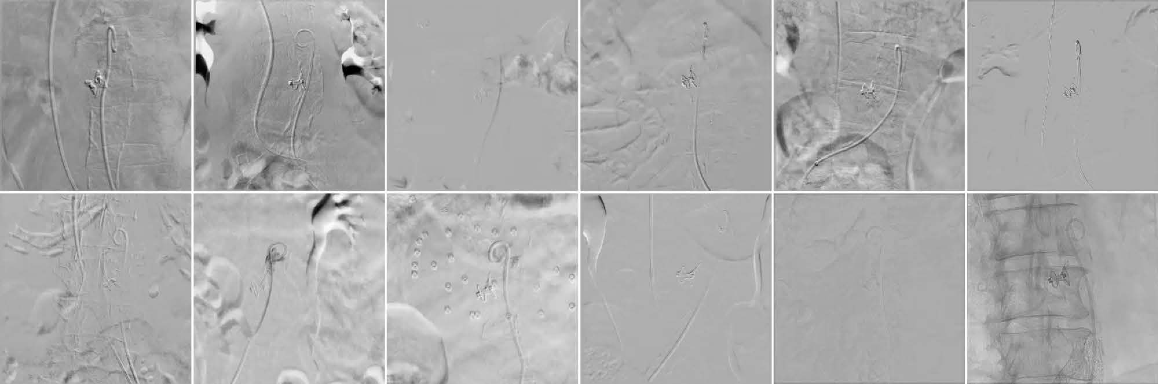
TCD completion angiography
75% immediate hemostasis
(versus 34% with Amplatzer cardiac occluders in NHLBI Prospective Transcaval Study)
toby.rogers@nih.gov

Slide 16
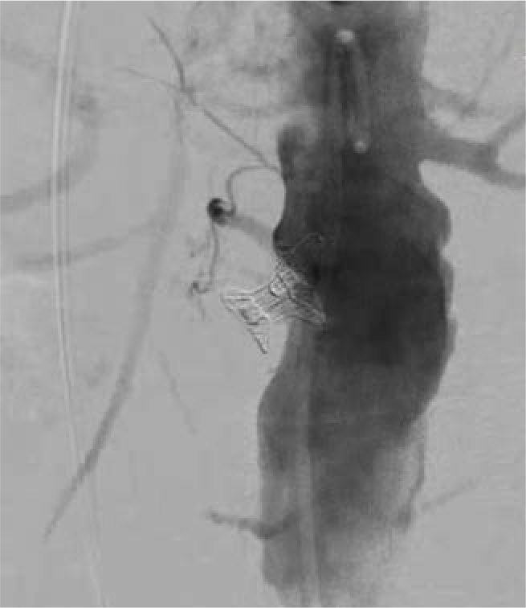
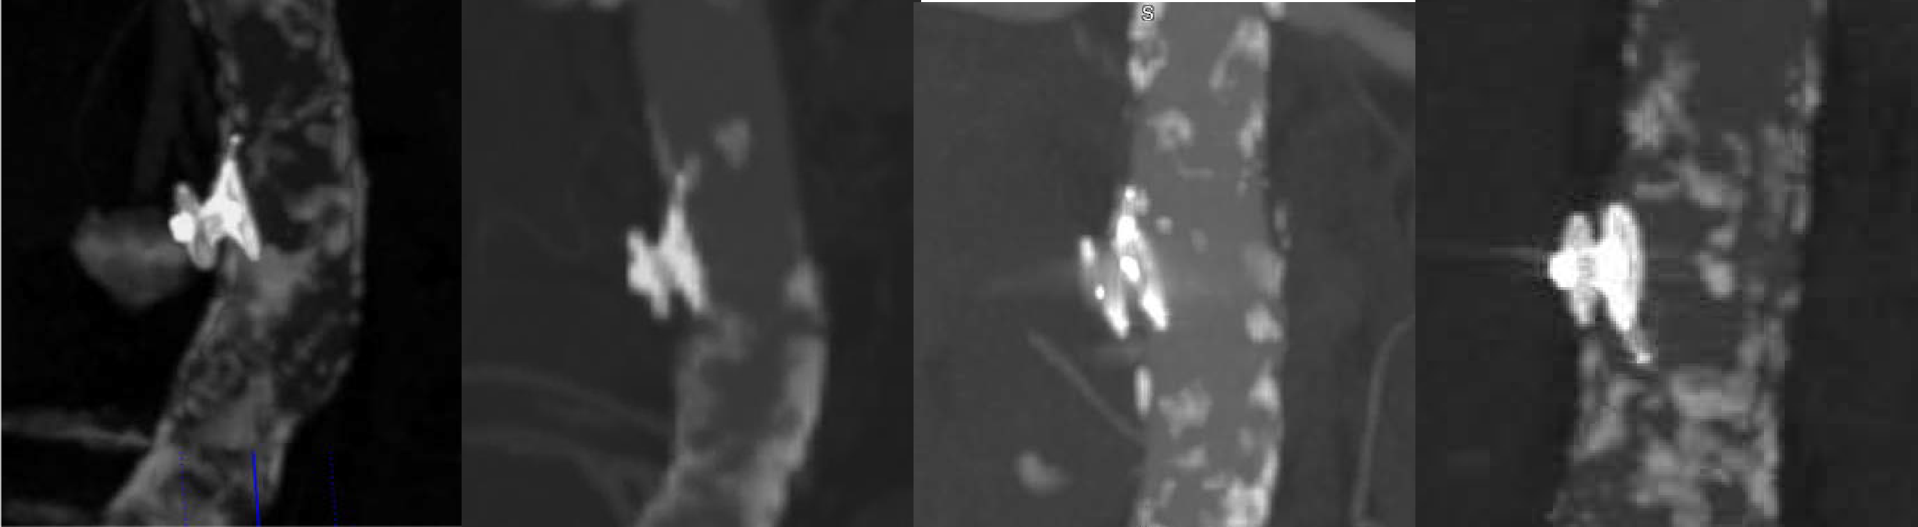
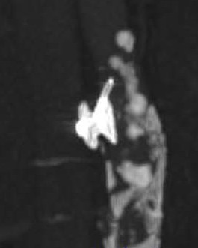
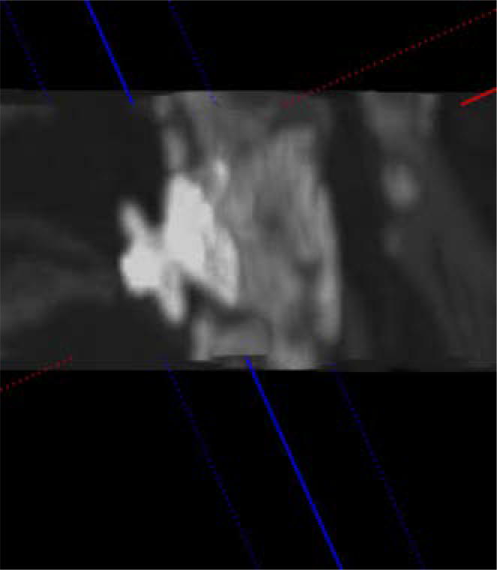
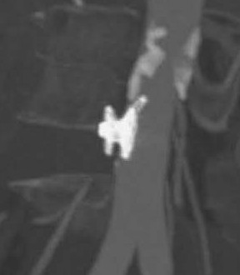
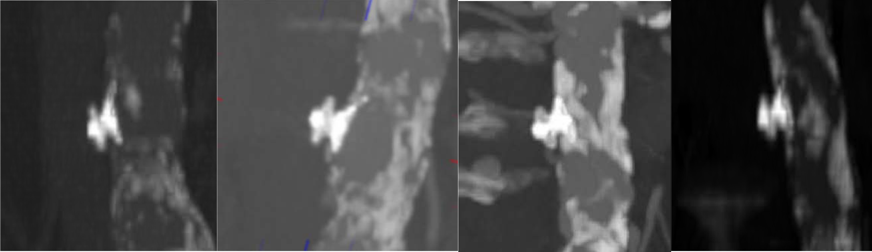
30-day follow-up: 100% occlusion
toby.rogers@nih.gov

Slide 17
Summary
The Transmural Systems Transcaval Closure Device (TCD) promoted rapid hemostasis and eliminated transcaval-related bleeding complications in this Early Feasibility Study
The TCD successfully closed the transcaval tract in all subjects at 30 days
Dedicated devices will simplify transcaval access and closure
toby.rogers@nih.gov

