Slide 1
30-Day Safety and Echocardiographic Outcomes Following Transcatheter Aortic Valve Replacement with the Self-Expanding Repositionable Evolut PRO System
John K. Forrest, MD, For the Evolut PRO US Clinical Study Investigators

Slide 2
Background
TAVR with the self-expanding CoreValve has lower mean gradients, larger valve areas and improved survival when compared to surgery.
SAVR still maintains lower rates of aortic regurgitation.
Rates of moderate/severe paravalvular leak at 30 days range from 3.4%-5.3% for the 2 current generation FDA-approved TAVR devices on the market today.¹⁻²
Moderate/severe residual paravalvular leak has been associated with worse survival.³⁻⁴ The Evolut PRO represents the next generation self-expanding TAVR in the CoreValve Evolut family. Building off the Evolut platform, it consists of an external pericardial wrap with the intent to reduce prosthetic valve regurgitation while maintaining the benefits of a low-profile, self-expanding, and repositionable supra-annular valve.
Evolut PRO ACC.17
2

Slide 3
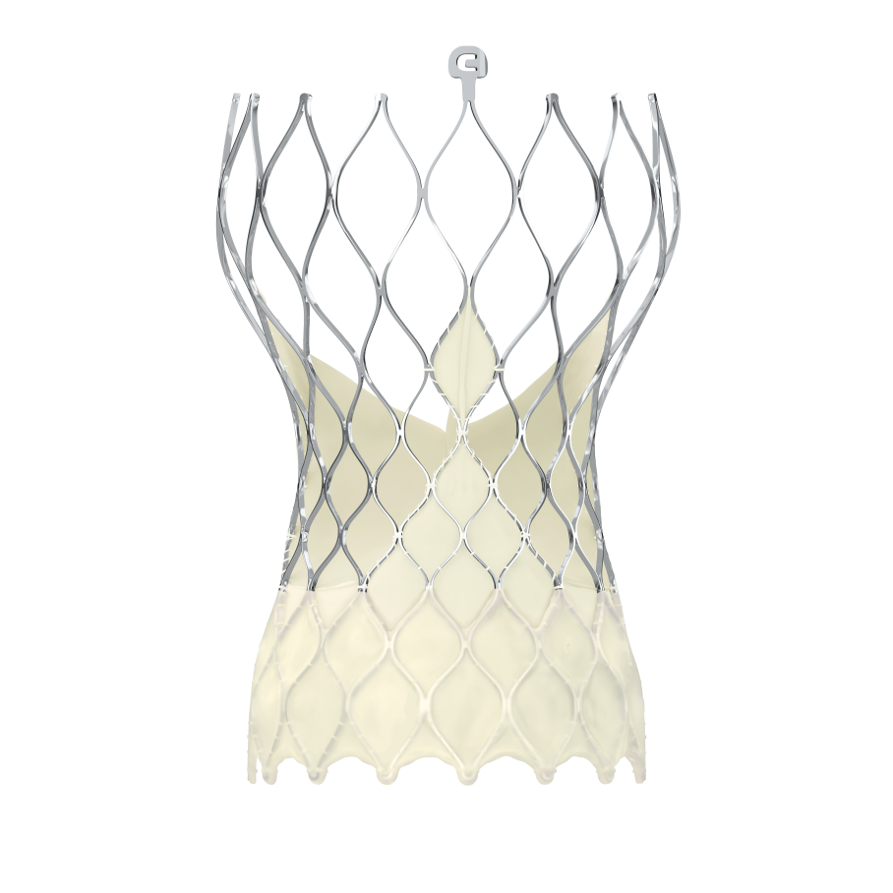
The Evolut PRO is the Next Generation Evolut R Valve
Porcine pericardial wrap on lower 1.5 rows of inflow cells
Evolut R
Evolut PRO
Evolut PRO ACC.17

Slide 4
Evolut PRO Study Methods
The Evolut PRO Study is a 60-patient prospective, multicenter, controlled, non-randomized single-arm study at 8 US centers.
The 2 primary safety endpoints were all-cause mortality and disabling stroke at 30 days.
The primary efficacy endpoint was the percentage of patients with none or trace aortic regurgitation at 30 days.
An independent Echocardiographic Core Laboratory (Mayo Clinic, Rochester, MN) was used to adjudicate all echocardiographic assessments.
Evolut PRO ACC.17

Slide 5
Evolut PRO Baseline Characteristics
Characteristic, mean ± SD or % |  | N=60
Age, years |  | 83.3 ± 7.2
Female |  | 65.0
BSA, m² |  | 1.8 ± 0.2
STS – PROM, % |  | 6.4 ± 3.9
NYHA Class III or IV |  | 70.0
Peripheral vascular disease |  | 43.3
Atrial fibrillation / atrial flutter |  | 18.6
Diabetes mellitus |  | 43.3
Severe aortic calcification |  | 20.5
LV ejection fraction, % |  | 58.9 ± 12.4
Pre-existing pacemaker |  | 15.0
Evolut PRO ACC.17
5

Slide 6
Evolut PRO Procedural Outcomes
Characteristic, % or mean ± SD | N = 60
General anesthesia | 58.3
Iliofemoral access approach | 98.3
Valve Size Implanted
26 mm | 40.0
29 mm | 60.0
Pre-TAVR balloon dilation | 51.7
Post-implant balloon dilation | 26.7
Percentage of patients repositioned | 35.0
Average implant depth, mm | 4.3 ± 1.6
Evolut PRO ACC.17

Slide 7
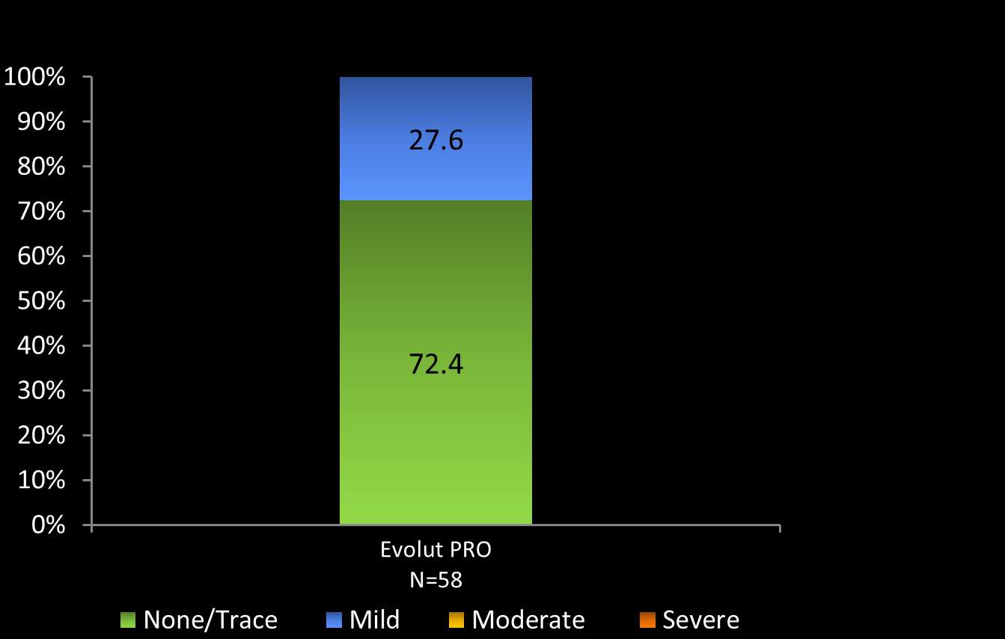
Evolut PRO Aortic Regurgitation at 30 Days
Percent of Evaluable Echocardiograms
Evolut PRO ACC.17

Slide 8
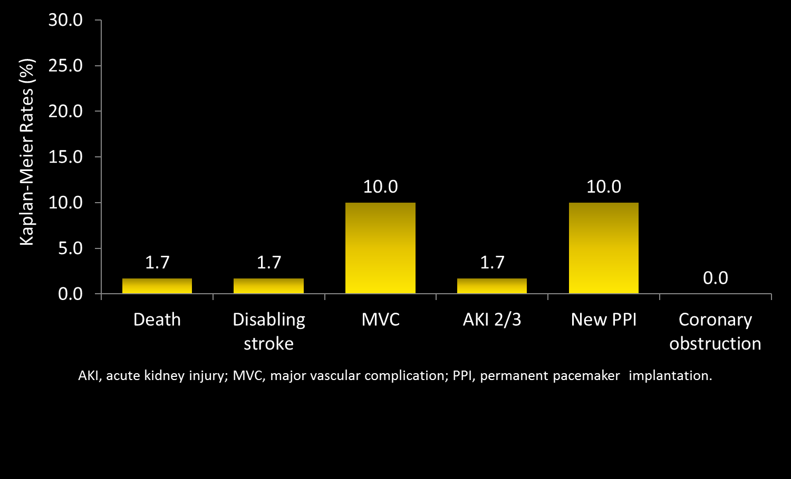
Evolut PRO Safety Outcomes at 30 Days
Evolut PRO ACC.17

Slide 9
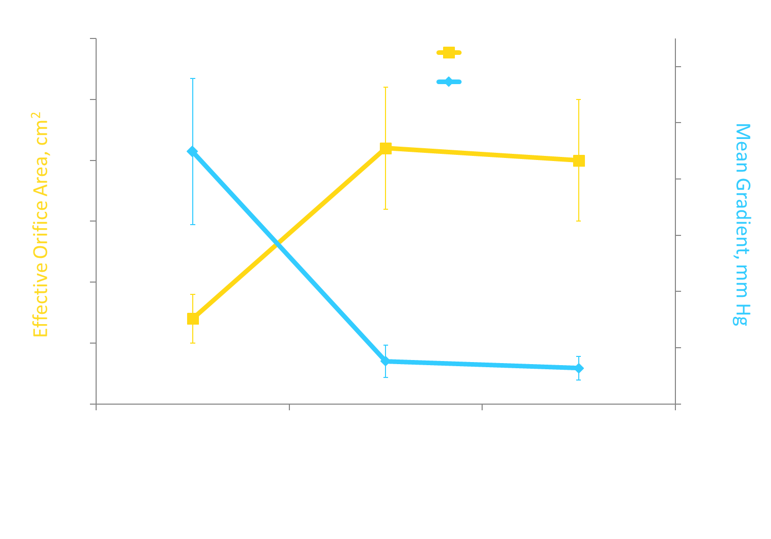
Evolut PRO Valve Performance
Gradient | 59 | 57 | 55
EOA | 57 | 49 | 47
Evolut PRO ACC.17
Error bars are standard deviations.

Slide 10
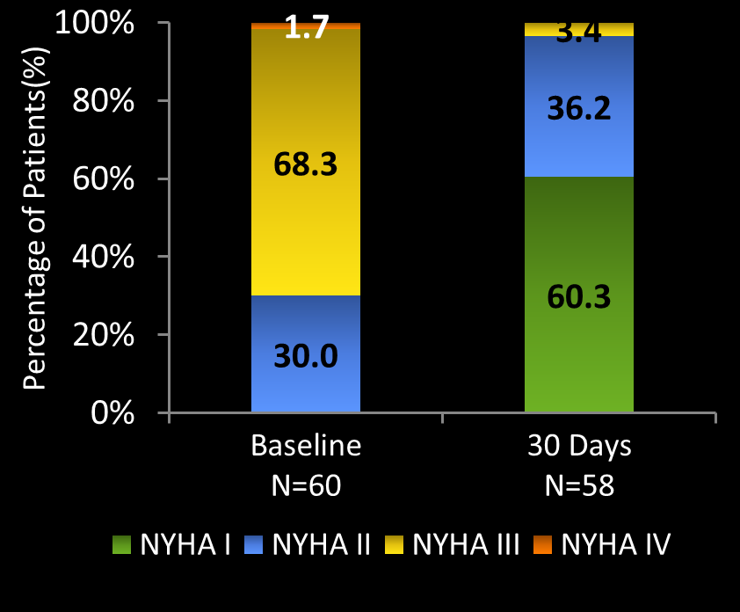
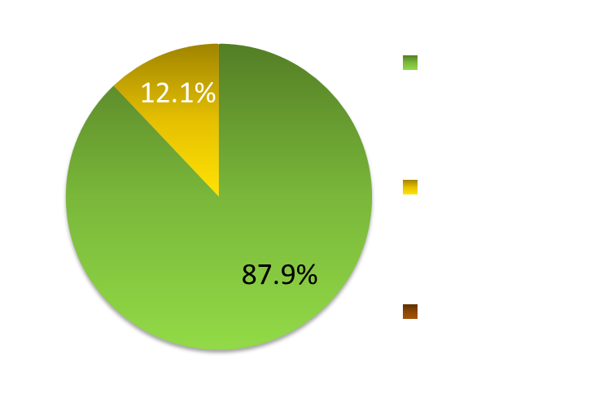
Evolut PRO New York Heart Association
87.9% of Survivors Improved NYHA Class at 30 Days
Evolut PRO ACC.17

Slide 11
Evolut PRO Clinical Summary
The majority of patients (72.4%) implanted with the Evolut PRO valve had none or trace regurgitation at 30 days. The rest of the patients had mild aortic regurgitation (27.6%).
There were no patients with more than mild aortic regurgitation at 30 days.
The valve demonstrated excellent hemodynamics with a new permanent pacemaker rate of 10% at 30 days.
Evolut PRO ACC.17

