Slide 1
A Case I’m Proud of

Slide 2
Lourdes Prieto, M.D.
Disclosures:
I have no relevant financial relationships

Slide 3
Patient History
19 yo with DORV, large VSD, pulmonary stenosis
3 days old - right BT shunt
2 yrs - VSD closure & 16 mm RV to PA homograft
7 yrs –large RVOT pseudoaneurysm at homograft insertion site – pseudoaneurysm resection and homograft replacement (21 mm)

Slide 4
Patient History
19 yrs - Homograft stenosis, Vmax 4 m/sec by echo
MRI – stenosis at proximal homograft/valve, regurgitant fraction 12%
RV mildly dilated with low normal function
Decreased stamina
H/o bilateral femoral vein occlusion

Slide 5
Hemodynamics
RV pressure 80% systemic
33 mm gradient from RV to MPA under general anesthesia

Slide 6
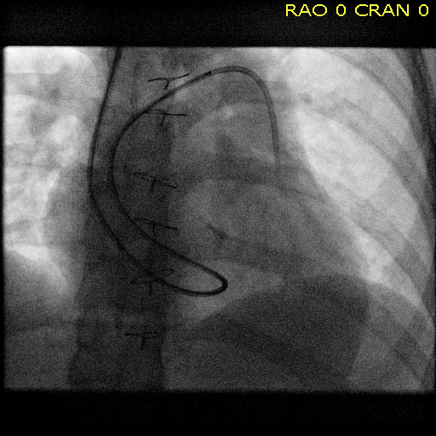
Catheter course a bit challenging…

Slide 7
Can we open a femoral vein?
We will try!

Slide 8
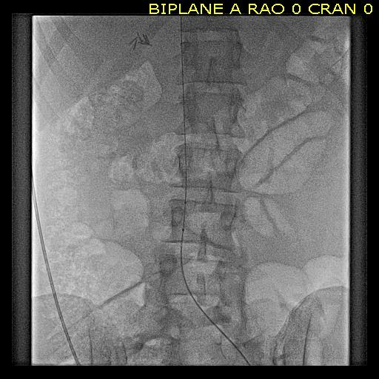
Wire goes up!

Slide 9
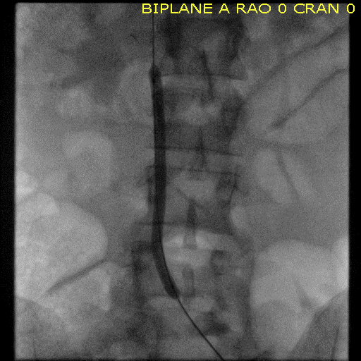
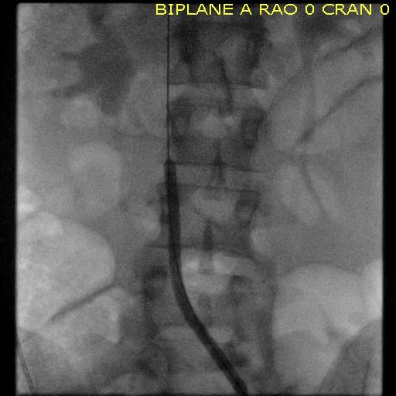
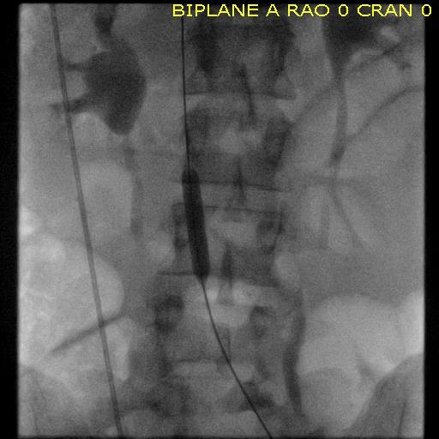
Progressive iliac vein dilation

Slide 10
Much better!

Slide 11
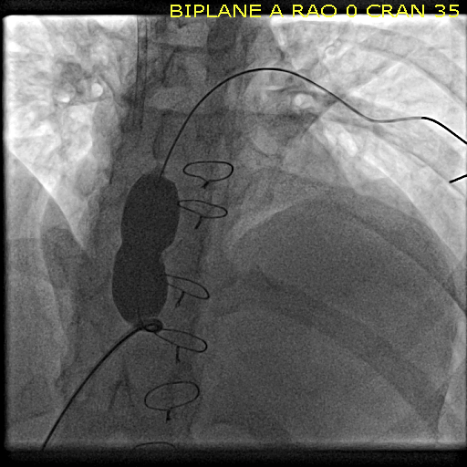
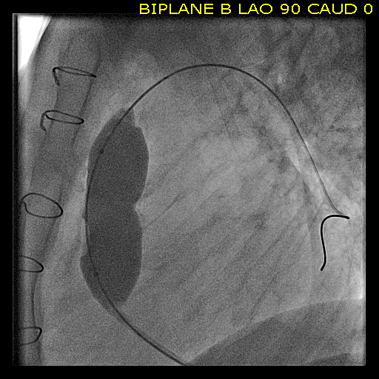
Balloon sizing

Slide 12
R/o Coronary Compression

Slide 13
Pre-stenting

Slide 14
Things look good…

Slide 15
Melody valve deployment

Slide 16
High pressure dilation – Atlas Stopped at 6 atm

Slide 17
Post high pressure dilation – MPA angio

Slide 18
Post high pressure dilation- RVOT angio

Slide 19
Wait and repeat angiogram…

Slide 20
Never sit in the Cath Lab with nothing to do…

Slide 21
Final RVOT angiogram

Slide 22
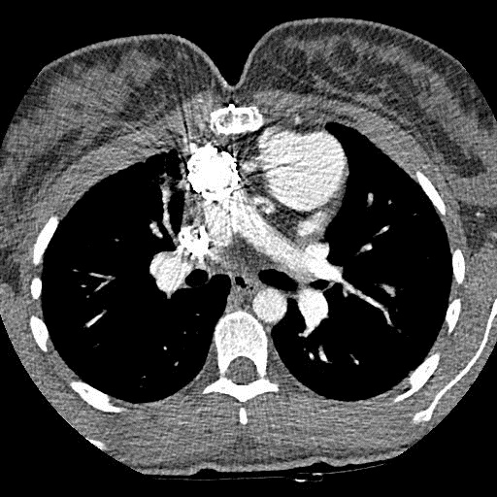
CT one day post
Contained pocket, no change from angio
CT dose reduction protocol - 263 mGycm

Slide 23
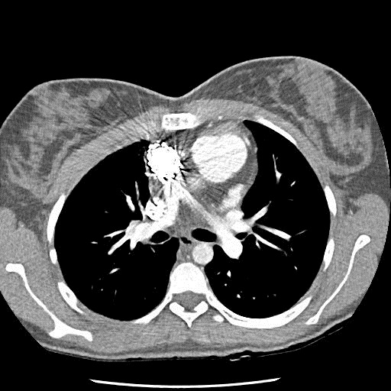
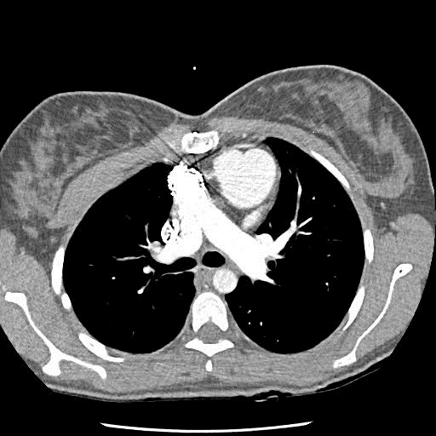
CT one month post – Resolution
CT dose reduction protocol - 245 mGycm

Slide 24
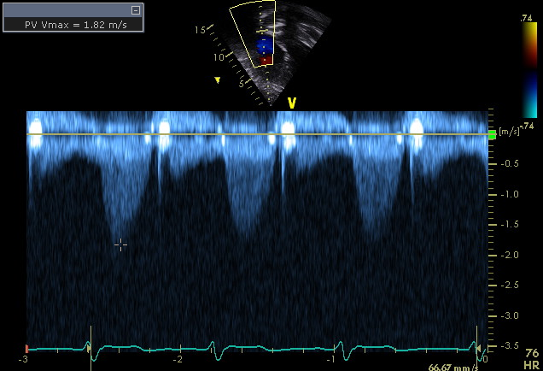
2 ½ yrs later…

