Slide 1
Strategies to Reduce Acute Kidney Injury and Improve Clinical Outcomes After Percutaneous Coronary Intervention: A Subgroup analysis of the Prevention of Serious Adverse Events Following Angiography (PRESERVE) Trial
Santiago Garcia, MD on behalf of PRESERVE investigators University of Minnesota and Minneapolis VA Healthcare System garci205@umn.edu

Slide 2
Disclosures
Dr. Garcia: Grant support from Edwards Lifesciences and consulting fees from Medtronic, Boston Scientific, Osprey Medical, and Surmodics
Funding: The trial was funded by the VA Cooperative Studies Program and the National Health and Medical Research Council of Australia
Disclaimer: The contents do not represent the views of the U.S. Department of Veterans Affairs or United Stated Government
The trial is registered in ClinicalTrials.gov NCT01467466

Slide 3
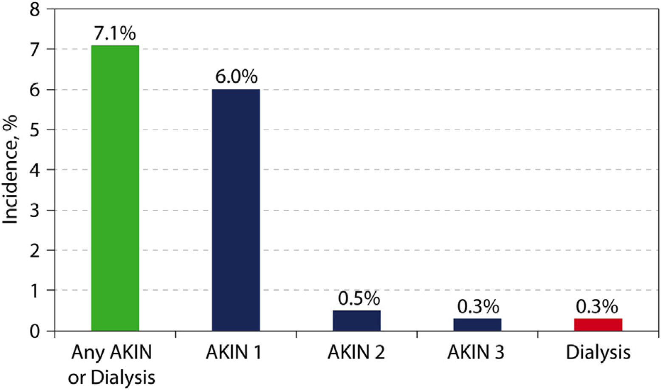
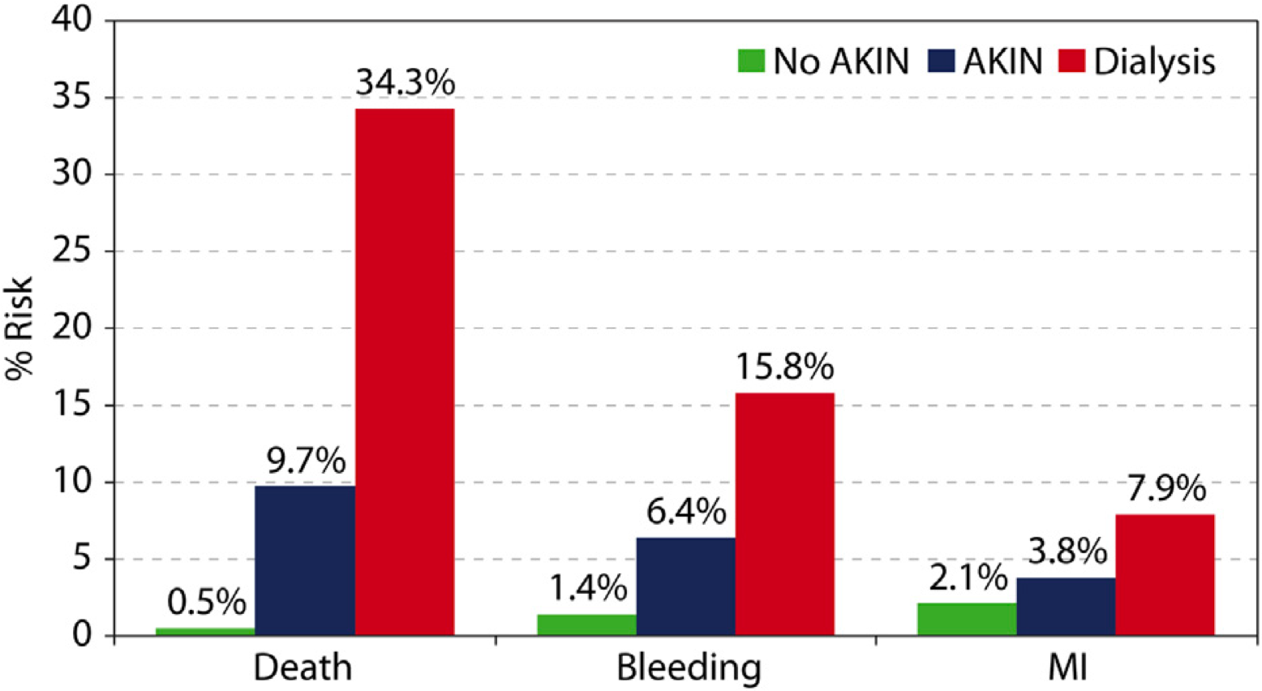
Background
Contrast-associated acute kidney injury (CAAKI) affects 7% of patients undergoing PCI
CA-AKI increases morbidity and mortality
Two widely used strategies to prevent CA-AKI in clinical practice include the use of intravenous
(IV) sodium bicarbonate to induce urine alkalinization and scavenging of reactive oxygen species through peri-procedural oral administration of acetylcysteine
Results of clinical trials and meta-analyses of these interventions have yielded inconsistent results
Tsai et al. JACC Cardiovasc Interv 2014; 7:1-9.

Slide 4
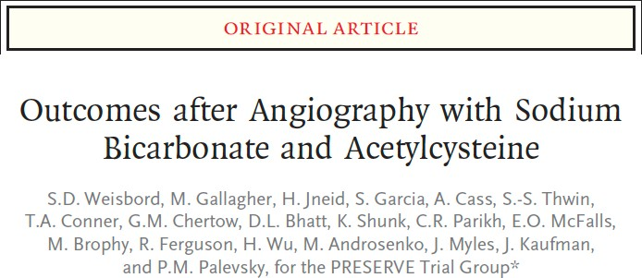
No benefit of IV sodium bicarbonate over IV sodium chloride or of oral acetylcysteine over placebo for the prevention of death, need for dialysis or persistent decline in kidney function at 90 days
The generalizability of the PRESRVE trial results to high-risk patients receiving larger contrast volume has been questioned
SCAI 2018
Scientific Sessions
N Engl J Med. 2018;378(7):603-14.
Nat Rev Nephrol. 2018.

Slide 5
Study Objective
To conduct a subgroup analysis of PRESERVE participants who underwent PCI to compare the efficacy of IV sodium bicarbonate with IV sodium chloride and of oral acetylcysteine compared with placebo in this high-risk patient group

Slide 6
PRESERVE
International, double-blind, placebo and comparator-controlled, randomized clinical trial with a 2 x 2 factorial design
Patients were enrolled at 53 medical centers in the United States (35 Veterans Affairs sites), Australia (13 sites), Malaysia (3 sites), and New Zealand (2 sites)
Study participants were randomized to receive IV 1.26% sodium bicarbonate or IV 0.9% sodium chloride and oral N-acetylcysteine or oral placebo using a centralized, computer-generated permuted-block plan stratified by site
The administration of IV fluids was protocolized with dose/timing/rate ranges (3-12 ml/kg prior to angiography, 1-1.5 ml/kg/hour during angiography/PCI, and 1-3 ml/kg/hour after angiography)

Slide 7
Study Population: Inclusion Criteria
Pt undergoing elective or urgent coronary or non-coronary angiography
≥ 3 hours between identification of patient for study and procedure
Pre-angiography eGFR <60 ml/min/1.73m² with diabetes
eGFR defined by 4-variable MDRD equation
DM defined as use of insulin and/or oral hypoglycemic medication at time of angio
Pre-angiography eGFR <45 ml/min/1.73m²
mellitus
Ability to provide informed consent
Undergoing PCI
with or without diabetes

Slide 8
Study Population: Exclusion Criteria
Currently receiving any form of dialysis
eGFR <15 ml/min/1.73m²
Unstable baseline SCr based on Δ of ≥25% over 3 days prior to angiogram
Decompensated heart failure based on use of:
IV inotropes or nesiritide
Isolated ultrafiltration tx
Intra-aortic balloon pump
Emergent angiogram defined as
<3 hrs between pt identification and angiogram
IV iodinated contrast within prior 7 days
Oral or IV NAC within prior 48 hours
Known allergy to NAC
Known allergy to iodinated contrast
Age <18 years
Prisoner
Ongoing participation in another interventional trial (other than CSP 588)
Unwillingness to comply with 96-hour and 90-day SCr assessments
Pregnant

Slide 9
Trial End-Points
Primary end-point: A composite of death, need for dialysis, or a persistent increase of at least 50% in serum creatinine at 90 days after angiography.
Secondary end-point: CAAKI, defined as an increase in serum creatinine of at least 25% or 0.5 mg/dl at 4 days following angiography.

Slide 10
Statistics
Analyses among PRESERVE participants who underwent PCI
To compare demographic, clinical, and procedural variables between groups we used the t-test for normally distributed continuous data, the Wilcoxon rank-sum test for non-normally distributed continuous data, and the chi-square test for categorical variables.
To assess the effect of treatment groups on the primary end-point we extended the multivariable logistic regression model used in the main trial to test for the interaction between PCI and treatment assignment.
Exploratory analysis among pre-specified subgroups of interest; according to eGFR stratum, the presence of diabetes, albuminuria stratum, contrast volume, and country.

Slide 11
Results: Study Flow
4,937 patients underwent angiography
471 underwent non-coronary angiography
4,466 underwent coronary angiography
1,161 underwent PCI
568 were randomized to receive IV sodium bicarbonate
593 were randomized to receive IV sodium chloride
598 were randomized to receive acetylcysteine
563 were randomized to receive placebo

Slide 12
Baseline characteristics according to performance of PCI
Demographic and clinical characteristics | PCI (N=1161) | No PCI (N=3304) | p-value
Age – mean (std) – years | 69.3 (8.4) | 69.8 (8.2) | 0.07
eGFR - median (IQR) – ml/min/1.73m² | 50.7 (41.7 – 60.1) | 50.2 (41.2 – 59.3) | 0.17
Diabetes mellitus – no. (%) | 952 (82.0) | 2692 (81.5) | 0.69
Contrast type Iodixanol – no. (%) | 646 (55.6) | 1569 (47.5) | 0.07
Contrast volume – median (IQR) – ml | 160 (115 – 220) | 75 (50 – 105) | < 0.01
Femoral - no. (%) Radial - no. (%) | 769 (66.2) 382 (32.9) | 2077 (62.9) 1197 (36.3) | 0.12
IV fluids Pre-angiography median (IQR) – ml | 350 (281-452) | 342 (275-437.5) | 0.04
IV fluids Intra-angiography median (IQR) – ml | 160 (110-220) | 98 (63-141) | < 0.01
IV fluids Post-angiography median (IQR) – ml | 590 (490-687) | 567 (464-666) | < 0.01

Slide 13
Baseline characteristics according to treatment assignment
IV Sodium Bicarbonate
IV Sodium chloride
p-value NAC Placebo
0.92 69.5 ± 8.4 69.1 ± 8.3
p-value
Age – mean (std) – years
69.1 ± 8.4
69.5 ± 8.4
0.80
eGFR - median (IQR) – ml/min/1.73m²
50.3
(40.9 - 60.3)
51.3
(42.7 - 59.9)
50.9
(42.5 - 60.1)
50.5
(41.1 - 60.1)
0.4
0.5
Diabetes mellitus – no. (%)
464 (81.7%)
488 (82.3%)
0.79
486 (81.3%)
466 (82.8%)
0.51
Contrast type
Iodixanol – no. (%)
324 (57%)
322 (54.3%)
0.35
330 (55.2%)
316 (56.1%)
0.75
Contrast volume – median (IQR) – ml
155
(112.5 - 220)
160
(120 - 220)
0.52
170
(118 - 225)
150
(112 - 220)
0.06
IV fluids Pre-angiography median (IQR) – ml
354
(278 - 464)
348
(282 - 444)
350
(282 - 450)
348
(280 - 454)
0.35
0.97
Intra-angiography median (IQR) – ml
152
(106 - 215)
167
(113 - 222)
0.05
160
(111 - 221)
160
(108 - 220)
0.89
Post-angiography median (IQR) – ml
588
(498 - 678)
590
(485 - 692)
588
(491 - 683)
590
(488 - 690)
0.64
0.92

Slide 14
Results
PRIMARY OUTCOME:
SECONDARY OUTCOME:
Sodium Bicarbonate vs. Sodium Chloride: OR 0.64 (0.33-1.24) Acetylcysteine vs. Placebo: OR 1.37 (0.71-2.62)
Sodium Bicarbonate vs. Sodium Chloride: OR 0.93 (0.65-1.34) Acetylcysteine vs. Placebo: OR 0.98 (0.69-1.41)
14.00%
12.00%
10.00%
8.00%
6.00%
4.00%
2.00%
0.00%
Primary End-Point (death, dialysis, persistent decline in kidney function)
Bicarbonate Saline
CAAKI
NAC Placebo

Slide 15
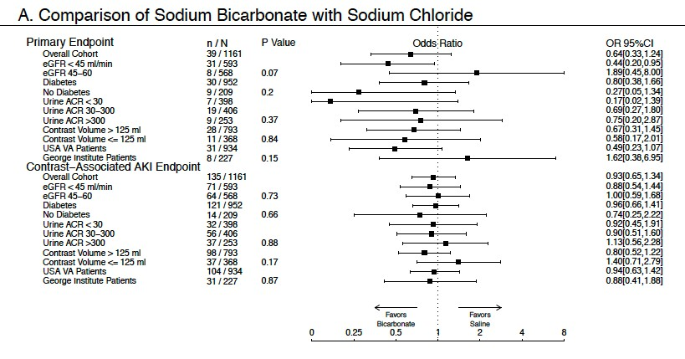
Subgroups of Interest: Sodium Bicarbonate vs. Sodium Chloride
SCAI 2018
Scientific Sessions

Slide 16
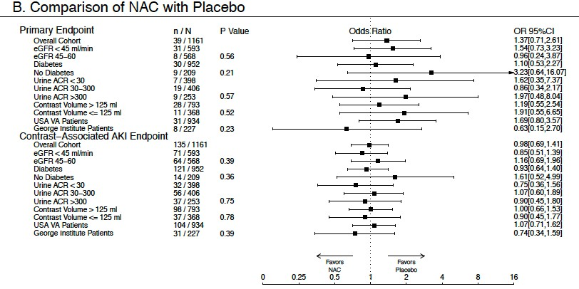
Subgroups of Interest: Acetylcysteine vs. Placebo
SCAI 2018
Scientific Sessions

Slide 17
Limitations
Very high-risk patients (i.e. STEMI and/or cardiogenic shock) were excluded, our findings may not be generalizable to these individuals
The power of the current analysis was limited based on the smaller number of patients compared with the overall PRESERVE trial However, overall results consistent with parent trial
Cohort was predominantly male

Slide 18
Conclusions
The present sub-group analysis of more than 1,150 patients, with over 500 in each treatment arm, represents the largest study of IV sodium bicarbonate and of acetylcysteine in patients undergoing PCI reported to date
Among high-risk patients for CAAKI undergoing PCI we found that neither IV sodium bicarbonate (compared with IV sodium chloride) nor oral acetylcysteine (compared to placebo) were superior in reducing serious adverse 90-day events or CAAKI
Intravascular volume expansion with isotonic sodium chloride should be considered the standard of care for the prevention of adverse renal outcomes in patients undergoing PCI

Slide 19
Strategies to Reduce Acute Kidney Injury and Improve Clinical Outcomes After Percutaneous Coronary Intervention: A Subgroup analysis of the Prevention of Serious Adverse Events Following Angiography (PRESERVE) Trial
Santiago Garcia, MD on behalf of PRESERVE investigators University of Minnesota and Minneapolis VA Healthcare System garci205@umn.edu

