Slide 1


Embargoed for 10:45 a.m. ET, 11-16-19
The Dapagliflozin and Prevention of Adverse-Outcomes in Heart Failure Trial (DAPA-HF)
Results in Nondiabetic Patients
John McMurray
BHF Cardiovascular Research Centre, University of Glasgow
& Queen Elizabeth University Hospital, Glasgow, UK.
On behalf of the DAPA-HF Committees and Investigators

Slide 2
Disclosures
DAPA-HF was funded by AstraZeneca
My institution has been paid by AstraZeneca for my time spent as principal investigator for DAPA-HF and for advisory boards related to dapagliflozin, diabetes and heart failure.

Slide 3
Background
Sodium-glucose co-transporter 2 (SGLT2) inhibitors prevent the development of heart failure in patients with type 2 diabetes (T2D). Can they be used to treat patients with established heart failure?
The benefits of SGLT2 inhibitors may be glucose-independent.
Can SGLT2 inhibitors be used to treat patients without T2D?
We tested the SGLT2 inhibitor dapagliflozin,10 mg once daily, added to standard therapy, in patients with heart failure and reduced ejection fraction (HFrEF) both with and without T2D

Slide 4
DAPA-HF Design
4,744 patients 20 countries
Enrolment
Randomization
Event-driven
Inclusion:
NYHA class II-IV
LVEF ≤40%
NT-proBNP ≥600 pg/ml*
Exclusion:
eGFR <30 ml/min/1.73 m²
SBP <95 mmHg
type 1 diabetes
N=2371
Placebo
≥844 Primary endpoints
Composite of:
CV death
HF hospitalization
Urgent HF visit
Dapagliflozin
10 mg once daily
N=2373
Visit 1
Visit 2
Visit 3
Visit 4
Visit 5
Visit 6 etc.
Day −14
Day 0
Day 14
Day 60
Day 120
Every 120 days
*≥400 pg/ml if HF hospitalization within ≤12 months; ≥900 pg/ml if atrial fibrillation/flutter

Slide 5
Key baseline characteristics
Characteristic | Diabetes (n=2139)* | No diabetes (n=2605)
Mean age (yr) | 67 | 66
Male (%) | 78 | 76
NYHA class II/III/IV (%) | 64/35/1 | 71/29/1
Mean LVEF (%) | 31 | 31
Median NT-proBNP (pg/ml) | 1484 | 1413
Mean systolic BP (mmHg) | 123 | 121
Ischaemic aetiology (%) | 62 | 51
Mean eGFR (ml/min/1.73m²) | 63 | 68
eGFR <60 ml/min/1.73m² (%) | 46 | 36
Prior heart failure hospitalization (%) | 49 | 46
*includes 156 patients with previously undiagnosed diabetes i.e. two HbA1c ≥6.5% (≥48 mmol/mol)

Slide 6
Baseline treatment
Treatment (%) | Diabetes (n=2139) | No diabetes (n=2605)
Diuretic | 95 | 92
ACE-inhibitor/ARB/ARNI⁺ | 93 | 94
ACE inhibitor | 55 | 57
ARB | 29 | 27
Sacubitril/valsartan | 11 | 11
Beta-blocker | 97 | 96
MRA | 72 | 71
ICD* | 27 | 26
CRT** | 7 | 8
⁺ARNI = angiotensin receptor neprilysin inhibitor
*ICD or CRT-D **CRT-P or CRT-D

Slide 7
Primary outcome

Slide 8
Primary composite outcome
CV Death/HF hospitalization/Urgent HF visit
Diabetes
No Diabetes
HR 0.75 (0.63,0.90)
Placebo
Placebo
HR 0.73 (0.60,0.88)
Placebo
Dapagliflozin
Dapagliflozin
Dapagliflozin
P interaction 0.80

Slide 9
Components of primary outcome
Cardiovascular death
Diabetes
No Diabetes
HR 0.79 (0.63,1.01)
Placebo
HR 0.85 (0.66,1.10)
Placebo
Dapagliflozin
Dapagliflozin
P interaction 0.70

Slide 10
Components of primary outcome
Worsening HF event
Diabetes
No Diabetes
Placebo
HR 0.77 (0.61,0.95)
HR 0.62 (0.48,0.80)
Placebo
Dapagliflozin
Dapagliflozin
P interaction 0.23

Slide 11
Secondary outcomes
In order of hierarchical testing

Slide 12
CV death or HF hospitalization
Diabetes
No Diabetes
HR 0.75 (0.63,0.90)
HR 0.73 (0.60,0.89)
Placebo
Placebo
Dapagliflozin
Dapagliflozin
P interaction 0.83

Slide 13
Total HF hospitalizations and CV death
Including first and repeat hospitalizations
Diabetes
No Diabetes
Rate Ratio 0.77 (0.63, 0.94)
Rate Ratio 0.73 (0.59, 0.91)
Placebo
Placebo
Dapagliflozin
Dapagliflozin
P interaction 0.74

Slide 14


Clinically meaningful change
(≥5 points) in KCCQ-TSS
Placebo
Dapagliflozin
Diabetes
No diabetes
0.78 (0.71, 0.87)
1.20 (1.09, 1.31)
Odds ratio
0.88 (0.81, 0.97)
1.12 (1.03, 1.22)
%
%
Deterioration
Improvement
P interaction 0.74
Deterioration
Improvement

Slide 15
Worsening renal function endpoint
Composite of: Sustained* ≥50% reduction in eGFR, end-stage renal disease (ESRD) or death from renal causes
 | Placebo No. (%) | Dapagliflozin No. (%) | Hazard ratio (95%CI)
Diabetes (n=2139) | 24 (2.3) | 18 (1.7) | 0.73 (0.39, 1.34)
No diabetes (n=2605) | 15 (1.2) | 10 (0.8) | 0.67 (0.30, 1.49)
P interaction 0.86
ESRD consisted of sustained eGFR below 15 ml/min/1.73m², sustained dialysis or kidney transplantation *Sustained = 28 days or more

Slide 16
All-cause death
Diabetes
No Diabetes
HR 0.78 (0.63,0.97)
HR 0.88 (0.70,1.12)
Placebo
Placebo
Dapagliflozin
Dapagliflozin
P interaction 0.45

Slide 17
Treatment effect according to baseline HbA1c

Slide 18
Treatment effect by diabetes status and HbA1c
Primary endpoint
 | Dapagliflozin (n=2373) | Placebo (n=2371)
All patients | 386/2373 | 502/2371
Type 2 diabetes at baseline
Yes | 215/1075 | 271/1064
No | 171/1298 | 231/1307
HbA1c tertiles in patients without T2D at baseline
≤5.6% | 65/521 | 77/485
5.7-5.9% | 44/365 | 66/388
≥6.0% | 62/408 | 87/432
HR (95% CI)
0.74 (0.65, 0.85)
0.75 (0.63, 0.90)
0.73 (0.60, 0.88)
0.74 (0.53,1.04)
0.71 (0.48,1.04)
0.72 (0.52,1.00)
0.5
0.8
1.0
1.25
Dapagliflozin Better
Placebo Better

Slide 19
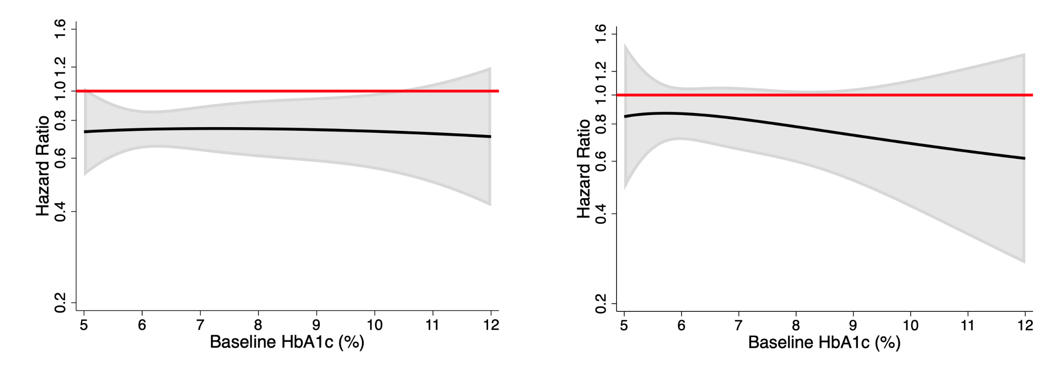
Treatment effect according to
baseline HbA1c (All patients)
Primary endpoint
Cardiovascular death
Placebo
better
HR=1 (unity)
Dapa better
Continuous HR
95%CI

Slide 20
Safety and tolerability

Slide 21
Safety/adverse events (AEs)
Diabetes
No diabetes
Patients exposed to at least one dose of study drug* | Placebo | Dapa | P-value | Placebo | Dapa | P-value
AE of interest (%)
Volume depletion | 7.8 | 7.8 | 1.00 | 6.1 | 7.3 | 0.24
Renal AE | 8.7 | 8.5 | 0.94 | 6.0 | 4.8 | 0.19
Fracture | 2.4 | 2.1 | 0.66 | 1.9 | 2.1 | 0.78
Amputation | 0.8 | 1.1 | 0.66 | 0.2 | 0.1 | N/A
Major hypoglycaemia⁺ | 0.4 | 0.4 | N/A | 0 | 0 | N/A
Diabetic ketoacidosis | 0 | 0.3 | N/A | 0 | 0 | N/A
AE leading to treatment discontinuation (%) | 5.4 | 4.0 | 0.15 | 4.5 | 5.3 | 0.41
Any serious AE (incl. death) (%) | 48.3 | 41.7 | 0.002 | 36.9 | 34.6 | 0.24
*The safety population included patients receiving ≥1 dose of trial medication: dapagliflozin n= 2368 and placebo n=2368. ⁺Major hypoglycemia defined as hypoglycemia requiring the assistance of another person to actively administer carbohydrates, glucagon, or take other corrective action.

Slide 22
Summary and conclusions
When added to standard therapy, dapagliflozin reduced the risk of worsening heart failure events and cardiovascular death, and improved symptoms, in patients with HFrEF, both with and without T2D
The relative and absolute risk reductions in death and hospitalization were substantial, clinically important, and consistent in patients with and without T2D
Dapagliflozin was well tolerated and the rate of treatment discontinuation was low in patients with and without T2D
Dapagliflozin offers a new approach to the treatment of HFrEF in patients with and without T2D

