Slide 1

Late Breaking Clinical Trials: The Consistent CTO study 1-year OCT findings & 2-year clinical outcomes
CONventional antegrade vs Sub-Intimal Synergy sTENTing in Chronic Total Occlusions
Dr Simon Walsh MD FRCP
On behalf of the CONSISTENT CTO Investigators

Slide 2

How was the study executed?
Single arm study
Recruited patients with clinical indication for CTO PCI
QoL assessment before PCI
CTO PCI according to usual practice
IVUS before stenting with Synergy EES
12 month QoL, angiogram and OCT
Long-term follow-up ongoing

Slide 3
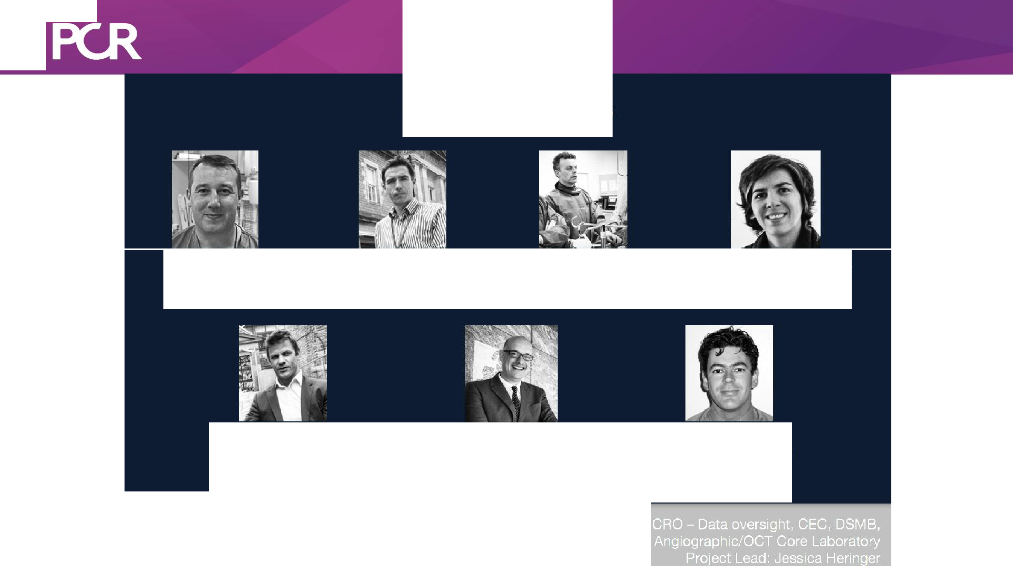
°' I
euro
,
0
N
Investigators
Dr Simon Walsh
Dr Calm Hanratty
Dr James Spratt
Dr Margaret McEntegart
Belfast Trust
Belfast Trust
Royal Infirmary Edinburgh
Golden Jubilee Glasgow
Chief Investigator
Princ ipal Invest igat or
Principal Investiga tor
Principal lnves1igator
Dr Julian Strange,
Dr Elliot Smith,
Dr Jonathan Hill,
Bristol Royal Infirmary
St Bartholamew's London
Kings College London
Principa l Investigator
Principal Invest
igator
Principal Inves tigator
Funding: Unrestricted Grant Boston Scientific
l,,t; U:esearcn ,enTer
urafSr.i,swlar

Slide 4

PCR
euro
1) Patient has CTO and clinical
indication for PCI (no anatomical
3) Baseline assessment for symptoms
and Qol
•.
5) IVUS before stent implant to
confirm dissection or not
7) Telephone follow-up 2, 3 & 5 years
excl•usion)
...
..
.
•
...
.
•
.
.
..
...
.
.
.
•
•
•
2) Informed consent provided
4) CTO PCI: Strategy as appropriate to lesion anatomy (hybrid approach)
6) 12-month hospital visit: Angiogram/OCT and repeat qualitative
assessments

Slide 5
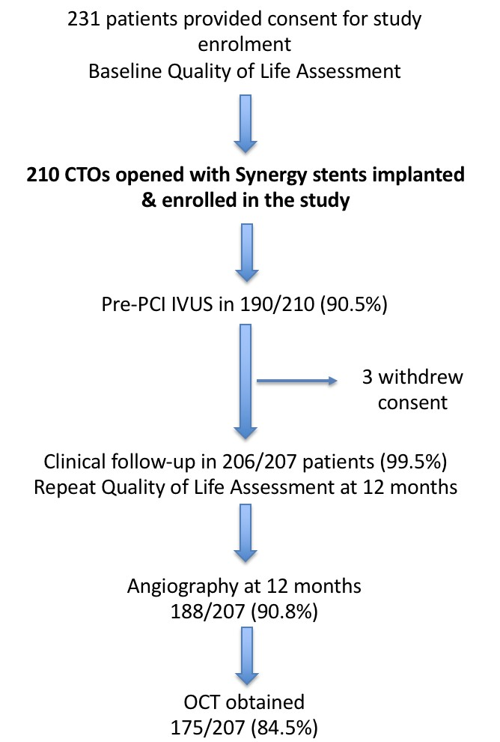
Study Flow

Slide 6
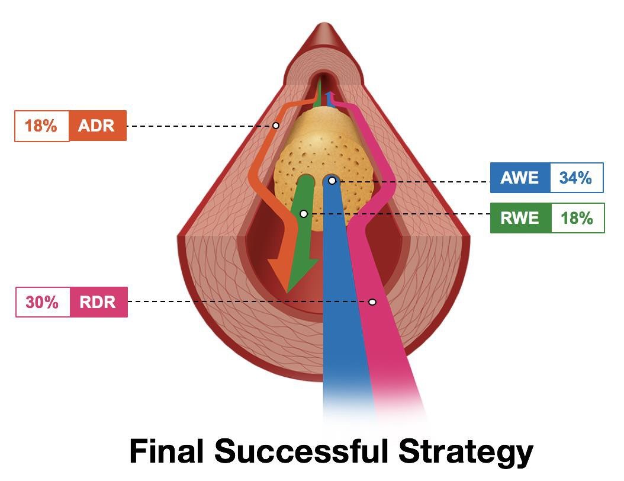
Approaches

Slide 7
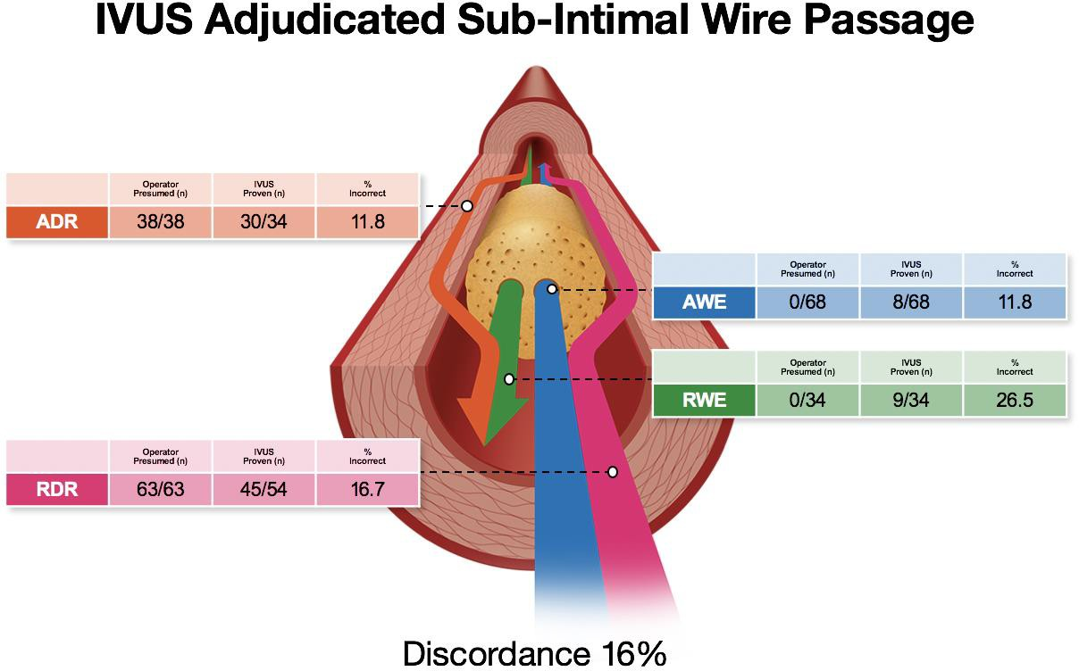
Pre-PCI IVUS

Slide 8
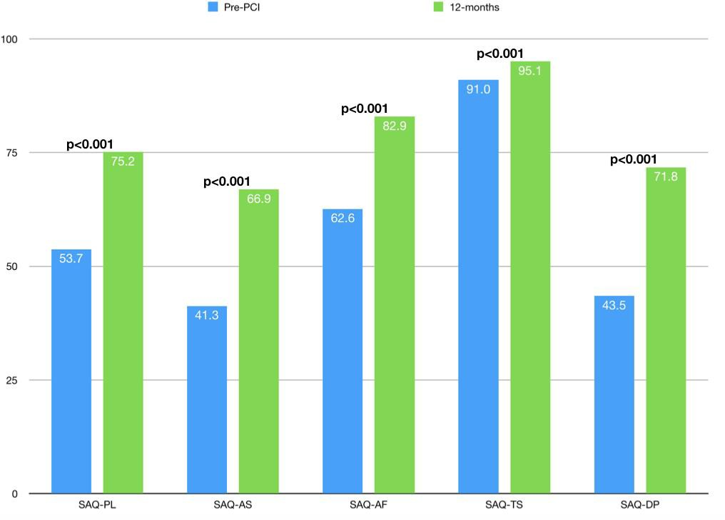
12-month QoL & Clinical Outcomes
TVF 5.2%
MACE 10%
Low procedural complications
Marked improvements in SAQ and EQ5D

Slide 9
Intravascular Healing
Many patients are denied PCI for CTO lesions due to limited data (including RCT) regarding QoL
There has been a misplaced perception that intravascular healing is adverse for patients with long reconstructions, +/- blunt dissection techniques are used in the vessel +/- sub-intimal stenting
Patients with complex occlusions can expect improved quality of life
after a CTO PCI with low rates of major adverse events

Slide 10
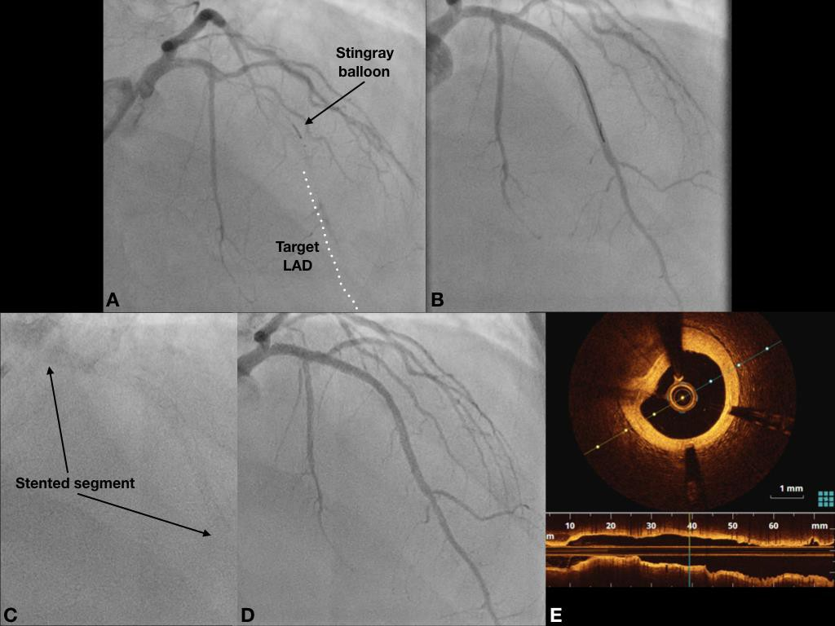
12- month OCT findings

Slide 11
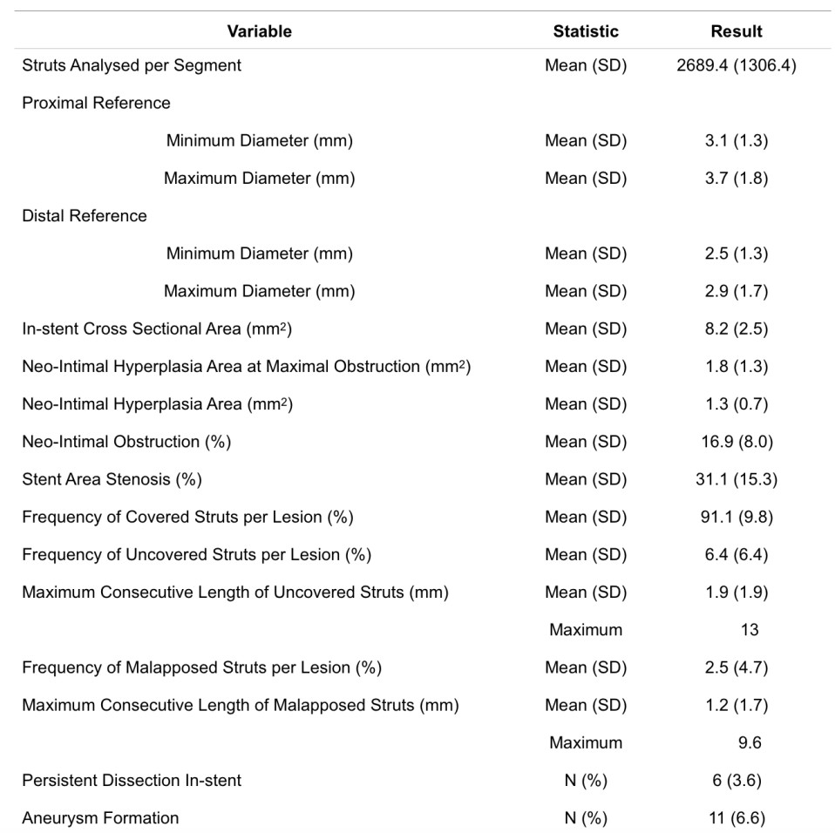
12-month OCT findings (n=167)
High strut coverage (>90%)
Low rates of malapposition (4.7%)
Low persistent dissection (3.6%) despite using blunt dissection in 48% of cases
Low rates of late aneurysm formation

Slide 12
12-month OCT findings
Healing comparable to non-occlusive disease
Neo-intimal layer forms in sub-intimal stented segments
Healing correlates with good clinical outcomes
Side-by-side analysis ongoing with IVUS to correlate confirmed dissection with later OCT

Slide 13
2-year clinical outcomes
Available 206/207 patients (99.5%)
Device oriented primary endpoint - TVF (cardiac death, MI related to target vessel, ischaemia driven revascularization of target vessel)
12-months 5.7% (after CEC re-adjudication on single MI), 24 months 10.0%

Slide 14
2-year clinical outcomes
MACE (all mortality, all MI, TVR) 10% at 12 months, 17% at 24 months
Mortality - 0 cardiac death at 12 months, 1 cardiac death at 24 months
All cause mortality 3 patients at 12 months (1.4%), 9 patients at 24 months
(4.3%)
Where known, cause of death included: cerebrovascular (2), metastatic CA
(2), sepsis, AAA rupture

Slide 15
2-year clinical outcomes
TVR 7.1% at 12 months and 11.9% at 24 months
All MI 1.4% at 12 months and 2.4% at 24 months
Definite ST 1.9% at 12 months and 2.9% at 24 months

Slide 16
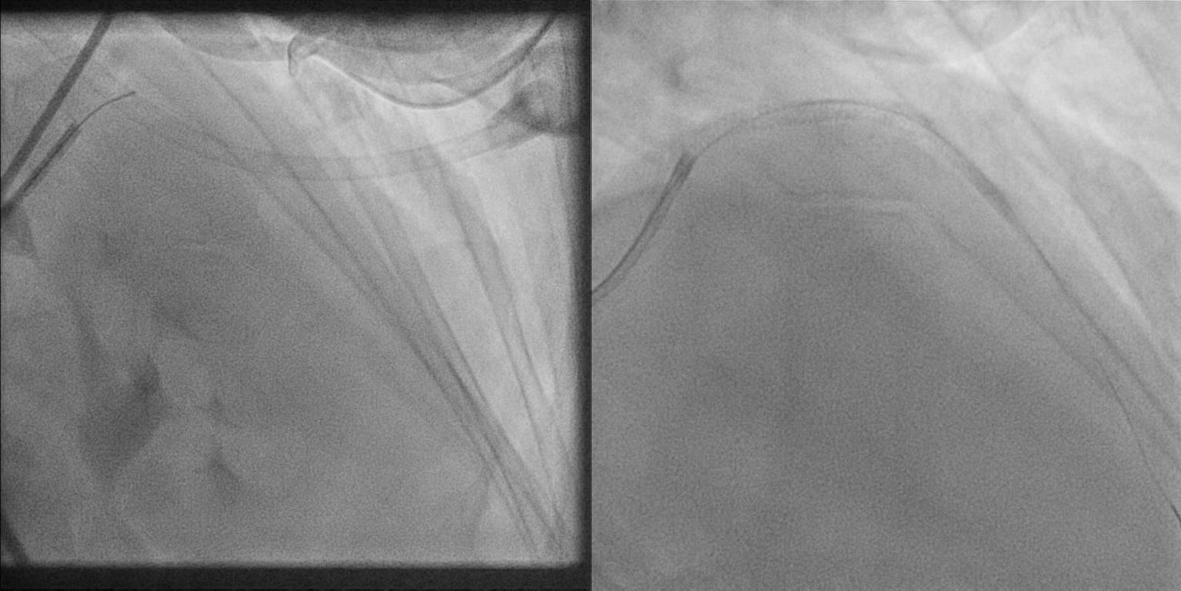
Wire based procedure

Slide 17
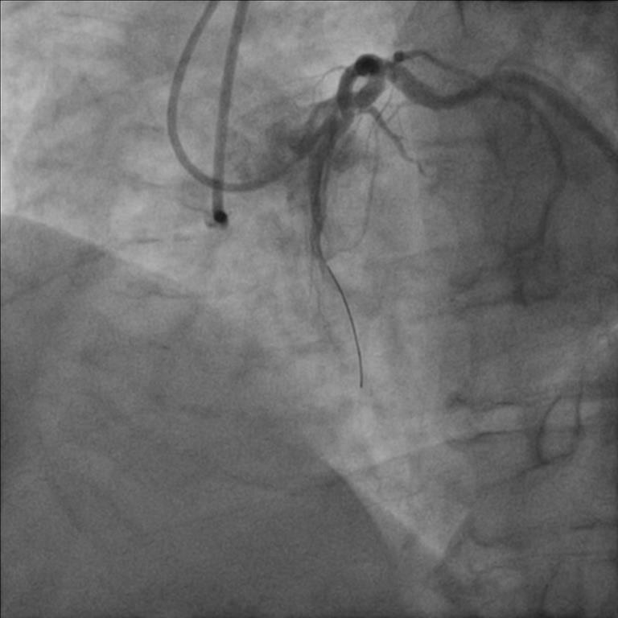
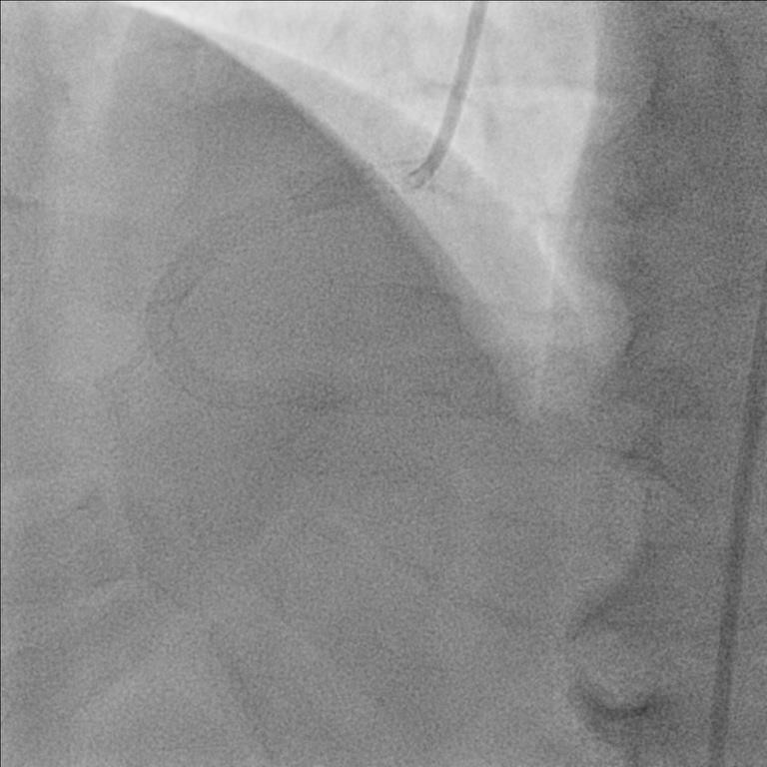
Dissection based procedure

Slide 18
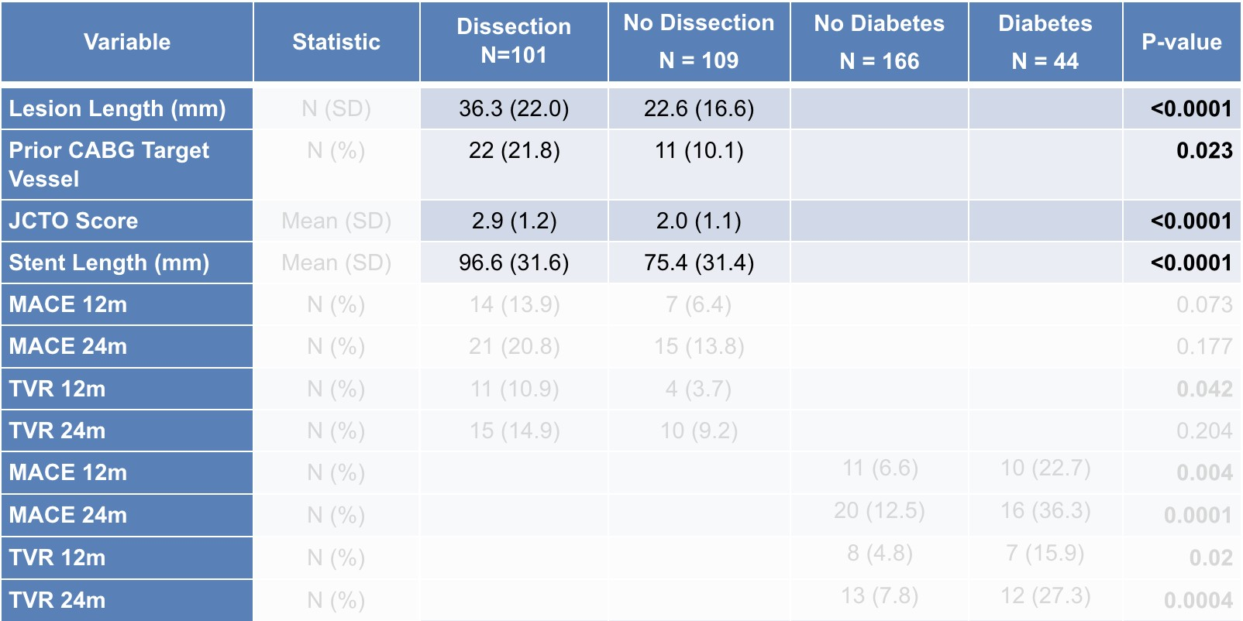
Sub-group analysis

Slide 19
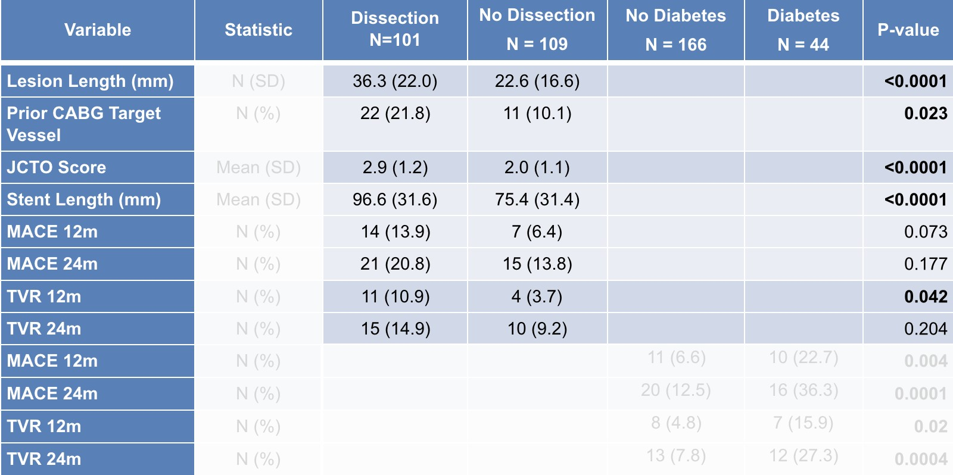
Sub-group analysis

Slide 20
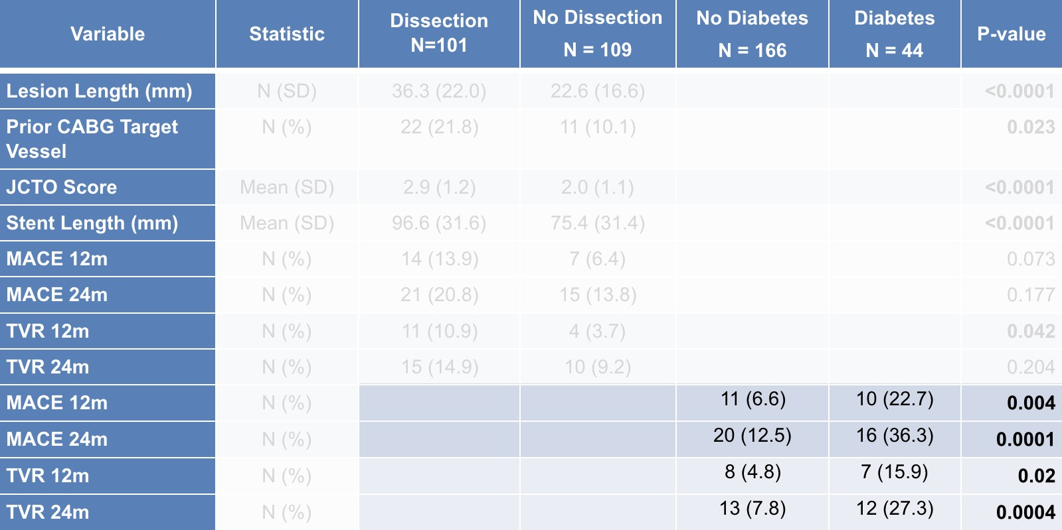
Sub-group analysis

Slide 21
24m MACE in Context
CONSISTENT 17%
Syntax2 13.2%
Matched Syntax1 PCI cohort 21.9%
Matched Syntax1 CABG cohort 15.1%

Slide 22
Conclusions
Intravascular healing is good with modern DES despite vessel
reconstruction
MACE is acceptable for very complex lesions
Diabetes strongest predictor of TVR
Approach does not predict MACE at 2 years

