Slide 1
Mortality prediction using machine learning : insights from the FRANCE-TAVI registry
Pavel OVERTCHOUK
Gilles LEMESLE
Eric VAN BELLE
Christophe BAUTERS
Jean Philippe VERHOYE
Thierry LEFEVRE
René KONING
Pascal MOTREFF
Stefan STORTECKY
Stephan WINDECKER
Thomas PILGRIM
Helene ELTCHANINOFF
Martine GILARD
Pascal LEPRINCE
Bernard IUNG
Hervé LE BRETON
Jean-Philippe COLLET
Thomas MODINE
Pavel Overtchouk
pavel.overtchouk@mail.mcgill.ca
Lille University Hospital, Lille, France

Slide 2
Disclosures
Training grant from European Society of Cardiology
Research grant from Fédération Francaise de Cardiologie

Slide 3
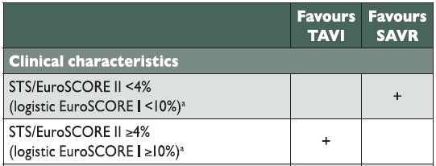
ESC guidelines 2017

Slide 4
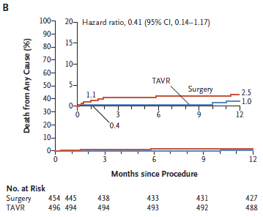
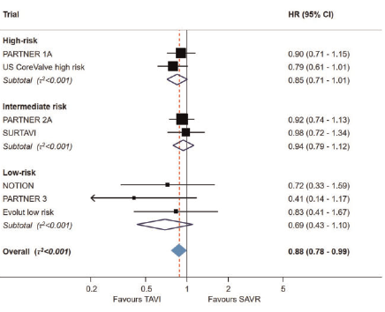
Since the guidelines… low risk trials and all-risk meta-analysis
Evolut Low Risk
Popma et al NEJM 2019
≥ non-inferiority between TAVI and SAVR irrespective of « risk »
PARTNER 3
Mack et al NEJM 2019
Are prediction scores of any use?
Siontis et al EHJ 2019

Slide 5
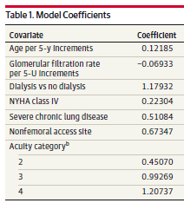
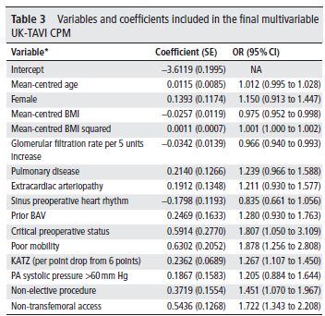
Since the guidelines… TAVI scores
STS/ACC-TVT TAVI score
UK TAVI score
Edwards et al,
JAMA cardiology 2016
Martin et al, Heart 2018

Slide 6
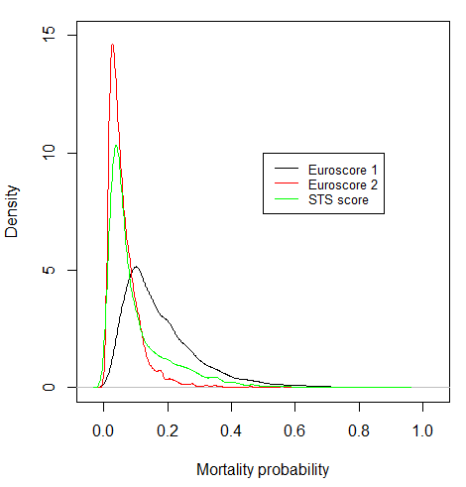
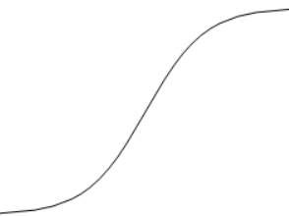
Classical approach
Inflection point = 50%
If survival >>> death:
model tends to predict
the most frequent event
So what could we do?
« Low risk » patients: STS 2%
« High risk » patient: STS 12%

Slide 7
Hypothesis
A machine learning approach can yield a better mortality prediction performance

Slide 8
Objectives
To build a predictive model for in-hospital and 1-year mortality after TAVI using machine learning
To compare its performance to recommended and commonly used surgical scores

Slide 9
Study Settings
France-TAVI (SFC & DGOS) → prediction model construction
Bern TAVI Registry → independent validation cohort

Slide 10
Methods
Database: FRANCE TAVI
Inclusion → multi-centre, French, prospective, registry
Period → January 2013 and December 2015
Mortality outcome → INSEE query on April 12th 2016
Data processing
Missing values → multiple imputation
Outcome event dissymmetry: SMOTE
Machine learning (ML) modeling
Model: shallow neural network
Train =2/3 | test = 1/3 | validation = independent

Slide 11
Study Endpoint
Area under the receiver operating curve (AUC)
Net reclassification improvement (NRI)

Slide 12
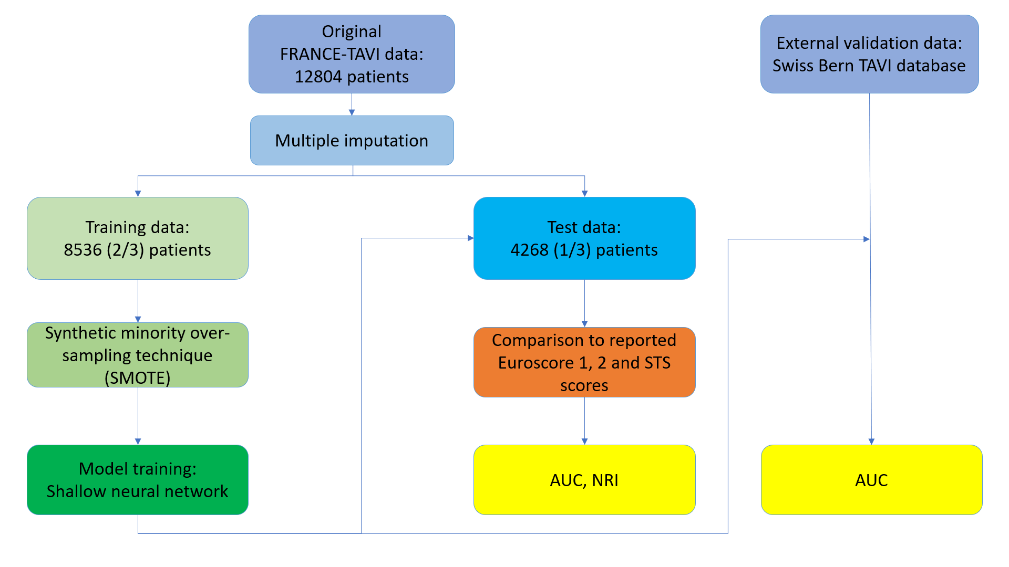
Flow chart
Notes:
colors

Slide 13
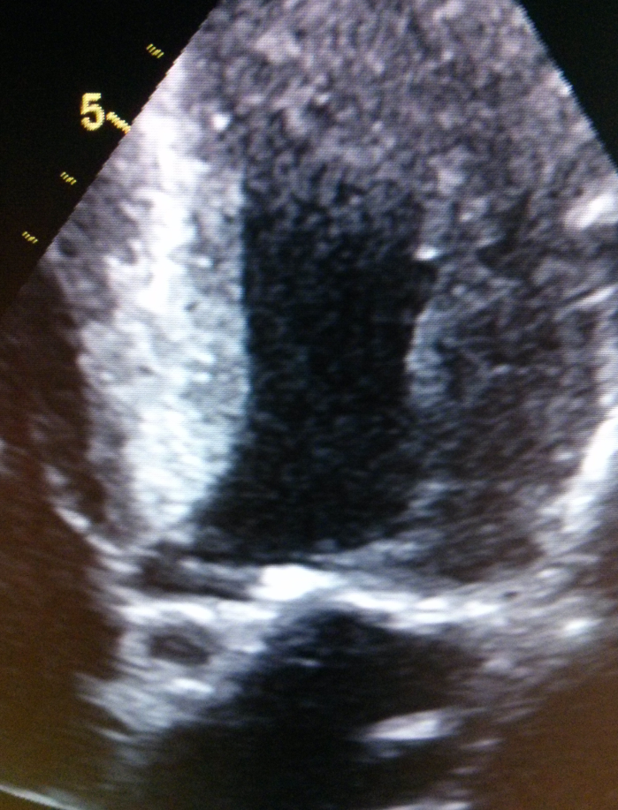
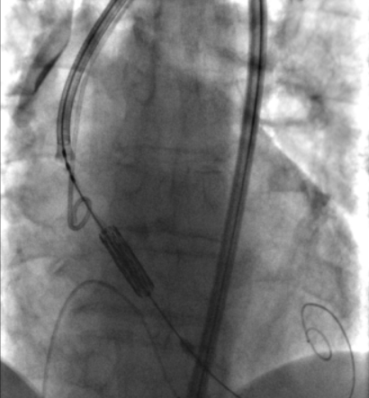
Model
Age
Sex
PAD
Respiratory failure
Cardiac surgery
Diabetes mellitus
Coronary artery disease
Body mass index
Severe reduction of mobility
Cerebrovascular events
Atrial fibrillation
LVEF
Aortic mean gradient
Grade mitral regurgitation
Systolic pulmonary pressure
Grade aortic regurgitation
Patient history
Echocardio-graphy
Shallow
Neural Network
Emergent procedure
TAVI access
Size of the prosthesis
Type of bioprosthesis
NYHA class
Acute pulmonary oedema
Critical pre-operative state
Creatinin
Procedure characteristics
Symptoms and biology

Slide 14
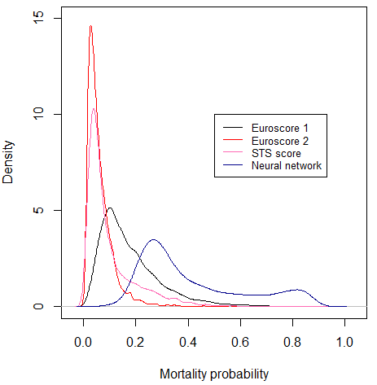
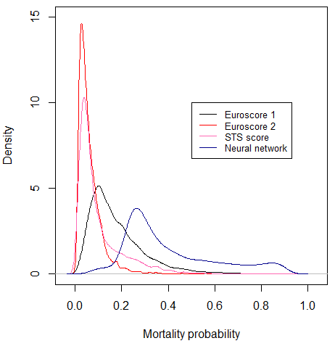
In-hospital mortality
1-year mortality

Slide 15
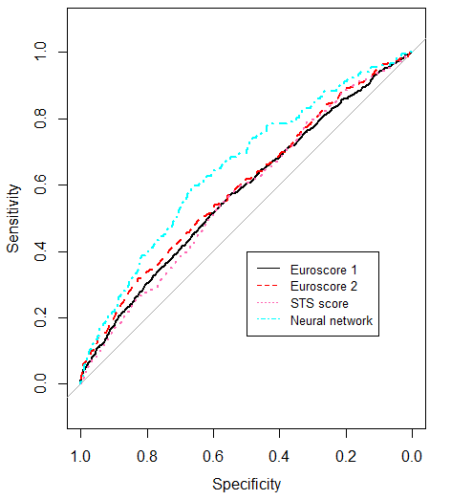
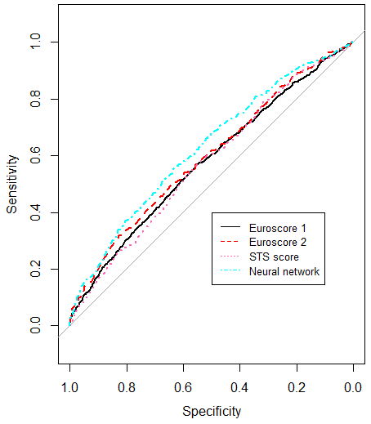
In-hospital mortality
1-year mortality
P<0.05
P<0.05

Slide 16
Results
 | Neural network (NN) | Euroscore 1 | Euroscore 2 | STS score
In-hospital mortality
AUC | 0.65 (0.61-0.70) | 0.58 (0.53-0.62) | 0.60 (0.56-0.63) | 0.57 (0.54-0.61)
P-value for difference with NN | - | 0.005 | 0.048 | 0.005
1-year mortality
AUC | 0.63 (0.60-0.65) | 0.56 (0.53-0.58) | 0.59 (0.56-0.61) | 0.55 (0.53-0.57)
P-value for difference with NN |  | <0.001 | 0.013 | <0.001

Slide 17
Reclassification: in-hospital mortality risk
 | Euroscore 1 | Euroscore 2 | STS score
Net reclassification index | 0.27 (0.18-0.35) | 0.17 (0.04-0.32) | 0.21 (0.06-0.36)
P-value | <0.001 | 0.014 | 0.006
*Tested threshold low versus high risk = 4%

Slide 18
External validation (Bern registry) for the neural network model
 | In-hospital mortality | 1-year mortality
AUC | 0.68 (0.60-0.76) | 0.65 (0.61-0.69)

Slide 19
Discussion
Better AUC with the machine learning approach
Better discrimination of low versus high risk
Better screening of « high risk » ➔ prevention

Slide 20
Limitations
No data → Frailty, biology, imaging, environment

Slide 21
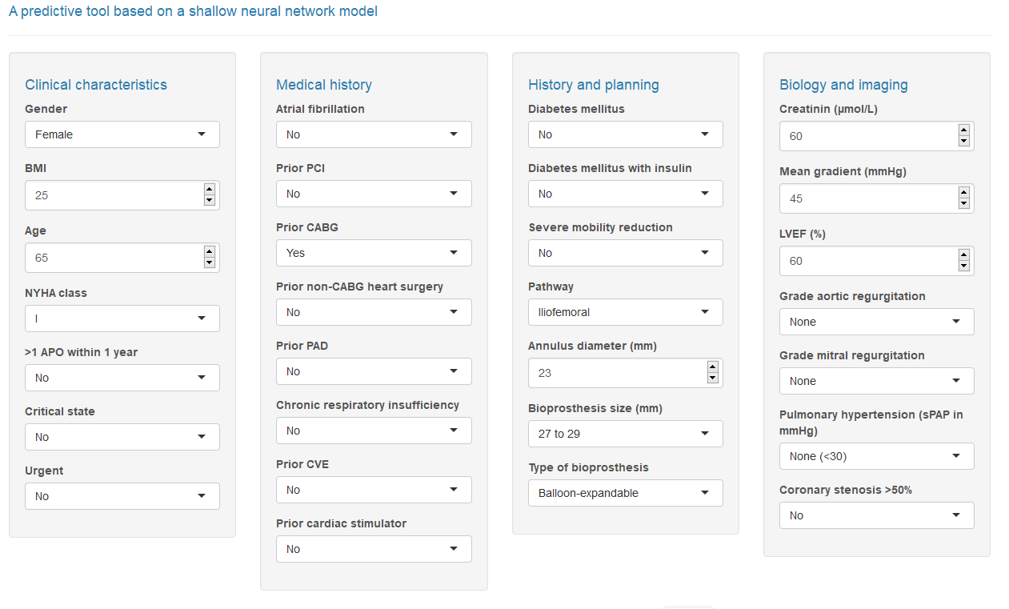
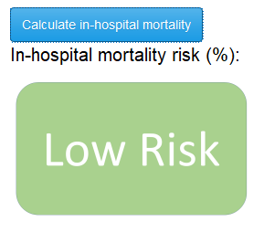
https://tae-calc.shinyapps.io/tae-calc/
%

Slide 22
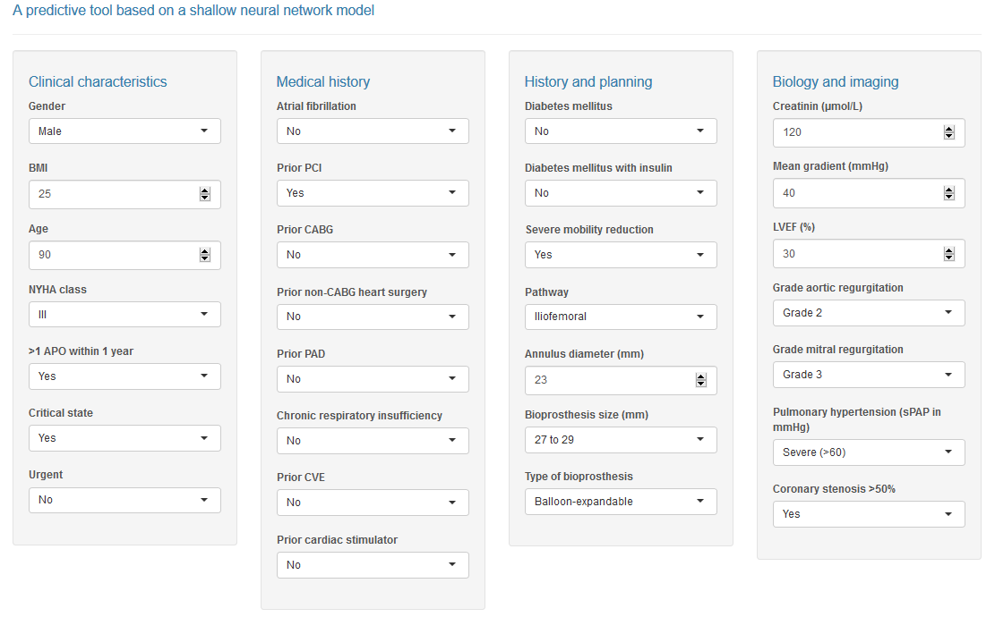
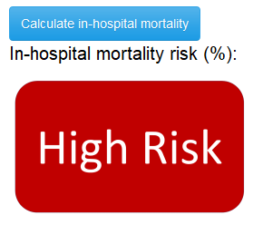
https://tae-calc.shinyapps.io/tae-calc/
%
Notes:
23 mm diameter

