Slide 1
Imaging vs Hemodynamic Assessments for Severity of PVR During TAVR: Factors Influencing Treatment Thresholds
Ted Feldman, M.D., MSCAI FACC FESC
Evanston Hospital
CRT
Cardiovascular Research Technologies
Washington D.C.
March 4-6th, 2018
Notes:
Imaging the Aortic Valve
1:30 PM - 4:00 PM
1:30 PM
Session ModeratorsModerator:Haim Danenberg, MD
Moderator:Howard C. Herrmann, MD, FACC, MSCAI
1:30 PM
Essentials of Echocardiogram Imaging for Transcatheter Aortic Valve ReplacementSpeaker:Zuyue Wang, MD
1:40 PM
Sizing Algorithms for Transcatheter Aortic Valve Implantation with Multiple Detector CTSpeaker:Gaby Weissman, MD
1:50 PM
Assessing Residual Aortic RegurgitationSpeaker:Federico M. Asch, MD
2:00 PM
Getting the Most from CT for TAVRSpeaker:Philipp Blanke, MD
2:10 PM
Imaging Considerations for Optimal Valve-in-Valve Procedures Sizing and Prevention of Coronary ObstructionSpeaker:Danny Dvir, MD
2:20 PM
Multimodality Imaging for Transcatheter Aortic Valve Replacement Thrombosis UpdateSpeaker:Raj Makkar, MD, FSCAI
2:30 PM
How to Deal with Discrepancy Between Imaging Modalities Pre and Post Transcatheter Aortic Valve ReplacementSpeaker:Gaby Weissman, MD
2:40 PM
How to Perform and Analyze a Stress Echocardiogram in Valvular Heart DiseaseSpeaker:Zuyue Wang, MD
2:50 PM
Role of MRI in Procedural Planning and in the Adjudication of PAR SeveritySpeaker:Joao L. Cavalcante, MD
3:00 PM
Imaging Versus Hemodynamic Assessments to Determine the Severity of PVR During TAVR: Factors Influencing Treatment ThresholdsSpeaker:Ted Feldman, MD, MSCAI
3:10 PM
The Changing Face of Bicuspid Aortic Valve Disease – Lessons from MDCTSpeaker:Jeffrey J. Popma, MD, FACC
3:20 PM
Using Imaging to Define the Next Generation of Transcatheter Valve DevicesSpeaker:Hasan A. Jilaihawi, MD
3:30 PM
A New Era in Fusion Imaging for Structural Heart ProceduresSpeaker:Constantino Peña, MD
3:40 PM
Roundtable Discussion with Audience Question&Answer: Imaging the Aortic ValvePanel Moderator:Haim Danenberg, MD
Panel Moderator:Howard C. Herrmann, MD, FACC, MSCAI
Panel:Philipp Blanke, MD
Panel:Danny Dvir, MD
Panel:Hasan A. Jilaihawi, MD
Panel:Raj Makkar, MD, FSCAI
Panel:Constantino Peña, MD
Panel:Jeffrey J. Popma, MD, FACC
Panel:Gaby Weissman, MD
4:00 PM
Adjourn

Slide 2
Ted Feldman MD, MSCAI FACC FESC
Disclosure Information The following relationships exist: Grant support: Abbott, BSC, Cardiokinetics, Corvia, Edwards, WL Gore
Consultant: Abbott, BSC, Edwards, WL Gore
Stock Options: Mitralign
Off label use of products and investigational devices will be discussed in this presentation

Slide 3
VARC 2 Angiographic Assessment
Mild- reflow of contrast in the outflow tract and middle portion of the LV but clearing with each beat
Moderate- reflow of contrast in the whole LV cavity with incomplete washout in a single beat and faint opacification of the entire LV over several cardiac cycles
Severe- opacification of the entire LV with the same intensity as in the aorta and persistence of the contrast after a single beat
J Am Coll Cardiol 2013;62:11–20

Slide 4
Echo grading is imprecise in practice
acute hemodynamic changes during TAVR affect Doppler and color flow assessment
semiquantitative parameters of AR severity, such as jet width, vena contracta, or pressure half-time, are best applied in central jets
not ideal for quantification of the eccentric, circumferential PAR jets seen in patients with TAVR
acoustic shadowing by the prosthesis and native calcification also may obscure PAR jets
holodiastolic flow reversal in the descending Ao identifies >mild AR sensitivity 86% & rules out significant AR specificity 92%
J Am Coll Cardiol 2013;62:11–20

Slide 5
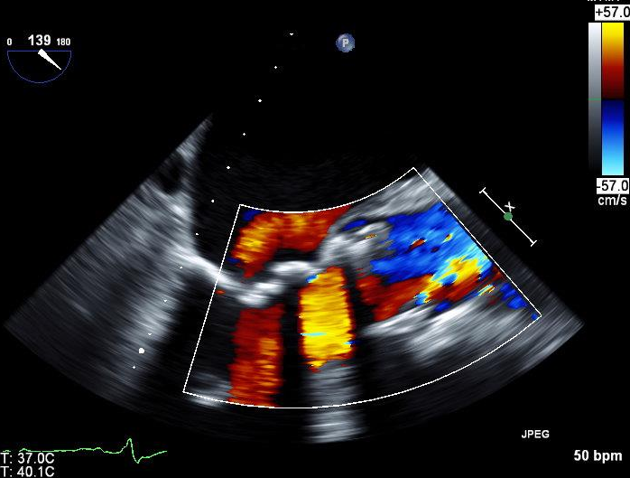
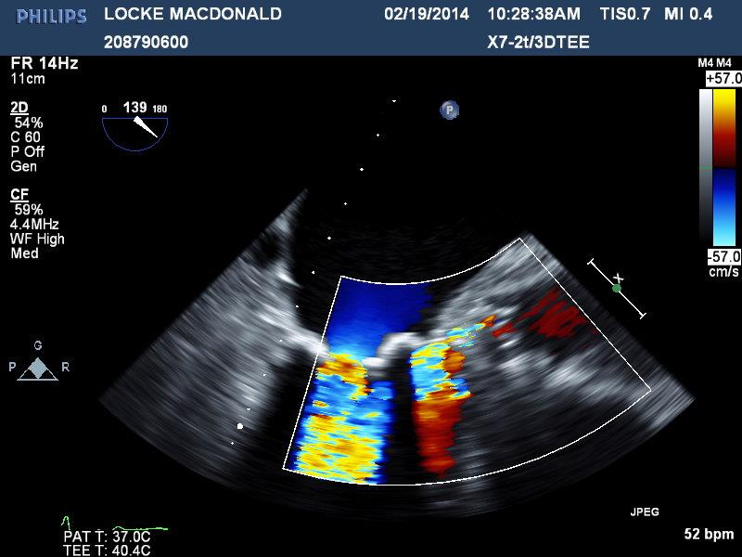
Shadowing

Slide 6
AR Index in a Patient with Moderate PVL
AoP_{sys} 120 mmHg
RAoP_{dia} 40 mmHg
LVEDP 20 mmHg
Aortic Regurgitation Index = [(AoP_{dia} – LVEDP) / AoP_{sys}] x 100
= [(40 – 20) / 120] x 100 = 16.7
Sinning et al, JACC 2012;59:1134-41
Notes:
After deploymemt of a THV, the severity of PAR can be assessed by the Aortic Regurgitation Index, which we introduced recently. This index is calculated according to the formula: diastolic blood pressure in the aorta minus LVEDP over systolic BP in the aorta multipied by 100.
In this example, the patient had moderate PAR after TAVI with a low transvalvular gradient reflected by an AR index of 16.7.

Slide 7
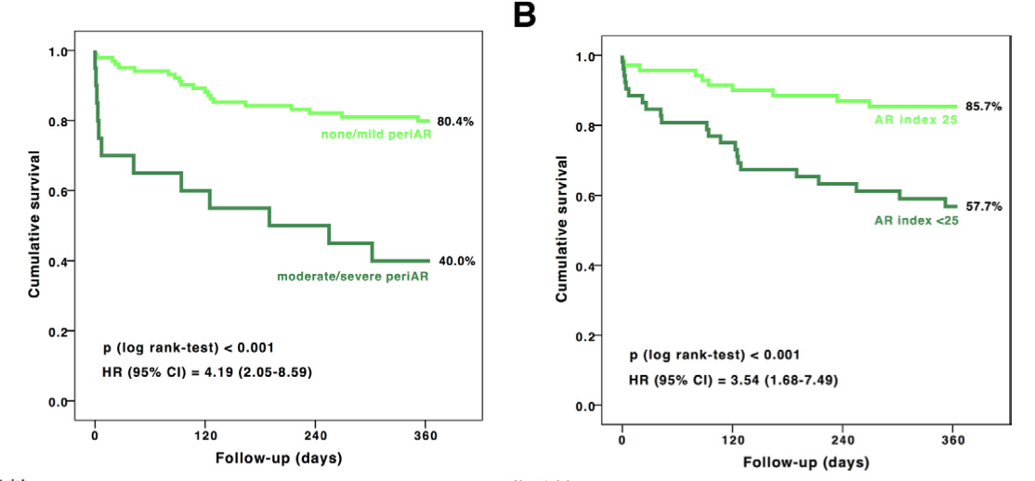
Impact of Paravalvular Leakage on Outcome in Patients After TAVI Validation of the AR Index
J Am Coll Cardiol Intv 2012;5:858–65
Notes:
The aim of this study was to evaluate the performance of the aortic regurgitation (AR) index as a new hemodynamic parameter in an independent transcatheter aortic valve implantation (TAVI) cohort and validate its application.
Background Increasing evidence associates more-than-mild periprosthetic aortic regurgitation (periAR) with increased mortality and morbidity; therefore precise evaluation of periAR after TAVI is essential. The AR index has been proposed recently as a simple and reproducible indicator for the severity of periAR and predictor of associated mortality.
Methods The severity of periAR was evaluated by echocardiography, angiography, and periproce- dural measurement of the dimensionless AR index 􏰄 ([diastolic blood pressure 􏰃 left ventricular end-diastolic pressure]/systolic blood pressure) 􏰇 100. A cutoff value of 25 was used to identify pa- tients at risk.
Results One hundred twenty-two patients underwent TAVI by use of either the Medtronic Cor- eValve (Medtronic, Minneapolis, Minnesota) (79.5%) or the Edwards-SAPIEN bioprosthesis (Edwards Lifesciences, Irvine, California) (20.5%). The AR index decreased stepwise from 29.4 􏰆 6.3 in patients without periAR (n 􏰄 26) to 28.0 􏰆 8.5 with mild periAR (n 􏰄 76), 19.6 􏰆 7.6 with moderate periAR (n 􏰄 18), and 7.6 􏰆 2.6 with severe periAR (n 􏰄 2) (p 􏰀 0.001). Patients with AR index 􏰀25 had a significantly increased 1-year mortality rate compared with patients with AR index 􏰈25 (42.3% vs. 14.3%; p 􏰀 0.001). Even in patients with none/mild periAR, the 1-year mortality risk could be further stratified by an AR index 􏰀25 (31.3% vs. 14.3%; p 􏰄 0.04).
Conclusions The validity of the AR index could be confirmed in this independent TAVI cohort and provided prognostic information that was complementary to the severity of AR.

Slide 8
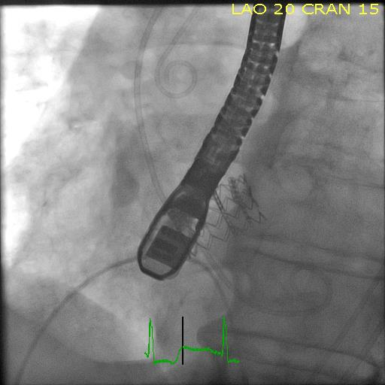
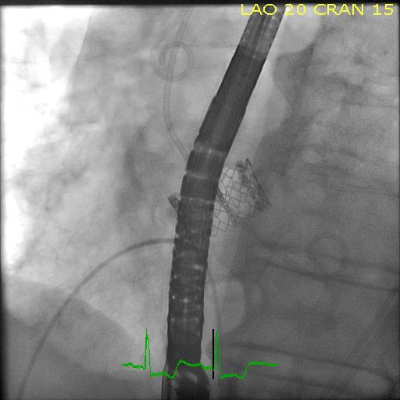

Slide 9
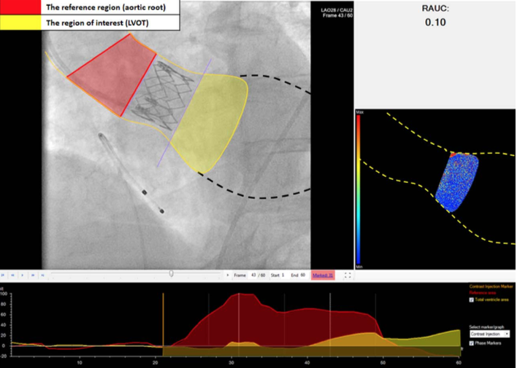
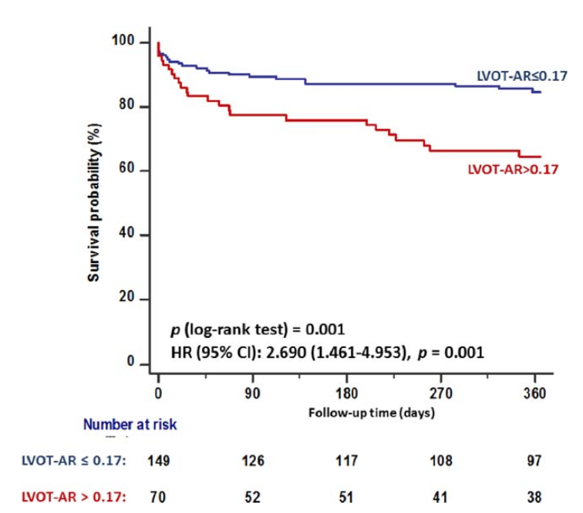
Angiographic Assessment of Aortic Regurgitation by Video-Densitometry in the Setting of TAVI: Echocardiographic and Clinical Correlates
LVOT is interrogated as a region of interest (yellow), aortic root serves as reference region (red). Time–density curves (lower) and color-weighted contrast time–density map (right) are generated. The relative area under the time–density curve (RAUC) of the region of interest as a fraction of that of the reference region is computed (0.10 in this case).
patients with LVOT-AR > 0.17 demonstrated a higher incidence of mortality
n=228
Abdelghani M. Catheterization and Cardiovascular Interventions 2017
Notes:
We sought to investigate a new angiographic method for aortic regurgita- tion (AR) severity assessment in the setting of transcatheter aortic valve implantation (TAVI). Background: AR after TAVI is common but challenging to quantitate, especially in the cath-lab. Methods: In 228 patients, AR was quantitated before and after TAVI by echocardiography and by video-densitometric analysis of aortograms. Contrast time– density curves for the aortic root (the reference region) and the left ventricular outflow tract, LVOT were generated. LVOT-AR was calculated as the area under the curve of the LVOT as a fraction of the area under the curve of the reference region. Results: LVOT-AR was 0.10 6 0.08, 0.13 6 0.10 and 0.28 6 0.14 in none-trace, mild and moderate-severe post-TAVI AR as defined by echocardiography (P < 0.001) and a cut- point of >0.17 corresponded to moderate-severe AR on echocardiography (area under the curve 5 0.84). At follow-up (median, 496 days), patients with LVOT-AR 0.17 showed a significant reduction of LV mass index (LVMi; 121 [95–148] vs. 140 [112– 169] g/m2, P 5 0.009) and the prevalence of LV hypertrophy (LVH; 64 vs. 88%, P 5 0.001) compared to baseline. In patients with LVOT-AR > 0.17, LVMi (149 [121–178] vs. 166 [144–188] g/m2, P 5 0.14) and the prevalence of LVH (74 vs. 87%, P 5 0.23) did not show a significant change. Compared to patients with LVOT-AR 0.17, those with LVOT-AR > 0.17 had an increased 30-day (16.4% vs. 7.1%, P 5 0.035) and one year mortality (32.9 vs. 14.2%, log rank P value 5 0.001; HR: 2.690 [1.461–4.953], P 5 0.001). Conclusions: LVOT-AR > 0.17 corresponds to greater than mild AR as defined by echocardiography and predicts impaired LV reverse remodeling and increased early
INTRODUCTION
Brazilian multicenter TAVI registry. List of participat- ing centers, details of inclusion and exclusion criteria, TAVI-procedure technical aspects, and adjudication of adverse events have been previously described [13]. The study protocol has been approved by the ethical committee at each of the participating centers and all patients provided informed written consent. All patients had postimplantation aortic root angiography and were scheduled for TTE during the same admission for the index procedure (predischarge TTE) and for planned follow-up at 6 and 12 months and annually thereafter.
Angiography
Aortic root angiography was performed before and, at least 10 min, after valve implantation in the same projection as the preprocedural aortogram. Aortography was performed using a nonionic contrast injected through a pigtail catheter positioned above the pros- thetic valve (in case of a balloon-expandable device) or within the distal third of the prosthetic valve (in case of a self-expanding device). Out of 399 aorto- grams, 61 aortograms were unreliable for determination of AR severity due to disturbance of the valve compe- tence by a guide wire/catheter during acquisition.
Videodensitometric Analysis of Aortographic Data
VD analysis was performed using a dedicated soft- ware (CAAS A-Valve 2.0.2: Pie Medical Imaging, Maastricht, The Netherlands) where a contour is drawn to include the contrast-filled aortic root (which serves as the reference region) and the left ventricular outflow tract (LVOT) which serves as the region of interest (ROI) (Fig. 1). Contrast time–density curves (TDCs) are generated for the reference region and for the ROI through weighing the summated pixel density against time. The relative area under the curve (RAUC) is cal- culated as the area under the TDC of the ROI as a fraction of the area under the TDC of the reference region. RAUC is averaged over the first three cardiac cycles after the start of contrast arrival at the aortic root after subtracting the static background radioden- sities. RAUC has a theoretical range of zero (indicating no contrast leaking to the ROI) to one (indicating that the density of contrast in the ROI is exactly the same as that in the reference area). Further technical
and midterm mortality after TAVI.

Slide 10
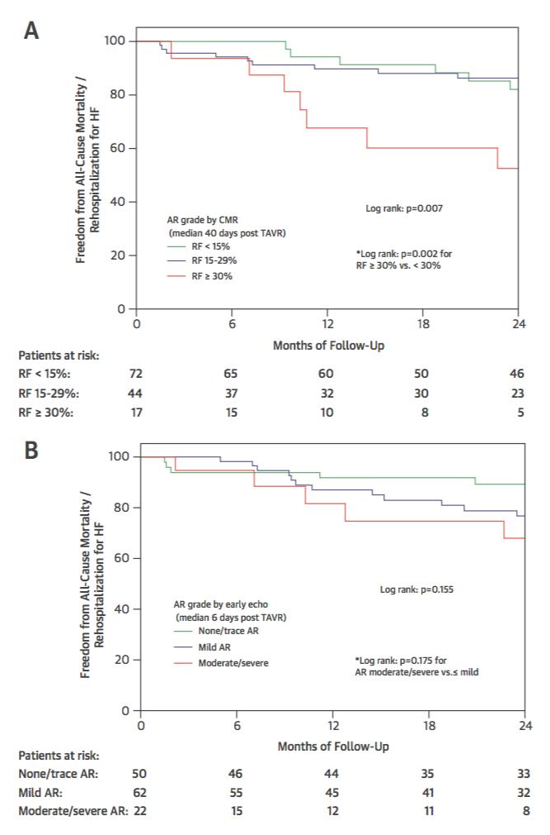
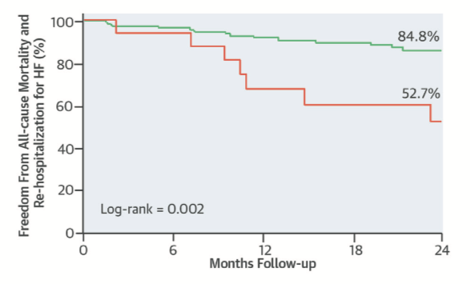
MRI to evaluate AR after TAVR
MRI
MRI
CMR performed a median of 40 days post-TAVR had a greater association with post-TAVR clinical events vs early TTE (p < 0.01)
RF 30% best predicted poorer clinical outcomes (p < 0.001)
TTE
Ribeiro, H.B. et al. J Am Coll Cardiol. 2016;68(6):577–85
Notes:
We included 135 patients from 3 centers. AR was quantified using regurgitant fraction (RF) measured byphase-contrast velocity mapping CMR at a median of 40 days post-TAVR, and using Doppler echocardiography at amedian of 6 days post-TAVR. Median follow-up was 26 months. Clinical outcomes included mortality and rehospitali-zation for heart failure.
RESULTSModerate-severe AR occurred in 17.1% and 12.8% of patients as measured by echocardiography and CMR,respectively. Higher RF post-TAVR was associated with increased mortality (hazard ratio: 1.18 for each 5% increase in RF[95% confidence interval: 1.08 to 1.30]; p<0.001) and the combined endpoint of mortality and rehospitalization for heartfailure (hazard ratio: 1.19 for each 5% increase in RF; 95% confidence interval: 1.15 to 1.23; p<0.001). Prediction modelsyielded significant incremental predictive value; CMR performed a median of 40 days post-TAVR had a greater associationwith post-TAVR clinical events compared with early echocardiography (p<0.01). RF$30% best predicted poorer clinicaloutcomes (p<0.001 for either mortality or the combined endpoint of mortality and heart failure rehospitalization).

Slide 11
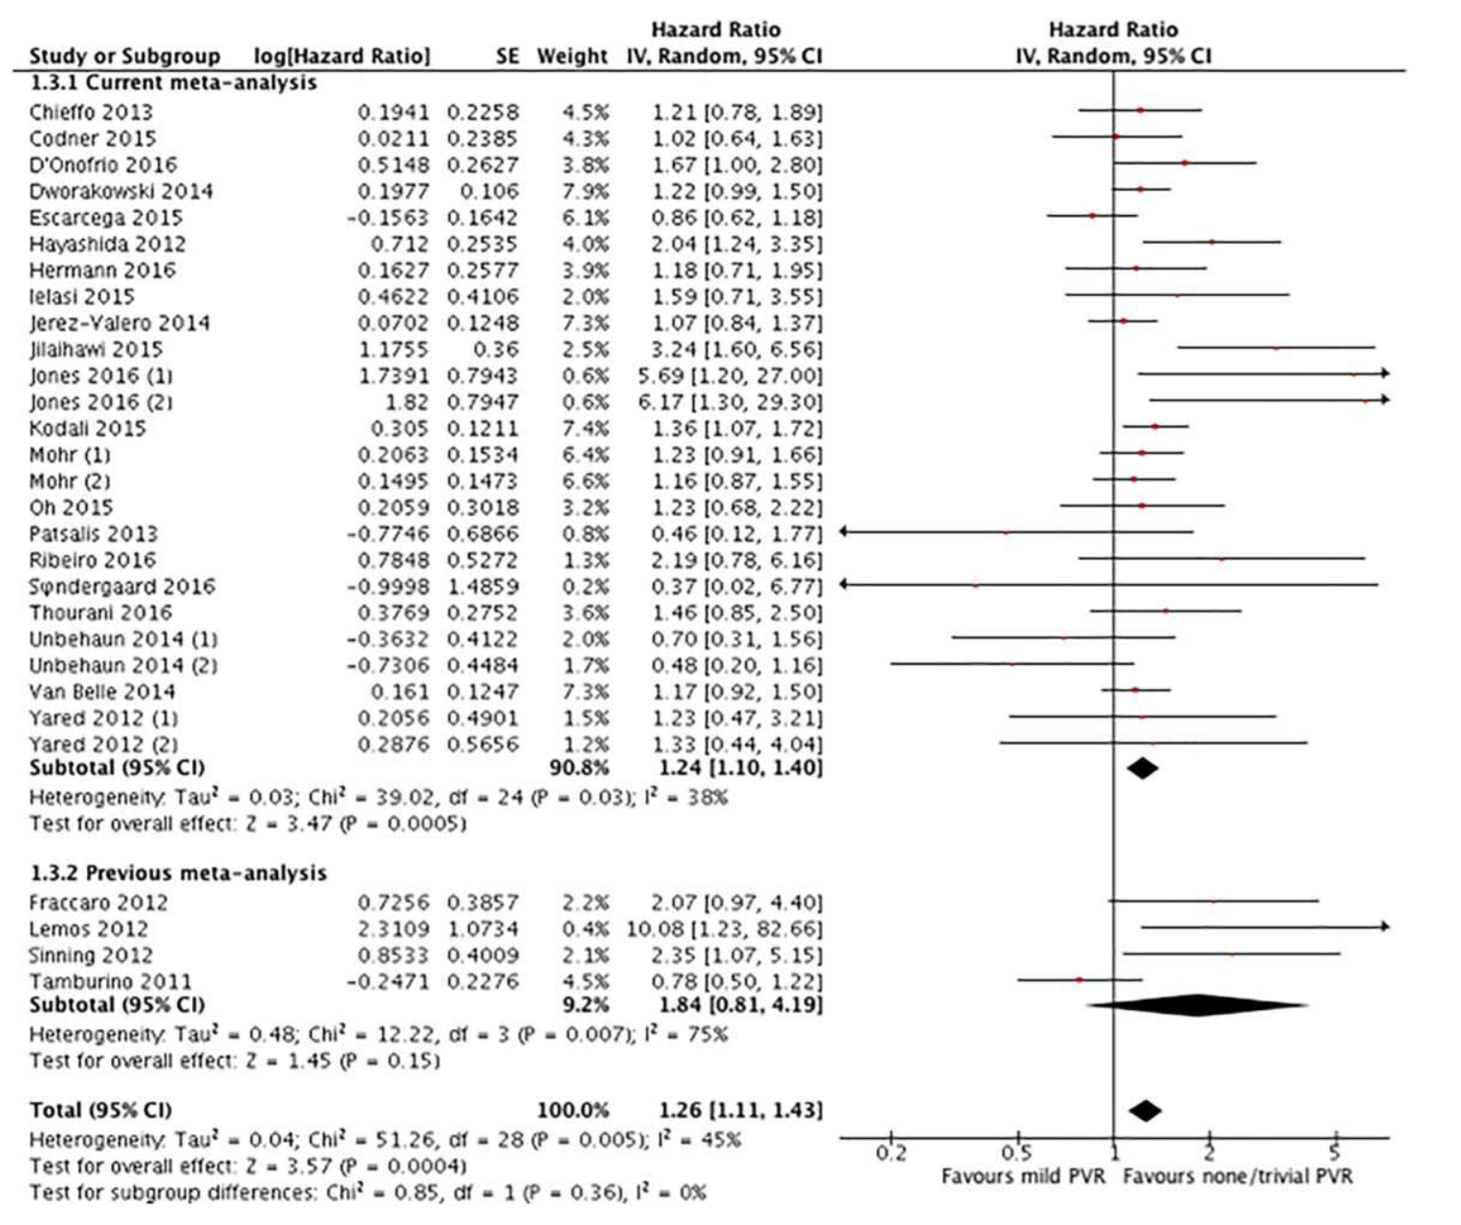
Mild PVL after TAVR: A meta-analysis
25 articles including 21,018 patients
Favors MILD PVL Favors NONE/trivial PVL
Catheter Cardiovasc Interv. 2018;91:135–147
Notes:
A systematic literature search was conducted through PUBMED andEMBSE. Manuscripts that reported hazard ratio (HR) with 95% confidence interval (CI) for clinicaloutcome of interest (all-cause and cardiac mortality) has been included. Random-effects modelwas used for calculation of HR. A total of 25 articles including total of 21,018 patients were finallyincluded for quantitative synthesis (meta-analysis). Our pooled analysis demonstrated higher all-cause mortality in patients with mild PVR compared to none/trivial PVR (HR 1.26, 95%CI 1.11–1.43,I2545%,p<0.001) (follow up duration range 6 months to 5 years). Significant heterogeneityamong studies was observed (pfor heterogeneity50.005). Egger’s test showed no evidence ofpublication bias. Cardiovascular mortality was increased in patients with mild PVR compared withnone/trivial PVR (HR 1.28, 95%CI 1.05–1.57,I258%,p50.02) (follow up duration range 1–3years).
Conclusions:Mild PVR was associated with increased all-cause and cardiovascular mortality afterTAVI. Whether further interventions in mild PVR is of benefit, has yet to be determined.

Slide 13
1 Month Moderate & Severe Paravalvular Leak Echo Core Lab Adjudicated Clinical Trials
% Patients with Mod/Severe PVL
Next Gen TAVR Devices
 | SAPIEN XT PARTNER II, Inop¹ | SAPIEN PARTNER II Inop¹ | CoreValve ADVANCE² | CoreValve Extreme Risk³ | CoreValve High Risk⁴ | TVT 2013 | TVT 2014 | Portico CE Study⁵ | SAPIEN 3⁶ | Direct Flow DISCOVER⁷ | LOTUS REPRISE II & EXT⁸
 | N=236 | N=225 | N=639 | N=418 | N=390 | N=9039 | N=12785 | N=75 | N=150 | N=100 | N=250
¹Leon M, ACC 2013, ²Linke A, PCR 2014. ³Popma J, JACC 2014; 63(19): 1972-81, ⁴Adams D, N Engl J Med 2014; 370: 1790-98,
⁵Manoharan, et al. TCT 2014. ⁶Webb J, EuroPCR 2014. ⁷Schofer, JACC 2013. ⁸Meredith I, London Valves 2014

Slide 14
Predictors of Paravalvular Regurgitation After TAVR Using SAPIEN 3
n=281
Kaneko H. Am J Cardiol 2017;119:618e622
Notes:
Paravalvular regurgitation (PVR) is a common and serious complication after transcatheter aortic valve implantation (TAVI). New-generation balloon-expandable SAPIEN 3 has an outer sealing skirt to minimize PVR. However, the predictors of PVR after SAPIEN 3 transcatheter heart valve (THV) implantation have not been well investigated. We sought to clarify the determinants of PVR after TAVI using SAPIEN 3 with quantitative multi- detector computed tomography (MDCT) assessment. This study analyzed 281 patients with severe symptomatic aortic stenosis who underwent TAVI using SAPIEN 3. Quantitative assessment of aortic root dimensions and calcium volume for leaflet, annulus, and left ventricular outflow tract were retrospectively performed with MDCT. MDCT nominal area oversizing was calculated using the following formula: % oversizing [ (THV nominal area/ MDCT derived annular area L 1) 3 100. Logistic regression analysis was performed to determine the predictors of PVR greater than or equal to mild. PVR greater than or equal to mild was observed in 19% (53 of 281). Quantity and asymmetry of aortic valve calcium of annulus, left ventricular outflow tract, and leaflet were associated with higher incidence of PVR greater than or equal to mild, except leaflet asymmetry. Lower percentage of THV oversizing was also associated with PVR. Multivariable logistic regression analysis showed that larger calcification volume of annulus and lower percentage of THV oversizing were independent predictors of PVR greater than or equal to mild. These results suggest that prosthesis/annulus incongruence and aortic annulus calcification predicted PVR greater than or equal to mild after TAVI using SAPIEN 3.

Slide 15
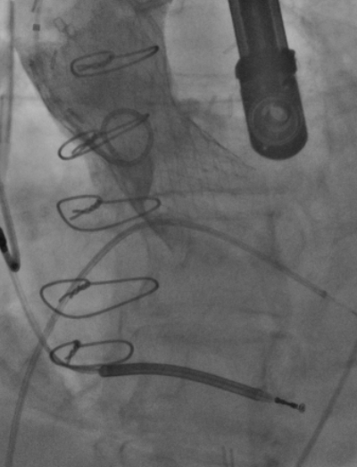
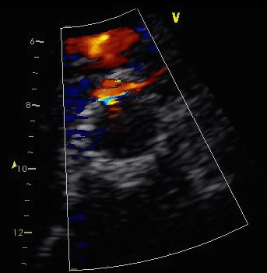
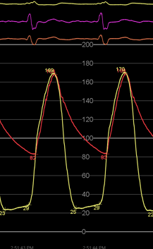
Assessment of Post-Procedural AR:
Requires agreement of three assessment tools
Angiogramm
Echocardiography
Hemodynamics
Notes:
15

Slide 16
Aortic Regurgitation Index
ARI= (AoDias-LVEDP/AoSys)x100
Ao
LV
Baseline HR 52bpm ARI 29
Post TAVR HR 71 ARI 11
Ali O, Salinger MH, Levisay JP, Feldman T:
High pacing rates for management of aortic insufficiency after balloon aortic valvuloplasty or transcatheter aortic valve replacement. Cathet Cardiovasc Intervent 83:162-168, 2014
Notes:
ARI= (AoDias-LVEDP/AoSys)x100
Sinning JM, Hammerstingl C, Vasa-Nicotera M, Adenauer V, Lema Cachiguango SJ, Scheer AC, Hausen S, Sedaghat A, Ghanem A, Müller C, Grube E, Nickenig G, Werner N. Aortic regurgitation index defines severity of peri-prosthetic regurgitation and predicts outcome in patients after transcatheter aortic valve implantation. J Am Coll Cardiol. 2012 Mar 27;59(13):1134-41.

Slide 17
Low profile vascular plugs for paravalvular leaks after TAVR
AI severity was graded by multiple methods. Holodiastolic flow reversal was seen at the level of the proximal descending aorta was seen in all cases by TEE at the time of the procedure and at the level of the proximal descending aorta and the abdominal aorta on preprocedure transthoracic echocardiography (TTE). Velocity time integrals of forward systolic and reversed diastolic flow were compared and were consistent in all cases with at least 3+ AI. Pressure half time was less than 250 msec in all cases. The circumferential length was >10 mm (>15% of stent circumferential length) in all cases indicative of at least moderate AI.
The decision to intervene with a vascular plug was made on the basis of the coexistence of PVL with symptoms of LV failure.
Feldman T, Salinger MH, Levisay JP, Smart S
Catheterization and Cardiovascular Interventions 83:280–288 (2014)

Slide 18
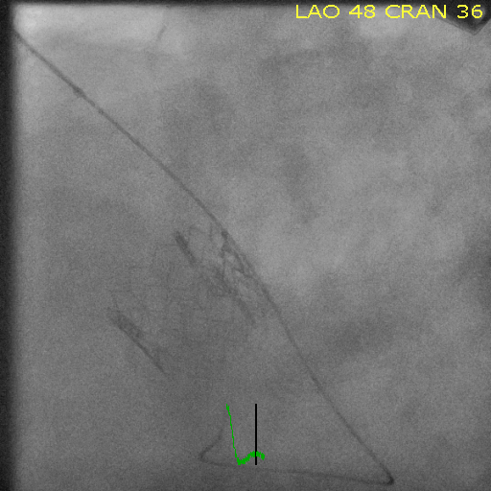
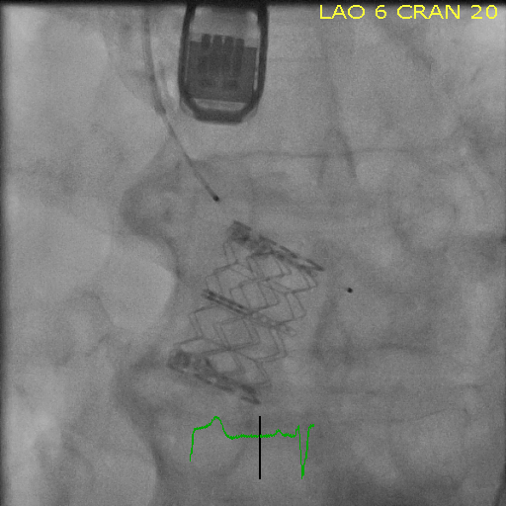
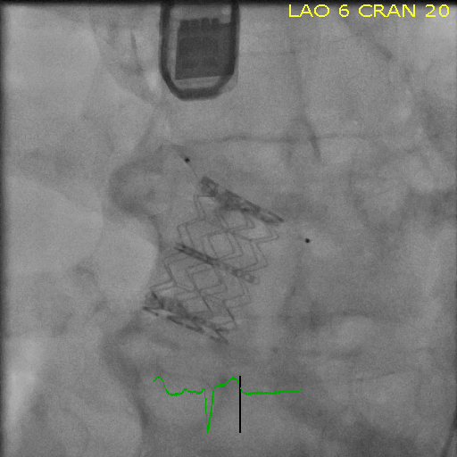

Slide 19
Pre AVP: ARI=26 Post AVP: ARI=33
Feldman T, Salinger MH, Levisay JP, Smart S: Low profile vascular plugs for paravalvular leaks after TAVR.
Cathet Cardiovasc Intervent 2014 Feb 1;83(2):280-8.
Notes:
Case 5- Ryan
Figure 7: The aortic regurgitation index (ARI) before and after placement of an AVP for PVL from patient 5 (Table 1). On the left, the baseline ARI was 26. On the right, after reduction of the PVL from severe to trace, the ARI has increased to 33.

Slide 20
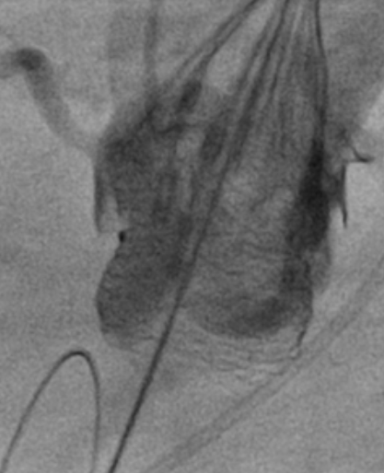
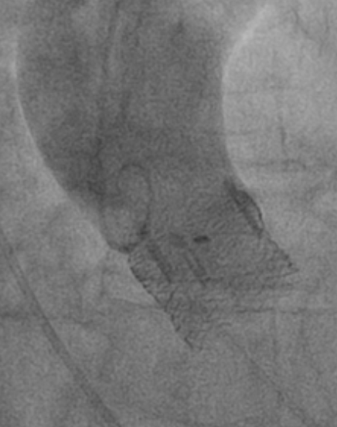
Repositioning to Resolve PVL
1st Position Reposition

Slide 21
PVL post-TAVI vs PVL post-SAVR at 30 days
Mod/Severe PVL
Mild PVL
Standard of Care:
SAVR Arms of
TAVI Trials
TAVI Clinical Trials
and Registries
% Patients with PVL
0.3
 | PARTNER SAVR¹ | CoreValve HR SAVR² | P2A SAVR³ |  | EVOLUT R US Study⁴ | EVOLUT R CE Mark⁵ | SAPIEN 3 S3HR & S3i^{†6} | SAPIEN XT P2A^{†7} | Direct Flow DISCOVER⁸ | LOTUS RESPOND*⁹ | LOTUS REPRISE II/II EXT¹⁰
 | N=179 | N=307 | N=801 |  | N=228 | N=58 | N=1504 | N=872 | N=81 | N=996 | N=177
*7d/Discharge; 30d angiography not mandated per protocol. †Intermediate risk patient population. Results from different studies are not directly comparable. Information provided for educational purpose only. ¹Leon, NEJM 2012 Supp. Appendix. ²Adams, NEJM 2014 Suppl. Appendix. ³Thourani, Lancet 2016 Suppl. Appendix. ⁴Popma TCT 2016. ⁵Manoharan, JACC 2015. ⁶Kodali , ACC 2015. ⁷Leon NEJM 2016. ⁸Lefevre T, JACC:CI 2016;9:68-75. ⁹Falk V, PCR 2016. ⁷⁰Meredith, PCR LV 2014.

