Slide 1
FFR_{angio} Accuracy vs. STandard FFR:
Results from the FAST-FFR Trial
William F. Fearon, MD
On Behalf of the FAST-FFR Study Investigators

Slide 2
Disclosure Statement of Financial Interest
Within the past 12 months, I or my spouse/partner have had a financial interest /arrangement or affiliation with the organization(s) listed below
Affiliation/Financial Relationship Institutional Grant/Research Support: Consulting Fees/Honoraria:
Major Stock Shareholder/Equity Interest: Royalty Income:
Ownership/Founder: Salary:
Intellectual Property Rights: Other Financial Benefit:
Company
Abbott, Medtronic, CathWorks, Boston Scientific
Stock Options HeartFlow

Slide 3
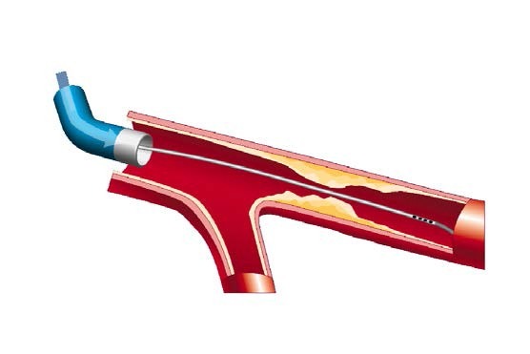
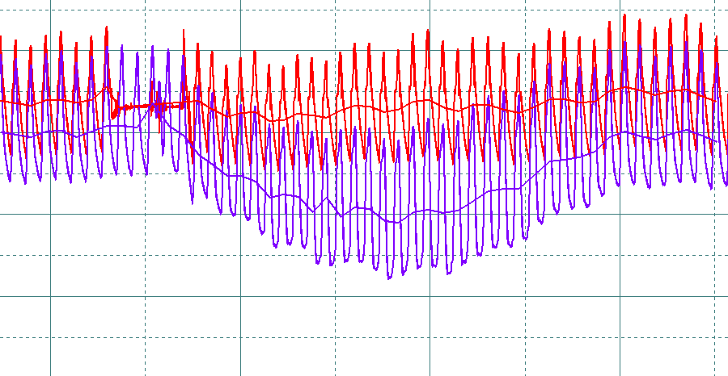
Fractional Flow Reserve
Proximal Pressure (Pa)
Distal Pressure (Pd)
FFR = P_{d} / P_{a}
during maximal flow
P_{a}
P_{d} / P_{a} = 60 / 100 FFR = 0.60
P_{d}

Slide 4

















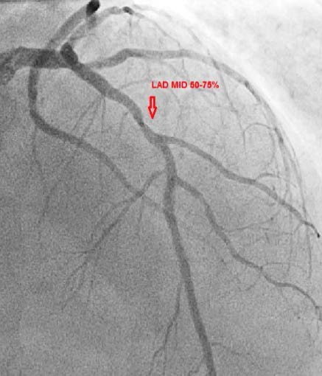
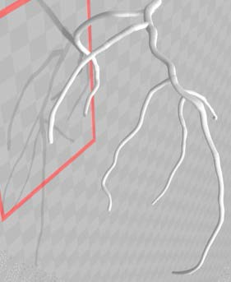
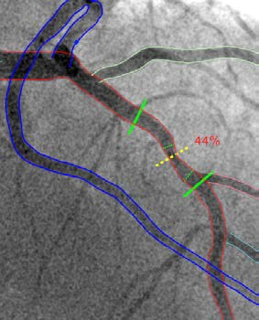
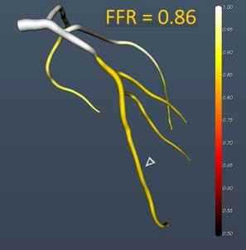
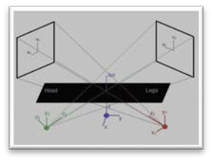
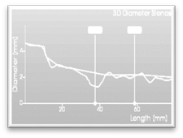
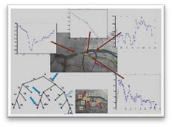








^{FFR}angio
1
2
3
4
Optimal 2D angiography
3D model reconstruction
Stenosis assessment
Hemodynamic evaluation
Optimal projections Optimal frame Motion compensation
Extracting centerlines Tree topology
Bifurcation analysis 2D-QCA analysis Estimating diameters
Resistance mapping Maximum blood flow Flow rate ratio

Slide 5
Methods
Objective
The FAST-FFR study is a prospective, multicenter, international trial comparing the accuracy of on-site FFR_{angio} with pressure wire-derived FFR.

Slide 6
Methods
Co-Primary Endpoints
Sensitivity & Specificity of FFR_{angio} as compared with pressure wire-derived FFR using a cutoff value ≤ 0.80.
Powered to meet the lower bound of the 95% CI for pre- defined performance goals set at:
  Sensitivity = 0.70
  Specificity = 0.75

Slide 7
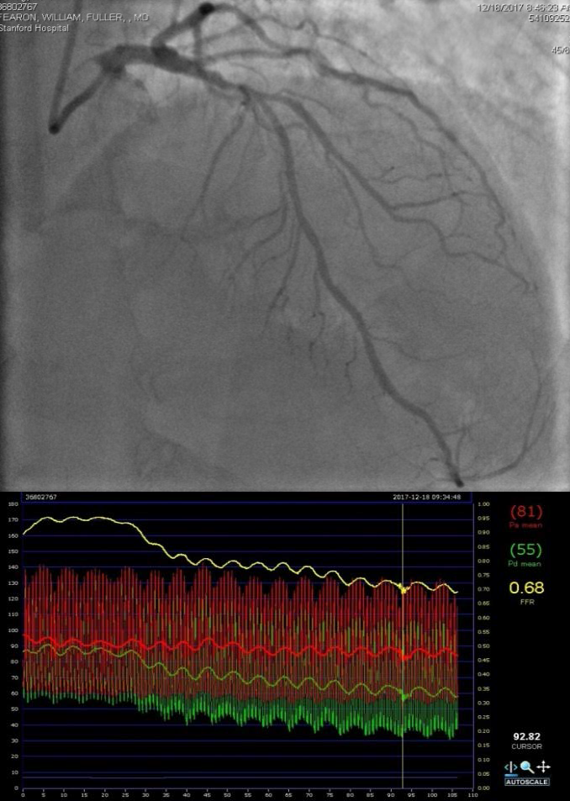
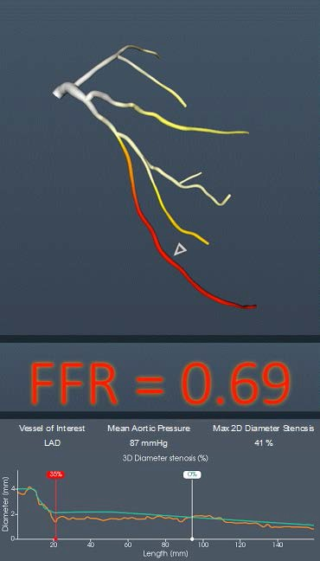
FFR and FFR_{angio} Case Example
FFR=0.68

Slide 8
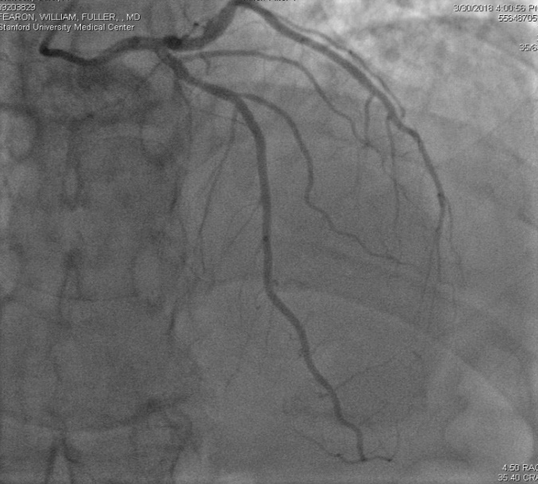
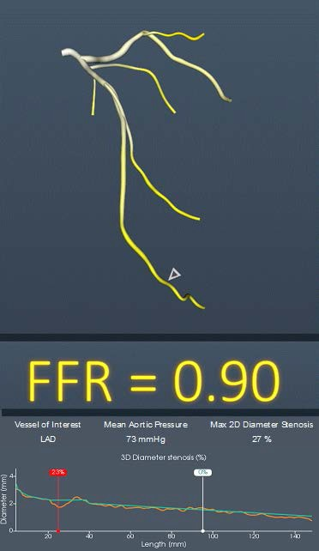
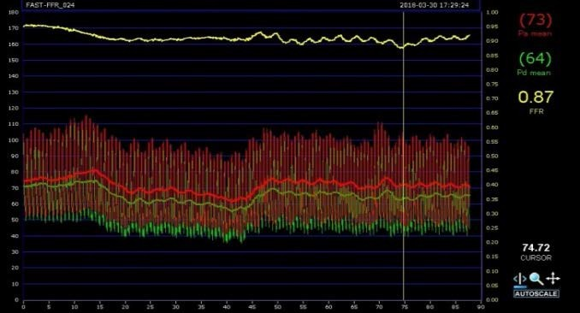
FFR and FFR_{angio} Case Example
FFR=0.87

Slide 9
Results
FFR and FFR_{angio} Results
Physiologic Result
FFR
^{FFR}angio
Mean
0.81 ± (0.13)
0.80 ± (0.12)
Median
0.83 (0.74, 0.90)
0.82 (0.73, 0.89)
% of positive lesions (≤ 0.80)
43.3%
45.5%
% within 0.70-0.90
58.9%
63.6%
% within 0.75-0.85
31.3%
31.0%
FFR_{angio} was successfully measured in 98.7% of cases

Slide 10
Results
Primary and Secondary Endpoints
Diagnostic Characteristic
Sensitivity 93.5% (87.8, 96.6)
Specificity 91.2% (86.0, 94.6)
Diagnostic accuracy 92.2% (88.7, 94.8)
Positive Predictive Value 89.0% (82.6, 93.2)
Negative Predictive Value 94.8% (90.3, 97.3)
Accuracy around FFR cutpoint (0.75-0.85)
Sensitivity 88.5%
Specificity 85.1%
Diagnostic accuracy 86.9%

Slide 11
Summary
FFR derived from routine coronary angiography (FFR_{angio}) had very high sensitivity, specificity and diagnostic accuracy, all of which were greater than 90% for predicting the reference standard, coronary pressure wire-derived FFR.
FFR_{angio} and FFR remained highly correlated over the entire range of FFR values.
FFR_{angio} was successfully measured in almost all
cases included.

Slide 12
Conclusion
FFR_{angio} may provide an easier and potentially faster method for performing physiology guided assessment of the overall coronary angiogram with similar accuracy to the reference standard, coronary pressure wire-based FFR.
This may translate into a greater percentage of patients undergoing physiologic guidance for revascularization decisions and ultimately improve
long-term outcomes.

