Slide 3
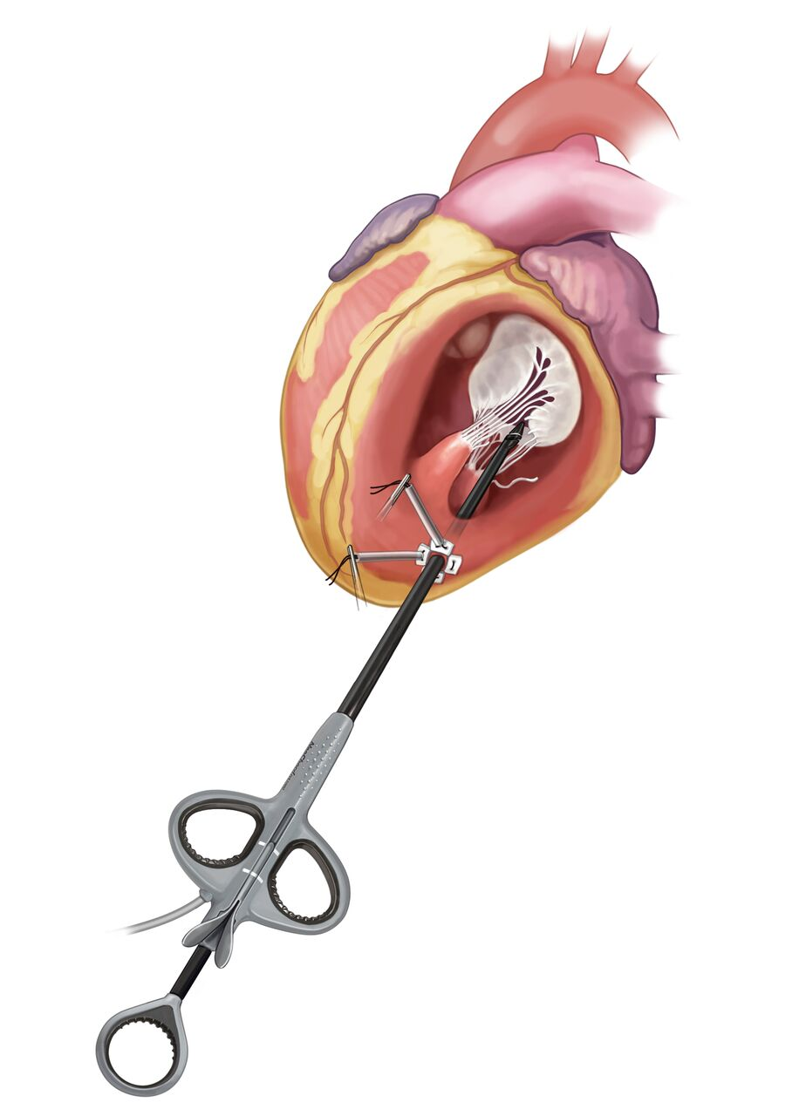
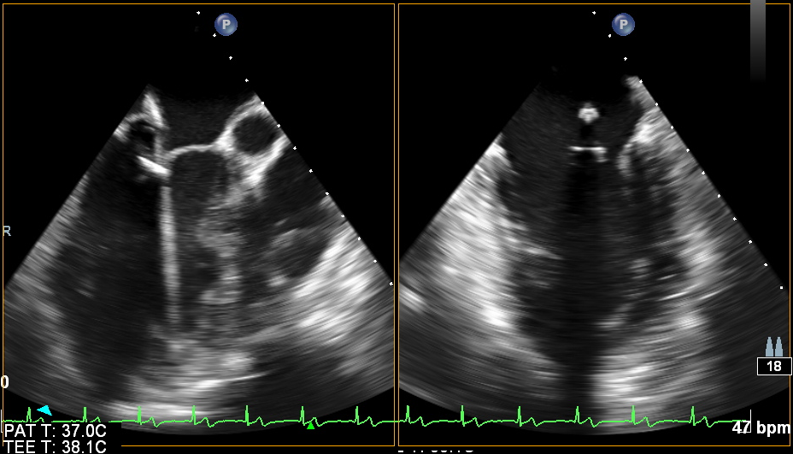
Device Navigation Leaflet Capture
Distal tip
Saddle
CAUTION: Investigational Device Limited by Federal (United States) Law to Investigational Use

Slide 4
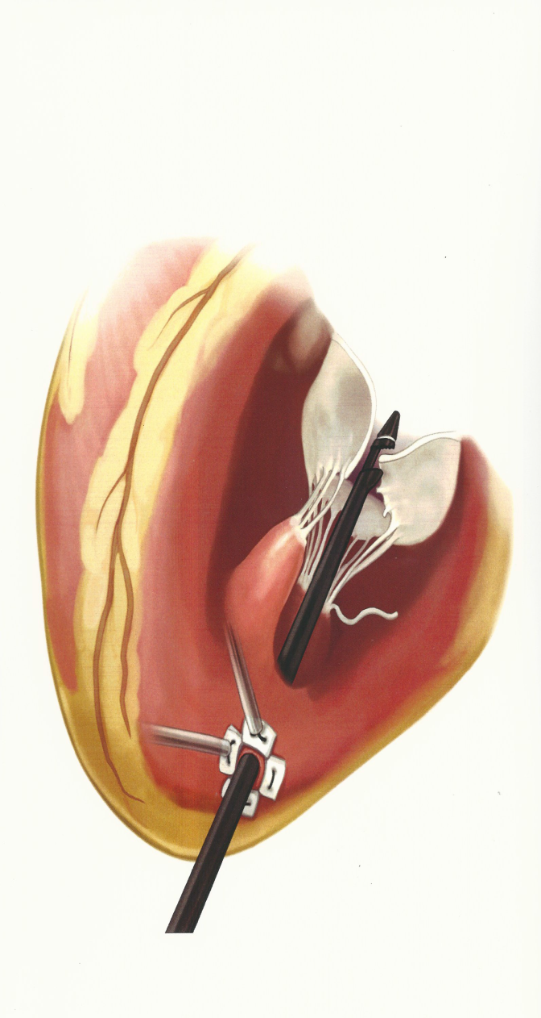
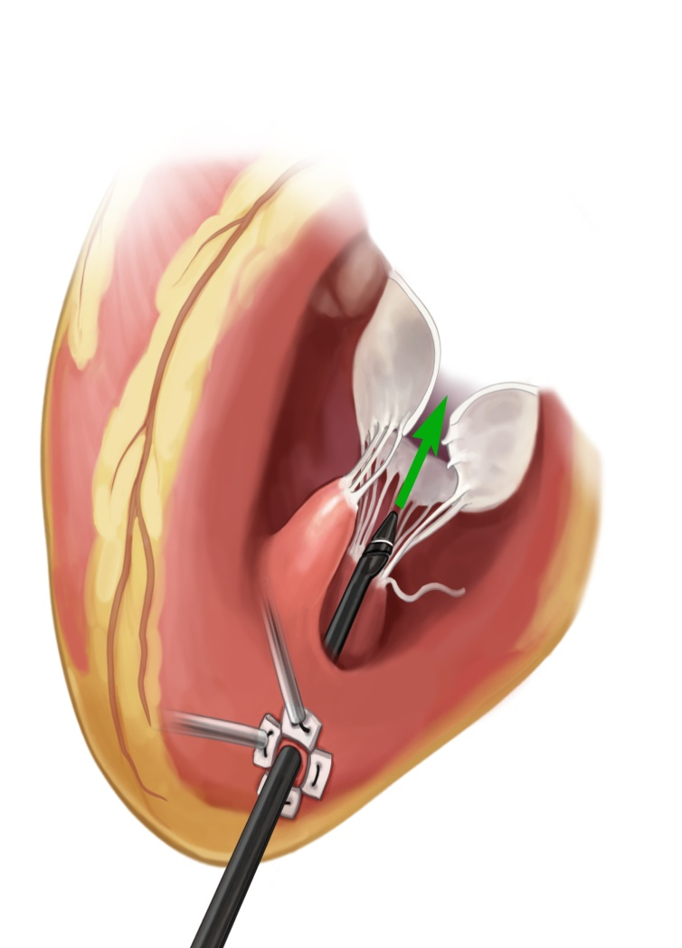
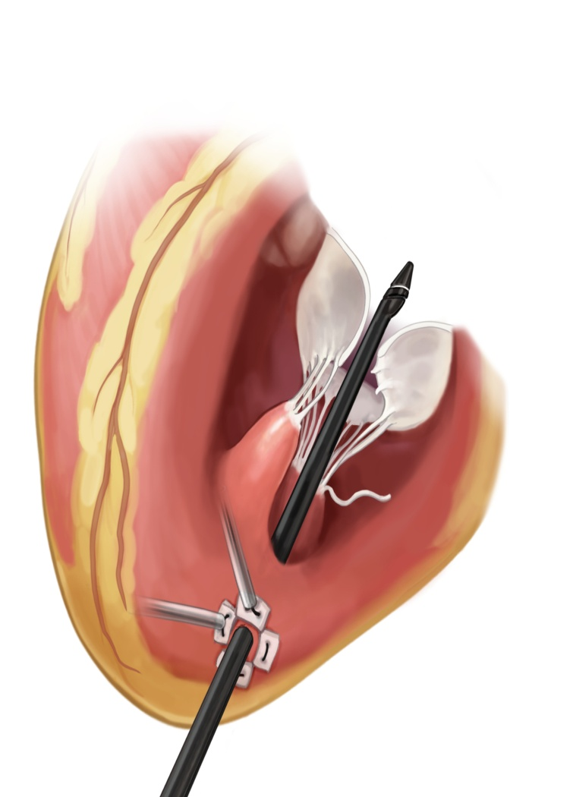
Artificial Chordae Placement
Device guided into LA
Device tip is positioned to prolapse
Device jaws are opened at prolapse
CAUTION: Investigational Device Limited by Federal (United States) Law to Investigational Use

Slide 5
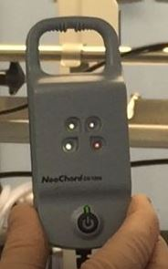
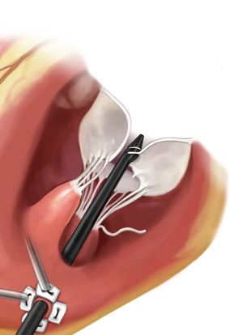
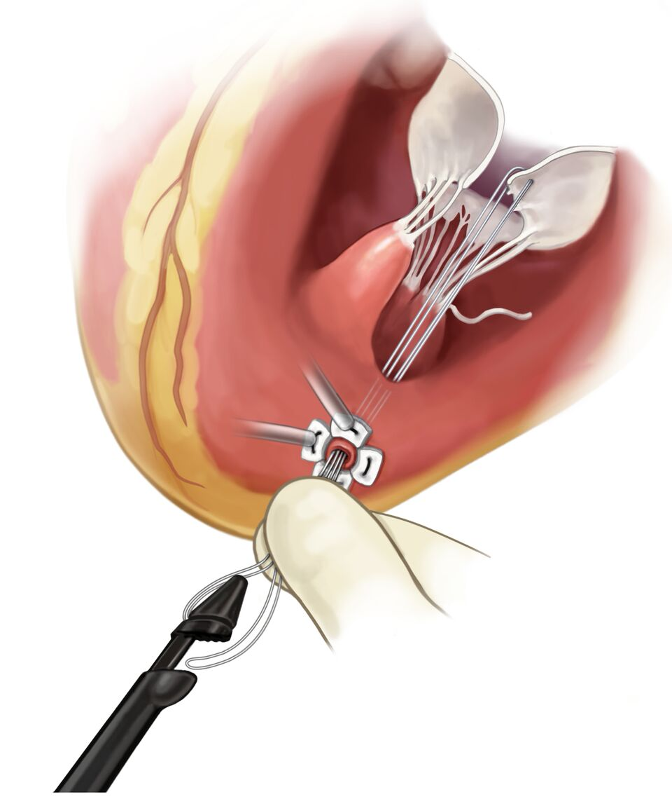
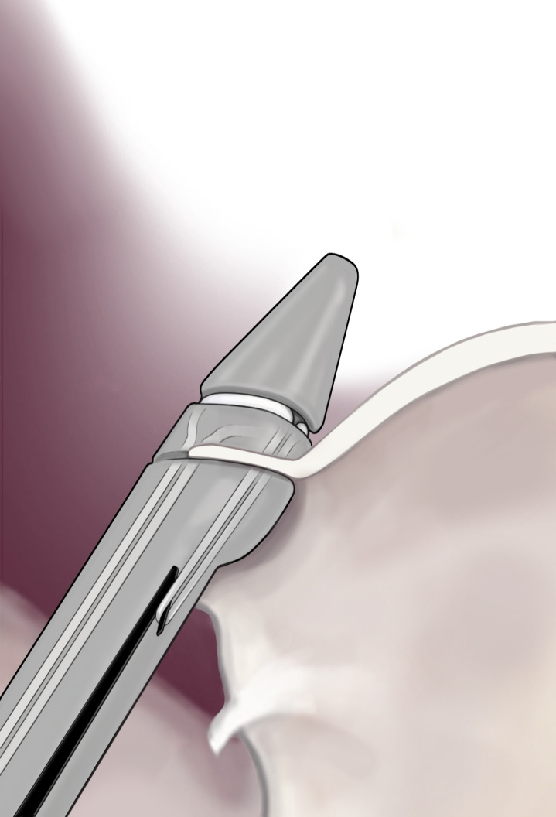
Artificial Chordae Placement
Needle pierces leaflet and withdraws artificial chord
Device is withdrawn leaving the tails and loop of artificial chord
Leaflet is captured in Jaws and confirmed by 4 lights on LCM
CAUTION: Investigational Device Limited by Federal (United States) Law to Investigational Use

Slide 6
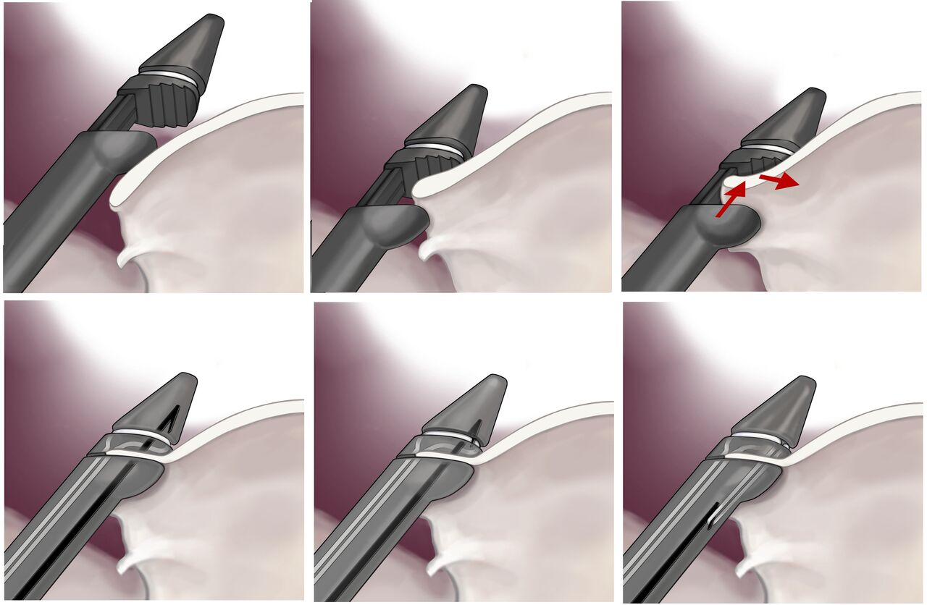
Artificial Chordae Placement
Distal tip is positioned into the atrium
Using 3D, the device is slowly withdrawn until the saddle disappears beneath the leaflet
With the lights blinking on the LCM, the device is gently pushed into the atrium and toward the annulus (uploading the leaflet)
The jaws are closed capturing the leaflet and the needle is advance thru the leaflet
The needle is withdrawn hooking the suture
The needle is withdrawn out of the device.
A
B
C
D
E
F
A minimum of (3) Artificial Chordae are required
CAUTION: Investigational Device Limited by Federal (United States) Law to Investigational Use

Slide 7
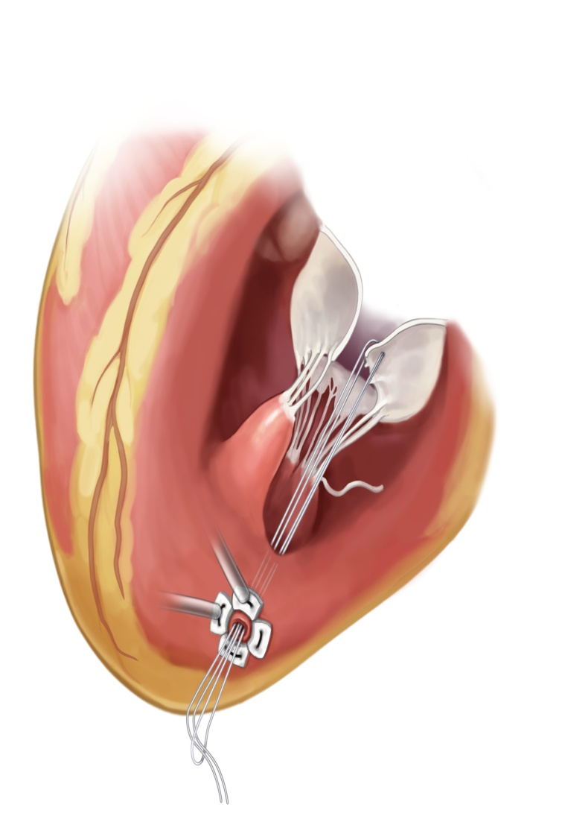
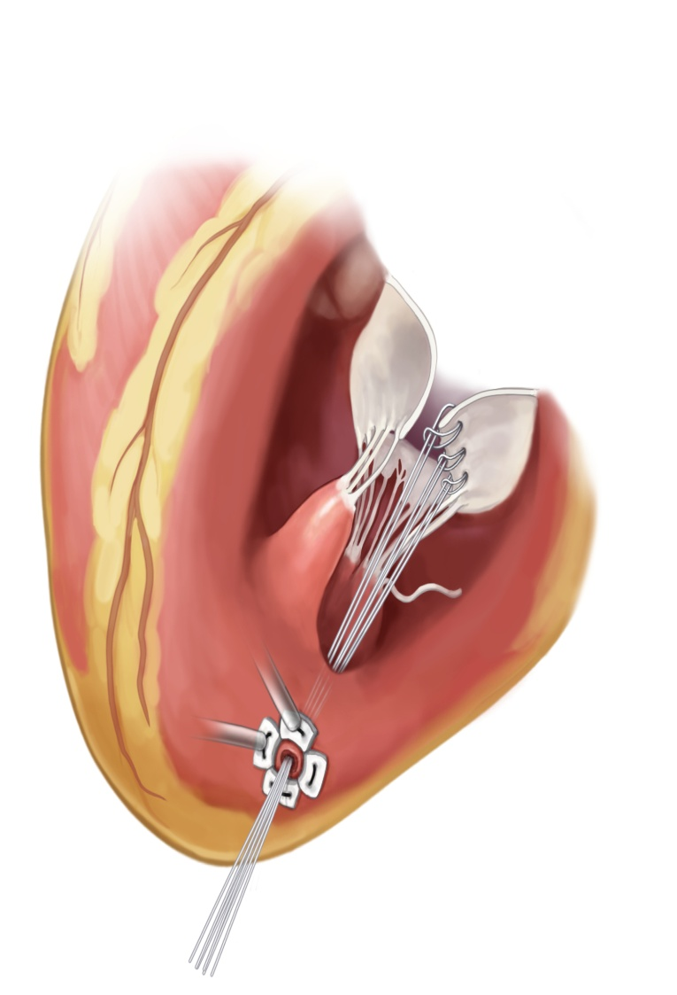
Artificial Chordae Placement
Half hitch is created
Half hitch is pulled up to prolapsed leaflet
Minimum of 3 artificial chords are placed
CAUTION: Investigational Device Limited by Federal (United States) Law to Investigational Use

Slide 13
Intended Use / Indication for Use
Placement of artificial chordae when the natural chordae tendinae have become elongated or ruptured due to degenerative mitral valve disease.
Subjects with degenerative mitral valve disease having Grade III moderate or Grade IV severe mitral regurgitation

Slide 14
Trial Objective
Demonstrate that the Neochord Artificial Chordae Delivery System is:
Superior to traditional mitral valve repair surgery in terms of safety.
Non-Inferior in terms of effectiveness for the surgical repair of degenerative mitral regurgitation.

Slide 15
Effectiveness
When compared to the control group, the proportion of subjects in the treatment group with:
Freedom from Grade II or Grade III moderate, or Grade IV severe mitral regurgitation
Freedom from mitral valve replacement, or mitral valve re-intervention
The primary effectiveness endpoint is measured at POD 390 or 1 year by the Core Laboratory.
Patients followed for 5 years

Slide 19
MAE’s
All-cause mortality
All-cause stroke
Peri-procedural myocardial Infarction
Major surgical site complications
Unplanned permanent pacemaker insertion
Major, extensive, life-threatening, or fatal bleeding
Acute kidney injury (Stage 3)
Prolonged ventilation
Primary safety endpoint at POD 30 or hospital discharge

Slide 20
Inclusion Criteria
1. 21 years or older
2. Has an indication for isolated surgical mitral valve repair per ACC/AHA and ESC/ EACTS Guidelines
3. Is a candidate for mitral valve repair with cardiopulmonary bypass
4. Has Grade III moderate or Grade IV severe degenerative mitral valve regurgitation per baseline Echo Core Lab assessment

Slide 21
Inclusion Criteria
5. Anatomical considerations:
a. Isolated segmental prolapse of the A2 or P2 segment
b. Anterior leaflet covers at least 65% of anterior-posterior annular distance
c. Anatomic and general suitability as determined by Central Screening Committee
6. Provides written informed consent prior to trial procedures
7. Agrees to attend all follow-up assessments for up to 5 years and is willing to comply with specified follow-up evaluations at clinical investigational sites and/or obtain all protocol-specified diagnostic tests

Slide 22
Exclusion Criteria
1. Other valve disease that requires intervention on the aortic, tricuspid, or pulmonary valve
2. Prior mitral valve surgery, which included repair, replacement, annuloplasty, valvuloplasty, or any other mitral valve intervention
3. Active endocarditis or endocarditis within 3 months (90 days) of the scheduled index procedure
4. Previous or current evidence of an intra-cardiac mass, thrombus, or vegetation

Slide 23
Exclusion Criteria
5. Coronary artery disease that requires intervention or treatment or has had coronary artery disease that required intervention or treatment within 3 months (90 days) of the scheduled index procedure
6. Tricuspid valve regurgitation that requires surgical intervention
7. Atrial Fibrillation that requires surgical intervention
8. Requires a planned therapeutic, interventional, or surgical procedure within 1 month (30 days) of the scheduled index procedure
9. Chronic renal failure requiring renal replacement therapy

Slide 24
Exclusion Criteria
10. Stroke, cerebrovascular accident (CVA) or transient ischemic attack (TIA) within 3 months (90 days) prior to scheduled index procedure
11. Myocardial infarction (MI) within 3 months (90 days) prior to scheduled index procedure
12. Life expectancy of less than 2 years (24 months)
13. Left ventricular aneurysm
14. Bleeding disorders or coagulopathies
15. Acute or semi-acute medical conditions such as respiratory distress, pulmonary edema, or myocarditis

Slide 25
Exclusion Criteria
16. Acute active infection requiring antibiotic therapy
17. Contraindicated for transesophageal echocardiography
18. Prior organ transplant or is currently an organ transplant candidate
19. Currently pregnant or lactating or planning to become pregnant
20. Currently participating in another clinical trial that would interfere with protocol treatment or follow-up
21. Need for emergent surgery for any reason

Slide 26
Key reasons patients have been screened out by the Central Screening Committee:
Multiple jets of MR (3 patients)
Mild MR (1 patient)
Insufficient coaptation potential (2 patients)

