Slide 1
Diagnosing and Treating Access Site Complications
Michael J. Singh, MD FACS RPVI
UPMC Heart and Vascular Institute
Co-director, UPMC Aortic Center
February 2018

Slide 2
Michael Singh, MD FACS RPVI
I have no disclosures and no relevant financial relationships related to this presentation.

Slide 3
Case example
81 year old sedentary obese female
Nov 2017 coronary angio, PTCA via left CFA access
6Fr angioseal

Slide 4
Case example
December 2017 left groin pain
CTA 4 cm left CFA pseudoaneurysm
Successful thrombin injection
Jan 2018 gram (-) UTI

Slide 5
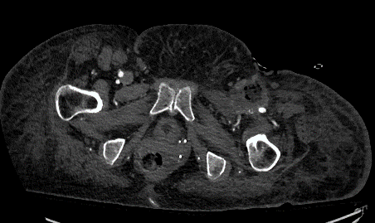
Case example
Feb 2018 admitted WBC 33,000, left leg edema
Duplex scan left femoral vein DVT, AVF present
CTA showed left CFA mycotic thrombosed pseudoaneurysm

Slide 6
Case example
Jan 2018 left CFA ligation, repair of AVF, debridement and vac
February 2018 left above knee amputation

Slide 7
Significance of Access Site Complications
not infrequent and in many cases can be predicted
adverse events are directly associated with an increased M&M
common source of medical legal liability following interventions
timely diagnosis and management is essential

Slide 8
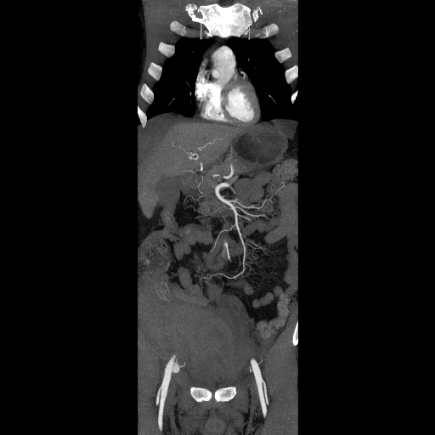
Access Site Complications “Alternative Facts or Truth?”
Increasing frequency?
1) more interventionists
2) expanding array of endovascular techniques
3) larger access, redo access
4) aging population
5) unfavorable anatomy
6) closure devices:
ISAR-CLOSURE study*
diagnostic: vasc closure 6.9% v. manual 7.9%*
Refuted NCDR CathPCI registry
manual 2.8% v. 2.1% closure device**
* Schulz-Schupke S. JAMA 2014
** Marso SP JAMA 2010
Notes:
Shorter time to hemostasis, early ambulation, discharge, and increased turnover, continued utilization reflects the fact their perceived advantages outweigh the occasional complication
Comp rate 19702 20% to current 1% diag, 1-6% interventions

Slide 9
Closure Devices: Confounding Benefits
Shorter time to hemostasis
Quicker ambulation and discharge
Patient satisfaction and comfort
Perceived advantages of vessel closure (VCD) appear to support their continued utilization, but VCD…
fail to decrease overall complication rates; 1% diagnostic and 1-6% for interventions
associated with device specific complications

Slide 10
Biancari 2010
31 prospective studies, 7,528 patients
Randomized to VCD or compression

Slide 11
Complication rates: Meta-analysis of randomized trials on efficacy of VCD
Similar rates bleeding, transfusion, hematoma, false aneurysm
VCD- higher rates arterial ischemic complications, infection, need for surgical repair
Biancari Am Heart J 2010

Slide 12
Access Site Complications- Facts
Diagnostic procedures 0.5-1.8%
Interventions 1.5-9.0%
All cause mortality 0.8-7.5%
Femoral hematoma 1-7.7%
Retroper hematoma 0.7-2.5%
False aneurysm 0.5-2.5%
AV fistula 0.5-1.7%
Arterial occlusion 1.5 %
Infection <1%
Schulz-Schupke S. JAMA 2014
Marso SP JAMA 2010
Arora N Am Heart J 2007
Notes:
Shorter time to hemostasis, early ambulation, discharge, and increased turnover, continued utilization reflects the fact their perceived advantages outweigh the occasional complication
Comp rate 19702 20% to current 1% diag, 1-6% interventions

Slide 13
Femoral Access Site Complications: Contributing Factors
Patient related:
Older age
Female gender
Small access vessel
Low BMI or obesity
PAD (CFA occlusive disease)
Scar tissue at access site
Diabetes, chronic kidney disease
Procedure related:
high & low puncture groin
independent predictor (OR, 28.7; P<.0001)*
accounts for 71%*
lateral wall laceration
large caliber sheaths
prior procedures
GPIIB/IIIA infusion & lytic cases
13
*Sherev DA Catheter Cardio Interv 2005

Slide 14
Access Site Complications
Early diagnosis:
Peripheral vascular exam: pre & post procedure
Assess distal perfusion (pulses or ABI)
Serial access site exams post intervention
Adverse event management:
Compression
Endovascular options
balloon, stent, embolize, athrectomy, etc.
Open surgical repair
often the best choice in some situations

Slide 15
Access Site Complications
Infection
Bleeding
Hematoma, retroperitoneal bleeding, false aneurysm
Device or operator failure?
Anticoagulation?
Vessel occlusion
Direct mechanical- foot plates, plaque disruption, intimal dissection, thrombus formation
Embolization- plugs, plaque or thrombus

Slide 16
Access Site Infection
Relatively uncommon (<0.25%)
despite placement of foreign body in access site
Practice good sterile technique
reprep access site before insertion of VCD
Consider prophylactic antibiotics
Major problem- treat aggressively
exploration, debridement and reconstruction

Slide 17
Femoral Access & VCD with Necrotizing Fasciitis

Slide 18
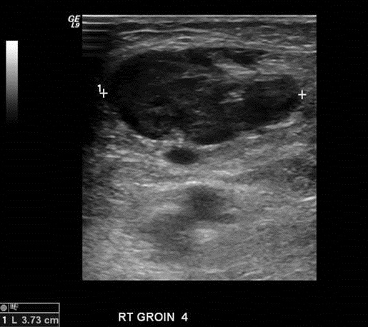
Femoral Hematoma
Trivial or potentially life threatening
Symptoms vary:
mild to severe groin pain, access site swelling, skin necrosis
Ecchymosis early with progressive extension
Risks:
low access, lateral wall laceration, large sheaths, failed closure, anticoagulation
Ultrasound- quick and cost effective, assess for false aneurysm
CTS- rule out retroperitoneal hemorrhage
18
Notes:
18
This slide has the Slide Design template “content” applied.
The first level bullet has been set up with a “null” character to make it appear unbulleted and still allow automatic bullets for subsequent levels. The second through fifth levels have bullets: from the left margin, tab once (or click the “increase indent” button) and the second level bullet will appear; further tabbing increases the indent and produces the corresponding bullet.

Slide 19
Femoral Hematoma
Management:
Manual compression, bed rest, correct coags, resuscitate, serial Hct and observation
Watch for delayed hemorrhage
Majority resolve without intervention- inform patient of prolonged bruising
19
Notes:
19
This slide has the Slide Design template “content” applied.
The first level bullet has been set up with a “null” character to make it appear unbulleted and still allow automatic bullets for subsequent levels. The second through fifth levels have bullets: from the left margin, tab once (or click the “increase indent” button) and the second level bullet will appear; further tabbing increases the indent and produces the corresponding bullet.

Slide 20
Femoral Hematoma Indications for Surgical Repair
Severe pain
Expanding hematoma
Skin compromise
Compression CFV (DVT risk)
Femoral nerve compression
Recurrent bleed
wound complication rate >25%
20
Notes:
20
This slide has the Slide Design template “content” applied.
The first level bullet has been set up with a “null” character to make it appear unbulleted and still allow automatic bullets for subsequent levels. The second through fifth levels have bullets: from the left margin, tab once (or click the “increase indent” button) and the second level bullet will appear; further tabbing increases the indent and produces the corresponding bullet.

Slide 21
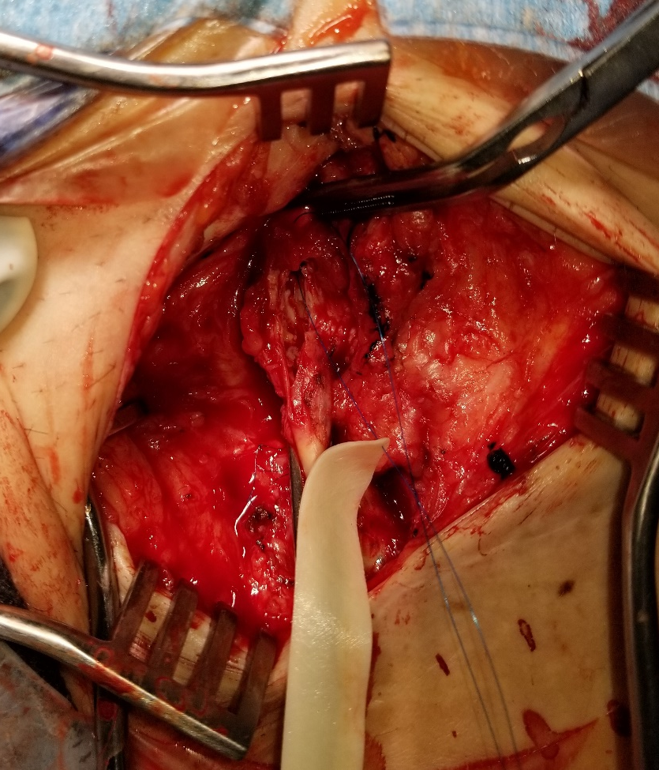
Arterial Repair and Evacuation Extensive Hematoma
21

Slide 22
Retroperitoneal Hematoma
Uncommon but morbid complication
High puncture above inguinal ligament
Risks- obese, women, post procedure anticoagulation, emergent procedure
Retroperitoneum- vast space, holds 2.5 liters of blood
22
Notes:
22
This slide has the Slide Design template “content” applied.
The first level bullet has been set up with a “null” character to make it appear unbulleted and still allow automatic bullets for subsequent levels. The second through fifth levels have bullets: from the left margin, tab once (or click the “increase indent” button) and the second level bullet will appear; further tabbing increases the indent and produces the corresponding bullet.

Slide 23
Retroperitoneal Hematoma- Diagnosis
Early recognition- essential
Abdominal pain & flank fullness
benign access site
Hypotension, tachycardia
Nerve compression- thigh pain, quadriceps weakness
Diagnosis- CTS, low threshold
23
Notes:
23
This slide has the Slide Design template “content” applied.
The first level bullet has been set up with a “null” character to make it appear unbulleted and still allow automatic bullets for subsequent levels. The second through fifth levels have bullets: from the left margin, tab once (or click the “increase indent” button) and the second level bullet will appear; further tabbing increases the indent and produces the corresponding bullet.

Slide 24
Retroperitoneal Hematoma- Management
Individualized treatment plan
Correct coags, bed rest, serial Hct, transfuse if needed (4 PRBC)
Operate for nerve compression, hemodynamically unstable, expanding hematoma, compartment syndrome
Repair CFA injury and decompress retroperitoneum
24
Notes:
24
This slide has the Slide Design template “content” applied.
The first level bullet has been set up with a “null” character to make it appear unbulleted and still allow automatic bullets for subsequent levels. The second through fifth levels have bullets: from the left margin, tab once (or click the “increase indent” button) and the second level bullet will appear; further tabbing increases the indent and produces the corresponding bullet.

Slide 25
Pseudoaneurysm
Failure of the arteriotomy site to close, contained bleed in soft tissue
Often difficult to pick-up
hematoma formation
low puncture: SFA or profunda
Risks- failed VCD, large sheaths, anticoagulation, poor compression technique
Symptomatic- painful pulsatile mass
25
Notes:
25
This slide has the Slide Design template “content” applied.
The first level bullet has been set up with a “null” character to make it appear unbulleted and still allow automatic bullets for subsequent levels. The second through fifth levels have bullets: from the left margin, tab once (or click the “increase indent” button) and the second level bullet will appear; further tabbing increases the indent and produces the corresponding bullet.

Slide 26
Popovic 2008
11,992 consecutive patient via femoral access over 4 years
76 PSA (0.6%)
univ analysis: interventional proc, rhythmologic procedures, left groin access were predictive factors PSA
compression successful 71% (P<0.01)
Popovic B, Int Jour Card 2008

Slide 27
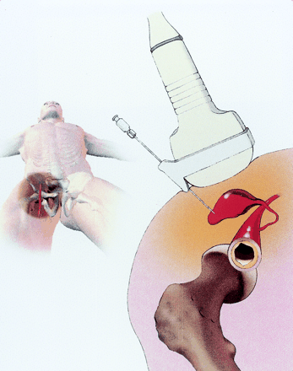
Pseudoaneurysm- Management
Observation- spontaneous thrombosis of small (<2cm) aneurysms in 2-4 weeks
U/S guided compression- 70-90% successful
time consuming, painful, mean time 22 min (20-120 min)
30-50% successful with anticoagulation
Thrombin injection- >95% successful
off label use, risk DVT/PE if undetected AVF, arterial thrombosis
good for PSA narrow(<3mm) necks,
not for broad necks or small native vessels (<4 mm) or large PSA (> 8 cm)
Open surgical repair- AVF, broad neck
Balloon occlusion, covered stent or coil embolization?
27
Notes:
27
This slide has the Slide Design template “content” applied.
The first level bullet has been set up with a “null” character to make it appear unbulleted and still allow automatic bullets for subsequent levels. The second through fifth levels have bullets: from the left margin, tab once (or click the “increase indent” button) and the second level bullet will appear; further tabbing increases the indent and produces the corresponding bullet.

Slide 28
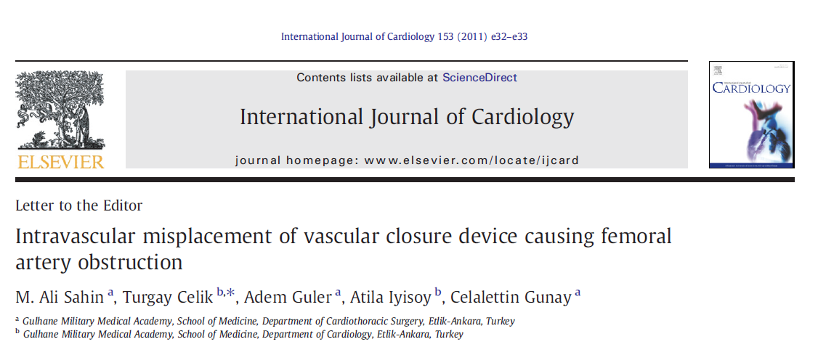
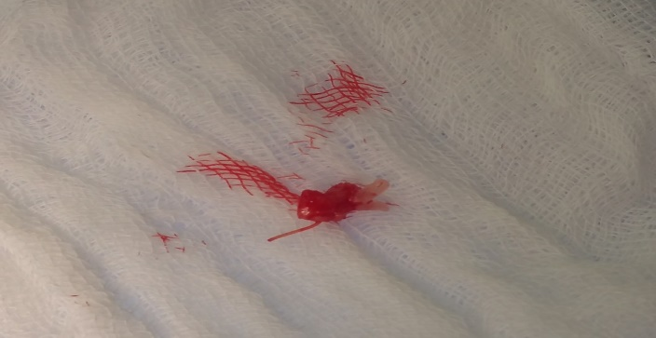
Acute Arterial Occlusion
Embolization
Plaque
Thrombus
Closure device foot plate

Slide 29
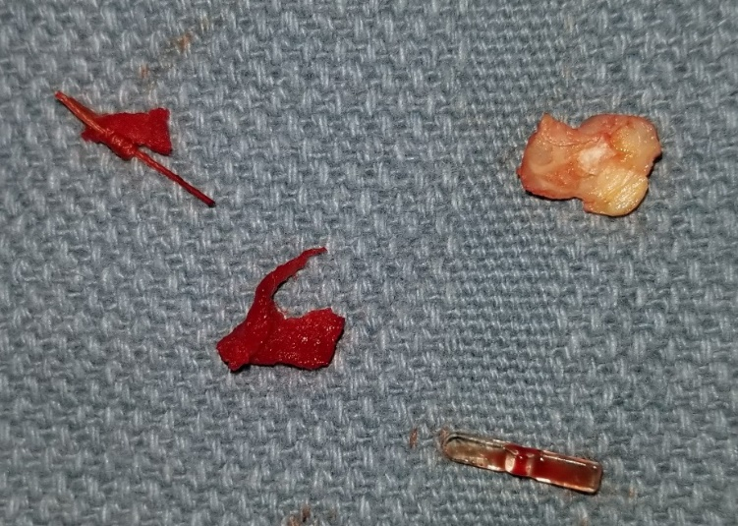
VCD Placed Intravascular
collagen plug, foot plate, plaque

Slide 30
Prevention of Access Site Complications
Access: choose the correct site and location (femoral, radial, etc.)
Fluoroscopy or U/S guided access
Micro puncture access, single puncture anterior wall
Observe guidewire advancement
Routine femoral angio before upsizing
Smallest sheath necessary
Anticoagulation strategy
Avoid use if high puncture
Proper patient and closure device selection

Slide 31
Conclusions
Access site complications occur infrequently and in many cases can be predicted
VCD generally demonstrate a good performance compared to manual compression
VCD are associated with an increased risk of infection, lower limb ischemia and need for surgical intervention
Be observant for procedure related access site complications, early diagnosis and intervention are necessary for favorable outcomes

Slide 32
Thank you
Pittsburgh, PA

