Slide 1
Optimizing Cost-
Effectiveness of TAVR:
What do we need to do differently?
David J. Cohen, M.D., M.Sc.
Vice Chairman of Medicine (Research)
Beth Israel Deaconess Medical Center, Boston
Professor of Medicine
Harvard Medical School
CRT 2018- 10 mins

Slide 2
Disclosures
Grant Support/Drugs
  Daiichi-Sankyo - Merck
  Astra-Zeneca
Grant Support/Devices
  Edwards Lifesciences - Abbott Vascular
  Medtronic - Boston Scientific
  CSI - Tendyne
Consulting/Advisory Boards
  Medtronic - Amgen
  Edwards Lifesciences
DJC: 2/18

Slide 3
TAVR Economics: Why do we care?
TAVR is expensive
  Valve currently costs ~6x more than comparable surgical valve
  Less expensive alternatives exist for many patients who are now being considered for TAVR (e.g., intermediate risk)
Concerns about whether it’s appropriate to prolong life for some extreme risk patients
  Are we doing the right thing?
  Are there better uses for these resources?
Population of eligible patients is large and growing→ even if TAVR is cost-effective, we may not be able to afford it for all patients

Slide 4
Impact of Patient Population on
Cost-Effectiveness of TAVR
Population | Δ Costs | Life Expectancy | ICER
Notes:
4

Slide 5
Impact of Patient Population on
Cost-Effectiveness of TAVR
Population | Δ Costs | Life Expectancy | ICER
Extreme Risk | ↑↑↑ | ↑↑↑ | Intermediate to High Value
Notes:
5

Slide 6
Impact of Patient Population on
Cost-Effectiveness of TAVR
Population | Δ Costs | Life Expectancy | ICER
Extreme Risk | ↑↑↑ | ↑↑↑ | Intermediate to High Value
Very High Risk* | Similar | Slight ↑ | High Value
* vs. surgical AVR
Notes:
6

Slide 7
Impact of Patient Population on
Cost-Effectiveness of TAVR
Population | Δ Costs | Life Expectancy | ICER
Extreme Risk | ↑↑↑ | ↑↑↑ | Intermediate to High Value
Very High Risk* | Similar | Slight ↑ | Dominant/ Excellent Value
High Risk* | ↑↑ | ↑↑ | Intermediate to High Value
* vs. surgical AVR
Notes:
7

Slide 8
Impact of Patient Population on
Cost-Effectiveness of TAVR
Population | Δ Costs | Life Expectancy | ICER
Extreme Risk | ↑↑↑ | ↑↑↑ | Intermediate to High Value
Very High Risk* | Similar | Slight ↑ | High Value
High Risk* | ↑↑ | ↑↑ | Intermediate to High Value
Intermediate Risk* | ??? | ??? | ???
* vs. surgical AVR
Notes:
8

Slide 9
TAVR Economics: Hospital Perspective
From 2011-2014, TAVR was paid based on SAVR DRGs
  Resulted in systematic underpayment due to much lower cost of SAVR, particularly for low risk patients
  Additional issues caused by PACT (Post-acute care transfer) payments for pts discharged to rehab or with home health within 6-7 days
Since 2015, TAVR has been paid according to TAVR-specific DRGs (266- with MCC; 267- without MCC)
  Overall payment to hospitals increased ~$8000
  Improved perverse incentives caused by PACT
  Did not correct the most important issue– geographic disparities that lead to substantial underpayment in “less costly” geographies

Slide 10
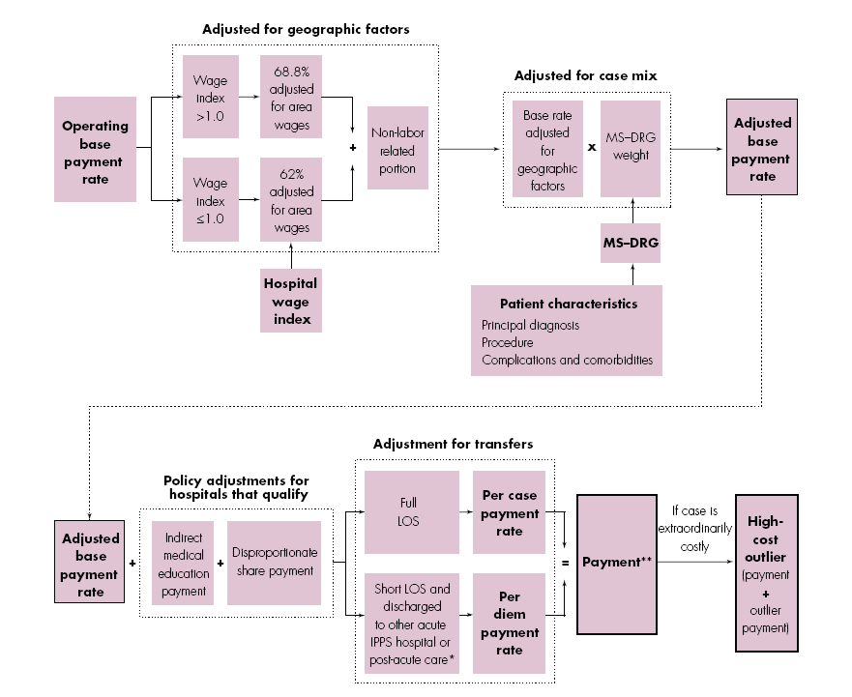
Hospital Reimbursement 101

Slide 11

Reimbursement for Intermediate Risk TAVR:
A Tale of Two Cities
Approx Cost of Intermediate
Risk TAVR in 2017
Procedure $38,000
Hosp Stay $14,000
Total $52,000
New York
$62,228
Dallas
$38,689
* Estimated 2018 rates for DRG 267

Slide 12
Reimbursement for Intermediate Risk TAVR:
A Tale of Two Cities
Approx Cost of Intermediate
Risk TAVR in 2017
Procedure $38,000
Hosp Stay $14,000
Total $52,000
Stanford
$76,780
Emory
$45,862
* Estimated 2018 rates for DRG 267

Slide 13
How can we improve the cost-effectiveness of TAVR today?
Avoid non-femoral approaches whenever possible
Size your valve correctly– limits need for VIV implants and other complications
Select your patients well (avoid “cohort C”)
Prevent complications– especially bleeding and acute kidney injury
Reduce length of stay for uncomplicated procedures (e.g., fast track, minimalist approach)
Notes:
13

Slide 14
How can we improve the cost-effectiveness of TAVR today?
Avoid non-femoral approaches whenever possible
Size your valve correctly– limits need for VIV implants and other complications
Select your patients well (avoid “cohort C”)
Prevent complications– especially bleeding and acute kidney injury
Reduce length of stay for uncomplicated procedures (e.g., fast track, minimalist approach)

Slide 15
Adjusted Incremental Costs
*Adjusted for age, sex, prior bypass surgery, peripheral vascular disease, diabetes, and STS mortality risk score ; R²=0.41

Slide 16
Attributable Costs
Complication | Incremental Cost of Complication | Frequency of Complication in PARTNER | Attributable Cost
Death | $42,008 | 4.9% | $2,069
Major stroke | $16,272 | 3.2% | $521
Major bleeding | $32,869 | 9.9% | $3,238
Renal failure | $68,051 | 4.2% | $1,809
Arrhythmia | $16,067 | 16.3% | $2612
Repeat TAVR | $119,905 | 0.5% | $591
Surgical AVR | $26,070 | 1.7% | $449
Total cost of complications |  |  | $11,324
Arnold SV, et al. Circ Cardiovasc Interv 2014;7:829-36

Slide 17
What drives costs of TAVR?
PARTNER A + B
Implications
Complications account for 24% of non-implant related costs→ substantial opportunity for savings
Even greater opportunity for savings from maximizing efficiency of care for uncomplicated admissions (8 day LOS in PARTNER)
Complications
$11,324
Valve
$30,960
Everything Else
$35,998
Arnold SV, et al. Circ Cardiovasc Interv 2014;7:829-36

Slide 18
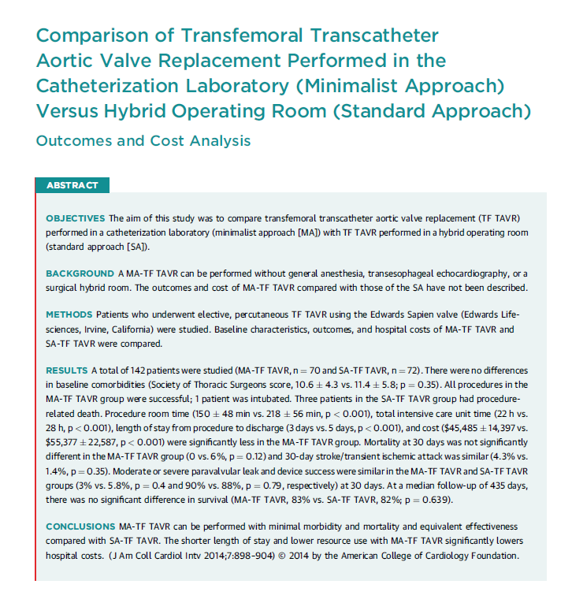
“Minimalist Approach”: Emory Experience
TAVR Economics
142 patients undergoing commercial TAVR using Sapien valve via TF approach
Standard approach (n=72)
  Hybrid OR, general anesthesia, femoral cutdown, TEE, ICU recovery
Minimalist approach (n=70)
  Cath lab, minimal anesthesia, no TEE, perc access, ICU or stepdown recovery
No differences in procedural success, 30 day mortality, or other procedural complications
Impact on Hospital Economics
↓ LOS 2 days (5→3)
↓ Cost by ~$10,000 ($55K→$45K)
Babaliaros V, et al. JACC Intv 2014;7:898-904

Slide 19
Index Hospitalization: Resource Use
S3i Economics
 | S3-TAVR | SAVR | P-Value
Proc. duration, mins | 84 ± 38 | 236 ± 83 | <0.001
LOS, days | 4.6 ± 5.7 [3] | 10.9 ± 7.6 [8] | <0.001
ICU | 1.8 ± 2.9 [1] | 4.6 ± 6.1 [3] | <0.001
Non-ICU | 2.7 ± 4.8 [2] | 6.2 ± 4.7 [5] | <0.001
New PPM | 8.4% | 7.0% | NS

Slide 20
Index Hospital Costs
S3i Economics
Δ = - $4155* (P=0.014)
$58,410*
$54,256*
* Trimmed means
** All costs propensity-adjusted

Slide 21
Follow-up Costs by Time Interval
S3i Economics
Δ = -$8003
1-Year Follow-up Costs*
XT-TAVR $27,361
SAVR $38,238
Δ = -$331
Δ = -$4857
Δ = - $11,377
P<0.001
D/C to
30 days
30 days to
6 months
6 to12
months
* Trimmed means
All costs propensity-adjusted

Slide 22
Total 1-Year Costs
S3i Economics
Δ = - 15,511 (p<0.001)
$96,489*
$80,977*
* Trimmed means

Slide 23
Summary
TAVR Economics 2018
Although up-front costs for TAVR are substantial, data from the pivotal trials demonstrate that TAVR is nonetheless
cost-effective for extreme risk and high risk patients and cost saving (economically dominant) for intermediate risk patients
For extreme risk patients, the cost-effectiveness of TAVR is driven by both improved survival and long-term QOL benefit compared with medical therapy
For intermediate risk patients, reduced downstream costs are the major factor driving favorable economics
Although reductions in complications have contributed to improving cost-effectiveness of TAVR, the greatest opportunity for cost savings lies in maximizing efficiency of care for uncomplicated procedures (e.g., minimalist approach)

