Slide 1

Embolization of a Corevalve
Haim Danenberg
Hadassah Medical Center
Jerusalem, Israel

Slide 2

Disclosures
Haim Danenberg, MD
Clinical Proctor for Medtronic

Slide 3
CoreValve US Pivotal trial
Events* | 1 Month |  |  | 1 Year |  |  | 2 Years
 | TAVR | SAVR | P | TAVR | SAVR | P | TAVR | SAVR | P
Reintervention | 0.8 | 0.0 | 0.10 | 2.2 | 0.0 | 0.008 | 2.5 | 0.4 | 0.02
Surgical | 0.5 | 0.0 | 0.18 | 0.8 | 0.0 | 0.10 | 0.8 | 0.4 | 0.38
Percutaneous | 0.3 | 0.0 | 0.34 | 1.4 | 0.0 | 0.04 | 1.7 | 0.0 | 0.02
Valve endocarditis | 0.0 | 0.0 | --- | 0.6 | 1.3 | 0.31 | 0.9 | 1.7 | 0.35
Valve thrombosis | 0.0 | 0.0 | --- | 0.0 | 0.0 | --- | 0.0 | 0.0 | ---
Embolization | 0.0 | 0.0 | --- | 0.0 | 0.0 | --- | 0.0 | 0.0 | ---
* Percentages reported are Kaplan-Meier estimates and log-rank P values
3

Slide 4
FORWARD 30-Day Safety Endpoints
Evoult R
Event, Kaplan-Meier Rate (%) | Evolut R N=300
Myocardial Infarction | 0.3
New Pacemaker¹ | 15.4
Prosthetic Valve Thrombosis | 0.0
Prosthetic Valve Endocarditis | 0.0
Valve Embolization | 1.0
Valve Migration | 0.0
Mitral Valve Apparatus Damage | 0.0
¹Subjects with pacemaker or ICD at baseline are included in the denominator.

Slide 5
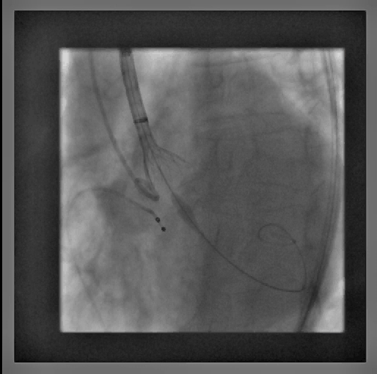
Partial embolization simple to handle..

Slide 6
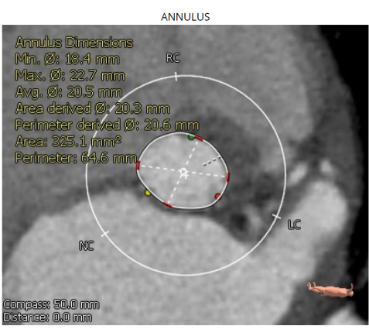
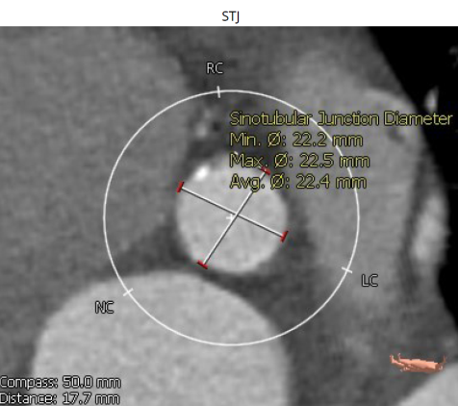
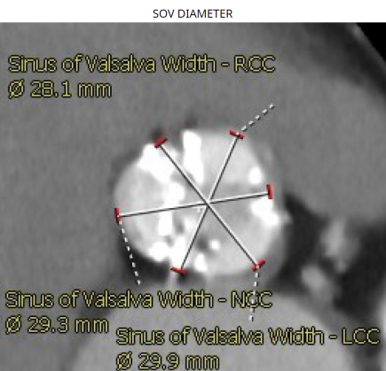
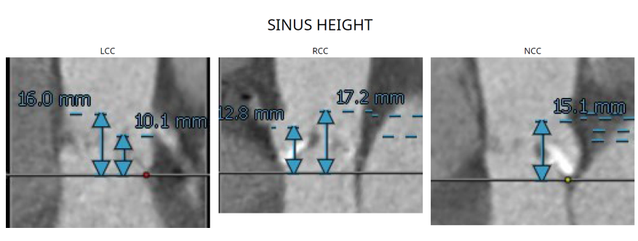
Post release embolization
RC, 85 y-o
AVA 0.5 mm2, MG 60 mmHg
CTS measurements:
  Annulus P-D 20.5mm
  SOV width 28-29mm
  STJ 22.4mm
  Sinus height 15-17mm

Slide 7
CR – procedural plan
Mild sedation/full percutaneous TAVR
Temp pacemaker – LT femoral V
Confida wire
MDT Evolut 26mm

Slide 8
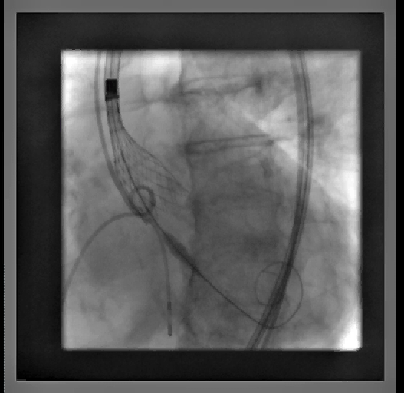
Evolut before release

Slide 9
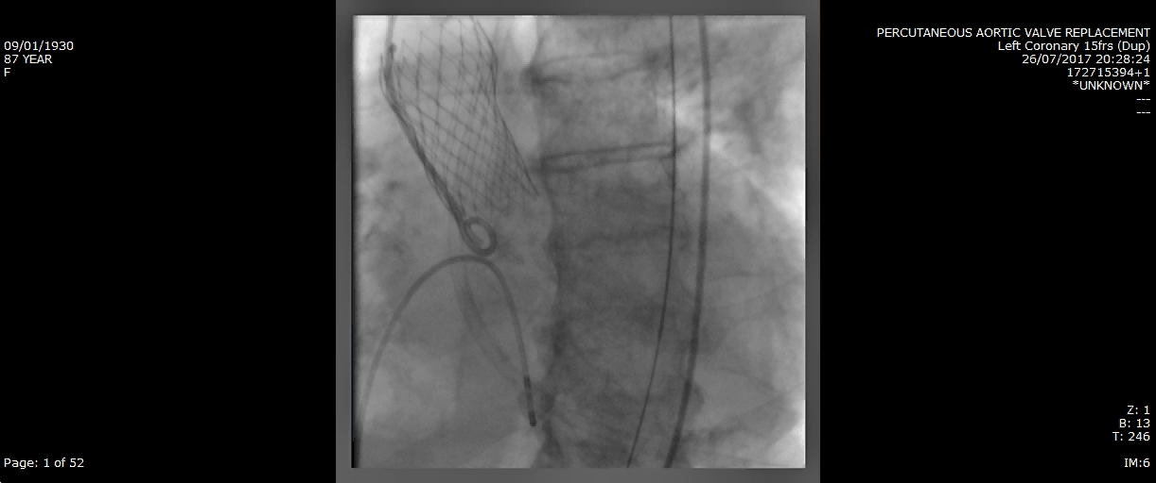
Following release
BP 140/40
Fully awake and alert
Call for a second valve

Slide 10
Risk for coronary blood flow

Slide 11
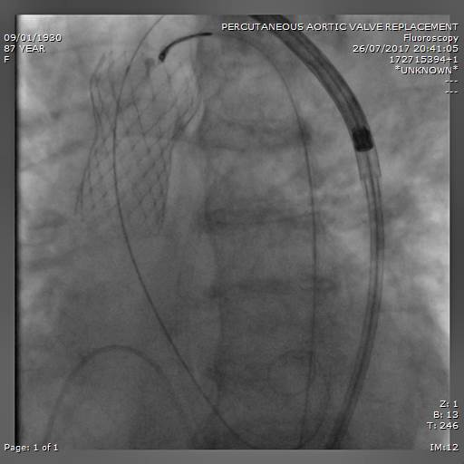
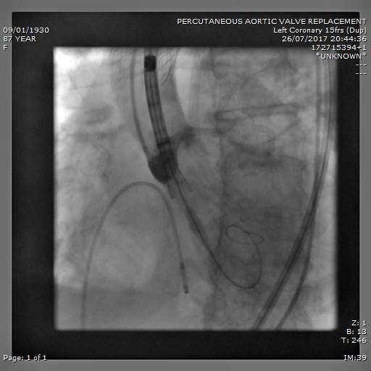
Snare above STJ & hold in place

Slide 12
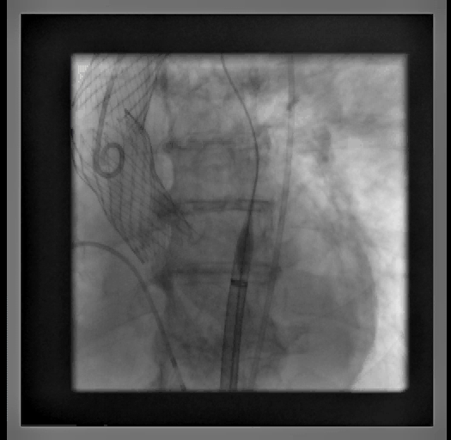
Post 2nd valve

Slide 13
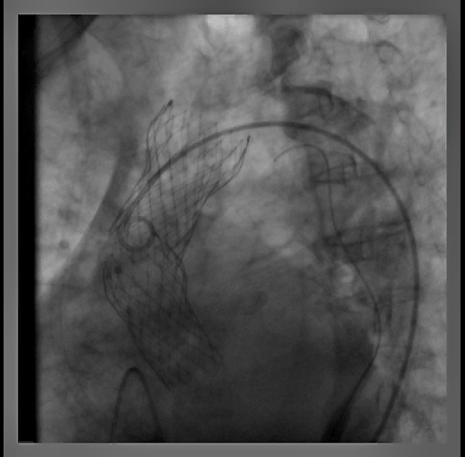
Post 2nd valve

Slide 14
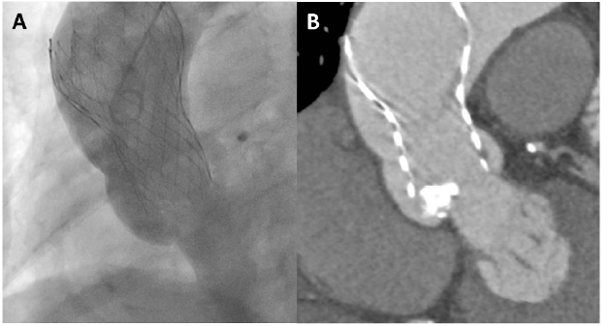
It’s not always that complicated
Tanaka Y, Tanaka M & Saito S, CCI 2015

Slide 15

Conclusions
Corevalve/Evolut embolization (pop-out) is infrequent
Valve emobization calls for a second valve implantation (VinV); some cases – acute AI and hemodynamic collapse
Snaring of the first valve to a position distal to the STJ should be considered to avoid creation of a “covered chimney” from the annulus to the STJ that will obstruct coronary flow

Slide 16
Thank You!

